Slide 1
Dataset | Corpus
Sentiment Analysis | Annotation
Gold Standard | Word Frequencies
N-Gram | Language Modeling
CORPUS LANGUAGE MODELS
Week 3
Dr. Shafiq Ur Rehman khan
Namal Univeristy, Mianwali

Slide 2
Corpora in NLP
corpus
noun, plural corpora or, sometimes, corpuses.
1. a large or complete collection of writings:
poetry.
the entire corpus of Old English
Linguistics. a body of utterances, as words or sentences, assumed to be representative of and used for lexical, grammatical, or other linguistic analysis.

Slide 3
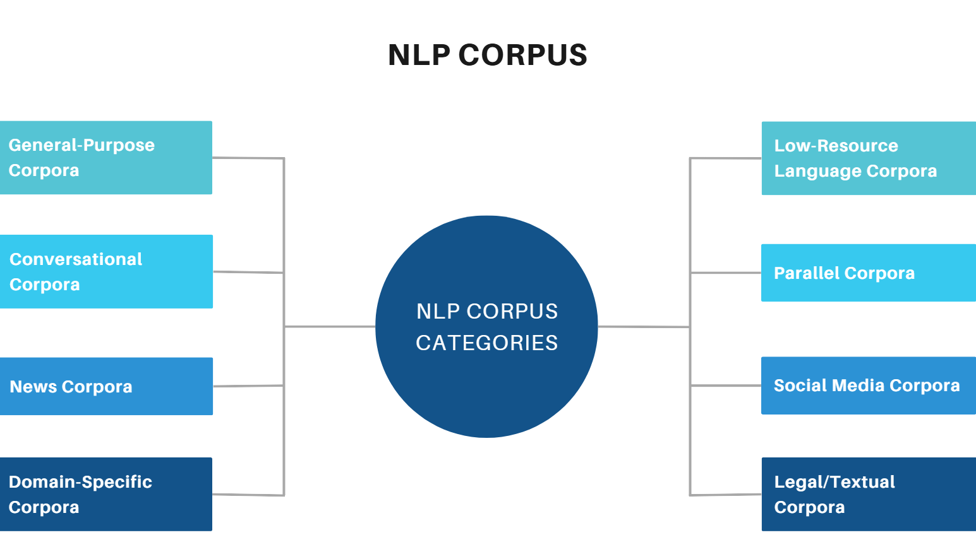
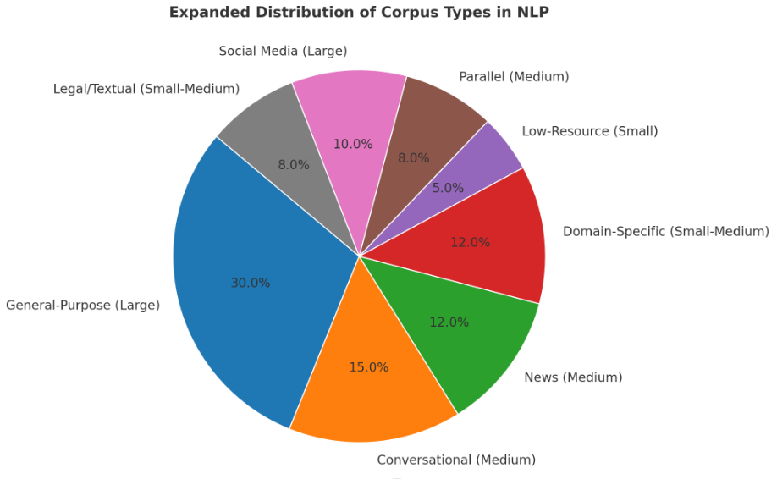

Slide 4
Corpora in NLP
To understand and model how language works, we need empirical evidence. Ideally, naturally-occurring corpora serve as realistic samples of a language.
Aside from linguistic utterances, corpus datasets include metadata—side information about where the language comes from, such as author, date, topic, publication.
Of particular interest for core NLP, and therefore this course, are corpora with linguistic annotations—where humans have read the text and marked categories or structures describing their syntax and/or meaning.

Slide 5

Sentiment Analysis
Goal: Predict the opinion expressed in a piece of text. E.g., + or −. (Or a rating on a scale.)

Slide 6
Sentiment Analysis
Filled with horrific dialogue, laughable characters, a laughable plot, ad really no interesting stakes during this film, "Star Wars Episode I: The Phantom Menace" is not at all what I wanted from a film that is supposed to be the huge opening to the segue into the fantastic Original Trilogy. The positives include the score, the sound effects, and most of the
KJ Proulx (/user/id/896976177/)
* Super Reviewer
Extraordinarily faithful to the tone and style of the originals, The Force Awakens brings back the Old Trilogy's heart, humor, mystery, and fun. Since it is only the first piece in a new three-part journey it can't help but feel
incomplete. But everything that's already there, from the stunning visuals, to the thrilling action sequences, to the charismatic new characters,
Matthew Samuel Mirliani (/user
/id/896467979/)
* Super Reviewer

Slide 7
Sentiment Analysis
**
Filled with horrific dialogue, laughable
characters, a laughable plot, ad really no interesting stakes during this film, "Star Wars Episode I: The Phantom Menace" is not at all what I wanted from a film that is supposed to be the huge opening to the segue into the fantastic Original Trilogy. The positives include the score, the sound effects, and most of the
*****
Extraordinarily faithful to the tone and style of
the originals, The Force Awakens brings back the Old Trilogy's heart, humor, mystery, and fun. Since it is only the first piece in a new three-part journey it can't help but feel
incomplete. But everything that's already there, from the stunning visuals, to the thrilling action sequences, to the charismatic new characters,
KJ Proulx (/user/id/896976177/)
* Super Reviewer
Matthew Samuel Mirliani (/user
/id/896467979/)
* Super Reviewer
RottenTomatoes.com

Slide 8
Sentiment Analysis
**
Filled with
characters, a
*****
faithful to the tone and style of
the originals, The Force Awakens brings back
horrific
dialogue,
plot, ad really
laughable
Extraordinarily
laughable
no
interesting
stakes during this film, "Star Wars
the Old Trilogy's , , , and
. Since it is the first piece in a new
heart
humor
mystery
Episode I: The Phantom Menace" is what I wanted from a film that is
the huge opening to the segue into the Original Trilogy. The
fun
only
not at all
supposed to
three-part journey it can't help but feel
. But everything that's already there,
from the visuals, to the action sequences, to the new characters,
be
incomplete
fantastic
positives
include
stunning
thrilling
the score, the sound effects, and most of the
charismatic
KJ Proulx (/user/id/896976177/)
* Super Reviewer
Matthew Samuel Mirliani (/user
/id/896467979/)
* Super Reviewer
RottenTomatoes.com + intuitions about positive/negative cue words

Slide 9
So, you want to build a sentiment analyzer
Questions to ask yourself:
1. What is the input for text+metadata?)
each
prediction?
(sentence?
full
review
text?
What are the possible outputs? (+ or − / stars)
How will it decide?
How will you measure its effectiveness?
The last one, at least, requires data!

Slide 10
BEFORE you build a system, choose a dataset for evaluation!
Why is data-driven evaluation important?
Good science requires controlled experimentation.
Good engineering requires benchmarks.
Your intuitions about typical inputs are probably wrong.
Sometimes you want multiple evaluation datasets: e.g., one for development as you hack on your system, and one reserved for final testing.

Slide 11
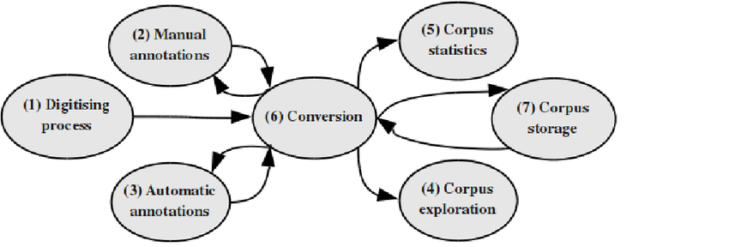
Where can you get a corpus?
Many corpora are prepared specifically for linguistic/NLP research with text from content providers (e.g., newspapers). In fact, there is an entire subfield devoted to developing new language resources.
You may instead want to collect a new one, e.g., by scraping websites. (There are tools to help you do this.)

Slide 12
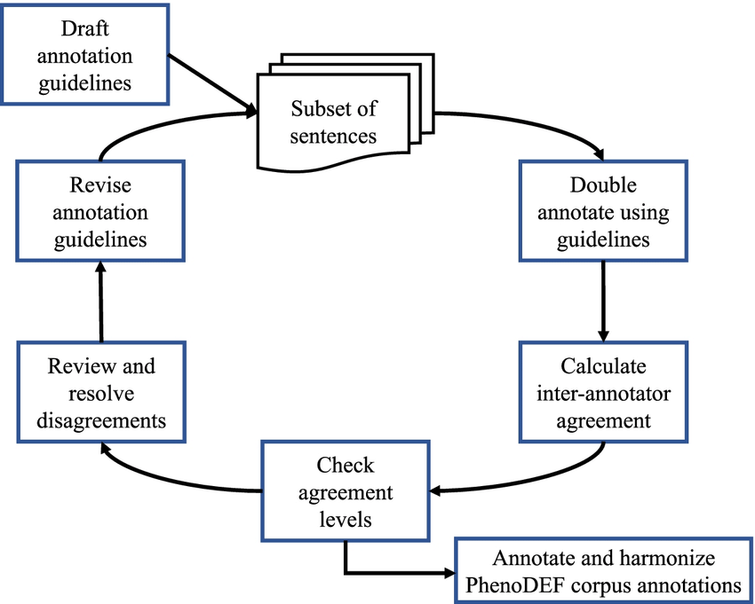
Annotations
To evaluate and compare sentiment analyzers, we need reviews with gold labels
(+ or −) attached. These can be
derived automatically from the original data artifact (metadata such as star ratings), or
added by a human annotator who reads the text
– Issue to consider/measure: How consistent are human annotators? If they often have trouble deciding or agreeing, how can this be addressed?
More on these issues later in the course!

Slide 13
An evaluation measure
Once we have a dataset with gold (correct) labels, we can give the text of each review as input to our system and measure how often its output matches the gold label.
Simplest measure:
# correct
accuracy =
# total
More measures later in the course!

Slide 14
A simple sentiment classification algorithm
Use a sentiment lexicon to count positive and negative words:
Positive: absolutely adorable accepted acclaimed accomplish achieve action active admire adventure affirm
. . .
Negative:
abysmal adverse alarming angry annoy anxious apathy appalling atrocious awful
beaming beautiful believe beneficial bliss bountiful bounty brave bravo brilliant bubbly
calm celebrated certain champ champion charming cheery choice classic classical clean
. . .
bad banal barbed
belligerent bemoan beneath boring broken
callous can’t clumsy coarse cold collapse confused
contradictory contrary corrosive corrupt
. . .
From http://www.enchantedlearning.com/wordlist/
Simplest rule: Count positive and negative words in the text. Predict whichever is greater.

Slide 15
Some possible problems with simple counting
Hard to know whether words that seem positive or negative tend to actually be used that way.
sense ambiguity
sarcasm/irony
text could mention expectations or opposing viewpoints, in contrast to author’s actual opinon
Opinion words may be describing (e.g.) a character’s attitude rather than an evaluation of the film.
Some words act as semantic modifiers of other opinion-bearing words/phrases, so interpreting the full meaning requires sophistication:
I can’t stand this movie
vs.
I can’t believe how great this movie is

Slide 16
What if we have more data?
Perhaps corpora can help address the first objection:
1. Hard to know whether words that seem positive or negative tend to actually be used that way.
A data-driven method: Use frequency counts to ascertain which words tend to be positive or negative.

Slide 17
N-gram Language Modeling

Slide 18
Intuitive interpretation
“Probability of a sentence” = how likely is it to occur in natural language
Consider only a specific language (English)
Not including meta-language (e.g. linguistic discussion)
P(the cat slept peacefully) > P(slept the peacefully cat) P(she studies morphosyntax) > P(she studies more faux syntax)

Slide 19
Language models in NLP
It’s very difficult to know the true probability of an arbitrary sequence of words.
But we can define a language model that will give us good approximations.
Like all models, language models will be good at capturing some things and less good for others.
We might want different models for different tasks.
Today, one type of language model: an N-gram model.

Slide 20
Spelling correction
Sentence probabilities help decide correct spelling.
mis-spelled text no much effert
↓ (Error model)
possible outputs
no much effect so much effort no much effort not much effort
...
↓
(Language model)
best-guess output
not much effort

Slide 21
Automatic speech recognition
Sentence probabilities help decide between similar-sounding options. speech input
↓ (Acoustic model)
possible outputs
She studies morphosyntax She studies more faux syntax She’s studies morph or syntax
...
↓
(Language model)
best-guess output
She studies morphosyntax

Slide 22
Machine translation
Sentence probabilities help decide word choice and word order.
non-English input
↓
(Translation model)
She is going home She is going house
She is traveling to home To home she is going
...
possible outputs
↓
(Language model)
best-guess output
She is going home

Slide 23
LMs for prediction
LMs can be used for prediction as well as correction.
Ex: predictive text correction/completion on your mobile phone.
Keyboard is tiny, easy to touch a spot slightly off from the letter you meant.
Want to correct such errors as you go, and also provide possible completions.
Predict as as you are typing: ineff...
In this case, LM may be defined over sequences of characters instead of (or in addition to) sequences of words.

Slide 24
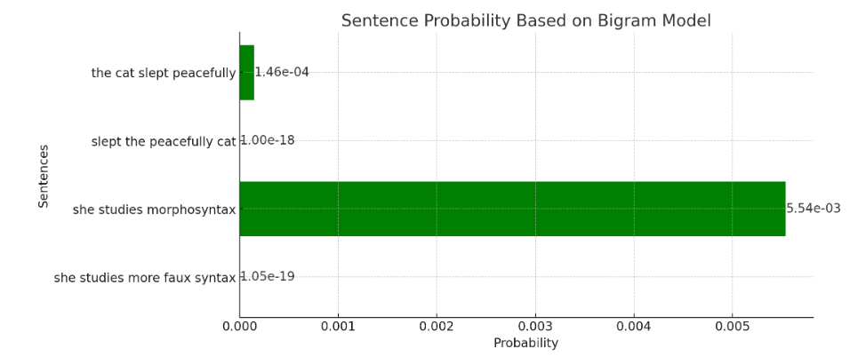

Slide 25
But how to estimate these probabilities?
We want to know the probability of word sequence w→ = w₁ . . . w_{n} occurring in English.
Assume we have some training data: large corpus of general English text.
We can use this data to estimate the probability of w→ (even if we never see it in the corpus!)

Slide 26
Probability theory vs estimation
Probability theory can solve problems like:
I have a jar with 6 blue marbles and 4 red ones.
If I choose a marble uniformly at random, what’s the probability it’s red?

Slide 27
Probability theory vs estimation
Probability theory can solve problems like:
I have a jar with 6 blue marbles and 4 red ones.
If I choose a marble uniformly at random, what’s the probability it’s red?
But often we don’t know the true probabilities, only have data:
I have a jar of marbles.
I repeatedly choose a marble uniformly at random and then replace it before choosing again.
In ten draws, I get 6 blue marbles and 4 red ones.
On the next draw, what’s the probability I get a red marble?
First three facts are evidence.
The question requires estimation theory.

Slide 28
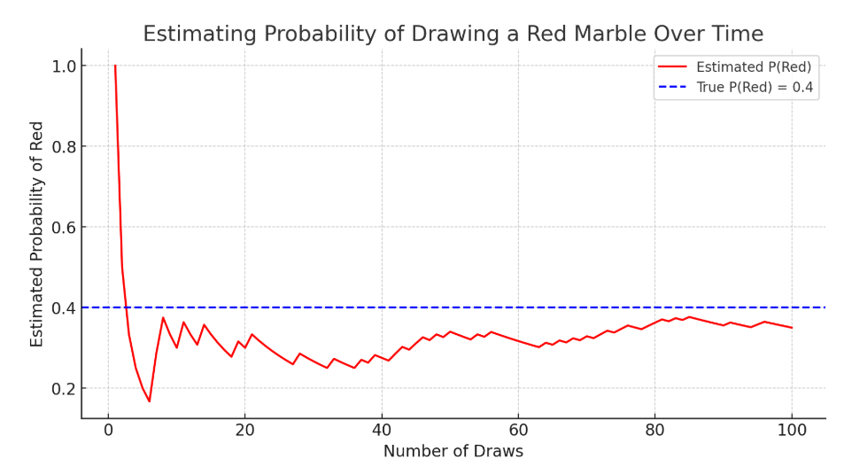

Slide 29
Notation
I will often omit the random variable in writing probabilities, using P (x) to mean P (X = x).
When the distinction is important, I will use
P (x) for true probabilities
P^{ˆ}(x) for estimated probabilities
P_{E}(x) for estimated probabilities using a particular estimation method E.
But since we almost always mean estimated probabilities, I may get lazy later and use P (x) for those too.
Example of dice
True probability of 3 = 1/6
Estimated probability of rolling a dice 10 times (3 two time)= 2/10
Estimated probabilities using estimation method = 18/100

Slide 30
Relative frequency estimation
Intuitive way to estimate discrete probabilities:
C(x)
P_{RF}(x) =
N
where C(x) is the count of x in a large dataset, and
N = ^{Σ}_{x}′ C(x′) is the total number of items in the dataset.
M&M example: P_{RF}(red) = ³⁷² = .142
2620
This method is also known as maximum-likelihood estimation (MLE) for reasons we’ll get back to.

Slide 31
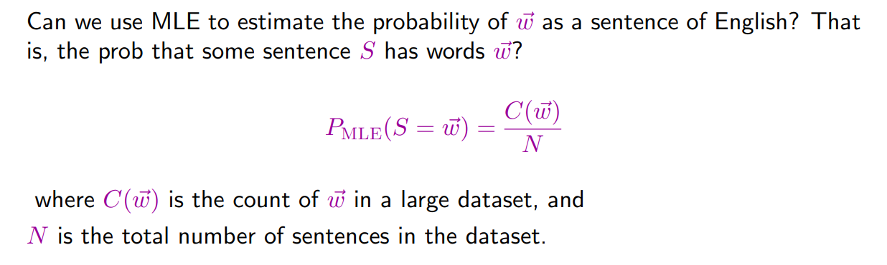
Maximum-likelihood estimation for sentences?

Slide 32
The problem with MLE
MLE thinks anything that hasn’t occurred will never occur (P=0).

Slide 33
Sparse data
In fact, even things that occur once or twice in our training data are a problem. Remember these words from Europarl?
cornflakes, mathematicians, pseudo-rapporteur, lobby-ridden, Lycketoft, UNCITRAL, policyfor, Commissioneris, 145.95
All occurred once. Is it safe to assume all have equal probability?
This is a sparse data problem: not enough observations
to estimate
probabilities well simply by counting observed data. where we had large counts for all colours!)
(Unlike the M&Ms,
For sentences, many (most!) will occur rarely if ever in our training data. So we need to do something smarter.

Slide 34
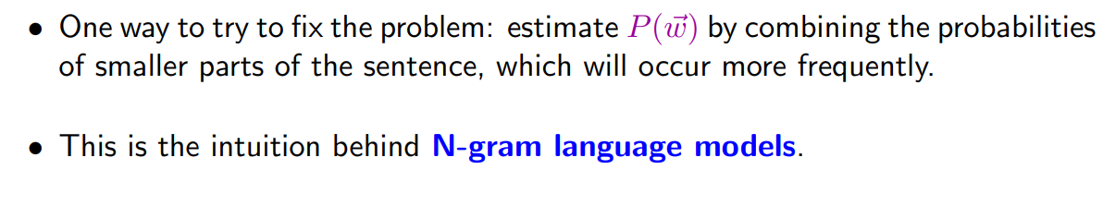
Towards better LM probabilities

Slide 35
Deriving an N-gram model
We want to estimate P (S = w₁ . . . w_{n}).
– Ex: P (S = the cat slept quietly).
This is really a joint probability over the words in S: P (W₁ = the, W₂ = cat, W₃ = slept, . . . W₄ = quietly).
Concisely, P (the, cat, slept, quietly) or P (w₁, . . . w_{n}).

Slide 36
Deriving an N-gram model
We want to estimate P (S = w₁ . . . w_{n}).
– Ex: P (S = the cat slept quietly).
This is really a joint probability over the words in S: P (W₁ = the, W₂ = cat, W₃ = slept, . . . W₄ = quietly).
Concisely, P (the, cat, slept, quietly) or P (w₁, . . . w_{n}).
Recall that for a joint probability, P (X, Y ) = P (Y |X)P (X). So,
P (the, cat, slept, quietly) = P (quietly|the, cat, slept)P (the, cat, slept)
= P (quietly|the, cat, slept)P (slept|the, cat)P (the, cat)
= P (quietly|the, cat, slept)P (slept|the, cat)P (cat|the)P (the)

Slide 37
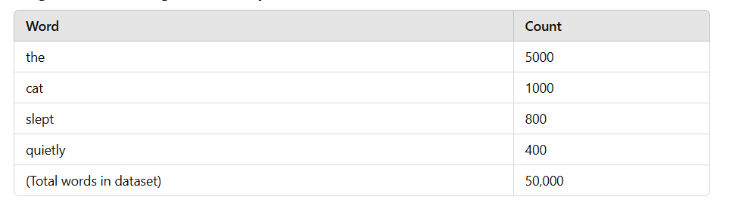
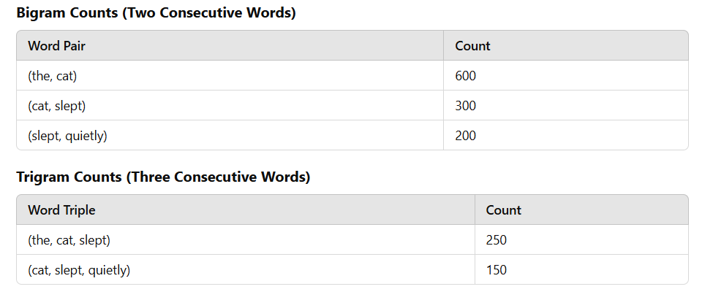
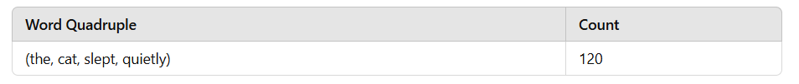

Slide 38
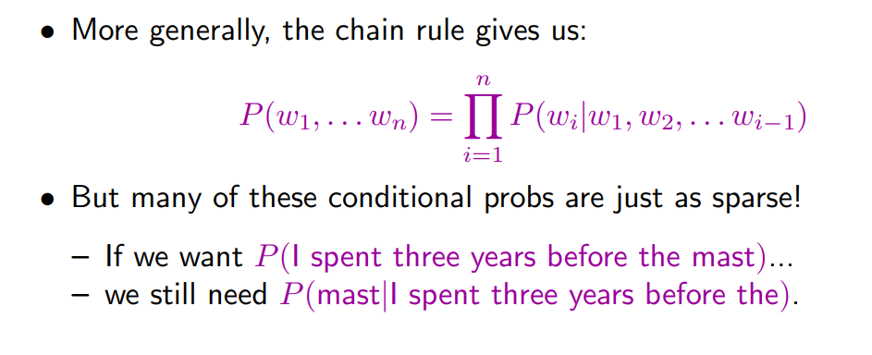
Deriving an N-gram model

Slide 39
Deriving an N-gram model
So we make an independence assumption: the probability of a word only depends on a fixed number of previous words (history).
trigram model: P (w_{i}|w₁, w₂, . . . w_{i−1}) ≈ P (w_{i}|w_{i−2}, w_{i−1})
bigram model: P (w_{i}|w₁, w₂, . . . w_{i−1}) ≈ P (w_{i}|w_{i−1})
unigram model: P (w_{i}|w₁, w₂, . . . w_{i−1}) ≈ P (w_{i})
In our example, a trigram model says
P (mast|I spent three years before the) ≈ P (mast|before the)

Slide 40
Trigram independence assumption
Put another way, trigram model assumes these are all equal:
P (mast|I spent three years before the)
P (mast|I went home before the)
P (mast|I saw the sail before the)
P (mast|I revised all week before the)
because all are estimated as P (mast|before the)
Not always a good assumption! But it does reduce the sparse data problem.

Slide 41
Estimating trigram conditional probs
We still need to estimate P (mast|before, the): the probability of mast given the two-word history before, the.
If we use relative frequencies (MLE), we consider:
Out of all cases where we saw before, the as the first two words of a trigram,
how many had mast as the third word?

Slide 42
Estimating trigram conditional probs
So, in our example, we’d estimate
C(before, the, mast)
P_{MLE}(mast|before, the) =
C(before, the)
where C(x) is the count of x in our training data.
More generally, for any trigram we have
C(w_{i−2}, w_{i−1}, w_{i})
) =
P
MLE(wi|wi−2, wi−1
C(w_{i−2}, w_{i−1})

Slide 43
C(before, the) = 55
C(before, the, mast) = 4
C(before, the, mast)
= 0.0727
C(before, the)
P_{MLE}(mast) is 0.00049, and P_{MLE}(mast|the) is 0.0029.
So seeing before the vastly increases the probability of seeing mast next.

Slide 44
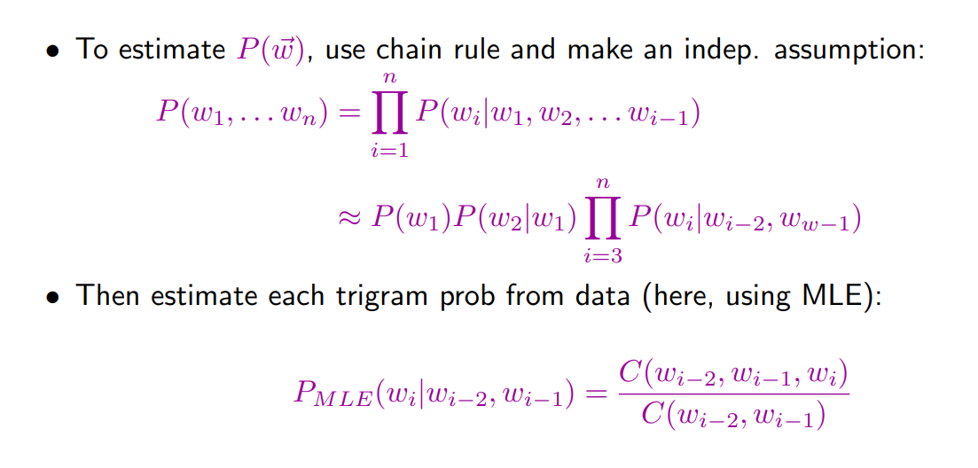
Trigram model: summary

Slide 45
Practical details (1)
Trigram model assumes two word history:
Y
i=3
n
P (w→ ) = P (w₁)P (w₂|w₁)
P (w_{i}|w_{i−2}, w_{w−1})
But consider these sentences:
w₁ w₂ w₃ w₄
he saw the yellow
feeds the cats daily
What’s wrong? Does the model capture these problems?

Slide 46
Beginning/end of sequence
To capture behaviour at beginning/end of sequences, we can augment the input:
w−1 w0 w1 w2 w3 w4 w5
<s> <s> he saw the yellow </s>
<s> <s> feeds the cats daily </s>
That is, assume w₋₁ = w₀ = <s> and w_{n+1} = </s> so:
Y
i=1
n+1
P (w→ ) =
P (w_{i}|w_{i−2}, w_{i−1})
Now, P (</s>|the, yellow) is low, indicating this is not a good sentence.

Slide 47
Beginning/end of sequence
Alternatively, we could model all sentences as one (very long) sequence, including punctuation:
two cats live in sam ’s barn . sam feeds the cats daily . yesterday , he saw the yellow cat catch a mouse . [...]
Now, trigrams like P (.|cats daily) and P (,|. yesterday) tell us about behavior at sentence edges.
Here, all tokens are lowercased. What are the pros/cons of not doing that?

Slide 48
Practical details (2)
Word probabilities are typically very small.
Multiplying lots of small probabilities quickly gets so tiny we can’t represent the numbers accurately, even with double precision floating point.
So in practice, we typically use negative log probabilities (sometimes called
costs):
Since probabilities range from 0 to 1, negative log probs range from 0 to ∞:
lower cost = higher probability.
Instead of multiplying probabilities, we add neg log probabilities.

Slide 49
Summary
“Probability of a sentence”: how likely is it to occur in natural language? Useful in many natural language applications.
We can never know the true probability, but we may be able to estimate it from corpus data.
N -gram models are one way to do this:
To alleviate sparse data, assume word probs depend only on short history.
Tradeoff: longer histories may capture more, but are also more sparse.
So far, we estimated N -gram probabilites using MLE.

Slide 50
Coming up next
Weaknesses of MLE and ways to address them (more issues with sparse data).
How to evaluate a language model: are we estimating sentence probabilities accurately?

