Slide 1
Emotions

Slide 2
Emotions are reactions that human beings experience in response to events or situations.
the word emotion indicates a subjective, affective state that is relatively intense and that occurs in response to something we experience.
We can be at the heights of joy or in the depths of despair or. We might feel angry when we are betrayed, fear when we are threatened, and surprised when something unexpected happens.

Slide 3
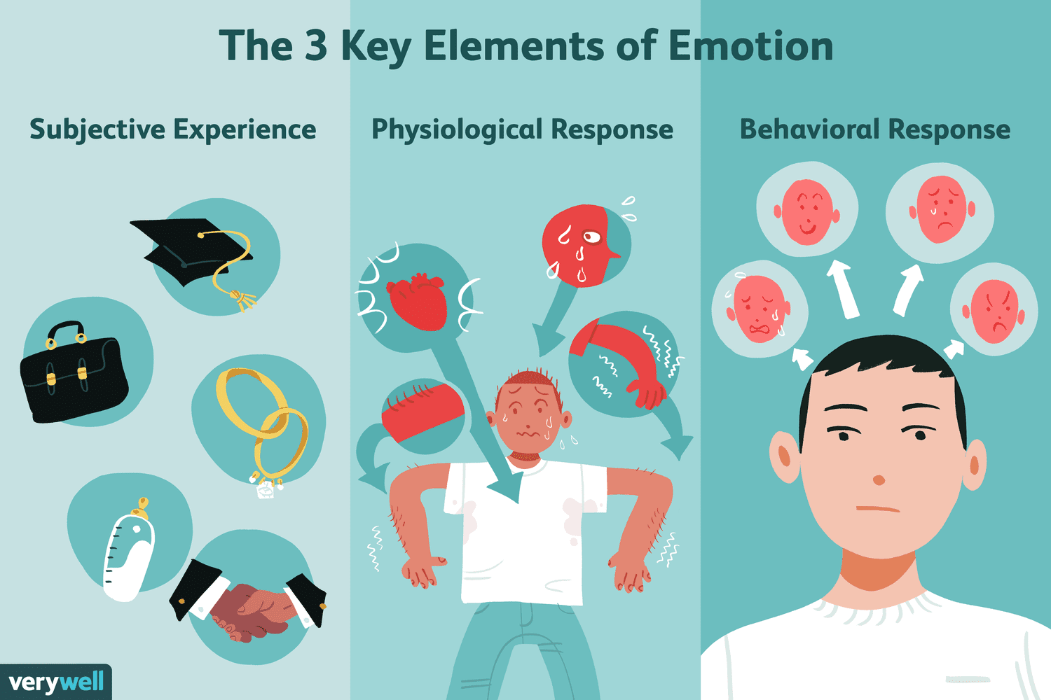

Slide 4
Emotions are complex psychological states that involve three distinct components:
A subjective experience,
A physiological response
A behavioral or expressive response.

Slide 5
Functions of Emotions
Preparing us for action
Shaping our future behavior
Helping us interact more effectively with others

Slide 6
The Functions of Emotions
Preparing us for action:
Emotions act as a link between events in our environment and our responses. For example, if you saw an angry dog charging toward you, your emotional reaction (fear) would be associated with physiological arousal of the sympathetic division of the autonomic nervous system, the activation of the “fight-or-flight” response.

Slide 7
Shaping our future behavior:
Emotions promote learning that will help us make appropriate responses in the future. For instance, your emotional response to unpleasant events teaches you to avoid similar circumstances in the future.

Slide 8
Helping us interact more effectively with others:
We often communicate the emotions we experience through our verbal and nonverbal behaviors, making our emotions obvious to observers. These behaviors can act as a signal to observers, allowing them to understand better what we are experiencing and to help them predict our future behavior.

Slide 9
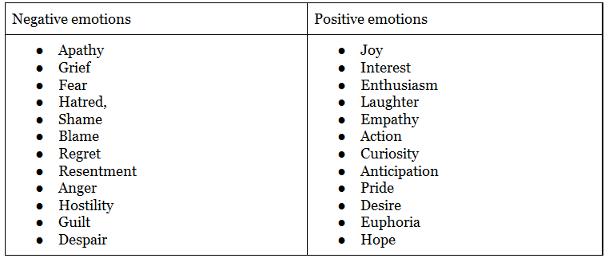

Slide 10
The Roots of Emotions
Consider, for instance, the experience of fear. Pretend that it is late on New Year’s Eve.
You are walking down a dark road, and you hear a stranger approaching behind you. It is clear that he is not trying to hurry by but is coming directly toward you. You think about what you will do if the stranger attempts to rob you or, worse, hurt you in some way.

