Slide 1

METAHEURISTIC OPTIMIZATION AND DEEP LEARNING APPROACHES FOR RESILIENT DDOS DETECTION IN IOT ENVIRONMENTS
Name: Shaik Sardar Zubair Ahamed
Reg. No : 2467106
Supervisor : Dr. Vandana Reddy
Mentor Name : Dr. Balamurugan M

Slide 2
INTRODUCTION – DDOS ATTACK
A cyberattack where multiple compromised devices flood a target system
Causes severe performance degradation or complete system crash
Affects organizations of all sizes, from small systems to large enterprises
Results in significant data, bandwidth, and energy losses
Can also expose systems to potential data breaches
Necessitates intelligent and accurate detection mechanisms

Slide 3
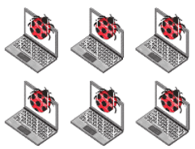





DDOS ATTACK
Malicious Traffic
Attacker Computer
Offline
Server
Real Traffic
Real Terminal User
Not Reachable

Slide 4



DISTRIBUTED DENIAL OF SERVICE (DDOS) ATTACK
HACKER
In the most common example of denial-of-Service (DoS) attacks, an attacker uses a network of hijacked computers.
This network is used to flood the target site with phony server requests, leaving no bandwidth for legitimate traffic.
TARGET SERVER

Slide 5
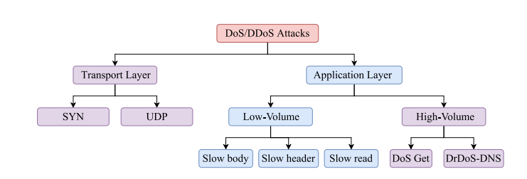
Types of DDoS attacks

Slide 6
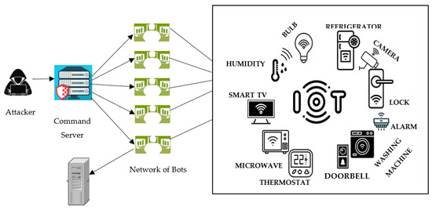
DDoS attack model in lightweight IoT networks

Slide 7
Objectives
To develop a deep learning-based model for accurate and efficient detection of DDoS attacks in IoT networks.
To design an ensemble optimization framework by integrating the Cheetah Optimization Algorithm (ChOA) and Particle Swarm Optimization (PSO) to enhance detection performance and minimize false positives.

Slide 8
Problem Statement
The rapid growth of IoT networks generates complex traffic, making DDoS detection challenging due to evolving attack patterns and limitations of static methods. Deep learning offers potential but requires optimal hyperparameter tuning, where manual approaches are inefficient. Hence, an intelligent system combining DL with optimization algorithms is needed for accurate and adaptive DDoS detection in IoT environments.

Slide 9
Title | Authors | Publication details | Gaps identified | Methodology used | Results
A Hybrid Cheetah and Grey Wolf Optimization Algorithm for Network Intrusion Detection | Deepshikha Kumari, Amit Kumar, et al. | Publication: Engineering Research Express, IOP Science Year: 2025 | Existing DL-based intrusion systems lack optimal convergence and often suffer from overfitting and slow learning due to poor hyperparameter tuning. | A hybrid optimization method combining Cheetah Optimization Algorithm (COA) and Grey Wolf Optimizer (GWO) is used to optimize CNN parameters on multiple intrusion detection datasets | Achieved accuracy up to 99.12%, showing significant performance improvement over standalone CNN or single optimizers.
Enhancing DDoS Attack Mitigation Using Machine Learning and Blockchain-Based Mobile Edge Computing in IoT | M. Chaira, A. Belhenniche, R. Chertovskih | Publication: MDPI Year: 2025 | Existing DDoS detection models fail in distributed IoT settings due to latency and lack of decentralized protection. | Used Random Forest and Transformer models with blockchain-enabled edge computing for decentralized and real-time DDoS detection. CICDDoS2019 dataset was used. | Achieved 99.78% detection accuracy and reduced detection latency using Transformer + Blockchain MEC framework.
A DDoS Detection Model Based on Multi-Strategy Integrated Zebra Optimization Algorithm | X. Liu, L. Wang, et al. | Publication:Springer Year: 2025 | Traditional optimization algorithms lack diversity and get stuck in local optima when tuning DL models. | Proposed an enhanced Zebra Optimization Algorithm integrated with CNN-LSTM | Achieved ~98.7% F1-score, showing robustness and stability over other metaheuristics.

Slide 10
Title | Authors | Publication details | Gaps identified | Methodology used | Results
DDoS Threats in IoT: A Review of Blockchain-Based Defense Strategies | Fiza Abdul Rahim, Abdul Ghafar Jaafar, Noor Hafizah Hassan, Abdulrahman Aminu Ghali, Khairol Shapawi Abdul Karim | Publication: SSRN (Social Science Research Network) Year: 2024 | Limited integration of AI and blockchain in current IoT DDoS mitigation solutions. | Systematic literature review using PRISMA guidelines. | Integration with AI and federated learning enhances anomaly detection and real-time threat response.
Distributed Denial of Service Attack Detection and Mitigation Strategy in 5G‑Enabled Internet of Things Networks | J. Suresh Babu, A. Padmapriya, R. Subramanian, P. Vijayakumar, Neeraj Kumar, M. Shamim Hossain | Publication:Springer Year: 2024 | Traditional methods lack real-time response for 5G-enabled IoT traffic. | A hybrid edge-SDN-ML framework is developed for real-time DDoS detection and mitigation in 5G-IoT networks. | Improved detection accuracy and reduced false positives. Scalable and adaptable in 5G-IoT settings.
Blockchain-Based Cybersecurity Mechanism for Detecting and Mitigating DDoS Attacks in IoT Networks | K. Kamalanaban, R. Murugan, P. Vijayakumar, N. Kumar, B. Ghosh, M. Alazab | Publication:Elsevier Year: 2024 | Existing DDoS detection methods are not efficient for dynamic and resource-constrained IoT environments. | Blockchain-based framework using federated learning and edge computing for collaborative DDoS detection in IoT. | Improved DDoS detection accuracy and reduced false alarms. Demonstrated scalability and efficiency in simulated IoT environments.

Slide 11
Title | Authors | Publication details | Gaps identified | Methodology used | Results
Machine Learning in IoT Security: Current Solutions and Future Challenges | Fatima Hussain, Rasheed Hussain, Syed Ali Hassan, Ekram Hossain | ArXiv Date of Publication: April 11, 2019 | Traditional cryptographic methods don’t scale for IoT's size and complexity. Surveys lack coverage of ML/DL for IoT security holistically. | Explains DL models like CNN, RNN, LSTM, GAN, and DBN for IoT. Maps ML/DL to security tasks like intrusion, malware, DDoS, and auth. | ML/DL models enable smart anomaly detection, classification, and forecasting. SVM, RF, CNN, and autoencoders are widely effective in threat detection.
IoT Security: Botnet Detection in IoT using Machine Learning | Satish Pokhrel, Robert Abbas, Bhulok Aryal | ArXiv Date of Publication: April 6, 2021 | Most studies use imbalanced datasets, leading to misleading accuracy. Feature engineering is often ignored, causing overfitting and high computational cost. Many models do not validate generalizability using proper cross-validation. | Preprocessing included: data cleansing, min-max normalization, and transformation of categorical features. Applied feature engineering using Chi-square test to select top 8 features. | KNN gave the best results with 92.1% accuracy and 92.2% ROC AUC on balanced data. Naïve Bayes showed ~99% accuracy but only 60.9% ROC AUC, indicating poor detection of minority class.

Slide 12
Title | Authors | Publication details | Gaps identified | Methodology used | Results
A Survey of Machine and Deep Learning Methods for Internet of Things (IoT) Security | Mohammed Ali Al-Garadi, Amr Mohamed, Abdulla Al-Ali, Xiaojiang Du, Mohsen Guizani | ArXiv Date of Publication: July 29, 2018 | Traditional security is weak for IoT’s complexity. ML/DL not deeply explored in prior IoT security surveys. Zero-day threats and dynamic attacks need better detection. | DL techniques like CNN, RNN, AE, GAN applied. Mapped models to IoT layers (device, network, application). Also discussed RL for adaptive IoT security. | ML/DL detect anomalies and predict attacks effectively. DL outperforms traditional ML in complex scenarios. Models improve accuracy and scalability of IoT security.
A Machine Learning Security Framework for IoT Systems | Miloud Bagaa, Tarik Taleb, Jorge Bernal Bernabe, Antonio Skarmeta | IEEE Access Date of Publication: May 21, 2020 | Current IoT security lacks adaptive, end-to-end solutions. Limited integration of SDN/NFV with AI in real-time defenses. Difficulty handling emerging, unknown attack types. | Framework combines ML, SDN, and NFV for threat defense. Uses supervised ML (e.g., SVM, J48, RF) for attack detection. | Achieved up to 99.71% accuracy using anomaly-based detection. Random Forest and AdaBoost performed best in attack detection.

Slide 13
Title | Authors | Publication details | Gaps identified | Methodology used | Results
An Efficient DDoS TCP Flood Attack Detection and Prevention System in a Cloud Environment | A. Aqeel Sahi, David Lai, Yan Li, Mohammed Diykh. | Publication: IEEE Access Year: 2017 | Lack of accuracy–speed balance and cloud-specific validation in DDoS detection. | Proposed CS_DDoS with two phases: detection using classifiers (LS-SVM, NB, KNN, MLP) and prevention via IP blacklisting. | LS-SVM gave best performance with ~97% accuracy (single-source) and ~94% (multi-source), outperforming existing methods.
Detection and Prevention of DDoS Attacks on the IoT | Shu-Hung Lee, Yeong-Long Shiue, Chia-Hsin Cheng, Yi-Hong Li, Yung-Fa Huang; | Publication: MDPI Year: 2022 | Prior IoT DDoS methods used single models, limited accuracy, and lacked edge deployment. | Built an autonomous defense system combining edge computing + two independent 2D CNN models trained on packet traffic and packet feature datasets, then weighted their outputs to detect and classify SYN, UDP, ICMP, and mixed flood attacks. | The 2D CNN models achieved very high accuracy (~99.5% on packet traffic dataset, ~99.8% on packet feature dataset)
SDN-Based Architecture for Transport and Application Layer DDoS Attack Detection by Using Machine and Deep Learning | Noe Marcelo Yungaicela-Naula, Cesar Vargas-Rosales, Jesús Arturo Pérez-Díaz; | Publication:IEEE Access Year: 2021 | Lack of up-to-date datasets and limited simulated or testbed assessment in prior SDN-based DDoS detection work. | Designed an SDN-based framework using ML/DL models (SVM, RF, MLP, CNN, LSTM, GRU) with CICDoS datasets and Mininet+ONOS testbed for transport/application-layer DDoS detection. | Achieved >99% accuracy on classifying unseen traffic; detection rates over ~98% for transport-layer attacks and ~95% for application-layer attacks in simulated SDN setup.

Slide 14
CICDDOS2019 DATASET
Developed by the Canadian Institute for Cybersecurity (CIC) in 2019
Contains benign traffic and 12 types of DDoS attacks (UDP Flood, TCP SYN Flood, HTTP Flood, ICMP Flood, DNS Flood, etc.)
Includes approximately 0.43 million flow records
Each flow is characterized by over eighty statistical and header-based features
Widely recognized as a benchmark dataset for machine learning and deep learning-based DDoS detection research
We used CICDDoS2019 because it is a standard benchmark dataset with twelve types of DDoS attacks and over four hundred thirty-one thousand records. It is well-validated, widely used in research, and ensures our results are comparable with existing studies. Newer datasets are not as standardized or extensively validated.

Slide 15
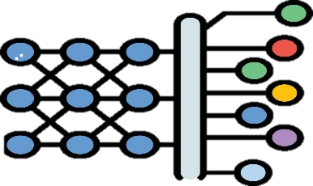

IoT
DATA COLLECTION
DATA PREPROCESSING
FEATURE ENGINEERING
DEEP LEARNING CNN
Cheetah Optimization Algorithm
METHODOLOGY
EVALUATION

Slide 16





Initialize swarm with CNN hyperparameters: {Learning rate, Filters, Kernel size, Dropout, Batch size}
For each particle:
Build and train CNN with given parameters
Evaluate fitness = Accuracy – False Positives
Update pBest (particle best) and gBest (global best)
Update velocity & position of particles
Repeat until convergence or max iterations
Output optimal hyperparameters and retrain CNN for final DDoS detection
PSO Logic for DDoS Classification
Initialization
Velocity and Position Update
Fitness evaluation
Global best

Slide 17
PSO LOGIC EQUATIONS
Velocity Update Equation
vi​(t+1) = w⋅vi​(t) + c1​r1​(pBesti​−xi​(t)) + c2​r2​(gBest−xi​(t))
w⋅vi​(t) → Inertia
c1​r1​(pBesti​−xi​(t)) → Cognitive term
c2​r2​(gBest−xi​(t)) → Social term
2. Position Update Equation
xi​(t+1) = xi​(t) + vi​(t+1)

Slide 18
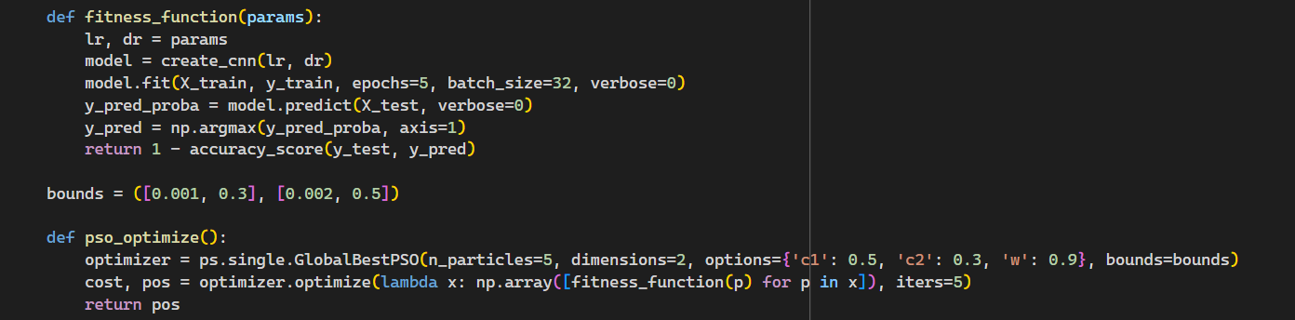
PSO LOGIC CODE

Slide 19


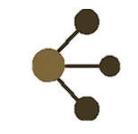
Cheetah Optimization Algorithm - Overview
Inspired by cheetah hunting behaviour to balance exploration and exploitation.
Start with random solutions (cheetahs) searching the space.
Uses surrounding strategy to refine positions.
Best solution becomes the leader, guiding others to converge faster.
Applied to optimize deep learning hyperparameters for accurate DDoS detection.
Cheetah optimization algorithm
Surrounding strategy
Random installation
Population of candidate solutions
Updating solution positions
Leader selection
Choosing the best solution

Slide 20
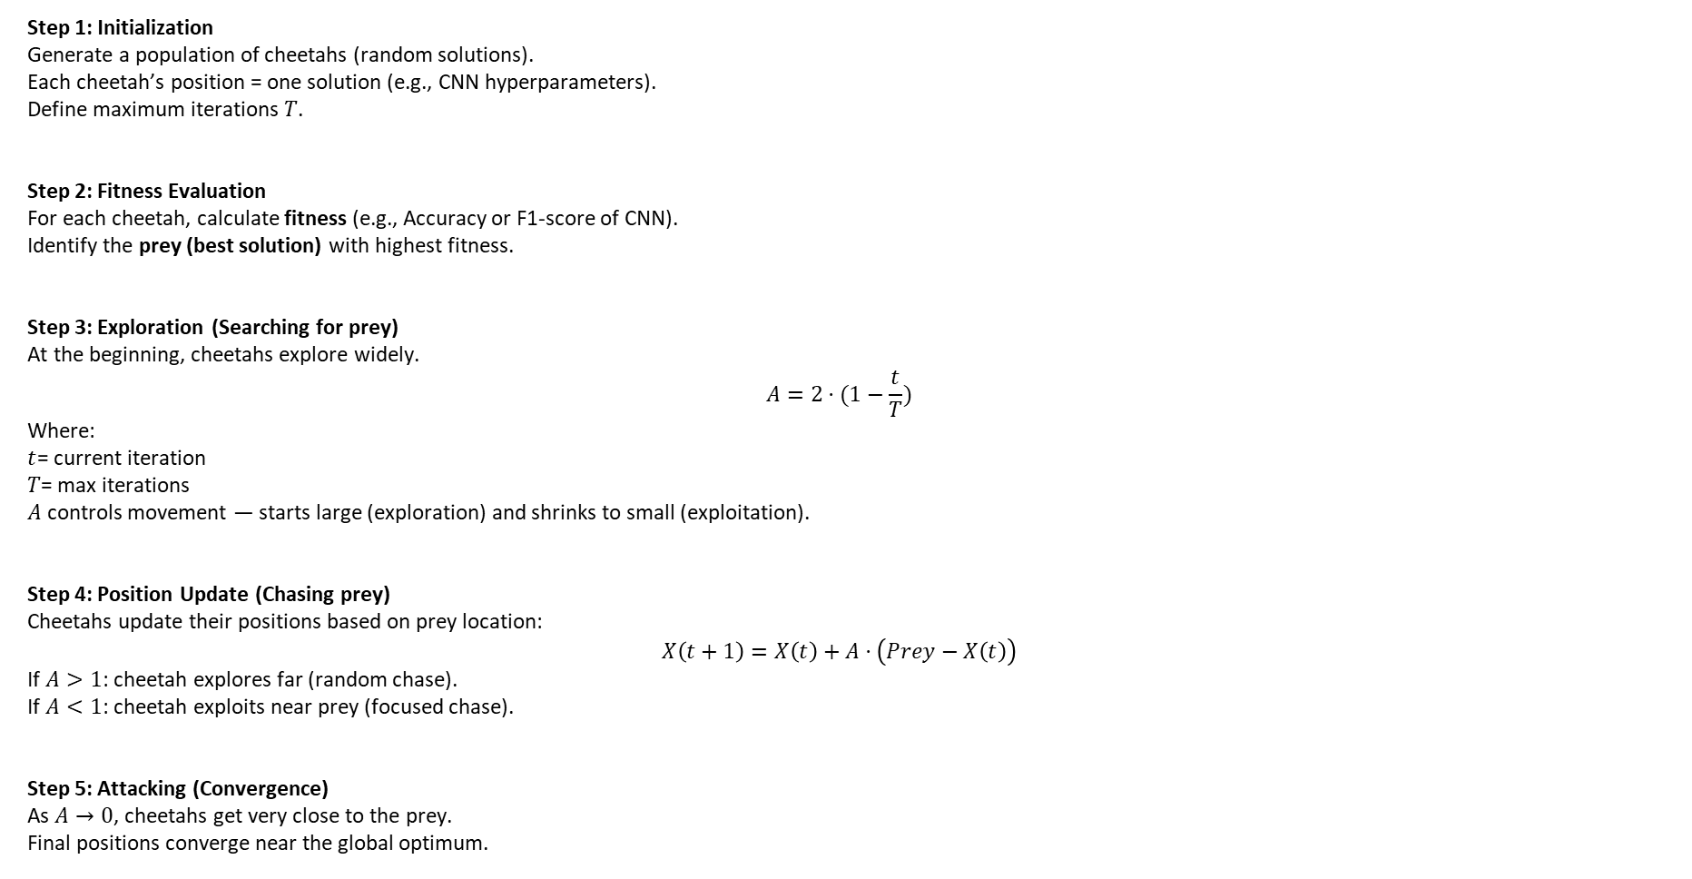
Step 1: Initialization
Generate a population of cheetahs (random solutions).
Each cheetah’s position = one solution (e.g., CNN hyperparameters).
Define maximum iterations $T$.
Step 2: Fitness Evaluation
For each cheetah, calculate fitness (e.g., Accuracy or F1-score of CNN).
Identify the prey (best solution) with highest fitness.
Step 3: Exploration (Searching for prey)
At the beginning, cheetahs explore widely.
$$A=2⋅(1−\frac{t}{T})$$
Where:
$t$= current iteration
$T$= max iterations
$A$ controls movement — starts large (exploration) and shrinks to small (exploitation).
Step 4: Position Update (Chasing prey)
Cheetahs update their positions based on prey location:
$$X\left(t+1\right)=X\left(t\right)+A⋅\left(Prey−X\left(t\right)\right)$$
If $A>1$: cheetah explores far (random chase).
If $A<1$: cheetah exploits near prey (focused chase).
Step 5: Attacking (Convergence)
As $A→0$, cheetahs get very close to the prey.
Final positions converge near the global optimum.

Slide 21
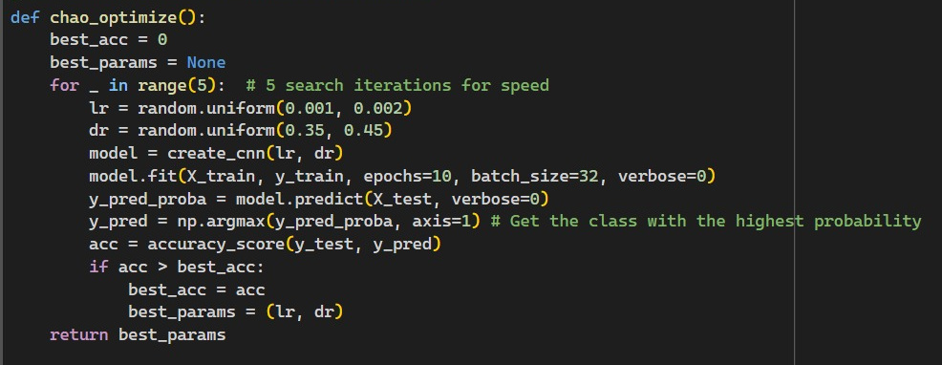
CHoA LOGIC CODE

Slide 22

Ensemble Model
Combines predictions from ChOA and PSO optimized CNN models.
ChOA is given more weight since it performs slightly better.
Final prediction:
$y_{final}=0.55⋅y_{ChOA}+0.45⋅y_{PSO}$

Slide 23
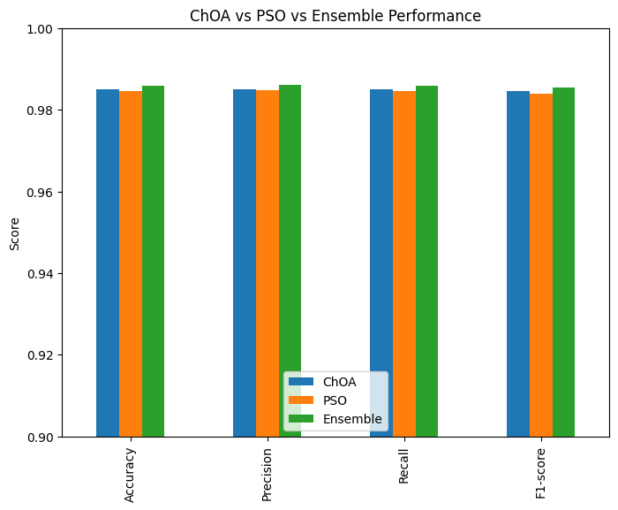
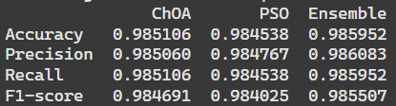
Results
COMPARISON OF PERFORMANCE METRICS

Slide 24
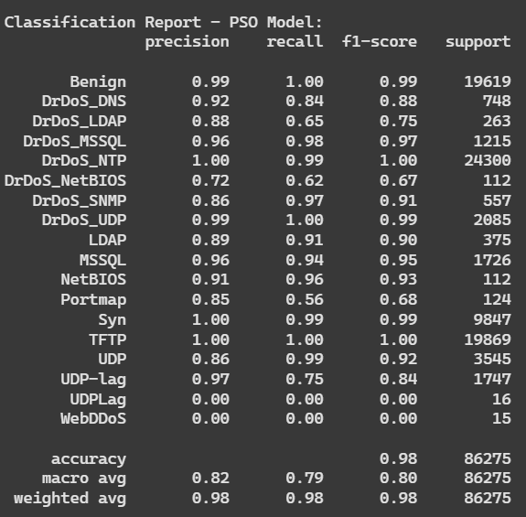
CLASSIFICATION REPORT FOR CNN WITH PSO OPTIMIZATION

Slide 25

CLASSIFICATION REPORT FOR CNN WITH CHoA OPTIMIZATION

Slide 26
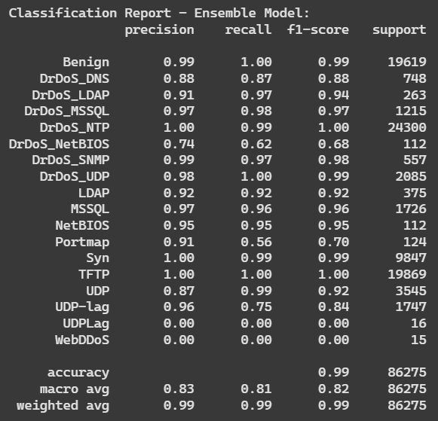
CLASSIFICATION REPORT FOR CNN WITH ENSEMBLE OPTIMIZATION

Slide 27
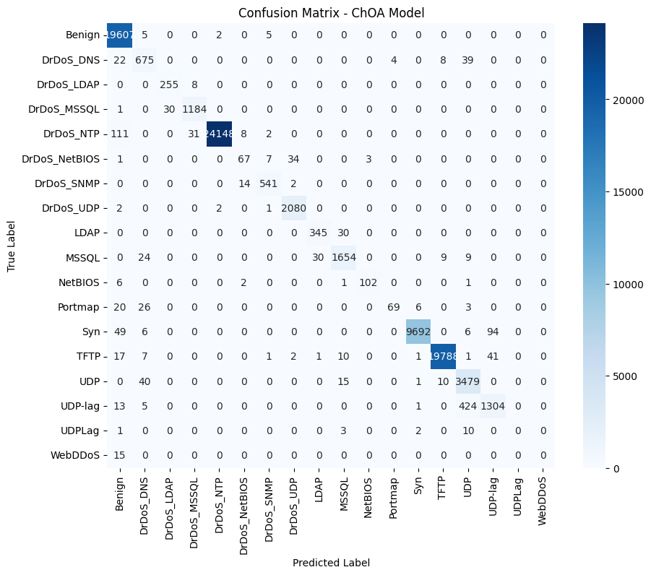

Slide 28


Slide 29
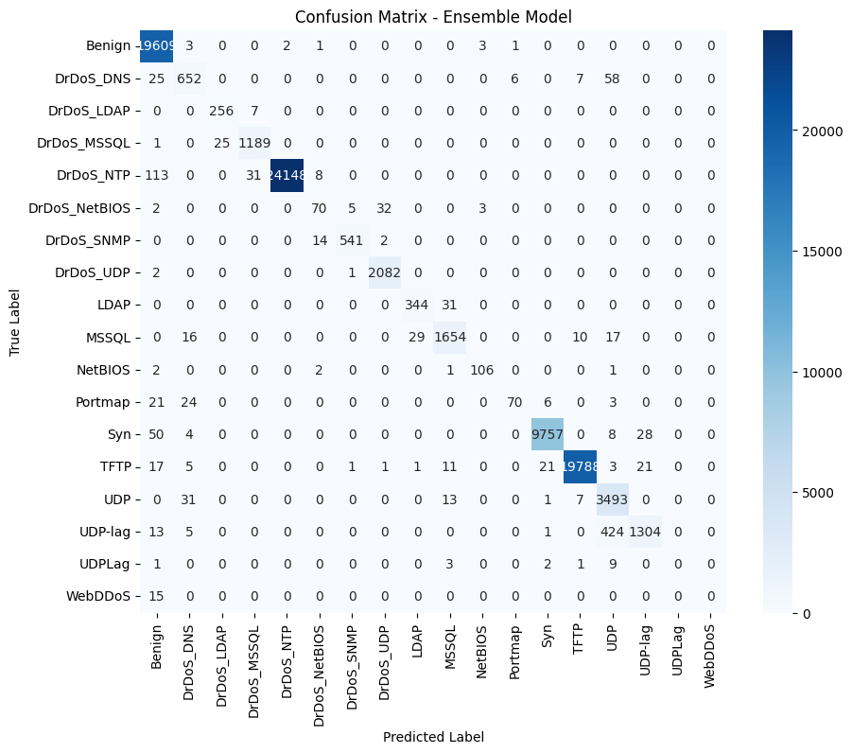

Slide 30
False Positives by Class for ChoA vs PSO Optimization

Slide 31
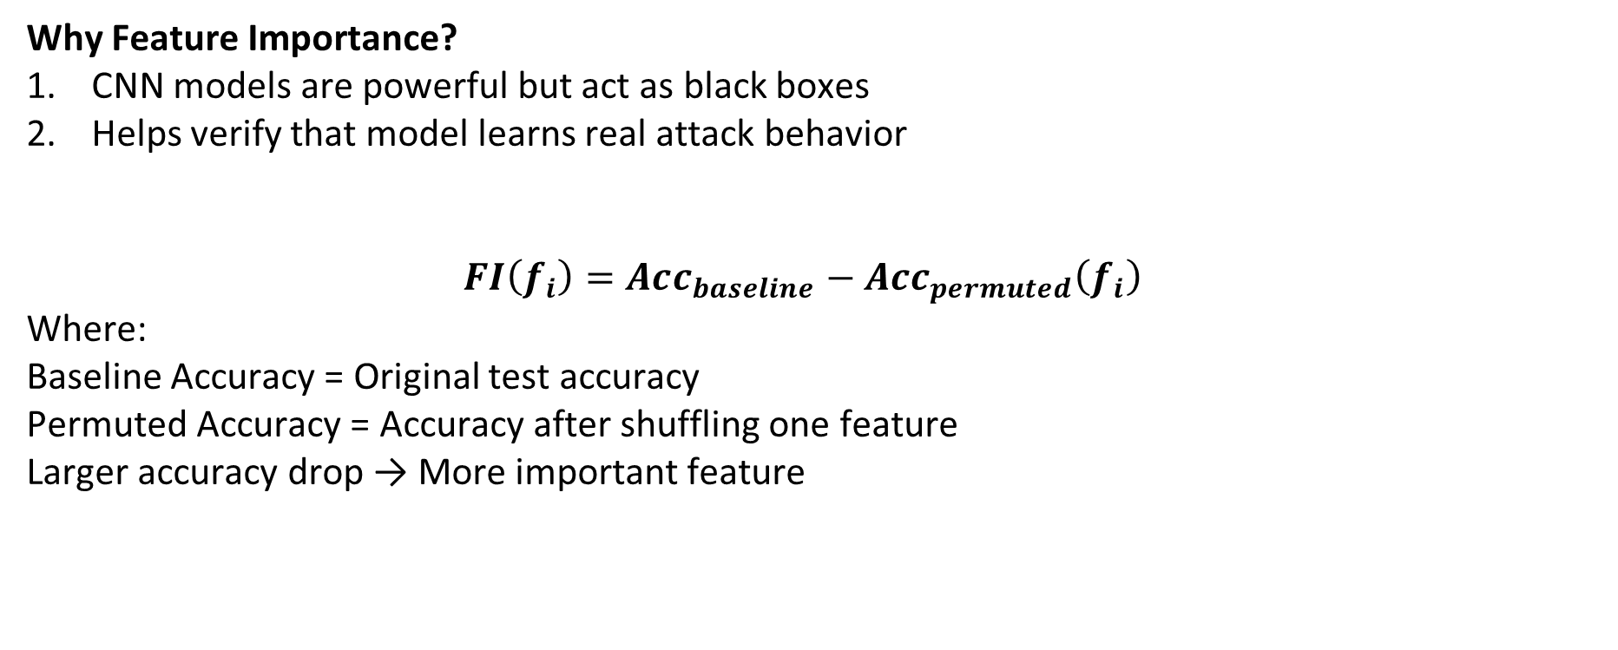
Permutation Feature Importance – Concept & Process
Why Feature Importance?
CNN models are powerful but act as black boxes
Helps verify that model learns real attack behavior
$$FI\left(f_{i}\right)=Acc_{baseline}−Acc_{permuted}\left(f_{i}\right)$$
Where:
Baseline Accuracy = Original test accuracy
Permuted Accuracy = Accuracy after shuffling one feature
Larger accuracy drop → More important feature

Slide 32

Algorithm
Train optimized CNN model.
Compute baseline accuracy on test data.
For each feature $f_{i}$:
Shuffle values of $f_{i}$.
Predict using trained CNN.
Compute permuted accuracy.
Calculate importance score.
Repeat for multiple iterations.
Compute mean importance.
Rank features based on importance values.

Slide 33
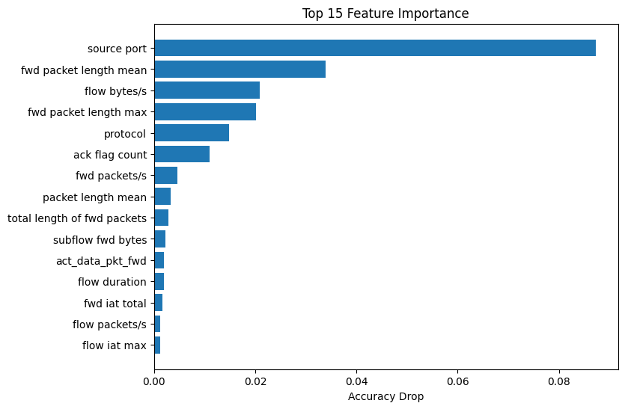
FEATURE IMPORTANCE

Slide 34
Conclusion
The ensemble of PSO and ChOA optimized the deep learning-based DDoS detection system, combining PSO’s accuracy with ChOA’s faster convergence. This hybrid approach delivered a more robust, efficient, and adaptive solution for securing IoT networks.

