Slide 1
Traffic Signal Timing Optimizer from Intersection Video
AI2002 Artificial Intelligence - Semester Project (Fall 2026)
Path A (Software-Based)
[MEMBER 1] | [MEMBER 2] | [MEMBER 3]
06 December 2026

Slide 2
Problem
Many intersections run fixed-time cycles set once and never adapted
Green time wasted on empty approaches while others queue
Adaptive systems need buried loop sensors - costly to install
Root cause: the signal does not know actual demand per approach

Slide 3
Motivation & Real-World Justification
Stakeholder: traffic engineer / municipal operator
Decision: what green split minimises total delay this cycle?
Camera-only solution needs no road works - uses existing CCTV
Affects daily commuters, fuel use and emissions

Slide 4
Objectives
Detect & classify vehicles with a trained model
Convert counts to capacity-aware demand (PCU)
Compute an optimal signal plan (Webster's method)
Quantify delay reduction vs fixed-time baseline
Demonstrate the complete flow in a Streamlit app

Slide 5
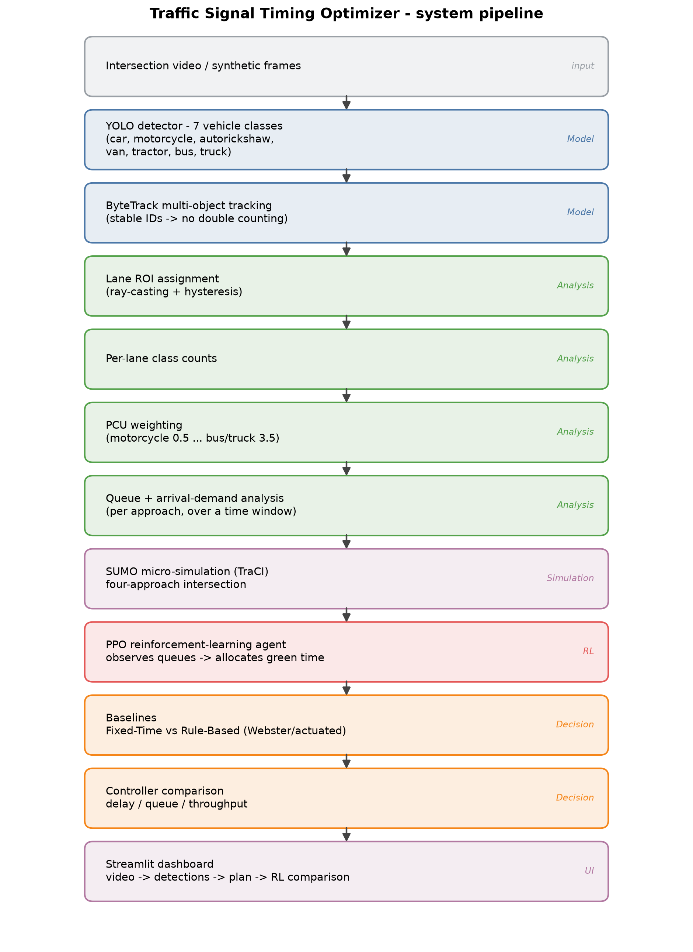
System Architecture
Model -> Analysis -> Decision, wrapped in a Streamlit app

Slide 6
Layer 1 - Detection Model
YOLOv8n single-stage detector, fine-tuned from COCO weights
7 classes: car, motorcycle, autorickshaw, van, tractor, bus, truck
Fine-tuning needed: 3 classes do not exist in COCO at all
Trained on Kaggle GPU (local GPU thermally throttles)
~34 FPS inference at 640 px on the local T1200

Slide 7
Dataset
Three public Roboflow datasets merged into one 7-class set
8,513 images (train 6,746 / val 962 / test 805), 21,275 boxes
Unified class index via explicit remapping
Documented limitations: class imbalance, video-derived frames

Slide 8
Layer 2 - Tracking & Lane Counting
ByteTrack assigns persistent IDs -> count once, not per frame
Geometric lane ROIs (polygon + ray-casting + hysteresis)
Lane assignment is geometry, not a learned task - honest scoping
Output: de-duplicated per-lane class counts

Slide 9
Key Insight - PCU Weighting
Naive counting: one vehicle = one vehicle
But a bus occupies far more capacity than a motorcycle
Passenger Car Units: motorcycle 0.5 ... bus/truck 3.5
This is why the detector must classify, not just detect

Slide 10
Layer 3 - Webster's Method
Flow ratio y = q / s (arrival flow / saturation flow)
Optimal cycle Co = (1.5 L + 5) / (1 - Y)
Green split g_i = (y_i / Y) (Co - L)
Clamped to practical cycle/green limits
Delay compared against the fixed-time plan
Oversaturation (Y >= 1) is flagged, not silently mishandled

Slide 11
Simulation & Reinforcement Learning
Measured demand drives a SUMO four-approach intersection (TraCI)
PPO agent: state = per-approach queues + phase + elapsed green
Action = keep/switch phase; reward = negative total queue
Compared against Fixed-Time and Rule-Based (actuated) controllers
Trained on CPU (~120k steps, no GPU thermal risk)

Slide 12
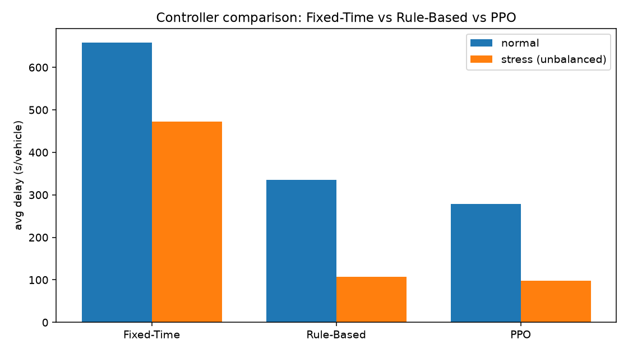
Results - Adaptive Control
PPO cuts delay vs Fixed-Time by 57.6% (normal) / 79.4% (stress)

Slide 13
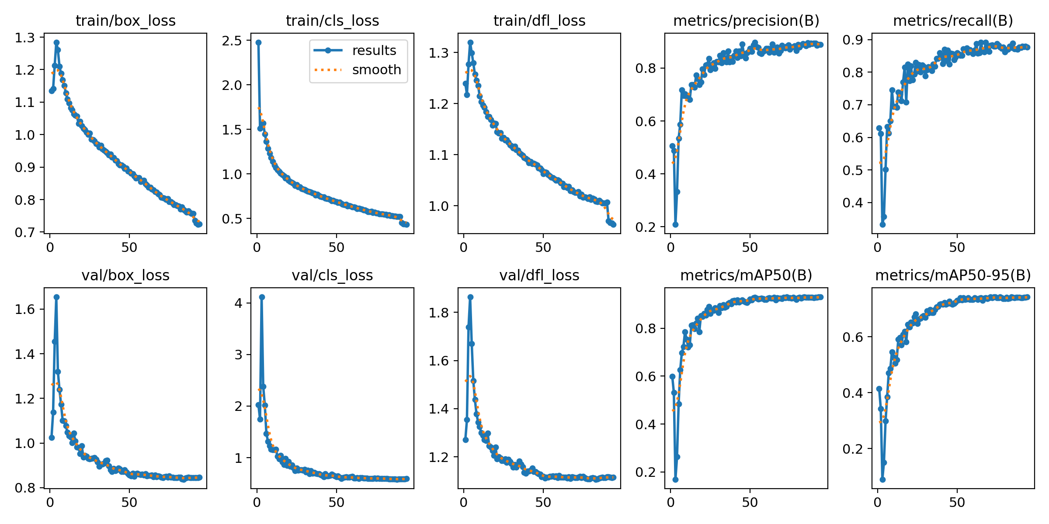
Results - Detection
Training curves: loss and mAP over epochs

Slide 14
Results - Detection Accuracy
COCO zero-shot baseline: mAP@0.5 = 0.727 (only 4 classes)
Fine-tuned (ours): mAP@0.5 = 0.944 (7 classes)
+0.217 mAP@0.5, and 3 classes COCO cannot detect
Per-class AP@0.5: autorickshaw 0.976, bus 0.974, van 0.957

Slide 15
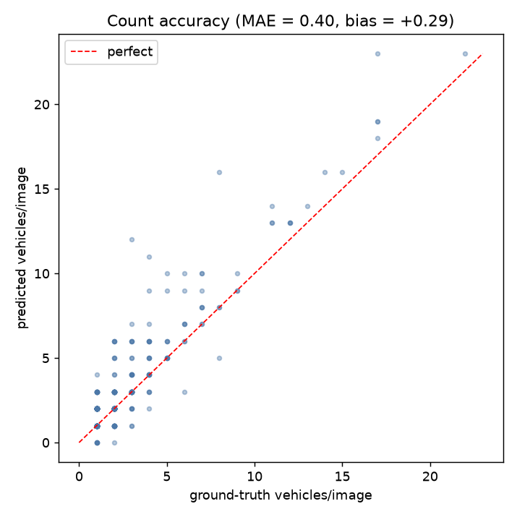
Results - Count Accuracy
MAE 0.395 vehicles/image, 74.8% exact counts (805 images)

Slide 16
Results - PCU Ablation
Same scenario, two plans: naive count vs PCU-weighted
Green P1: 26.1 s (naive) vs 23.0 s (PCU) - a 3.1 s shift
Naive counting under-serves the heavy-vehicle approach
Proves PCU weighting changes the recommendation, not cosmetic

Slide 17
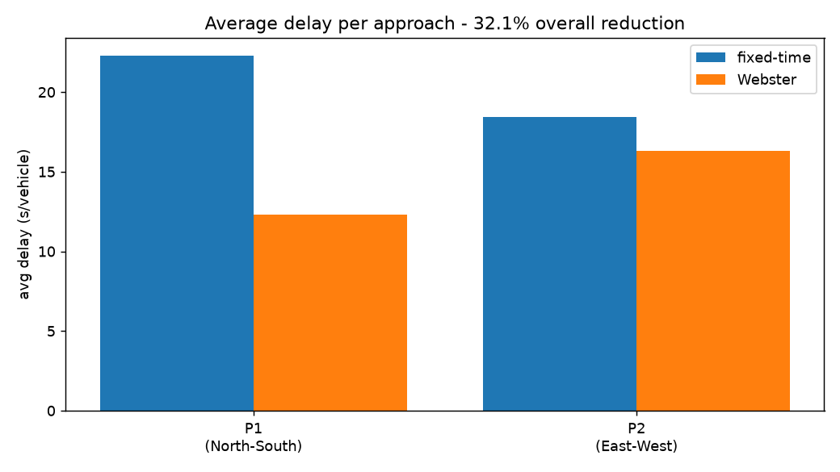
Results - Delay Reduction
Fixed-time 20.64 s/veh -> Webster 14.01 s/veh = 32.1% reduction

Slide 18
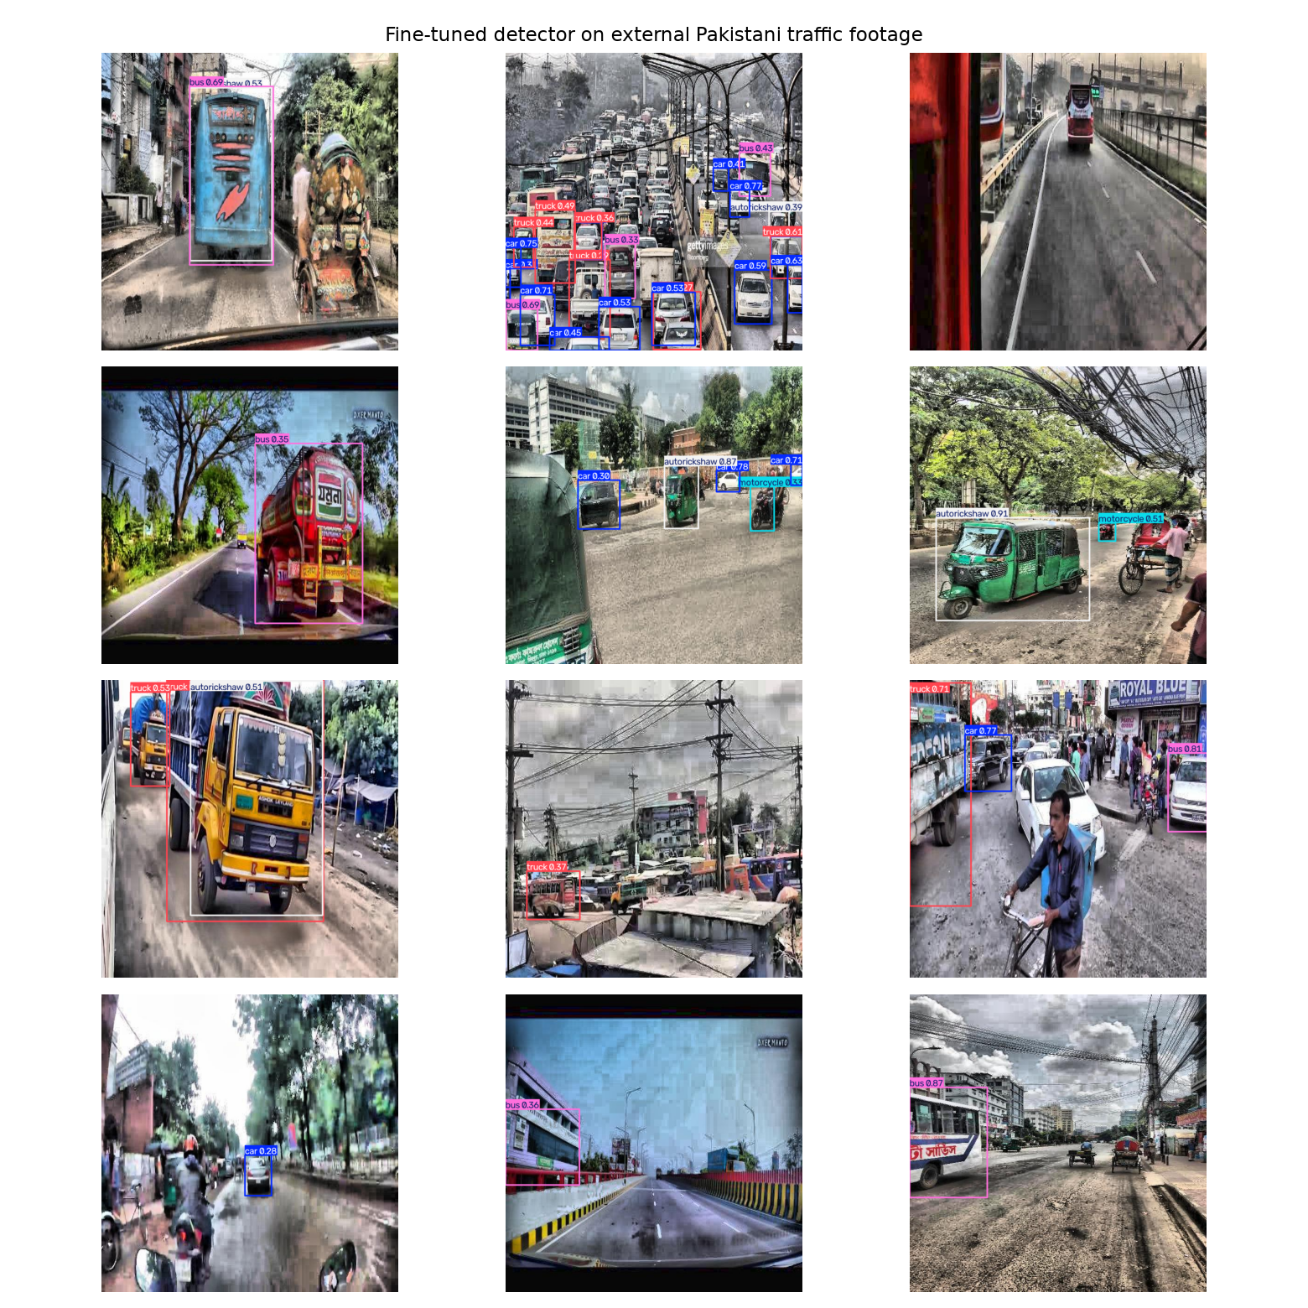
Domain Gap - External Footage
On Pakistani footage: 2.53 detections/img, all 7 classes found (qualitative)

Slide 19
Limitations
Class imbalance (bus/van thin); per-class metrics reported
Video-derived frames -> likely near-duplicate leakage; 0.944 optimistic
Domain gap: not Pakistan data; external labels unusable for mAP
PCU & saturation flow are documented constants, not measured
Lane ROIs manual; Webster valid only under undersaturation
Assistive prototype, not a certified signal controller

Slide 20
Conclusion & Future Work
A small fine-tuned detector + PCU analysis recommends better signal plans
32.1% average delay reduction vs fixed-time on the demonstration
Future: hand-labelled local data, multi-intersection coordination,
learned lane assignment, RL adaptive control, edge ONNX deployment

Slide 21
Thank You
Questions?
Code, report and figures are organised under the project repository

