Slide 1
Optimizing the power consumption
of Zone 1 based on various environmental and
meteorological factors in
Wellington, New-Zealand
Zubariya Suleka Z
July 2025

Slide 2
The Objective
The objective is to develop a machine learning model that can predict the power consumption (Zone 1 Power Consumption) of Wellington, New Zealand based on various environmental and meteorological factors.

Slide 3
Dataset Overview
Total rows: 52,540
Features: 7 predictors, 1 target (Power Consumption)
Data types: 6 numerical, 1 categorical
Missing data: ~1.44%
Target variable is continuous and skewed
Data describes environmental factors affecting power usage

Slide 4
Data Cleaning
Outlier Treatment
Column cleanup
Missing value Treatment
Renamed columns for clarity
Extracted numeric values from strings
757 missing values in total
Mean / median imputation used
Capping using IQR method

Slide 5
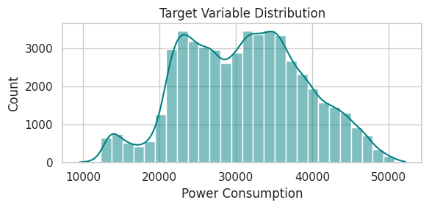
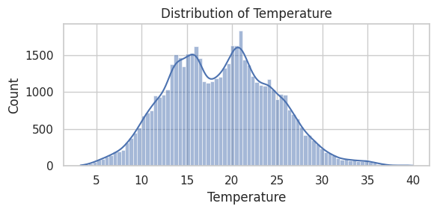
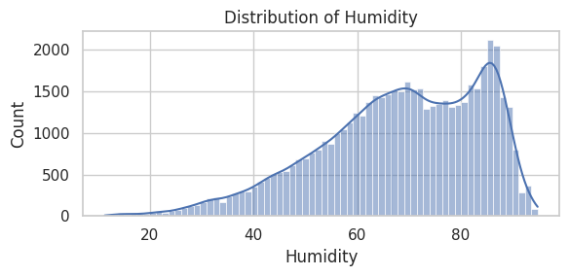
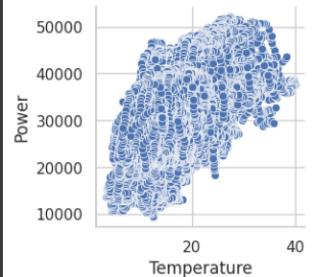
Exploratory Data Analysis
Target (Power) is right-skewed and multimodal
Mild nonlinear relationship between Temperature and Power
Temperature shows a slightly skewed bimodal distribution, indicating mixed seasonal patterns.
Humidity is left-skewed, with most values concentrated above 60%
Most features have weak or no visible linear relationship with the target.

Slide 6
Data Preprocessing
Dependent/Independent separation
Train / Test split
Feature Scaling
01
03
Independent (x) = Temperature , Humidity, Wind_Speed , general_diffuse_flows, diffuse_flows , Air_Quality_Index, Cloudiness
Dependent (y) = Power
Training Data - 80%
Test Data - 20%
Numerical features scaled using StandardScaler
02

Slide 7
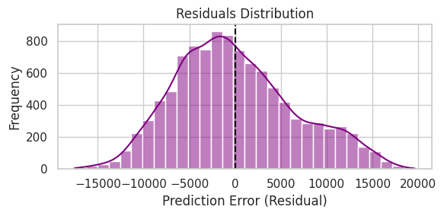
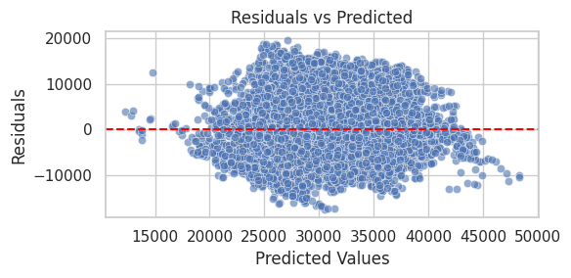
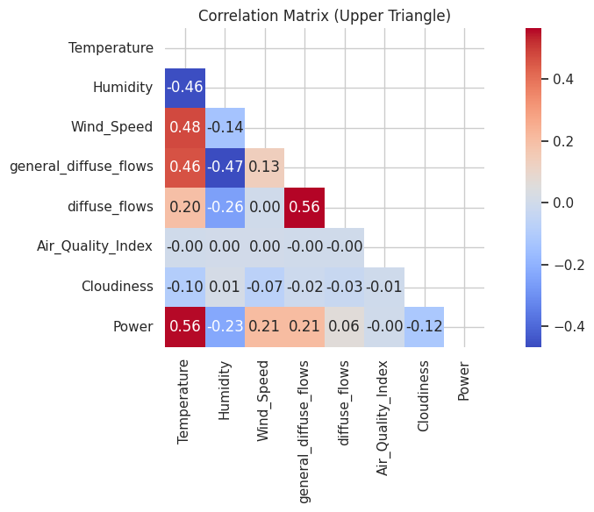
Checking Linear regression Assumptions
Slight left skew
Unimodal
Normality of residuals violated
Residual vs Predicted graph shows funneling in both ends
Slight variance in residual spread
Not homoscedastic
general_diffuse_flows and diffuse_flows show high correlation
Presence of multicollinearity

Slide 8
Model Comparison
Size/time
Accuracy (R2)
RMSE
1
Dummy Regressor
0.0000
8037.41
2
Linear Regression
0.3302
6577.95
3
Ridge Regression
0.3302
6577.93
4
Polynomial Regression
0.4065
6191.42
5
Decision Tree Regression
0.2703
6865.89
6
KNN Regression
0.3985
6233.50
7
Random Forest Regression
0.6361
4848.79
8
XGboost Regression
0.5507
5387.54
9
Stacking Ensemble
0.5928
5129.15

Slide 9
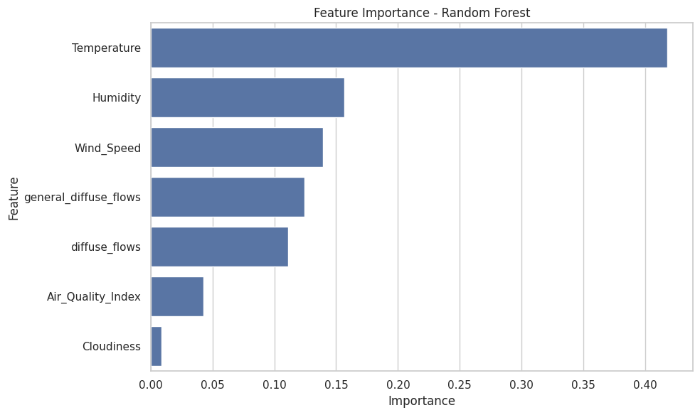
Feature Importance
1
Temperature
2
Humidity
3
Wind_speed

Slide 10
Feature selection
Dropped the least important feature - Cloudiness
Evaluated model performance before and after feature selection
Before Feature Selection:
RMSE = 4848.79, R² = 0.6361
After Feature Selection:
RMSE =4898.50, R² = 0.6286
Dropping Cloudiness slightly reduced model performance, suggesting it may still add marginal value. Retaining it could be beneficial

Slide 11
Hyperparameter Tuning
Random Forest regressor
XG Boost regressor
Tuned Parameters
'n_estimators': [100, 200],
'max_depth': [None, 10, 20],
'min_samples_split': [2, 5],
'min_samples_leaf': [1, 2],
'max_features': ['sqrt', 'log2']
Tuned Parameters:
'n_estimators': [100, 200],
'max_depth': [3, 6, 10],
'learning_rate': [0.01, 0.1],
'subsample': [0.8, 1.0],
'colsample_bytree': [0.8, 1.0]
Before Tuning:
RMSE = 4848.79, R² = 0.6361
After Tuning:
RMSE = 5177.27, R² = 0.5851
Before Tuning:
RMSE = 5387.54, R² = 0.5507
After Tuning:
RMSE = 5387.68, R² = 0.5507
Tuning did not improve results — possibly due to limited search space or already optimal default values.

Slide 12
Final Model
Random Forest Regressor
Cross validation score:
R² = 0.6144
RMSE = 4977.35
Test results:
R² = 0.6361
RMSE = 4848.79

Slide 13
THANK YOU

