Slide 1
SleepWell
SleepWell AI: An Intelligent Sleep Quality Prediction and Personalized Sleep Improvement System

Slide 2
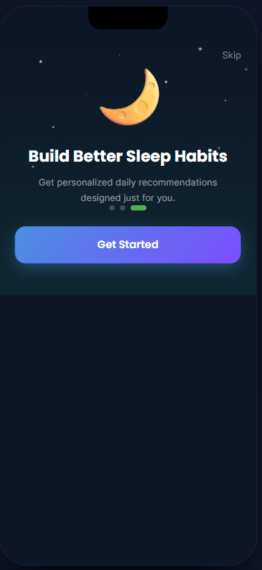
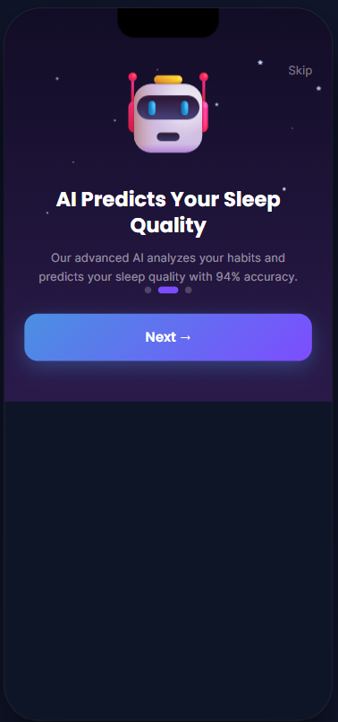
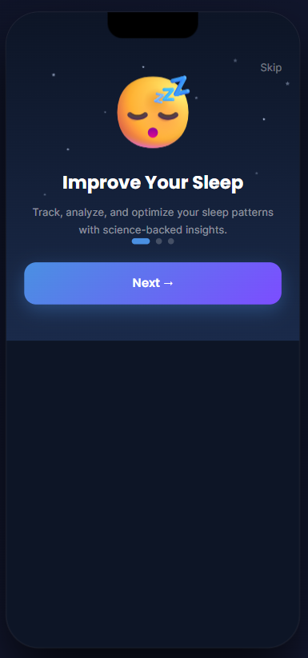
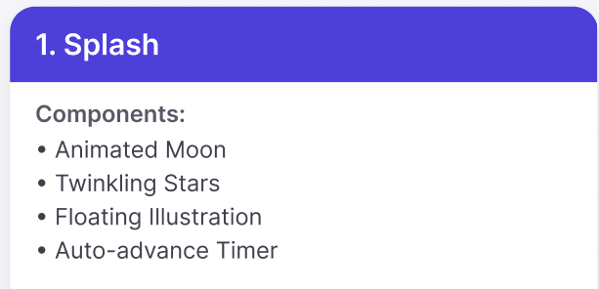
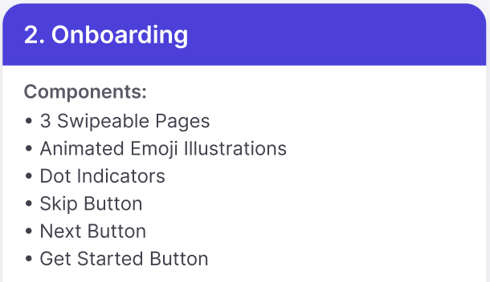
1. Onboarding Page Features:
Feature | Description
Welcome Illustration | Displays a sleep-themed illustration to visually introduce the application's purpose.
Onboarding Title | Displays the current onboarding message (e.g., "Improve Your Sleep").
Onboarding Description | Displays a brief explanation of the application's benefits (e.g., "Track, analyze, and optimize your sleep patterns with science-backed insights.").
Progress Indicator | Displays the user's current position within the onboarding sequence using pagination dots (e.g., Step 1 of 3).
Next Button | Navigates the user to the next onboarding screen.
Skip Button | Allows the user to skip the onboarding process and proceed directly to the authentication or home screen.
Background Theme | Displays the application's branded dark-themed interface with decorative elements for an engaging user experience.

Slide 3
Element | Page 1 | Page 2 | Page 3
Screen Type | Onboarding Screen | Onboarding Screen | Onboarding Screen
Theme | Dark Sleep Theme | AI Theme | Night/Moon Theme
Background | Dark Navy Gradient | Dark Purple Gradient | Dark Blue Gradient
Font Family | Poppins | Poppins | Poppins
Title Font Size | 34–36 px, Bold | 34–36 px, Bold | 34–36 px, Bold
Button Font Size | 20 px, SemiBold | 20 px, SemiBold | 20 px, SemiBold
Skip Font Size | 16 px | 16 px | 16 px
Body Text Color | Light Gray (#B8C1D9) | Light Gray (#B8C1D9) | Light Gray (#B8C1D9)
Button Color | Left: #5DA9FF → Right: #7A4DFF | Left: #5DA9FF → Right: #7A4DFF | Left: #5DA9FF → Right: #7A4DFF
Button Text Color | White | White | White
Button Shape | Rounded Rectangle | Rounded Rectangle | Rounded Rectangle
Primary Image | Sleeping Emoji | AI Robot | Crescent Moon
Image Style | 3D Emoji Illustration | 3D Robot Illustration | 3D Moon Illustration
Image Size | ~120 × 120 px | ~120 × 120 px | ~120 × 120 px
Navigation | Next Button | Next Button | Get Started Button
Clickable Items | Skip, Next, Progress Indicator | Skip, Next, Progress Indicator | Skip, Get Started, Progress Indicator

Slide 4
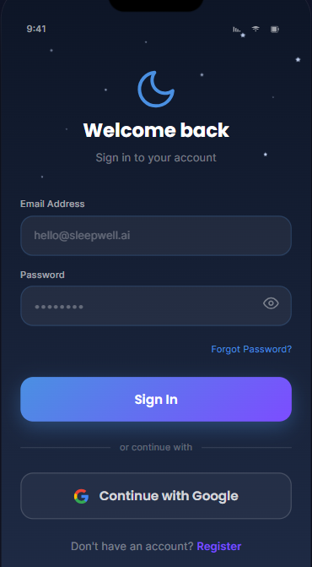
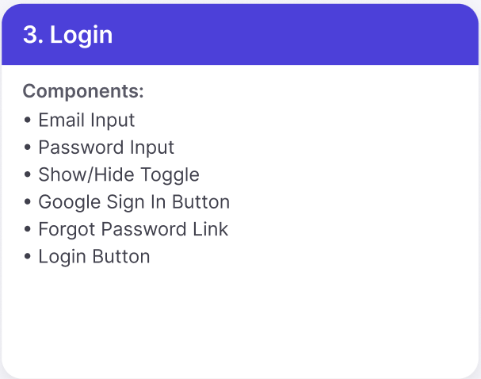
2.Login Page Features
Feature | Description
App Logo | Displays the application's logo and brand identity.
Welcome Back Heading | Greets returning users and indicates they are on the login page.
Sign In Subtitle | Informs users that they need to sign in to access their account.
Email Address Field | Allows users to enter their registered email address.
Password Field | Allows users to enter their account password securely.
Show/Hide Password Icon | Toggles password visibility to help users verify their input.
Forgot Password? Link | Redirects users to the password recovery page to reset their password.
Sign In Button | Authenticates the entered credentials and logs the user into the application.
Continue with Google Button | Enables users to sign in quickly using their Google account.
Register Link | Directs new users to the account registration page if they do not already have an account.

Slide 5
UI Element | Font | Font Size | Background | Text Color | Button Style | Image/Icon | Type | Clickable
Screen Background | — | — | Dark Navy Gradient (#121B33 → #1E2B4F) | — | — | Small star decorations | Background | No
Logo (Moon) | — | ~48 × 48 px | Transparent | Blue (#5B8DFF) | — | Crescent Moon Icon | Image | No
Welcome back | Poppins / SF Pro Display (Bold) | 34–38 px | Transparent | White (#FFFFFF) | — | — | Heading | No
Sign in to your account | Poppins / SF Pro Display (Regular) | 18 px | Transparent | Light Gray (#9AA3B2) | — | — | Subtitle | No
Email Address Label | Poppins (Medium) | 14 px | Transparent | Light Gray (#C8CDD8) | — | — | Label | No
Email Input Field | Poppins (Regular) | 16 px | Dark Blue (#2A3654) | Placeholder Gray (#7E8798) | Rounded (14–16 px radius) | — | Text Input | Yes
Password Label | Poppins (Medium) | 14 px | Transparent | Light Gray (#C8CDD8) | — | — | Label | No
Password Input Field | Poppins (Regular) | 16 px | Dark Blue (#2A3654) | White / Gray | Rounded (14–16 px radius) | Eye Visibility Icon | Password Input | Yes
Eye Icon | — | 20 px | Transparent | Gray (#8C95A5) | — | Visibility Icon | Icon | Yes
Forgot Password? | Poppins (Medium) | 14 px | Transparent | Blue (#4D8DFF) | — | — | Text Link | Yes
Sign In Button | Poppins (SemiBold/Bold) | 20 px | Blue → Purple Gradient (#5A9CFF → #7357FF) | White (#FFFFFF) | Rounded (16–18 px radius) | — | Primary Button | Yes
Divider ("or continue with") | Poppins (Regular) | 13 px | Transparent | Gray (#8D96A6) | Horizontal Lines | — | Divider | No
Continue with Google Button | Poppins (SemiBold) | 18 px | Dark Blue (#2A3654) | White (#FFFFFF) | Rounded Border (16 px) | Google Logo | Secondary Button | Yes
Google Logo | — | 20–24 px | Transparent | Multi-color | — | Google "G" Logo | Image | No
Don't have an account? | Poppins (Regular) | 15 px | Transparent | Gray (#A5ADBA) | — | — | Text | No
Register | Poppins (SemiBold) | 15 px | Transparent | Purple (#7B5CFF) | — | — | Link | Yes

Slide 6
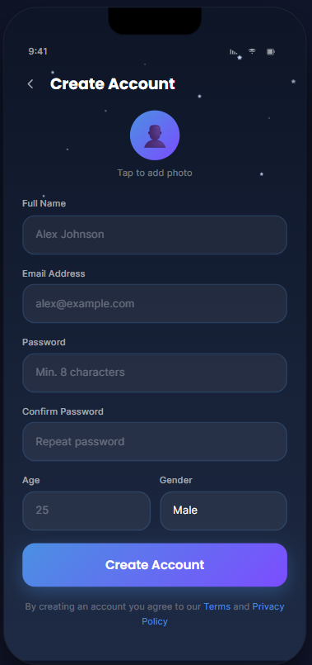
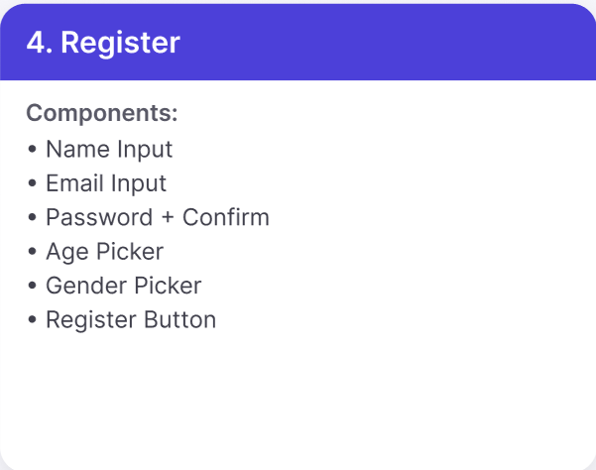
3. Create Account Page Features
Feature | Description
Back Button | Returns the user to the previous screen or login page.
Create Account Title | Indicates that the page is used for new user registration.
Profile Photo Placeholder | Displays a default avatar and allows users to upload a profile picture.
Tap to Add Photo | Opens the device gallery or camera to select a profile image.
Full Name Field | Allows users to enter their full name.
Email Address Field | Allows users to enter a valid email address for account registration.
Password Field | Allows users to create a secure password (minimum of 8 characters).
Confirm Password Field | Requires users to re-enter the password to ensure accuracy.
Age Field | Allows users to enter their age.
Gender Field | Allows users to select their gender from the available options.
Create Account Button | Validates the entered information and creates a new user account.
Terms and Privacy Policy Notice | Informs users that creating an account means they agree to the application's Terms of Service and Privacy Policy.

Slide 7
Component | Font | Font Size | Background | Text Color | Button/Field Style | Image/Icon | Type | Clickable
Back Arrow | SF Pro Display / Poppins | 20 px | Transparent | #FFFFFF | None | Left Arrow Icon | Navigation Icon | Yes
Create Account | Poppins Bold | 34–36 px | Transparent | #FFFFFF | None | No | Heading | No
Profile Picture | — | 72 × 72 px | Blue–Purple Gradient Circle | White | Circular Avatar | User Profile Icon | Image | Yes
Tap to add photo | Poppins Regular | 14 px | Transparent | #9AA3B2 | None | No | Text Link | Yes
Full Name | Poppins Medium | 14 px | Transparent | #C7CDD8 | None | No | Label | No
Full Name Field | Poppins Regular | 16 px | #2A3654 | #FFFFFF | Rounded (16 px) | No | Text Input | Yes
Email Address | Poppins Medium | 14 px | Transparent | #C7CDD8 | None | No | Label | No
Email Address Field | Poppins Regular | 16 px | #2A3654 | #FFFFFF | Rounded (16 px) | No | Email Input | Yes
Password | Poppins Medium | 14 px | Transparent | #C7CDD8 | None | No | Label | No
Password Field | Poppins Regular | 16 px | #2A3654 | #FFFFFF | Rounded (16 px) | No | Password Input | Yes
Confirm Password | Poppins Medium | 14 px | Transparent | #C7CDD8 | None | No | Label | No
Confirm Password Field | Poppins Regular | 16 px | #2A3654 | #FFFFFF | Rounded (16 px) | No | Password Input | Yes
Age | Poppins Medium | 14 px | Transparent | #C7CDD8 | None | No | Label | No
Age Field | Poppins Regular | 16 px | #2A3654 | #FFFFFF | Rounded (16 px) | No | Number Input | Yes
Gender | Poppins Medium | 14 px | Transparent | #C7CDD8 | None | No | Label | No
Gender Field | Poppins Regular | 16 px | #2A3654 | #FFFFFF | Rounded (16 px) | Dropdown/Selection | Selection Field | Yes
Create Account Button | Poppins SemiBold | 20 px | Blue–Purple Gradient (#5A9CFF → #7357FF) | #FFFFFF | Rounded Button (18 px) | No | Primary Button | Yes
Terms and Privacy Text | Poppins Regular | 13 px | Transparent | #8F98A8 | None | No | Informational Text | No
Terms | Poppins Medium | 13 px | Transparent | #4D8DFF | Text Link | No | Hyperlink | Yes
Privacy Policy | Poppins Medium | 13 px | Transparent | #4D8DFF | Text Link | No | Hyperlink | Yes

Slide 8
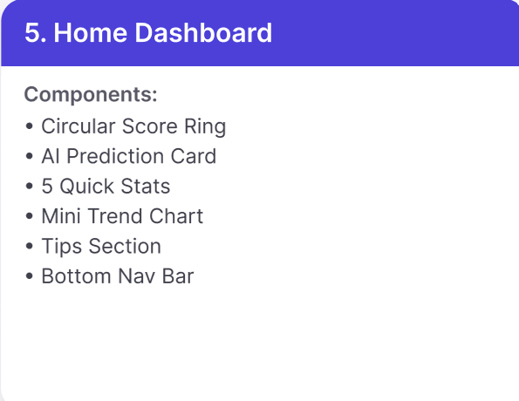
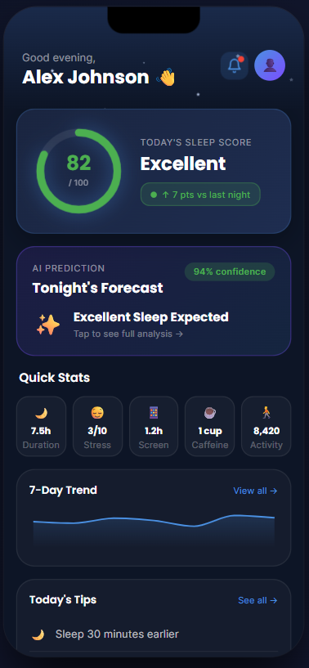
4. Home Dashboard Page Features
Feature | Description
Greeting Section | Displays a personalized greeting based on the time of day along with the user's name.
Notification Button | Allows users to view notifications, reminders, and alerts related to sleep tracking or the application.
Profile Button | Opens the user's profile where personal information and account settings can be managed.
Today's Sleep Score | Displays the user's current sleep score (e.g., 82/100) along with a quality rating such as Excellent.
Sleep Score Improvement Indicator | Shows the change in sleep score compared to the previous night (e.g., +7 points vs last night).
AI Prediction Card | Displays an AI-generated prediction of the expected sleep quality for the upcoming night.
Prediction Confidence | Indicates the confidence level of the AI prediction (e.g., 94% Confidence).
Sleep Forecast | Provides a brief prediction such as Excellent Sleep Expected with an option to view detailed analysis.
Quick Stats Section | Displays a summary of today's important sleep-related metrics.
Sleep Duration | Shows the total amount of sleep recorded (e.g., 7.5 hours).
Stress Level | Displays the user's current stress level or stress score.
Screen Time | Shows the total screen usage duration before sleep (e.g., 1.2 hours).
Caffeine Intake | Displays the number of caffeinated drinks consumed (e.g., 1 cup).
Daily Activity | Shows the number of steps or physical activity completed during the day (e.g., 8,420 steps).
7-Day Trend Graph | Displays a graphical overview of the user's sleep score or sleep quality over the past seven days.
View All (Trend) | Opens a detailed report containing historical sleep trends and analytics.
Today's Tips | Displays personalized recommendations to improve sleep quality (e.g., Sleep 30 minutes earlier).
See All (Tips) | Opens the complete list of personalized sleep improvement recommendations.

Slide 9
Component | Font | Font Size | Background | Text Color | Button/Card Style | Image/Icon | Type | Clickable
Greeting Text ("Good evening") | Poppins Regular | 16 px | Transparent | #A5ADBA | None | No | Text | No
User Name | Poppins Bold | 34 px | Transparent | #FFFFFF | None | No | Heading | No
Wave Emoji | Default Emoji | 24 px | Transparent | Multi-color | None | 👋 | Emoji | No
Notification Icon | SF Symbols / Material Icons | 24 px | Dark Blue (#243456) | White | Circular | Bell Icon | Icon | Yes
Profile Avatar | — | 48 × 48 px | Blue–Purple Gradient | White | Circular | User Avatar | Image | Yes
Sleep Score Card | Poppins | 16–18 px | #243456 | White | Rounded Card (20 px) | Circular Progress Indicator | Information Card | No
Sleep Score Number | Poppins Bold | 42 px | Transparent | Green (#4CD964) | None | No | Statistic | No
Sleep Score Status | Poppins Bold | 32 px | Transparent | White | None | No | Status Text | No
Progress Ring | — | 110 × 110 px | Transparent | Green | Circular Ring | Progress Indicator | Graphic | No
Improvement Badge | Poppins Medium | 15 px | Green Badge | #4CD964 | Rounded Badge | Green Dot | Badge | No
AI Prediction Card | Poppins | 16–18 px | #1F2947 | White | Rounded Card | Sparkle Icon | Information Card | Yes
Confidence Badge | Poppins SemiBold | 14 px | Green Badge | #4CD964 | Rounded Badge | No | Status Badge | No
Forecast Title | Poppins Bold | 28 px | Transparent | White | None | No | Heading | No
Prediction Message | Poppins SemiBold | 22 px | Transparent | White | None | Sparkle Icon | Text | No
Tap for Analysis | Poppins Regular | 14 px | Transparent | #8D96A6 | None | Arrow Icon | Link | Yes
Quick Stats Title | Poppins Bold | 24 px | Transparent | White | None | No | Heading | No
Quick Stats Cards | Poppins Medium | 16 px | #1F2947 | White | Rounded Cards | Moon, Face, Phone, Coffee, Walk Icons | Statistic Cards | Yes
7-Day Trend Card | Poppins Bold | 24 px | #1F2947 | White | Rounded Card | Line Chart | Chart Card | Yes
View All | Poppins Medium | 16 px | Transparent | #5A9CFF | None | Arrow Icon | Link | Yes
Trend Graph | — | Auto | Transparent | Blue | Line Graph | Chart | Graph | No
Today's Tips Card | Poppins Bold | 24 px | #1F2947 | White | Rounded Card | Moon Icon | Information Card | Yes
See All | Poppins Medium | 16 px | Transparent | #5A9CFF | None | Arrow Icon | Link | Yes
Sleep Tip | Poppins Medium | 18 px | Transparent | White | None | Moon Icon | Recommendation | No

Slide 10
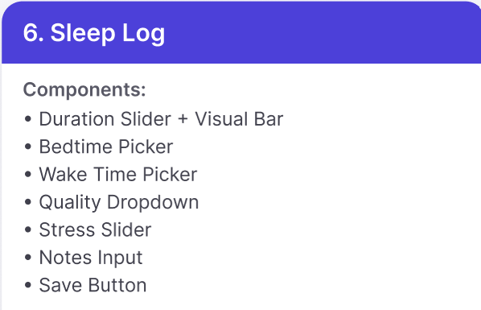
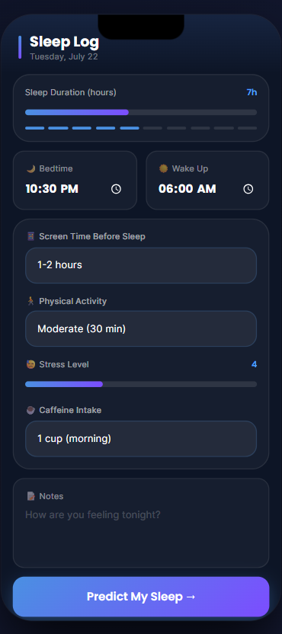
5. Sleep Log Page Features
Feature | Description
Sleep Log Title | Indicates that the page is used to record and review the user's daily sleep information.
Date Display | Shows the selected date for the sleep log entry (e.g., Tuesday, July 22).
Sleep Duration | Displays the total number of hours slept (e.g., 7 hours) along with a visual progress bar.
Sleep Duration Progress Bar | Provides a graphical representation of the user's sleep duration compared to the recommended sleep goal.
Bedtime Field | Displays or allows the user to select the time they went to bed (e.g., 10:30 PM).
Wake-Up Time Field | Displays or allows the user to select the time they woke up (e.g., 06:00 AM).
Screen Time Before Sleep | Allows users to record the amount of screen usage before bedtime (e.g., 1–2 hours).
Physical Activity Field | Allows users to record their daily physical activity level and duration (e.g., Moderate (30 min)).
Stress Level | Displays or allows users to select their stress level using a numeric scale and visual indicator (e.g., 4).
Caffeine Intake Field | Allows users to record the amount and timing of caffeine consumed (e.g., 1 cup (morning)).
Notes Section | Allows users to enter personal notes about how they are feeling or any factors that may affect their sleep.
Predict My Sleep Button | Submits the entered sleep-related information to generate an AI-based sleep quality prediction and recommendations.

Slide 11
Component | Font | Font Size | Background | Text Color | Button/Card Style | Image/Icon | Type | Clickable
Page Title (Sleep Log) | Poppins Bold | 30 px | Transparent | #FFFFFF | None | No | Heading | No
Date | Poppins Regular | 14 px | Transparent | #9CA3AF | None | No | Text | No
Sleep Duration Label | Poppins Medium | 14 px | Transparent | #A5ADBA | None | No | Label | No
Sleep Duration Value | Poppins Bold | 18 px | Transparent | #4F8EF7 | None | No | Statistic | No
Sleep Duration Card | Poppins Medium | 16 px | #1F2947 | White | Rounded Card (20 px) | Progress Bar | Information Card | No
Sleep Progress Bar | — | Auto | Transparent | Blue–Purple Gradient | Rounded Progress Bar | Progress Indicator | Graphic | No
Bedtime Card | Poppins Medium | 16 px | #1F2947 | White | Rounded Card (18 px) | Moon Icon, Clock Icon | Information Card | Yes
Bedtime Time | Poppins Bold | 24 px | Transparent | #FFFFFF | None | No | Time | Yes
Wake Up Card | Poppins Medium | 16 px | #1F2947 | White | Rounded Card (18 px) | Sun Icon, Clock Icon | Information Card | Yes
Wake Up Time | Poppins Bold | 24 px | Transparent | #FFFFFF | None | No | Time | Yes
Screen Time Label | Poppins Medium | 14 px | Transparent | #A5ADBA | None | Phone Icon | Label | No
Screen Time Field | Poppins Medium | 16 px | #27324A | White | Rounded Input | Phone Icon | Input Field | Yes
Physical Activity Label | Poppins Medium | 14 px | Transparent | #A5ADBA | None | Walk Icon | Label | No
Physical Activity Field | Poppins Medium | 16 px | #27324A | White | Rounded Input | Activity Icon | Dropdown | Yes
Stress Level Label | Poppins Medium | 14 px | Transparent | #A5ADBA | None | Face Icon | Label | No
Stress Level Value | Poppins Bold | 16 px | Transparent | #4F8EF7 | None | No | Statistic | No
Stress Slider | — | Auto | Transparent | Purple Gradient | Rounded Slider | Progress Indicator | Slider | Yes
Caffeine Intake Label | Poppins Medium | 14 px | Transparent | #A5ADBA | None | Coffee Icon | Label | No
Caffeine Intake Field | Poppins Medium | 16 px | #27324A | White | Rounded Input | Coffee Icon | Dropdown | Yes
Notes Label | Poppins Medium | 14 px | Transparent | #A5ADBA | None | Notes Icon | Label | No
Notes Text Area | Poppins Regular | 16 px | #1F2947 | #6B7280 | Rounded Text Area | Notes Icon | Multiline Input | Yes
Predict My Sleep Button | Poppins Bold | 18 px | Blue–Purple Gradient | White | Rounded Button (20 px) | Arrow Icon | Primary Button | Yes
Button Arrow | Poppins Bold | 18 px | Transparent | White | None | Arrow Icon | Icon | Yes
Main Container | — | Auto | #111827 | — | Rounded Layout | No | Container | No
Information Cards | Poppins Medium | 16 px | #1F2947 | White | Rounded Cards (18–20 px) | Various Icons | Card | Yes
Icons (Moon, Sun, Coffee, Activity, Notes, Clock) | SF Symbols / Material Icons | 18–22 px | Transparent | #A5ADBA | None | Flat Icons | Icon | No

Slide 12
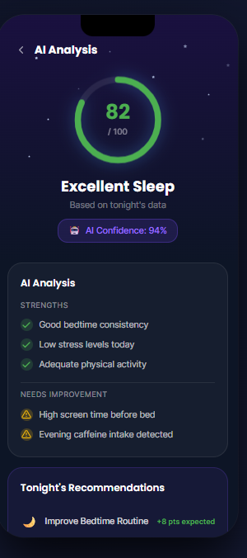
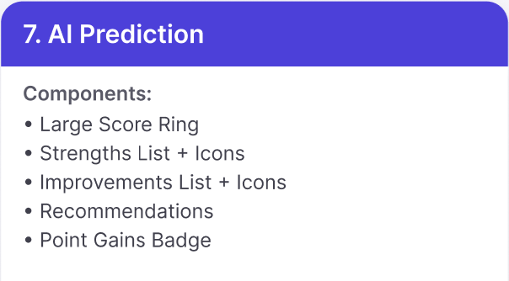
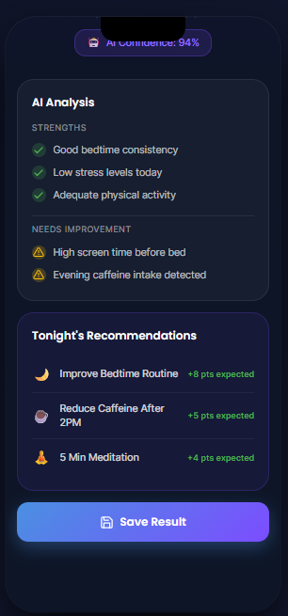
6. AI Analysis Page Features
Feature | Description
AI Analysis Title | Indicates that the page provides an AI-generated analysis of the user's sleep quality based on the recorded sleep data.
Sleep Score | Displays the user's overall sleep quality score (e.g., 82/100) generated by the AI model.
Sleep Score Indicator | Provides a circular progress indicator that visually represents the user's sleep score.
Sleep Quality Status | Displays the AI's overall assessment of the user's sleep quality (e.g., Excellent Sleep).
Analysis Basis | Indicates that the sleep analysis is generated using the user's sleep data collected for the current night.
AI Confidence Level | Displays the confidence percentage of the AI prediction (e.g., 94%), indicating how reliable the generated analysis is.
Strengths Section | Highlights positive sleep-related behaviors detected from the user's data, such as consistent bedtime, low stress levels, and adequate physical activity.
Needs Improvement Section | Identifies habits that may negatively affect sleep quality, such as excessive screen time before bed and late caffeine intake.
Tonight's Recommendations | Displays personalized AI-generated recommendations to improve future sleep quality.
Expected Improvement | Shows the estimated increase in sleep score that each recommendation may contribute (e.g., +8 pts expected).
Recommendation Items | Provides actionable suggestions such as improving bedtime routine, reducing caffeine intake after 2 PM, and practicing a short meditation before sleep.
Save Result Button | Allows users to save the AI analysis results and recommendations for future review and historical tracking.

Slide 13
Component | Font | Font Size | Background | Text Color | Button/Card Style | Image/Icon | Type | Clickable
Page Title (AI Analysis) | Poppins Bold | 22 px | Transparent | #FFFFFF | None | No | Heading | No
Back Arrow | SF Symbols / Material Icons | 20 px | Transparent | White | None | Arrow Icon | Icon | Yes
Decorative Stars | — | Auto | Transparent | #8B7CFF | None | Star Dots | Graphic | No
Sleep Score Circle | — | 120 × 120 px | Transparent | Green (#4CD964) | Circular Progress Ring | Progress Indicator | Graphic | No
Sleep Score Number (82) | Poppins Bold | 38 px | Transparent | #4CD964 | None | No | Statistic | No
Score Value (/100) | Poppins Medium | 16 px | Transparent | #A5ADBA | None | No | Text | No
Sleep Status (Excellent Sleep) | Poppins Bold | 28 px | Transparent | White | None | No | Status Text | No
Subtitle (Based on tonight's data) | Poppins Regular | 14 px | Transparent | #8D96A6 | None | No | Text | No
AI Confidence Badge | Poppins SemiBold | 14 px | #4B2A77 | #C084FC | Rounded Badge | AI Icon | Status Badge | No
AI Analysis Card | Poppins Medium | 16 px | #1F2947 | White | Rounded Card (20 px) | No | Information Card | No
AI Analysis Title | Poppins Bold | 18 px | Transparent | White | None | No | Heading | No
Strengths Label | Poppins SemiBold | 12 px | Transparent | #8D96A6 | None | No | Section Label | No
Good Bedtime Consistency | Poppins Regular | 15 px | Transparent | White | None | Green Check Icon | List Item | No
Low Stress Levels Today | Poppins Regular | 15 px | Transparent | White | None | Green Check Icon | List Item | No
Adequate Physical Activity | Poppins Regular | 15 px | Transparent | White | None | Green Check Icon | List Item | No
High Screen Time Before Bed | Poppins Regular | 15 px | Transparent | White | None | Warning Icon | List Item | No
Evening Caffeine Intake | Poppins Regular | 15 px | Transparent | White | None | Warning Icon | List Item | No
Recommendations Card | Poppins Medium | 16 px | #1F2947 | White | Rounded Card (20 px) | No | Information Card | No
Improve Bedtime Routine | Poppins Medium | 15 px | Transparent | White | None | Moon Icon | Recommendation | No
Save Result Button | Poppins Bold | 18 px | Blue–Purple Gradient | White | Rounded Button (20 px) | Save Icon | Primary Button | Yes

Slide 14
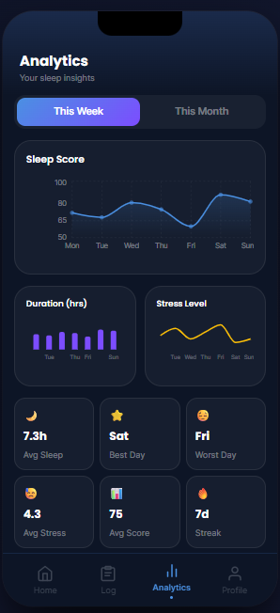
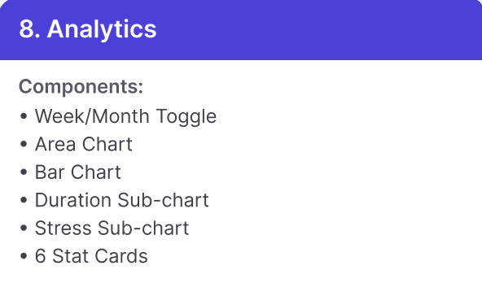
7. Analytics Page Features
Feature | Description
Analytics Title | Indicates that the page provides analytical insights into the user's sleep patterns and overall sleep performance.
Subtitle | Displays a brief description informing users that the page contains their sleep insights.
Time Period Selector | Allows users to switch between different analysis periods (e.g., This Week and This Month) to view sleep trends over time.
Sleep Score Chart | Displays a bar chart showing the user's sleep score progression across the selected time period (e.g., Week 1–Week 4).
Duration Chart | Displays a bar chart illustrating average sleep duration (in hours) for each day within the selected period.
Stress Level Chart | Displays a line graph showing daily stress levels, allowing users to observe fluctuations over time.
Average Sleep Card | Displays the user's average sleep duration for the selected period (e.g., 7.3 hours).
Best Day Card | Highlights the day with the highest sleep quality or sleep score (e.g., Saturday).
Worst Day Card | Identifies the day with the lowest sleep quality or sleep score (e.g., Friday).
Average Stress Card | Displays the user's average stress level calculated from the recorded sleep logs (e.g., 4.3).
Average Sleep Score Card | Displays the average AI-generated sleep score for the selected period (e.g., 75).
Sleep Streak Card | Displays the number of consecutive days the user has consistently recorded sleep data (e.g., 7-day streak).
Bottom Navigation Bar | Provides navigation to the main sections of the application, including Home, Sleep Log, Analytics, and Profile.

Slide 15
Component | Font | Font Size | Background | Text Color | Button/Card Style | Image/Icon | Type | Clickable
Page Title (Analytics) | Poppins Bold | 24 px | Transparent | #FFFFFF | None | No | Heading | No
Subtitle (Your Sleep Insights) | Poppins Regular | 14 px | Transparent | #AAB3C5 | None | No | Subtitle | No
Week Toggle Button | Poppins SemiBold | 15 px | Blue–Purple Gradient (#5B8CFF → #8B5CF6) | White | Rounded Pill Button | No | Toggle Button | Yes
Month Toggle Button | Poppins SemiBold | 15 px | #232D45 | #AAB3C5 | Rounded Pill Button | No | Toggle Button | Yes
Sleep Score Card | Poppins Medium | 16 px | #1B2438 | White | Rounded Card (20 px) | Line Chart | Information Card | Yes
Sleep Score Title | Poppins SemiBold | 15 px | Transparent | White | None | No | Section Title | No
Sleep Score Graph | — | Auto | Transparent | Blue (#5B8CFF) | None | Line Chart | Graph | No
Duration Card | Poppins Medium | 15 px | #1B2438 | White | Rounded Card (20 px) | Bar Chart | Information Card | Yes
Stress Level Card | Poppins Medium | 15 px | #1B2438 | White | Rounded Card (20 px) | Line Chart | Information Card | Yes
Avg Sleep Card | Poppins Bold | 22 px | #1B2438 | White | Rounded Card (16 px) | Moon Icon | Statistic Card | Yes
Best Day Card | Poppins Bold | 22 px | #1B2438 | White | Rounded Card (16 px) | Star Icon | Statistic Card | Yes
Best Day Label | Poppins Regular | 13 px | Transparent | #AAB3C5 | None | No | Text | No
Worst Day Card | Poppins Bold | 22 px | #1B2438 | White | Rounded Card (16 px) | Sad Face Icon | Statistic Card | Yes
Worst Day Label | Poppins Regular | 13 px | Transparent | #AAB3C5 | None | No | Text | No
Avg Stress Card | Poppins Bold | 22 px | #1B2438 | White | Rounded Card (16 px) | Neutral Face Icon | Statistic Card | Yes
Avg Stress Label | Poppins Regular | 13 px | Transparent | #AAB3C5 | None | No | Text | No
Avg Score Card | Poppins Bold | 22 px | #1B2438 | White | Rounded Card (16 px) | Bar Chart Icon | Statistic Card | Yes
Avg Score Label | Poppins Regular | 13 px | Transparent | #AAB3C5 | None | No | Text | No
Streak Card | Poppins Bold | 22 px | #1B2438 | White | Rounded Card (16 px) | Fire Icon | Statistic Card | Yes
Home Navigation | Poppins Medium | 12 px | Transparent | #6B7280 | Bottom Navigation | Home Icon | Navigation | Yes
Log Navigation | Poppins Medium | 12 px | Transparent | #6B7280 | Bottom Navigation | Clipboard Icon | Navigation | Yes
Analytics Navigation (Active) | Poppins Medium | 12 px | Transparent | #5B8CFF | Bottom Navigation | Analytics Icon | Navigation | Yes
Profile Navigation | Poppins Medium | 12 px | Transparent | #6B7280 | Bottom Navigation | Profile Icon | Navigation | Yes

Slide 16
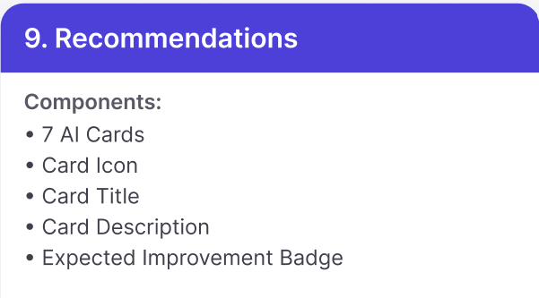
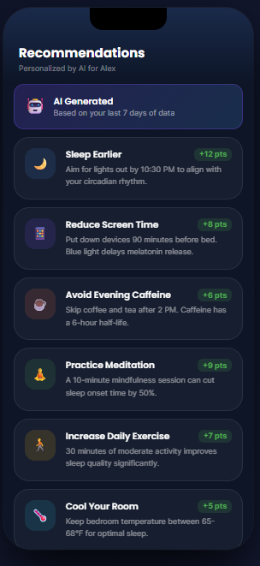
8. Recommendations Page Features
Feature | Description
Recommendations Title | Indicates that the page provides personalized AI-generated recommendations to improve the user's sleep habits and overall wellness.
Personalized Subtitle | Displays a message indicating that the recommendations are personalized for the logged-in user (e.g., "Personalized by AI for Alex").
AI Generated Banner | Highlights that all recommendations are generated by AI based on the user's recent sleep data (e.g., the last 7 days).
Recommendation Cards | Displays a list of personalized recommendations designed to improve sleep quality and healthy habits.
Sleep Earlier Recommendation | Suggests going to bed earlier (e.g., by 10:30 PM) to better align with the user's circadian rhythm.
Reduce Screen Time Recommendation | Advises limiting device usage before bedtime (e.g., avoid screens 90 minutes before sleep) to improve melatonin production.
Avoid Evening Caffeine Recommendation | Recommends avoiding coffee or tea after a specified time (e.g., after 2 PM) to minimize caffeine's effect on sleep.
Practice Meditation Recommendation | Encourages a short meditation session before bedtime to reduce sleep onset time and improve relaxation.
Increase Daily Exercise Recommendation | Suggests engaging in moderate daily physical activity (e.g., 30 minutes) to improve sleep quality.
Cool Your Room Recommendation | Recommends maintaining an optimal bedroom temperature (e.g., 65°–68°F) for better sleep quality.
Reward Points Badge | Displays the number of wellness points that the user can earn by completing each recommendation (e.g., +12 pts, +8 pts).
Recommendation Icon | Displays a visual icon representing the category of each recommendation (sleep, screen time, caffeine, meditation, exercise, temperature).
Scrollable Recommendations List | Allows users to scroll through all available personalized recommendations when the list exceeds the screen height.

Slide 17
Component | Font | Font Size | Background | Text Color | Button/Card Style | Image/Icon | Type | Clickable
Page Title (Recommendations) | Poppins Bold | 24 px | Transparent | #FFFFFF | None | No | Heading | No
Subtitle (Personalized by AI for Alex) | Poppins Regular | 14 px | Transparent | #8FA6C7 | None | No | Subtitle | No
AI Generated Card | Poppins SemiBold | 16 px | #25335A | White | Rounded Card (18 px) | Robot Icon | Information Card | No
AI Generated Subtitle | Poppins Regular | 13 px | Transparent | #AAB3C5 | None | No | Text | No
Sleep Earlier Card | Poppins Medium | 16 px | #1B2438 | White | Rounded Card (18 px) | Moon Icon | Recommendation Card | Yes
Sleep Earlier Title | Poppins SemiBold | 16 px | Transparent | White | None | No | Recommendation Title | No
Reduce Screen Time Card | Poppins Medium | 16 px | #1B2438 | White | Rounded Card (18 px) | Mobile Phone Icon | Recommendation Card | Yes
Reduce Screen Time Description | Poppins Regular | 13 px | Transparent | #AAB3C5 | None | No | Description | No
Avoid Evening Caffeine Card | Poppins Medium | 16 px | #1B2438 | White | Rounded Card (18 px) | Coffee Cup Icon | Recommendation Card | Yes
Avoid Evening Caffeine Description | Poppins Regular | 13 px | Transparent | #AAB3C5 | None | No | Description | No
Practice Meditation Card | Poppins Medium | 16 px | #1B2438 | White | Rounded Card (18 px) | Meditation Icon | Recommendation Card | Yes
Practice Meditation Title | Poppins SemiBold | 16 px | Transparent | White | None | No | Recommendation Title | No
Increase Daily Exercise Card | Poppins Medium | 16 px | #1B2438 | White | Rounded Card (18 px) | Walking Icon | Recommendation Card | Yes
Increase Daily Exercise Title | Poppins SemiBold | 16 px | Transparent | White | None | No | Recommendation Title | No
Increase Daily Exercise Description | Poppins Regular | 13 px | Transparent | #AAB3C5 | None | No | Description | No
Cool Your Room Card | Poppins Medium | 16 px | #1B2438 | White | Rounded Card (18 px) | Thermometer Icon | Recommendation Card | Yes
Cool Your Room Description | Poppins Regular | 13 px | Transparent | #AAB3C5 | None | No | Description | No

Slide 18
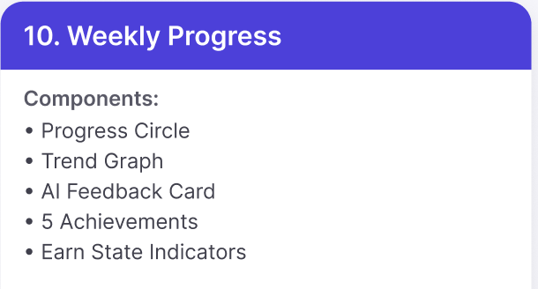
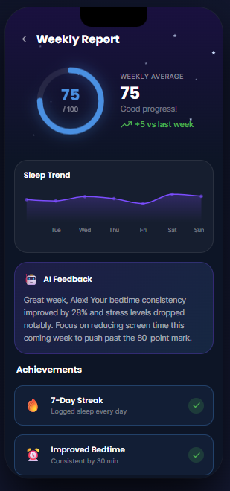
9. Weekly Report Page Features
Feature | Description
Weekly Report Title | Indicates that the page provides a summary of the user's sleep performance and progress for the current week.
Back Button | Allows the user to return to the previous screen.
Weekly Average Score Gauge | Displays the user's overall weekly sleep score using a circular progress indicator (e.g., 75/100).
Score Value | Shows the numerical weekly sleep score achieved during the selected week.
Weekly Average Summary | Displays the average sleep score for the week along with a short motivational message (e.g., "Good progress!").
Weekly Progress Indicator | Shows the change in sleep performance compared to the previous week (e.g., +5 vs last week).
Sleep Trend Chart | Displays a line graph illustrating the user's daily sleep score or sleep quality trend across the week (Tuesday–Sunday).
AI Feedback Card | Provides AI-generated feedback summarizing the user's weekly sleep improvements, strengths, and areas for further improvement.
Achievements Section | Displays milestones and accomplishments earned during the week based on the user's sleep habits.
7-Day Streak Achievement | Indicates that the user has successfully logged sleep every day for seven consecutive days.
Improved Bedtime Achievement | Recognizes that the user maintained a more consistent bedtime (e.g., within a 30-minute window).
Achievement Status Icon | Displays a completion indicator (e.g., checkmark) showing that an achievement has been successfully earned.
Scrollable Content | Allows users to scroll through the report if additional charts, feedback, or achievements are available.

Slide 19
Component | Font | Font Size | Background | Text Color | Button/Card Style | Image/Icon | Type | Clickable
Page Title (Weekly Report) | Poppins Bold | 24 px | Transparent | #FFFFFF | None | No | Heading | No
Weekly Score Circle | Poppins Bold | 36 px | Transparent | #5DA9FF | Circular Progress | Circular Progress Ring | Progress Indicator | No
Score Label (/100) | Poppins Regular | 14 px | Transparent | #AAB3C5 | None | No | Label | No
Weekly Average Label | Poppins Medium | 13 px | Transparent | #8FA6C7 | None | No | Label | No
Weekly Average Value | Poppins Bold | 32 px | Transparent | #FFFFFF | None | No | Statistic | No
Progress Status | Poppins Regular | 15 px | Transparent | #AAB3C5 | None | No | Status Text | No
Weekly Improvement | Poppins SemiBold | 14 px | Transparent | #37D67A | None | Trending Up Icon | Progress Indicator | No
Sleep Trend Card | Poppins Medium | 16 px | #1B2438 | White | Rounded Card (18 px) | Line Chart | Analytics Card | No
Sleep Trend Title | Poppins SemiBold | 16 px | Transparent | White | None | No | Section Title | No
Trend Graph | — | — | Transparent | Purple (#7C5CFF) | None | Line Graph | Chart | No
Day Labels (Tue–Sun) | Poppins Regular | 12 px | Transparent | #8FA6C7 | None | No | Axis Labels | No
AI Feedback Card | Poppins Medium | 16 px | #25335A | White | Rounded Card (18 px) | Robot Icon | Information Card | No
AI Feedback Title | Poppins SemiBold | 16 px | Transparent | White | None | No | Card Title | No
AI Feedback Description | Poppins Regular | 14 px | Transparent | #D3DAE8 | None | No | Body Text | No
Achievements Title | Poppins Bold | 20 px | Transparent | White | None | No | Section Heading | No
Achievement Card | Poppins Medium | 16 px | #1B2438 | White | Rounded Card (18 px) | Achievement Icon | Achievement Card | No
Achievement Title | Poppins SemiBold | 16 px | Transparent | White | None | No | Card Title | No
7-Day Streak Icon | — | 24 px | Transparent | — | None | Fire Icon | Achievement Icon | No
Improved Bedtime Icon | — | 24 px | Transparent | — | None | Alarm Clock Icon | Achievement Icon | No
Back Button | — | 22 px | Transparent | White | Icon Button | Left Arrow Icon | Navigation | Yes

Slide 20
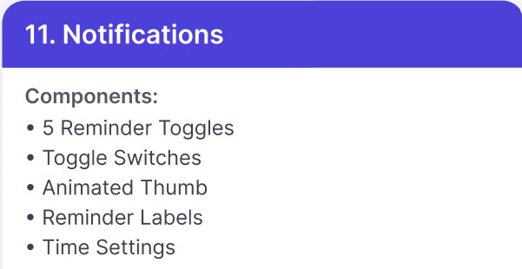
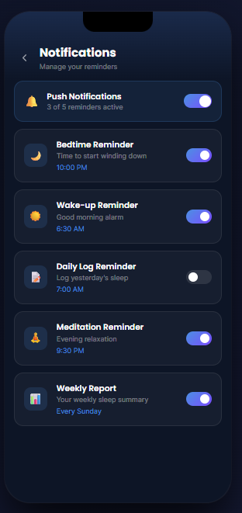
10. Notifications Page Features1
Feature | Description
Notifications Title | Indicates that the page allows users to manage application notifications and reminders.
Subtitle | Displays a brief description informing users that they can manage their reminders and notification preferences.
Back Button | Allows the user to return to the previous screen.
Push Notifications Toggle | Enables or disables all push notifications for the application. It also displays the number of currently active reminders (e.g., "3 of 5 reminders active").
Bedtime Reminder | Allows users to enable or disable bedtime reminders. Displays the scheduled reminder time (e.g., 10:00 PM).
Wake-up Reminder | Allows users to enable or disable wake-up reminders. Displays the scheduled alarm time (e.g., 6:30 AM).
Daily Log Reminder | Allows users to enable or disable reminders to log their previous night's sleep. Displays the scheduled reminder time (e.g., 7:00 AM).
Meditation Reminder | Allows users to enable or disable reminders for evening meditation sessions. Displays the scheduled reminder time (e.g., 9:30 PM).
Weekly Report Reminder | Allows users to enable or disable notifications for receiving their weekly sleep summary. Displays the scheduled delivery day (e.g., Every Sunday).
Reminder Icon | Displays an icon representing each notification category, such as bedtime, wake-up, sleep log, meditation, or weekly report.
Individual Toggle Switches | Allows users to independently enable or disable each reminder without affecting other notification settings.
Scrollable Notification List | Allows users to scroll through all notification settings if additional reminders are available.

Slide 21
Component | Font | Font Size | Background | Text Color | Button/Card Style | Image/Icon | Type | Clickable
Page Title (Notifications) | Poppins Bold | 24 px | Transparent | #FFFFFF | None | No | Heading | No
Subtitle (Manage your reminders) | Poppins Regular | 14 px | Transparent | #8FA6C7 | None | No | Subtitle | No
Notification Card | Poppins Medium | 16 px | #1B2438 | White | Rounded Card (18 px) | Notification Icon | Reminder Card | Yes
Reminder Title | Poppins SemiBold | 16 px | Transparent | White | None | No | Card Title | No
Reminder Description | Poppins Regular | 13 px | Transparent | #AAB3C5 | None | No | Description | No
Reminder Time/Day | Poppins Medium | 13 px | Transparent | #5DA9FF | None | No | Time Label | No
Toggle Switch (ON) | — | — | Transparent | White | Rounded Toggle | Toggle Switch | Switch | Yes
Toggle Switch (OFF) | — | — | Transparent | White | Rounded Toggle | Toggle Switch | Switch | Yes
Push Notifications Card | Poppins Medium | 16 px | #1B2438 | White | Rounded Card (18 px) | Bell Icon | Settings Card | Yes
Push Notifications Status | Poppins Regular | 13 px | Transparent | #AAB3C5 | None | No | Status Text | No
Bedtime Reminder Icon | — | 24 px | Transparent | — | Circular Icon Background | Moon Icon | Reminder Icon | No
Wake-up Reminder Icon | — | 24 px | Transparent | — | Circular Icon Background | Sun Icon | Reminder Icon | No
Daily Log Reminder Icon | — | 24 px | Transparent | — | Circular Icon Background | Clipboard Icon | Reminder Icon | No
Meditation Reminder Icon | — | 24 px | Transparent | — | Circular Icon Background | Meditation Icon | Reminder Icon | No
Weekly Report Reminder Icon | — | 24 px | Transparent | — | Circular Icon Background | Report Icon | Reminder Icon | No
Back Button | — | 22 px | Transparent | White | Icon Button | Left Arrow Icon | Navigation | Yes

Slide 22
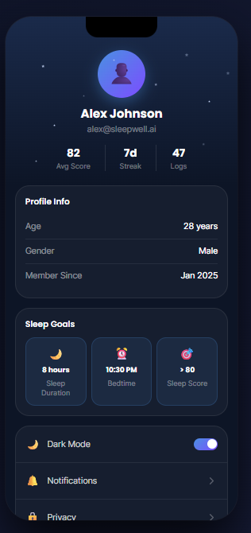
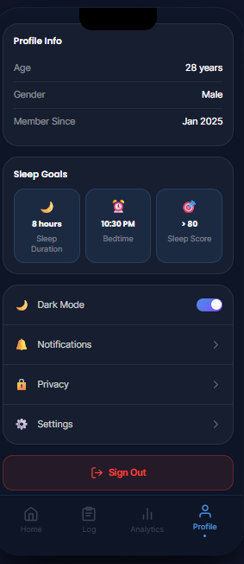
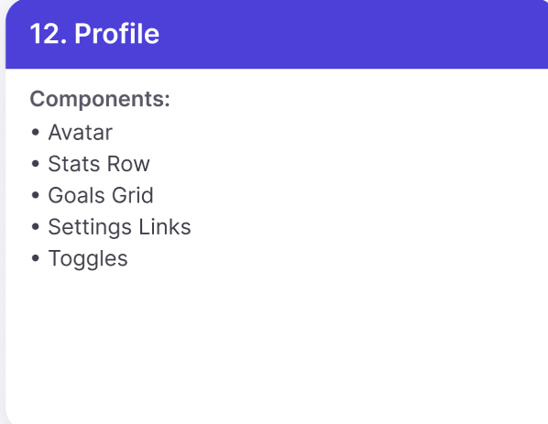
11. Profile Page Features

Slide 23
Profile Page Features
Feature | Description
Profile Header | Displays the user's profile picture, full name, and registered email address.
Profile Avatar | Displays the user's profile image or a default avatar if no custom image has been uploaded.
Average Sleep Score | Displays the user's overall average sleep score (e.g., 82).
Sleep Streak | Displays the number of consecutive days the user has achieved their sleep goals (e.g., 7 days).
Sleep Logs | Displays the total number of recorded sleep logs (e.g., 47 Logs).
Profile Information Section | Displays the user's personal profile details.
Age | Displays the user's age (e.g., 28 years).
Gender | Displays the user's selected gender (e.g., Male).
Member Since | Displays the month and year the user joined the application (e.g., Jan 2025).
Sleep Goals Section | Displays the user's configured sleep-related goals and targets.
Sleep Duration Goal | Displays the user's target nightly sleep duration (e.g., 8 hours).
Bedtime Goal | Displays the user's preferred bedtime (e.g., 10:30 PM).
Target Sleep Score | Displays the user's desired sleep score goal (e.g., > 80).
Dark Mode Toggle | Allows the user to enable or disable dark mode for the application interface.
Notifications Menu | Navigates the user to the Notifications settings page to manage reminders and alerts.
Privacy Menu | Navigates the user to the Privacy page to manage privacy preferences and account security settings.
Settings Menu | Navigates the user to the application's general settings page.
Sign Out Button | Allows the user to securely log out of their account.
Bottom Navigation Bar | Allows users to navigate between Home, Log, Analytics, and Profile pages.
Active Navigation Indicator | Highlights the currently selected Profile tab in the bottom navigation bar.

Slide 24
Component | Font | Font Size | Background | Color | Button | Image | Type | Clickable
User Name (Alex Johnson) | Poppins / Inter (Bold) | 24 px | Transparent | White (#FFFFFF) | No | No | Text | No
Email Address | Poppins / Inter | 14 px | Transparent | Light Gray (#94A3B8) | No | No | Text | No
Profile Avatar | — | 70 × 70 px | Blue Gradient Circle | Purple/Blue | No | Yes | Image | Yes (Edit Profile)
Avg Score | Poppins Bold | 20 px | Transparent | White | No | No | Text | No
Streak | Poppins Bold | 20 px | Transparent | White | No | No | Text | No
Logs | Poppins Bold | 20 px | Transparent | White | No | No | Text | No
Section Title (Profile Info, Sleep Goals) | Poppins Semi-Bold | 18 px | Card Background | White | No | No | Text | No
Profile Information Card | Poppins | 16 px | Dark Navy (#1E293B) | White | No | No | Card | No
Age, Gender, Member Since Labels | Poppins | 15 px | Transparent | Gray (#94A3B8) | No | No | Text | No
Age, Gender, Member Since Values | Poppins Bold | 16 px | Transparent | White | No | No | Text | No
Sleep Goal Cards | Poppins | 14–16 px | Dark Blue (#243B63) | White | No | Yes (Icons) | Card | No
Moon Icon | — | 28 px | Transparent | Yellow | No | Yes | Icon | No
Alarm Icon | — | 28 px | Transparent | Pink | No | Yes | Icon | No
Target Icon | — | 28 px | Transparent | Red | No | Yes | Icon | No
Dark Mode Row | Poppins Medium | 16 px | Dark Card | White | Toggle Switch | Moon Icon | Toggle | Yes
Notifications | Poppins Medium | 16 px | Dark Card | White | No | Bell Icon | Menu Item | Yes
Privacy | Poppins Medium | 16 px | Dark Card | White | No | Lock Icon | Menu Item | Yes
Settings | Poppins Medium | 16 px | Dark Card | White | No | Gear Icon | Menu Item | Yes
Sign Out | Poppins Bold | 18 px | Dark Red (#3A1F24) | Red (#EF4444) | Yes | Logout Icon | Button | Yes
Bottom Navigation Icons | Poppins | 12 px | Dark Navy | Gray / Blue (Active) | Yes | Icons | Navigation | Yes

Slide 25
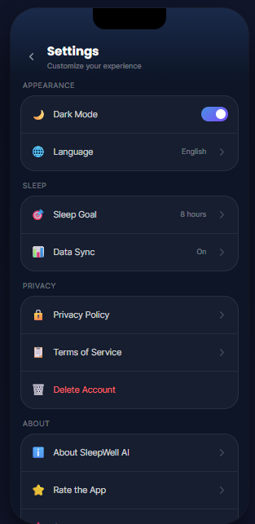
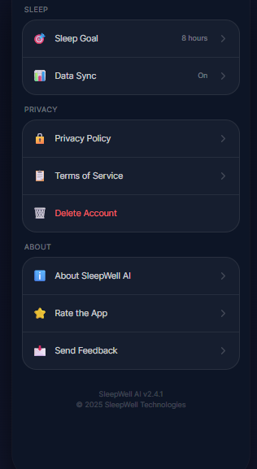
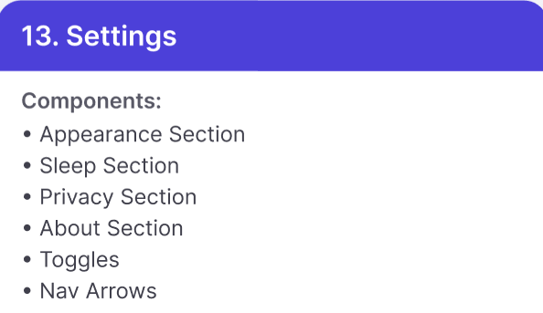
12. Settings Page Features

Slide 26
Settings Page Features
Feature | Description
Settings Header | Displays the page title Settings with the subtitle "Customize your experience."
Back Button | Allows the user to return to the previous screen.
Dark Mode Toggle | Allows the user to enable or disable Dark Mode for the application interface.
Language Setting | Displays the currently selected application language (e.g., English) and allows the user to change it.
Sleep Goal | Displays the user's configured sleep duration goal (e.g., 8 hours) and navigates to the Sleep Goal configuration page.
Data Sync | Displays the current synchronization status (e.g., On) and allows the user to manage or synchronize application data.
Privacy Policy | Navigates the user to the application's Privacy Policy page.
Terms of Service | Navigates the user to the application's Terms of Service page.
Delete Account | Allows the user to permanently delete their account after confirmation.
About SleepWell AI | Displays information about the application, including version details and developer information.
Rate the App | Allows the user to submit a rating for the application through the device's app store.
Send Feedback | Allows the user to submit feedback, suggestions, or report issues to the development team.
Application Version | Displays the current application version (e.g., v2.4.1).
Copyright Information | Displays the application's copyright information (e.g., © 2026 SleepWell Technologies).

Slide 27
Component | Font | Font Size | Background | Color | Button | Image | Type | Clickable
Screen Title (Settings) | Poppins / Inter Bold | 24 px | Transparent | White (#FFFFFF) | No | No | Text | No
Subtitle (Customize your experience) | Poppins / Inter | 14 px | Transparent | Gray (#94A3B8) | No | No | Text | No
Back Arrow | — | 24 px | Transparent | White | No | Arrow Icon | Icon | Yes
Section Headings (Appearance, Sleep, Privacy, About) | Poppins Semi-Bold | 14 px | Transparent | Gray (#64748B) | No | No | Text | No
Settings Card | Poppins | 16 px | Dark Navy (#1E293B) | White | No | No | Card | No
Dark Mode | Poppins Medium | 16 px | Card Background | White | Toggle Switch | Moon Icon | Toggle | Yes
Toggle Switch | — | 46 × 24 px | Blue (#5B7CFA) | White Knob | Yes | No | Switch | Yes
Language | Poppins Medium | 16 px | Card Background | White | No | Globe Icon | Menu Item | Yes
Selected Language (English) | Poppins | 14 px | Transparent | Gray (#94A3B8) | No | No | Text | No
Sleep Goal | Poppins Medium | 16 px | Card Background | White | No | Target Icon | Menu Item | Yes
Goal Value (8 hours) | Poppins | 14 px | Transparent | Gray (#94A3B8) | No | No | Text | No
Data Sync | Poppins Medium | 16 px | Card Background | White | No | Sync Icon | Menu Item | Yes
Sync Status (On) | Poppins | 14 px | Transparent | Gray (#94A3B8) | No | No | Text | No
Privacy Policy | Poppins Medium | 16 px | Card Background | White | No | Lock Icon | Menu Item | Yes
Terms of Service | Poppins Medium | 16 px | Card Background | White | No | Document Icon | Menu Item | Yes
Delete Account | Poppins Medium | 16 px | Card Background | Red (#EF4444) | No | Trash Icon | Menu Item | Yes
About SleepWell AI | Poppins Medium | 16 px | Card Background | White | No | Info Icon | Menu Item | Yes
Rate the App | Poppins Medium | 16 px | Card Background | White | No | Star Icon | Menu Item | Yes
Right Arrow Icons | — | 18 px | Transparent | Gray (#64748B) | No | Chevron Icon | Icon | Yes

