Slide 1
S16.E8 Final Project
Cameron Moeller
Michael Shannon
David Yu

Slide 2
Models
Conceptual
Logical
Relational

Slide 3
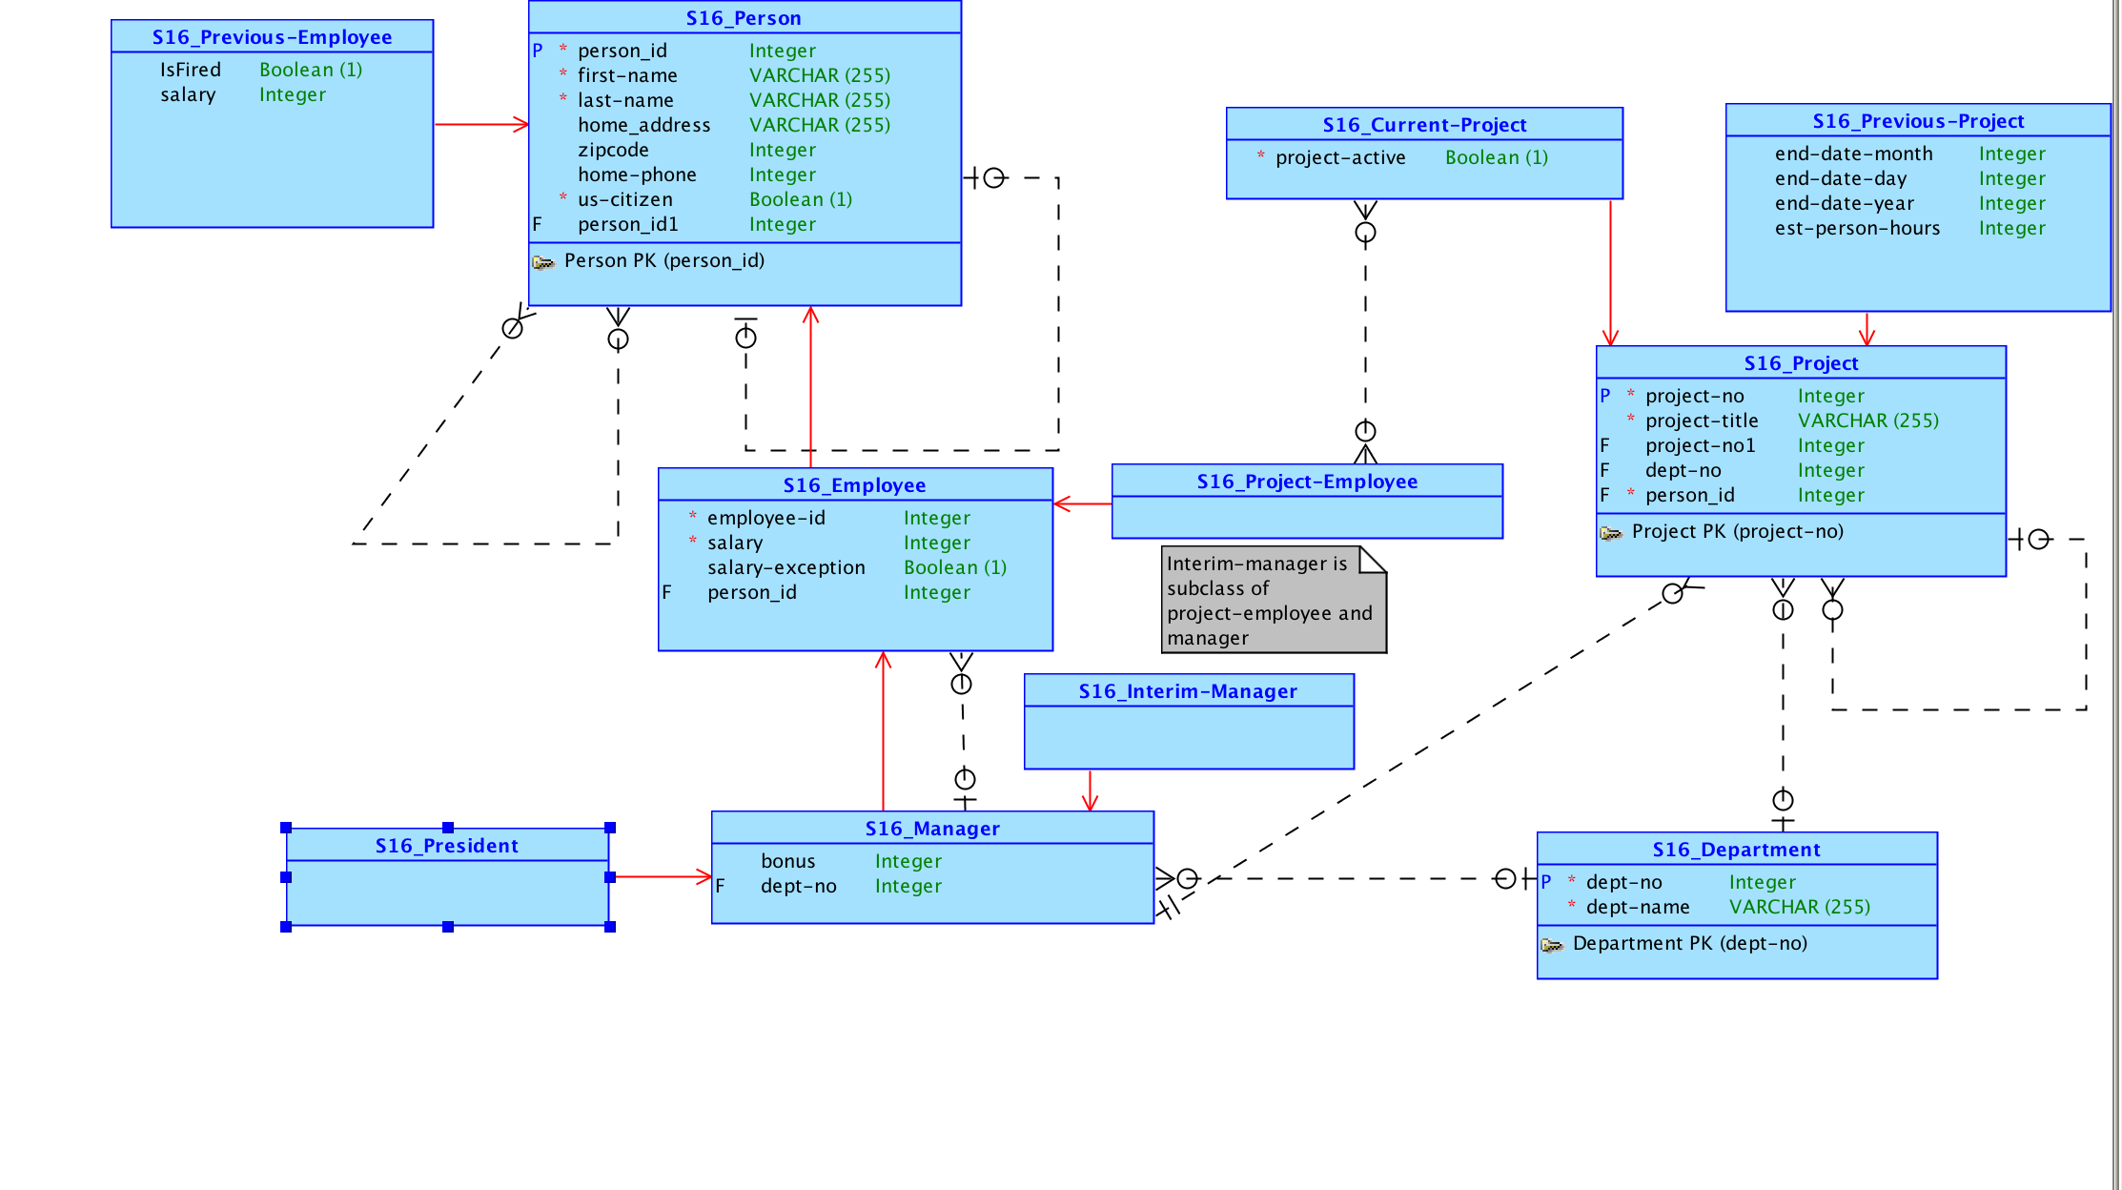

Slide 4
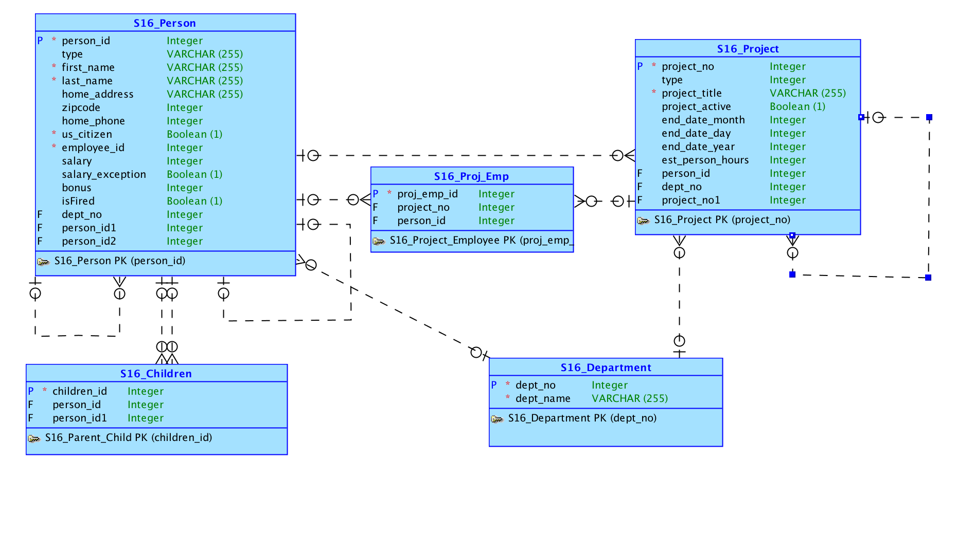

Slide 5
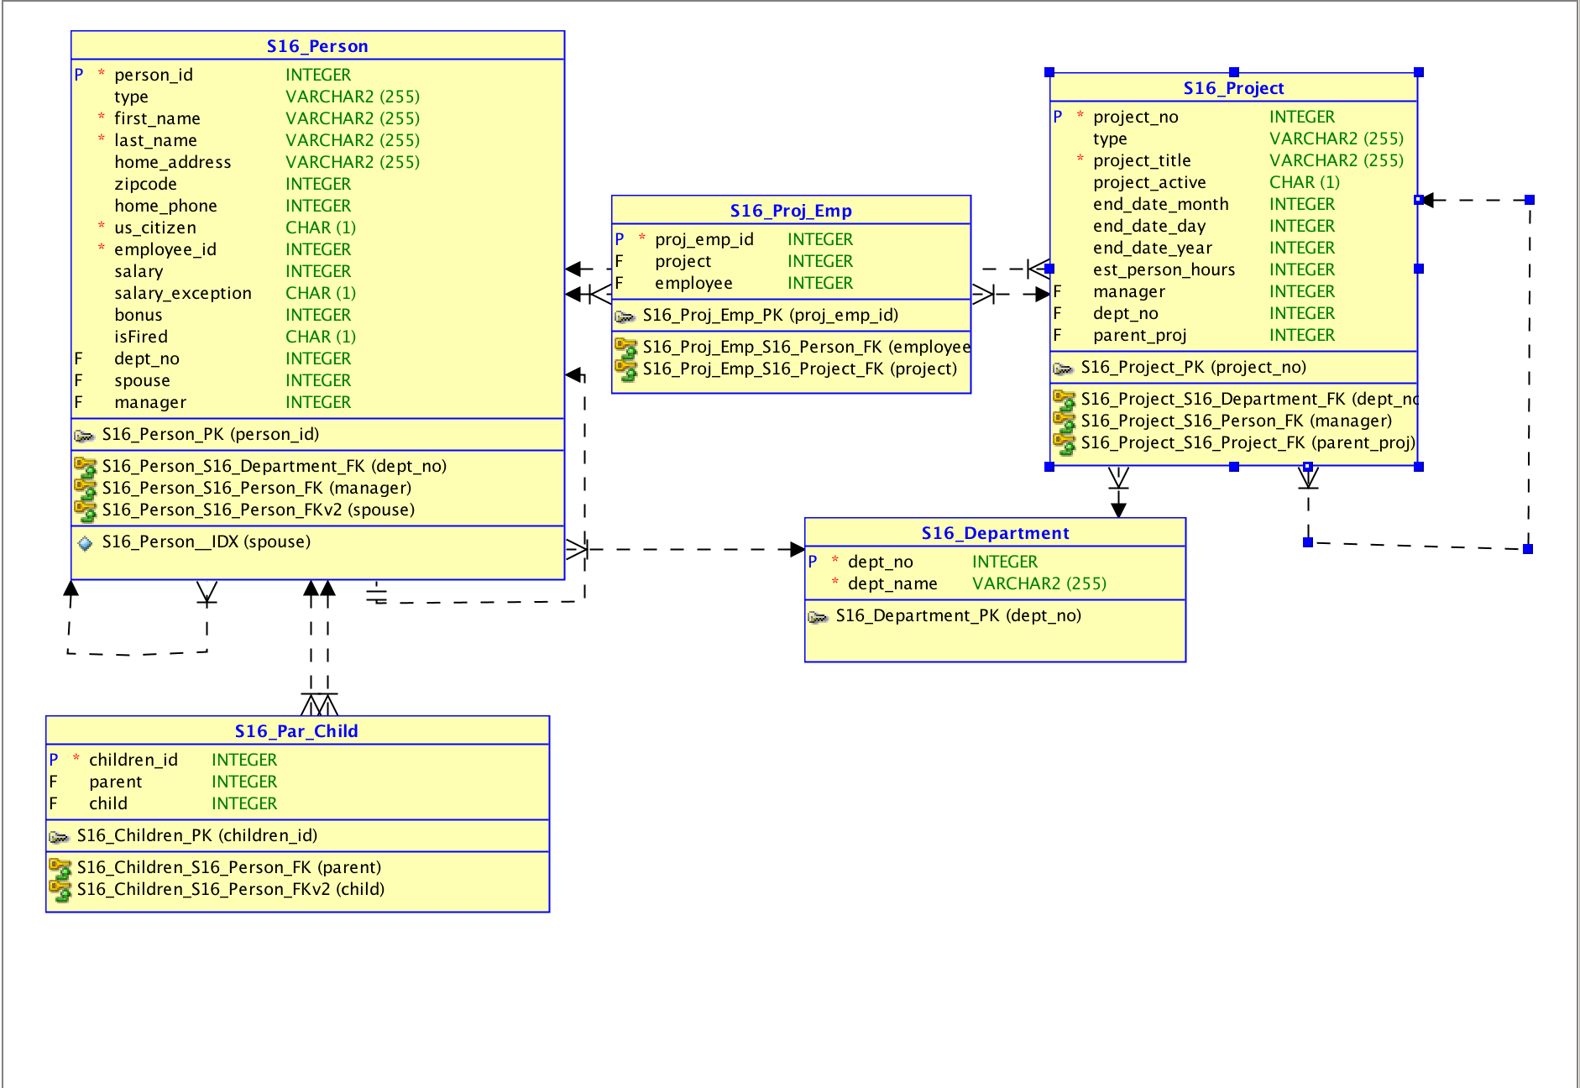

Slide 6
Application Features
A dynamic login page, generating names by type
Multiple forms on a page (Add Manager for a project while adding a project)
Different permissions based on login. Presidents can change employee status, add departments, etc.
President has ability to activate a project, moving it from “pending approval” to “active”
Can add project assignments and parent child relationships

Slide 7
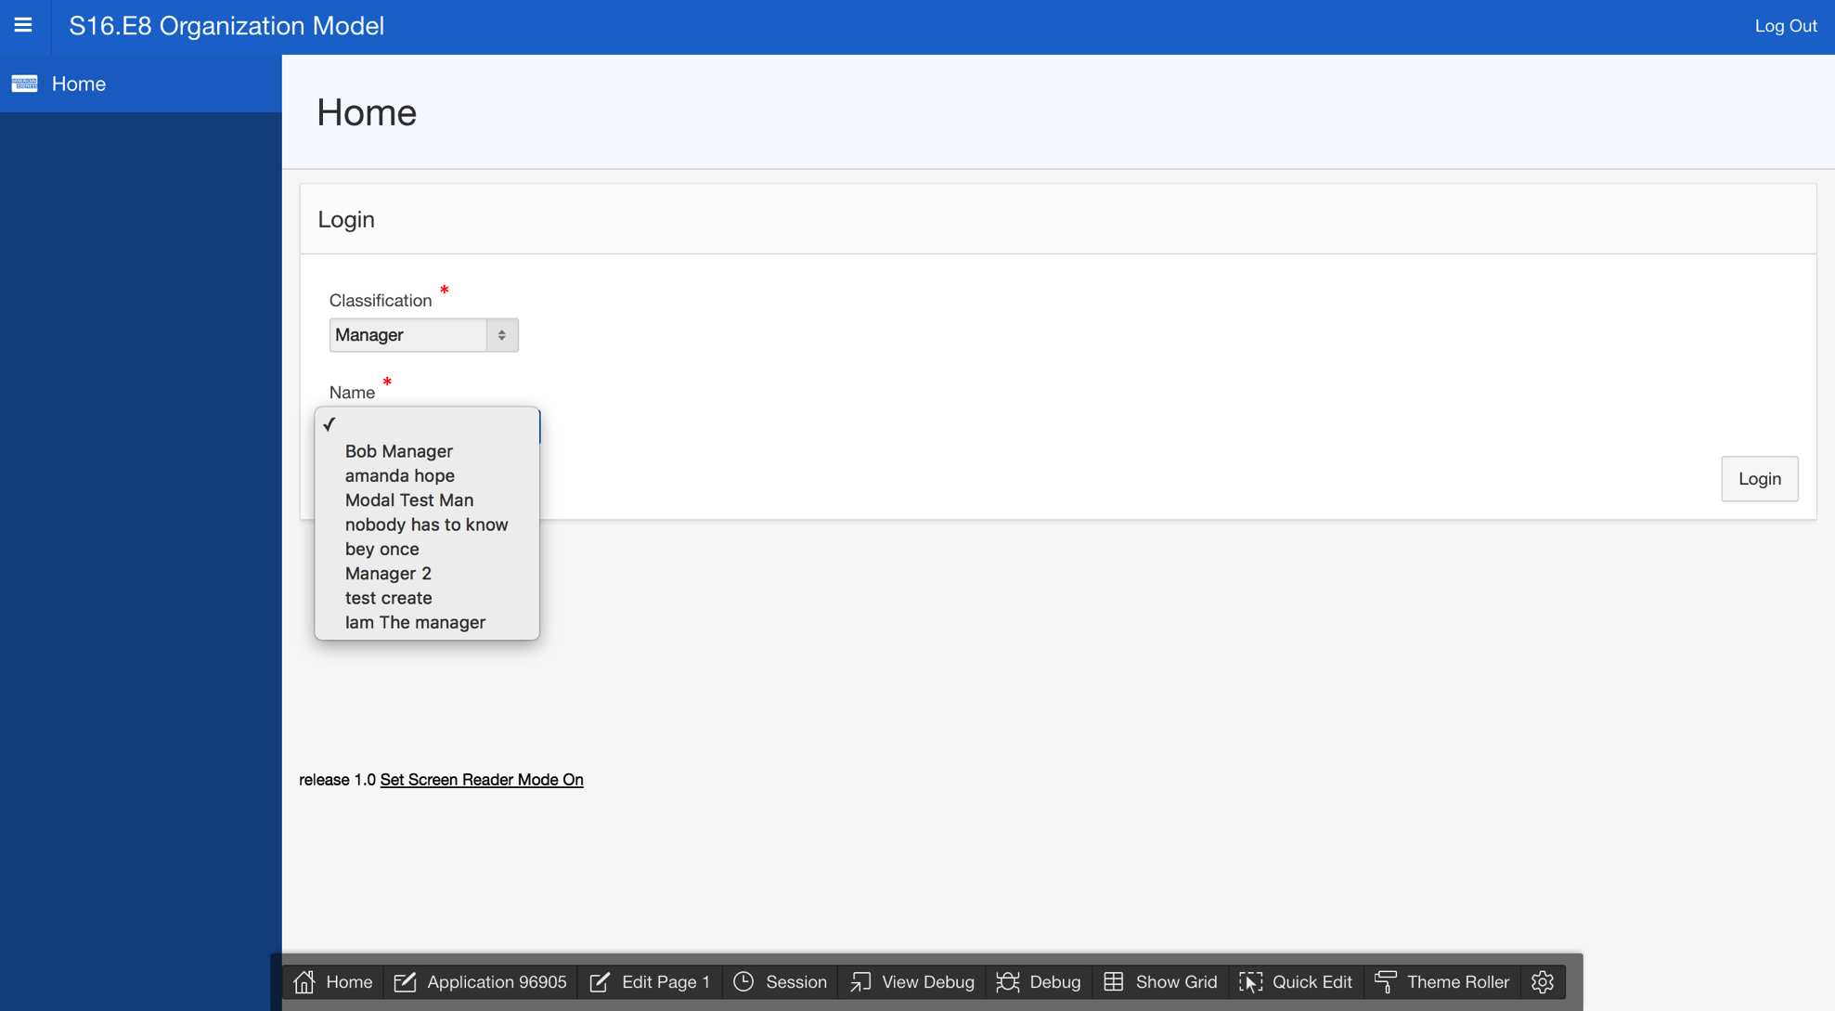

Slide 8
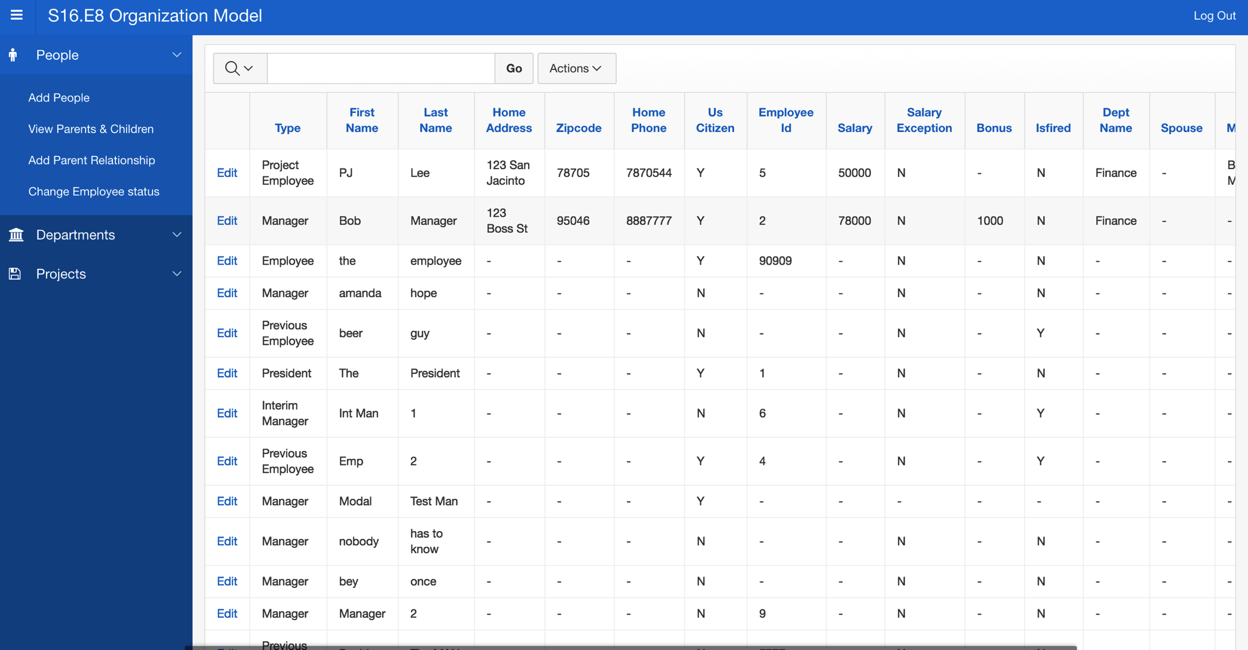

Slide 9
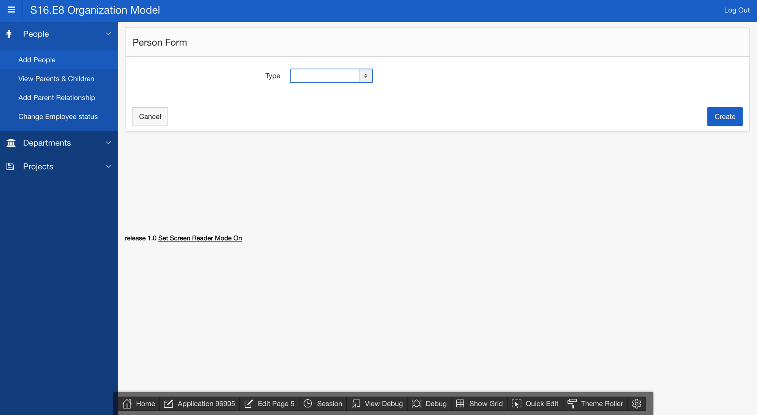
/Users/cameron/Desktop/Screen Shot 2016-04-27 at 12.20.04 PM.png

Slide 10
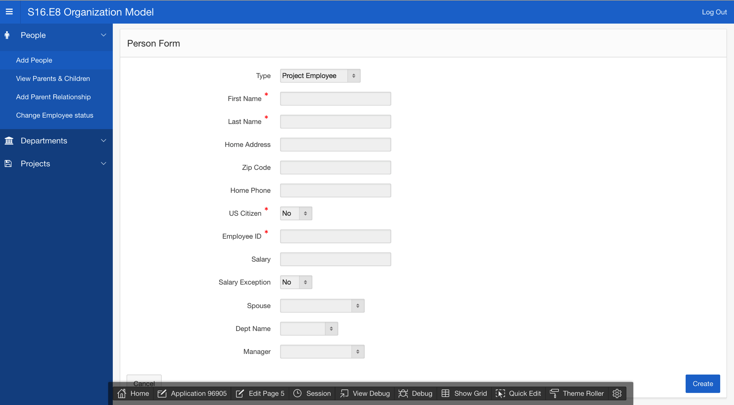

Slide 11
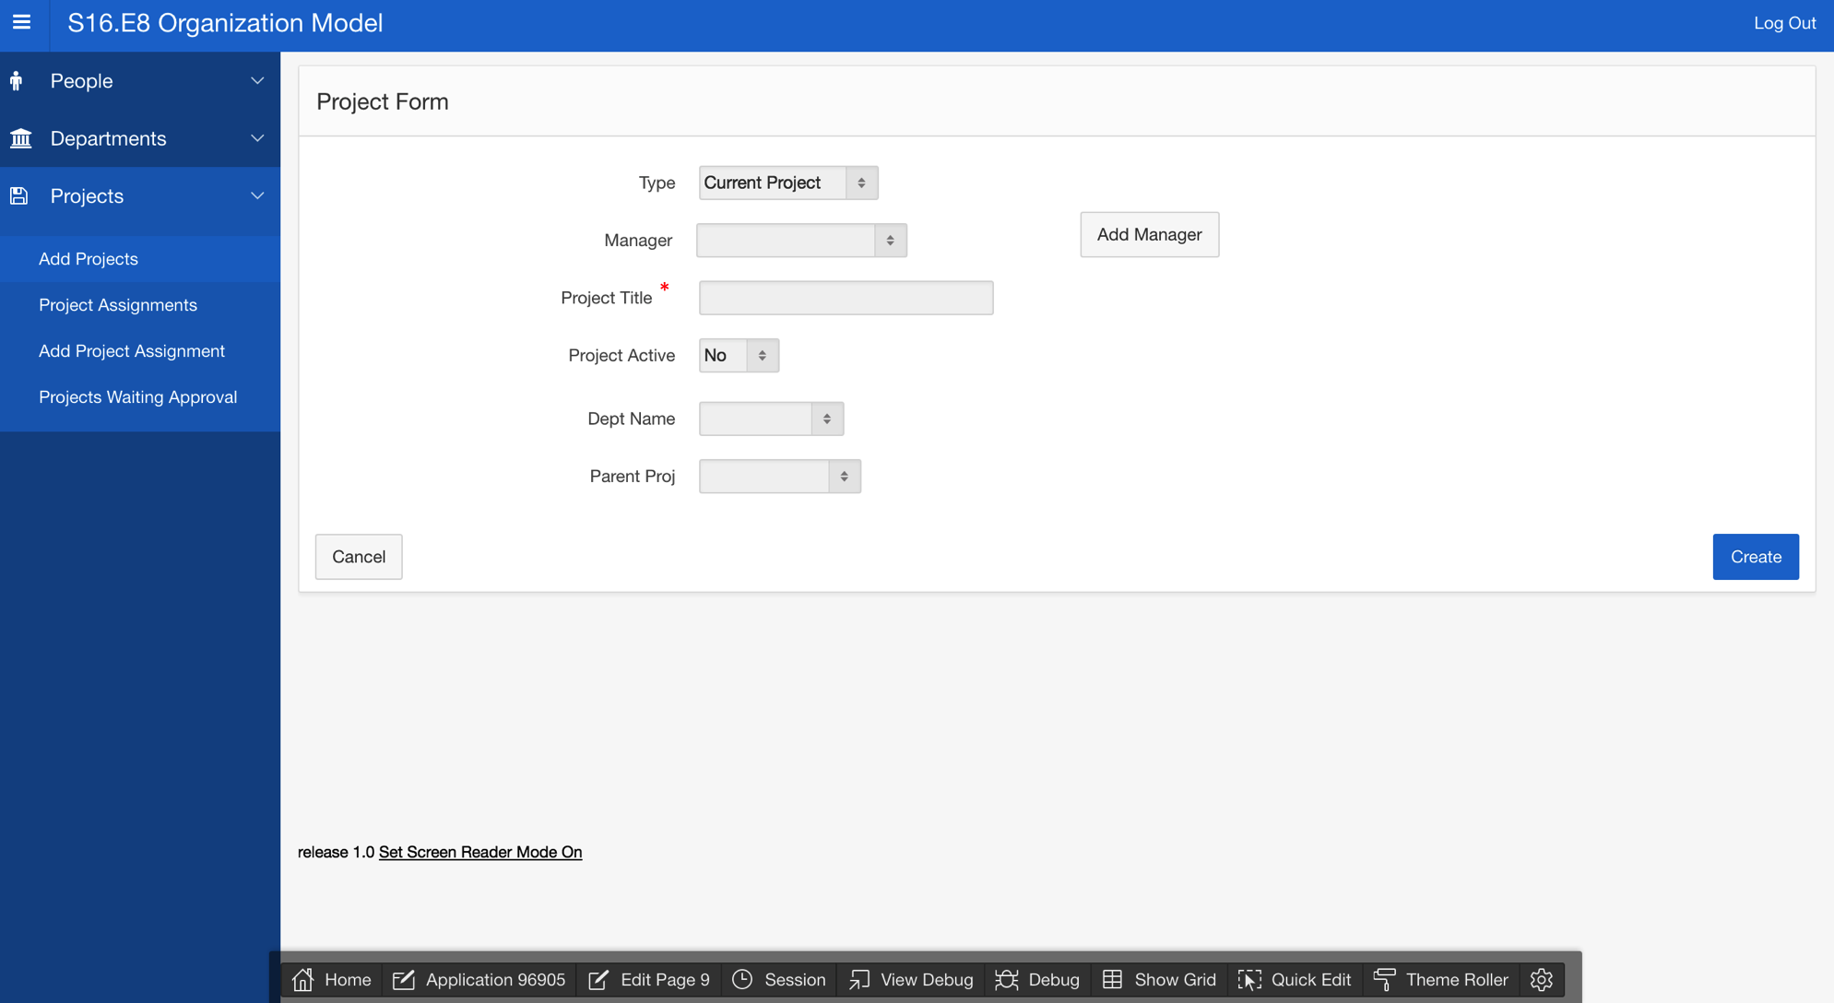

Slide 12
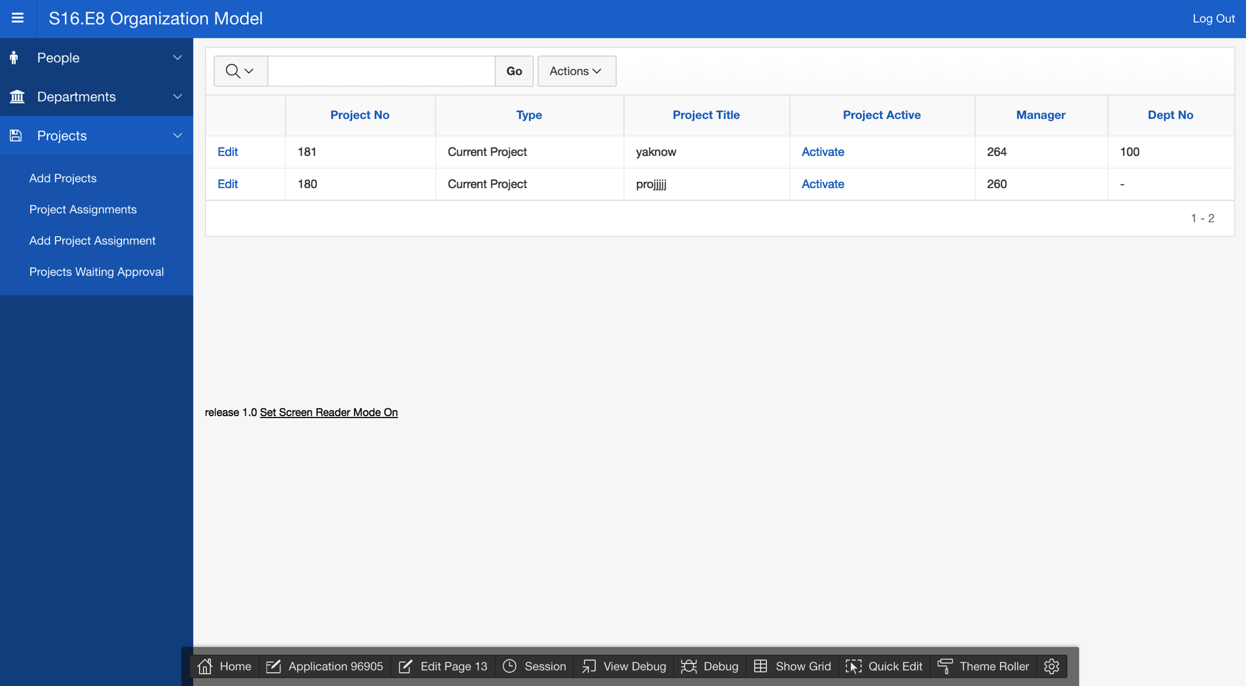

Slide 13
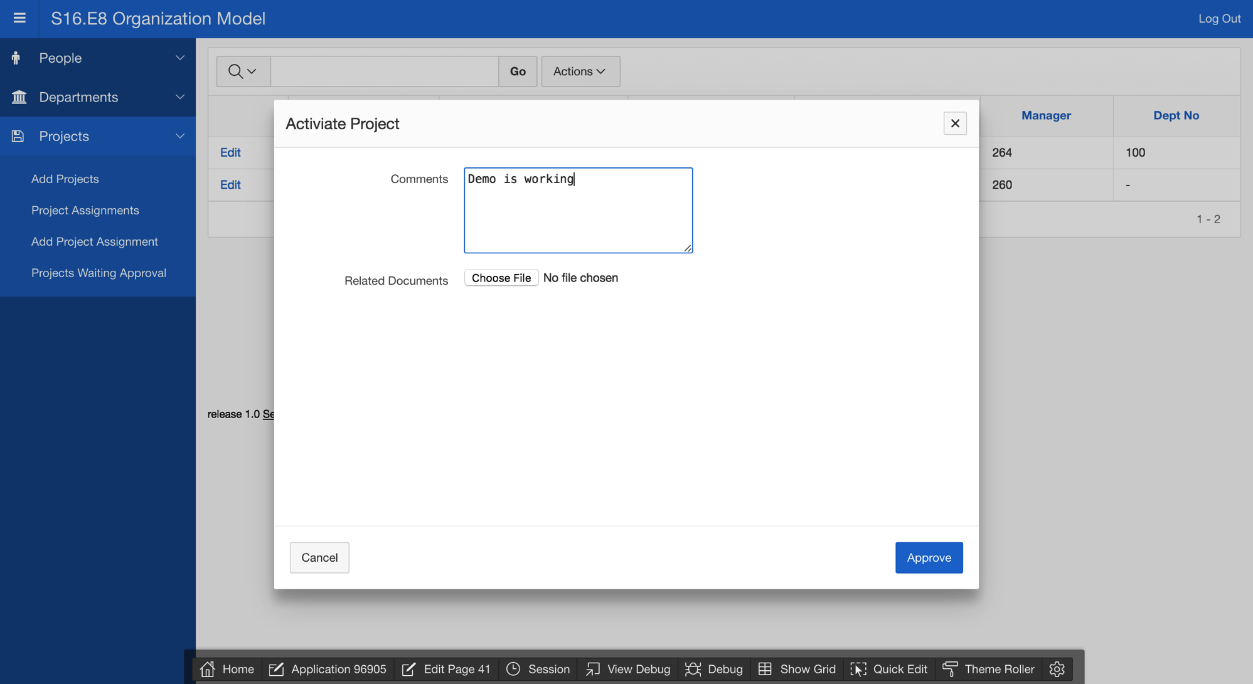

Slide 14
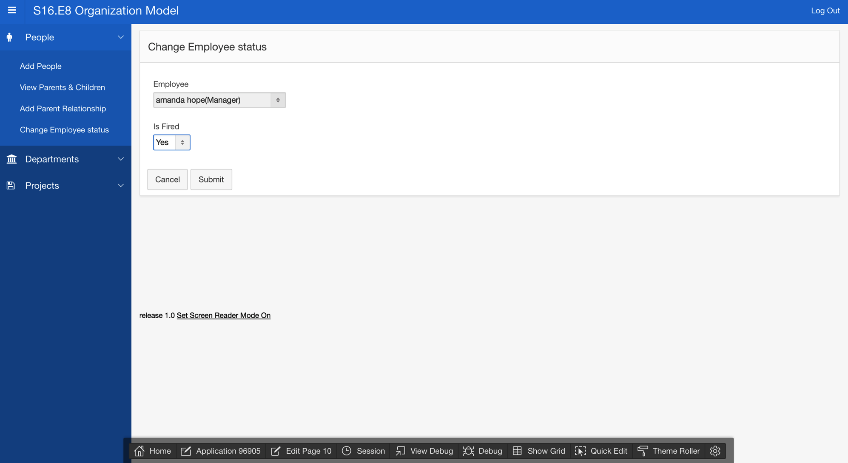

Slide 15
Part 1 URL
https://apex.oracle.com/pls/apex/f?p=96905:1:113798455054584:::::

Slide 16
Part 2
Built on a SIM database rather than a relational database
SIM only required 1 DDL file, follows an object-oriented design. Implicitly declared relationships
Relational uses 4 DDL files, must explicitly declare relationships.
SIM doesn’t need association classes, relational does.
Relational easier to implement in APEX, SIM still missing some functionality.

Slide 17
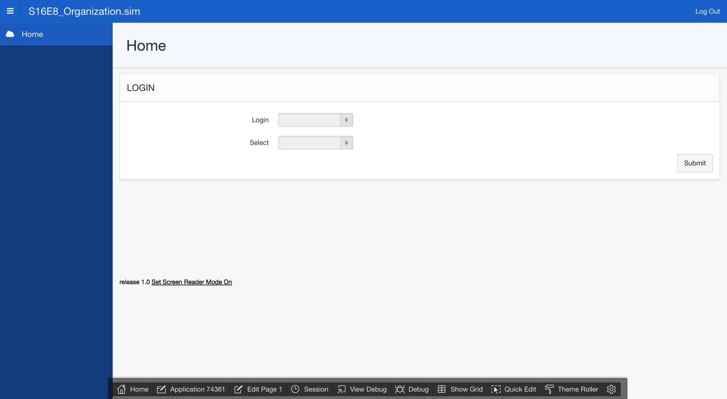

Slide 18
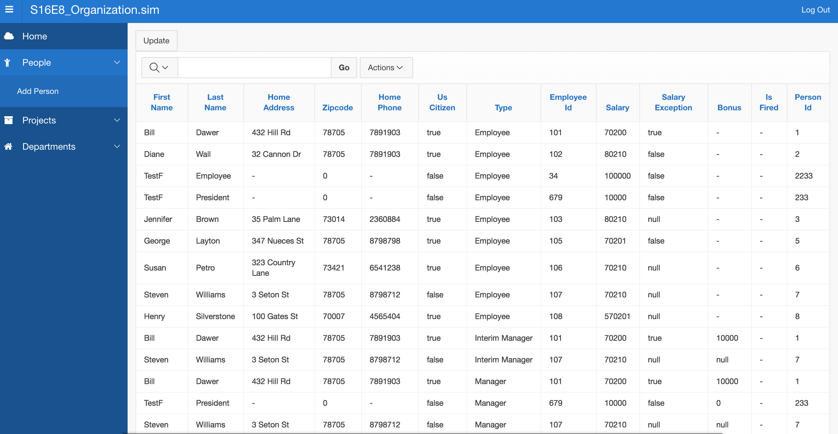

Slide 19
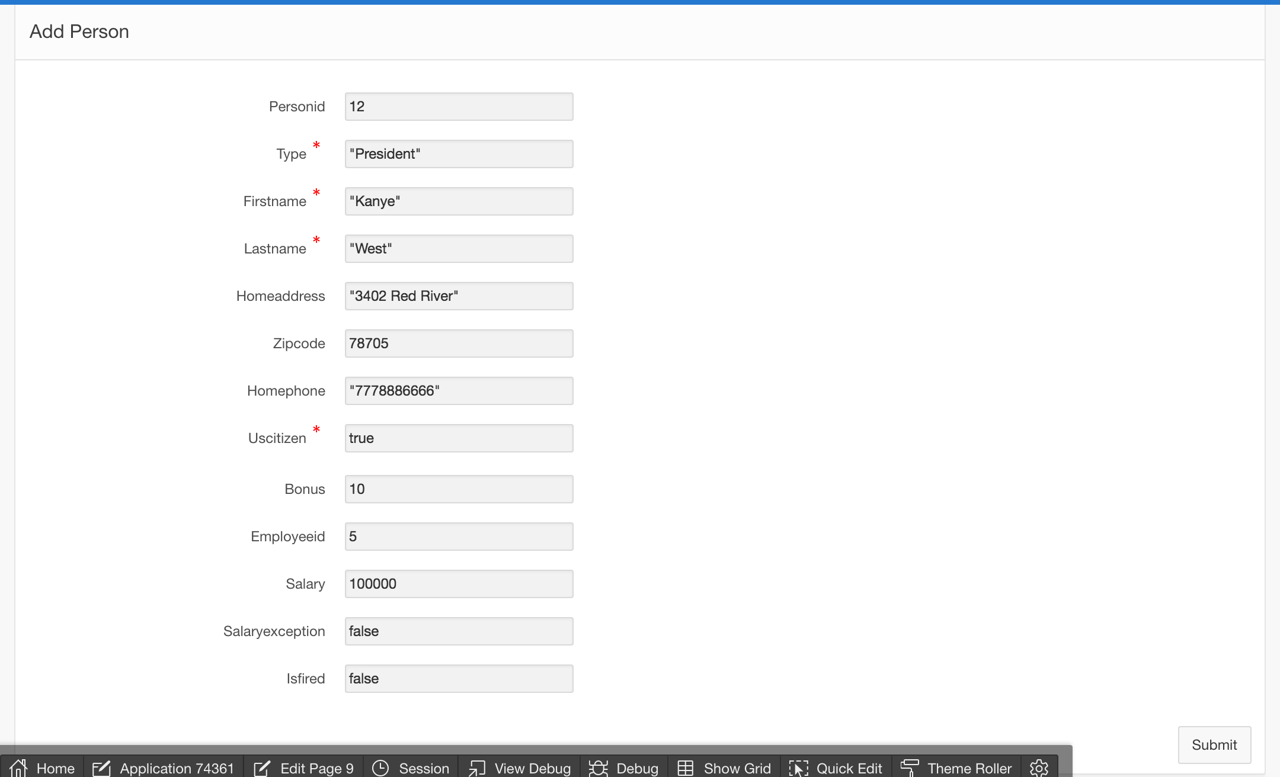

Slide 20
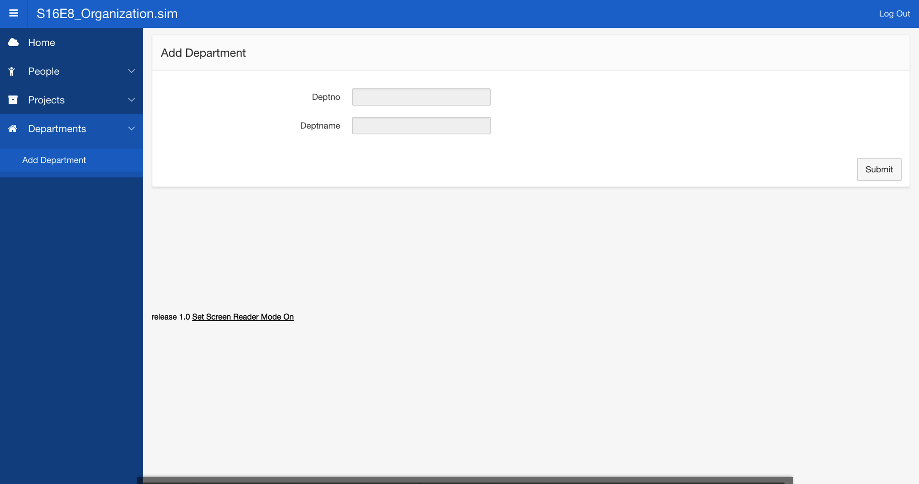

Slide 21
Part 2 URL
https://apex.oracle.com/pls/apex/f?p=74361:1:104908253308942:::::

Slide 22
Any Questions?

