Slide 1
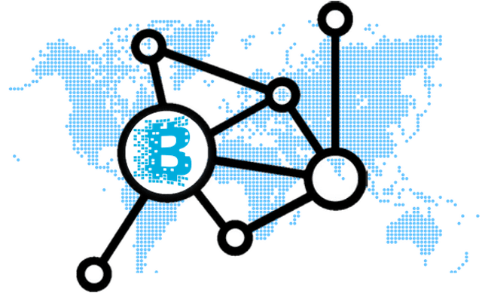
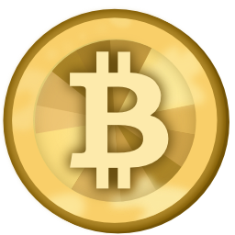
Name – Zubia Masood
Roll no – 1246
Room no – 13
Supervised by Prof Debanjana Dey
Topic - Blockchain and how it will impact financial markets through bitcoins and other types of cryptocurrencies

Slide 2
Introduction
Blockchain is a system of recording information in a way that makes it difficult or impossible to change, hack, or cheat the system.
The network is decentralized meaning it doesn’t have any governing authority or a single person looking after the framework.
As it gets rid of the need for a central authority, no one can just simply change any characteristics of the network for their benefit. Using encryption ensures another layer of security for the system.
The architecture is cleverly designed, and consensus algorithms are at the core of this architecture. Every blockchain has a consensus to help the network make decisions.

Slide 3


Data - A sends a cryptocurrency to B , Amount of crypto sent ,time ,etc.
Hash- unique identifier of a block
Hash of previous block – Unique identifier of previous block
Hash – 1Z8F
Previous Hash - 0000
Hash – 6BQ1
Previous Hash – 1Z8F
Hash – 3H4Q
Previous Hash - 6BQ1
Information in a block cannot be deleted or added as the hash of the block would change leading it to be invalid
Hash – 1Z8F
Previous Hash - 0000
Hash –
Previous Hash –
Hash – 3H4Q
Previous Hash - 6BQ1

Slide 4
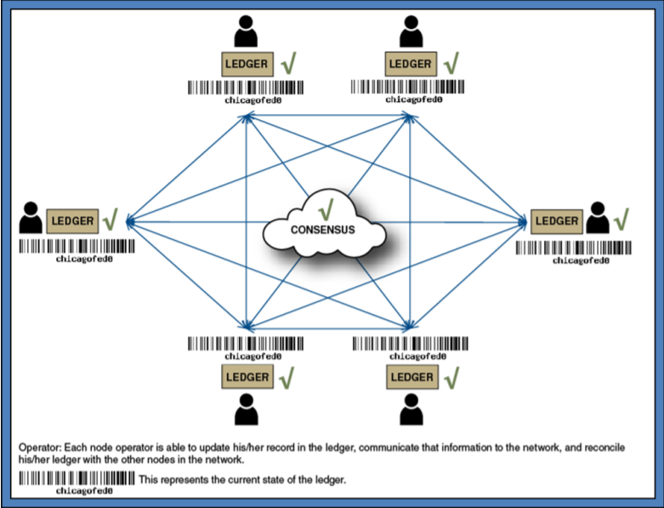
Introduction
Blockchain uses a consensus mechanism to verify every transaction in the blockchain.
for example if A sends certain number of bitcoin to B , then other nodes in the network verify if A originally had bitcoins.
If he did not have them in the first place then his request would be declined by others. And the transaction will decline.
On the contrast if he actually had bitcoins , then a consensus is achieved and a new block is added to the chain

Slide 5




Blockchain Timeline
2015
2016-17
2018-24
2025
Exploration of blockchain
Use cases assessments
Initial capability assessment
Leading edge banks deploy blockchain.
Adoption for external uses
Use of blockchain for auditing and compliance
Growth phase of blockchain begins.
New service providers and models merge
Deployments go around various asset classes
Blockchain to be used widely from 2025 onwards
Considered integral to capital market ecosystem

Slide 6
Literature Review
1)Beyond Bitcoin: What blockchain and distributed ledger technologies mean for firms by Alex Hughes , Andrew park , Jan Kietzmann and Chris Archer-Brown:
Cryptocurrencies like bitcoin etc have grown rapidly in adoption by users in the past 8 9 years . Although the main pillar of bitcoin which is blockchain has immense scope of application in many other sectors . Blockchain can be used to fuel innovation and drive increased efficiencies in many new domains such as digital arts management, supply chains, and healthcare—but there remain technical, organizational, and regulatory headwinds that must be overcome before mass adoption can occur.
2)Blockchain: A New Architecture for Digital Content by Rod Collins:
The combination of networks that are digitally accessed have given rise to the crimes of hacking and fraud. It is debatable that no data system constructed using traditional IT infrastructure is safe from hacking or frauds . Since we are on the verge of next industrial revolution it is prudent that digital content vulnerability should be transformed. Blockchain is a revolutionary technology which is a distributed ledger system that uses a network consensus to record and execute transactions. It is known from the popular currency bitcoin which is currently revolutionizing the financial sector. However blockchain is drawing attention because it can be applied to almost any industry and lower their costs . Its most remarkable feature is that no one can alter anything or any single transaction in blockchain.

Slide 7
Literature Review
3) Bitcoin: A Peer-to-Peer Electronic Cash System Satoshi Nakamoto: A completely peer to peer version of e cash would enable online payments to be sent directly from one place to another without going through a clearing house or financial institution. Digital signature may provide the solution but the main benefits would be lost if we still require a trusted third party to prevent double spending. Double spending can be solved by using a peer to peer network , this network would timestamp transactions by hashing them into an ongoing chain forming a record that can't be changed . The longest chain serves as a proof of events that took place . The network requires minimum structuring, Messages are broadcasted on best effort basis, and nodes can leave and rejoin the network at will, accepting the longest proof-of-work chain as proof of what happened while they were gone.
4) MultiChain Private Blockchain — White Paper Dr Gideon Greenspan, Founder and CEO, Coin Sciences Ltd:
The main causes behind bitcoin's slow adoption are 1)the existing users are very well versed with the current payment system ,and they dont want to take risks,2)there is difficulty in practicality of purchasing bitcoins,3)the volatility of bitcoin's value relative to government issued currencies such as rupee or dollar,4)the wrongful perception of bitcoin being insecure,5)questions over bitcoin's legal status,6)the irreversible nature of bitcoin transactions,7)a lack of support for bitcoin in the financial sector. Blockchain could help improve internal process within the financial sector by decreasing cost , reducing settlement times and discarding intermediaries.

Slide 8
Objectives
To explain how traditional or fiat currencies are lagging behind amidst so many technical innovations.
To establish the need of cryptocurrencies and a secure network such as blockchain
To infer how can blockchains be used for cryptocurrencies as well as for other industries
To find out how the blockchain is impacting financial markets with the help of cryptocurrencies such as bitcoin

Slide 9
Data and Research Methodology
Type of data - Secondary data
Data sources - Authors, research papers available online, books and other journals.
Need of the study – The slow and inefficient functioning of the financial markets and lengthy procedures for transfer of assets or money led to the rise of blockchain implementation possibility ascertainment.
Research methods used – Exploratory.

Slide 10
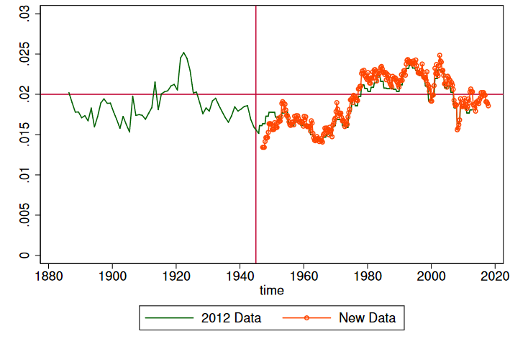
Analysis and Findings
Unit cost of financial intermediation hovers around 2% and is relatively stable over time.
It costs around two cents per year to maintain one dollar of an intermediated financial asset. Or equivalently the annual rate of return of savers is 2 percentage points below the funding costs of borrowers.
Hence this signifies that even though our financial system went from pen and paper to digitization , We as depositors haven’t really been benefited.

Slide 11
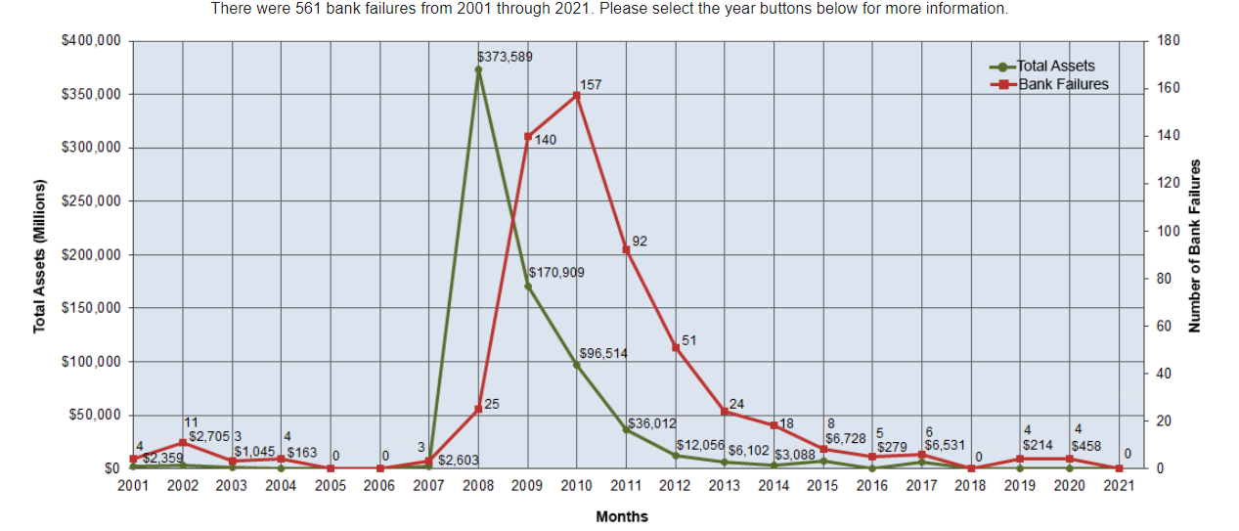
Bank failures since 2001

Slide 12
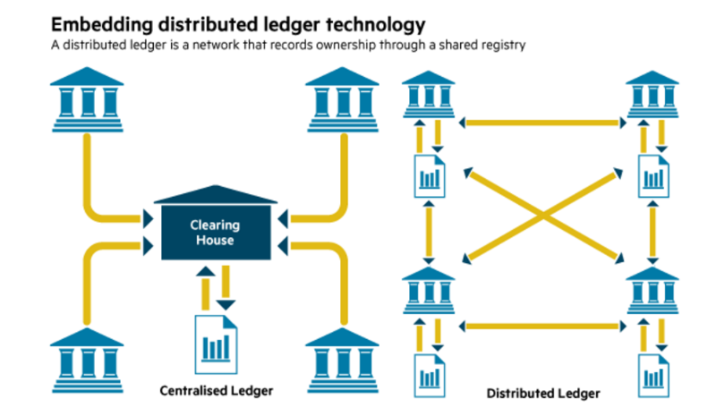
Distributed Ledger Technology(DLT)
Rules out the need of a bank to act as a financial intermediary
Reduces cost of transaction
Reduces need to trust banks blindly
Reduces time and friction for overseas transactions

Slide 13
Real Estate Tokenization
Highly illiquid
Valuation required for sale of ownership which is very lengthy and time consuming
Need to check if the buyer is an accredited investor.
The real estate developer might redeem the shares at a reduced value , hence is illiquid

Slide 14




Sarah owns a building worth 10 lakhs
John wants to invest in real estate with only 1 lakh
Traditionally John can’t invest 1 lakh in Sarah’s property
SOLUTION
Sarah can now divide the property into tokens
And sell the tokens to both
Institutional Investors
Individual Investors

Slide 15
Tokenization of stock
Shares can be tokenized as some share prices for a share can be very high as in the case of MRF Tyres it is around 80k.
Features of tokenized stock:
Divisible - If on a blockchain 1 share is represented by 10 tokens and if 1 token is purchased by an individual then he owns a fraction of share i.e 0.1 share which isn’t possible otherwise in the current picture.
Accessible: For many countries we serve, investors can’t easily purchase stocks like Apple, Tesla, etc. Tokenized Stocks give you a legal way to access the US stock market to buy and sell US stocks.
Always On: Traditional stocks on the US stock market only trade between 9:30 am – 4:00 pm everyday. Because these assets are tokenized, they can be traded 24 hours a day.

Slide 16
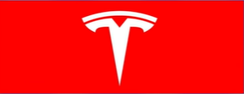

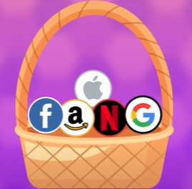
1 share of Tesla = 50000 INR
1 share divided into tokens representing fractional shares
1 token = 10000 INR
Tokenization of stock leads to Diversification of portfolio and Spreading of risk

Slide 17
Hedge against Inflation
Total amount of INR which can be issued – unlimited
Total amount of bitcoins which can be issued – 21 million
The supply of money is in the hands of the government and they can increase the supply of money anytime in the future leading to inflation and loss of purchasing power.
To hedge against that risk investment can be done in cryptocurrencies and at any time in future the supply of it wont increase and this is how we can uphold our purchasing power.
Bitcoin derives value from it’s limited supply and that it can used as a hedge against inflation

Slide 18
Smart Contracts for land
Blockchain could replace pen and paper contracts and can be used for land registration , periodic payments etc.
Smart contracts could be used to prevent the frauds resulting from Double Spending.
For example – Seller sells a land to Buyer , because of the lengthy process of registration , it takes one month to get the name of the new owner in the land papers . In that period Seller sells the same land to C ,which doesn’t belong to him resulting to fraud . Blockchain and tokenization of land can solve this problem as it is based on real time and title is immediately transferred.

Slide 19

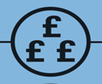
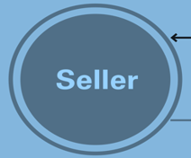
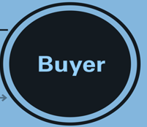


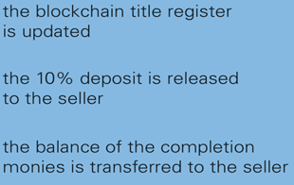

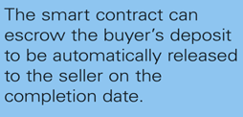

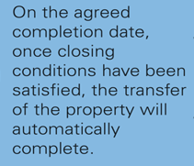



Slide 20
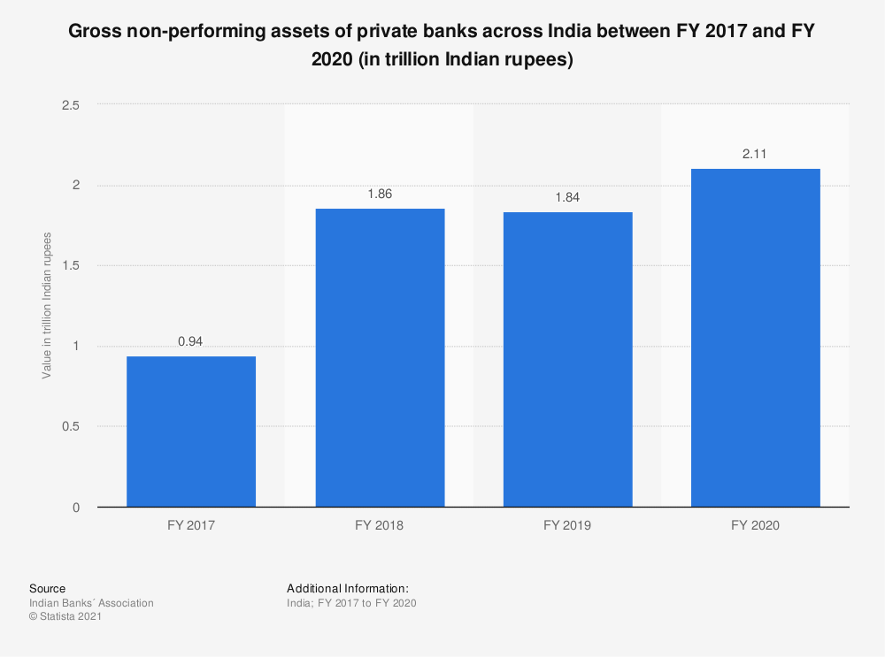
Smart Contracts for periodic payments
Voluntary default is big problem for Indian banks which leads to a rise in npas over the years.
Smart contracts can be created at the time of grant of loans.
Conditions might be pre specified such as as soon as the contract detects money in the wallets to the borrower,it automatically procures the interest or the loan amount . Hence voluntary default could be eliminated.

Slide 21
Recommendations
Future research can be done on various other important applications of blockchain
Once it is widely implemented research can be done on available data for the exact nature of benefits derived out of it
Opinion of various governments about the technology can be ascertained as that would determine the application of the technology and its benefits thereon

Slide 22
Conclusion
Blockchain technology has immense number of applications , and we are on the early days of blockchain and digital currency.
All the countries are trying to get to know the technology and understand it and explore to whatever areas it could be implemented in.
Many companies are buying bitcoin , some companies are conducting ICOs (initial coin offering),The republic of Georgia has implemented the blockchain technology for land registrations.
Hopefully in the coming 20 to 30 years we’ll see a great deal of more use cases of blockchain and meanwhile the challenges that blockchain currently faces will be resolved.

Slide 23
Limitations
Secondary data can be unreliable as blockchain has not been implemented widely yet.
Many governments are up for blockchain while others had banned blockchain earlier so it would depend from country to country how this technology is adopted.
The conclusion drawn from the research might be vague and incorrect as many people oppose to the technology as they don’t want to risk their money in a tech which they don’t even get the gist of

