Slide 1

Happy Deliveries Case Study

Slide 2
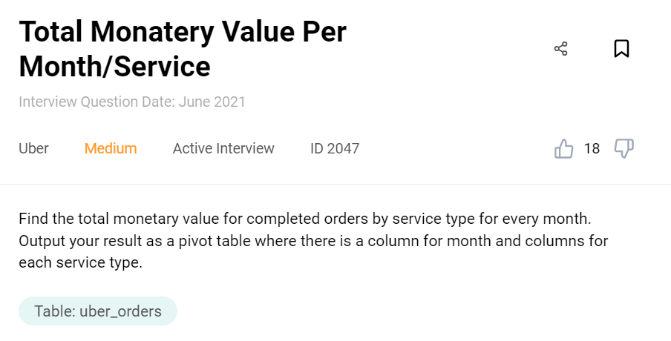
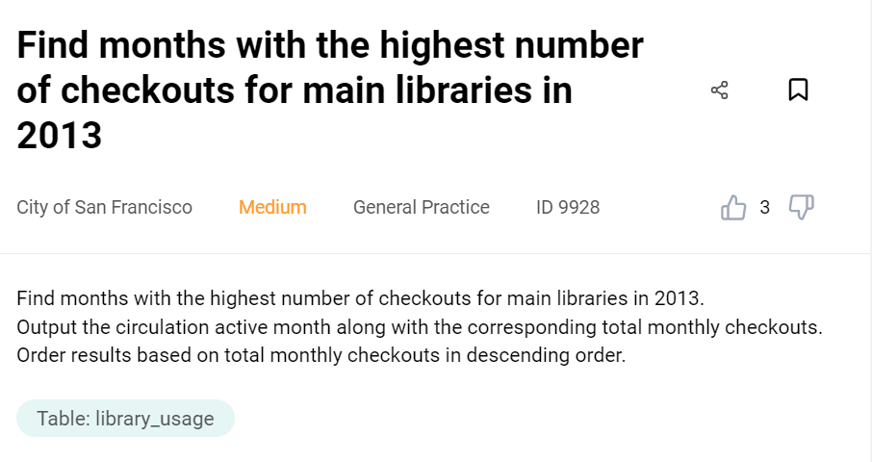
Question 1:
Compare monthly 2021 sales to 2022 and determine has ‘Happy Deliveries’ sales grown.

Slide 3
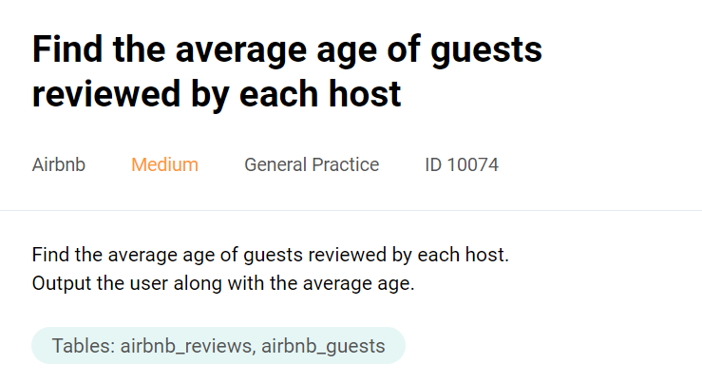
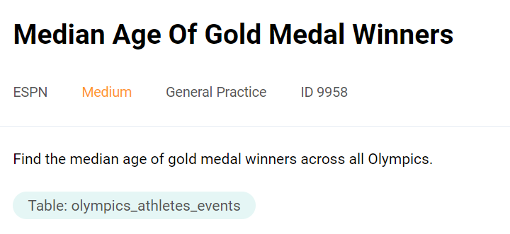
Question 2:
Looking to the loyalty card holders, what is the age distribution of those customers

Slide 4
Question 4:
Is there a relationship between the amount of a payment, the age of a person and whether or not they used discount codes (HINT: scatterplot with 3 layers )
Question 3:
Is there a relationship between the amount spend by a loyalty card holder and their age?

Slide 5
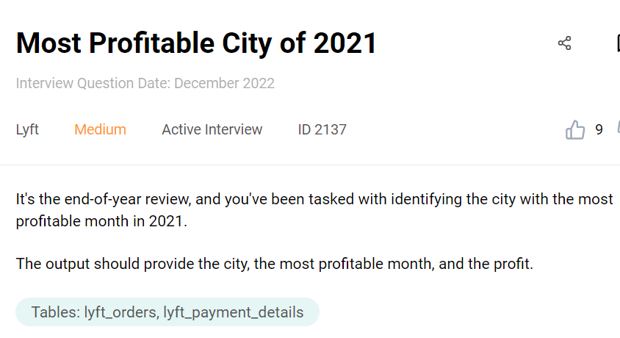
Question 5:
Compare the sales for 2022 across all regions

Slide 6
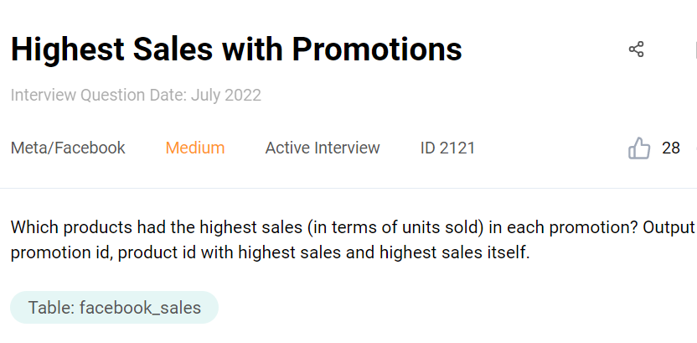
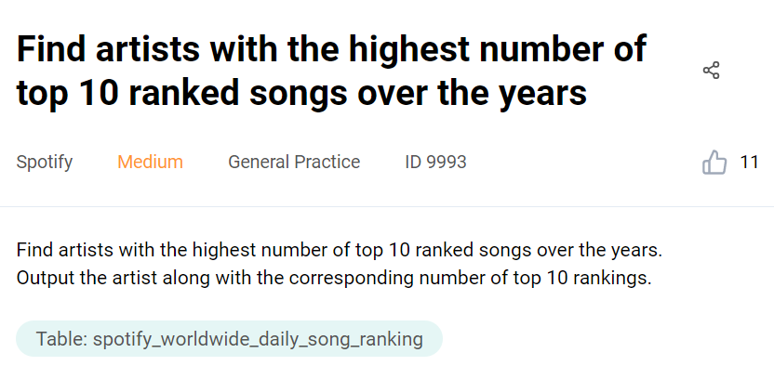
Question 6:
Christmas is coming and Happy Deliveries want to reward their high spending customers. Who are the top 10 highest spending customers in 2022? Find their ID, name and email address for the marketing department to contact them with a reward.

Slide 7
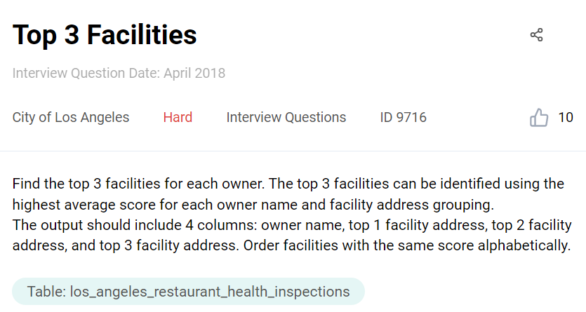
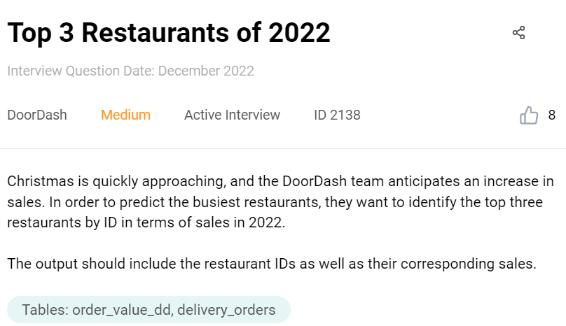
Question 7:
In order to keep up with the anticipated increase in sales over Christmas, Happy Deliveries want to find what are the top 3 restaurants, so they can allocate their resources more efficiently. What are the top 3 restaurants in terms of sales for 2022?

Slide 8
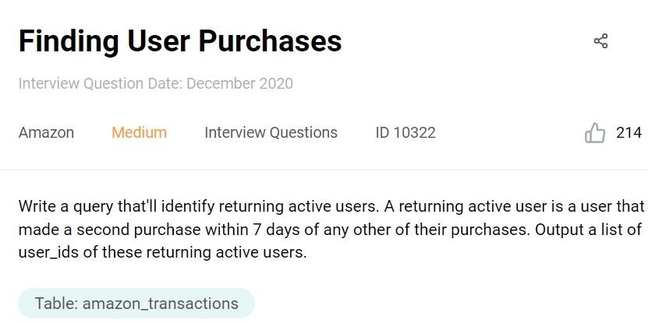
Question 8:
The marketing department wants to reach out to non-returning loyalty card customers from 2021 in hopes they can lower their customer churn rate. Find all the customers who are considered non-returning including their id, name and email. (HINT: Non-returning means they have only made only one purchase)

Slide 9
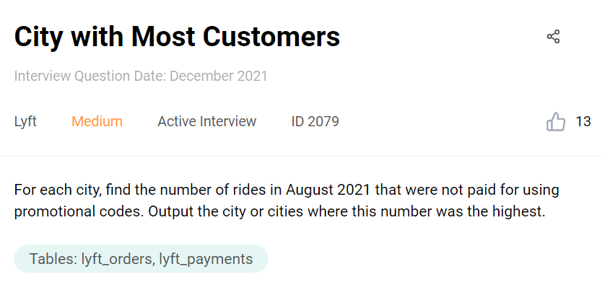
Question 9:
The sales team want to find out if the discount code ‘BLACKFRIDAY22’ was as successful as last years ‘BLACKFRIDAY21’. Find the total amount of sales from both discount codes.

Slide 10
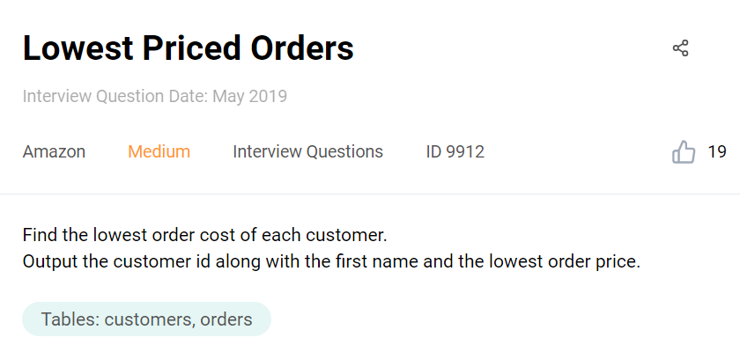
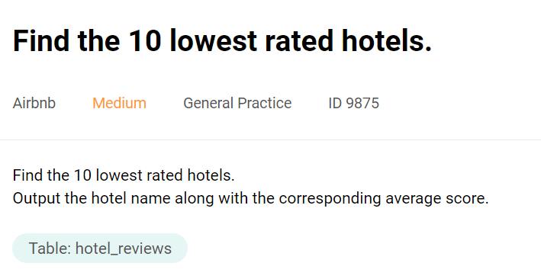
Question 10:
What were the locations with the lowest cumulative sales for 2022? Should the marketing department tailor their marketing efforts more towards this location (Perhaps other factors are responsible for example low population)

