Slide 1



IEEE DAY 2020
Introduction to GITHUB
Zubier Abdullah

Slide 2


What is GIT and why do we use it?
GIT is a version control software used throughout the world
It is used heavily throughout the IT industry all over the world
Created by Linus Torvalds in 2005

Slide 3
Why do we need version control?
Imagine you and four friends are working on a project, each doing one part of the whole thing
When it comes time to integrate all of your changes, nothing works
It becomes extremely difficult for you to figure out why and who is at fault
Tensions rise between teammates

Slide 4
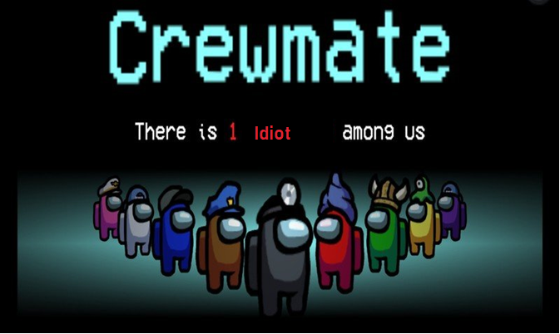
Why do we need version control?
Git helps us by tracking every change made to the code base so we know what happened

Slide 5
Why do we need version control?
Lets say your code was working and you made a change to it and now suddenly it stops working
Git also allows us to ‘revert’ our code to the point where it was last working so that we can retrace our steps
This is like a save point in a video game – you can always try again from that point if things get scary

Slide 6
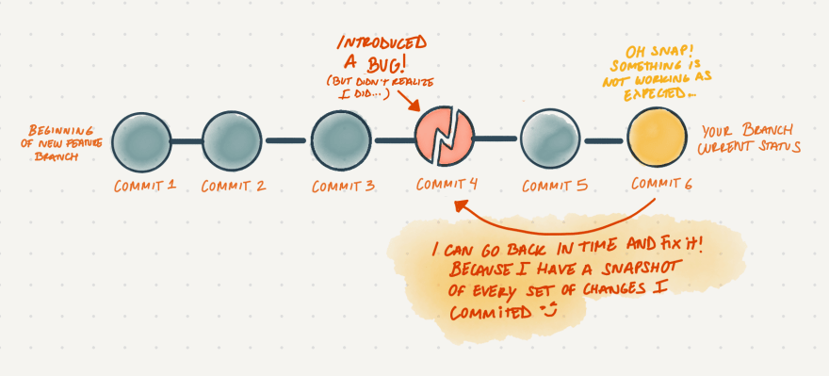
Why do we need version control?

Slide 7
Why do we need version control?
Finally it allows us to have a lot of control over what changes are allowed into the code base through the use of branches and pull requests

Slide 8
What’s a branch anyway?
Branches are an important concept when it comes to version control
Every project has a main/master branch and can have infinite subsequent branches which are derived from that branch

Slide 9
What’s a branch anyway?
Lets go back to our previous example – Saif is working on the UI of our project and Tahmid is working on the backend
They both create branches from the main branch and make their changes independent of each other
When their work is finished they create a pull request
Someone goes through their code, reviews it and if the code is correct, merges their code into the main branch

Slide 10

What’s a branch anyway?

Slide 11
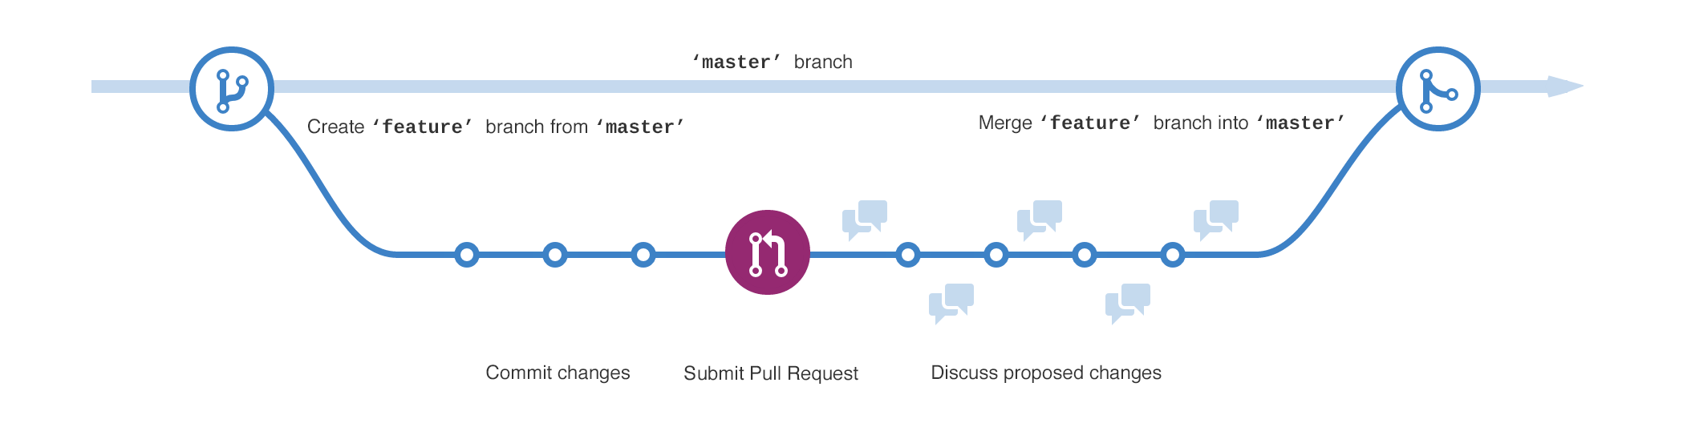
What’s a Pull Request anyway?
In our case, Saif makes his own feature branch where he works on the UI. When he is ready, he submits a pull request to Saima, his team leader.

Slide 12
What is GitHub?
GitHub is an online repository, using Git, which allows people to store and share their code with other developers from all across the world
It also is a great platform to work with other passionate coders from around the world on some of the largest projects in the world

Slide 13
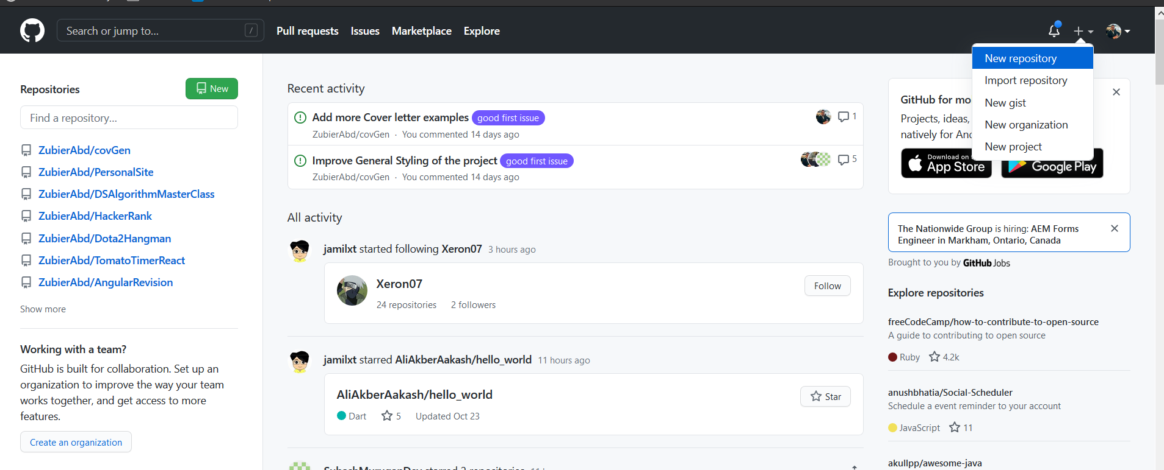
Creating a GitHub Account
Go to Github.com and click sign up
Once you have done so, click the plus sign on the right and click on new repository

Slide 14
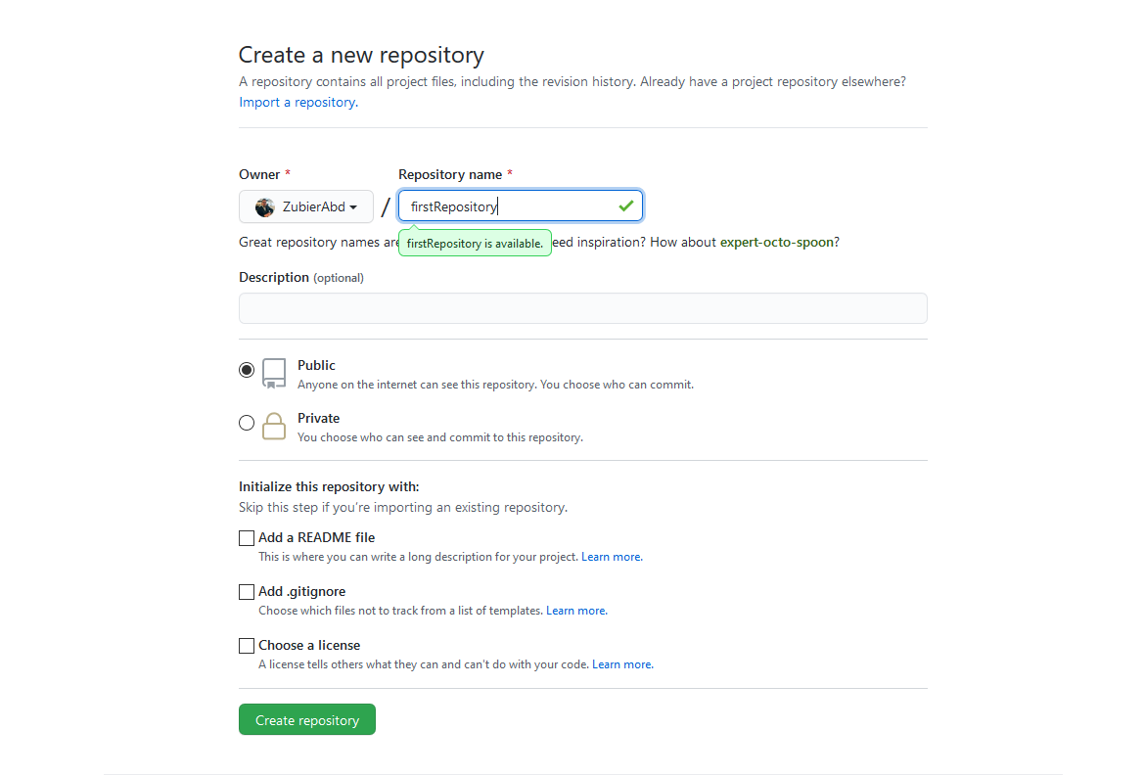
Creating a repository

Slide 15
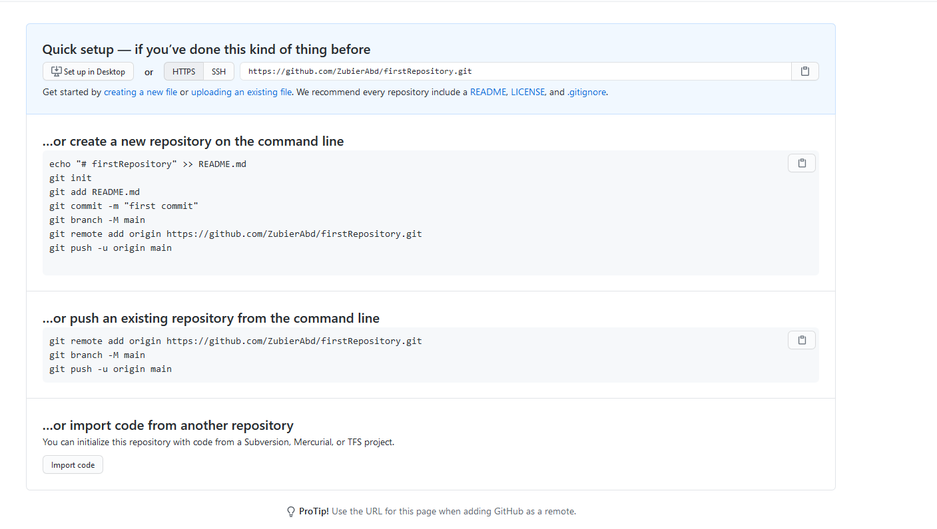
Copy the second part

Slide 16
Login from the terminal
git config --global user.name "your_username“
git config --global user.email your_email_address@example.com
You might need to do this

Slide 17
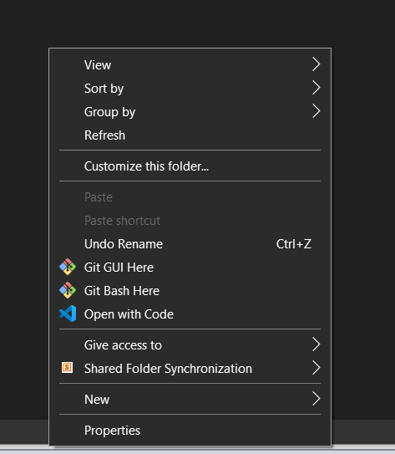
The BASH terminal
If you have GIT installed (which you should have by now), anytime you right click anything in windows explorer you will see two new options
Click Git Bash here

Slide 18
The Terminal
You will open the terminal
Copy paste the code you copied (you don’t need to understand what it means)
Ctrl + V will not work in Bash – The Hotkey is Shift + Ins to paste something
You can also right click and paste
Press enter
Congratulations (hopefully)
You’ve made your first commit

Slide 19
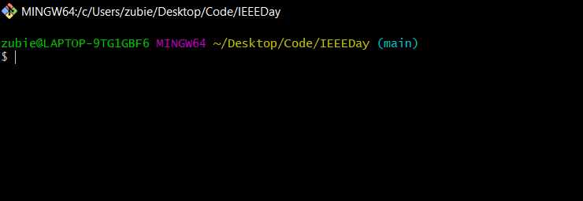
Don’t fear the Terminal
If you’ve never worked with the terminal, it can seem scary
You don’t need to be an expert with using the terminal to use git

Slide 20
Basic commands
git clone – this allows you to clone a repository from a link
git status – check the status of what files are changed/staged
git checkout – this allows you to switch branches from one branch to another
git branch – create a new branch with a certain name

Slide 21
Basic commands
git add – This allows you to add files that were changed to the staging area
git commit – this allows you to commit files which are ready to be sent to the remote server
git pull – this will bring changes from the remote repository and update your local files
git push – this will push changes from your local machine and update the remote repository

Slide 22
Examples of basic commands
Git clone – git clone https://github.com/ZubierAbd/covGen.git This will clone the repo from Github to my local machine
Git checkout – git checkout feature/zubierabd (or some other branch name) This will move you from one branch to the branch named feature/zubierabd
Git branch – git branch feature/tahmid140 This will create a new branch named feature/tahmid140

Slide 23
Examples of basic commands
git add – git add index.html Add the file index.html to the staging area
git commit – git commit –m ‘insert a commit message’
If you are ever stuck in VIM :qa!
git push – git push origin HEAD
git pull – git pull origin

Slide 24

I imagine this is how you are feeling

Slide 25
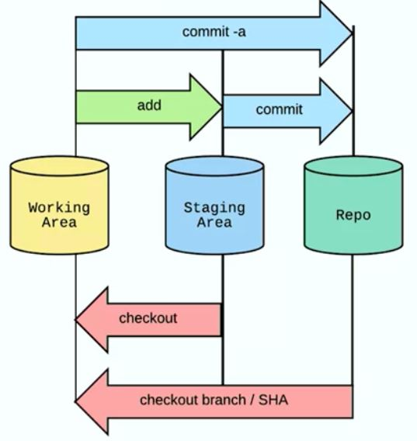
The GIT flow
Notes:
https://almasumfahim.com/git-stages/

Slide 26
Learn by doing
Go to the following link
https://github.com/ZubierAbd/IEEEDay
Look in the upper right – there will be a fork option
Fork the repository – this means you are creating a copy of it in your own Github account

Slide 27
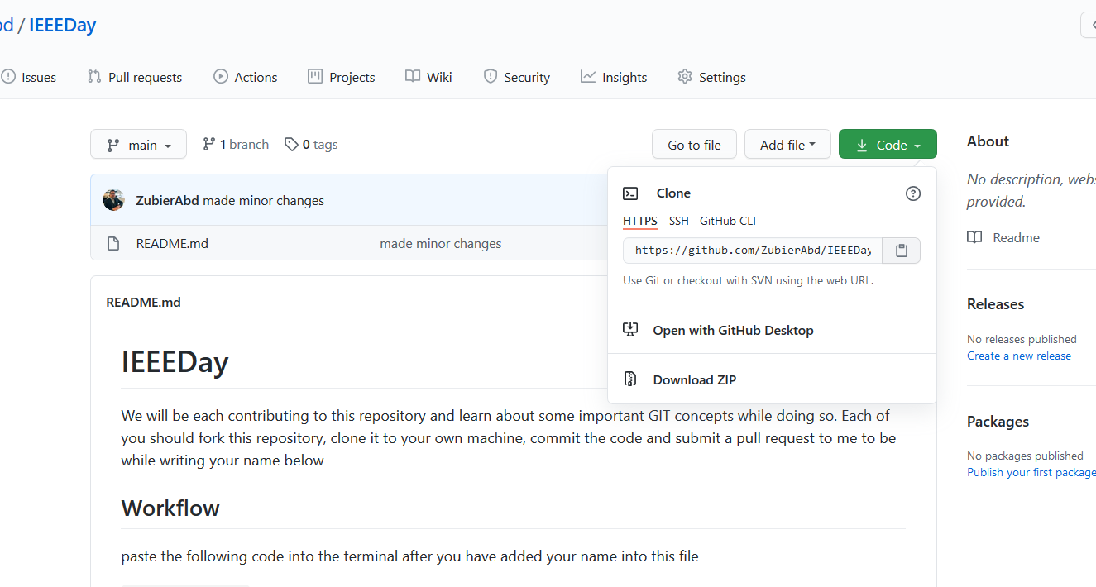
Learn by doing
git clone the forked repo to your local machine

Slide 28
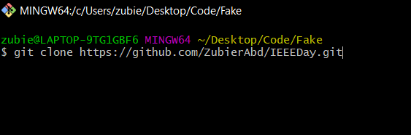
Learn by doing
git clone the forked repo to your local machine to any random folder

Slide 29
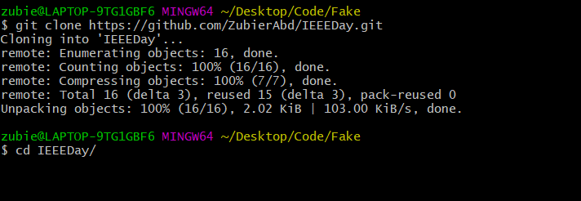
Learn by doing
cd into the folder (cd means change directory)

Slide 30
Learn by doing
git checkout –b `feature/yourname` This creates a branch named feature/yourname
Open README.md in your favourite code editor (or even notepad)
Add your name to the list and save
git status now

Slide 31
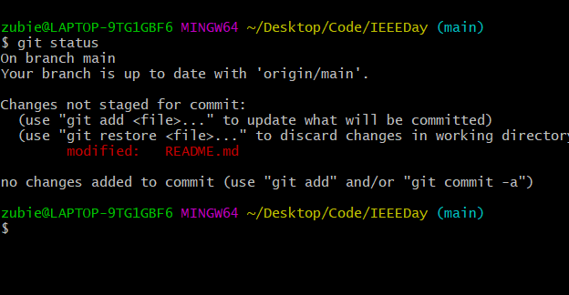
Learn by doing
git status
It will look like this

Slide 32
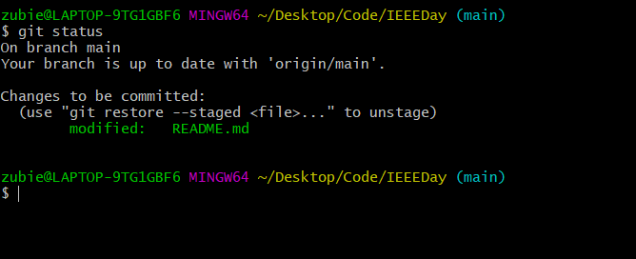
Learn by doing
git add README.md
Now git status again

Slide 33
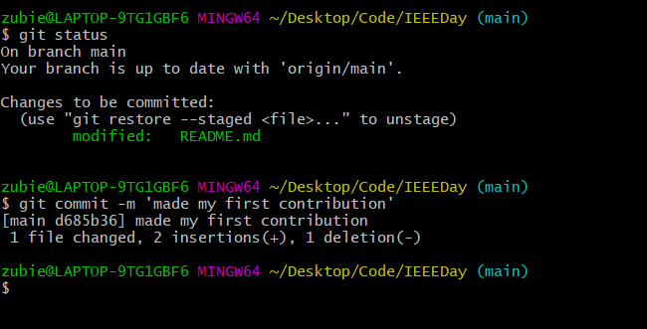
Learn by doing
git commit –m ‘some meaningful commit message’

Slide 34
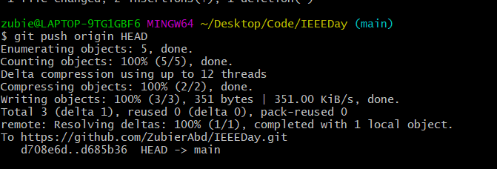
Learn by doing
Git push origin HEAD

Slide 35
Learn by doing
Go to github.com and to your repo
You will see that your changes made on the local machine will be updated on github as well
Now make a pull request to my repo and I will merge your code
Now you can brag to your friends and family

Slide 36
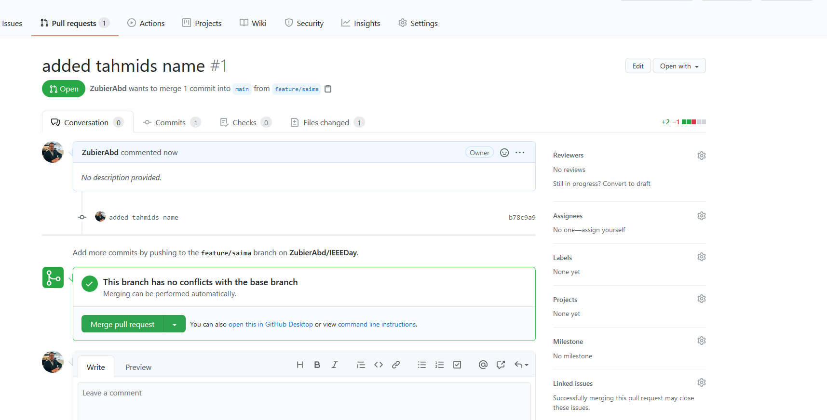
A sample pull request

Slide 37
Further Resources
Git website: http://git-scm.com/
Free on-line book: http://git-scm.com/book
Reference page for Git: http://gitref.org/index.html
Git tutorial: http://schacon.github.com/git/gittutorial.html
Link for Traversy Media guide

Slide 38
GITHUB for students also has some amazing benefits
https://education.github.com/pack
Use your north south email address and get a ton of free software and other benefits
Don’t miss out

Slide 39

Thank you
Thanks a lot for sitting through this presentation
Hopefully you’ve learned something

