Slide 1
Network Architecture

Slide 2
1
32
32
512
10

Slide 3
Appendix
Review: VGGNet — 1st Runner-Up (Image Classification), Winner (Localization) in ILSVRC 2014

Slide 4
OCC_VGG19_v1
Assistant node
Conv-64
Conv-64
Max pool
Conv-128
Conv-128
Max pool
Conv-256
Conv-256
Conv-256
Max pool
Conv-512
Conv-512
Conv-512
Max pool
Conv-512
Conv-512
Conv-512
Conv-512
Max pool
FC-512
Image
FC-10
Softmax

Slide 5
OCC_VGG19_v2
Assistant node
Conv-64
Conv-64
Max pool
Conv-128
Conv-128
Max pool
Conv-256
Conv-256
Conv-256
Max pool
Conv-512
Conv-512
Conv-512
Max pool
Conv-512
Conv-512
Conv-512
Conv-512
Max pool
FC-512
FC-10
Softmax
Image
FC-10

Slide 6
OCC_VGG19_v3
Assistant node
Softmax
Conv-64
Conv-64
Max pool
Conv-128
Conv-128
Max pool
Conv-256
Conv-256
Conv-256
Max pool
Conv-512
Conv-512
Conv-512
Max pool
Conv-512
Conv-512
Conv-512
Conv-512
Max pool
FC-512
occ
cross-entropy
Image
non-occ
FC-10
Softmax
cross-entropy

Slide 7
(s=4)
(s=4)
FC-64
(s=4)
(s=8)
Max pool
Conv-64
Max pool
FC-8
OCC_VGG19_v4_0
Conv-8
Max pool
Assistant node
Assistant node
OCC_VGG19_v4_0_3
OCC_VGG19_v4_0_6
(s=4)
(s=4)
FC-128
Max pool
Conv-128
Max pool
Assistant node
(s=4)
(s=4)
FC-32
(s=4)
(s=8)
Max pool
Conv-32
Max pool
Assistant node
Conv-4
Max pool
FC-4
Assistant node
OCC_VGG19_v4_0_2
(s=2)
(s=2)
Max pool
FC-256
Max pool
Conv-128
Max pool
Conv-256
Assistant node
OCC_VGG19_v4_0_4
OCC_VGG19_v4_0_7
(s=4)
(s=8)
FC-16
OCC_VGG19_v4_0_1
Conv-16
Max pool
Assistant node
Max pool
(s=2)
Max pool
FC-512
Max pool
Conv-128
Max pool
Conv-256
Conv-512
Assistant node
OCC_VGG19_v4_0_5
OCC_VGG19_v4_0
Conv-64
Conv-64
Max pool
Conv-128
Conv-128
Max pool
Conv-256
Conv-256
Conv-256
Max pool
Conv-512
Conv-512
Conv-512
Max pool
Conv-512
Conv-512
Conv-512
Max pool
FC-512
FC-10
Softmax
Image

Slide 8
(s=4)
(s=4)
FC-64
(s=4)
(s=8)
Max pool
Conv-64
Max pool
FC-8
OCC_VGG19_v4_0
Conv-8
Max pool
Assistant node
Assistant node
OCC_VGG19_v4_0_3
OCC_VGG19_v4_0_6
(s=4)
(s=4)
FC-128
Max pool
Conv-128
Max pool
Assistant node
(s=4)
(s=4)
FC-32
(s=4)
(s=8)
Max pool
Conv-32
Max pool
Assistant node
Conv-4
Max pool
FC-4
Assistant node
OCC_VGG19_v4_0_2
(s=2)
(s=2)
Max pool
FC-256
Max pool
Conv-128
Max pool
Conv-256
Assistant node
OCC_VGG19_v4_0_4
OCC_VGG19_v4_0_7
(s=4)
(s=8)
FC-16
OCC_VGG19_v4_0_1
Conv-16
Max pool
Assistant node
Max pool
(s=2)
Max pool
FC-512
Max pool
Conv-128
Max pool
Conv-256
Conv-512
Assistant node
OCC_VGG19_v4_0_5
OCC_VGG19_v4_0
Conv-64
Conv-64
Max pool
Conv-128
Conv-128
Max pool
Conv-256
Conv-256
Conv-256
Max pool
Conv-512
Conv-512
Conv-512
Max pool
Conv-512
Conv-512
Conv-512
Max pool
FC-512
FC-10
Softmax
Image

Slide 9
Assistant node
OCC_VGG19_v4_1
Softmax
occ
Max pool
(s=2)
Max pool
FC-512
non-occ
Conv-128
Max pool
Conv-256
Conv-512
Assistant node
Conv-64
Conv-64
Max pool
Conv-128
Conv-128
Max pool
Conv-256
Conv-256
Conv-256
Max pool
Conv-512
Conv-512
Conv-512
Max pool
Conv-512
Conv-512
Conv-512
Max pool
FC-512
FC-10
Softmax
Image

Slide 10
Assistant node
OCC_VGG19_v4_2
Softmax
occ
Max pool
(s=2)
Max pool
FC-512
non-occ
Conv-256
Conv-512
Assistant node
Conv-64
Conv-64
Max pool
Conv-128
Conv-128
Max pool
Conv-256
Conv-256
Conv-256
Max pool
Conv-512
Conv-512
Conv-512
Max pool
Conv-512
Conv-512
Conv-512
Max pool
FC-512
FC-10
Softmax
Image

Slide 11
Assistant node
OCC_VGG19_v4_3
Softmax
occ
(s=2)
Max pool
FC-512
non-occ
Conv-512
Assistant node
Conv-64
Conv-64
Max pool
Conv-128
Conv-128
Max pool
Conv-256
Conv-256
Conv-256
Max pool
Conv-512
Conv-512
Conv-512
Max pool
Conv-512
Conv-512
Conv-512
Max pool
FC-512
FC-10
Softmax
Image

Slide 12
Assistant node
OCC_VGG19_v4_light
Softmax
occ
OCC_VGG19_v4_0_5
non-occ
(s=4)
(s=8)
FC-16
Conv-16
Max pool
Assistant node
(s=2)
(s=2)
Conv-64
Conv-64
Max pool
Conv-128
Conv-128
Max pool
Conv-256
Conv-256
Conv-256
Max pool
Conv-512
Conv-512
Conv-512
Max pool
Conv-512
Conv-512
Conv-512
Max pool
FC-512
FC-10
Softmax
Image

Slide 13
Assistant node
OCC_VGG19_map_v1
Softmax
occ
non-occ
(s=2)
8
Conv-16
x
y
w
h
Regression
8
(s=2)
(s=2)
Conv-64
Conv-64
Max pool
Conv-128
Conv-128
Max pool
Conv-256
Conv-256
Conv-256
Max pool
Conv-512
Conv-512
Conv-512
Max pool
Conv-512
Conv-512
Conv-512
Max pool
FC-512
FC-10
Softmax
Image
32
32
Obstacle
Target object
input image

Slide 14
Assistant node
OCC_VGG19_map_v2
Softmax
occ
non-occ
(s=2)
8
Conv-16
8
(s=2)
(s=2)
Conv-64
Conv-64
Max pool
Conv-128
Conv-128
Max pool
Conv-256
Conv-256
Conv-256
Max pool
Conv-512
Conv-512
Conv-512
Max pool
Conv-512
Conv-512
Conv-512
Max pool
FC-512
FC-10
Softmax
Image
loss
32
32
Obstacle
Target object
input image

Slide 15
Assistant node
OCC_VGG19_map_v3
(s=2)
8
Softmax
Conv-16
8
occ
non-occ
(s=2)
8
(s=2)
(s=2)
Conv-16
Conv-16
Blur case
1. Train vgg first --->decrease loss
2. frozen vgg, train assistant ---> decrease loss
3. train vgg and assistant together
(s=2)
(s=2)
Occluded case
Conv-64
Conv-64
Max pool
Conv-128
Conv-128
Max pool
Conv-256
Conv-256
Conv-256
Max pool
Conv-512
Conv-512
Conv-512
Max pool
Conv-512
Conv-512
Conv-512
Max pool
FC-512
FC-10
Softmax
Image
loss
32
32
input image
32
Obstacle
32
Obstacle
Target object
Target object
Occluded case
Blur case

Slide 16
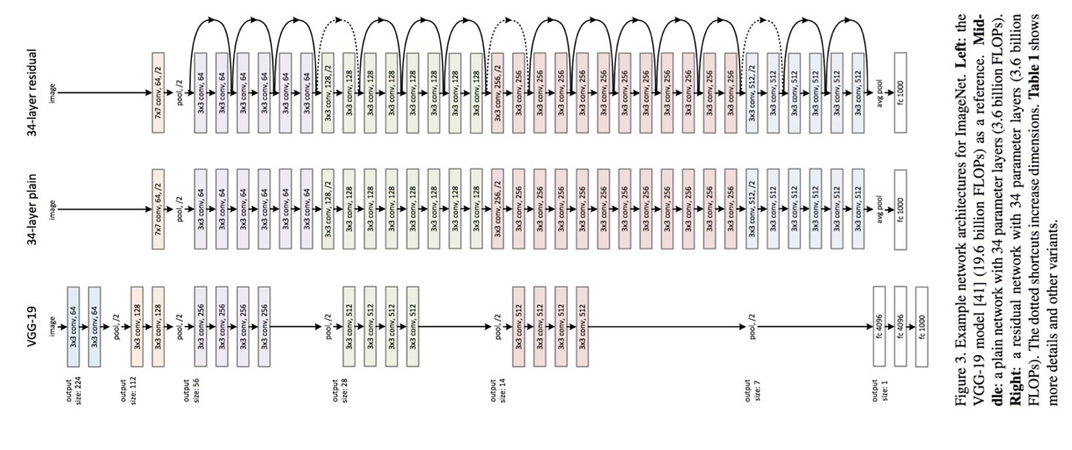
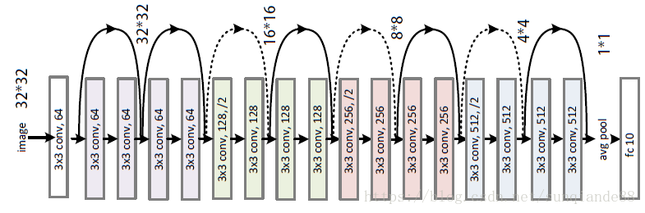
(s=2)
2
8
2
2
2
Conv-16
Conv-16
Resnet18
(s=2)
Occluded case
3
4
6
3
Resnet34

Slide 17
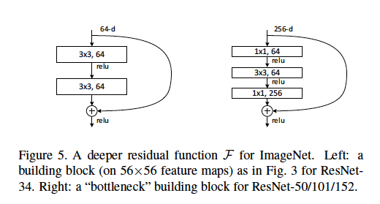
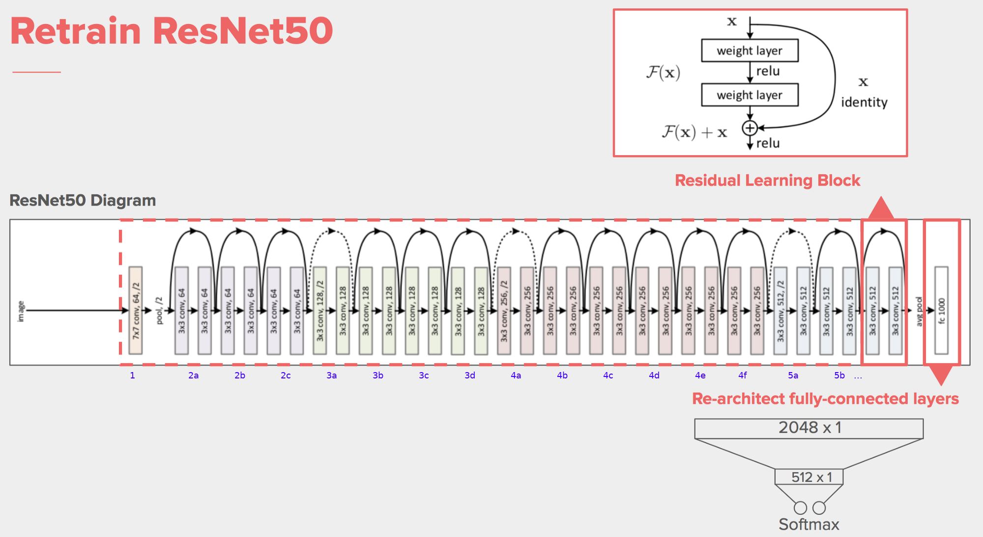
Resnet50 = Resnet34+bottleneck
3
4
6
3
Resnet34
ResNet101: ResNet(Bottleneck, [3,4,23,3])
ResNet152: ResNet(Bottleneck, [3,8,36,3])

Slide 18
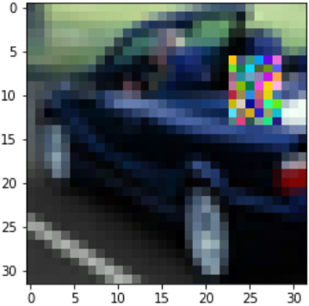
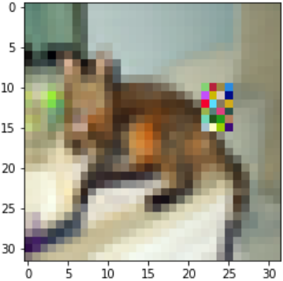
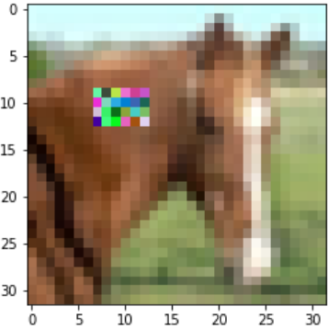
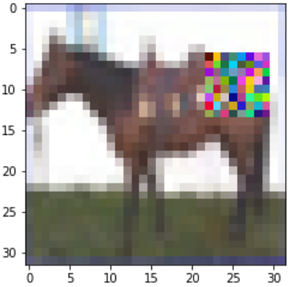
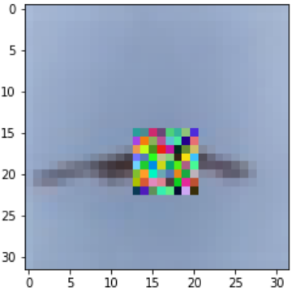
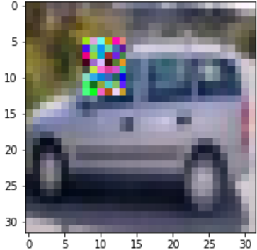
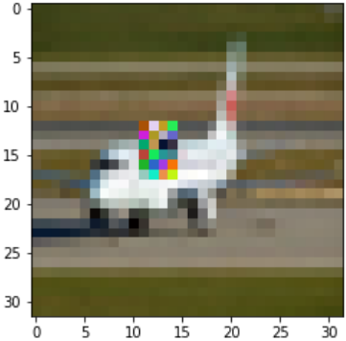
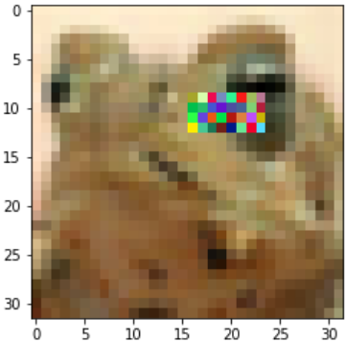

Slide 19
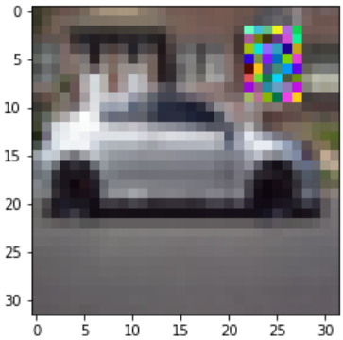
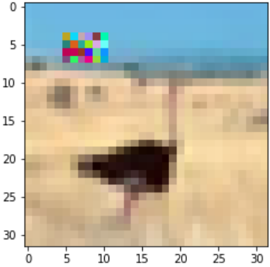
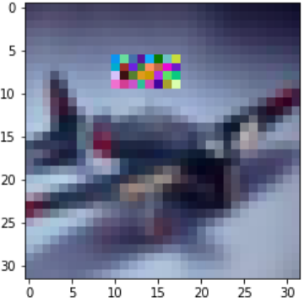

Slide 20
Experimental Result

Slide 21
file_name | Model | dataset (default: OCC_CIFAR10_average_class) | (Best Epoch) Test_Acc | Normalize_acc | Occ_Acc | loss func ratio (con, occ)
A-1 | VGG19 | / | (15) 44.01% (2-11) 43.15% (3-18) 44.67% (3-31) 44.93
A-2 | OCC_VGG19_v3 | / | (35) 47.59% (20) 47.75% |  | 99.19% 98.85% | 4.0, 1 4.0, 1
A-3 | OCC_VGG19_v4_0 | / | (27) 48.37% (58) 48.70% (71) 48.91% |  | 99.28%(first epoch:99.62% and can achieve 100%) | 4.0, 1
A-4 | OCC_VGG19_v4_0_1 | / | (21) 48.70% |  | 99.97%(first epoch:99.42% and can achieve 100%) | 4.0, 1
A-5 | OCC_VGG19_v4_0_2 | / | (31) 48.78% (61) 49.00% |  | 99.32%(first epoch:97.87% and can not achieve 100%) | 4.0, 1
A-6 | OCC_VGG19_v4_0_3 | / | (40) 47.73% (53) 48.66% |  | 99.00%(first epoch:97.24% and can not achieve 100%) 98.98% | 4.0, 1
 | OCC_VGG19_v4_0_4 | / | (26) 49.35% (32) 49.29% |  | 99.34%(first epoch:97.87% and can not achieve 100%) 99.23% | 4.0, 1
occ_vgg | OCC_VGG19_v4_0_5 | / | (37) 49.31% (62) 49.80% (67) 49.98% | (50) 49.56% | 99.05%(first epoch:97.15% and can not achieve 100%) 99.17% 98.03% | 4.0, 1
 | OCC_VGG19_v4_0_6 | / | (39) 49.63% |  | 98.94%(first epoch:97.15% and can not achieve 100%) | 4.0, 1
 | OCC_VGG19_v4_0_7 | / | (22) 45.77% (32) 46.03% (39) 45.70% |  | 99.25%(first epoch:97.57% and can not achieve 100%) 99.17% 99.36% | 4.0, 1
 | OCC_VGG19_v4_1 | / | (22) 48.32% |  | 99.96%(first epoch:99.62% and can achieve 100%) | 4.0, 1
 | OCC_VGG19_v4_2 | / | (22) 47.77% (41) 47.92% |  | 99.83%(first epoch:94.81% and can't achieve 100%) | 4.0, 1
 | OCC_VGG19_v4_3 | / | (44) 47.72 |  | (first epoch:81.43% and rise gradually ) | 4.0, 1
Epoch:50

Slide 22
OCC_VGG16_map_v3
file_name | Model | dataset (default: OCC_CIFAR10_average_class) | (Best Epoch) Test_Acc | Train_method | Learning_rate | loss func ratio (con, occ)
 | VGG16 | - | (31) 46.23% (44) 47.08% (85) 47.80% (107) 47.94% |  | 0.01
 | OCC_VGG16_v4_0_5 | - | (20) 48.98% (2-23) 49.37% (2-71) 50.10%
 | VGG16__map_v3 | - | (45) 44.83% (50) 44.96% (59) 45.22% | together | 0.01
 |  |  |  | VGG16 Assitant Together
Epoch:150

Slide 23
 | Model | dataset (default: OCC_CIFAR10_average_class) | (Best Epoch) Test_Acc | Normalize_acc | time: batch(100images) time_batch/time_epoch/time_epoch(net) | Occ_Acc | loss func ratio (con, occ)
 | ResNet18 | CIFAR10 | (78) 86.85% (82) 86.95% (125) 87.30% (130) 87.61% |  |  | train_acc can reach 100%
 | ResNet18 |  | (18)46.29% (2-8) 48.48% |  | 0.001814/1.6700/0.2150 | train_acc can reach 100% after epoch 30, test accuracy decrease repidly.
 | OCC_ResNet18_v4_0_5 | - | (27) 47.73% (76) 48.21% (90) 49.10% (126) 49.46% (149) 49.90 % | yes |  | train_acc can reach 100%, but train_occ_acc can not reach 100% after epoch 78, test accuracy > 48.5
 | OCC_ResNet18_v4_0_5 |  | (27) 47.38% (83) 48.22% (105) 49.52% (176) 50.51 % | no | 0.002065/1.560007/0.181724 0.002033/1.441478/0.178671 | train_acc can reach 100%, but train_occ_acc can not reach 100% after epoch 87, test accuracy > 49 after epoch 176, test accuracy > 50 | 4.0, 1 4.0, 1
Epoch:200

Slide 24
Random erasing paper (without random crop) ； model: VGG16_v4_0_5
file_name | Model | Train_dataset | test_dataset | Transform: Normalization | Random Crop | Flip(yes) | erasing probability | time (seconds) time_batch/time_epoch/time_epoch(net) | LR LR1：0~150: 0.1 -> 150~225: 0.01 -> 225~300: 0.001 LR2:0~150: 0.1 -> 150~165: 0.01 -> 160~300: 0.001
D-1 | ResNet20 | CIFAR10 | CIFAR10 | yes | no |  | 0.001580 | 1.126729 | 0.150087 | LR1: (83.82->91.51->92.84)
*D-2 | VGG16 | online_occ_CIFAR10 | CIFAR10 | yes |yes |  | 0.001373 | 1.143429 | 0.157021 0.001366 | 1.127112 | 0.154439 | LR1: (115)85.51 -> (158) 92.95-> (283) 94.81 LR2: (49) 84.78 -> (163)93.1 -> (295)94.3
D-3 | VGG16_v4_0_5 | online_occ_CIFAR10 | CIFAR10 | yes | no
D-4 | VGG16_v4_0_5 | online_occ_CIFAR10 | CIFAR10 | yes | yes
*D-5 | VGG16 | CIFAR10 | online_occ_CIFAR10 | yes |no |  | 0.001397 | 1.224532 | 0.159716 0.001376 | 1.111062 | 0.159240 | LR1: (125)75.36 -> (170)82.88-> (260)82.77 LR2:(121)76.09 -> (157)82.40 -> (286)82.58
*D-6 | VGG16_v4_0_5 VGG16_v4_0_5(fc_n=32) | online_occ_CIFAR10 | online_occ_CIFAR10 | yes |no yes |yes | 0.5 | 0.001586 | 1.161519 | 0.147763 0.001580 | 1.155648 | 0.149241 | LR1: (124)81.40 -> (162)90.29-> (293)91.79 LR1: (106)79.35 -> (169)90.69-> (294)93.08
*D-7 | VGG16 | online_occ_CIFAR10 | online_occ_CIFAR10 | yes |no yes |yes | 0.5 | 0.001403 | 1.171840 | 0.159959 0.001584 | 1.117327 | 0.159150 0.001408 | 1.207489 | 0.160579 | LR1: (113)81.52 -> (167)90.33-> (291)91.97 (59)82.25 -> (155)90.50-> (287)92.07 LR1: (145)80.74 -> (163)90.94-> (282)93.25
D-8 | VGG16_v4_0 | online_occ_CIFAR10 | CIFAR10 | yes | no
解决两个问题：
1. offline dataset：数据集是否正确
2. online dataset：如何在test阶段只使用一部分的网络
occ 有问题 不能被预测
本页记录，VGG16_v4_0_5太浅，换成
Epoch:200

Slide 25
Assistant node
OCC_VGG19_v4_1
Softmax
(s=4)
OCC_VGG19_v4_1_1
Conv-64
Max pool
Conv-128
Max pool
Conv-256
Max pool
Conv-512
Max pool
FC-512
Assistant node
occ
Max pool
(s=2)
Max pool
FC-512
non-occ
Conv-128
Max pool
Conv-256
Conv-512
Assistant node
Conv-64
Conv-64
Max pool
Conv-128
Conv-128
Max pool
Conv-256
Conv-256
Conv-256
Max pool
Conv-512
Conv-512
Conv-512
Max pool
Conv-512
Conv-512
Conv-512
Max pool
FC-512
FC-10
Softmax
Image

Slide 26
Random erasing paper (without random crop) ； model: VGG16_v4_0_5
file_name | Model | Train_dataset | test_dataset | Transform: Normalization | Random Crop | Flip(yes) | time (seconds) time_batch | time_epoch(net) | LR LR1：0~150: 0.1 -> 150~225: 0.01 -> 225~300: 0.001 LR2:0~150: 0.1 -> 150~165: 0.01 -> 160~300: 0.001
*D-7 (baseline) | VGG16 | online_occ_CIFAR10 | online_occ_CIFAR10 online_occ_CIFAR10_1.0 | yes |no yes |no 2 yes |yes | 0.001403 | 1.171840 | 0.159959 0.001584 | 1.117327 | 0.159150 0.001408 | 1.207489 | 0.160579 | LR1: (113)81.52 -> (167)90.33-> (291)91.97 (59)82.25 -> (155)90.50-> (287)92.07 90.68 LR1: (145)80.74 -> (163)90.94-> (282)93.25
*D-2 | VGG16 | online_occ_CIFAR10 | CIFAR10 | yes |yes | 0.001373 | 1.143429 | 0.157021 0.001366 | 1.127112 | 0.154439 | LR1: (115)85.51 -> (158) 92.95-> (283) 94.81 LR2: (49) 84.78 -> (163)93.1 -> (295)94.3
E-4 | VGG16_v4_3 | online_occ_CIFAR10 | online_occ_CIFAR10_0.5 online_occ_CIFAR10_1.0 CIFAR10 | yes |no yes |no 1 yes |no |  | 91.83 90.27 93.02
*E-5 | VGG16_v4_1 | online_occ_CIFAR10 | online_occ_CIFAR10 | yes | no | 0.002064 | 0.222304 | 91.72
*E-6 | VGG16_v4_1_1 | online_occ_CIFAR10 | online_occ_CIFAR10 | yes |no yes |yes | 0.001973 | 0.219315 0.001998 | 0.216026 | LR1:92.01 LR1:92.91
E-8 | VGG16_v4_1 | online_occ_CIFAR10 | CIFAR10 | yes | no | 0.001973 | 0.216578 | 93.54
Epoch:200

Slide 27
Resnet18
Conv-64
Conv-64
Max pool
Conv-128
Conv-128
Max pool
Conv-256
Conv-256
Conv-256
Max pool
Conv-512
Conv-512
Conv-512
Max pool
Conv-512
Conv-512
Conv-512
Conv-512
Max pool
FC-512
FC-10
Softmax
Image
(s=2)
2
8
Conv-16
Conv-16
(s=2)
2
2
2
Occluded case

Slide 28
Resnet18_map: train separately
file_name | train separately | Model | Train_dataset | test_dataset | Transform: Normalization | Random Crop | Flip(yes) | time (seconds) time_batch | time_epoch(net) | LR LR：0~150: 0.1 -> 150~225: 0.01 -> 225~300: 0.001
*F-1 (baseline) | no | Resnet18 Resnet34 Resnet50 | CIFAR10 CIFAR10 CIFAR10 | CIFAR10 CIFAR10 CIFAR10 | yes |yes(0.5,0) yes |yes(0.5,0) yes |yes(0.5,0) | 0.002009 | 3.338554 | 0.218680 0.003911 | 2.893080 | 0.350090 0.004534 | 5.410649 | 0.465354 | 96.16 96.34 96.08
*F-2 (baseline) | yes(block1) | Resnet18 | CIFAR10 | CIFAR10
Epoch:200

Slide 29
Pics for paper

Slide 30
Conv-64
Conv-64
Max pool
Conv-128
Conv-128
Max pool
Conv-256
Conv-256
Conv-256
Max pool
Conv-512
Conv-512
Conv-512
Max pool
Conv-512
Conv-512
Conv-512
Conv-512
Max pool
FC-512
FC-10
Softmax
Image
(a) VGG19
Assistant node
Conv-64
Conv-64
Max pool
Conv-128
Conv-128
Max pool
Conv-256
Conv-256
Conv-256
Max pool
Conv-512
Conv-512
Conv-512
Max pool
Conv-512
Conv-512
Conv-512
Conv-512
Max pool
FC-512
Image
FC-10
Softmax
(b ) OCC_VGG19_v1
Assistant node
FC-10
Softmax
Conv-64
Conv-64
Max pool
Conv-128
Conv-128
Max pool
Conv-256
Conv-256
Conv-256
Max pool
Conv-512
Conv-512
Conv-512
Max pool
Conv-512
Conv-512
Conv-512
Conv-512
Max pool
FC-512
Image
FC-10
(c ) OCC_VGG19_v2

Slide 31
Ablation Experiment
再做一组实验，用occluded dataset 训练过的model来test on 原始 CIFAR0，看看是否会提高accuracy，毕竟occluded就等于random crop的data agumentation了，应该会提高

Slide 32
idea
人是先看整体后看细节，所以前期的kernel_size大，深层kernel_size小，这样的Neural Network的效果会如何？
生成怎样的feature map使图片易于被分类，可将image分成8*8大小的格子，格子中数据为概率，（使用Deformable ConvNet）的思想，生成格子里的数据。

Slide 33
-1: 人是先看整体后看细节，所以感受野的大，深层感受野小，这样的Neural Network的效果会如何？
Conv-64
Conv-64
Max pool
Conv-128
Conv-128
Max pool
Conv-256
Conv-256
Conv-256
Max pool
Conv-512
Conv-512
Conv-512
Max pool
Conv-512
Conv-512
Conv-512
Conv-512
Max pool
FC-512
FC-10
Softmax
Image
(a) VGG19
64
128
32
number of kernel
256
512
512
8
8
32
32
32
16
16
8
16
64
128
32
16
16
32
128
DeConvNet
Pooling

Slide 34
-2: 人是先看整体后看细节，所以感受野的大，深层感受野小，这样的Neural Network的效果会如何？
Conv-64
Conv-64
Max pool
Conv-128
Conv-128
Max pool
Conv-256
Conv-256
Conv-256
Max pool
Conv-512
Conv-512
Conv-512
Max pool
Conv-512
Conv-512
Conv-512
Max pool
FC-512
FC-10
Softmax
Image
(a) VGG16
64
128
32
256
512
512
number of kernel
8
32
32
16
16
+
32
16
DeConvNet
Pooling

Slide 35
-3: 人是先看整体后看细节，所以感受野的大，深层感受野小，这样的Neural Network的效果会如何？
Conv-64
Conv-64
Max pool
Conv-128
Conv-128
Max pool
Conv-256
Conv-256
Conv-256
Max pool
Conv-512
Conv-512
Conv-512
Max pool
Conv-512
Conv-512
Conv-512
Max pool
FC-512
FC-10
Softmax
Image
(a) VGG16
64
128
32
number of kernel
256
512
512
DeConvNet
Pooling

Slide 36
Idea 1: experiment result
 | Model | dataset (default: OCC_CIFAR10_average_class) | (Best Epoch) Test_Acc | Top 2 | loss func ratio (con, occ)
 | VGG16 | CIFAR10 | (30) 84.72% (89) 84.91% (107) 84.93% (132) 85.47% | 93.93% 93.63%
 | VGG19 | / | (21) 83.39% (32) 84.70% | 93.01% 98.85%
 | VGG16_scale | / | (97) 84.44% (151) 85.42%
 | OCC_VGG19_v4_0_1 | / | (21) 48.70% | 99.97%(first epoch:99.42% and can achieve 100%)
 | OCC_VGG19_v4_0_2 | / | (31) 48.78% (61) 49.00% | 99.32%(first epoch:97.87% and can not achieve 100%)
 | OCC_VGG19_v4_0_3 | / | (40) 47.73% (53) 48.66% | 99.00%(first epoch:97.24% and can not achieve 100%) 98.98%
 | OCC_VGG19_v4_0_4 | / | (26) 49.35% (32) 49.29% | 99.34%(first epoch:97.87% and can not achieve 100%) 99.23%
 | OCC_VGG19_v4_0_5 | / | (37) 49.31% (62) 49.80% (67) 49.98% | 99.05%(first epoch:97.15% and can not achieve 100%) 99.17% 98.03%
 | OCC_VGG19_v4_0_6 | / | (39) 49.63% | 98.94%(first epoch:97.15% and can not achieve 100%)
 | OCC_VGG19_v4_0_7 | / | (22) 45.77% (32) 46.03% (39) 45.70% | 99.25%(first epoch:97.57% and can not achieve 100%) 99.17% 99.36%
 | OCC_VGG19_v4_1 | / | (22) 48.32% | 99.96%(first epoch:99.62% and can achieve 100%)
 | OCC_VGG19_v4_2 | / | (22) 47.77% (41) 47.92% | 99.83%(first epoch:94.81% and can't achieve 100%)
 | OCC_VGG19_v4_3 | / | (44) 47.72 | (first epoch:81.43% and rise gradually )

