Slide 1
Network Architecture

Slide 2
1
32
32
512
10

Slide 3
Appendix
Review: VGGNet — 1st Runner-Up (Image Classification), Winner (Localization) in ILSVRC 2014

Slide 4
OCC_VGG19_v1
Assistant node
Conv-64
Conv-64
Max pool
Conv-128
Conv-128
Max pool
Conv-256
Conv-256
Conv-256
Max pool
Conv-512
Conv-512
Conv-512
Max pool
Conv-512
Conv-512
Conv-512
Conv-512
Max pool
FC-512
Image
FC-10
Softmax

Slide 5
OCC_VGG19_v2
Assistant node
Conv-64
Conv-64
Max pool
Conv-128
Conv-128
Max pool
Conv-256
Conv-256
Conv-256
Max pool
Conv-512
Conv-512
Conv-512
Max pool
Conv-512
Conv-512
Conv-512
Conv-512
Max pool
FC-512
FC-10
Softmax
Image
FC-10

Slide 6
OCC_VGG19_v3
Assistant node
Softmax
Conv-64
Conv-64
Max pool
Conv-128
Conv-128
Max pool
Conv-256
Conv-256
Conv-256
Max pool
Conv-512
Conv-512
Conv-512
Max pool
Conv-512
Conv-512
Conv-512
Conv-512
Max pool
FC-512
occ
cross-entropy
Image
non-occ
FC-10
Softmax
cross-entropy

Slide 7
Assistant node
(s=4)
(s=4)
FC-64
Max pool
Conv-64
Max pool
OCC_VGG19_v4_0
Assistant node
Softmax
occ
(s=4)
(s=2)
(s=2)
OCC_VGG19_v4_0_3
non-occ
(s=4)
FC-128
Max pool
Conv-128
Max pool
Assistant node
OCC_VGG19_v4_0_2
(s=4)
(s=4)
Max pool
Conv-32
Max pool
FC-32
Assistant node
(s=2)
(s=2)
Max pool
FC-256
Max pool
Conv-128
Max pool
Conv-256
Assistant node
OCC_VGG19_v4_0_1
(s=2)
(s=2)
OCC_VGG19_v4_0_4
Max pool
(s=2)
Max pool
FC-512
Max pool
Conv-128
Max pool
Conv-256
Conv-512
Assistant node
OCC_VGG19_v4_0
Conv-64
Conv-64
Max pool
Conv-128
Conv-128
Max pool
Conv-256
Conv-256
Conv-256
Max pool
Conv-512
Conv-512
Conv-512
Max pool
Conv-512
Conv-512
Conv-512
Max pool
FC-512
FC-10
Softmax
Image

Slide 8
Assistant node
OCC_VGG19_v4_1
Softmax
occ
Max pool
(s=2)
Max pool
FC-512
non-occ
Conv-128
Max pool
Conv-256
Conv-512
Assistant node
Conv-64
Conv-64
Max pool
Conv-128
Conv-128
Max pool
Conv-256
Conv-256
Conv-256
Max pool
Conv-512
Conv-512
Conv-512
Max pool
Conv-512
Conv-512
Conv-512
Max pool
FC-512
FC-10
Softmax
Image

Slide 9
Assistant node
OCC_VGG19_v4_2
Softmax
occ
Max pool
(s=2)
Max pool
FC-512
non-occ
Conv-256
Conv-512
Assistant node
Conv-64
Conv-64
Max pool
Conv-128
Conv-128
Max pool
Conv-256
Conv-256
Conv-256
Max pool
Conv-512
Conv-512
Conv-512
Max pool
Conv-512
Conv-512
Conv-512
Max pool
FC-512
FC-10
Softmax
Image

Slide 10
Assistant node
OCC_VGG19_v4_3
Softmax
occ
(s=2)
Max pool
FC-512
non-occ
Conv-512
Assistant node
Conv-64
Conv-64
Max pool
Conv-128
Conv-128
Max pool
Conv-256
Conv-256
Conv-256
Max pool
Conv-512
Conv-512
Conv-512
Max pool
Conv-512
Conv-512
Conv-512
Max pool
FC-512
FC-10
Softmax
Image

Slide 11
Assistant node
OCC_VGG19_v4_light
Softmax
occ
(s=2)
Max pool
FC-512
non-occ
Conv-512
Assistant node
Conv-64
Conv-64
Max pool
Conv-128
Conv-128
Max pool
Conv-256
Conv-256
Conv-256
Max pool
Conv-512
Conv-512
Conv-512
Max pool
Conv-512
Conv-512
Conv-512
Max pool
FC-512
FC-10
Softmax
Image

Slide 12
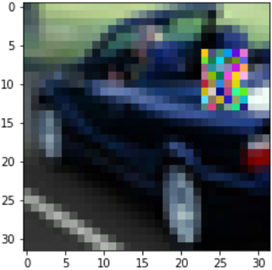
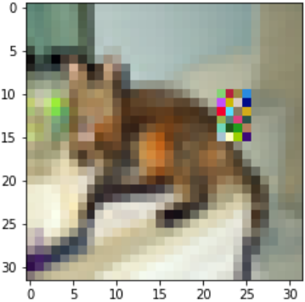
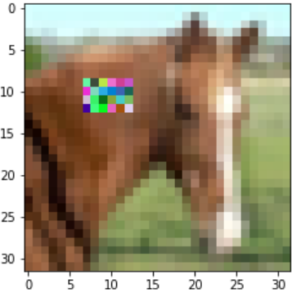
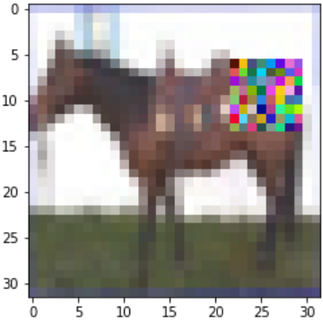
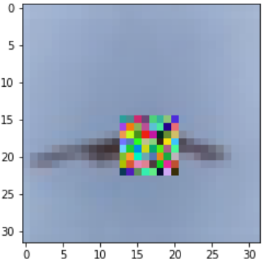
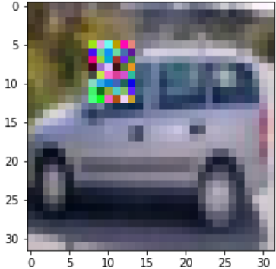
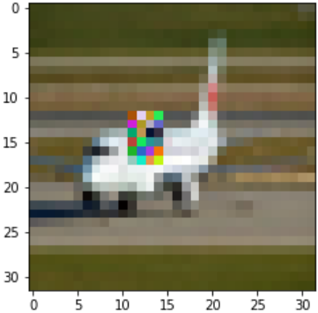
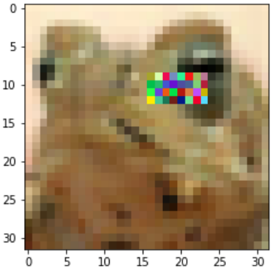

Slide 13
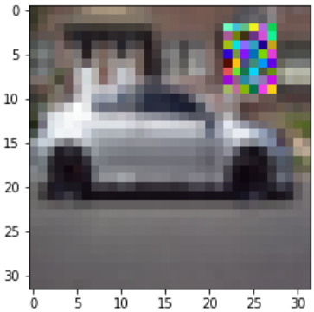
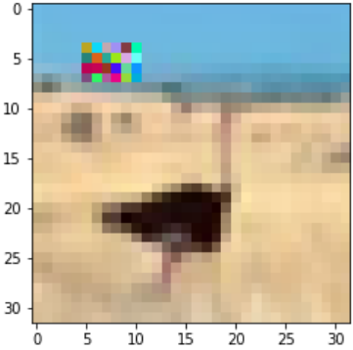
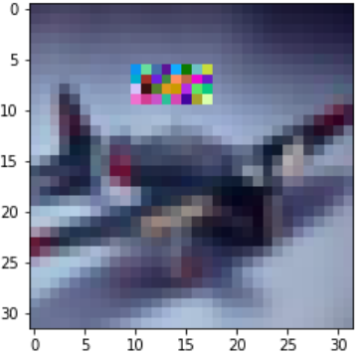

Slide 14
Experimental Result

Slide 15
 | Model | dataset (default: OCC_CIFAR10_average_class) | (Best Epoch) Test_Acc | Occ_Acc | loss func ratio (con, occ)
 | VGG19 | / | (15) 44.01%
 | OCC_VGG19_v3 | / | (35) 47.59% (20) 47.75% | 99.19% 98.85% | 4.0, 1 4.0, 1
 | OCC_VGG19_v4_0 | / | (27) 48.37% (58) 48.70% (71) 48.91% | 99.28%(first epoch:99.62% and can achieve 100%) | 4.0, 1
 | OCC_VGG19_v4_0_1 | / | (21) 48.70% | 99.97%(first epoch:99.42% and can achieve 100%) | 4.0, 1
 | OCC_VGG19_v4_0_2 | / | (31) 48.78% (61) 49.00% | 99.32%(first epoch:97.87% and can not achieve 100%) | 4.0, 1
 | OCC_VGG19_v4_0_3 | / | (40) 47.73% (53) 48.66% | 99.00%(first epoch:97.24% and can not achieve 100%) 98.98% | 4.0, 1
 | OCC_VGG19_v4_0_4 | / | (26) 49.35% (32) 49.29% | 99.34%(first epoch:97.87% and can not achieve 100%) 99.23%
 | OCC_VGG19_v4_1 | / | (22) 48.32% | 99.96%(first epoch:99.62% and can achieve 100%) | 4.0, 1
 | OCC_VGG19_v4_2 | / | (22) 47.77% (41) 47.92% | 99.83%(first epoch:94.81% and can't achieve 100%) | 4.0, 1
 | OCC_VGG19_v4_3 | / | (44) 47.72 | (first epoch:81.43% and rise gradually )
Epoch:50

Slide 17
Pics for paper

Slide 18
Conv-64
Conv-64
Max pool
Conv-128
Conv-128
Max pool
Conv-256
Conv-256
Conv-256
Max pool
Conv-512
Conv-512
Conv-512
Max pool
Conv-512
Conv-512
Conv-512
Conv-512
Max pool
FC-512
FC-10
Softmax
Image
(a) VGG19
Assistant node
Conv-64
Conv-64
Max pool
Conv-128
Conv-128
Max pool
Conv-256
Conv-256
Conv-256
Max pool
Conv-512
Conv-512
Conv-512
Max pool
Conv-512
Conv-512
Conv-512
Conv-512
Max pool
FC-512
Image
FC-10
Softmax
(b ) OCC_VGG19_v1
Assistant node
FC-10
Softmax
Conv-64
Conv-64
Max pool
Conv-128
Conv-128
Max pool
Conv-256
Conv-256
Conv-256
Max pool
Conv-512
Conv-512
Conv-512
Max pool
Conv-512
Conv-512
Conv-512
Conv-512
Max pool
FC-512
Image
FC-10
(c ) OCC_VGG19_v2

Slide 19
idea
人是先看整体后看细节，所以前期的kernel_size大，深层kernel_size小，这样的Neural Network的效果会如何？

Slide 20
人是先看整体后看细节，所以前期的kernel_size大，深层kernel_size小，这样的Neural Network的效果会如何？
Conv-64
Conv-64
Max pool
Conv-128
Conv-128
Max pool
Conv-256
Conv-256
Conv-256
Max pool
Conv-512
Conv-512
Conv-512
Max pool
Conv-512
Conv-512
Conv-512
Conv-512
Max pool
FC-512
FC-10
Softmax
Image
(a) VGG19
32
Resize
32
8
16
Resize
DeConvNet
32
8
16

