Slide 1
Media-Online Management (MOM)
SW701
Jens Mikkel Lauridsen, Johan Sørensen, Tommy Knudsen, Lisbeth Nielsen, Jakob Jørgensen and Lars Chr. Pedersen

Slide 2
Too much media
Danish Health Department
2,47
1,57

Slide 3
It can lead to
Sleep deprivation
Lack of physical exercise
Type 2 diabetes
Concentration issues

Slide 4
Problem Statment
Parents are not able to help their children administer their IT/TV consumption. This results in their children getting a lessened learning ability, a bad sleeping pattern and a higher risk of type 2 diabetes. How can hardware identification and webservices give parents the tools to help their children manage their media consumption?
To address this problem, we face the following technical challenges:
How do we identify unique users in a subtle and child friendly way.
How do we enforce restrictions on media devices.
How do we facilitate concepts as rules, permissions and chores without parents interaction.

Slide 5
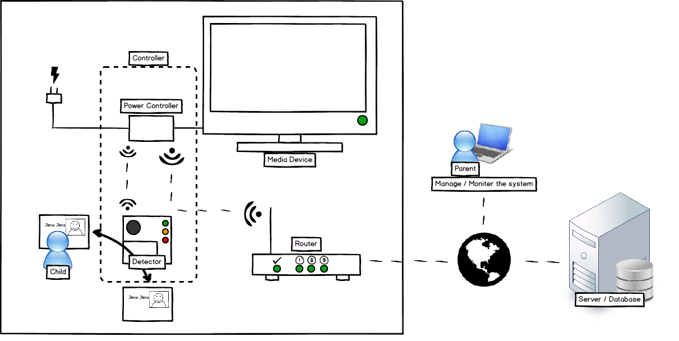
MOM an Overview

