Slide 1
Rules in The System
The rule concept
Real life rules
A child is grounded
A child are only allowed to watch TV from 16:00-19:00
A child get an allowance (in points) in the beginning of each month or week.
Parents must have access to any media, any time

Slide 2
Current Construction of a Rule
<Rule>:= <name>(
| (<ActionsetSet1><ConditionSet1>)*
…
| (<ActionsetSet5><ConditionSet5>)*)
<ActionsetSet5> := ("Access controller" | "Cannot access controller") <Controller>
<ConditionSet5> := <ConditionTimeperiod>
|<ConditionTrue> | <ConditionElse>
<ConditionElse>:= ("Device on" | "Device off") <Controller>

Slide 3
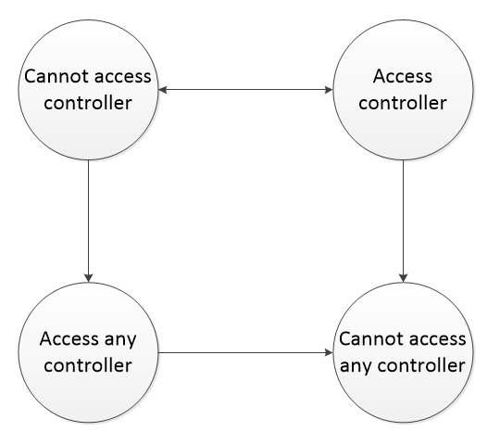
Rules can conflict - precedence
Precendence over Cannot access controller and Access controller depends on the Condition
Notes:
Timeperiod over true
Timeperiod non-repeat over repeatable
If both the same then access controller

Slide 4
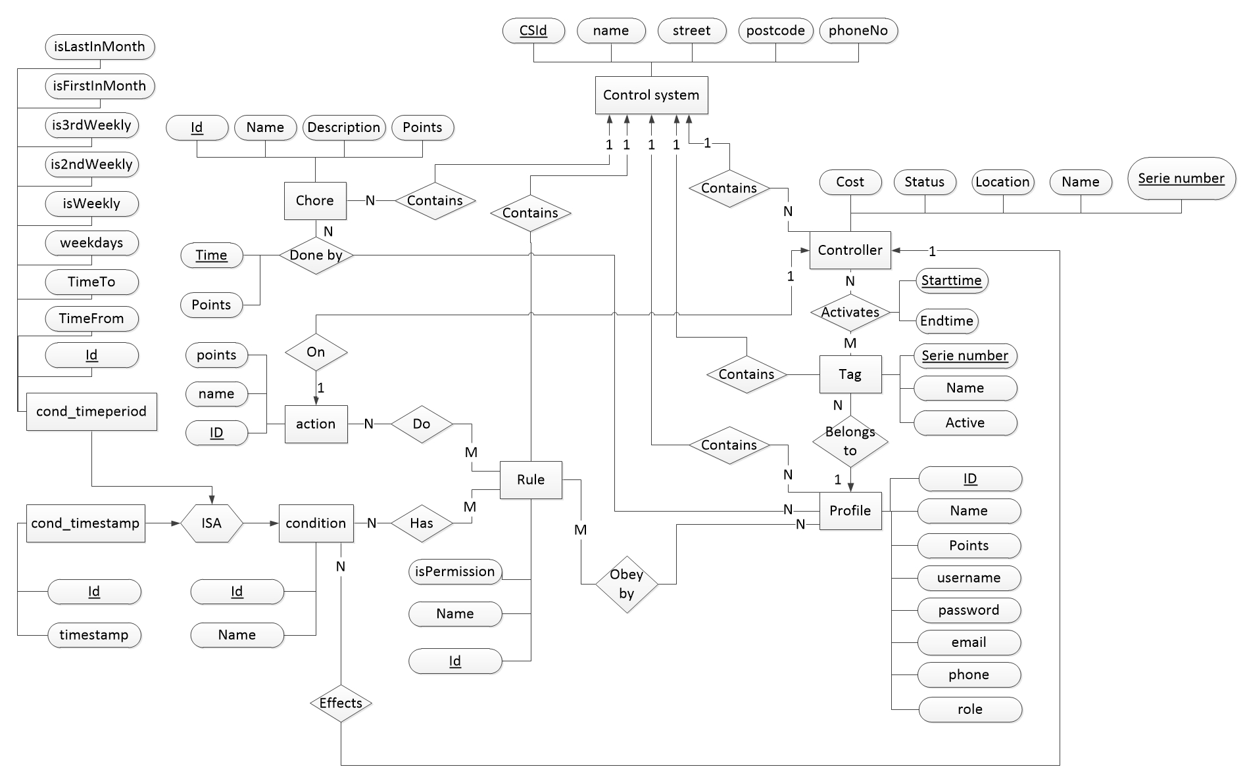
Rules in the Database

Slide 5
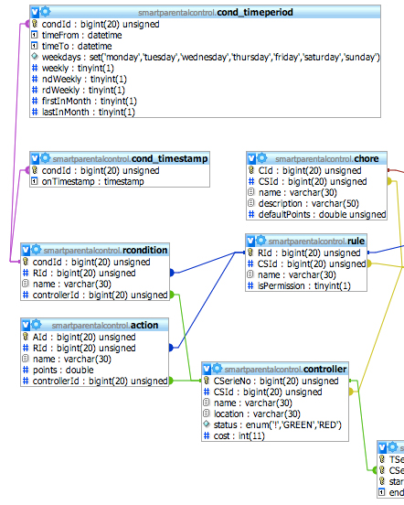
Rules in the Database
Mapping rules using partitioning
Notes:
Using main classes (repeat attributes)
Using partitioning, (the one used)
Using partitioning, (like 1. but all tubles is in cond -reduncancy attributes in the tables)
Using single relation, all attributes in one relation – alot of null values

Slide 6
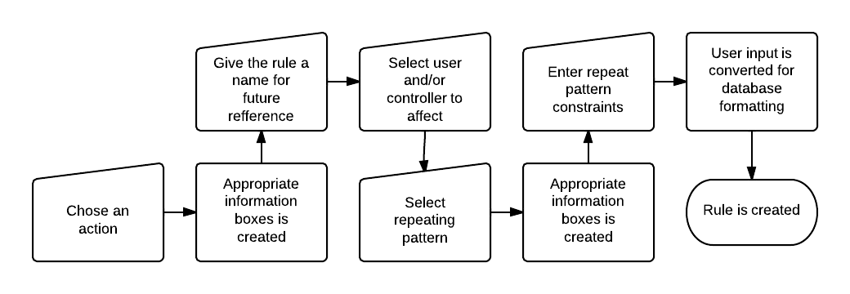
Rule in the WEB Interface

Slide 7
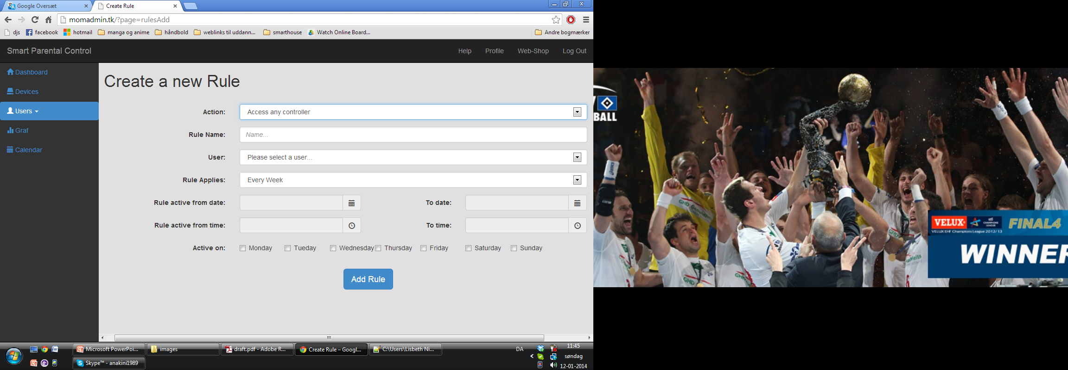
Rule in the WEB Interface

Slide 8
Rule design in the future
Rule design to the drawing board again
All rules should have atleast a start date
Consider further whether multiple conditions and actions should be allowed or not
Rule overlapping
Should it still be allowed to make sevaral overlapping rules?
Make the user aware when he makes an overlapping rule

