Slide 1
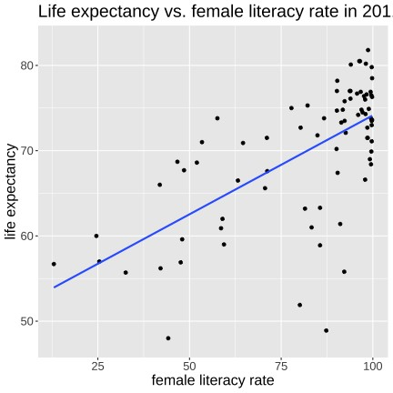
Association between two variables
b
We want to find:
Is there a linear association between x and y?
If so, what is the linear equation that best represents it?
y = mx + c
Unknowns are the line intercept (b)
and the line slope (m)
Correlation is not causation
https://medium.com/data-science/linear-regression-using-gradient-descent-97a6c8700931

Slide 2
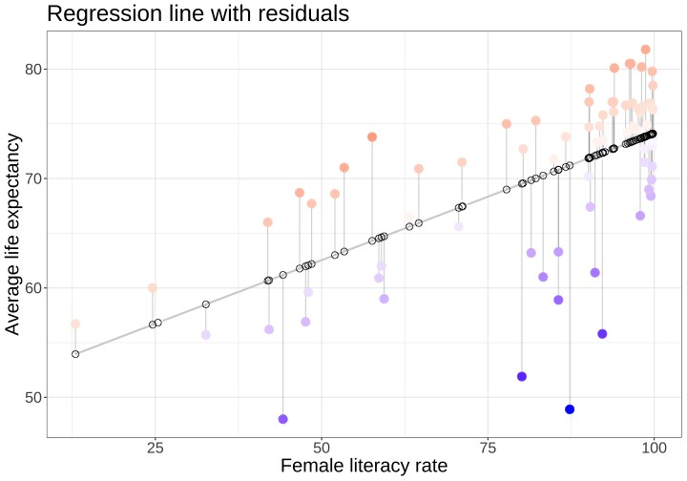


Finding the Line of Best Fit
residuals
To find the best-fit line → Minimize Residuals

Slide 3

How good is the correlation?
$$R^{2}= \frac{\text{variance} \text{of} \text{predicted} \text{values}}{\text{variance} \text{of} \text{observed} \text{values}}$$

Slide 4
https://towardsdatascience.com/creating-animation-to-show-4-centroid-based-clustering-algorithms-using-python-and-sklearn-d397ade89cb3/

