Slide 1

GitHub Copilot
AI Augmented Software Engineering
Zühlke | 17.3.2026 | Zürich

Slide 2




Our Coaches
Intro
AI Augmented Software Engineering @ Zühlke
  Jonathan Ziller
Principal Software Architect
jonathan.ziller@zuehlke.com
  Marco Romanutti
Lead Software Architect
marco.romanutti@zuehlke.com
  Lukas Grigis
Lead Software Architect
lukas.grigis@zuehlke.com

Slide 3

GitHub Copilot
Intro
Training @ Flughafen Zürich

Slide 4
GitHub Copilot Training
Intro
Training @ Flughafen Zürich
  Goals
Enable software engineers to fully leverage GitHub Copilot for enhanced productivity and innovation while maintaining best practices and quality.
  Target Audience
Software and Data Engineers who are actively coding and seek for guidance on how to leverage GitHub Copilot in their daily work.
  Approach
We focus on helping you understand the tools and concepts behind GitHub Copilot.
We are convinced that great engineers should not only be able to apply tools, but also truly master them.
We will
start with a baseline of intuitive Copilot usage
introduce concepts and methods for a more structured way of working with GitHub Copilot
Through demos, guided examples, and hands-on labs, you will have the opportunity to apply what you learn right away. You can find our repo here: https://github.com/Zuehlke/github-copilot-training
2026
© Zühlke

Slide 6

Demo:
Introducing GitHub Copilot and our Flight-Delay API
Notes:
Repo
Rough Structure
API Endpoints
Demo Data
Things to show regarding GitHub Copilot in PyCharm
Context Menu
Inline Chat
Chat Window
Chat Modes

Slide 7


  LAB: Vibe Coding
  Context
We are going to build an application that displays flight delays.
You are given an initial Python project that starts successfully but does not yet expose the required REST endpoints.
Familiarize yourself with the repo using GitHub Copilot and implement the endpoints described on the right.
  Your Task
Checkout the branch lab/vibe-coding and implement the following endpoints:
GET /delays?airline_code=AA&limit=50
→ returns 200 OK or 404 Not Found
  Tipps & Tricks
Use GitHub Copilot. If you are working in your IDE you can try out the different modes.
Notes:
Question to ask:
Does the application start? Does the endpoint work? Does the test run through?
Which mode did you use?
Did it add anything that you did not ask for?
E.g. Cache?
Did it make any assumptions? E.g.
Should 404 be returned when filters match zero records, or only when the data source itself is unavailable/empty?
What is the canonical mapping for airline_code (e.g., AA) to stored data?
Should response be a raw JSON array or an object (e.g., {"items":[...], "count": n})?
What are limit rules: default value, min, and max?
Should airline_code matching be case-insensitive?
What sort order should results use (e.g., created_at descending, scheduled time ascending, or file order)?
Did it use pydantic for your models?
Did it write tests?
Are the test method names what you would expect? Is the naming consistent?
Did it format the files correctly?
Would you ship that code to pod?
Confidence Vote?

Slide 8

Theoretical Foundation

Slide 9
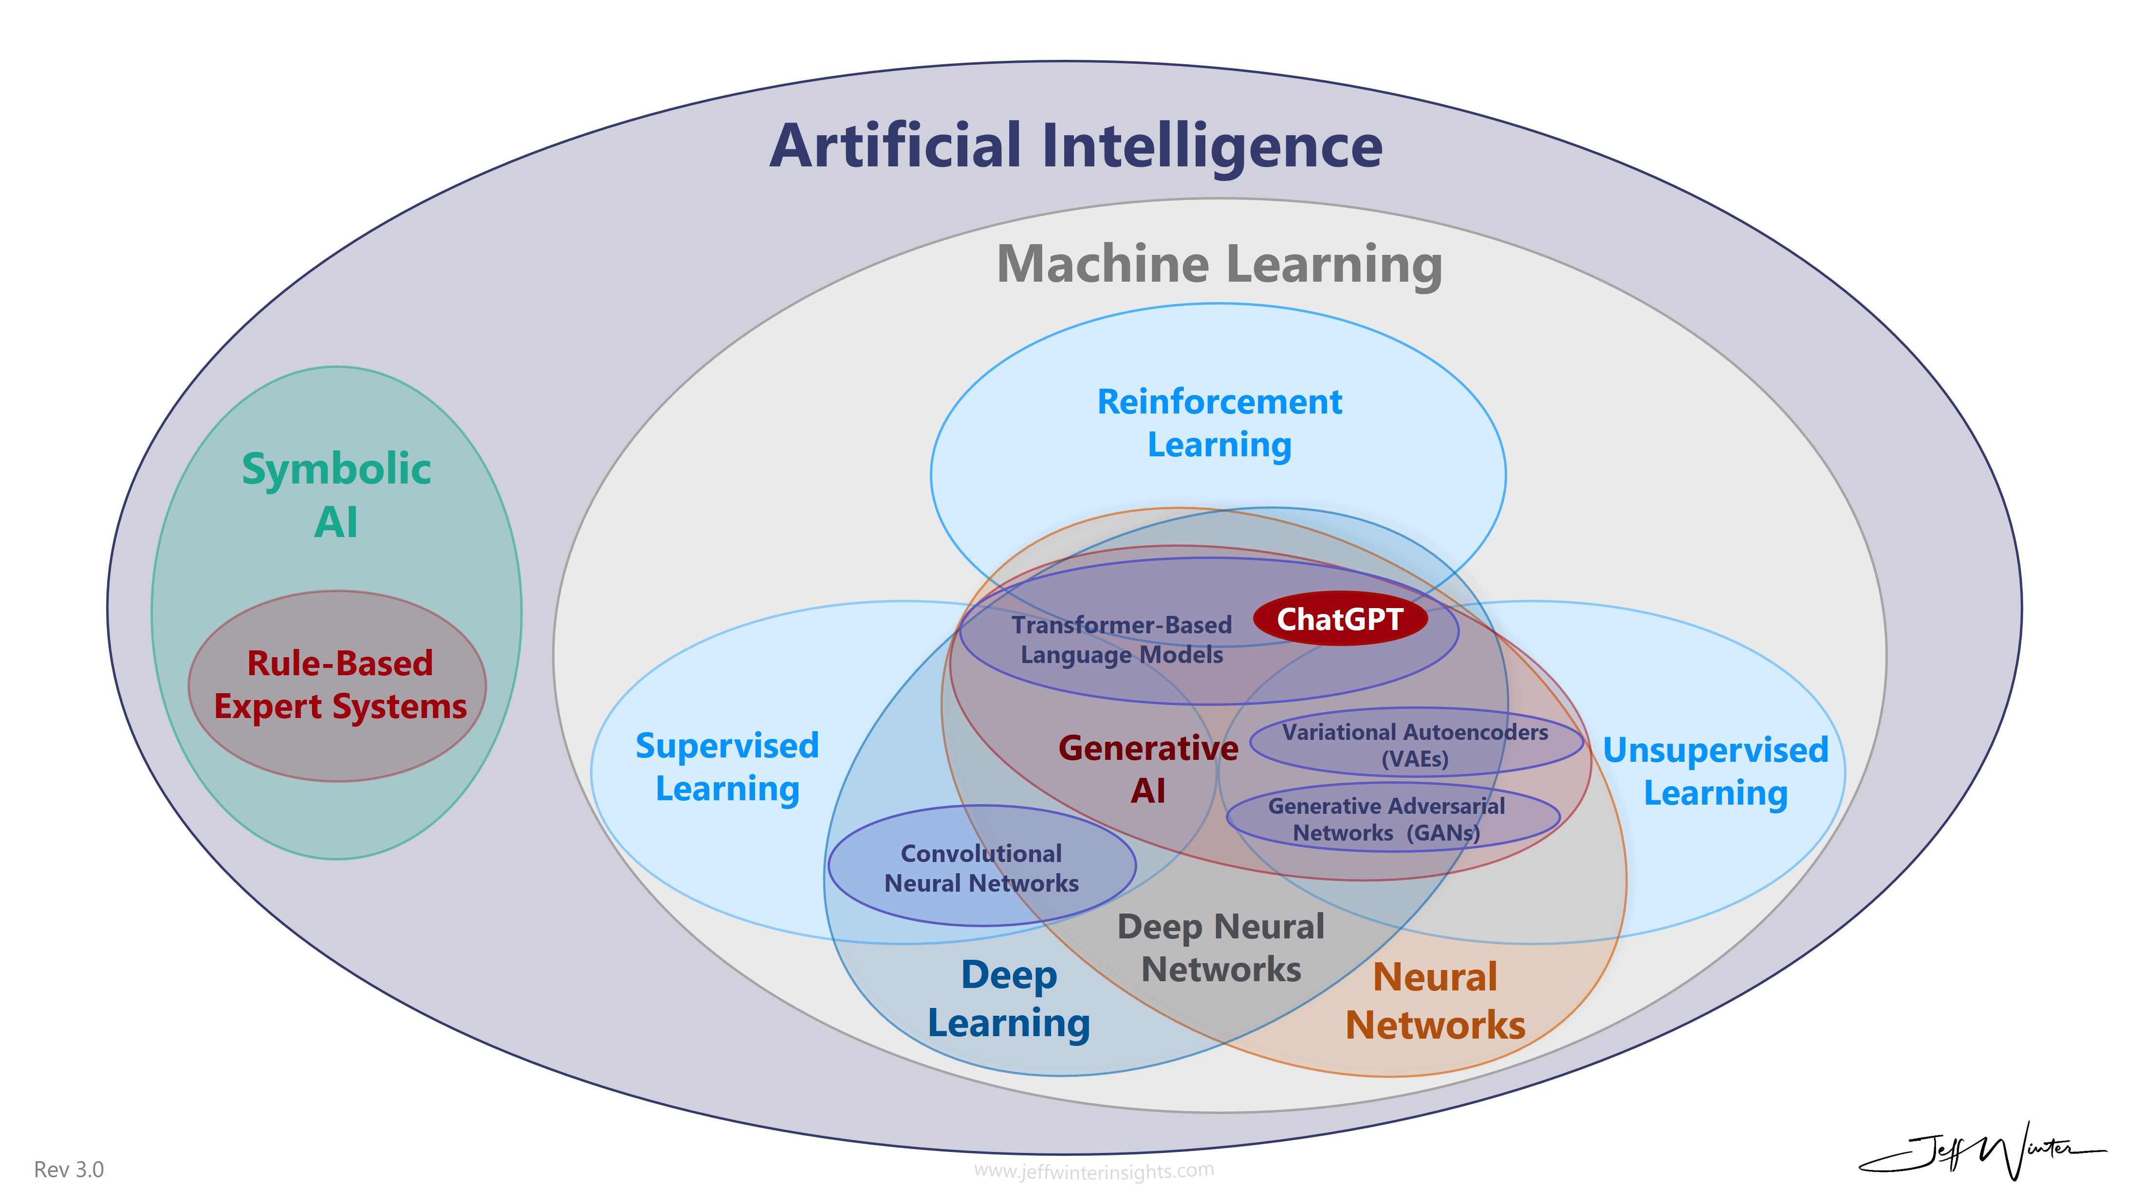
AI is not only LLM
Theoretical Foundation
    Supervised Learning
    Learns from labeled data (input → correct output) to make predictions or classifications; used for tasks like classification, regression, and fine-tuning AI systems with human guidance.
    Unsupervised Learning
    Learns from unlabeled data to discover hidden patterns, structures, or clusters; forms the foundation of many models (including LLM pre-training).
    Reinforcement Learning
    Learns through trial and error with rewards/penalties, optimizing decisions over time; often used to align AI behavior with human preferences (e.g., feedback-based tuning).
    Source: https://www.jeffwinterinsights.com/insights/chatgpt-venn-diagram

Slide 10
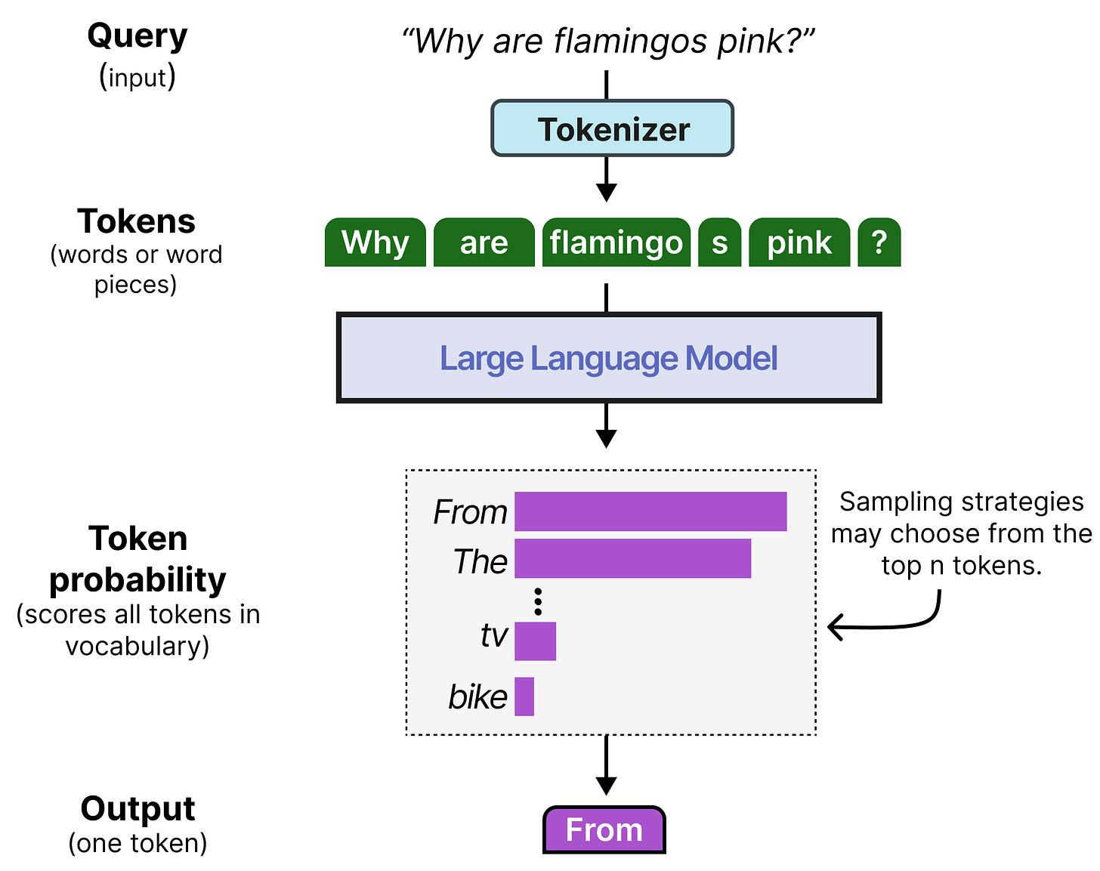
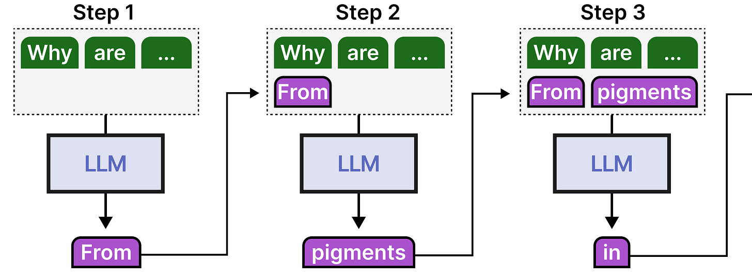
Large Language Model (LLM)
Theoretical Foundation
Basic Terminology
    What is a LLM?
A large language model (LLM) is a transformer-based neural network trained to predict the next token in a text sequence. For any given input text sequence, it computes a probability distribution over all possible next tokens, from which one token is sampled.
By repeating that step token by token, we can mimic conversations:
    Source: An Illustrated Guide to AI Agents, Maarten Grootendorst, Jay Alammar (2026)

Slide 11
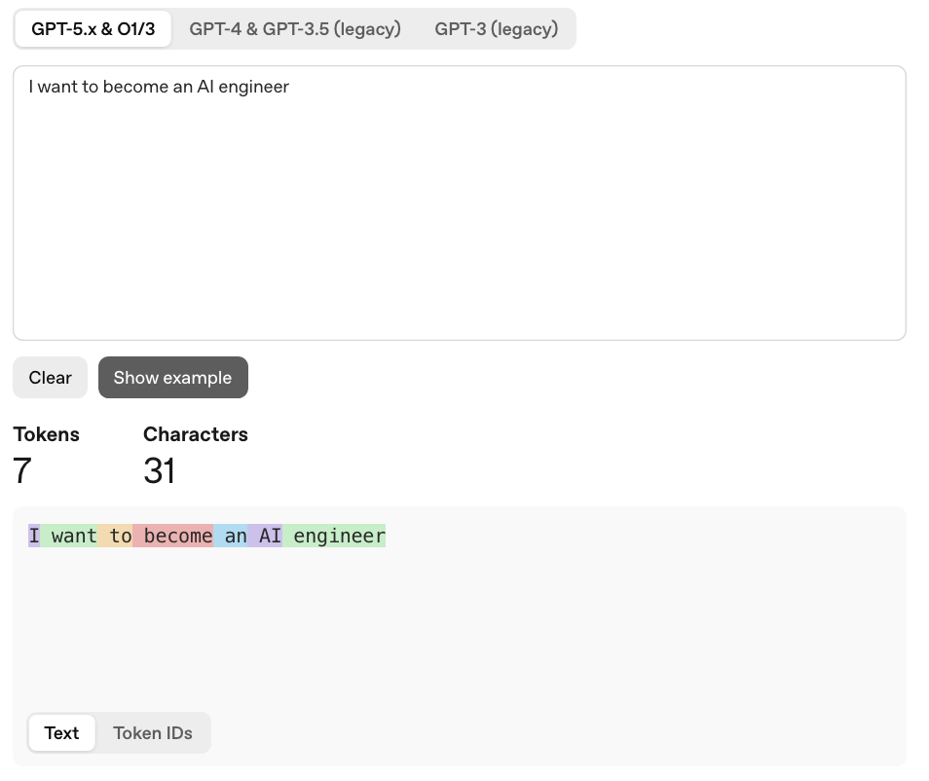
Large Language Model (LLM)
Theoretical Foundation
Tokens
    What is a Token?
Before a prompt is processed by a language model, it is passed through a tokenizer that splits the text into tokens. A token is the smallest unit a model operates on and may represent a full word, part of a word, a character, or punctuation. For example, a long word like “engineering” can be divided into multiple tokens, while short common words may consist of a single token.
Check out OpenAI’s tokenizer here: https://platform.openai.com/tokenizer

Slide 12
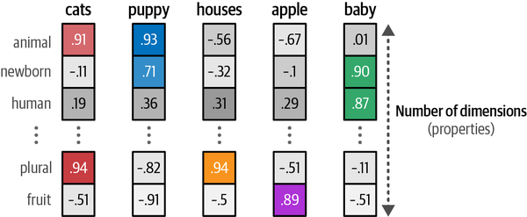
Large Language Model (LLM)
Theoretical Foundation
Embeddings
    What is an Embedding?
Embeddings are vector representations of tokens, sentences, or documents that encode their meaning and relationships in a continuous numerical space.
V = [ v₁, v₂, v₃, v₄ ]
    Each v_{i} is a number representing how much a vector matches a concept. Imagine the example for flamingo:
Dimensions = Bird, Red, Blue, Mammal
flamingo = [ 0.95, 0.8, 0.1, -0.6 ]
    Source: Hands-On Large Language Models, Jay Alammar & Maarten Grootendorst, (2024)

Slide 13
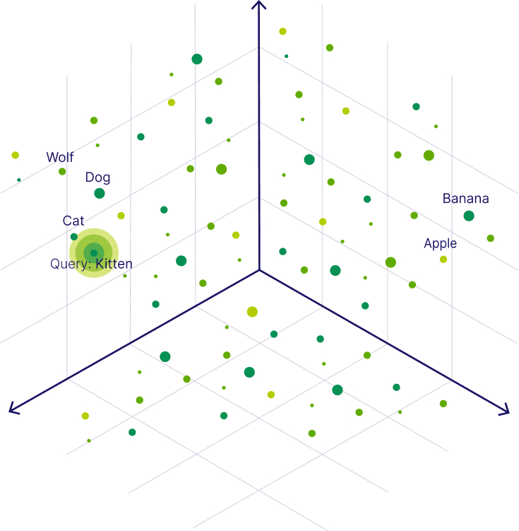
Large Language Model (LLM)
Theoretical Foundation
Embeddings
    Meaning and similarity
    Using distance metrics, we can determine how close one word is to another in meaning. When visualized in a simplified three-dimensional space, words with similar meanings appear closer together.
    Source: https://weaviate.io/blog/what-is-a-vector-database

Slide 14
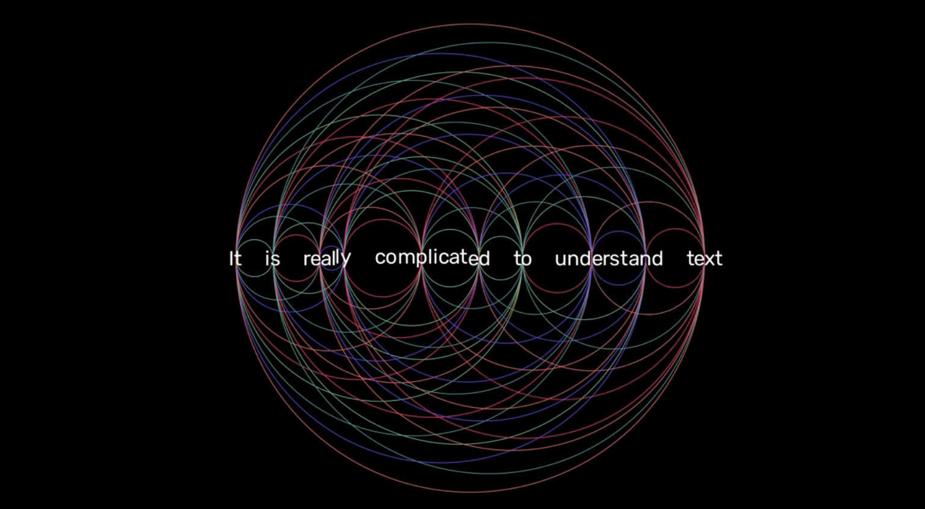
Large Language Model (LLM)
Theoretical Foundation
“Attention is all you need”
    Source: https://www.youtube.com/watch?v=RNF0FvRjGZk
Notes:
Example: If you want to understand a book you need to correlate information from the beginning to the book up until the last pages. Cross-references throughout the book

Slide 15
Large Language Model (LLM)
Theoretical Foundation
Attention
    Because a word’s meaning depends on its context, these connections matter a lot.
    The model also keeps track of word order, since position changes meaning.
The animal didn’t cross the street because it was too tired.
Dog bites man.
What is it referring to?
Man bites dog.
It is referring to the animal.
    Source: https://www.youtube.com/watch?v=RNF0FvRjGZk

Slide 16

Different Models

Slide 17
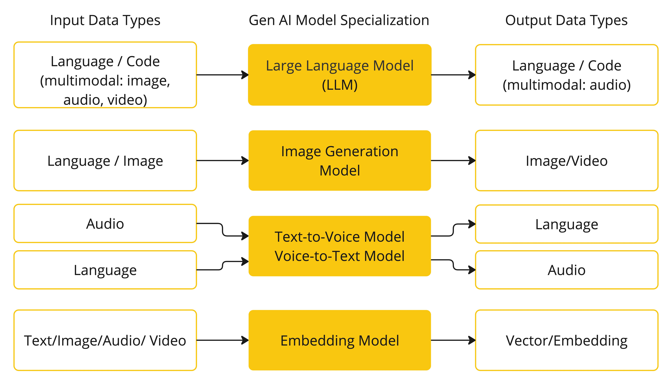
AI Model Types
Theoretical Foundation
    Chat Models → Think & write (conversation, Q&A, generation)
    Image Models → Draw (create images from text)
    Audio Models → Listen & speak (speech-to-text & text-to-speech)
    Embedding Models → Understand similarity (semantic search, matching)
    Moderation Models → Judge safety (content filtering)
    Key Takeaway
    AI model types each handle a different modality such as text, image, audio, meaning, and safety.
    Combining them enables powerful, real-world applications.
    Source: https://docs.spring.io/spring-ai/reference/concepts.html

Slide 18
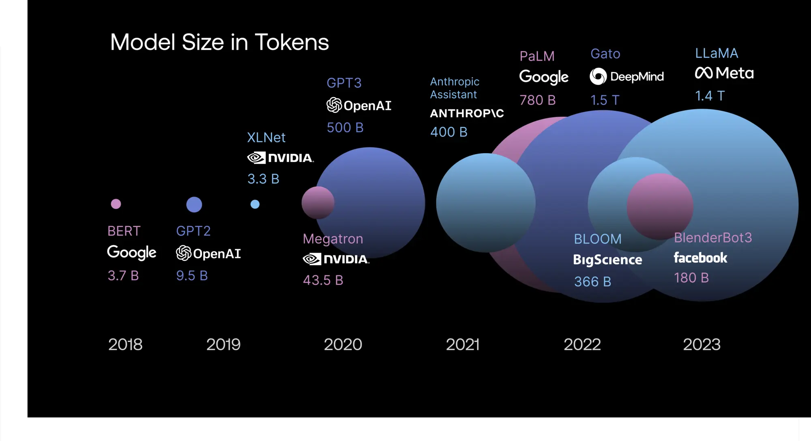
Large Language Model (LLM)
Theoretical Foundation
Model Size
Over the past years, model sizes and representation dimensions have increased significantly. Larger models and higher-dimensional representations can capture more complex language patterns, often leading to more precise and context-aware outputs.
    Source: https://scale.com/guides/large-language-models

Slide 19
Discussion:
Choose the right model for the task
Notes:
Question:
- Which model did you use before in the LAB and why?

Slide 20

Prompt Engineering

Slide 21
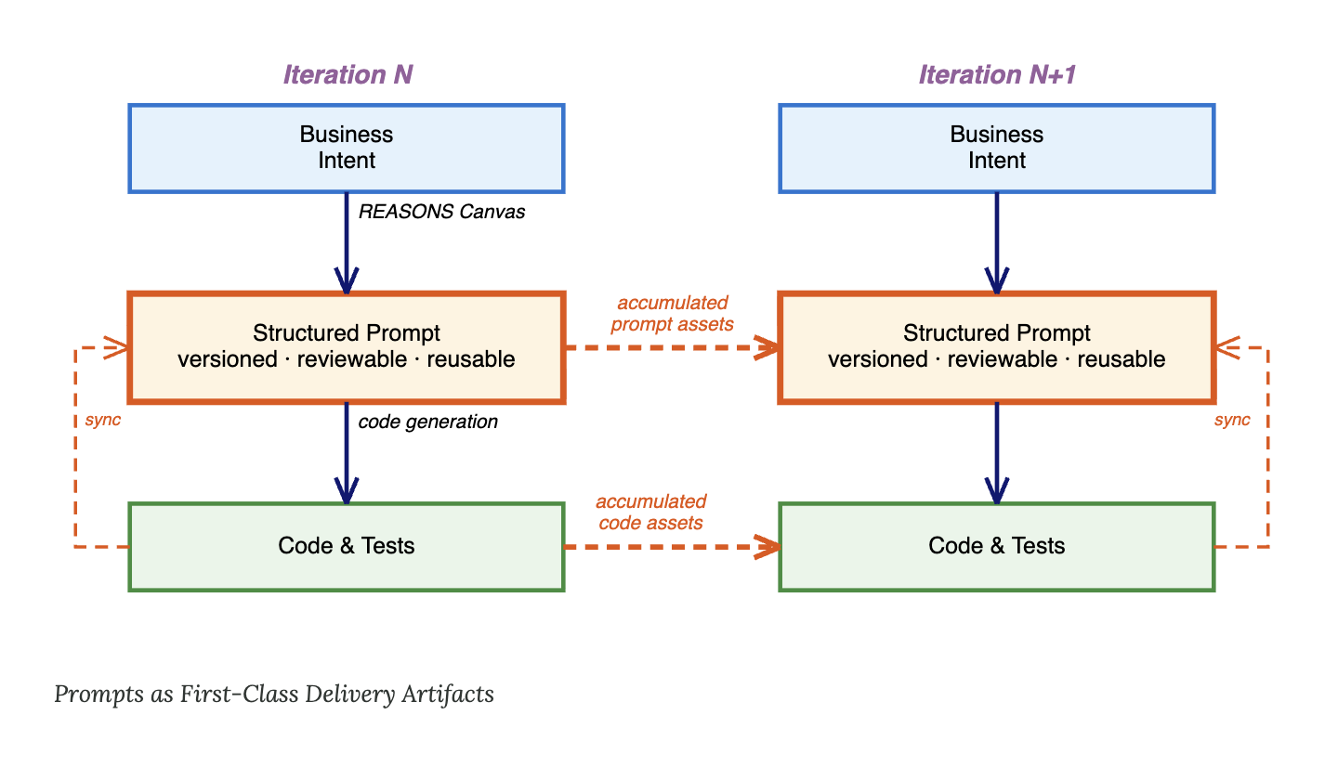
Prompt Engineering
Theoretical Foundation
Increasing the likelihood of acceptable outputs from non-deterministic models
  Structured Prompts
Prompt engineering is the deliberate process of designing, refining, and optimizing inputs (prompts) to guide generative AI models, like ChatGPT or LLMs, toward producing accurate, relevant, and high-quality outputs.
https://www.ibm.com/think/topics/prompt-engineering
https://martinfowler.com/articles/structured-prompt-driven/
https://en.wikipedia.org/wiki/Specification-driven_development
2026
© Zühlke

Slide 22
Prompt Engineering
Theoretical Foundation
Commonly used techniques
  Zero-shot Prompting
Zero-shot prompting is the simplest type of prompting: you give the model a direct instruction with no examples, and it relies on its pre-trained knowledge to complete the task.
Classify the sentiment of the following text as positive, negative, or neutral.
Text: I think the vacation was okay.
Sentiment:
Neutral
  One-shot and Few-shot Prompting
One-shot and Few-shot prompting enhances zero-shot prompting by providing one or many examples before the new task, which helps clarify expectations and improves model performance.
Classify the sentiment of the following text as positive, negative, or neutral.
Text: The product is terrible. Sentiment: Negative ☹
Text: Super helpful, worth it. Sentiment: Positive ☺
Text: It doesn’t work! Sentiment:
Neutral 😐
2026
© Zühlke
Notes:
Nur auf der Tonspur

Slide 23
Demo:
Prompt Template

Slide 24
  LAB: Document project using Prompt Template
  Context
We will generate project documentation for this repository using a prompt template. The prompt template makes use of AI augmented prompting to create AI-friendly output that can be used by agents later.
  Your Task
Checkout the branch lab/prompt-template and create the project documentation in chat by executing /create-project-documentation in Copilots chat.
  Tipps & Tricks
Example documentation can be found in the branch solution/prompt-template.
Notes:
Question to ask:

Slide 25

15’ Break

Slide 26

Context Engineering

Slide 27
Large Language Model (LLM)
Theoretical Foundation
Limitations of traditional LLMs
    (1) No memory
When we continue the “conversation”, any given LLM will showcase one of its main disadvantages. It does not remember conversations!
What is 1 + 1?
The answer is 2
What did I just ask?
I have no knowledge about a previous question.
    (2) Capabilities that go beyond text
There are many other tasks that LLMs often fail at, including basic math like multiplication and division.
What is 8 * 34.2 / 3.49?
Thinking…

Slide 28
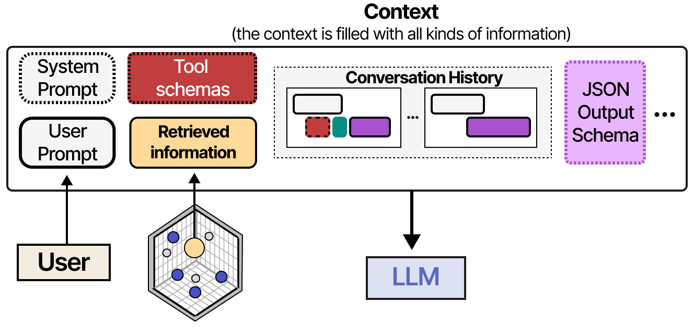
Context Engineering
Theoretical Foundation
Augmenting the LLM with additional information
    What belongs to a Context?
System prompt: The core context and rules for the agent, which define how it should behave.
User prompt: What you write into the chat window.
Tool schemas: Description of core tools like reading and writing files built into agent. Can be extended and limited by you.
Retrieved information: External information that is typically stored in a vector database and accessed through RAG-like techniques (semantic memory).
Conversation history: Both the conversation between the user and assistant, but also the LLM’s internal thoughts.
    Source: An Illustrated Guide to AI Agents, Maarten Grootendorst, Jay Alammar (2026)

Slide 29
Demo:
Information about your Session Context
Notes:
Show
Idea.log
Help -> Diagnostic Tools -> Debug Log Setting -> com.github.copilot:trace
Tools -> GitHub Copilot Log Diagnostics
- Context window icon

Slide 30
Context Engineering
Theoretical Foundation
Increasing the likelihood of acceptable outputs from non-deterministic models
  Prompt Templates
.github/prompts/*.prompt.md
Reusable prompt templates for specific tasks.
  Instructions
.github/copilot-instructions.md
Repository-wide instructions that shape persona, coding standards and behavioral rules for Copilot.
.github/instructions/**/*.instructions.md
Path-specific instructions for Copilot, only applicable for certain files.
2026
© Zühlke

Slide 31
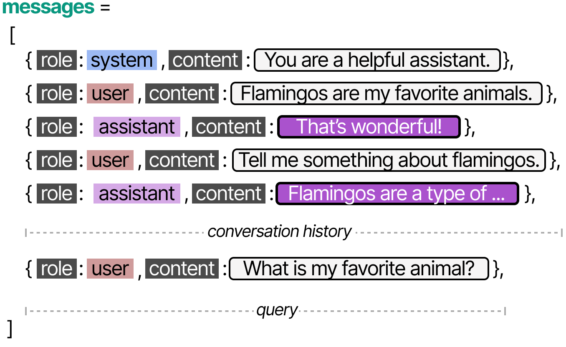
Context Engineering
Theoretical Foundation
Augmenting the LLM with additional information
Working Memory
Working memory is a type of short-term memory that is typically defined as a system with limited capacity that temporarily holds information that we need for things like decision-making and reasoning. For LLMs, it is typically the chat history of the LLM that is being stored in memory and continuously fed back to the LLM.
    Source: An Illustrated Guide to AI Agents, Maarten Grootendorst, Jay Alammar (2026)

Slide 32

Memory
Theoretical Foundation
Context Engineering
System Prompt
    The Claude Code Stack
Claude Code’s context is built from CLAUDE.md, skills, subagents, hooks, conversation history, workspace context, user input, and tool schemas.
Together, these elements shape how Claude Code understands requests and generates responses. In the upcoming sections, we’ll take a closer look at each part of this stack and how they work together.
Subagent Definitions
CLAUDE.md (Memory)
Skills
Auto memory
Tool schemas
Retrieved Workspace Context
Conversation History
User Prompt
Repsonse Formatting

Slide 33
Demo:
Instruction Files
Notes:
Demo
General instruction file
Path specific instruction files

Slide 34
  LAB: Setup IDE to increase the likelihood of acceptable output
  Context
In this exercise, you will configure your project so GitHub Copilot produces more consistent and probabilistic outputs.
Your goal is to reduce ambiguity and improve output quality.
  Your Task
Checkout the branch lab/instructions and
create a repository instruction file defining general behavior and constraints for Copilot in this repository
add path-specific instruction files for python and testing
Implement the same endpoint again:
    GET /delays/?airline_code=AA&limit=50
  Tipps & Tricks
Files to create:
.github/copilot-instructions.md
.github/instructions/python/python.instructions.md
.github/instructions/testing/testing.instructions.md
You can copy the instruction files from the branch solution/instructions.
Notes:
Question to ask:
Does the application start? Does the endpoint work? Does the test run through?
Did it use pydantic for your models?
Yes, its even properly described
Did it write tests?
Yes
Are the test method names what you would expect? Is the naming consistent?
Yes
Did it format the files correctly?
Yes
Did it make any assumptions? E.g.
How should airline_code map to dataset values (AA vs names like SWISS)? Option A: explicit code→airline mapping; Option B: filter by flight_number prefix; Option C: treat as no-match (404).
Should limit be optionally, bounded (e.g., ge=1, le=100) and have a default? This affects validation behavior (422 vs truncation).
Should 404 apply only to filtered/no-match requests, or also when the base data file is empty/unreadable?
Yes!
Would you ship that code to pod?
Confidence Vote?

Slide 35
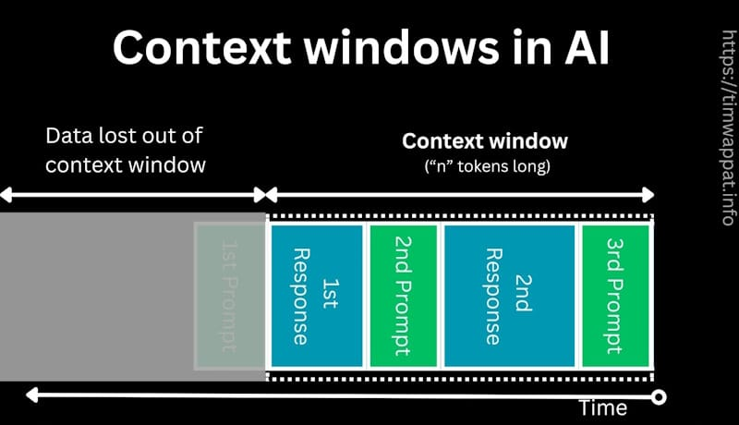
Context Engineering
Theoretical Foundation
Maximal amount of information a model can process
    Context Window
    Previous user messages, Copilot responses, tool calls, and tool outputs make up the model’s active context. The context window is the maximum amount of text (in tokens) the model can process at once, while the context size is how much of that limit is currently used. When the window is full, older content may be removed.
    Source: https://timwappat.info/understanding-context-windows-in-llms/

Slide 36
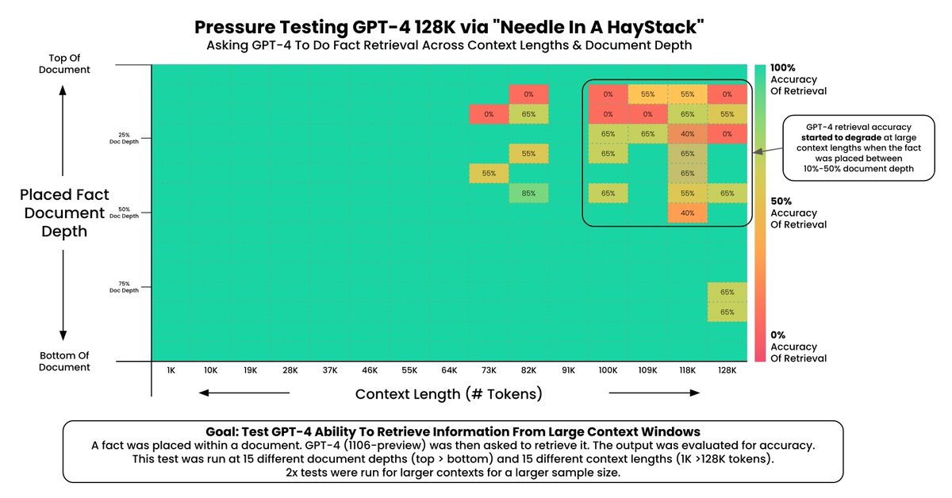
Context Engineering
Theoretical Foundation
What causes Context Degradation?
(1) Context Size
A common benchmark for long-context LLMs in 2023–early 2024 was the Needle In A Haystack (NIAH) test. A random fact (“needle”) is inserted into a long context (“haystack”), and the model must retrieve it. Results show performance degrades as context length increases.
Context size also impacts cost and latency. While you could load millions of tokens (e.g., full databases or conversation history), the model must process all of them, increasing latency and VRAM usage. Simply dumping everything into the context is inefficient and unsustainable.
    Source: https://arize.com/blog-course/the-needle-in-a-haystack-test-evaluating-the-performance-of-llm-rag-systems/

Slide 37
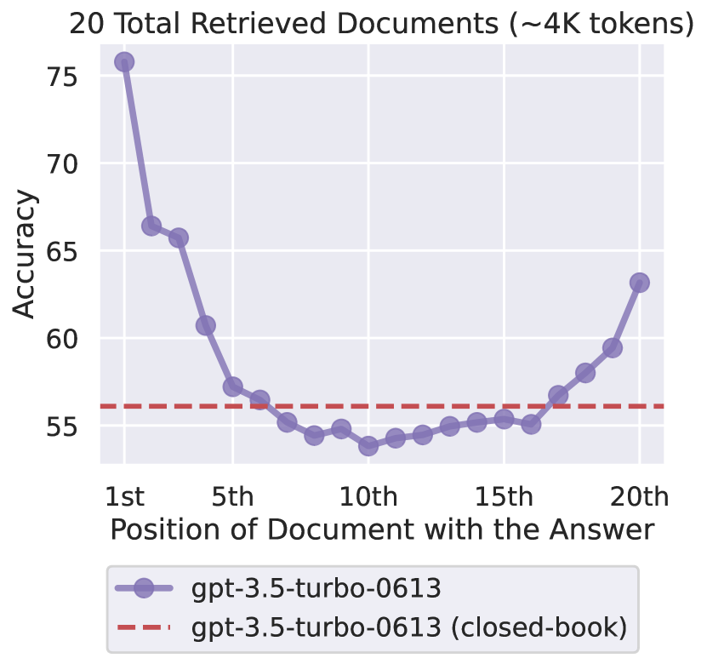
Context Engineering
Theoretical Foundation
What causes Context Degradation?
    (2) Context Ordering
The order of information strongly affects agent performance. Research shows LLMs focus more on the beginning and end of prompts, often missing details in the middle—known as the “lost-in-the-middle” effect.
This mirrors human behavior: the serial-position effect explains that people remember the first (primacy) and last (recency) items best, and the middle worst.
    Source: https://ar5iv.labs.arxiv.org/html/2307.03172

Slide 38

AI Augmented Workflow
Notes:
Coding Standards Followed (Testing)
Still lack of what actually happens inside (no human in the loop),

Slide 39

AI Augmented Workflow
Theoretical Foundation
Development Workflow
    Best Practices:
    Time-box AI sessions
    Building boundaries around cognitive load
    Invest time in refining and planning
    Focus on method rather than chasing features
    Accepting 80% output as “good enough”
    Build a harness using deterministic tools
  Refine
  Plan
  Implement
    Provide key project context to guide the AI.
    Create a clear, structured implementation plan.
    Generate and test code based on the plan.
    Outcome: Faster implementation, better architectural alignment, and more consistent code quality.
Notes:
The value of focusing on user experience design is proven.
Studies show it leads to significant cost savings and growth benefits.
By constantly keeping users in mind, you gain fresh ideas and find ways to do more with less.

Slide 40
What is an Agent?
It’s a problem solver that understands your intent, builds a solution, and iterates until it gets it right.
  »
Alexandra Lietzke
GitHub

Slide 41
Context Engineering
Theoretical Foundation
Increasing the likelihood of acceptable outputs from non-deterministic models
  Prompt Templates
.github/prompts/*.prompt.md
Reusable prompt templates for specific tasks.
  Instructions
.github/copilot-instructions.md
Repository-wide instructions that shape persona, coding standards and behavioral rules for Copilot.
.github/instructions/**/*.instructions.md
Path-specific instructions for Copilot, only applicable for certain files.
  Agents
.github/agents/*.agent.md
Specialized agents with tailored expertise for specific tasks.
.github/skills/**/SKILL.md
Folders of reusable instructions, scripts, and resources that Copilot can load for specific tasks.
2026
© Zühlke

Slide 42
Demo:
Custom Agents & Handoffs

Slide 43
  LAB: Agentic Workflow
  Context
So far you've used Copilot to generate code directly.
Now you will enforce an agentic workflow that separates refinement, planning, and implementation to improve quality and predictability.
  Your Task
  Checkout branch lab/agentic-workflow and
  prepare agents for refine → plan → implement in .github/agents/.
  You can reuse the existing skills in .github/skills/.
  Implement the same endpoint again using the workflow:
    GET /delays/?airline_code=AA&limit=50
  Tipps & Tricks
Files to create:
.github/agents/refine.agent.md
.github/agents/plan.agent.md
.github/agents/implement.agent.md
You can copy the agent files from the branch solution/agentic-workflow.

Slide 44
AI Augmented Engineering
Theoretical Foundation
The new reality (I)
  More decisions & context switches
  You’ve become a reviewer, not a builder
AI shortens execution time, but instead of reducing workload, expectations increase. Engineers end up juggling more problems per day, which dramatically increases cognitive load.
Instead of creating from scratch, engineers now: Prompt, review AI output, judge correctness and safety, rewrite and refine. Reviewing is more mentally exhausting than creating. AI-generated code requires intense scrutiny because it can be subtly wrong.
  Non-determinism causes background stress
  The hype treadmill creates FOMO
AI outputs vary even with the same input. Engineers are trained to reason in deterministic systems, so collaborating with a probabilistic one creates constant low-grade anxiety.
New tools, models, and frameworks launch constantly. Trying to keep up leads to endless experimentation, shallow adoption, and burnout.
    Source:https://siddhantkhare.com/writing/ai-fatigue-is-real

Slide 45
AI Augmented Engineering
Theoretical Foundation
The new reality (II)
  The “just one more prompt” trap
  Perfectionism clashes with “80% good” output
You iterate endlessly trying to perfect AI output — often spending more time prompting than it would take to write the code yourself.
AI rarely produces perfect results. Engineers with high standards struggle with constantly polishing near-correct output.
  Thinking skills can atrophy
  Social media comparison makes it worse
Outsourcing first-draft thinking to AI weakens core reasoning skills over time. Without deliberate practice, mental sharpness declines.
AI success stories are highlight reels. Nobody posts the wasted hours or production bugs caused by AI.
    Source: https://siddhantkhare.com/writing/ai-fatigue-is-real

Slide 46

Agent Harness

Slide 47
Agent Harness
Theoretical Foundation
Harnessing LLM Output
  Solution Space
  Prompt Engineering
  Contetx Engineering
  Context Engineering
  Increasing the likelihood of acceptable outputs from non-deterministic models
  Harnessing LLM output using deterministic tools
  Agent Harness

Slide 48
Agent Harness
Theoretical Foundation
Harnessing LLM output using deterministic tools
  Agent Hooks
.github/hooks/*.json
Execute deterministic commands during agent lifecycles.
Available lifecycle events:
SessionStart
UserPromptSubmit
PreToolUse
PostToolUse
SubagentStart
SubagentStop
Stop
...
New hooks field in *.agent.md
Agent-scoped hook for custom agents.
    Preview
2026
© Zühlke

Slide 49
Demo:
Harnessing LLM output with agent-scoped hook

Slide 50
Draft
  LAB: Agent Harness
  Context
  Your Task
  Tipps & Tricks
.

Slide 51

Tools

Slide 52
Large Language Model (LLM)
Theoretical Foundation
Limitations of traditional LLMs
    (1) No memory
When we continue the “conversation”, any given LLM will showcase one of its main disadvantages. It does not remember conversations!
What is 1 + 1?
The answer is 2
What did I just ask?
I have no knowledge about a previous question.
    (2) Capabilities that go beyond text
There are many other tasks that LLMs often fail at, including basic math like multiplication and division.
What is 8 * 34.2 / 3.49?
Thinking…

Slide 53

Tools
Theoretical Foundation
Augment your LLM with Tools
  Tool Creation
  Tool Definition
  Tool Selection
  Tool Calling
  Output Processing
LLMs can be extended with deterministic capabilities, such as performing math. The tool is created outside the LLM.
The LLM must be informed about available tools, either through prompts or structured schemas like JSON.
The LLM decides which tool (if any) fits the user’s query. Strong reasoning and planning abilities are essential for accurate selection.
The LLM generates a formatted tool call as text, but external code must extract and execute it. The system runs the function using the provided arguments.
After the tool runs, its output is added back into the conversation so the LLM can generate a final response. This makes it appear as if the LLM executed the tool itself.
  Example
System Prompt
Reasoning
Answer
You can use the …
You can use the following tools:
- multiply(a,b)
Let me check the tools available.
The only tool provided is the ’multiply’ function.
<tool_call>
{
“name”: “multiply”,
“arguments”: …
}
</tooll_call>
What is 5.1 x 7.3?
def multiply(a, b)
Let me check …
<tool_call>
37.23

Slide 54
Tools
Theoretical Foundation
Model Context Protocol
    What is MCP?
The Model Context Protocol (MCP) standardizes how tools and APIs connect to LLMs, acting as a universal interface between them. Instead of users manually tracking tools, writing JSON schemas, and updating integrations, MCP centralizes this responsibility through an MCP server. MCP is often referred to as the “USB-C port of AI” due to its universal nature.
    https://digimoor.com/mcp-integration-with-llms-revolutionizing-ai-communication-and-capabilities/

Slide 55
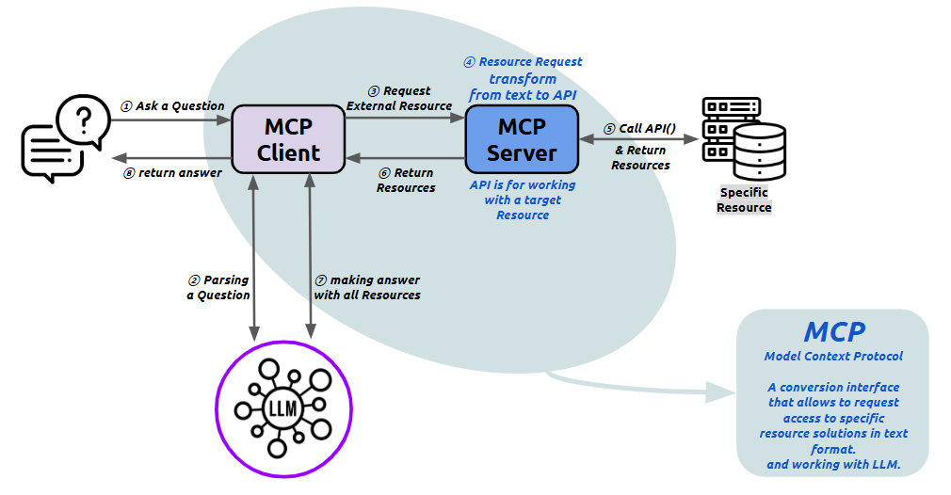
Tools
Theoretical Foundation
Model Context Protocol
    https://eeumee.net/2025/04/07/mcp-1-_-flow/

Slide 56
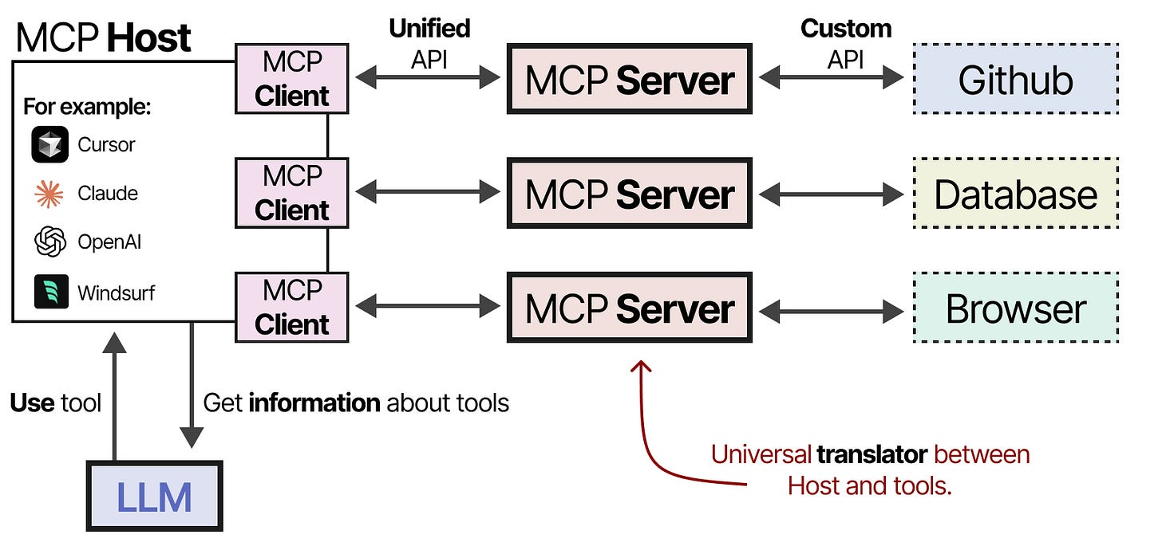
Tools
Theoretical Foundation
Model Context Protocol
    What components are used in MCP?
MCP Server: Provides context, tools, and capabilities to the LLMs
MCP Host: LLM application (such as Cursor) that manages connections
MCP Client: Maintains one-to-one connections with MCP servers
    Source: https://newsletter.maartengrootendorst.com/p/a-visual-guide-to-llm-agents

Slide 57
Demo:
Integrate Snyk to check
code for vulnerabilities

Slide 58
Draft
  LAB: Create a tool
  Context
  Your Task
  Tipps & Tricks
.

Slide 59
Summary
Theoretical Foundation
Methods and Tooling for AI Augmented Engineering
  Solution Space
Prompt Templates
  Prompt Engineering
Instruction Files
  Contetx Engineering
  Context Engineering
Agent, Skills & Agentic Workflow
  Increasing the likelihood of acceptable outputs from non-deterministic models
Agent Hooks
  Harnessing LLM output using deterministic tools
  Agent Harness
Git Hooks, CI/CD, …

Slide 60
15’ Break

Slide 61
Prompt Engineering
Theoretical Foundation
Basic Techniques
  Chain-of-Thought Prompting (COT)
Chain-of-Thought (CoT) prompting guides the model to show its reasoning steps before giving a final answer. It’s useful for complex tasks like math, logic, or multi-step problems where step-by-step thinking improves accuracy.
Q: John has 10 apples. He gives away 4 and then receives 5 more. How many apples does he have?
A: John starts with 10 apples. He gives away 4, so 10 - 4 = 6.
He then receives 5 more apples, so 6 + 5 = 11. Final Answer: 11
Q: John has 20 apples. He receives 6 and gives away 1. How many apples does he have?
A: John starts with 20 apples.
He receives 6 → 20 + 6 = 26.
He gives away 1 → 26 − 1 = 25.
Final Answer: 25
2026
© Zühlke

Slide 62
Prompt Engineering
Theoretical Foundation
Basic Techniques
  Zero-shot Chain-of-Thought Prompting (Zero-Shot COT)
Zero-Shot Chain-of-Thought (Zero-Shot CoT) is a simple extension of CoT prompting that requires no examples. By adding a phrase like “Let’s think step by step.” to a question, the model generates its own reasoning process, often leading to more accurate answers.
If John has 5 pears, then eats 2, and buys 5 more, then gives 3 to his friend, how many pears does he have?
Let's think step by step.
John starts with 5 pears. He eats 2 pears, leaving him with 3 pears. He buys 5 more pears, giving him a total of 8 pears. He gives 3 pears to his friend, leaving him with only 5 pears.
2026
© Zühlke

Slide 63
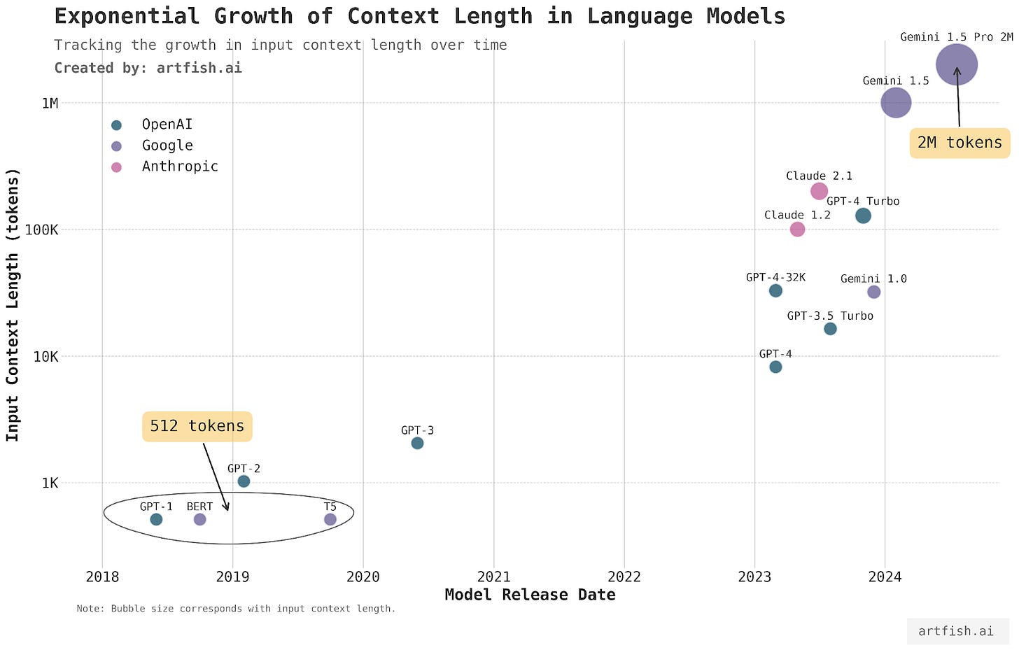
Context Engineering
Theoretical Foundation
Context Size
Context Size has grown exponentially in the past
The context window of language models have been growing at an exponential rate in the last few years. So what is the issue?
    Source: https://www.artfish.ai/p/long-context-llms

Slide 64
Memory
Theoretical Foundation
Context Engineering
System Prompt
    The GitHub Copilot Stack
GitHub Copilot’s context is built from several layered components — including instructions, templates, conversation history, workspace context, user input, tools, and response formatting.
Together, these elements shape how Copilot understands requests and generates responses. In the upcoming sections, we’ll take a closer look at each part of this stack and how they work together.
Agent Instructions
Copilot Instructions
Prompt Templates
Skills
Tool schemas
Retrieved Workspace Context
Conversation History
User Prompt
Repsonse Formatting

Slide 65
An agent is anything that can be viewed as perceiving its environment through sensors and acting upon that environment through actuators.
  »
Russel & Norvig
AI: A Modern Approach (2026)

Slide 66
Tools
Theoretical Foundation
Model Context Protocol
    https://eeumee.net/2025/04/07/mcp-1-_-flow/

Slide 67
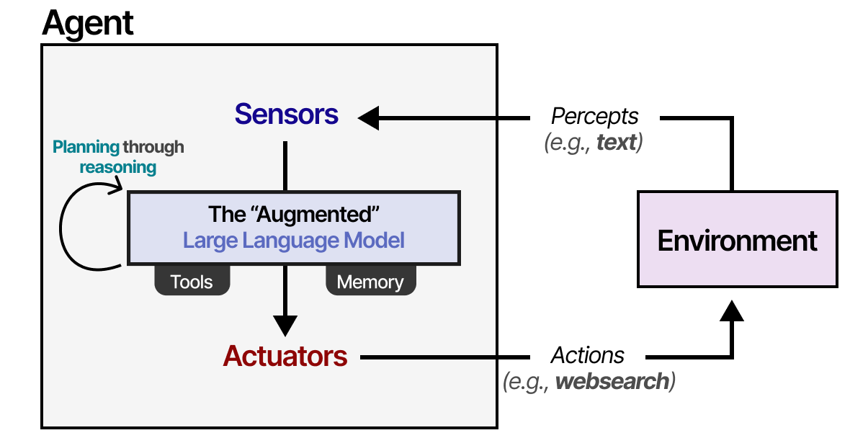
Large Language Model (LLM)
Theoretical Foundation
Agentic AI
    What is an Agent?
    Agents interact with their environment and typically consist of several important components:
    Environments: The world the agent interacts with
    Sensors: Used to observe the environment
    Actuators: Tools used to interact with the environment
    LLM: The “brain” or rules deciding how to go from observations to actions
    Source: An Illustrated Guide to AI Agents, Maarten Grootendorst, Jay Alammar (2026)

Slide 68
Tools
Theoretical Foundation
Model Context Protocol
    What components are used in MCP?
MCP Server: Provides context, tools, and capabilities to the LLMs
MCP Host: LLM application (such as Cursor) that manages connections
MCP Client: Maintains one-to-one connections with MCP servers
    Source: https://newsletter.maartengrootendorst.com/p/a-visual-guide-to-llm-agents

Slide 69
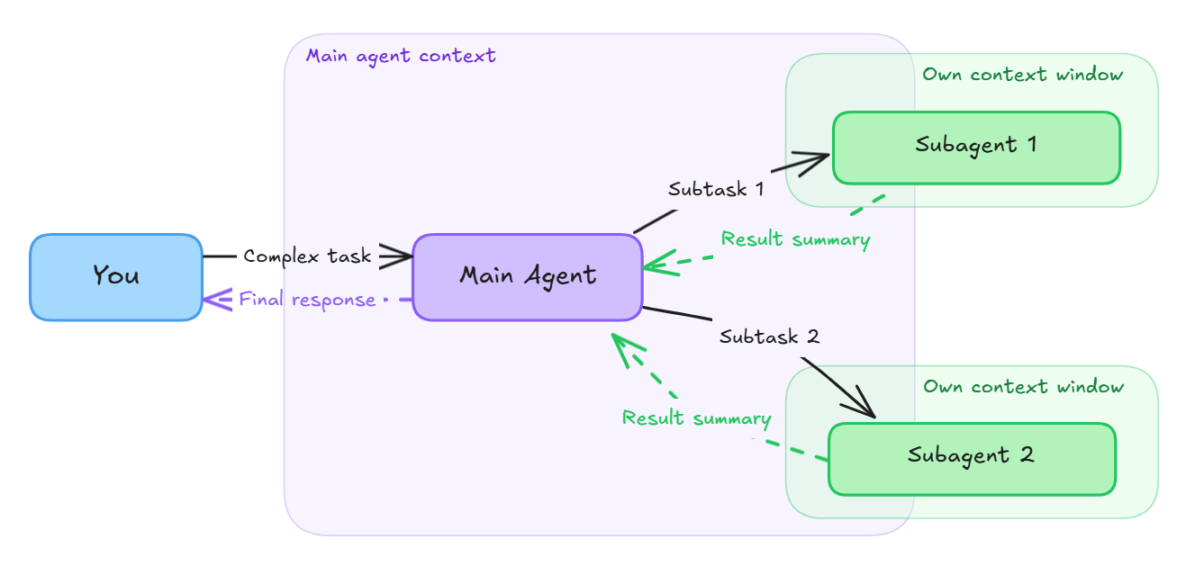
Large Language Models (LLM)
Theoretical Foundation
Agentic AI
    Subagents
Subagents are context-isolated AI helpers that a main Copilot agent can launch to handle specific subtasks (like research, analysis, or code review) and then return just the results. Because each subagent runs in its own context window, they don’t clutter the main conversation, can run in parallel, and help keep the main agent focused while reducing token usage. You can also use custom agents as subagents to give them specialized behavior.
    Source: https://code.visualstudio.com/docs/copilot/agents/subagents

