Slide 1

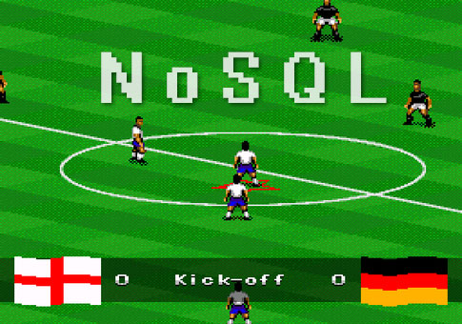

Slide 2

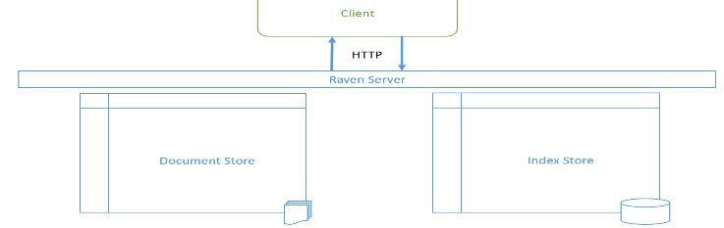
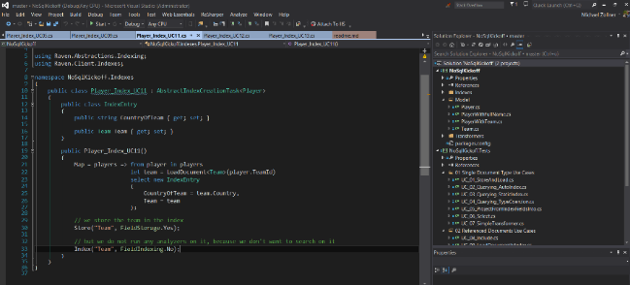
What can you expect ?
Workshop about with…
…a bit of theory about Document Databases and RavenDB
and
…a decent amount of practice

Slide 3
Opinions, Experience, Rumours, Prejudices Let’s gather some, so we can address them later
Relational vs. Non-relational (NoSQL) Databases
Anxieties
Fears
Hopes
Known Problems
Known Advantages
War stories
Notes:
Referential Integrity
JOINs
Denormalization / Duplication

Slide 4








Let’s start with some theory…
Key-Value Stores
Graph Databases
NoSQL Technologies
Document Databases
Column Stores

Slide 5
Document Databases Introduction
A document database is something else than a document management system (i.e. SharePoint or any other advanced CMS)
The documents in a document database are not pdf’s or word documents but structured data stored as json, xml or in binary format.
The documents in a document database are very often a serialized version of (parts of) the in-memory object tree of your application.
Document databases offer queryable access to those structured documents, their content and their metadata

Slide 6
Document Databases Serialized Objects

Slide 7
Document Databases What are the advantages of this approach ?
There is a 1 : 1 mapping between in-memory object model and persisted data.
Developers don’t need to deal with object-relational impedance mismatch*.
There are no ORMs or similar mapping layers needed to store or query data.
Loading one document is often enough to satisfy one (detail) screen
You can easily duplicate a document (or parts of it) to enable advanced features such as versioning, audit trails, garbage bins, archives and historical snapshots.

Slide 8
Document Databases Object-relational Impedance Mismatch: The Vietnam of Computer Science
“The conceptual and technical difficulties faced, when mapping a relational structure (linked tabular rows) to the class/object structure (a graph)”
Document Databases can remove the problem of impedance mismatch without adding another layer of abstraction, but by removing one.
«There’s no problem in computer science that cannot be elegantly solved by adding a layer of abstraction. There’s no performance problem in computer science that cannot be solved by removing a layer of abstraction.»
Gustavo Alonso

Slide 9
Document Databases What are further advantages of this approach ?
Aggregates and hierarchies (1:n relationships) that inherently belong together are stored together.
You don’t need to resolve references/relationships at query time and consequently you don’t pay any performance penalty for JOINs or N+1 Selects.
Read performance in a purely denormalized setup is unmatched. You only pay for document identification, document loading and deserialization.

Slide 10
Document Databases What are the disadvantages of this approach ?
You need to get comfortable with the concept of denormalization and duplicated data.
You need to make sure that data is correctly denormalized and kept up to date (if it is no historical snapshot).
When optimizing for several access paths, your documents can grow very large.
You pay the price of denormalization at write time, so your writes can take a bit longer.

Slide 11
Document Databases What if I don’t want to go full-blown denormalized ?
Fear not !
All document databases have the possibility of modelling relations/references similar to what you are used to in relational databases.
You can reference other documents by key and resolve these references at index or query time (i.e. use a JOIN-like operation).
Those references (unlike foreign keys) are however not checked for integrity by the database, so you don’t have any constraints, e.g. when deleting a reference.

Slide 12
Document Databases Data Modelling real world problems
Very seldom are you going to model your data either entirely denormalized or entirely normalized. The truth (as always) lays somewhere in-between.
Yet, in comparison to a relational database you have more modelling choices.
Depending on the use case, you can now decide yourself how you want to store and access your data.
The database does not impose a schema or structure onto the data. The database has an implicit schema, but it is not schemaless.

Slide 13
Document Databases So what do you get ?
Increased Developer Productivity
Your mental model, your in-memory object model and your persistence model are aligned. You don’t need to translate between those models.
Incredible Performance Gains
Optimized for reads instead of writes, because that’s what we do most of the time.
Flexibility and freedom to model the data any way you need it
And additional data modelling options that didn’t exist in the relational world or were very hard to implement

Slide 14
It’s all about tradeoffs
We trade off safety-nets against flexibility
referential integrity store anything
schema checks modelling choices
constraints easy schema changes
We do more maintenance to get better performance
create and maintain indexes fast queries
denormalization overhead less joins
manual consistency checks less query time lookups

Slide 15
Document Databases The main conceptual differences to relational databases
Relational Database | Document Database
Optimized for writes | Optimized for reads
Access paths are ignored | Data Model is optimized for access paths
Anomalies are avoided | Anomalies are accepted
Transactional consistency and durability is guaranteed | Transactional consistency and durability is guaranteed for document writes and loads
Personal and global consistency is guaranteed | Personal and global consistency is guaranteed for document writes and loads
Explicit and enforced schema | Implicit schema that is not enforced

Slide 16
How to choose a NoSQL any database?
Answer these questions
How will you write data? How frequently will it be changed? How important is write latency ?
How will you read data? Do you read individual data items or several related items ?
What will be tolerable read latency? How many concurrent requests do you have?
What consistency is needed between reads and your own writes (personal consistency) ?
What consistency between writes of relatively unrelated items?
What does the database need to know about the internal structure of the data?
What’s your preferred programming language and runtime environment?

Slide 17

RavenDB Characteristics
Document Database written in .NET
First class .NET Clients but everything runs over REST
Web-based Management UI
Embeddable in client
Can run in-memory (e.g. for testing)
Based on proven existing technologies
ESENT (storage layer of Exchange Server and Active Directory)
Lucene.NET (.NET port of Apache Lucene Indexing Technology known from ElasticSearch and Apache SOLR)
Notes:
Java & javascript client library there, but not as far as .NET (-> future)
Voron -> linux

Slide 18
RavenDB Built-in Features
Search Features
Full Text Search
Spatial Search
Faceted Search
Suggestions
More Like This
Operational Features
Change Tracking & Subscriptions
Sharding
Backups
Windows Authentication
SSL Support

Slide 19
RavenDB Bundles & Plugins
Authorization
Cascade Delete
Compression
Encryption
Expiration
Periodic Export
NodaTime
SQL Replication
Unique Constraints
Versioning
Cluster & Replication
Quotas
Temporal Versioning
http://ravendb.net/docs/article-page/3.0/csharp/server/bundles

Slide 20
RavenDB Concepts 2 stores
Client
HTTP
Raven Server
Document Store
Index Store

Slide 21
RavenDB Concepts Document Store vs. Index Store
Document store stores documents as serialized JSON on disk.
Index store does not store documents, but only pointers to documents (index entries).
As a developer you interact with both stores through different APIs.

Slide 22
Document Store has ACID characteristics Write transactions are Atomic, Consistent, Isolated and Durable
Document Store API follows the Unit of Work (transaction) pattern.
Documents are persisted on disk and retrieved from disk. Disk performance is extremely critical.
Documents are stored as JSON whose structure is chosen by the client.
Documents can only be retrieved (loaded) by key (or key prefix).
Performance characteristics of a hashtable or dictionary: O(1)

Slide 23
Index Store has BASE characteristics
Lucene indexes are separate auxiliary data structures that help us find documents.
Lucene queries are the only way to query for documents based on their content.
Basic Availability, Soft state
Index store always returns the currently available results very fast (which may not be the latest results).
Eventually consistent
Affected indexes are (re-)created or updated asynchronously after a write operation to the document store. During (re-)creation/update the index is said to be stale and can not yet respond with the latest document changes. It will respond with old or stale results, though.
The index will (eventually) be consistent again, after it was successfully updated.

Slide 24
Key Concepts Personal Consistency
Query your own writes scenario:
Add or manipulate a business object, go back to the overview page and expect the added object (or change) to be there.
Personal consistency can be compromised with the BASE characteristics of the index store, because re-indexing is asynchronous and might be slower than the next query (we are talking about milliseconds here).
RavenDB has special mechanisms to deal with this problem (WaitForIndexing)
Consistency of unrelated reads and writes (global consistency) is usually not a problem for the user, as he does not know what others are doing.

Slide 25
Key Concepts Collections
A collection is a virtual construct that bundles together similar documents.
Most documents belong to exactly one collection. Some to none.
Conventions:
All documents with the same collection prefix in their key belong to the same collection
Keys are strings composed of a collection prefix and a number separated by a slash
Players/1, Organizations/55, Employments/17

Slide 26
Key Concepts Collections
More conventions:
The collection prefix is taken from the pluralized type name of the object
The .NET Class of the document’s object type is additionally stored as metadata in the document to help the serializer.
For each collection we usually create at least one index, so that we can retrieve the documents by their properties.

Slide 27
Key Concepts Key Generation Options
The key of the document is stored in the Id property of the document. Each object therefore needs to have an Id field of type string.
The key is either set explicitly by the client, calculated via a client side key generation algorithm (HiLo) or set by the server (to a GUID).
With HiLo key generation, each client can use a set of keys without contacting the server and generating conflicts. There will however be holes in the key space and keys won’t be given out sequentially.
To generate keys without holes, you need to contact the server and ask for the next valid key.

Slide 28
Key Concepts Collections
What goes into a collection (as a separate document) ?
All objects which have their own explicit identity within the given domain, i.e. all entities
Correlates heavily with the main objects of your domain, i.e. the things you talk about when you explain your domain to somebody.
All Aggregate Roots (if you model your domain with DDD)
All Relationships between two entities, if you have to store data specific to the relationship itself or if the relationship has its own identity (e.g. the Employment of a Player with a Club)

Slide 29
Key Concepts Collections
What does not go into a collection (as a separate document) ?
All things without explicit identity that belong exclusively to one entity and are not shared between more entities.
All parts of an aggregate root (DDD)
All Value Objects (DDD)
Examples:
The settings of a user, the address of an organization, the order line items of an order, the tags of a blog post

Slide 30
Key Concepts Indexes
An index is an auxiliary data structure that is created from an index definition.
During index (re-)creation and index update certain fields of a document are extracted into an index entry object.
The index definition tells the indexer which documents should be indexed, which of their fields should be extracted and how those fields should be stored in the index entry.
Each index entry points to the id of the document, of which the values were extracted from (inverted index).

Slide 31
Key Concepts Indexes
There are three different index types in RavenDB
Default Map Index: For each document exactly one index entry is created
Fan-out Map Index: For each document one or more index entries are created
Map-Reduce Index: For a subset of documents one index entry is created (aggregates)
When you submit a query to RavenDB, you specify the index and the content of the query. RavenDB finds the matching index entries to your query and returns
a) Default Map Index: one document for each index entry found
b) Fan-out Map Index: one document for each index entry found (with potential duplicates)
c) Map-Reduce Index: the index entries found
Index entry lookup is an O(log n) operation and document lookup an O(1) operation

Slide 32
Key Concepts Indexes
Each field of an index entry is usually optimized for a specific use case or query need, such as Full Text Search, Direct comparison, Sorting, Spatial Queries
If you have conflicting query needs for one field (e.g. Full Text Search and Sorting) then you need to store the field multiple times in the index entry, each one optimized for the respective use case.
You can also store the original field value unchanged in an index entry to serve it from the index directly, so you don’t need to go to the document store to fetch it.

Slide 33
Key Concepts Full Text Search
Lucene provides rich full-text search capabilities that we can leverage in RavenDB
By default each indexed field is tokenized and transformed with the default RavenDB analyzer which creates one single lowercase token from the value of the field. This default token is not suitable for Full Text search, only for direct comparison.
We can tell RavenDB to use one of the other built-in Lucene analyzers which support full-text queries.
Those analyzers will tokenize and transform the value of the field with full-text techniques like stemming, stop-word removal and many other things.

Slide 34
Key Concepts Full Text Search Analyzers
The quick brown fox jumped over the lazy dogs, Bob@hotmail.com 123432.
LowerCaseKeywordAnalyzer [RavenDB default] not usable for full text search, only for direct comparison [the quick brown fox jumped over the lazy dogs, bob@hotmail.com 123432.]
StandardAnalyzer [Lucene default] light stemming:
[quick] [brown] [fox] [jumped] [over] [lazy] [dog] [bob@hotmail.com] [123432]
StopAnalyzer no light stemming, will only tokenize on white space:
[quick] [brown] [fox] [jumped] [over] [lazy] [dogs] [bob] [hotmail] [com]
SimpleAnalyzer, will tokenize on all non-alpha characters, will make all the tokens lowercase:
[the] [quick] [brown] [fox] [jumped] [over] [the] [lazy] [dogs] [bob] [hotmail] [com]
WhitespaceAnalyzer will just tokenize on white spaces:
[The] [quick] [brown] [fox] [jumped] [over] [the] [lazy] [dogs,] [bob@hotmail.com] [123432.]
KeywordAnalyzer will perform no tokenization, will consider the whole text as one token:
[The quick brown fox jumped over the lazy dogs, bob@hotmail.com 123432.]

Slide 35
Key Concepts Safe by default
RavenDB has sensible default limits for most operations.
All of these limits are configurable, but there is a reason these values are chosen: Speed
Query returns 128 results if you don’t specify otherwise (max. 1024). This forces you to use paging.
Each session only permits 30 commands (read and write operations). This forces you to have small units of work (transactions).
Default index entry fan-out per document is 15.
and some more…

Slide 36
Operations
RavenDB either runs as Windows Service or embedded in IIS
Some global Settings are configured in a config file in the installation folder
Authentication
Folder Locations
Database specific settings are either configured with the management UI or via API
Most Database specific settings are stored as documents inside the database itself or in the <system> database (eat your own dogfood)

Slide 37
Operations Management UI
Database creation and deletion
Activation of plugins / bundles
Backups
Periodic Exports
Replication / Cluster Setup
Sharding
Manual Export / Import of Data
Status of database
Debugging endpoints / Debug Dumps

Slide 38
Let’s code

Slide 39
Let’s code Agenda and Use Cases
Overview List of all Players
RavenDB Basics
Searching and Finding Specific Players
Indexes and Querying Unrelated Documents
Team Profile and Player Profile
Modelling and Querying Relationships
Statistics and Reporting
Aggregations (Map/Reduce)
Advanced RavenDB Features

Slide 40
Overview List of all Players Topics
Get to know the solution and git workflow
Get to know the session (Unit of Work) concept
Learn how to store a list of documents
Learn how to retrieve one or many documents by their id
Query a collection using dynamic indexes and paging

Slide 41
Overview List of all Players Exercises
We have to limit the time for each pair of exercises to <10 min
E01-StoreAndLoadPlayers.cs
Exercise 01
As a user I want store a list of the following players: "Christiano Ronaldo", "Lionel Messi" and "Bastian Schweinsteiger".
Exercise 02
As a user I want to be able to receive back the whole list of players ("Christiano Ronaldo", "Lionel Messi" and "Bastian Schweinsteiger") I stored before.
git checkout E01 //Exercise
git checkout S01 //Solution

Slide 42
Load Document
Client
04: Deserialize as TDocument
HTTP
01: Load<TDocument>(id)
Raven Server
02: Load(id)
03: Return JSON
Document Store
Index Store

Slide 43
Load Multiple Documents
Client
04: Deserialize as TDocument
HTTP
01: Load<TDocument>(ids)
Raven Server
02: Load(ids)
03: Load JSON
Document Store
Index Store

Slide 44
Overview List of all Players Exercises
E02-QueryAutoIndexWithPaging.cs
Exercise 03
As a user I want to get a list of 5 players at once (paged list).
Exercise 04
As a user I want to get the second list of 5 players at once (paged list).
git checkout E02 //Exercise
git checkout S02 //Solution

Slide 45
Query Auto Index with Paging
Client
07: Deserialize as TDocument
01: Query<TDocument>().Take(5).Skip(10)
HTTP
02: Find or Create Auto Index (TIndex) for TDocument
Raven Server
05: Load(ids)
06: JSON
04: [ids]
03: TIndex (), 5, 10
Document Store
Index Store

Slide 46
Let’s code Agenda and Use Cases
Overview List of all Players
RavenDB Basics
Searching and Finding Specific Players
Indexes and Querying Unrelated Documents
Team Profile and Player Profile
Modelling and Querying Relationships
Statistics and Reporting
Aggregations (Map/Reduce)
Advanced RavenDB Features

Slide 47
Searching and Finding Specific Players Topics
Theory
Introduction to static indexes
Exercises
Learn how to create static indexes
Learn how to query static indexes
Learn how to use type coercion in LINQ
Learn how to leverage Full Text Search capabilities

Slide 48
Static Indexes
Static means, that we tell the server about it. Dynamic indexes are created on demand.
A static index is created or updated with an index definition that is executed on the server (usually during startup).
In .NET you can inherit from AbstractIndexCreationTask to create an index definition.

Slide 49
Duck Typing or Structural Typing
If it walks like a duck and quacks like a duck, it is a duck.
If two structures (in our case JSON, .NET Class or Lucene Index Entry) have the same properties, they are compatible. This also works for a subset of properties from each side.
{
FirstName: «Max»,
LastName: «Müller»,
Birthdate: 1990-01-01
}
public string FirstName {get;set;}
public string LastName {get;set;}
public string DisplayName {get;set;}

Slide 50
Query Model vs. Result Model
The structure that you execute your query against (the Lucene index entry) is in most cases not the same structure that you will get back as result (the JSON document).
For the RavenDB Server both structures are untyped strings. It doesn’t know anything about .NET types.
With the strongly typed .NET client API you can associate .NET types with these structures to have nicely typed support for queries and results.
List<Person> joes = session.Query<Person_Index.IndexEntry, Person_Index>()
.Where(entry => entry.FirstName == «Joe»);
However, the .NET compiler does not know anything about the relationship between the Person_Index.IndexEntry class and the Person class. This statement won’t compile.

Slide 51
Query Model vs. Result Model
For normal queries, structural typing is used for the query model and strict typing is used for the result model. If the query model has the same property names as the result model, you can therefore use the same type for those two:
List<Person> joes = session.Query<Person, Person_Index>()
.Where(entry => entry.FirstName == «Joe»);
This approach does not work if you have index entry fields that have no corresponding property in the Person class.
This will throw an exception at runtime, if the document being returned has a different .NET class stored in its metadata.

Slide 52
Query Model vs. Result Model Explicit Type Coercion
To make clear which type represents the query model and which type represents the result model, you should always specify the types of the respective structures explicitly.
List<Person> joes = session.Query<Person_Index.IndexEntry, Person_Index>()
.Where(entry => entry.FirstName == «Joe»)
.OfType<Person>();
You can use the OfType<T>() or Cast<T>() operator to do so.
This allows you to have different fields in the index entry than in the document.

Slide 53
Searching and Finding Specific Players Exercises
E03-QueryStaticIndexWithFilter.cs
Exercise 05
As a user I want to find the player "Christiano Ronaldo"
Exercise 06
As a user I want to query for all players that start with a "C" in the first name
git checkout E03 //Exercise
git checkout S03 //Solution

Slide 54
Simple Query
Client
06: Type coercion
HTTP
01: Query<TDocument, TIndex>().Where(name=foo)
Raven Server
04: Load(ids)
05: JSON
03: [ids]
02: TIndex (name: foo)
Document Store
Index Store

Slide 55
Searching and Finding Specific Players Exercises
E04-QueryStaticIndexWithTypeCoercion.cs
Exercise 07
As a user I want to find the player "Christiano Ronaldo“ by querying the full name
Exercise 08
As a user I want to find all players that have the Nationality “Brazil”
git checkout E04 //Exercise
git checkout S04 //Solution

Slide 56
Query with type coercion
Client
06:
HTTP
01: Query<TIndexEntry, TIndex>().Where(name=foo) .OfType<TDocument>()
Raven Server
04: Load(ids)
05:
03: [ids]
02: TIndex (name: foo)
Document Store
Index Store

Slide 57
Searching and Finding Specific Players Exercises
E05-QueryFullTextIndex.cs
Exercise 09
As a user I want to find players that contain the name fragment "van", "di" or "de"
Exercise 10
As a user I want to find players whose first name ends with "an"
git checkout E05 //Exercise
git checkout S05 //Solution

Slide 58
Projection Operators Mapping one structure to another structure
RavenDB has three different projection operators, that are each able to map the result structure (the document or the index entry) to a different target structure.
Select<T>() Operator known from LINQ
ProjectFromIndexFieldsInto<T>() Operator
Transformers

Slide 59
Projection with Select
Client
06: Deserialize as TTarget
HTTP
01: Query<TIndexEntry, TIndex>().Where(name=foo)
.OfType<TDocument> .Select<TTarget>(selectorFn)
Raven Server
04: Load(ids)
05:
selectorFn()
03: [ids]
02: TIndex (name: foo)
Document Store
Index Store

Slide 60
Getting values from the index directly
Lucene let’s you store raw values in index entry fields. Those are not used for querying but can be returned as part of the result.
The ProjectFromIndexFieldsInto<TTarget>() operator will grab all index entry fields whose field names are equivalent to the property names of TTarget. If all properties of TTarget can be filled, the result is returned immediately.
The remaining properties of TTarget are then taken from the document itself.

Slide 61
Filling a target object from index only
Client
04:
HTTP
01: Query<TIndexEntry, TIndex>().Where(name=foo) .ProjectFromIndexFieldsInto<TTarget>()
Raven Server
03: Map Matched Properties from TIndexEntry
02: TIndex (name: foo)
Document Store
Index Store
TTarget ⊇ TIndexEntry

Slide 62
Filling a target object from index and document store
Client
06:
HTTP
01: Query<TIndexEntry, TIndex>().Where(name=foo) .ProjectFromIndexFieldsInto<TTarget>()
Raven Server
04: Load(ids) & Map Matched Properties from TDocument
05:
03: [ids] & Map Matched Properties from TIndexEntry
02: TIndex (name: foo)
Document Store
Index Store
TTarget ⊇ TDocument
TTarget ⊇ TIndexEntry

Slide 63
Transforming results on the server
With transformers you can transform the results of a query on the server into a target structure.
Transformers let you pass parameters and let you load other documents and therefore are the most powerful projection operators.

Slide 64
Query with Transformer
Client
08:
HTTP
01: Query<TIndexEntry, TIndex>().Where(name=foo) .TransformWith<TTransformer, TTargetType>()
Raven Server
04: Load(ids)
06: LoadDocument()
03: [ids]
02: TIndex (name: foo)
07: TTargetType
Document Store
Transformer
Index Store
05: TDocument

Slide 65
Let’s code Agenda and Use Cases
Overview List of all Players
RavenDB Basics
Searching and Finding Specific Players
Indexes and Querying Unrelated Documents
Team Profile and Player Profile
Modelling and Querying Relationships
Statistics and Reporting
Aggregations (Map/Reduce)
Advanced RavenDB Features
If there is time…

Slide 66
Team Profile and Player Profile Topics
Theory
Modelling in relational databases
Modelling in RavenDB
Denormalization
N:M relationship as an example
Exercises
Introduce Transformers
Use LoadDocument in Indexes and Transformers

Slide 67
Domain Model
Modelling tradeoffs can be shown with 2 entities and 1 relationship
Player
1
n
Employment
n
1
Team

Slide 68
Modelling relationships Modelling problems in relational databases
Normalization is used to prevent redundancies and modification anomalies
Impedance mismatch between normalized database tables and denormalized object model → O/R mapper and JOINs needed to store and load objects
6th normal form needed to model time aware data (e.g. employments)
Storing historic values / snapshots of values (e.g. name of competition in a year)
Historical Data changes for different reasons
Data correction (→ fix history)
The world changes (→ write history)

Slide 69
Modelling relationships Modelling in RavenDB
Very similar to modelling objects in object-oriented languages
Objects can be stored and loaded as-is
Little to no impedance mismatch and little to no mapping needed
2 basic ways to model relationships
Normalized: store reference to another document and use JOINs in queries
Denormalized: store document or its copy inside another document when it is created/changed/deleted
2 ways to resolve relationships when using normalized references
At query time
At index time

Slide 70
Modelling relationships Denormalization possibilities
Containment
Embedded document has no identity and lives fully inside “parent” document.
Redundant storage
Embedded document is a copy of a document which has its own identity and lives in a separate collection

Slide 71
Modelling relationships Redundant storage
Advantages
No joins needed
Faster retrieval of documents, faster queries
Storing historic values / snapshots
Disadvantages
Updating redundant copies in case of data correction
Unbounded lists
Size of document

Slide 72
Modelling relationships Different types of relationships
Cardinality
1:1 relationships (e.g. each player has exactly one account/login)
1:n relationships (e.g. each competition has one or many seasons)
n:m relationships (e.g. each player is employed by one or many teams and each team has one or many employed players)
Aggregations vs. Compositions
Identity vs. no identity (can it live on its own or not)
Hierarchies
Cascade of 1:n relationships

Slide 73
Many players are employed by many teams 3 Objects, 6+ Modelling Choices
Fully embed Employments in Players
Fully embed Employments in Teams
Keep Players, Employments and Teams in separate collections
Use references to loosely couple them
Embed a copy of the Employments in players and team
Embed a copy of player and team in employment
Let Employments share the same key prefix as either player or team

Slide 74
Keep Players, Employments and Teams in separate collections Use references to loosely couple them
Pro: Employments keep their identity, Easier date range queries on employments
Con: Join needed, Search for players plus employments requires complex index or expensive query
Players
Employments
Teams

Slide 75
Team Profile and Player Profile Exercises
E06-EmploymentInSeparateCollection.cs
Exercise 11a
As a user I want to know what players have been employed by "Borussia Dortmund" in season "2013-2014".
Exercise 12a
As a user I want to find all employments of “Gonzalo Higuaín”
git checkout E06-1 / git checkout S06-1 //Exercise 11a (I) / Solution 11a (I)
git checkout E06-2 / git checkout S06-2 //Exercise 11a (II) / Solution 11a (II)
git checkout E06-3 / git checkout S06-3 //Exercise 12a (I) / Solution 12a (I)
git checkout E06-4 / git checkout S06-4 //Exercise 12a (II) / Solution 12a (II)

Slide 76
Fully embed Employments in Players (or vice versa)
Pro: Fast loading of player+employments, no joins
Con: Reverse index for teams needed, fan-out index for employments needed, potentially unbounded list, no identity
Players
Teams

Slide 77
Team Profile and Player Profile Exercises
E07-EmploymentEmbeddedInPlayer.cs
Exercise 11b
As a user I want to know what players have been employed by "Borussia Dortmund" in season "2013-2014".
Exercise 12b
As a user I want to find all employments of “Gonzalo Higuaín”
git checkout E07-1 //Exercise 11b
git checkout S07-1 //Solution 11b
git checkout E07-2 //Exercise 12b
git checkout S07-2 //Solution 12b

Slide 78
Keep Players, Employments and Team in separate collections Embed a copy of the Employments in players and clubs
Pro: Query on date ranges, fast loading of player/team, no joins
Con: Keep embedded copies up to date, pay attention to unbounded lists
Players
Employments
Teams

Slide 79
Team Profile and Player Profile Exercises
E08-EmploymentCopyEmbeddedInPlayer.cs
Exercise 11c
As a user I want to know what players have been employed by "Borussia Dortmund" in season "2013-2014".
Exercise 12c
As a user I want to find all employments of “Gonzalo Higuaín”
git checkout E08-1 ... git checkout E08-4 //Exercises 11c (I)-(IV)
git checkout S08-1 ... git checkout S08-4 //Solutions 11c (I)-(IV)
git checkout E08-5 //Exercise 12c
git checkout S08-5 //Solution 12c

Slide 80
Modelling relationships General Decision Drivers independent from relationship type
Optimize for the most common use case(s)
Optimize for reads instead of writes
If two things are often used together, put them together
Either in a document or in an index

Slide 81
Let’s code Agenda and Use Cases
Overview List of all Players
RavenDB Basics
Searching and Finding Specific Players
Indexes and Querying Unrelated Documents
Team Profile and Player Profile
Modelling and Querying Relationships
Statistics and Reporting
Aggregations (Map/Reduce)
Advanced RavenDB Features
If time allows…

Slide 82
Statistics and Reporting Topics
Learn how to create Map/Reduce indexes

Slide 83
Statistics and Reporting Exercises
E09-MapReduce.cs
Exercise 13
As a user I want to have a list of all teams with the total number of players that ever played in each team
Exercise 14
As a user I want to have the total number of players that ever played in "Real Madrid“
git checkout E09 //Exercises 13 and 14
git checkout S09 //Solutions 13 and 14

Slide 84
Statistics and Reporting Exercises
E10-Salaries.cs
Exercise 15
As a user I want to have a list of all teams with their average salary
Exercise 16
As a user I want to have a list of all nationalities with their average salary
Exercise 17
As a user I want to have a list of all countries with their average salary
git checkout E10-1 / git checkout S10-1 //Exercise 15 and Solution
git checkout E10-2 / git checkout S10-2 //Exercise 16 and Solution
git checkout E10-3 / git checkout S10-3 //Exercise 17 and Solution

Slide 85
Advanced Features Topics
Concepts
Trash can
Event Sourcing
Migrations
Notifications/Subscriptions
versioning, audit trails, garbage bins, archives and historical snapshots

Slide 86
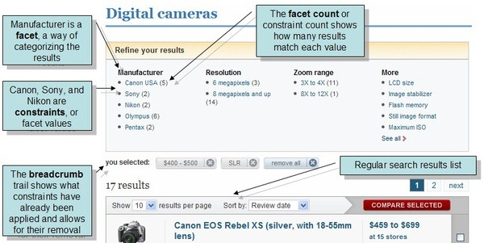
Advanced Topics Faceted Search

Slide 87
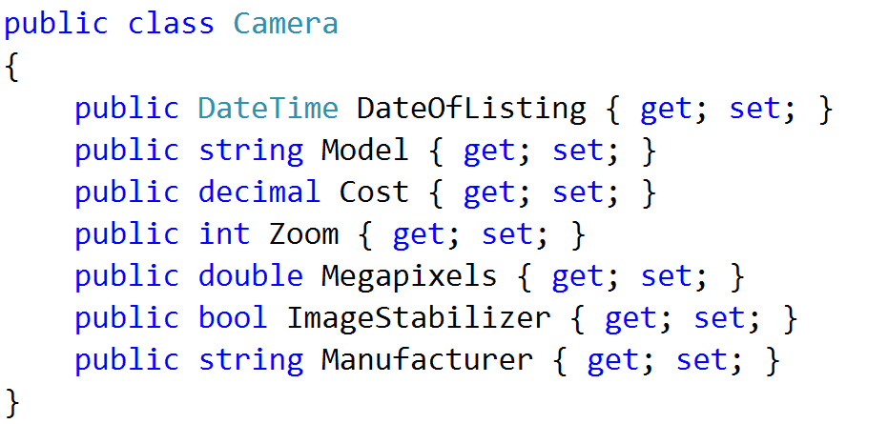
Advanced Topics Faceted Search
Sorry, no Soccer this time!

Slide 88
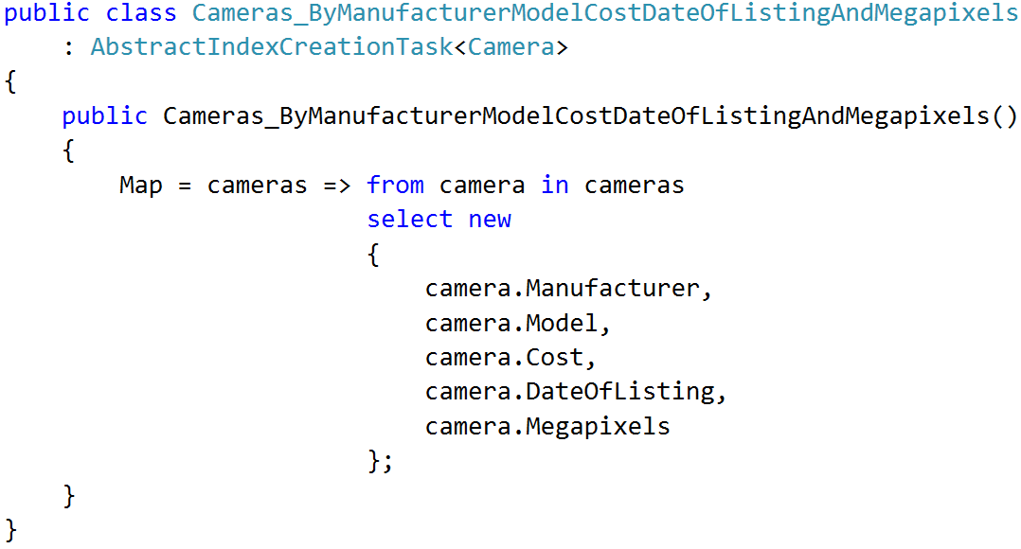
Advanced Topics Faceted Search

Slide 89
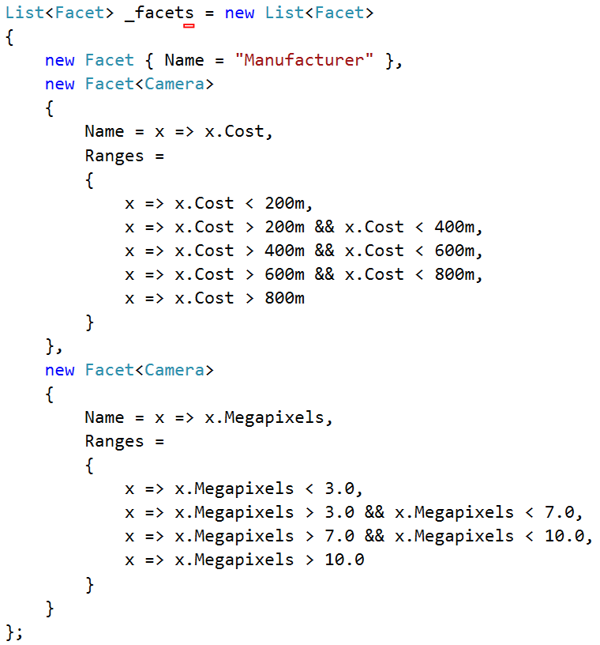
Advanced Topics Faceted Search

Slide 90
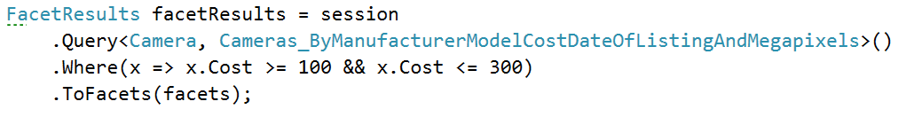
Advanced Topics Faceted Search
Cost_Range: [
{
Range: '[NULL TO Dx200.0]',
Count: 115
},
{
Range: '[Dx200.0 TO Dx400.0]',
Count: 102
}
]
Manufacturer: [
{
Range: 'canon',
Count: 42
},
{
Range: 'nikon',
Count: 46
},
]
Megapixels_Range: [
{
Range: '[NULL TO Dx3.0]',
Count: 42
},
{
Range: '[Dx3.0 TO Dx7.0]',
Count: 79
},
]

