Slide 1

Functional test automation - Selenium

Slide 2
Introduction
Quality assurance and test automation
Test automation plays significant role as part of quality assurance process .
Having stable automated tests makes process of testing influence of newly implemented functionalities on behaviour of the old ones much more reliable and faster.
Considering statement above, test automation doesn’t replace manual human testing effort! – It is designed for maintenance purposes of the old functionalities.
Considering large amount time and money needed for test automation and maintenance, it is highly advised to perform careful planning and creating adequate strategy before diving into test cases creation.

Slide 3
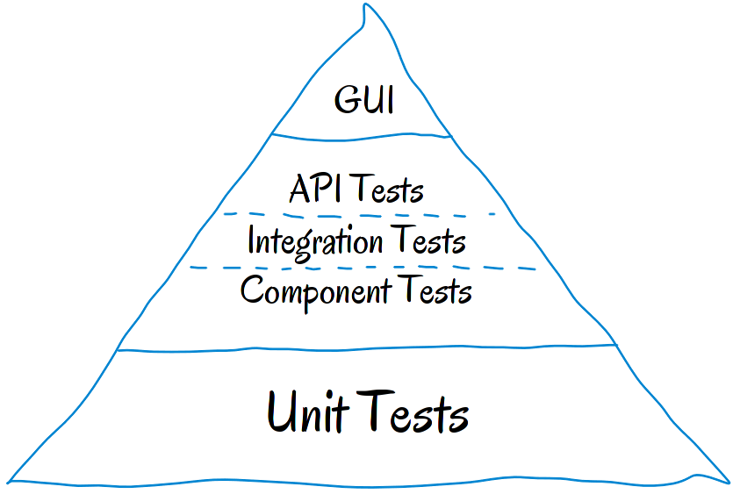
Testing strategy
Test pyramid
Test pyramid is the way of thinking about various kinds of Tests
that should be used for generating optimal test portfolio.
Surface area of the pyramid corresponds to the amount of particular
test type looked from the aspects of execution speed, creation and
maintenance cost.
As can be noticed from image, largest amount of Unit tests is required.
Reasons: High execution speed, small creation / maintenance costs.
Next are tests that can be performed via API layer of application,
Integration, Component.
Functional (UI) automated tests have smallest area due to large creation and
Maintenance costs.

Slide 4
User interface test automation
Pros and cons.
Advantages:
Simulates end user behaviour through the application. Can assure that functioning of the application at the highest level is not corrupted by new implementations. Covering huge amount of code through execution. Can be more reliable and faster than human manual testing effort.
Disadvantages:
Much slower than API and Unit tests. High creation costs, maintenance can become time consuming when test amount gets larger. Can offer false sense of quality, potential inability to catch incorrect behaviour of the application. Can be unreliable, sensitivity to changes that are not actual bugs (Changes in element locator values…)

Slide 5
User interface test automation
Tools
There are a lot of tools on market for performing UI test automation, they can be classified into “Record and play” and “Scripting” types.
Record and play:
User has graphical interface which enables him to record his actions by physically clicking through the application and in that way TCs are generated.
Tools: Selenium IDE …
NOTE: This way creates very unstable tests so it is best to be avoided.
Scripting:
Using corresponding library, page elements are selected and corresponding actions defined. More stable tests are created, possibility of running tests on various different browsers. Scripts can be coded in Java, C#, Python, Javascript …
Tools: Selenium Webdriver interface, Protractor

Slide 6
Selenium
Introduction
Selenium Is free, open source set of libraries developed for “Automating browsers”. It contains WebDriver interface that enables creation of automated scripts that can be run on various browsers (Chrome, IE, Firefox, …).
Selenium main purpose is creation of automated web application tests, but his usage is not confined in that area only. Various web-based administrative tasks can be automated using this interface.
For overcoming high maintenance costs and low reliability of UI testing scripts, various coding patterns can be applied. In this course we will cover page object model pattern supported by PageFactory class.
Entire course content is followed by real life examples from our internal web application zLibrary. Programming language used is JAVA.

Slide 7
Selenium
Course content
Downloading and setting up Selenium
Locator techniques & tools to identify WebObjects
Defining actions on Web elements and execution synchronization
Handling Alert popups, multiple windows and Frames
Limiting WebDriver scope
Selenium Assertions
Page object model pattern
PageFactory
TestNG
Maven
Integration TestNG with Maven, Surefire plugin and generating reports
Advanced Selenium

Slide 8
Selenium
Downloading and setting up Selenium
1. Selenium libraries can be downloaded from URL: https://www.seleniumhq.org/download/ , as it can be observed this interface if available for Java, C#, Ruby, Python, Javascript (Node).
2. Next step is downloading browser drivers, they are provided from browser manufactures so Selenium can access it more easily (Override security restrictions, etc.), download URLs:
Chrome: http://chromedriver.chromium.org/downloads
IE: https://www.seleniumhq.org/download/
Firefox: https://www.seleniumhq.org/download/ (This driver is called Mozilla Geckodriver)
3. Create new project in preferred IDE and import all libraries downloaded from step1
4. Create new class and set System property with path to location where downloaded drivers reside (from step2). Key – Value pairs are:
System.setProperty(“webdriver.gecko.driver”, GECKODRIVER_PATH) – Mozilla
System.setProperty(“webdriver.chrome.driver”, CHROMEDRIVER_PATH) – Chrome
System.setProperty(“webdriver.ie.driver”, IEDRIVER_PATH) – Internet explorer
IMPORTANT: Always check that browser version you are using for testing corresponds to driver version used!

Slide 9
Selenium
Downloading and setting up Selenium
After including Selenium and setting up system property, WebDriver object has to be created. This object will receive most of the methods that are related to actions defined on various elements.
Syntax: Chrome: WebDriver driver = new ChromeDriver(); | Firefox: WebDriver driver = new FirefoxDriver(); |
After these steps are performed, you are ready for writing scripts.
Opening desired URL can be achieved by calling .get(URL) method on driver object. E.g. driver.get(www.zuehlke.com) – This line of code will open new browser window with URL.
There are two ways of closing browser:
Closing current browser – driver.close();
Closing all browsers – driver.quit();
Best practice:
Because there might be need to run your scripts on various browsers and environments, good thing is that initialisation steps be defined inside public static method of a separate class that returns WebDriver object already configured (Called e.g. “BrowserFactory”). Considering demand for high script flexibility, one of ways to manage it is to create Interface where all technical info is contained (Browser drivers paths, environment URLs, user info…).
See Images on next page for example.

Slide 10
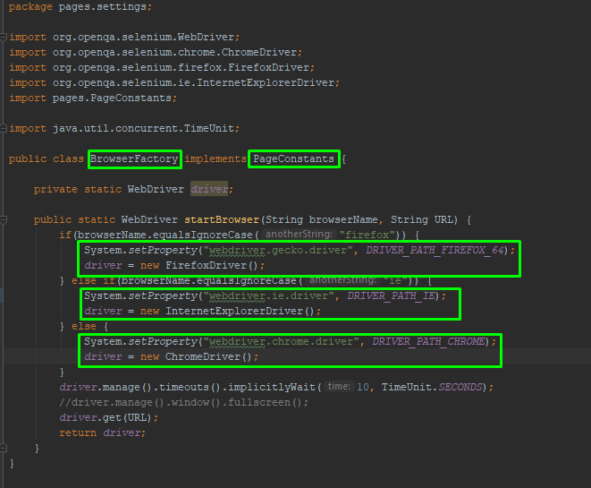
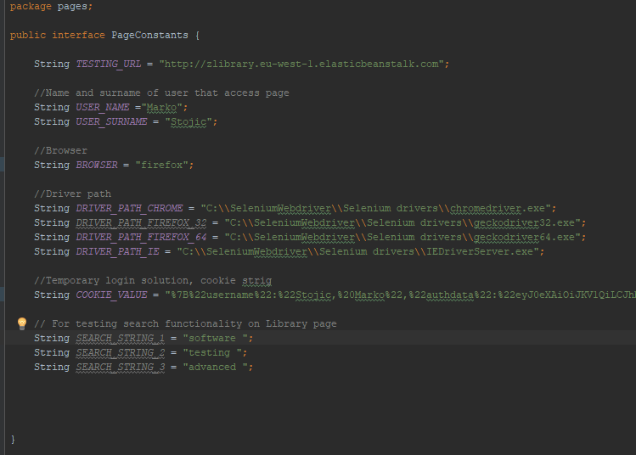
Selenium
Downloading and setting up Selenium - Example

Slide 11
Selenium
Locator techniques
Web objects has to be uniquely identified in order to define actions on them. There are several ways for achieving that, via: ID, class, name, link text, Xpath, Css selector.
Best and fastest way is to identify it via “ID” attribute, but one must be careful that it is has static value.
In Selenium there is class called “By” that exports methods used for locating desired WebObjects. Examples:
ID: By submitButton = By.id(“submit”);
Class: By submitButton = By.className(“submit”);
Link text: By submitButton = By.linkText(“Submit”);
Xpath: By submitButton = By.xpath(“//button[@id=‘submit’]”);
CSS: By submitButton = By.cssSelector(“button[id=‘submit’]”);
See image above:

Slide 12
Selenium
Locator techniques - XPath
Syntax: //tag name[@attribute=‘attribute value’] | e.g. //a[@id=‘test’]
Xpath can be used as relative and absolute.
Relative is preferred way, with it we target specific element directly or starting from nearest unique element in structure e.g. //a[@id=‘test’]/button
Absolute goes to the desired element using complete path from HTML root element. If anything changes on this path, xpath gets invalid. E.g. /html/body/div[5]/div/div[2]…
Going to parent, child or sibling from current element (Traversing):
Parent – Child traversing | Syntax: //tag name[@attribute=‘attribute value’]/tag name/…/tag name | e.g. //a[@id=‘test’]/div[2]/button
Child – Parent traversing | Syntax: // tag name[@attribute=‘attribute value’]/parent::tag name | e.g. //a[@id=‘test’]/parent::div
Current sibling traversing (On same hierarchy level) | Syntax: //tag name[@attribute=‘attribute value’]/following-sibling::tag name | e.g. //a[@id=‘test’]/following-sibling::div
Regular expressions
Any tag name element with certain attribute: //*[@attribute=‘attribute value’] | e.g. //*[@class=‘test’] → Locates all elements with class attribute value ‘test’
Element that contains certain text: //tag name[contains(text(), ‘desired text’)]

Slide 13
Selenium
Locator techniques – CSS selector
Advantages: faster than xpath, easier syntax.
Syntax: tag name[attribute=‘attribute value’] | e.g. a[id=‘test’]
There are shortcuts for writing CSS Selector when selecting elements via class or id, Syntax:
ID: #id value | e.g. #test
CLASS: .class value | e.g. .test
Going to child or sibling from current element (Traversing):
Parent – Child traversing | Syntax: tag name[attribute=‘attribute value’]>tag name>…>tag name | e.g. a[id=‘test’]>div[2]>button
Child – Parent traversing | Cannot be done using CSS selector, this is downfall of using this way.
Current sibling traversing (On same hierarchy level) | Syntax: tag name[@attribute=‘attribute value’]+tag name | e.g. a[id=‘test’]+div
Regular expressions
Attribute value contains value: tag name[attribute*=‘attribute value’]

Slide 14
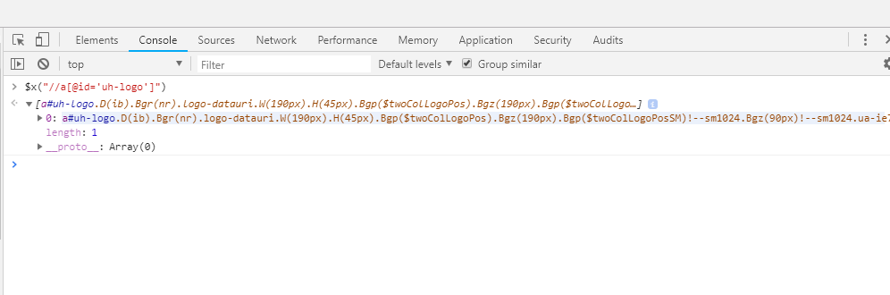
Selenium
Locator techniques - verifying custom made locator
There are a lot of tools for generating xpath / css locations but it is highly recommended to write them on your one by going to browser’s developer tools and inspecting desired element.
After you’ve written yours xpath / css selector location, it has to be verified. Best way of doing that is in console tab of browser’s developer tools.
For Xpath, Syntax: $x(“your xpath”) | e.g. $x(“//a[@id=‘test’]”)
For Css selector, Syntax: x(“your css”) | e.g. x(“a[id=‘test’]”)
After entering this line of code, element should be listed underneath, check if this is element or elements that are expected. See example screenshot:

Slide 15
Selenium
WebElement and List<WebElement>
WebElement represents HTML element of application that is located in Selenium using “By”. On this object actions can be defined.
After you have uniquely identified page element via previously mentioned locator techniques and stored it’s value in By object (e.g. By loginButton = By.xpath(“//button[@id=‘submit’]”)) you are ready to get web element object.
This can be done using method .getElement(ByObject) that is called on WebDriver driver object. As parameter to this method By object containing locator is passed. This method returns WebElement object.
Example code: WebDriver driver = new ChromeDriver(); By loginButton = By.cssSelector(“button[@id=‘submit’]”) ; WebElement loginButtonEl = driver.getElement(loginButton);
Method .getElements(ByObject) returns List<WebElement> , this method is quite useful e.g. for identifying if element is present in HTML code. If it is not present, List<WebElement> will have size 0.

Slide 16
Selenium
Defining actions on WebElement objects
Now that WebElement objects are defined, you need to define actions to be performed on them. It is done by calling specific method on corresponding object.
Simple actions:
Element.click(); - Clicks on defined WebElement
Element.sendKeys(“Text”); - Inputs “Text” value into input field | NOTE: For sending specific keyboard actions (e.g. Shift …) use Keys class constants (e.g. Keys.SHIFT …)
Element.isDisplayed(); - Returns Boolean value if element is displayed on page (NOTE: Always first check if element is present in code before checking, that can be done by asking if List<WebElement> is > 0)
There are a lot more simple actions that Selenium WebDriver provides, these are most commonly used.

Slide 17
Selenium
Defining actions on WebElement objects
Composite actions – Defining several actions in one step:
For performing more complicated actions on WebElements composite actions are used (e.g. Drag and drop from element1 to element2 …)
First step is to define Actions object and pass WebDriver object as parameter into it’s constructor: Actions action = new Action(driver);
Now on this object corresponding methods are called (>= 1), when composition of actions is defined .build().perform() methods need to be called in order for composite action to be run.
Examples:
Simulates moving mouse pointer to WebElement element, clicking on it and holding “Shift” key while writing text into input field (Large letter input) – action.moveToElement(element).click().keyDown(Keys.SHIFT).sendKeys(“test”).build().perform();
Simulates drag and drop from WebElement source to WebElement target – action.dragAndDrop(source, target).build().perform();
NOTE: There are a lot of interesting actions, their names are self-descriptive and you can play with them using automated methods suggestions provided by IDE.

Slide 18
Selenium
Defining actions on WebElement objects – static Dropdown menu
Static dropdown is menu where offered options are preloaded, in HTML structure it has <select> tag.
Selenium WebDriver library exports Select class that is convenient for handling this kind of element. In this class constructor previously located WebElement is passed and various available method can be called on this object.
Code: WebElement staticDropdown = By.xpath(“//select[@id=‘prices’]”); Select dropdown = new Select(staticDropdown);
Methods available in Select class are:
dropdown.selectByValue(“2”) – Selects value two from dropdown options.
dropdown.selectByVisibleText(“text”) – Selects value from dropdown options that has visible value “two”.
dropdown.selectByIndex(3) – Select third option in row from dropdown options.

Slide 19
Selenium
Defining actions on WebElement objects – Checkboxes & RadioButtons
Checkboxes
Since checkbox can have two states (selected and not selected), WebDriver library provides .isSelected() method that return Boolean value if checkbox is selected. As with all other examples, this method is called on previously defined WebDriver object.
HINT: In some forms dropdown menu can be opened over checkbox at moment when we want to perform some action on it. Selenium will throw error “not clickable”. In this cases it is good practice to first check if element .isDisplayed() before attempting to perform some action on it.
Radio buttons
Set of radio buttons on one page usually have common type and name attributes. Best way of handling radio buttons Is to locate them by common attribute and then using .getElements(Locator) to get all of them in one List<WebElement> . Now elements can be chosen by index (elements.get(index)) of iterated through for loop in order to perform action on desired element. E.g.
for(int I = 0; I < elements.size(); i++) {
if(elements.getAttribute(“name”).equals(“Male”)) elements.get(i).click();
}

Slide 20
Selenium
Script synchronization
Since scripts are running with tempo that is independent of application under test, it needs to be well synchronized for sake of testing stability and validity. E.g. if you run into slow loading page during execution and script has no pause defined at this point it will keep running lines of code and start looking for element that is not yet loaded which will cause it to fail.
During scripts creation one should always have in mind balance between script stability and it’s execution time (Greater stability, more time it takes to execute). It is quite important to balance these two factors.
There are two types of script synchronization:
1. Implicit wait
Implicit wait is defined globally on WebDriver object so it is applied between every two test steps. Script will wait for presence of element NumSec until throwing an error if not found.
This wait should always be defined, but kept on minimal value since it can make script execution time much longer.
Code: driver.manage().timeouts().implicitlyWait(NumSec, TimeUnit.SECONDS);

Slide 21
Selenium
Script synchronization
1. Explicit wait
Explicit wait is defined on some particular element. For example script will wait for specific element to be present on page until continuing with execution.
It is defined using Code: WebDriverWait wait = new WebDriverWait(driver, 25);
Second parameter in WebDriverWait constructor represents max number of seconds script should wait before throwing an error. This object should be defined once per script, potentially as instance variable (To be visible to all class methods) or in separate class that handles syncs.
Once wait object is created, explicit wait can be defined by calling method “until” on it: wait.until(ExpectedConditions.desiredActivity);
As parameter to “until” method we pass ExpectedConditions class that has various desired activities defined in it. Mostly used activities are:
wait.until(ExpectedConditions.visibilityOfElementLocated(ByObject)) – Waits until element located by By object passed is visible, or MAX seconds defined.
wait.until(ExpectedConditions.invisibilityOfElementLocated(ByObject)) – Waits until element located by By object is invisible.
wait.until(ExpectedConditions.presenceOfElementLocated(ByObject)) – Waits until element located by By object is present in code.
wait.until(ExpectedConditions.elementToBeClickable(ByObject)) – Waits until element located by By object is clickable.
NOTE: There are a lot of more ExpectedConditions, you can investigate them by observing list of proposed methods in this class.

Slide 22
Selenium
Handling alert popups
When alert displays on page we are scripting, in order to define actions on it we must first switch Selenium driver on that popup.
Code to do this is: Alert alert = driver.switchTo().alert(); - calling this methods on WebDriver object returns Alert object.
Now actions can be performed:
alert.accept() – Accepts message prompted
alert.dismiss() – Dismisses message prompted
alert.getText() – Returns prompted text
alert.sendKeys(“Text”) – Enter “Text” in input field of alert (if any)

Slide 23
Selenium
Handling multiple windows
Some actions performed on pages can lead us to new tab or new browser page, these are steps for handling multiple windows situation:
First we need to call getWindowsHandles() method on WebDriver object, this method returns set of opened windows unique IDs.
Next iterate through given set and switch to desired window, note that IDs are placed in this set in order these windows were opened.
Code:
Set<String> handles = driver.getWindowHandles(); // Returns Set of unique window IDs
Iterator<String> iterator = handles.iterator(); // Creates new Iterator to go through IDs
String id = iterator.next(); // Returns first ID
String id1 = iterator.next(); // Returns second ID, and so on…
…
Now use id do switch your driver to desired window:
driver.switchTo().window(id);

Slide 24
Selenium
Handling frames
Frames are containers that are independent from main HTML code, their content may come from some other web site. To perform element actions on these pages we need to switch Selenium driver there using .switchTo() method. Frames can be identified in HTML by tag <iframe>.
There are several inbuilt methods for handling frames:
driver.switchTo().frame(5) // Switches to frame that is 5th in row from root of the page.
driver.switchTo().frame(WebElement frame) // Switches to frame that was previously located and stored as WebElement object.
driver.switchTo().frame(String idValue) // Switches to frame that has “id” attribute value idValue.
Quite often it happens that injected frames don’t have static id values, that makes them hard to locate using traditional locator techniques. Best way of switching to desired frame is:
Find some uniquely identifiable element locator from desired frame using inspector and store it in By variable
Get list of all frames on page using code: driver.findElements(By.tagName(“iframe”))
Iterate through list of frames using for loop, in every iteration switch to next frame and ask if WebElement located in step 1 is present, if it is you are currently on right frame so break out of the loop. See code example on next page.
NOTE: After you are done with performing actions on frame don’t forget to switch back to origin page, syntax: driver.switchTo().defaultContent();

Slide 25
Selenium
Handling frames dynamically, example:
By locatorInsideFrame = By.id(“unique”);
List<WebElement> frames = driver.findElements(By.tagName(“iframe”));
for(int I = 0; I < frames.size(); i++) {
driver.switchTo(frames.get(i));
List<WebElements> insideFrameElements = driver.findElements(locatorInsideFrame);
if(insideFrameElements.size() > 0) break;
}

Slide 26
Selenium
Limiting WebDriver scope
Limiting scope of WebDriver makes driver to look for elements only inside scope of one particularly defined section. E.g. If we want to search for elements inside footer section only, disregarding rest of page, or if we want to search for elements inside one particular div element.
Limiting scope is done by calling .findElement() or .findElements() on already defined WebElement object which in this case represents section element where we want to remain.
This strategy might be helpful when trying to identify elements that are not uniquely identifiable on global page scope.
Example:
WebElement footerSection = driver.findElement(By.id(“footer”));
WebElement footerColumn = footerSection.findElement(By.id(“leftColumn”));
List<WebElement> links = footerColumn.findElements(By.tagName(“a”));
…. And so on …

Slide 27
Selenium
Assertions
Assertions are lines of code inside script that are used to compare expected vs actual results at that point of script execution. They are the most important parts of script since their failure will make script to fail and catch undesired behaviour of application under test.
If assertions are not set properly, scripts may not fail on undesired behaviour and miss their purpose so become useless.
Selenium built in assertions:
Assert.assertEquals(message, expected, actual) // Stops script and writes message in console output if expected != actual
Assert.notEquals(message, expected, actual) // Stops script and writes message in console output if expected == actual
We will cover assertions in more details in Junit section since this framework has its own set.

Slide 28
Selenium
Page object model pattern
Page object model (POM) is a test case design pattern that makes code cleaner, easy to understand and keeps maintenance efforts as low as possible.
In POM every single page of application under test is one class. Every page class should contain all relevant WebElements from corresponding page. Locators of elements should be instance variables, public methods are actually actions defined on them and should be named so they precisely describe action and element (e.g. clickLoginButton(), enterUsername(String username) …).
Since all relevant methods used in page classes are called on WebDriver object, there are several ways of passing it into class:
Pass already initialized WebDriver object through page class constructor, store it inside class instance variable
If using PageFactory in POM, driver instance is handled by passing WebDriver object in .initElements(driver, PageName.class) method (Will be covered in more details)
By having page objects separated from actual running TCs, WebElements located in page classes become reusable and centralized so e.g. if path to some element changes we have to change it in only one place and these changes are automatically reflected in all TCs that use it.

Slide 29
Selenium
Page object model – basic approach
Basic approach in creating POM (Without using PageFactory) can be separated in several actions:
Create package called “pages” where all page classes will be stored.
In every page class define By objects with unique WebElement locators as instance variables.
Create WebDriver instance variable.
Create constructor method that accepts WebDriver object as parameter and sets value of this driver to passed driver.
Define public methods with defined actions on elements.
Add methods for checking if WebElement is present in code that returns boolean value. e.g. public boolean isPresentLoginButton() { driver.findElements(loginButton).size() > 0; }
NOTE: When using page classes in our TCs, new object is created and WebDriver object is passed in constructor. Actions are defined by calling methods on appropriate page object.
See examples on following pages:

Slide 30
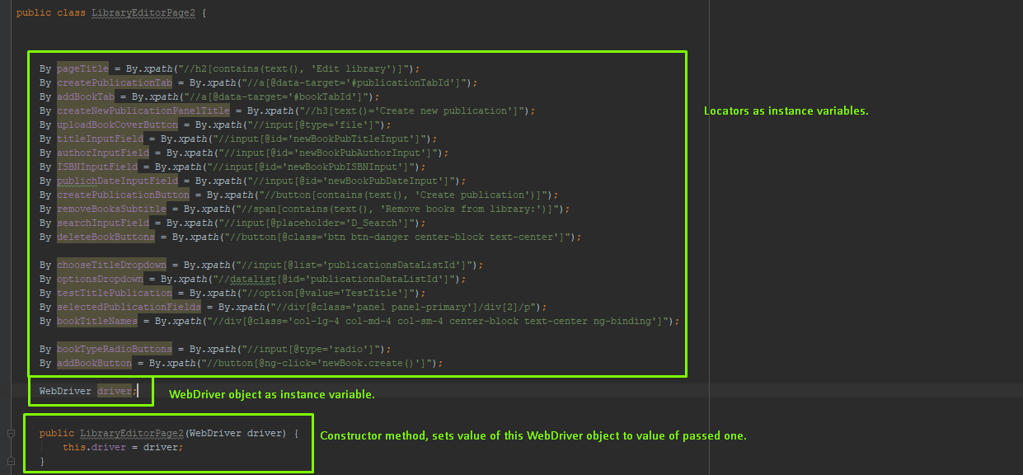
Selenium
Page object model – basic approach – Example

Slide 31
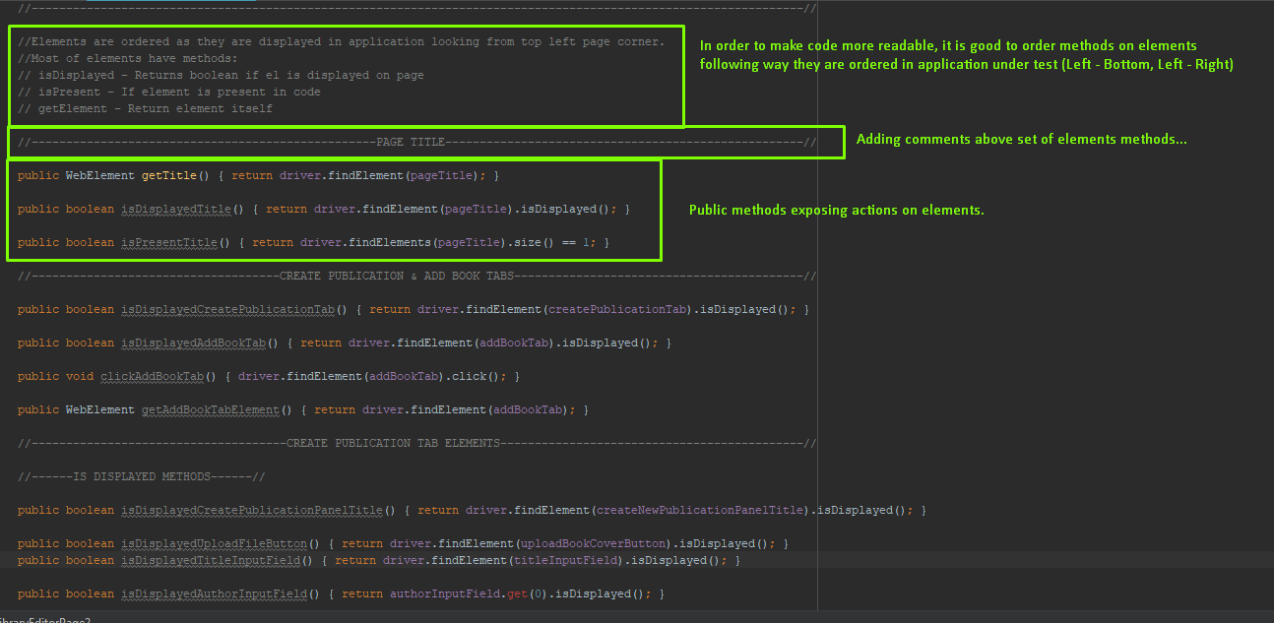
Selenium
Page object model – basic approach – Example – constructor

Slide 32
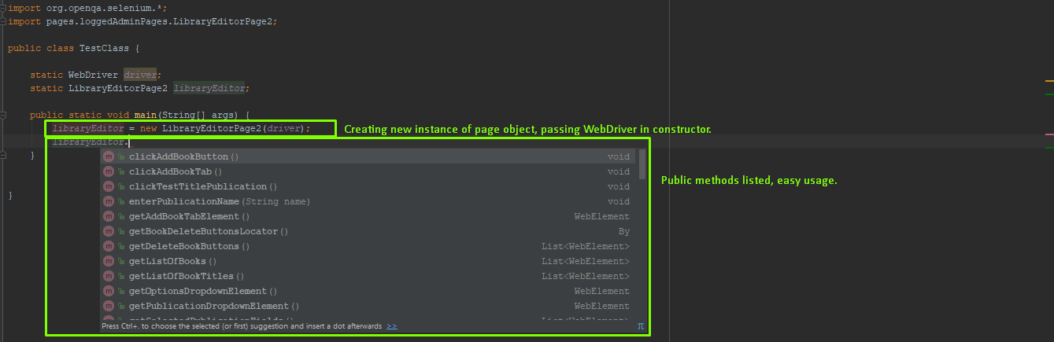
Selenium
Page object model – basic approach – Example – usage in TCs

Slide 33
Selenium
Page object model –PageFactory class
Approach in creating POM with PageFactory can be separated in several actions:
Create package called “pages” where all page classes will be stored.
In every page class define instance variables using @FindBy(how = How.LocationTechnique, using=“Locator value”) annotation.
Create WebDriver instance variable.
Define public methods with defined actions on elements.
Notice that when using PageFactory approach, there is no need of defining constructor method and passing/storing WebDriver object. All of these actions are handled by PageFactory class internally.
Usage of classes defined this way in concrete TCs is a little bit different then on basic approach. New page object variable needs to be initialised using following syntax: e.g. Navigation navigate = PageFactory.initElements(driver, Navigation.class)
One of options when defining public methods is using List<WebElement> for storing WebElements, this approach makes script execution slower but reduces maintenance efforts since if element is not found on page, “Index out of bounds” exception with exact line of code where it occurred will be displayed. By having this you can jump to problematic line of code just by clicking link in console logs.
NOTE: There are a lot of other annotation and methods exported by this class than presented in this presentation, investigate them if needed.
See examples on next page:

Slide 34
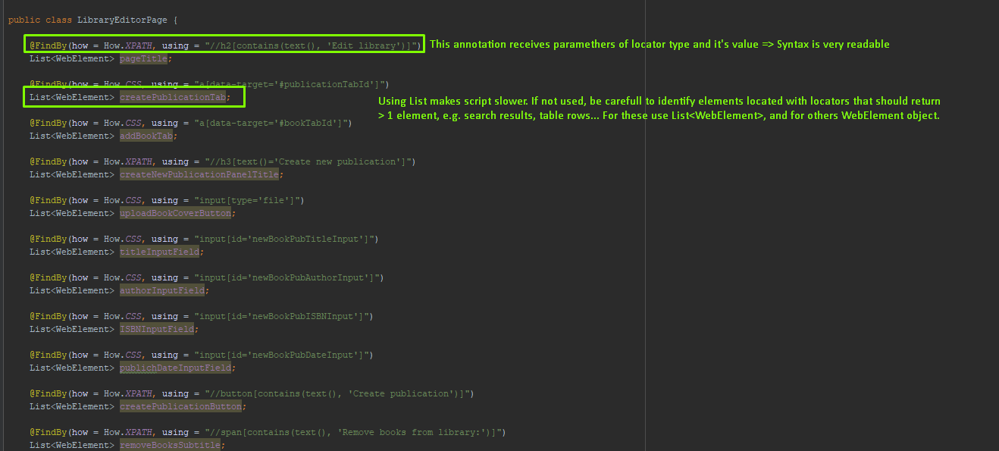
Selenium
Page object model – Examples

Slide 35
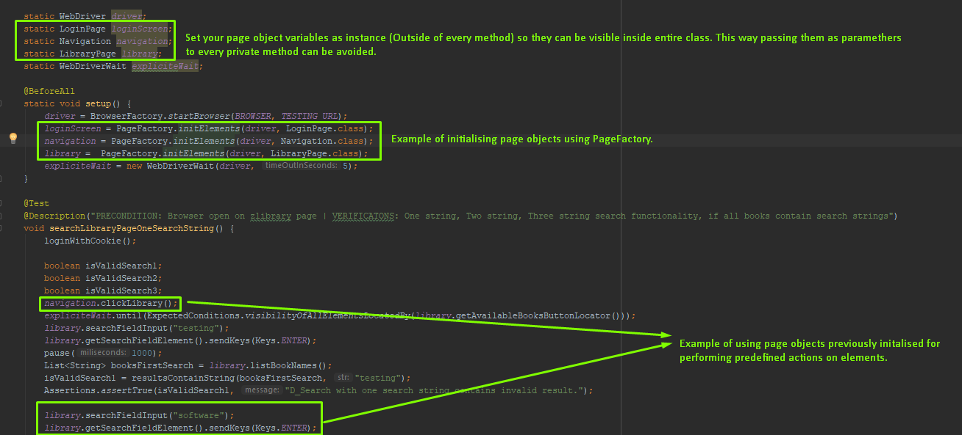
Selenium
Page object model – Examples – Usage in TCs

Slide 36
Selenium
TestNG – See documentation: https://testng.org/doc/index.html
TestNG is an open source framework designed for writing tests in Java programming language.
Advantages of using frameworks in automated TCs creation:
No need for calling public static void main(String[] args) when executing tests. Junit handles this internally.
Easier organization of TCs using @Test annotation. Class is test suite, @Test represent individual TCs.
Execution results displayed in console visually.
Wide amount of possible annotations and assertions.
Possibility of exporting execution results in XML file.
Possibility of managing execution using XML file.

Slide 37
Selenium
TestNG – Creating tests
Test suite is one class file and individual test cases are specified using @Test annotation.
Under @Test annotation test case is defined as method that returns void, without privacy method declaration part
E.g. @Test
void searchLibraryPageWithOneSearchString() { …code… };
@BeforeSuite / @AfterSuite annotations are used as test suite precondition/postcondition at global level, code under these annotations will be executed before/after all tests defined are.
E.g. @BeforeAll @AfterAll
static void createUsers() { …code…}; static void deleteUsers() { …code…}
@BeforeEach / @AfterEach annotations are used as test case precondition/postcondition at level of TC. Code under these annotations will be executed before/after every @Test method.
@BeforeMethod / @AfterMethod annotations are used when we want certain method to be executed before / after every TC annotated with @Test.

Slide 38
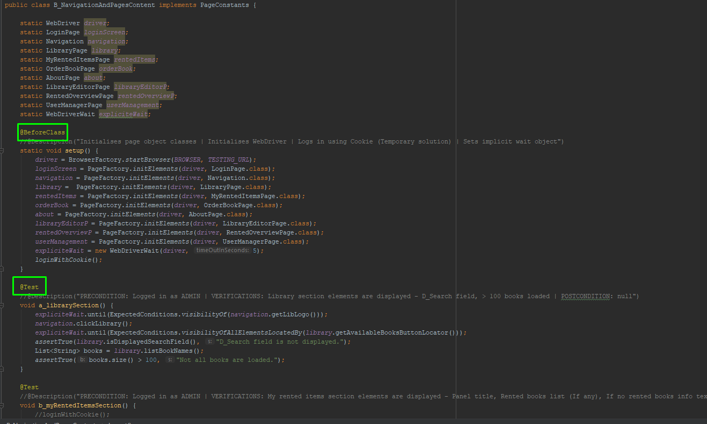
Selenium
TestNG – Creating tests - Example

Slide 39
Selenium
TestNG – Assertions
This framework offers a lot of various assertions, they are very well documented on their website.
Refer to URL: http://static.javadoc.io/org.testng/testng/6.8.17/org/testng/Assert.html

Slide 40
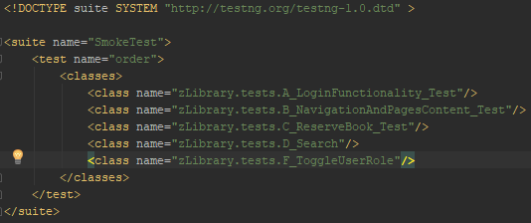
Selenium
TestNG – Executing tests – testng.xml file
TestNG manages defined TCs execution internally, without necessity of using public static void main(String[] args) method.
Inside testing.xml file test suite, test folder and tests are listed.
<suite name:“TestSuite”> defines test suite, <test name:”TestFolder”> defines test folder and <class name:“TC”> nested inside <classes> tag represent test cases, example:
Test cases can be run directly from testing.xml file.

Slide 41
Selenium
TestNG – Executing tests – Managing execution
Using testing.xml file you can manage execution patterns in a lot of useful ways.
Skipping specific TCs from test class (Annotated with @Test) using include and exclude mechanisms, can be done by adding <methods> tag nested inside corresponding test class tag. Inside <methods> tag, <include> or <exclude> tags should be nested with name attribute that represents name of method to be included/excluded.
Regular expressions can be used when including/excluding mechanisms by adding .* at the end of method name. This way all methods that start, end or contain certain string can be influenced. E.g. <exclude name=“test.*”>
Exclude mechanism ignores corresponding annotated @Test method in class.
Include mechanism ignores all methods except corresponding method.
All test cases inside one package can be defined in testing.xml using <package> tag with name attribute containing package name nested inside <packages> tag.
See example on next page.

Slide 42
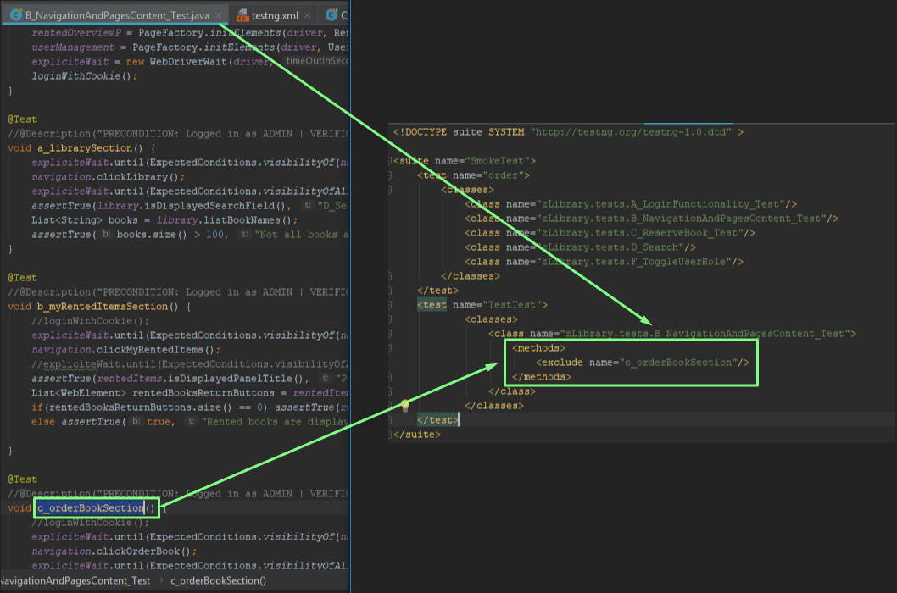
Selenium
TestNG – Executing tests – Exclude mechanism example

Slide 43
Selenium
Maven
Maven is software project and build management tool for Java frameworks
Why is Maven important in building robust testing framework:
Access to central repository to access dependencies – URL: https://mvnrepository.com/
Maintaining common structure across organization – Templates for various projects – URL: https://maven.apache.org/guides/getting-started/maven-in-five-minutes.html
Flexibility in integrating with CI tools – Ability to run TCs via cmd
Has plugins for Test framework execution - (e.g. Surefire)

Slide 44
Selenium
Maven - Terminology
GroupId – package name in project
Uniquely identifies project
Artifact – project name in generated project
Subproject of the groupId, e.g. Selenium project in C# or other language
Building project, see https://maven.apache.org/guides/getting-started/maven-in-five-minutes.html - Choose archetype quickstart, it is most commonly used template for testing.
Hint when using automatically generated projects in Eclipse: We need to create .classpath file (Generated automatically when we create project using Eclipse). Since this project structure is generated outside of Eclipse we need to create .classpath file manually. Go to directory where src folder is present, and in cmd type mvn eclipse:eclipse.
Maven stores downloaded dependencies into C:\Users\username\.m2\repository directory.

Slide 45

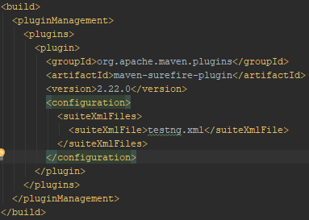
Selenium
Maven – pom.xml, test execution plugin, integration with testing.xml
Pom.xml file is most important file in maven based projects. Inside it dependencies, plugins and configurations are defined.
Every dependency has groupId, artifactId, version. See image below:
Pom.xml file can manage plugins used also. One of very useful plugins in test automation when using Maven is Surefire plugin, it manages test execution.
Plugins are added by adding <build> with nested <pluginManagement> , <plugins> and <plugin> tags. See image below:

Slide 46
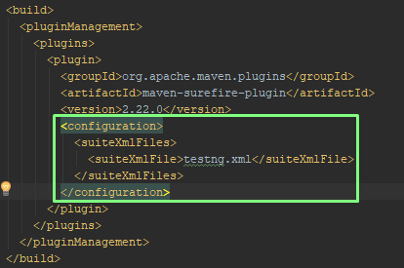
Selenium
Maven – pom.xml, test execution plugin, integration with testing.xml
One more thing worth mentioning about configuring pom.xml file is that in it testing.xml can be incorporated. This way provides integration of TestNG execution management capabilities with maven so execution can be handled from testing.xml and run using maven itself.
This can be done by adding <configuration> tag with nested <suiteXmlFiles> and <suiteXmlFile> inside previously added <pluginManagement> , <plugins> , <plugin> . See image below:
Example of complete pom.xml file can be found on image displayed on next slide.

Slide 47
Selenium
Maven – pom.xml, test execution plugin, integration with testing.xml
One more thing worth mentioning about configuring pom.xml file is that in it testing.xml can be incorporated. This way provides integration of TestNG execution management capabilities with maven so execution can be handled from testing.xml and run using maven itself.
This can be done by adding <configuration> tag with nested <suiteXmlFiles> and <suiteXmlFile> inside previously added <pluginManagement> , <plugins> , <plugin> . See image below:
Example of complete pom.xml file can be found on image displayed on next slide.

Slide 48
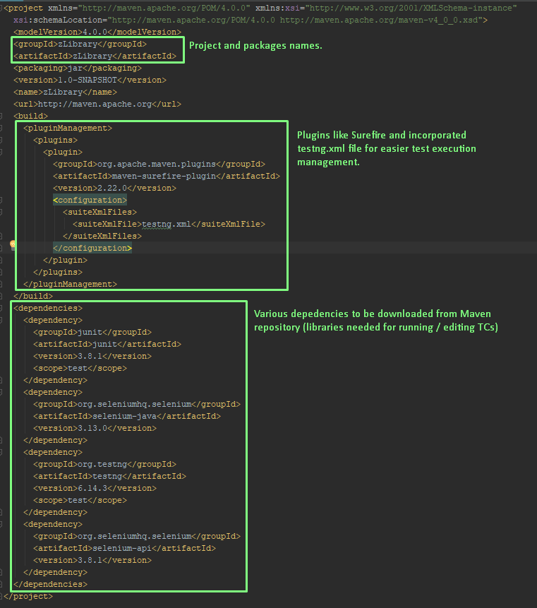
Selenium

Slide 49
Selenium
WebDriverManager
In order to achieve complete robustness of your scripts, there is one more step that need to be performed.
Remember when we mentioned at the beginning of this presentation that in order to run scripts on specific browser you need to download corresponding driver and set system property to relative path that driver is stored. Bad side of this approach is that these files are quite large and you don’t have enough flexibility since relative path is used in your code. So when new people pull scripts from repo, they would need to download these files, put in desired folders and change paths in script code.
To overcome this drawbacks you should add following dependency in your pom.xml file:
<depedency>
<groupId>io.github.bonigarcia</groupId>
<artifactId>webdrivermanager</artifactId>
<version>2.2.5</version>
</depedency>
Library usage: In your BrowserFactory class comment out System.setProperty(“…”, “…”) and instead put following line of code:
WebDriverManager.chromedriver().setup();
NOTE: There are corresponding methods for every available browser, see screenshot example on next page.
Example of complete pom.xml file can be found on image displayed on next slide.

Slide 50
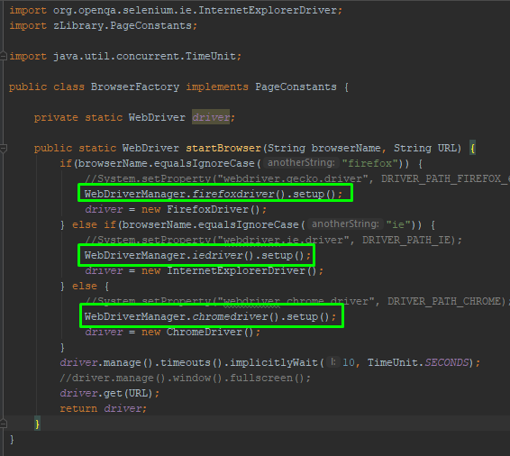
Selenium
WebDriverManager

Slide 51
Selenium
Reports generated from Surefire plugin
Once tests are executed using Maven with Surefire plugin, execution results are automatically generated. In order for them to be generated at least one of existing TCs included in execution have to fail or to be skipped.
Reports are stored in projectName/target/surefire-reports folder as .html file.
There are two types of reports generated: index.html and emailable-report.html
index.html represents quite detailed file that contains number of passed failed and skipped TCs with corresponding error logs and individual methods execution times.
emailable-report.html is report on one page convenient for sending on email to persons of interest.
See emailable-report.html example on next page.

Slide 52
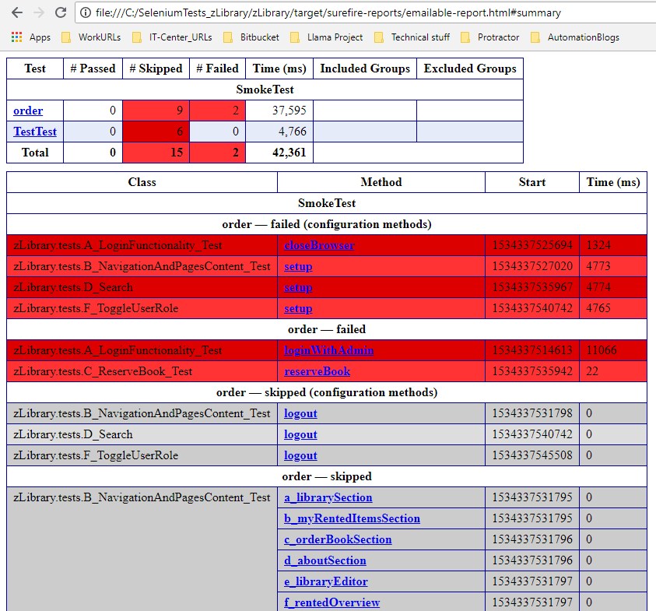
Selenium

