Slide 1
JavaScript basics -introduction TO the Curriculum

Slide 2
Introduction to the course
This course was created for new developers who have less experience with HTML, CSS and JavaScript.
Goal is to get a foundational understanding you can build upon and make the boarding easier on projects.
The course covers :
The basic concepts of JavaScript
Debugging
Best practice
The complete course can be found on BitBucket:
https://bitbucket.org/zuehlke/zrs_curriculum/src

Slide 3
Format
Every topic is a separate presentation
Presentations are written in markdown format
You will need the following tools:
MarkdownPad or a different markdown reader/editor
WebStorm or a different text editor/ IDE with JavaScript syntax support
NodeJs
Some projects may require additional setup (ask if you need any help)

Slide 4
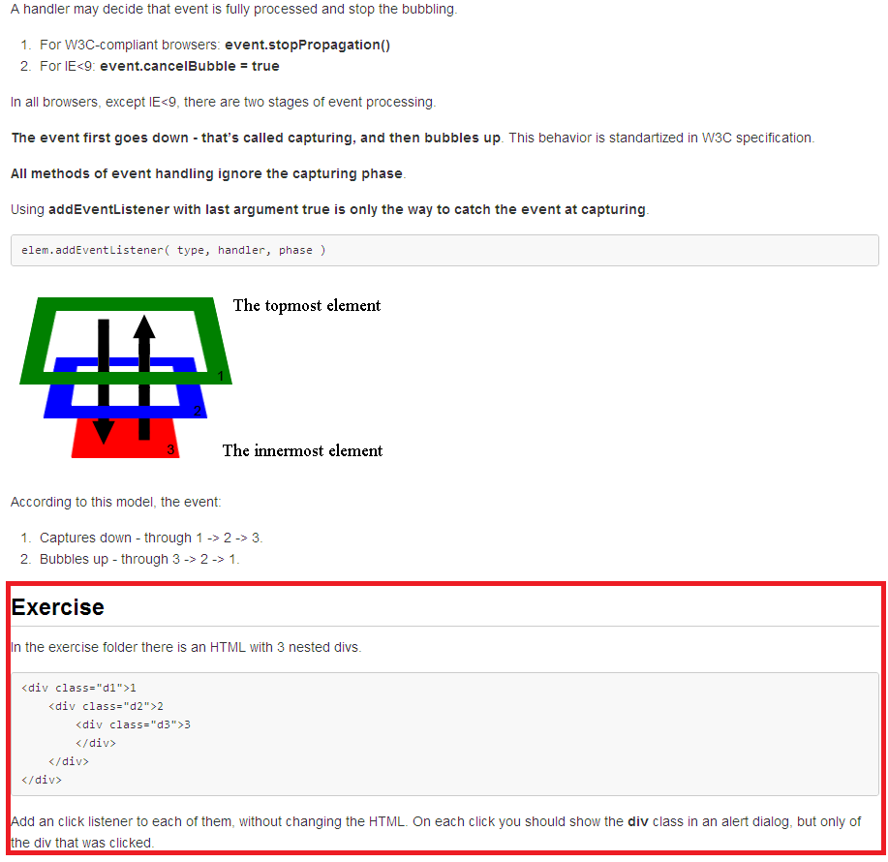
Format
At the end of each presentations is an exercise you should try to solve
The exercise files are in the same folder as the presentation

Slide 5
Topics covered
This course covers the following topics:
JS basics
JS standard library
HTML & CSS basics
JS functions
DOM Manipulation
Events
JS objects
AJAX
Debugging
Best practices

Slide 6
JS basics
JavaScript basics presentation covers the basic functionalities of the language by ECMAScript 5 specifications.
It covers data types, operators, flow control and loops, error handling (Error object, try...catch...finally) and scope of variables.

Slide 7
JS standard library
JS standard library presentation covers built-in objects like Math, Date, Array and String including their methods and properties.
The presentations provides an overview of built in functions that can be used to manipulate objects.

Slide 8
HTML & CSS basics
HTML & CSS basics go through the basic components of a web page like the HTML tags, CSS selectors and the HTML forms.
The presentation gives a very basic overview of how web pages should be structured and how styling can be applied.

Slide 9
JS functions
JS functions presentation covers how functions can be declared, gives an overview of closures, scopes higher order functions.
This presentation should give an insight on how JavaScript functions are different from functions in other programming languages.

Slide 10
DOM Manipulation
DOM Manipulation presentation covers:
JS native functions
jQuery manipulation (selectors & functions)

Slide 11
Events
Events presentation explains event bubbling and capturing, how we can listen for events on DOM elements, and different ways to implement listeners using vanilla JavaScript and jQuery.

Slide 12
JS objects
JS objects presentation covers JavaScript’s prototypical inheritance, different ways to create new objects and how namespacing can be used to reduce global variables.

Slide 13
AJAX
AJAX presentation covers:
Theory on AJAX
JS Native AJAX calls
jQuery AJAX calls

Slide 14
Best practices
Best practices presentation provides a basic guideline on how to organize and write HTML, CSS and JavaScript code.

Slide 15
Debugging
Debugging:
To get a better understanding of how Chrome Developer Tools can be used we created an AngularJs application that gets the data from a NodeJs server.
The instructions on how to run the applications are in the Read Me files of the applications.
Feel free to ask for help

Slide 16
contact
If you have any questions, you can contact:
Sutulovic Mladen
Starcevic Milan
Spuzic Nenad

