Slide 1
JavaScript basics -introduction TO the Curriculum

Slide 2
Introduction to the course
Introduction to the course:
For beginners
Covers the basic concepts of JavaScript
Debugging
Best practice
Goal is to get a foundational understanding you can build upon

Slide 3
Format
Every topic is a separate presentation
Presentations are written in markdown format
Tools you will need:
MarkdownPad or a different markdown reader/editor
WebStorm or a different text editor/ IDE
NodeJs

Slide 4
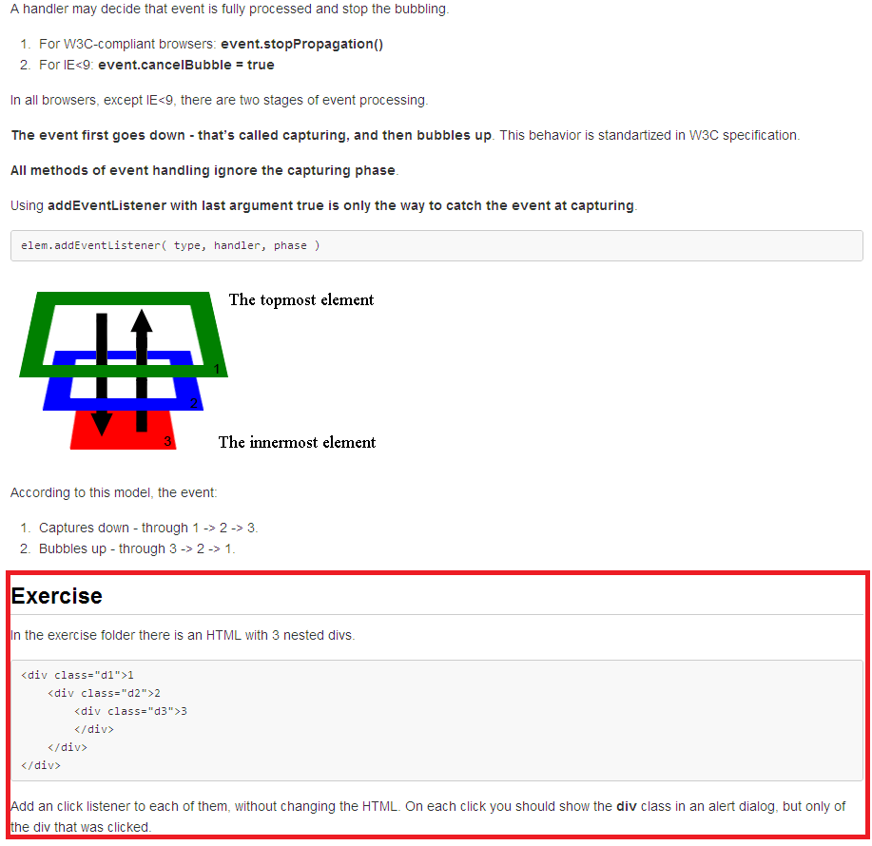
Format
At the end of each presentations is an exercise
The exercise files are in the same folder as the presentation

Slide 5
Topics covered
The following topics are covered:
JS basics
JS standard library
HTML & CSS basics
JS functions
DOM Manipulation
Events
JS objects
AJAX
Debugging
Best practices

Slide 6
JS basics
JS basics cover:
types,
operators,
flow control & oops,
error handling (Error object, try...catch...finally).

Slide 7
JS standard library
JS standard library presentation covers:
array manipulation
string manipulation
Math
Date
3rd party (lodash, underscore...) etc.

Slide 8
HTML & CSS basics
HTML & CSS basics presentation covers:
html tags
css selectors
forms

Slide 9
JS functions
JS functions presentation covers:
function declarations
function expressions
closures
Self invoking functions
How to organize functions

Slide 10
DOM Manipulation
DOM Manipulation presentation covers:
JS native functions
jQuery manipulation (selectors & functions)

Slide 11
Events
Events presentation covers:
Event bubbling & capturing
JS native event functions
jQuery event functions

Slide 12
JS objects
JS objects presentation covers:
Functions as constructors
Prototyping
Namespacing

Slide 13
AJAX
AJAX presentation covers:
Theory on AJAX
JS Native AJAX calls
jQuery AJAX calls

Slide 14
Best practices
Best practices:
Covers best practices for HTML, CSS and JavaScript

Slide 15
Debugging
Debugging:
Live session using a more complex application
Chrome Developer Tools

Slide 16
contact
If you have any questions, you can contact:
Sutulovic Mladen
Starcevic Milan
Spuzic Nenad

