Slide 1
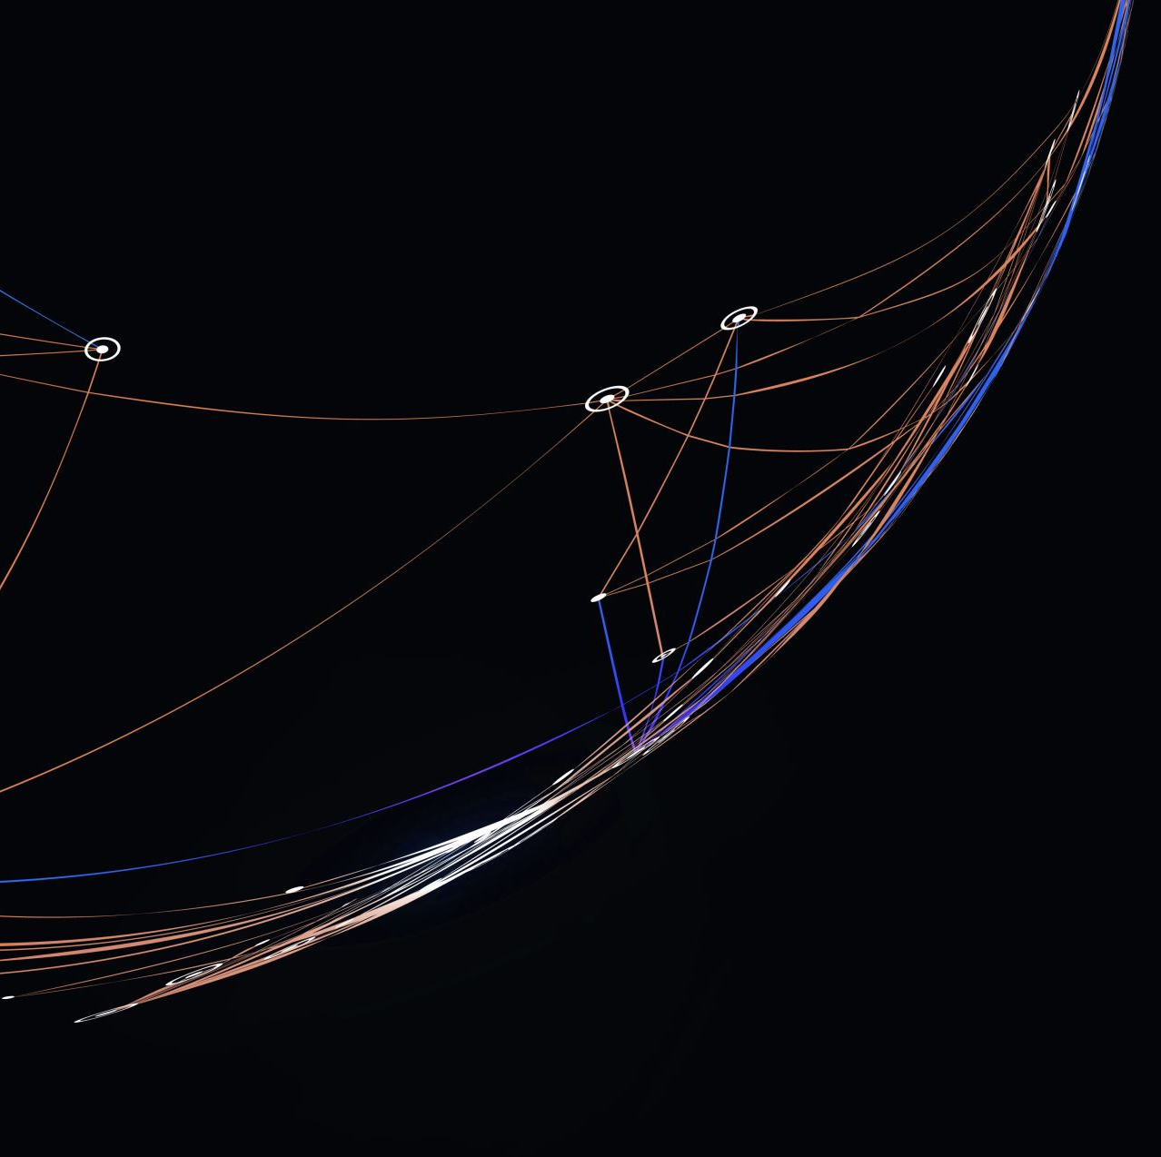
HACKITUP
Hackathon
Topic : WEB 2.0

Slide 2


WEB 2.0 It refers to the websites and web applications that are more interactive, user-centered and dynamic . This was started in early 2000s. Web 2.0 sites rely on user-generated content, collaboration, and social networking to create a more engaging and interactive online experience. They often include features such as blogs, social media platforms, video-sharing sites, and online communities basically a web page used for interaction with capability of sharing information with massive amount of information. Examples:- of Web 2.0 platforms include Facebook, Twitter, YouTube, Wikipedia, and LinkedIn.

Slide 3

Problem Statement Mental health issues have become more prevalent in the digital age, but many people are still hesitant to seek professional help. How can you design a platform that provides affordable and accessible mental health support through digital channels

Slide 4
Mental health assistance platform
Mental Health assistance platform is an interactive website through which we plan to provide help to the people who seek help, from different sources to deal with their mental health
Mental health is a major issue nowadays , as many people struggle with it , without knowing that they might have some problems

Slide 5

Target Audience
Teens who have pressure of there carrier and are unable to figure out what to choose so that they do not have any regrets
Couples in relationship who may have trust issues on their partner or who may have recently divorced.
Peoples who are introverts and are shy to open up their opinion publicly.
People who has lost their loved ones and are in state of shock.
People having problems in their life but do not want to share

Slide 6
What is our Role ?
We are making a website through which we are trying to reach our target audience .
We will provide them some facilities , through which they can be helped.
The name of the website is “Innerspace” .
The name was selected based on the concept of exploring one’s inner self and finding inner peace within .

Slide 7

Features in the platform The features we would provide are : 1. A 24*7 chat bot / assistant that would be available whenever chatting feature is used. 2. An option to contact a certified psychiatrist, as per need. 3. An option to video call or call the psychiatrist, when needed. 4. An option to schedule a personal visit if needed, ( book an appointment) . 5. An option to organize a group session with other users ( video/physical). And many more…
*some features might not work to the expectation currently

Slide 8

Business model
The business model we are using is a subscription model , through which users can avail our services on a monthly , quarterly or a yearly basis . Depending on the need of the user . The user can select either basic or the premium plan , according to their needs.

Slide 9

Subscription Plans
Benefits of plan | Normal | Premium
Personal consultant
Text messaging service
Office visits
Phone call service
24 x 7 Chat bot
Group video sessions
Number of appointments per week | 3 | 7
One day price | 49 | 99
Weekly price | 149 | 349
Monthly price | 749 | 899
Yearly price | 3199 | 5199
*prices can be changes as per need , just for reference

Slide 10

Future Prospects
The future prospect for this project is that we can add an option by which the bot would assess the user and tell them , if they need the help of the psychiatrist or they can help themselves a series of steps which when followed correctly can help solve the problem faced by themselves without the need of a psychiatrist.
Another option can be to add an option by which user can get a psychiatrist which suits them the best , which is judged by their situation and their need.
We can also add an option for digital worksheets / assignments specifically designed for the user to help them .
*Many more features can be added

Slide 11

Team:- Tarun Pradhan Prathamesh Nimkar Abhishek Dhamane Aniket Shivam

