Slide 1

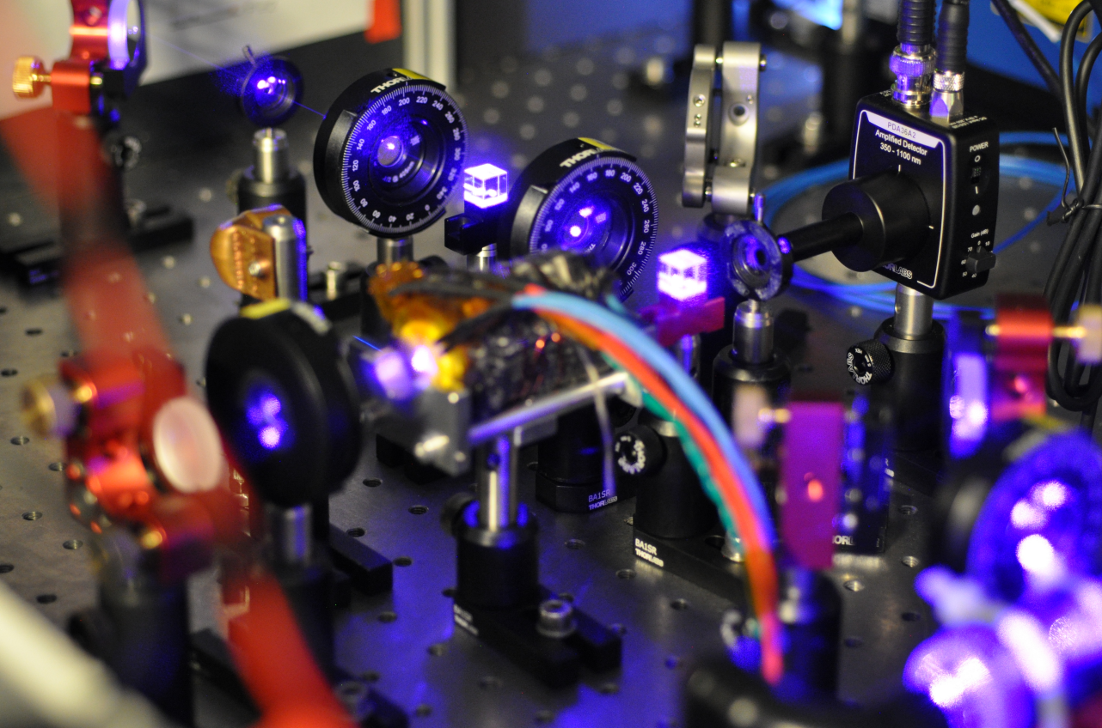
Thermal attenuation noise of optical power from a 420 nm light source in hot ^{85,87}Rb vapor
QTutorium
Student
Julien Kluge
564513

Slide 2
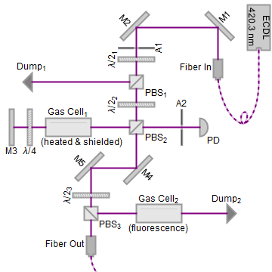
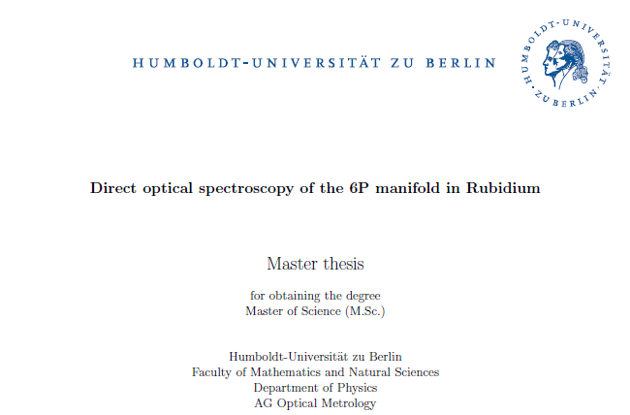
The Idea
Experiment
Dopplerfreie
Sättigungsspektroskopie
in heißen Rubidium Dampf

Slide 3
The Idea
Experiment
Dopplerfreie
Sättigungsspektroskopie
in heißen Rubidium Dampf

Slide 4
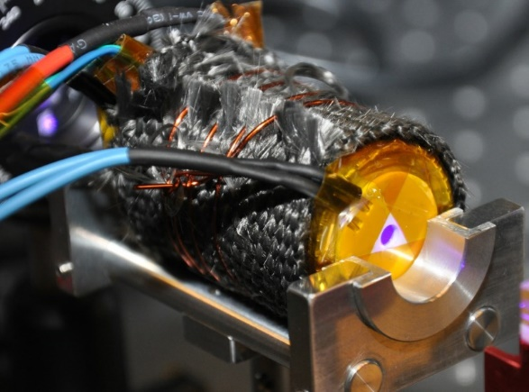
The Idea
Experiment
Dopplerfreie
Sättigungsspektroskopie
in heißen Rubidium Dampf

Slide 5
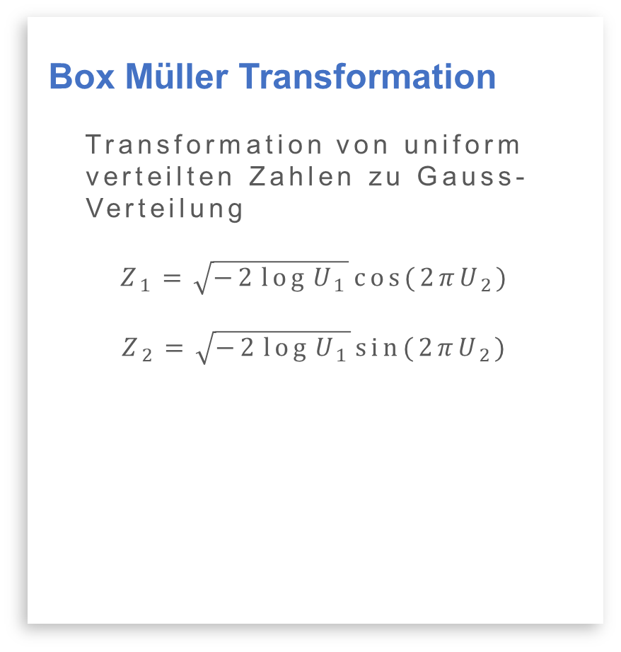
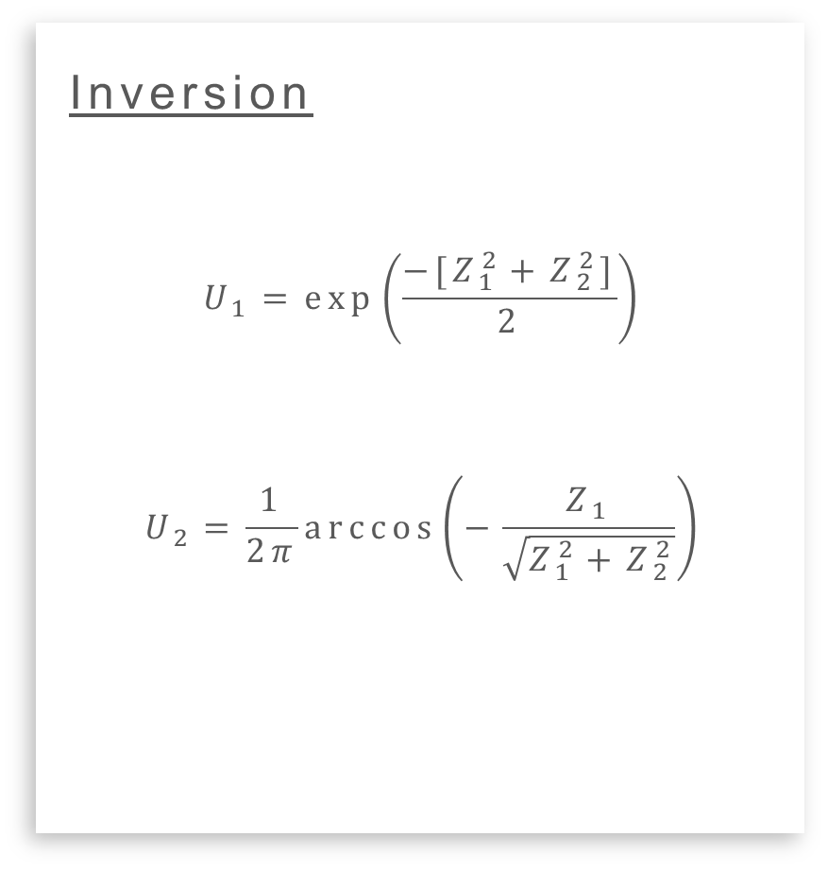
Proposed evaluation
Box Müller Transformation
Transformation von uniform
verteilten Zahlen zu Gauss-
Verteilung
$$Z_{1}=\sqrt{−2\log{U_{1}}}\cos{(2πU_{2})}$$
$$Z_{2}=\sqrt{−2\log{U_{1}}}\sin{(2πU_{2})}$$
Inversion
$$U_{1}=\exp\left(\frac{−[Z_{1}^{2}+Z_{2}^{2}]}{2}\right)$$
$$U_{2}=\frac{1}{2π}\arccos\left(−\frac{Z_{1}}{\sqrt{Z_{1}^{2}+Z_{2}^{2}}}\right)$$
Scott, D. W. Box Muller transformation. Wiley Interdisciplinary Reviews: Computational Statistics 3, 177 179. issn: 1939-0068 (2011).

Slide 6
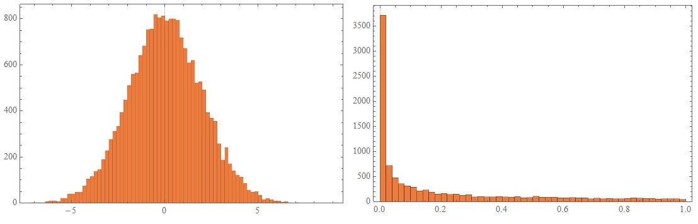
Proposed evaluation
Box Müller Transformation
Transformation von uniform
verteilten Zahlen zu Gauss-
Verteilung
$$Z_{1}=\sqrt{−2\log{U_{1}}}\cos{(2πU_{2})}$$
$$Z_{2}=\sqrt{−2\log{U_{1}}}\sin{(2πU_{2})}$$
Inversion
$$U_{1}=\exp\left(\frac{−[Z_{1}^{2}+Z_{2}^{2}]}{2}\right)$$
$$U_{2}=\frac{1}{2π}\arccos\left(−\frac{Z_{1}}{\sqrt{Z_{1}^{2}+Z_{2}^{2}}}\right)$$
Scott, D. W. Box Muller transformation. Wiley Interdisciplinary Reviews: Computational Statistics 3, 177 179. issn: 1939-0068 (2011).

Slide 7
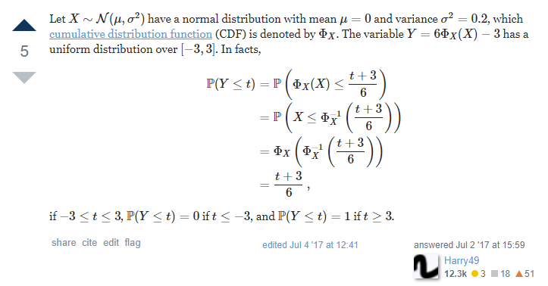
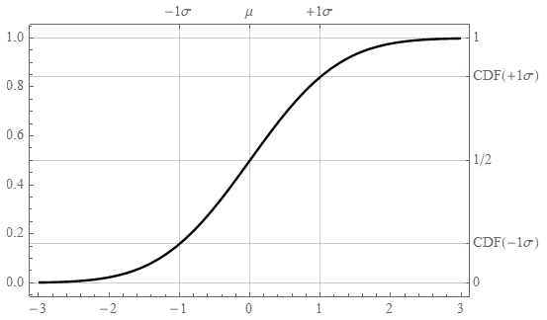

New evaluation
Cumulative distribution
function
math.stackexchange to
the rescue
CDF
$$U_{1}(μ,σ)=\frac{1}{2}\left[1+\operatorname{erf}\left(\frac{x−μ}{\sqrt{2}σ}\right)\right]$$
https://math.stackexchange.com/a/2344086/373704

Slide 8
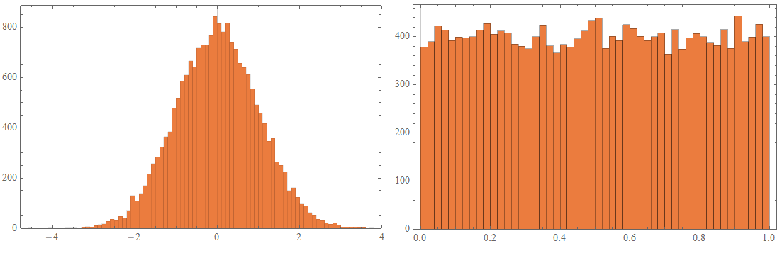
New evaluation
Cumulative distribution
function
math.stackexchange to
the rescue
CDF
$$U_{1}(μ,σ)=\frac{1}{2}\left[1+\operatorname{erf}\left(\frac{x−μ}{\sqrt{2}σ}\right)\right]$$
https://math.stackexchange.com/a/2344086/373704

Slide 9
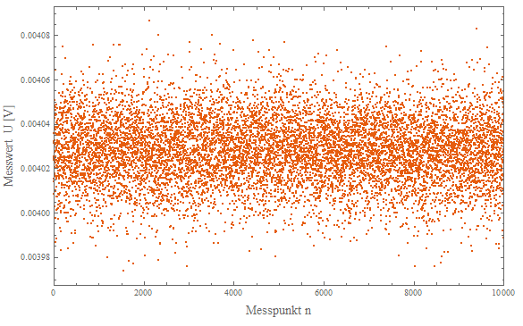
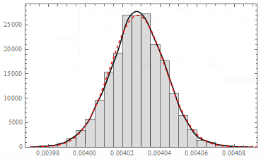
First measurements
Electrical noise of the PD
Electrical noise of the PD
prevalent normal distributed
with set gain of 20 dB
Histogram
Perfectly gauss (or is it?)

Slide 10
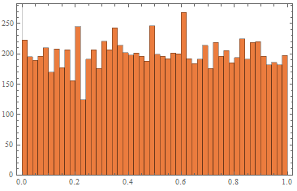
First measurements
Electrical noise of the PD
Apply CDF evaluation
Result
Looks good doesn’t it?

Slide 11
First measurements
Electrical noise of the PD
Apply CDF evaluation
Result
NIST test suite with
binarize(uniform*10⁶):

Slide 12
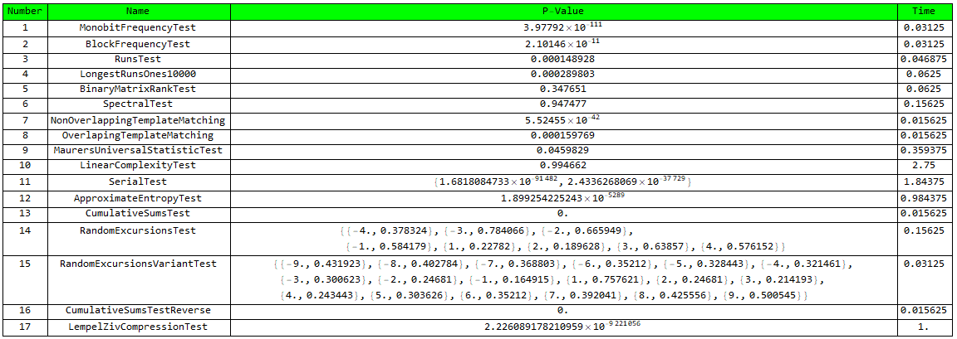
First measurements

Slide 13
First measurements
Wtf…

Slide 14
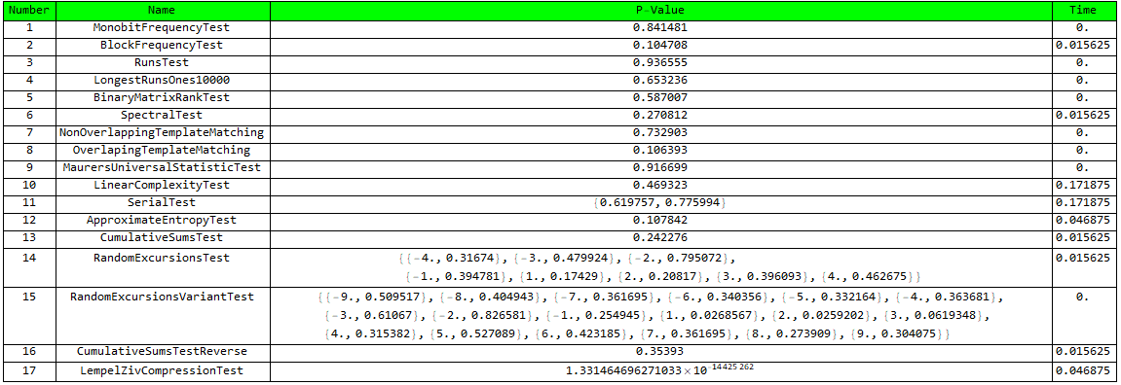
First measurements
Better, but far less data
Again with binarize(uniform)

Slide 15
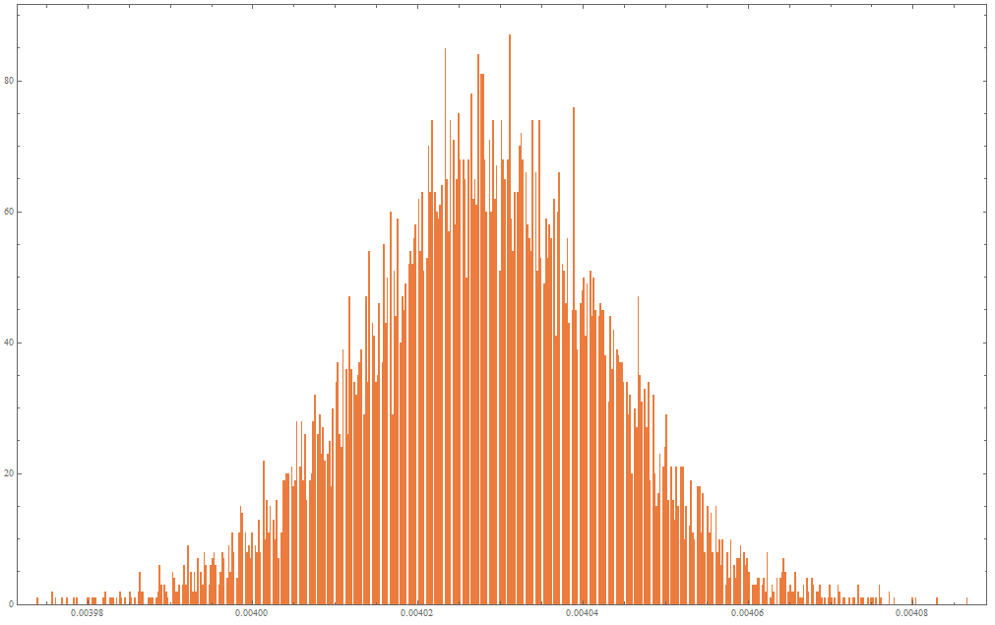
Electrical noise fault
ADC discretization
387 different values
where measured
equivalent: 300 nV/sample

Slide 16
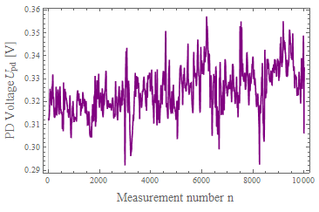
Laser power attenuation measurement
PD Power measured
Laser power (non-resonant)
measured by PD with 5% of
intensity and gas cell at 75°C
Evaluation
What do we want from that
signal?

Slide 17
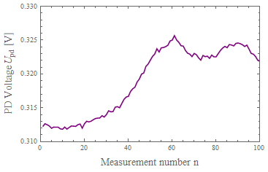
Laser power attenuation measurement
PD Power measured
Laser power (non-resonant)
measured by PD with 5% of
intensity and gas cell at 75°C
Evaluation
What do we want from that
signal?

Slide 18
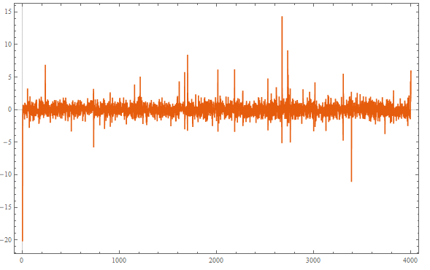
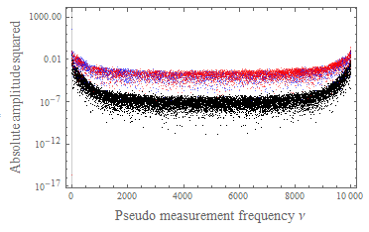
Laser power attenuation measurement
Fourier filtering
Filter out lower frequency
components by the means of
a FFT
Evaluation
Normed back transformation
result:

Slide 19
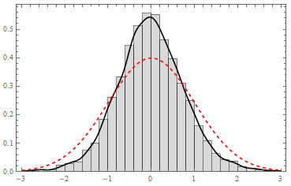
Laser power attenuation measurement
Histogram
WTF v2
Evaluation

Slide 20
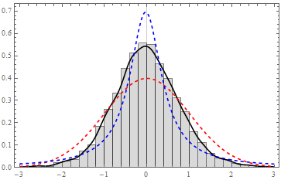
Laser power attenuation measurement
Histogram
WTF v2
Evaluation

Slide 21
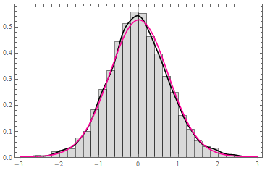

Laser power attenuation measurement
Histogram
WTF v2
Evaluation
Voigt distribution with
$σ=0.71$ and $Γ=0.054$

Slide 22
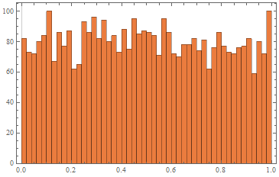
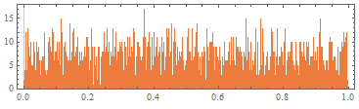
Laser power attenuation measurement
CDF
Evaluation

Slide 23
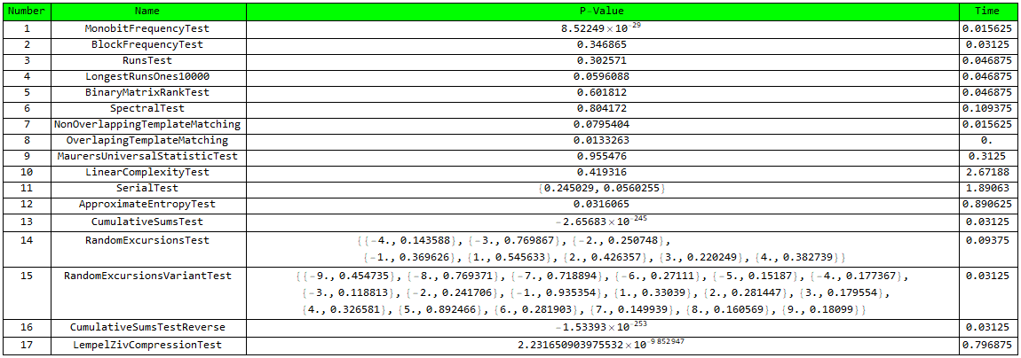
Laser power attenuation measurement

Slide 24
Laser power attenuation measurement

Slide 25
Laser power attenuation measurement
Results
For every measurement:
Monobit test & CumSum test
fails
Always compressible
Correlation of successive
values suspected
Temperature not dependent
Worse quality than pi or e
schade.

Slide 26
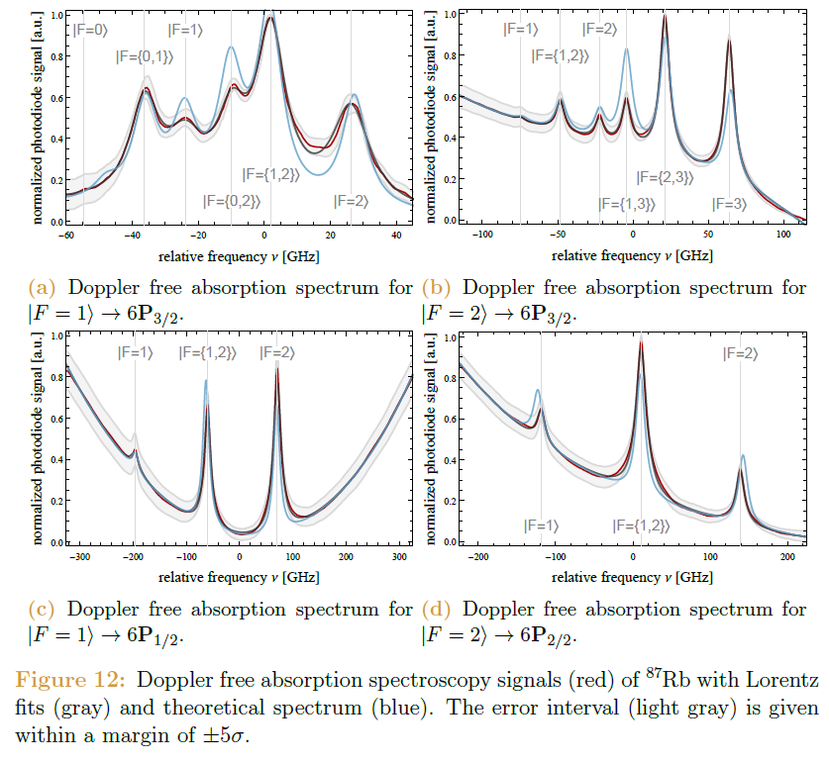
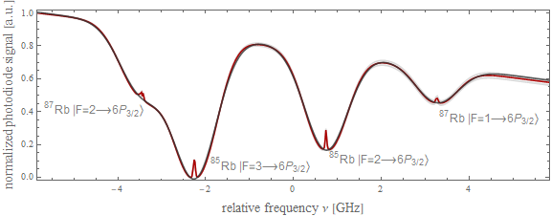
Laser power attenuation measurement
Results
For every measurement:
Monobit test & CumSum test
fails
Always compressible
Correlation of successive
values suspected
Temperature not dependent
Worse quality than pi or e
schade.

Slide 27
Vielen Dank für die Aufmerksamkeit

