Slide 1


Certificate Manager Project
Streamlining Student Grade and Certification Management

Slide 2
Introduction
Welcome to our presentation on the Certificate Manager Project.
This system is designed to streamline the management process for educational academies. It allows teachers to input their students’ information, assign responsible teachers, and track financial and academic progress.

Slide 3

The Problem
Automated Eligibility Checks
The system automatically checks student eligibility for certification based on predefined criteria.

Slide 4
Automated Eligibility Checks and Grade Tracking
1
Automated Eligibility Checks
2
Automated Grade Tracking
The system automatically checks student eligibility for certification based on predefined criteria.
The system tracks student grades in real-time, providing comprehensive insights into academic performance.

Slide 5

Features Overview
Seamless Integration
Customizable Templates
The system integrates with existing student information systems (SIS) for effortless data exchange.
Generate professional certificates with customizable templates that align with your institution's branding.

Slide 6

User Roles and Permissions
Implements robust user roles and permissions to enhance data security and operational efficiency.
Enforces access control to maintain data integrity and streamline workflows.
Assigns distinct levels of access to specific functionalities and data for different user roles.
Aligns access privileges with user responsibilities to ensure smooth operations.
Restricts unauthorized actions, allowing only authorized users to perform designated tasks.

Slide 7



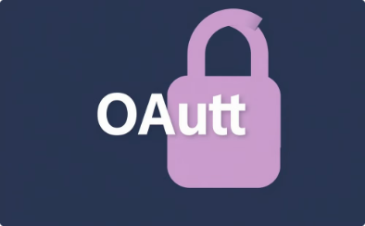
Technology Stack
Frontend Development
Backend Development
Database Management
Authentication
Leveraging Java Spring Framework for robust backend functionality.
Implementing Spring Security with OAuth integration for secure user authentication.
Utilizing HTML, CSS, and JavaScript for a user-friendly and responsive interface.
Employing MySQL or PostgreSQL to store and manage student data securely.

Slide 8

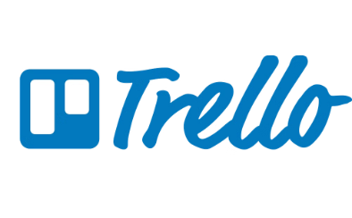


Development Tools and Platforms
GitHub
Trello
Balsamiq
AWS
For version control, code collaboration, and project management.
For task management, project organization, and team communication.
For rapid prototyping and wireframing user interfaces.
For cloud-based infrastructure, serverless computing, and data storage.

Slide 9

Conclusion
The Certificate Manager Project streamlines student grade and certification management, enhancing efficiency, security, and student satisfaction.

Slide 10
Thank You
We appreciate your interest in the Certificate Manager Project.

