Slide 1


Certificate Manager Project
Streamlining Student Grade and Certification Management

Slide 2
Introduction
Welcome to our presentation on the Certificate Manager Project. This system is designed to streamline the management process for educational academies. It allows teachers to input their students’ information, assign responsible teachers, and track financial and academic progress.

Slide 3

The Problem
Manual Processes
Disorganized Systems
Lack of Synchronization
Many institutions rely on manual methods for student records, payment tracking, and certificate issuance.
Outdated or disconnected systems lead to errors, wasted time, and inefficiency.
Teachers, accountants, and administrators struggle to keep data consistent across various departments.

Slide 4
The Solution
Centralized Platform
Automated Processes
Provides a single hub for teachers, accountants, and administrators to input and access student information.
Streamlines tasks like eligibility checks, grade tracking, and certificate generation, reducing manual work.
Data Integrity
Improved Efficiency
Ensures consistent and accurate data across the system, eliminating inconsistencies and errors.
Saves time, reduces manual errors, and increases overall efficiency for the institution.

Slide 5

Features Overview
1.Student Data Management:
2.Certificate Issuance:
Easily input, organize, and manage student information, including personal details, academic progress, and payment records.
Automatically generates certificates for students who meet all financial and academic requirements.
3.User-Friendly Interface: Intuitive design for easy navigation by users with varying levels of technical expertise.

Slide 6
Future Overview
1.Mobile Application Support:
2.Customizable Templates:
Developing a mobile-friendly version or dedicated app for easier access by students, teachers, and administrators.
Allowing academies to design and customize certificates to match their branding and requirements.

Slide 7


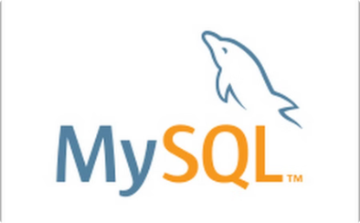
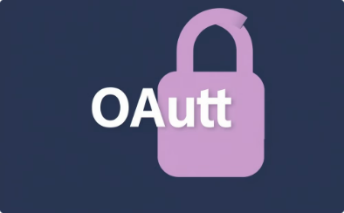
Technology Stack
Frontend Development
Backend Development
Database Management
Authentication
Leveraging Java Spring Framework for robust backend functionality.
Implementing Spring Security with OAuth integration for secure user authentication.
Utilizing HTML, CSS, and JavaScript for a user-friendly and responsive interface.
Employing MySQL or PostgreSQL to store and manage student data securely.

Slide 8




Development Tools and Platforms
GitHub
Trello
Balsamiq
AWS
For version control, code collaboration, and project management.
For task management, project organization, and team communication.
For rapid prototyping and wireframing user interfaces.
For cloud-based infrastructure, serverless computing, and data storage.

Slide 9

Conclusion
The Certificate Manager Project streamlines student grade and certification management, enhancing efficiency, security, and student satisfaction.

Slide 10
Thank You
We appreciate your interest in the Certificate Manager Project.

