Slide 1
Online Restaurant
Group 7

Slide 2
Group members
Afifa Zulfiqar
Zuha Usman Ghani
Hafsa Saeed
Zoha Mujahid
Musham Munir

Slide 3
Objectives

Slide 4
Website and Excel Objectives
To create a simple and attractive restaurant website
To present Cheezious food menu and services clearly
To use Excel for storing and analyzing menu data
To connect Excel data with website content
To apply Excel formulas and charts

Slide 5
Website Overview
The Cheezious Restaurant website is designed to provide complete information to customers in a simple and user-friendly way. The website is created using HTML and CSS.
Website Pages:
Home Page
Menu / Products Page
Services Page
Contact Page

Slide 6
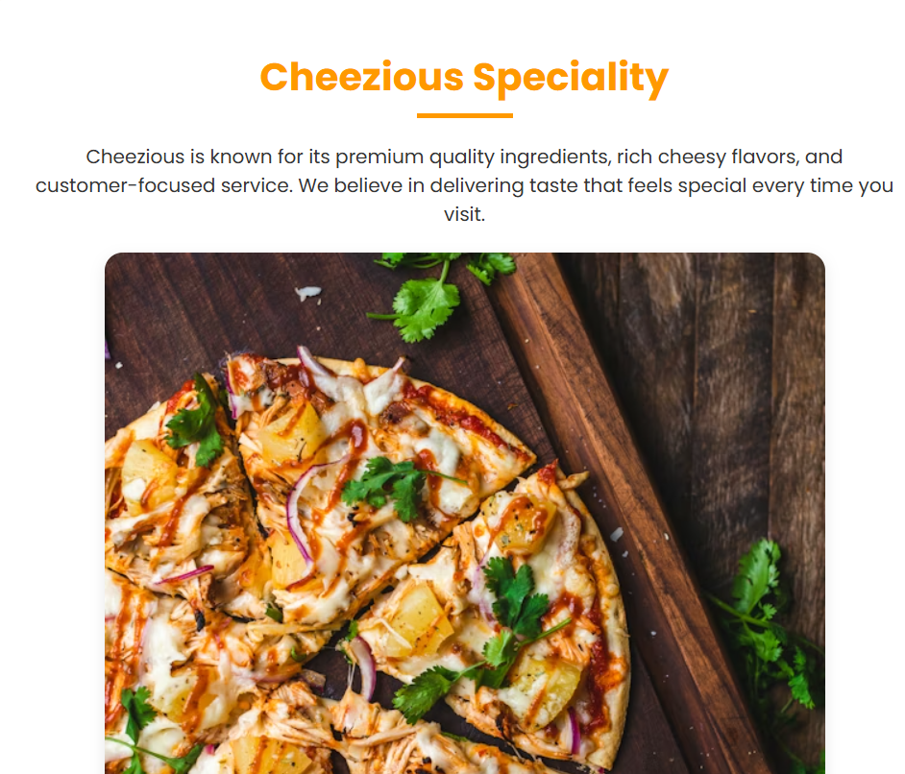
Demo Screenshot: Home Page
The Home page introduces Cheezious Restaurant with a clean layout and attractive colors. It displays the restaurant name, tagline, and navigation menu for easy access to other pages.

Slide 7
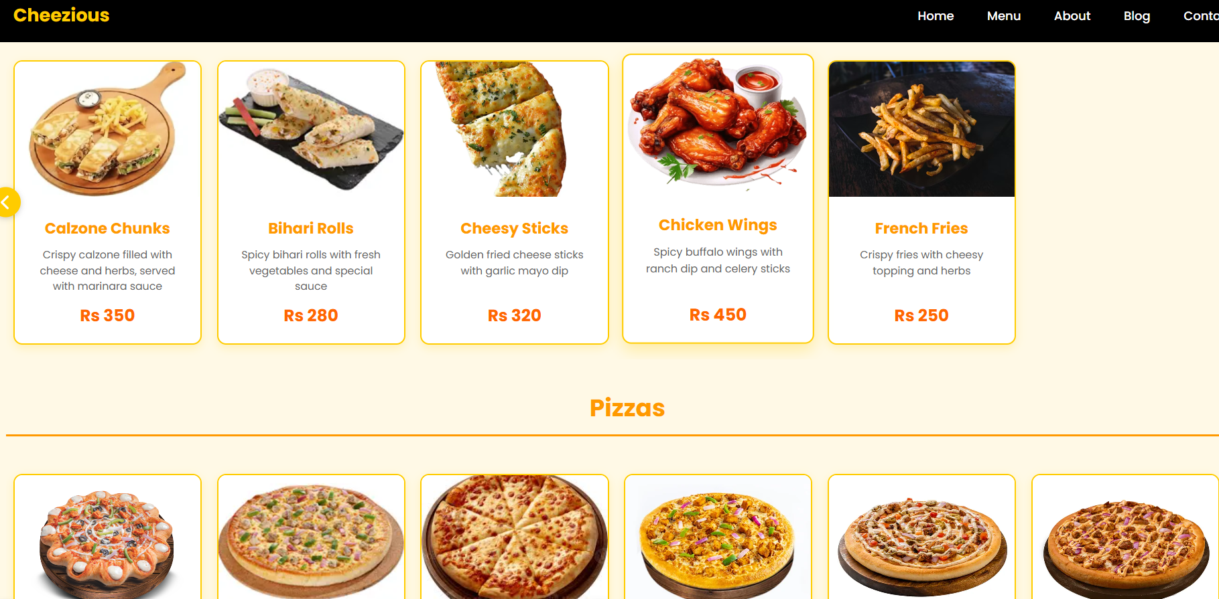
Services Page
The services page introduces Cheezies Restaurant with a clean layout and attractive colors. It displays the restaurant name, tagline, and navigation menu for easy access to other pages.
The Product / Services page shows Cheezious food items such as pizzas, burgers, and deals. It also highlights restaurant services including dine-in seating, takeaway, and delivery options.

Slide 8
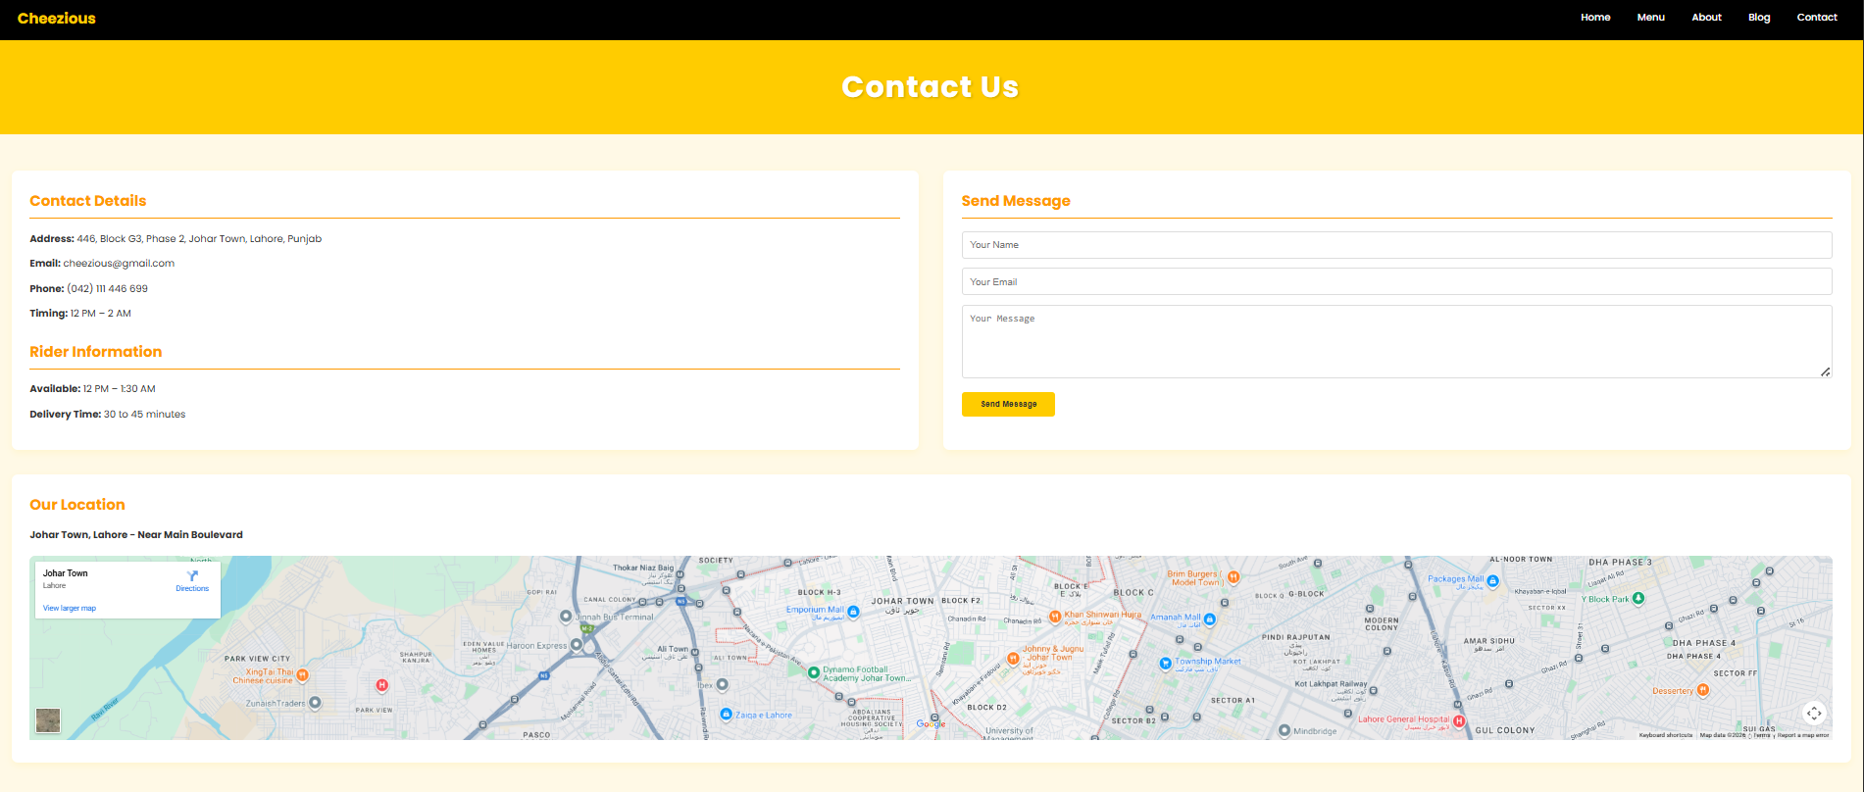
Contact Page
The Contact page provides customer contact details such as phone number, email address, and location. It helps customers easily reach the restaurant for orders or inquiries.

Slide 9
Excel Data Overview
Why we use excel?
Excel formula
Excel formulas such as SUM, AVERAGE, and IF are used to analyze menu prices. A chart is created to show price comparison or sales summary in a visual form.
Excel is used to store menu items, prices, and category information. The data helps in managing and updating website content accurately.

Slide 10
Excel Data Overview

Slide 11
GitHub URL
https://hafsa-876.github.io/group7_-online-resturant 20
https://afifazulfqar717.github.io/Group7_OnlineRestaurant/contact.html
https://mashammunir.github.io/group7_online-restaurant
/https://zoha67-jkl.github.io/Group7_OnlineRestaurant
https://zuha-usman1307.github.io/Group7_OnlineRestaurant//

Slide 12
Thank you

