Slide 1

Software Development Project Formalities and Schedule 10th of October, 2019

Slide 2
Formalities and Schedule
Lecture/Lab: C-119
Thursday 13:30 – 16:45

Slide 3
Learning Objectives
After the SDP course students should be able to:
select and apply modern software engineering methods and technology,
create and assess software designs,
structure, organize and conduct collaborative software development in a team

Slide 4
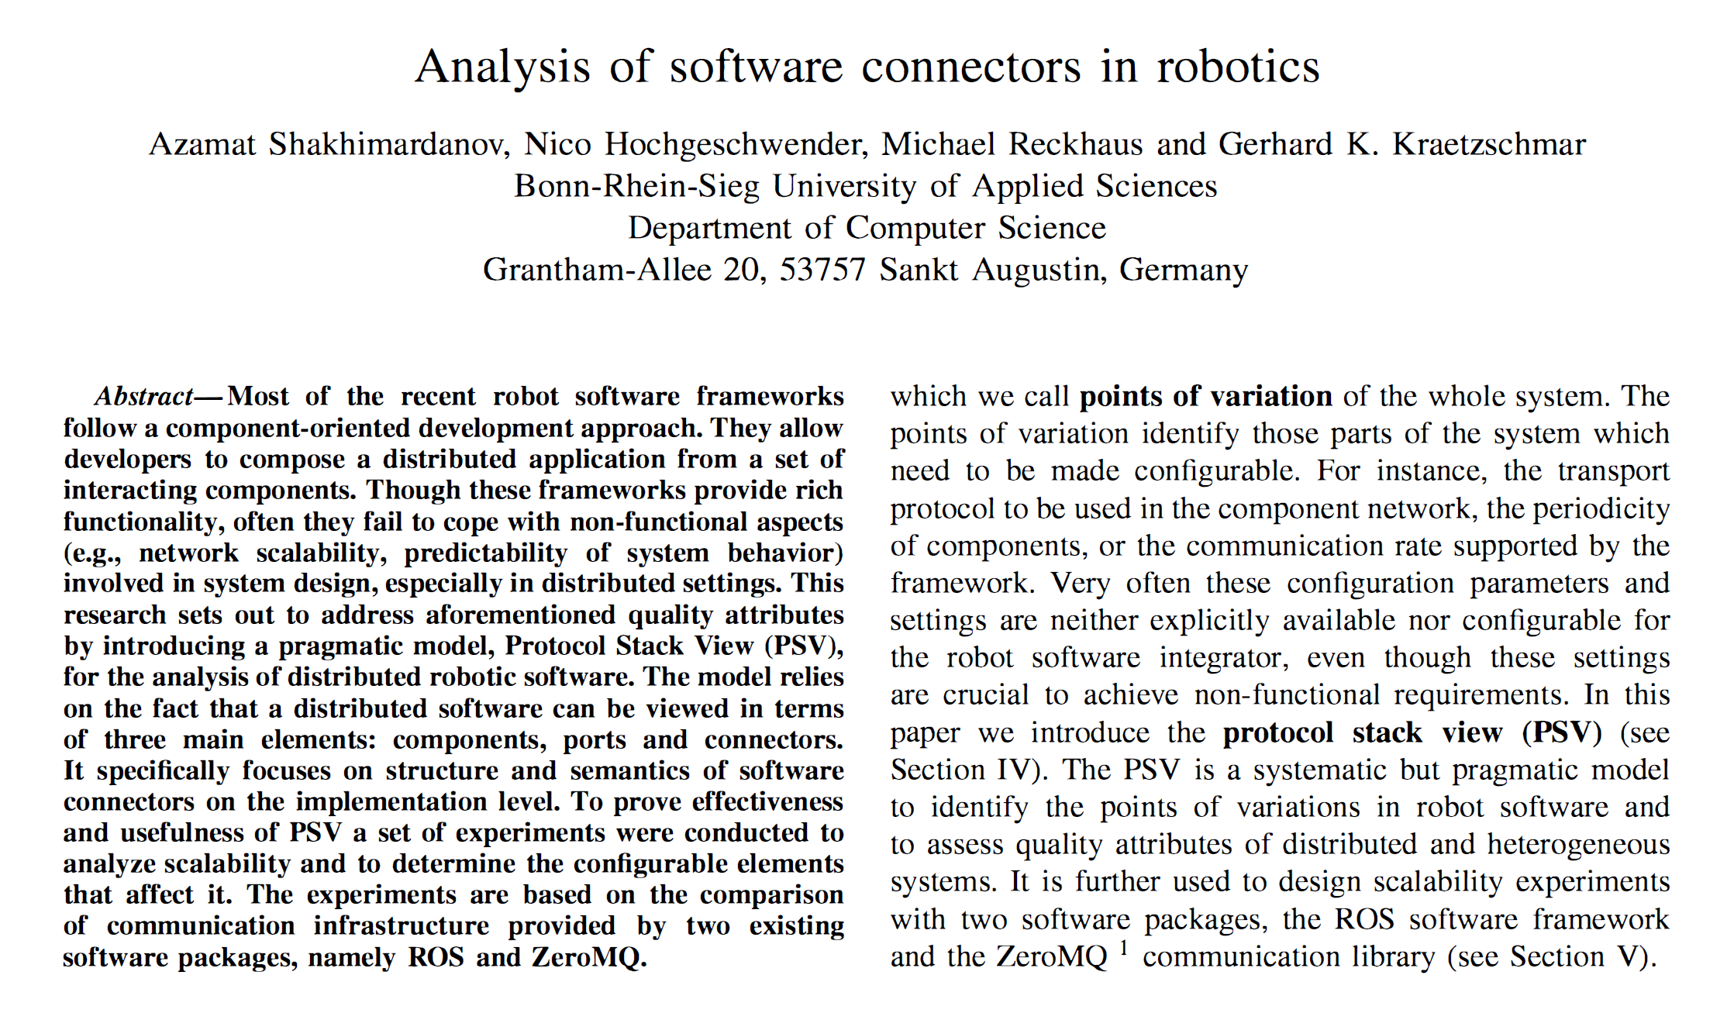
Evaluating ROS 2.0 Communication Layer
Inter-process and distributed communication
Different dimensions to be considered:
What to evaluate? E.g. latency, scalability,…
Where and how to evaluate? Controlled parameters (e.g. message size, number of components,…)
…
IROS-2011

Slide 5
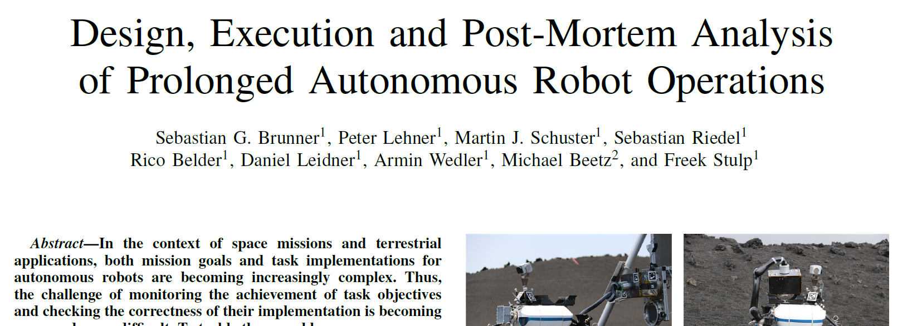
Post-mortem Analysis of ROS Nodes with Visualization Methods
Problem: ROS bag files are just on „topic“ level
We need to have an analysis of the activities of the individual nodes

Slide 6
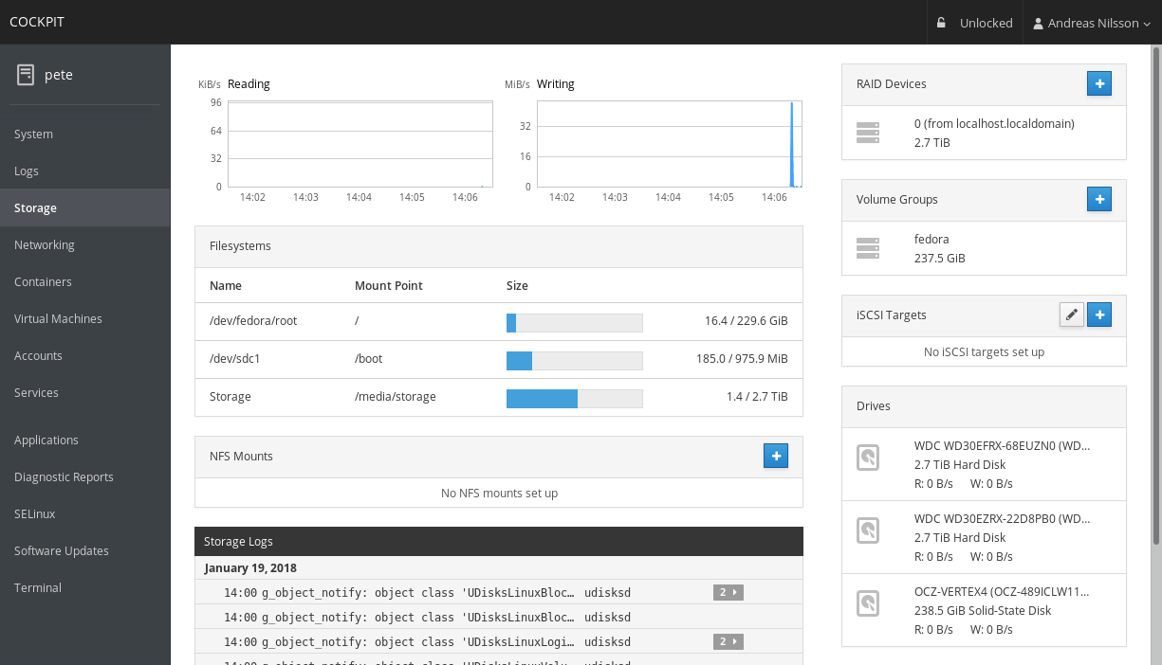
Dashboard for ROS-based System
Motivation: RoboCup@Work
Idea: Dashboard as for servers

