Slide 1
KTML Inventory
Data Warehouse
Bronze → Silver → Gold pipeline, Power BI dashboard, and a live-connected Excel workbook
Project Overview

Slide 2
DATA PIPELINE
Medallion Architecture
Sources to consumption, layer by layer
SOURCES
BRONZE
SILVER
GOLD
CONSUME
CSV Files
Flat-file exports loaded via batch job
Object Type
Object Type
Object Type
Reporting & BI
Tables
Tables
Views
Power BI dashboard
Load
Load
Load
Batch processing
Full load / truncate & insert
Batch processing
Full load / truncate & insert
None
SQL Queries
Transformation
Ad-hoc analysis via SSMS
Transformation
Transformation
Data integration
Aggregation
Business logic
None
Data cleansing
Standardization & normalization
Derived columns
Data enrichment
Data Model
Star schema / flat & aggregated tables
KTML Inventory Data Warehouse
2

Slide 3
GOLD LAYER
Business-Ready Views
Two aggregated views power every downstream report
gold.hand_inventory_summary
gold.inventory_aging_summary
Stock on hand, grouped by item and warehouse
Aging buckets showing how long stock has been sitting
COLUMNS
COLUMNS
item
item_name
warehouse
total_quantity
variant_count
item_number
product_name
aging_percentage
p1_quantity … p5_quantity
total_aged_quantity
KTML Inventory Data Warehouse
3

Slide 4
OUTPUTS
Deliverables
Built on top of the gold layer of KTML_InventoryDW
Power BI Dashboard
Excel Workbook
Stock by warehouse (clustered bar)
Stock by item, top items ranked
Item-wise P1–P5 aging breakdown
Slicers for warehouse and item
Aging % summary card
Live connection to KTML_InventoryDW
gold.hand_inventory_summary table
gold.inventory_aging_summary table
Refreshable via Data → Refresh All
Ready for PivotTable analysis
KTML Inventory Data Warehouse
4

Slide 5
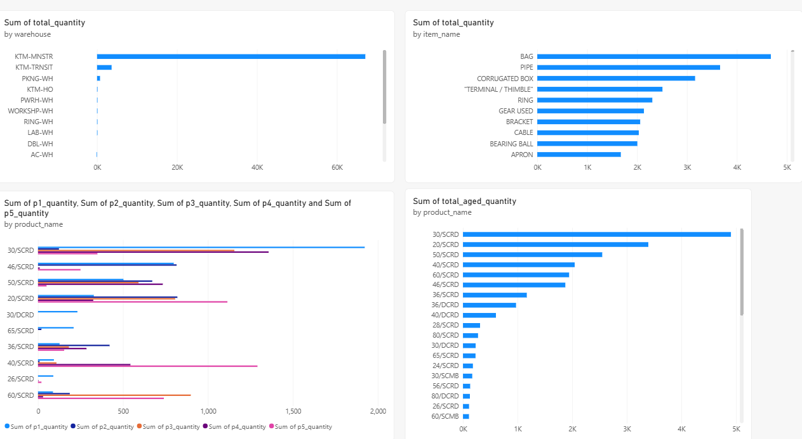
POWER-BI Dashboard
A four-panel view of hand inventory, showing stock concentration by warehouse, top items by quantity, item-wise P1–P5 aging distribution, and total aged stock by product — giving a complete picture of where inventory sits and how long it's been aging

Slide 6
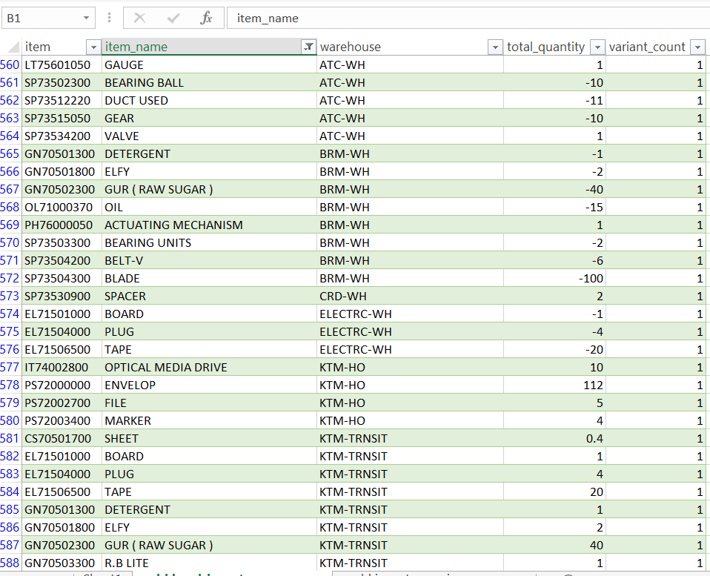
EXCEL FILE
A live-connected Excel workbook pulling gold.hand_inventory_summary and gold.inventory_aging_summary directly from KTML_InventoryDW, refreshable on demand for ad-hoc analysis.

