Slide 1
Customer Reviews (Batch Ingestion and Processing)
End-to-End Data Pipeline
Mohammad Zuhaili Bin Amin (01412212)
Video Link: https://www.youtube.com/watch?v=zm0oXkUFCA8

Slide 2

TABLE OF CONTENTS
01
02
03
04
About the project
Introduction of Project, Persona, and Scenarios
Big Data Pipeline
Big Data Architecture Diagram
Tech Stack
Tech stack used in this project
Conclusion
Wrapping up the entire project

Slide 3
01
About The Project
Introduction of Project, Persona, and Scenarios

Slide 4


Introduction
Online customer reviews, prevalent on platforms like Yelp and TripAdvisor, have become pivotal in shaping consumer decisions.
A one-star increase on Yelp can boost a restaurant's revenue by 5-9%.
However, the world of online reviews also has its challenges, such as the lack of visualisation and more in-depth insights.

Slide 5
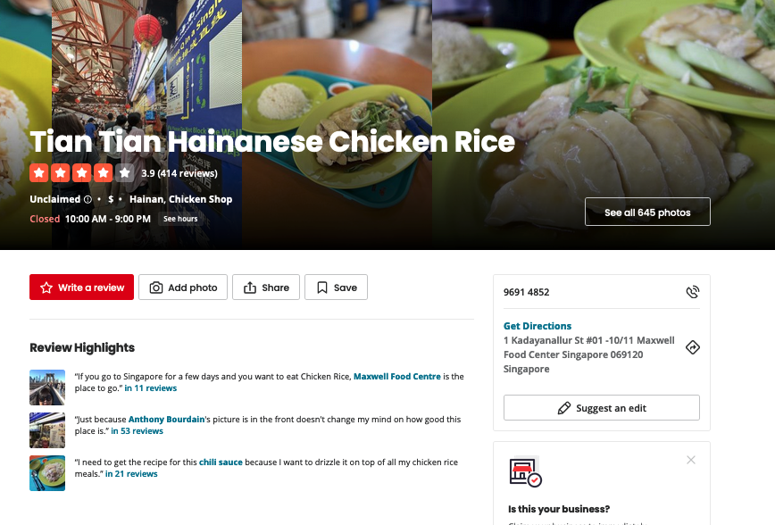
Tian-Tian Hainanese Chicken Rice
Most reviewed Singapore Restaurant on Yelp
Many reviews
Will be using this restaurant’s reviews for this project

Slide 6

Persona
Name: Tian Tian
Who: Owner of Tian Tian Hainanese Chicken Rice
Feels that the current reviews that she can see on Yelp is not informative enough
Wants to use the data from reviews on Yelp on her restaurant to make more informed business decisions

Slide 7

Scenario 1
Tian Tian wants to find out how the business is doing in terms of public support and ratings.
On Yelp, each review contains a 0-5 star rating.
An end-to-end data pipeline can value-add to this by analysing the ratings of the reviews and finding out the general support and standing of the business over the years on social media

Slide 8

Scenario 2
Tian Tian wants to find out the talking point (the hot topics) of the business through the customer reviews.
An end-to-end data pipeline can value-add to this scenario through using the text data to do topic modeling and finding out what customers always talk about in their reviews
e

Slide 9

Scenario 3
Tian Tian wants to find out the sentiment of the reviews about her business - is it generally positive or negative?
An end-to-end data pipeline can value-add to this, by ingesting the reviews’ text data and performing natural language processing on said data, and subsequently doing sentiment analysis on the data.

Slide 10
02
Big Data Pipeline
Big Data Architecture Diagram

Slide 11
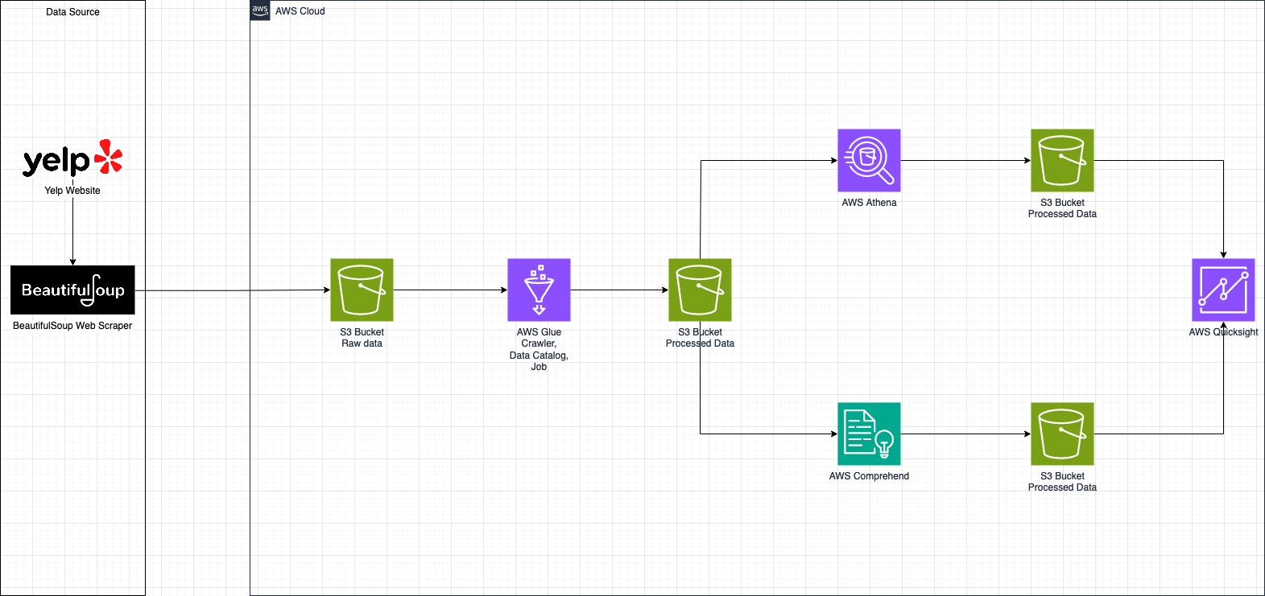
Big Data Architecture Diagram

Slide 12
03
Tech Stack
Tech stack used in this project

Slide 13



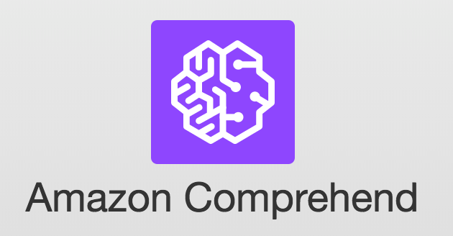


Tech Stack

Slide 14
04
Conclusion
Wrapping up the entire project

Slide 15
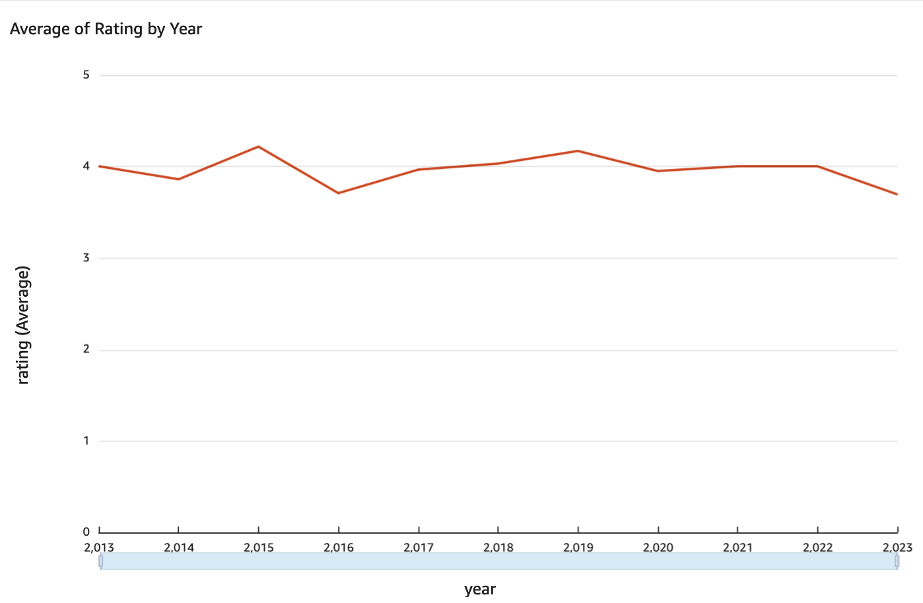
Average of Rating by Year
Generally consistent throughout the years
About 3.5-4.5 stars each year

Slide 16
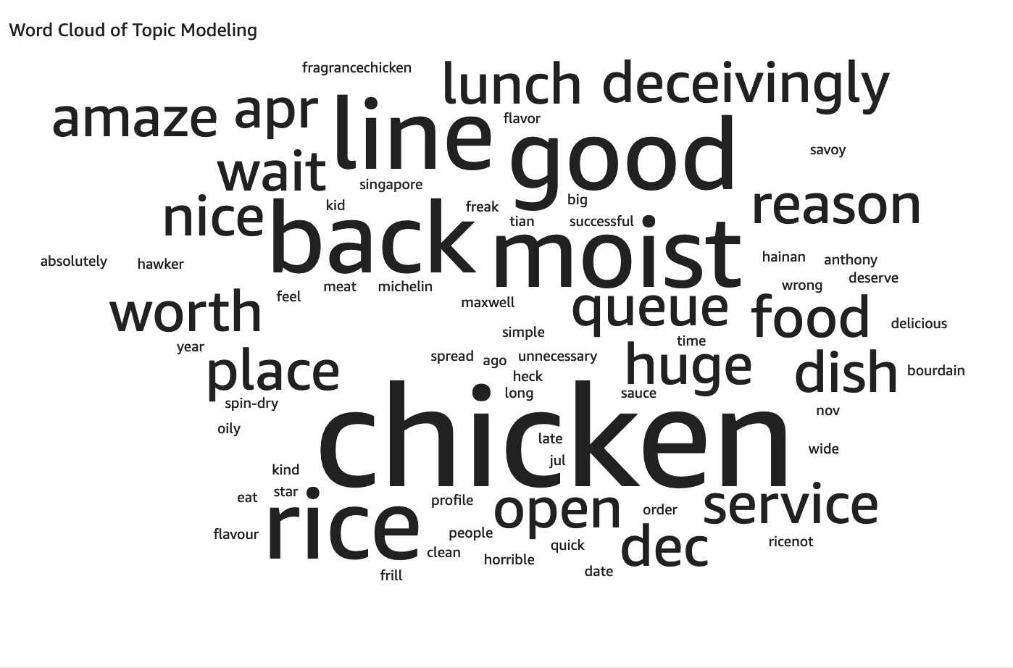
Word Cloud of Topic Modeling
Chicken and rice were talked about most
Shows that chicken rice is a hot topic among the reviews

Slide 17
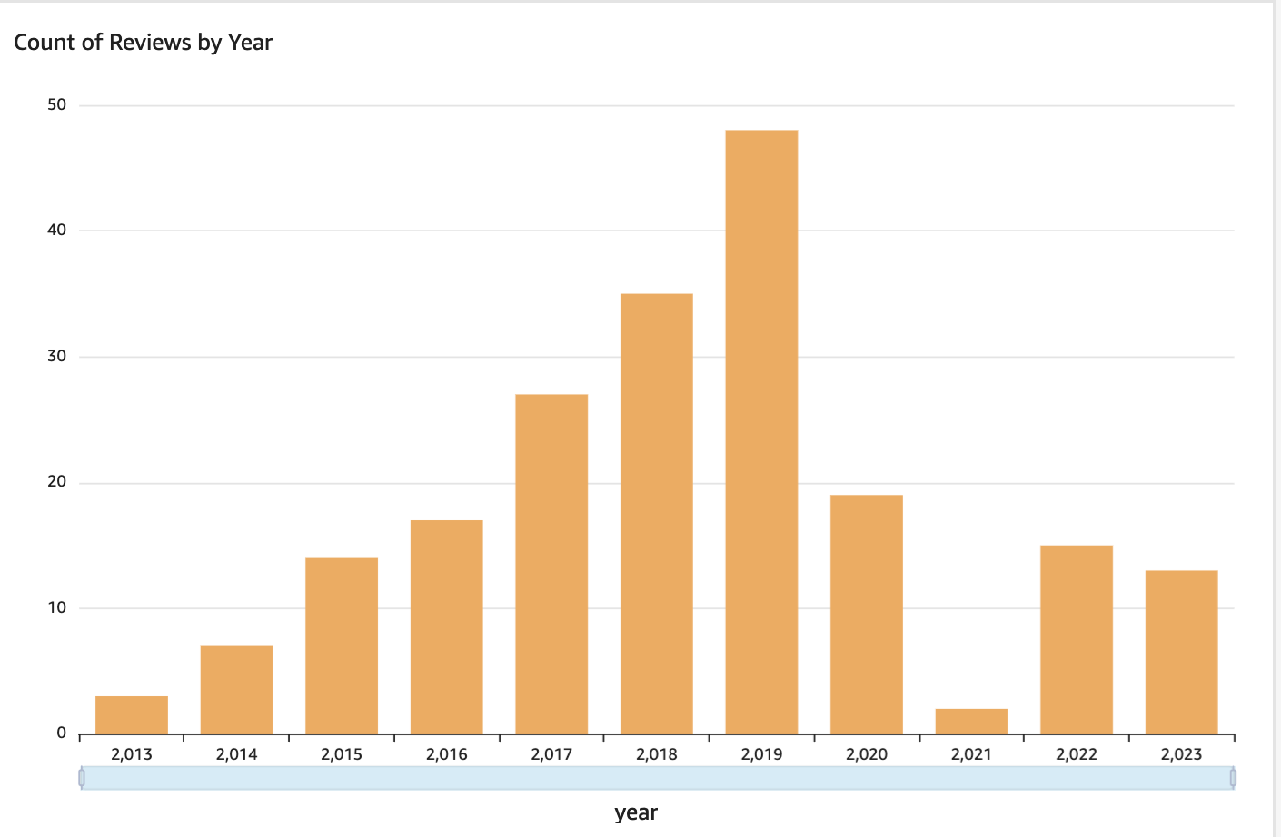
Count of Review by Year
Shows that this dataset consists mostly of reviews in 2019, and the least in 2021.

Slide 18
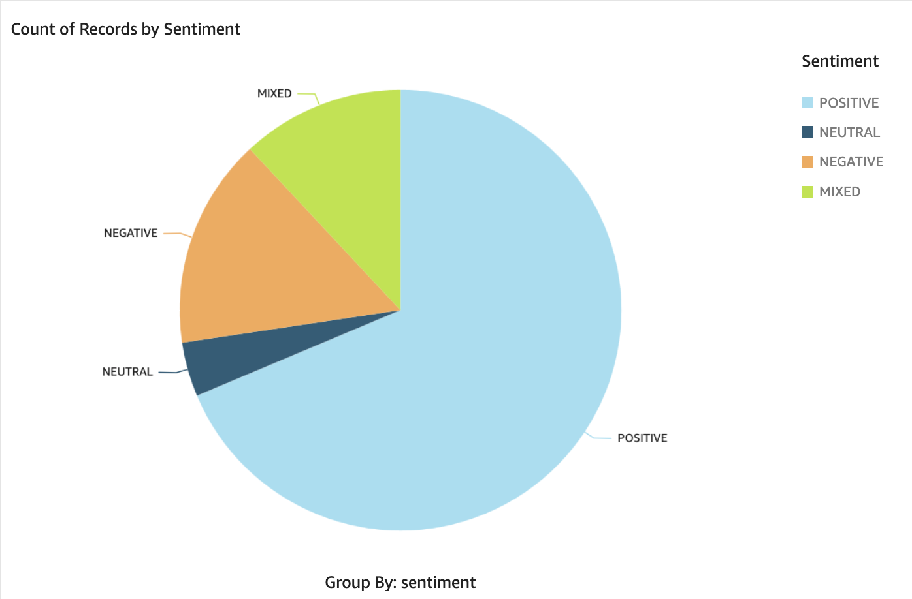
Count of Records by Sentiment
Shows that the reviews were mostly positive

Slide 19
Conclusion
Tian Tian is now satisfied with the insights that she has gained through this big data pipeline.
She is able to understand the business’ standing through analysing the ratings, understand the hot topics of her restaurant via topic modelling, and is able to understand the general sentiments of her restaurant.
She will be able to make better use of the data to come to business decisions in the future.

Slide 20

Thank You

