Slide 1
SentinelForce
Presented By:
Zuhair Ahmed(20-42115-1)
Sajid Ibna Mahbub(20-42109-1)

Slide 2
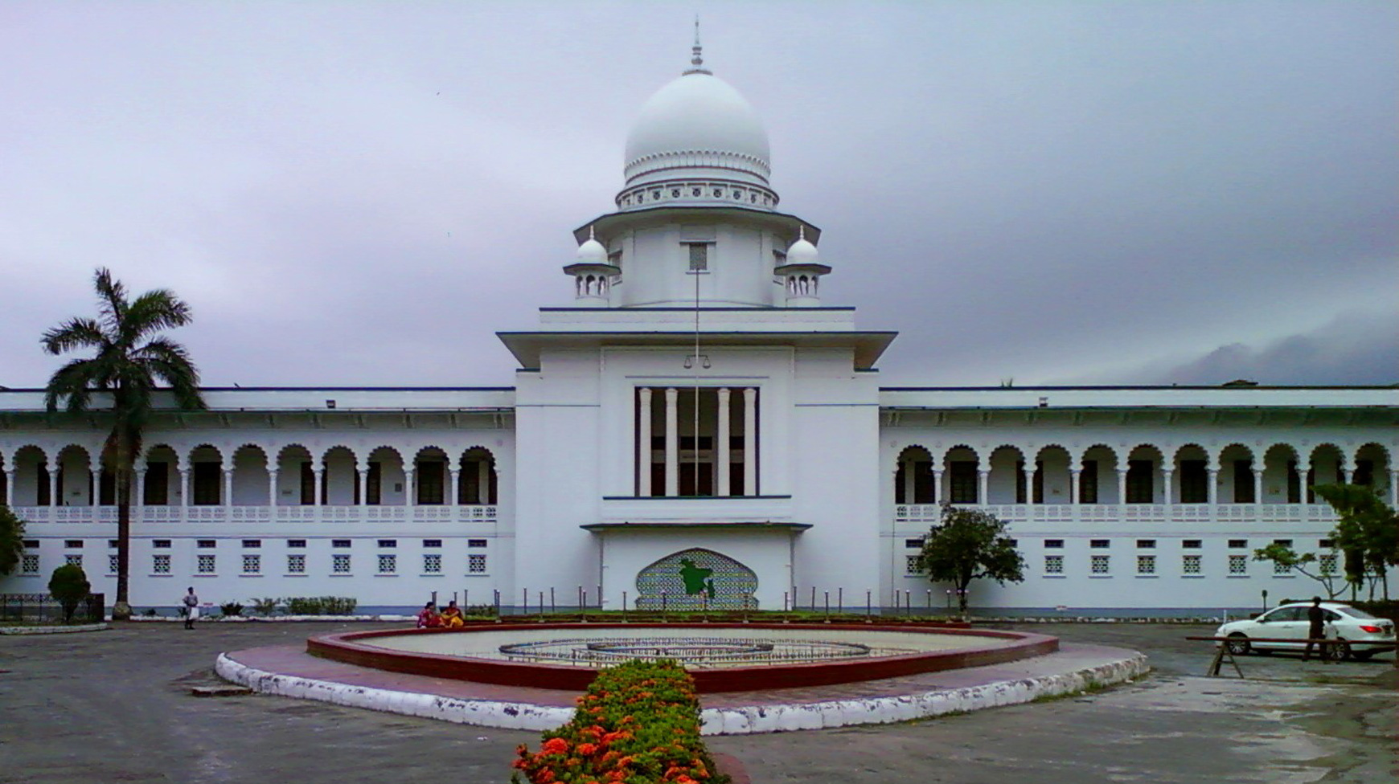

Admin Login
Civilian Use
Police Login
Exit
Have an emergency complain?
Fill In!

Slide 3
Admin Login
Civilian Use
Police Login
Exit
Have an emergency complain?
Fill In!

Slide 4
Crime Information
Asgor
01*********
Victim Name
Victim Cell No:
Victim Address
29/b old town,Dhaka
Crime Brief Details
2:30 pm
Crime Time
19/b gulistan
Crime Location
Male
Criminal Gender
Submit
Back

Slide 5
Crime Information
Asgor
01*********
Victim Name
Victim Cell No:
Victim Address
29/b old town,Dhaka
Crime Brief Details
Crime Recorded Successfully
2:30 pm
Crime Time
Ok
19/b gulistan
Crime Location
Male
Criminal Gender
Submit
Back

Slide 6
Admin Login
Civilian Use
Police Login
Exit
Have an emergency complain?
Fill In!

Slide 7
Police Login
Police Id
Tarif
Police Password
******
Submit
Back

Slide 8
Add Criminal
Delete Criminal
Criminal Info
Update
Emergency Complain Box
Logout

Slide 9
Add Criminal
Delete Criminal
Criminal Info
Update
Emergency Complain Box
Logout

Slide 10
Criminal Information
Criminal Name:
Muntasir Mamun
Criminal added
Criminal Id:
893
Ok
Criminal Age:
31 years
Criminal Gender:
Male
Submit
Back

Slide 11
Add Criminal
Delete Criminal
Criminal Info
Update
Emergency Complain Box
Logout

Slide 12
Criminal Informations
Criminal Id:
345
Delete
Criminal Id:
754
Delete
Criminal Id:
763
Delete
Criminal Id:
973
Delete
Submit
Back

Slide 13
Criminal Informations
Criminal Id:
345
Delete
Are you sure?
Criminal Id:
754
Delete
Yes
No
Criminal Id:
763
Delete
Criminal Id:
973
Delete
Submit
Back

Slide 14
Criminal Informations
Criminal Id:
345
Delete
Criminal Record Deleted
Criminal Id:
754
Delete
OK
Delete
Criminal Id:
763
Criminal Id:
973
Delete
Submit
Back

Slide 15
Add Criminal
Delete Criminal
Criminal Info
Update
Emergency Complain Box
Logout

Slide 16
Criminal Informations
Criminal Id:
345
View
Criminal Id:
754
View
Criminal Id:
763
View
Criminal Id:
973
View
Submit
Back

Slide 17
Criminal Information
Criminal Name:
Muntasir Mamun
Criminal Address:
21/b gulistan,Dhaka
Criminal Id:
893
Committed Crime:
Stealing
Criminal Age:
31 years
Crime Scene:
45/2 Wari,Dhaka
Criminal Gender:
Male
Crime Date:
12/4/20
Back

Slide 18
Add Criminal
Delete Criminal
Criminal Info
Update
Emergency Complain Box
Logout

Slide 19
Criminal Informations
Criminal Id:
345
Update
Criminal Id:
754
Update
Criminal Id:
763
Update
Criminal Id:
973
Update
Submit
Back

Slide 20
Criminal Information
Criminal Name:
Criminal Address:
Criminal Id:
345
Committed Crime:
Criminal Age:
Crime Scene:
Criminal Gender:
Crime Date:
Update
Back

Slide 21
Criminal Information
Criminal Name:
Muntasir Mamun
Criminal Address:
21/b gulistan,Dhaka
Updated Successfully
Criminal Id:
345
Committed Crime:
Stealing
Criminal Age:
31 years
OK
Crime Scene:
45/2 Wari,Dhaka
Criminal Gender:
Male
Crime Date:
12/4/20
Back

Slide 22
Add Criminal
Delete Criminal
Criminal Info
Update
Emergency Complain Box
Logout

Slide 23
Emergency Crime Information
Asgor
01*********
Victim Name
Victim Cell No:
Victim Address
29/b old town,Dhaka
Crime Brief Details
2:30 pm
Crime Time
19/b gulistan
Crime Location
Male
Criminal Gender
Back

Slide 24
Admin Login
Civilian Use
Police Login
Exit
Have an emergency complain?
Fill In!

Slide 25
Civilian Login
Civilian Name:
Imdadul Haque
Criminal Id:
693
View
Back

Slide 26
Criminal Information
Criminal Name:
Muntasir Mamun
Criminal Address:
21/b gulistan,Dhaka
Criminal Id:
893
Committed Crime:
Stealing
Criminal Age:
31 years
Crime Scene:
45/2 Wari,Dhaka
Criminal Gender:
Male
Crime Date:
12/4/20
Back

Slide 27
Admin Login
Civilian Use
Police Login
Exit
Have an emergency complain?
Fill In!

Slide 28
Admin Id
Sajid
Admin Password
****
Submit
Back

Slide 29
Add Police
Delete Police
Add Criminal
Delete Criminal
Criminal Info
Logout

Slide 30
Police Information
Police Name:
Muntasir Mamun
Police added
Police Id:
893
Ok
Police Age:
25 years
Police Gender:
Male
Submit
Back

Slide 31
Add Police
Delete Police
Add Criminal
Delete Criminal
Criminal Info
Logout

Slide 32
Police Informations
Police Id:
345
Delete
Police Id:
754
Delete
Police Id:
763
Delete
Police Id:
973
Delete
Submit
Back

Slide 33
Police Informations
Police Id:
345
Delete
Are you sure?
Police Id:
754
Delete
Yes
No
Police Id:
763
Delete
Police Id:
973
Delete
Submit
Back

Slide 34
Police Informations
Police Id:
345
Delete
Police Deleted
Police Id:
754
Delete
OK
Delete
Police Id:
763
Police Id:
973
Delete
Submit
Back

Slide 35
Add Police
Delete Police
Add Criminal
Delete Criminal
Criminal Info
Logout

Slide 36
Criminal Information
Criminal Name:
Muntasir Mamun
Criminal added
Criminal Id:
893
Ok
Criminal Age:
31 years
Criminal Gender:
Male
Submit
Back

Slide 37
Add Police
Delete Police
Add Criminal
Delete Criminal
Criminal Info
Logout

Slide 38
Criminal Informations
Criminal Id:
345
Delete
Criminal Id:
754
Delete
Criminal Id:
763
Delete
Criminal Id:
973
Delete
Submit
Back

Slide 39
Criminal Informations
Criminal Id:
345
Delete
Are you sure?
Criminal Id:
754
Delete
Yes
No
Criminal Id:
763
Delete
Criminal Id:
973
Delete
Submit
Back

Slide 40
Criminal Informations
Criminal Id:
345
Delete
Criminal Record Deleted
Criminal Id:
754
Delete
OK
Delete
Criminal Id:
763
Criminal Id:
973
Delete
Submit
Back

Slide 41
Add Police
Delete Police
Add Criminal
Delete Criminal
Criminal Update
Logout

Slide 42
Criminal Informations
Criminal Id:
345
Update
Criminal Id:
754
Update
Criminal Id:
763
Update
Criminal Id:
973
Update
Submit
Back

Slide 43
Criminal Information
Criminal Name:
Criminal Address:
Criminal Id:
345
Committed Crime:
Criminal Age:
Crime Scene:
Criminal Gender:
Crime Date:
Update
Back

Slide 44
Criminal Information
Criminal Name:
Muntasir Mamun
Criminal Address:
21/b gulistan,Dhaka
Updated Successfully
Criminal Id:
345
Committed Crime:
Stealing
Criminal Age:
31 years
OK
Crime Scene:
45/2 Wari,Dhaka
Criminal Gender:
Male
Crime Date:
12/4/20
Back

Slide 45
Admin Login
Civilian Use
Police Login
Exit
Have an emergency complain?
Fill In!

Slide 46
Thank You
©Otaku Coders

