Slide 1

UNet
Group Members:
ZUHAIR AHMED (20-421151-1)
MD. ALI AHNAF (20-42378-1)
SADIA SULTANA ALI (20-42386-1)
PRITOM DEBNATH (20-42414-1)

Slide 2
Introduction
UNet is a popular convolutional neural network (CNN) architecture used for image segmentation.
The architecture was specifically designed for biomedical image segmentation, where it is often necessary to segment small, complex objects with high accuracy.
UNet's architecture is well-suited for semantic segmentation.

Slide 3
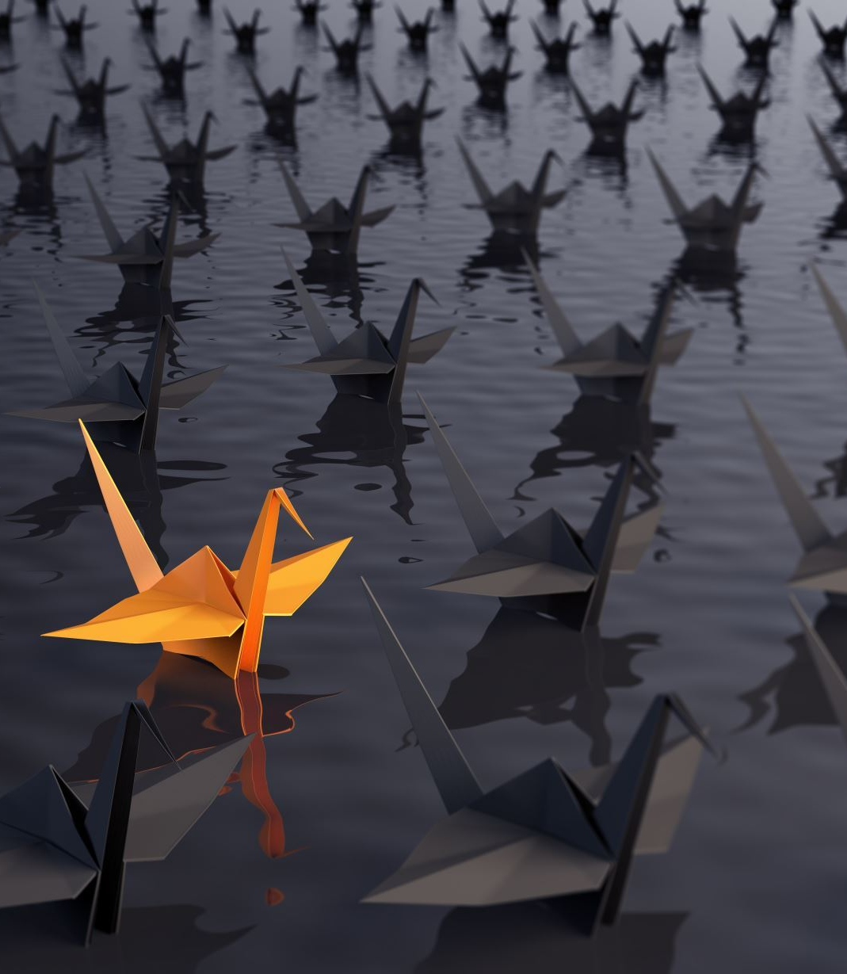
Uniqueness of UNet
Skip connections
Symmetric architecture
Reduced memory usage
Efficient training

Slide 4
Why use UNet?
High accuracy
Effective use of skip connections
Efficient memory usage
Versatility

Slide 5
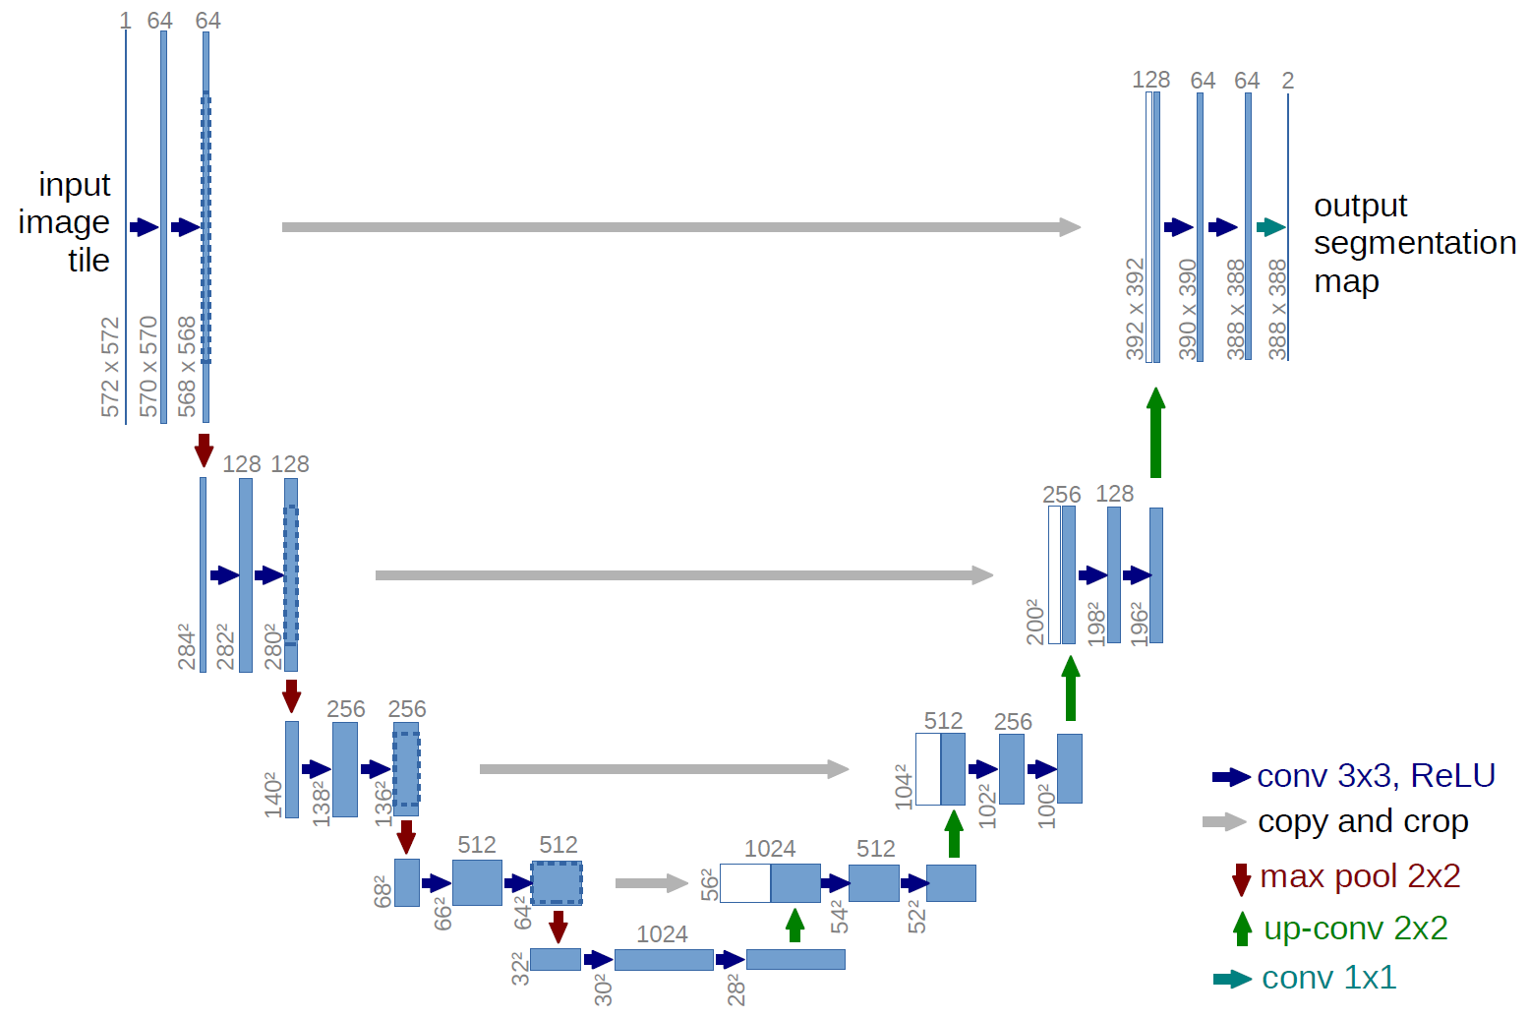
The UNet Architecture
2 Convolutional Layer operations having size of 3 x 3 kernel followed by ReLU Unit
Max Pooling of 2 x 2 operation with stride 2 for downsampling (Encoder)
2 x 2 Up-Sampling / Transposed Convolutions (Decoder)
Concatenation / Skip Connections which allow the decoder to access high-level features from the encoder

Slide 6
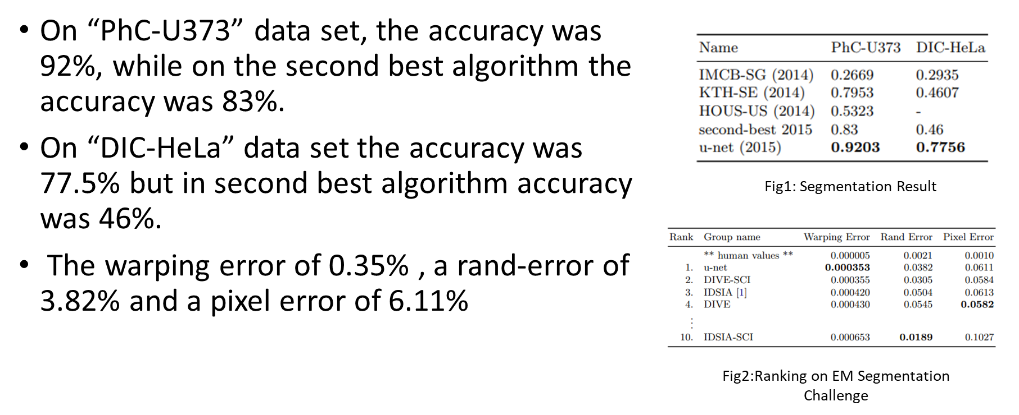
Result

Slide 7
Advantages
Encoder Decoder architecture
Effective use of limited data
Higher accuracy
Fast training and inference

Slide 8
Disadvantages
Memory requirements
Computationally intensive
Limited context
Sensitivity to image quality

Slide 9
UNet Implementation
Biomedical image segmentation
Object detection and segmentation
Natural language processing

Slide 10
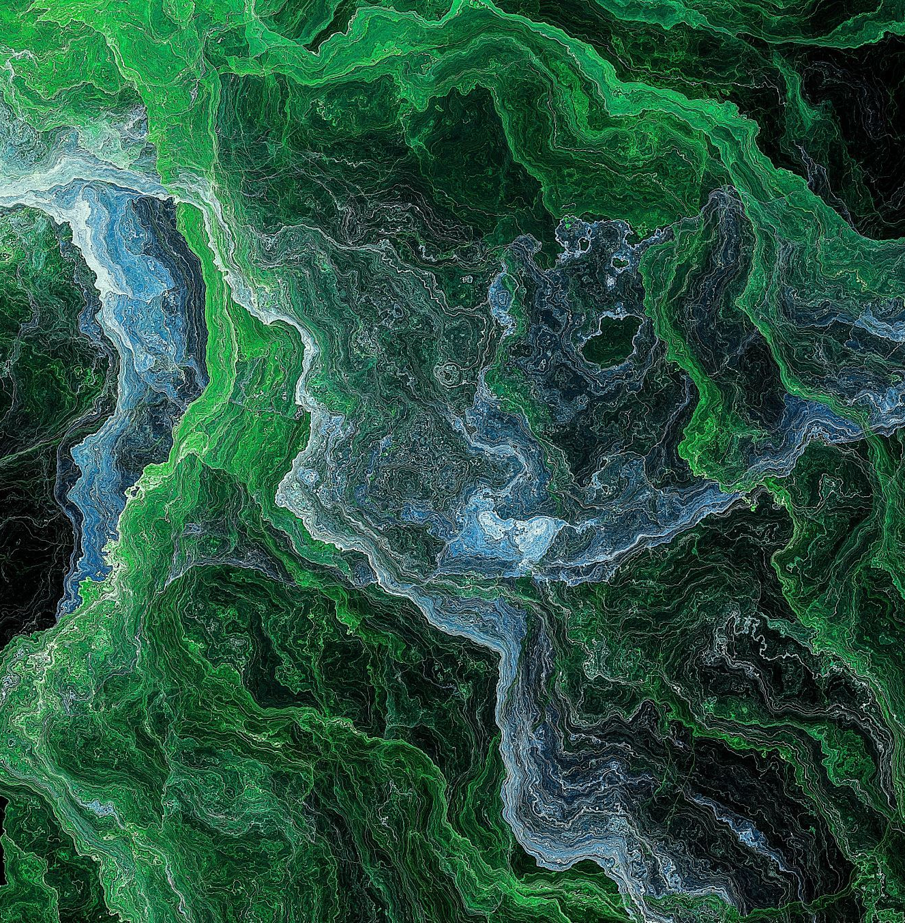
UNet Variations
UNet++
Residual UNet
Nested UNet
Recurrent UNet

Slide 11

Future Scope
Multi-modal image segmentation
Real-time segmentation
Few-shot learning
3D image segmentation
ncorporating attention mechanisms

Slide 12
References
He, K., Gkioxari, G., Doll´ar, P., Girshick, R.: Mask R-CNN. In: 2017 IEEE International Conference on Computer Vision (ICCV), pp. 2980–2988. IEEE (2017)
Huang, G., Liu, Z., Weinberger, K.Q., van der Maaten, L.: Densely connected convolutional networks. In: Proceedings of the IEEE Conference on Computer Vision and Pattern Recognition, vol. 1, p. 3 (2017)
Lee, C.-Y., Xie, S., Gallagher, P., Zhang, Z., Tu, Z.: Deeply-supervised nets. In: Artificial Intelligence and Statistics, pp. 562–570 (2015)
Li, X., Chen, H., Qi, X., Dou, Q., Fu, C.-W., Heng, P.A.: H-DenseUNet: hybrid densely connected UNet for liver and liver tumor segmentation from CT volumes.arXiv preprint arXiv:1709.07330 (2017)
Long, J., Shelhamer, E., Darrell, T.: Fully convolutional networks for semantic segmentation. In: Proceedings of the IEEE Conference on Computer Vision and Pattern Recognition, pp. 3431–3440 (2015)

Slide 13

Thank You

