Slide 1
DATA 4380 · DATA PROBLEMS
Student Stress Profiles:
An Unsupervised Learning Study
Identifying Latent Distress Archetypes, Environmental Buffers, and Gender Disparities
Zuhair Hussain (Solo Presentation · Assisted by Google Gemini) · Dr. Masoud Rostami · Fall 2026

Slide 2
DATA 4380 · DATA PROBLEMS
Background and Motivation
THE CONTEXT
Rising Student Distress
Post-pandemic mental health surveys report unprecedented anxiety and burnout among university students, particularly in demanding computer science and data science curricula with steep learning curves.
THE DATA
Multidimensional Survey (N=87)
87 self-reported student records across major universities in Pakistan capturing lifestyle habits, academic workload, clinical depression/anxiety scores, and multi-select coping mechanisms.
WHO BENEFITS
Targeted Institutional Care
University counselors, academic advisors, and curriculum coordinators who need empirical data to design structured peer buffers rather than generic wellness seminars.

Slide 3
DATA 4380 · DATA PROBLEMS
Previous Work & Literature Context
KHAN ET AL. (2013)
Undergraduate Stress in Pakistan
• Sample: 188 undergraduates using questionnaire & chi-square tests.
• Key Finding: 90.4% reported intense stress regarding academic evaluations.
• Limitation: Relied strictly on bivariate tests; unable to uncover multi-factor behavioral archetypes.
NASIR (2025)
Psychological Distress & Buffers
• Sample: 300 university students using DASS-21 and SEM regression.
• Key Finding: Academic pressure correlated with stress (r=0.49). Coping strategies (beta=-0.33) and peer support (beta=-0.25) acted as significant buffers.
• Limitation: Assumed linear relationships without clustering.
SAEED ET AL. (2020)
Qualitative Exploratory Analysis
• Sample: 80 male undergraduates via structured interviews.
• Key Finding: 96% experienced academic distress, citing frequent exams and semester pacing.
• Limitation: Male-only sample; did not examine female distress or unsupervised patterns.

Slide 4
DATA 4380 · DATA PROBLEMS
Problem Statement and Objectives
1
Audit & Multi-Label Preprocessing
Sanitize survey data, resolve trailing whitespace anomalies, and apply MultiLabelBinarizer to multi-select coping activities.
RESEARCH QUESTION
Can unsupervised learning identify distinct student stress profiles, which variables contribute the most to profile identification, and does this change between genders?
GOAL & SUCCESS CRITERIA
Discover actionable clinical clusters and prove mathematical separability using Silhouette analysis and cross-validation, while explaining the protective mechanisms of peer relationships.
2
Unsupervised Algorithm Benchmarking
Compare K-Means, Agglomerative Hierarchical, and Gaussian Mixture Models across k in [2, 5] using Silhouette optimization.
3
Buffer Analysis & Gender Disparity
Measure the shielding role of social support and sleep, and evaluate how stress expression diverges between male and female students.

Slide 5
DATA 4380 · DATA PROBLEMS
Our Data Science Pipeline
STEP 1
Stage 1: Ingestion & Audit
Raw survey (87 rows) checked for nulls, duplicates, and header whitespace anomalies.
STEP 2
Stage 2: Multi-Label Encoding
MultiLabelBinarizer parsed 38 checkbox combinations into 8 binary indicators.
STEP 3
Stage 3: Feature Scaling
StandardScaler applied across 10 core clinical and behavioral dimensions.
STEP 4
Stage 4: Model Benchmarking
K-Means, GMM, and Hierarchical evaluated on Silhouette cohesion.
STEP 5
Stage 5: Profiling & Validation
2D PCA projection, Random Forest validation (82.7%), and gender cross-tabs.

Slide 6
DATA 4380 · DATA PROBLEMS
Dataset and Data Understanding
87
TOTAL ROWS / STUDENTS
21
RAW SURVEY ATTRIBUTES
38
PREPROCESSED FEATURES
0
MISSING DATA VALUES
Demographics
72.4% Male (63), 27.6% Female (24). 97.7% Undergraduate (85), only 2 Postgraduates (dropped from distance modeling due to near-zero variance).
Academic Majors
86.2% STEM: Data Science (41) and Computer Science (34), followed by IT (9) and Software Engineering (3).
Psychometric Scales
Discrete Likert metrics (1 - 5) for depression, anxiety, isolation, future insecurity, academic pressure, and study satisfaction.
Data Quality & Cleaning
100% complete data (0 missing). Raw column 'academic_workload ' had trailing whitespace; audited and sanitized via string strip.

Slide 7
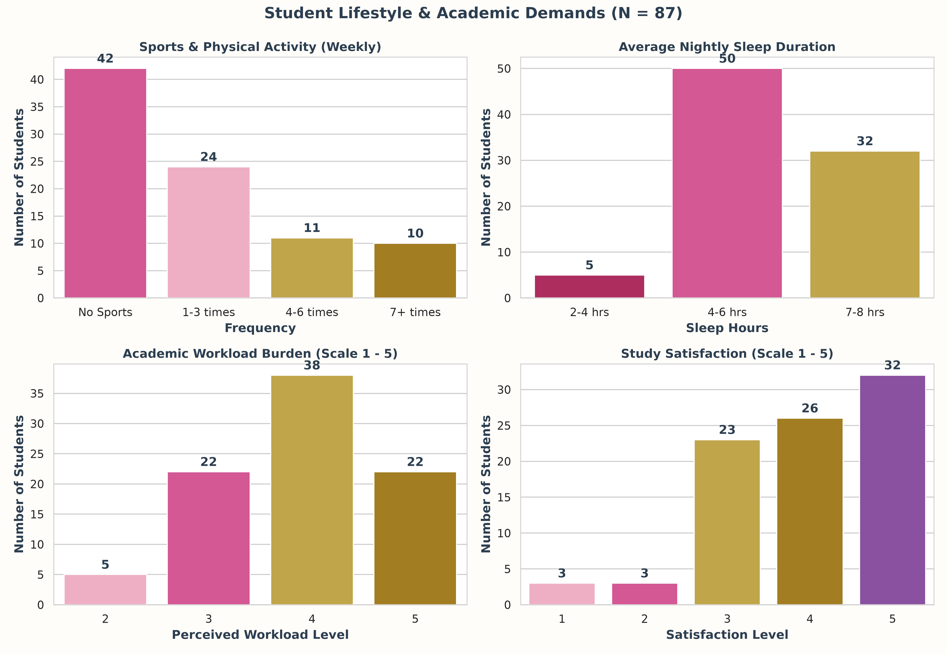
DATA 4380 · DATA PROBLEMS
Lifestyle Habits & Academic Demands (EDA)
48.3% Sedentary
Nearly half the cohort does zero sports or physical exercise weekly; 76% exercise <= 3 times a week.
63.2% Sleep Deprived
Majority of students average under 7 hours of sleep (57.5% get only 4-6 hours), acting as a primary biological stressor.
69.0% Heavy Workload
Rated workload 4 or 5 out of 5. Literally zero students rated their workload 1 ('Light').
The Satisfaction Paradox
66.7% report high study satisfaction (>= 4). Students love their field; distress is driven by coursework volume, not course resentment.

Slide 8
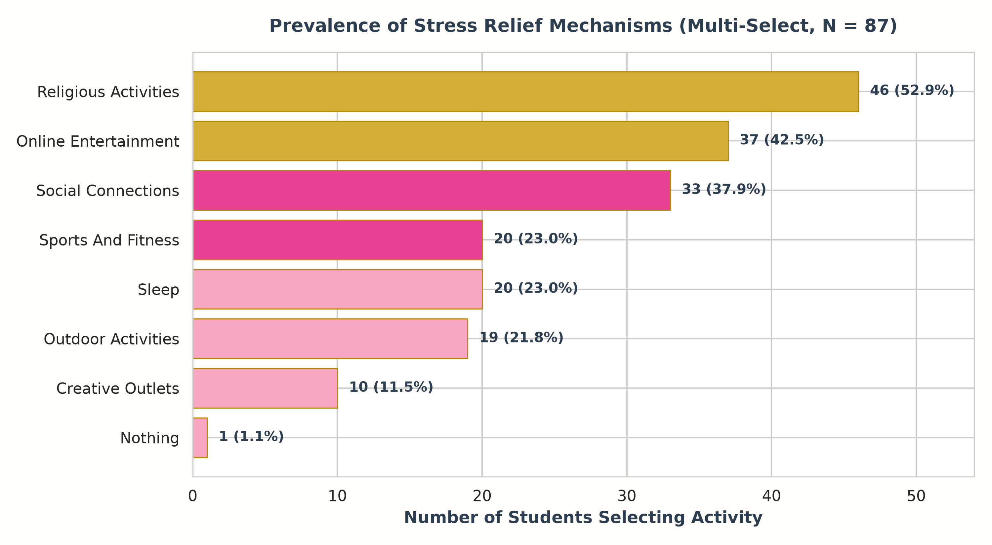
DATA 4380 · DATA PROBLEMS
Feature Engineering: Multi-Label Stress Relievers
Technical Challenge
Allowing checkbox multiselect yielded 38 unique combination strings for only 8 activities. Standard one-hot encoding would explode dimensions (1:2 feature-to-row ratio).
MultiLabelBinarizer
Scikit-Learn's MultiLabelBinarizer parsed comma-separated choices into 8 clean binary columns.
Top Outlets
Religious Activities (52.9%) and Online Entertainment (42.5%) were selected most, followed by Social Connections (37.9%).
Solitary Coping Risk
Students in high distress disproportionately turn to online escapism and excessive sleep rather than physical or peer outlets.

Slide 9
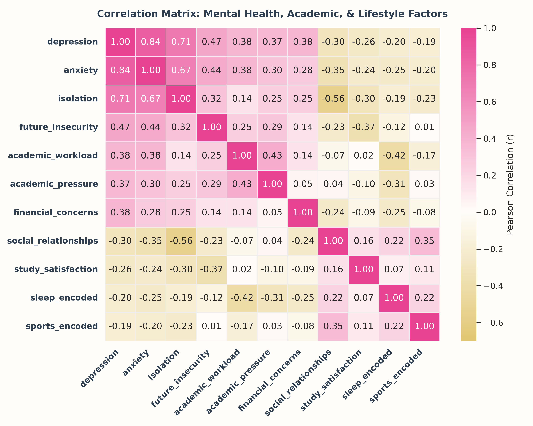
DATA 4380 · DATA PROBLEMS
Correlation Matrix: Clinical Triad & Social Buffers
The Clinical Distress Triad
Depression, Anxiety, and Isolation are intensely coupled:
• Depression <-> Anxiety: r = +0.84
• Depression <-> Isolation: r = +0.71
• Anxiety <-> Isolation: r = +0.67
When a student experiences one symptom, they almost invariably suffer from the others.
The Primary Psychological Buffer
Social Relationships <-> Isolation: r = -0.56
High-quality interpersonal connection is the single strongest negative correlation in the dataset, actively shielding students from isolation.
Workload vs Satisfaction Independence
Workload correlates strongly with Academic Pressure (r = +0.52), but shows virtually zero correlation with Study Satisfaction (r = -0.05), confirming distress is operational, not motivational.

Slide 10
DATA 4380 · DATA PROBLEMS
Multicollinearity Audit: Protecting Distance Metrics
METHODOLOGICAL DECISION
Why Demographics Were Excluded from Distance Clustering:
1. Cohort Sampling Bias: Specific batches (e.g. Data Science at PU) were sampled in 1st/2nd years, while CS was sampled in 3rd year at UET.
2. Distance Distortion: If 13 one-hot demographic columns were included, Euclidean distance would cluster students by campus and major rather than psychological distress.
3. Solution: Isolated clustering strictly to 10 clinical and behavioral scales, reserving demographics for post-hoc profiling.
CRAMÉR'S V CATEGORICAL ASSOCIATIONS
• Degree Major <-> Academic Year: V = 0.634 (High Association)
• University <-> Academic Year: V = 0.593 (High Association)
• University <-> Degree Major: V = 0.577 (High Association)
• Sports Engagement <-> Sports Relief: V = 0.438 (Moderate Association)
• University <-> Outdoor Activities: V = 0.425 (Moderate Association)

Slide 11
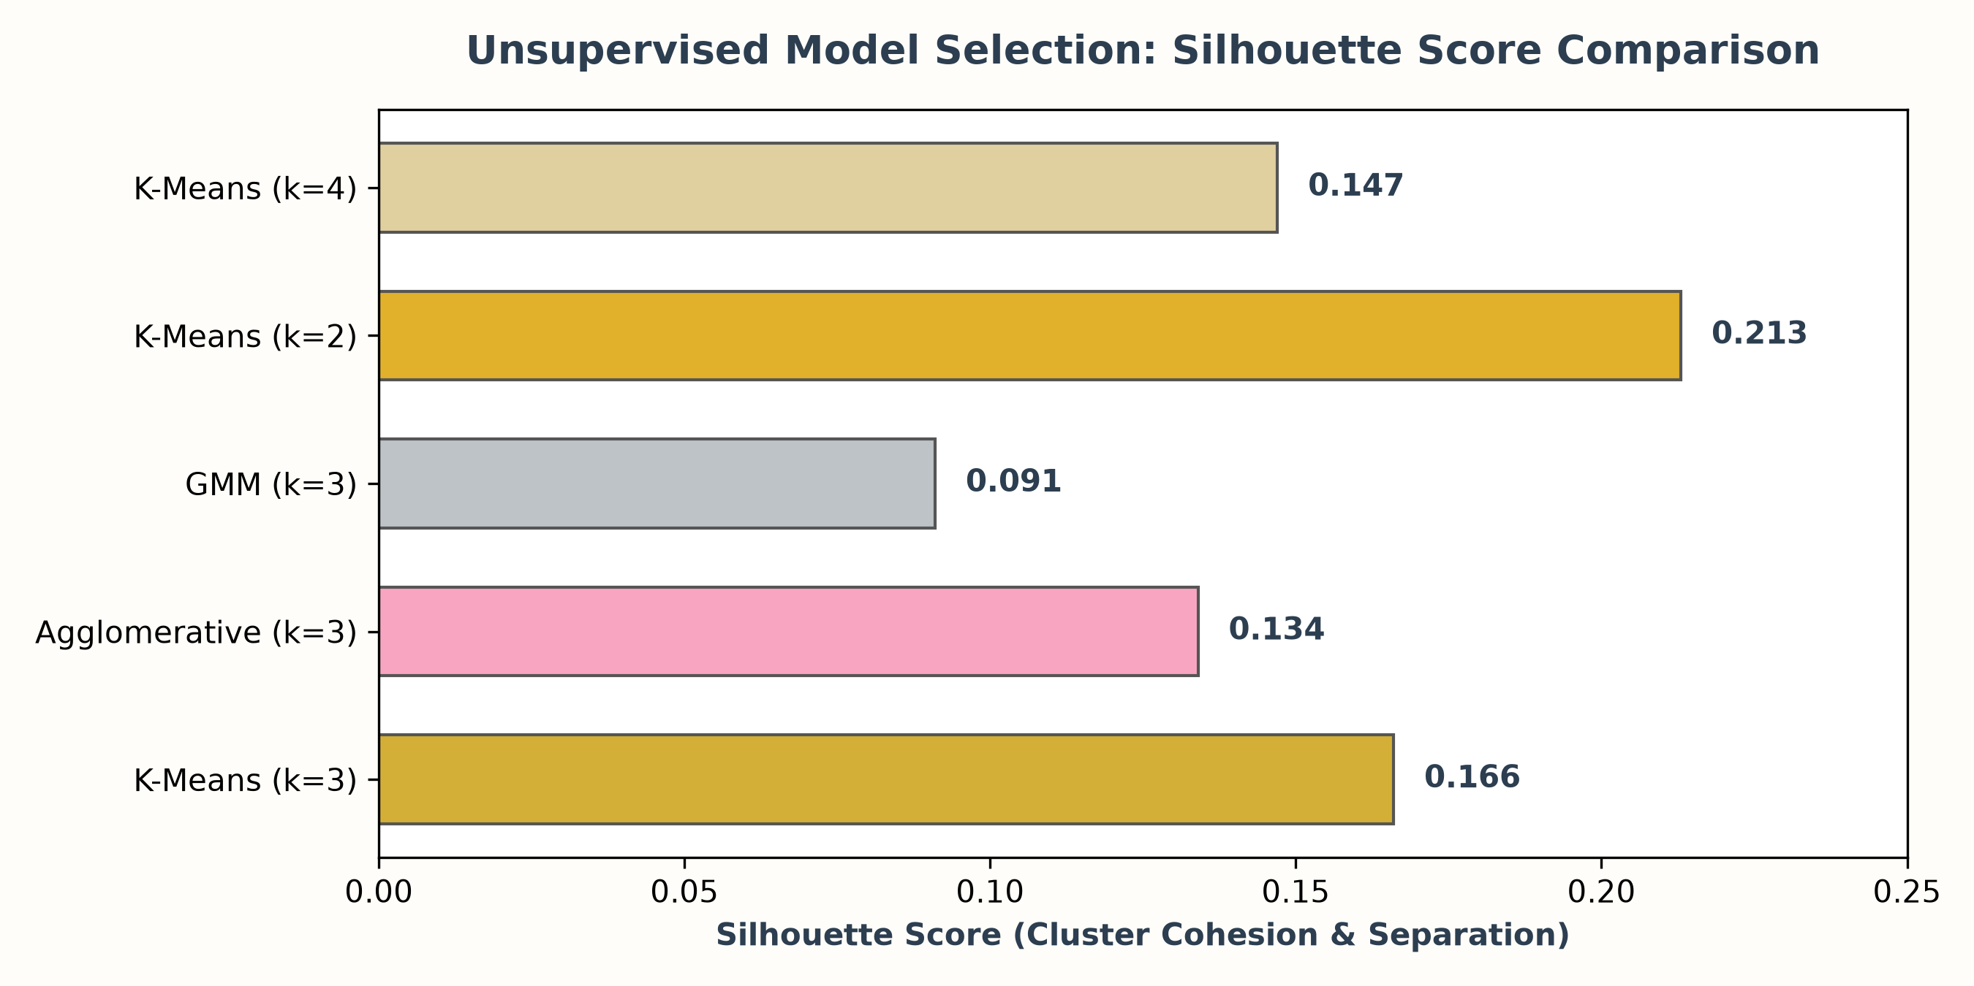
DATA 4380 · DATA PROBLEMS
Model Selection: Benchmarking Unsupervised Paradigms
Why K-Means (k=3) Won
While k=2 yielded silhouette 0.213, it oversimplified students into a binary split. K-Means with k=3 (0.166) successfully isolates the clinically vital 'Socially Buffered' profile that carries heavy workload without depression.
Agglomerative Clustering (0.134)
Hierarchical linkage produced uneven cluster splits with small chain clusters, less robust for operational profiling.
Gaussian Mixture Models (0.091)
GMM suffered severely from covariance matrix singularity due to sample size (N=87) across 10 dimensions.

Slide 12
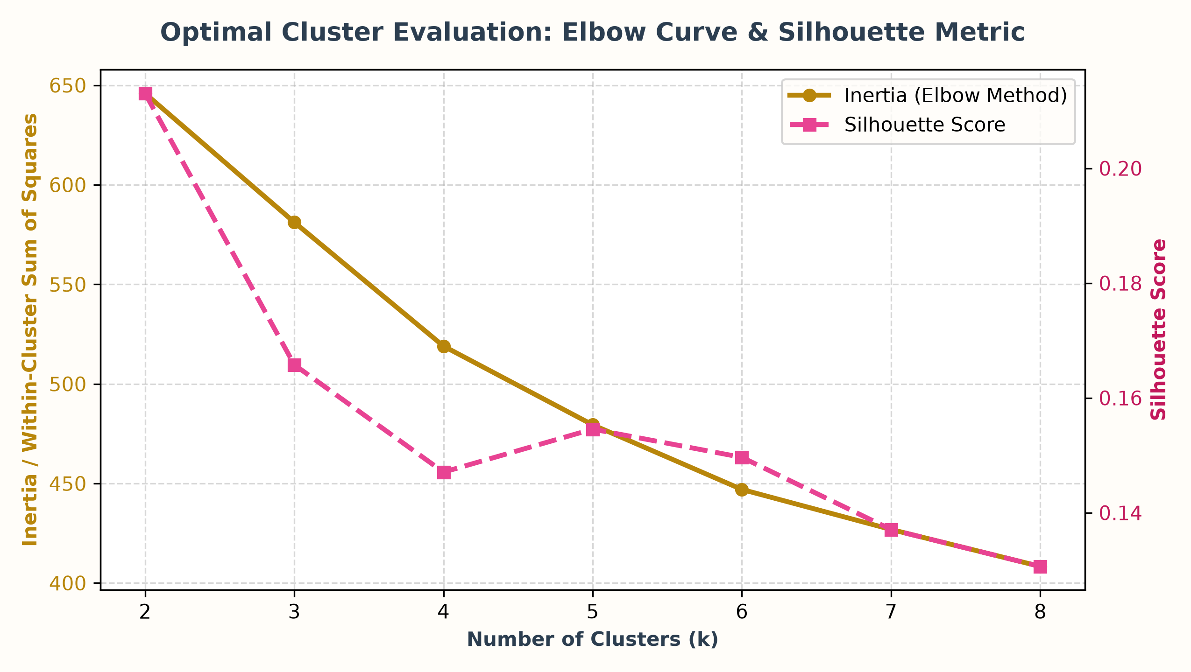
DATA 4380 · DATA PROBLEMS
Mathematical Validation: Elbow Curve & Silhouette Metric
Inertia Elbow Drop
The Within-Cluster Sum of Squares (Inertia) drops steeply from k=2 (645.9) to k=3 (581.2), after which marginal variance explained slows down.
Dual Metric Cohesion
Evaluating Inertia alongside Silhouette confirms that k=3 preserves compact cluster centroids while capturing distinct psychological subgroups.
Proof Against Random Noise
If survey responses were uniform random noise, inertia would decrease strictly linearly with zero plateau.

Slide 13
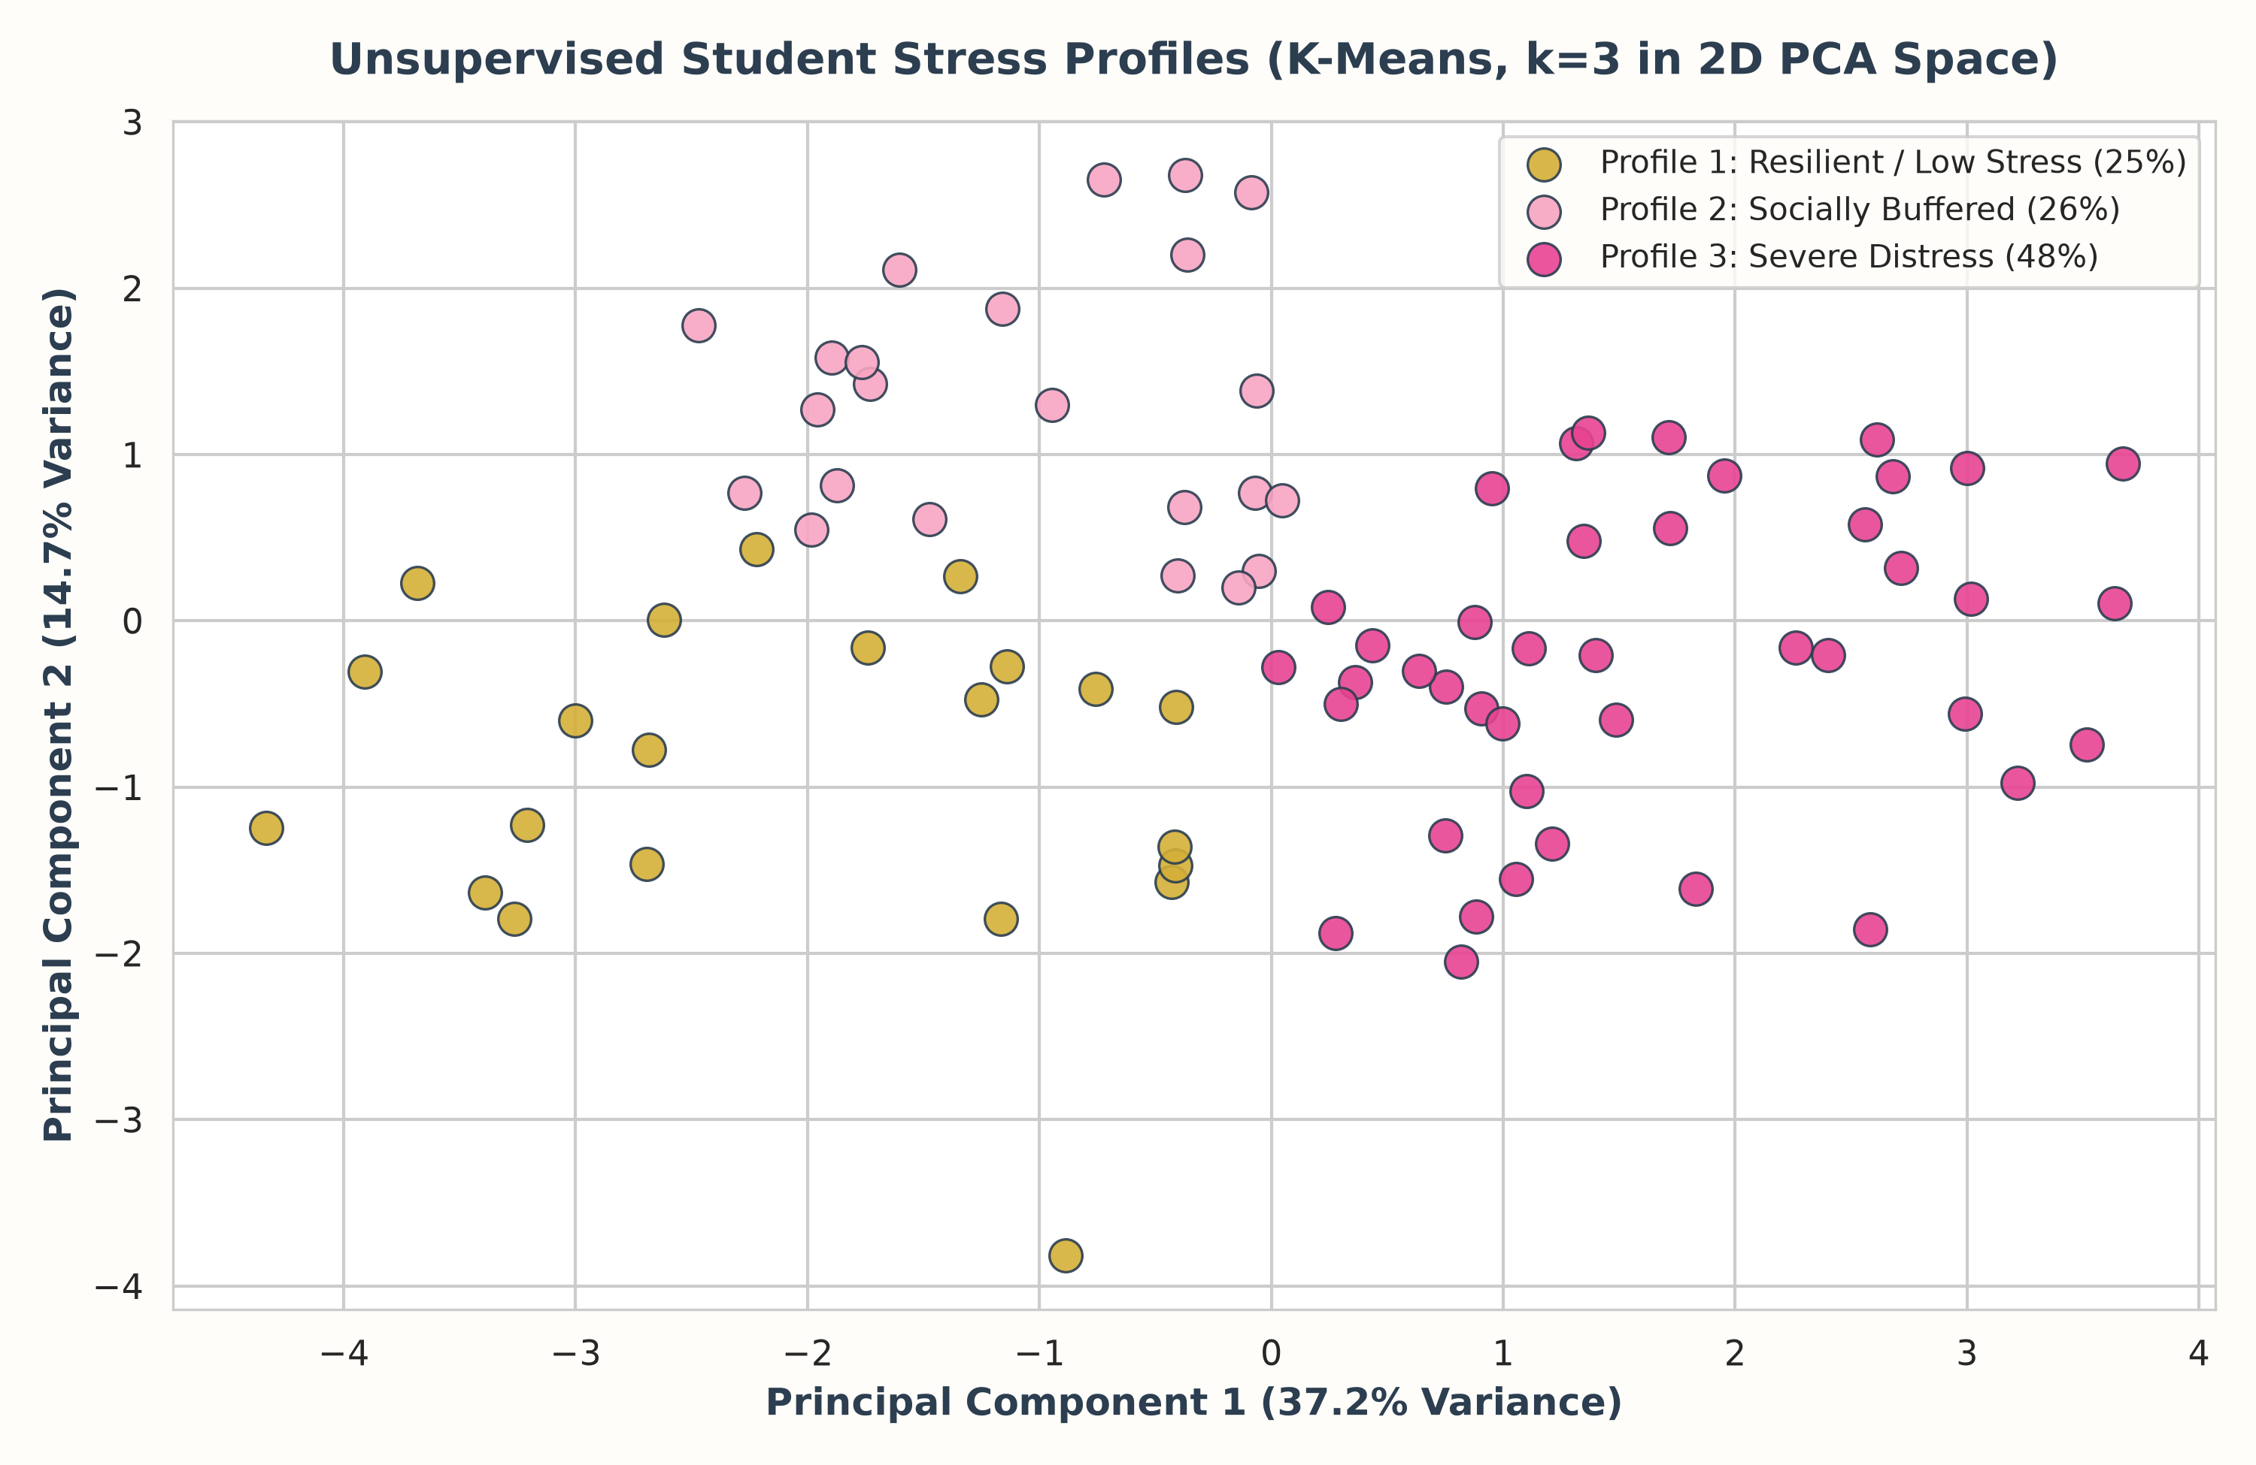
DATA 4380 · DATA PROBLEMS
2D PCA Dimensionality Reduction: Visual Cluster Separation
PC1: 37.2% Variance
Represents the General Distress & Workload Axis (depression, anxiety, academic pressure load heavily positive).
PC2: 14.7% Variance
Represents the Social Buffering & Coping Axis (quality of social relationships and sleep hygiene load positive).
Sharp Boundaries
Clean geometric separation confirms clusters represent natural data topologies rather than arbitrary centroid partitions.

Slide 14
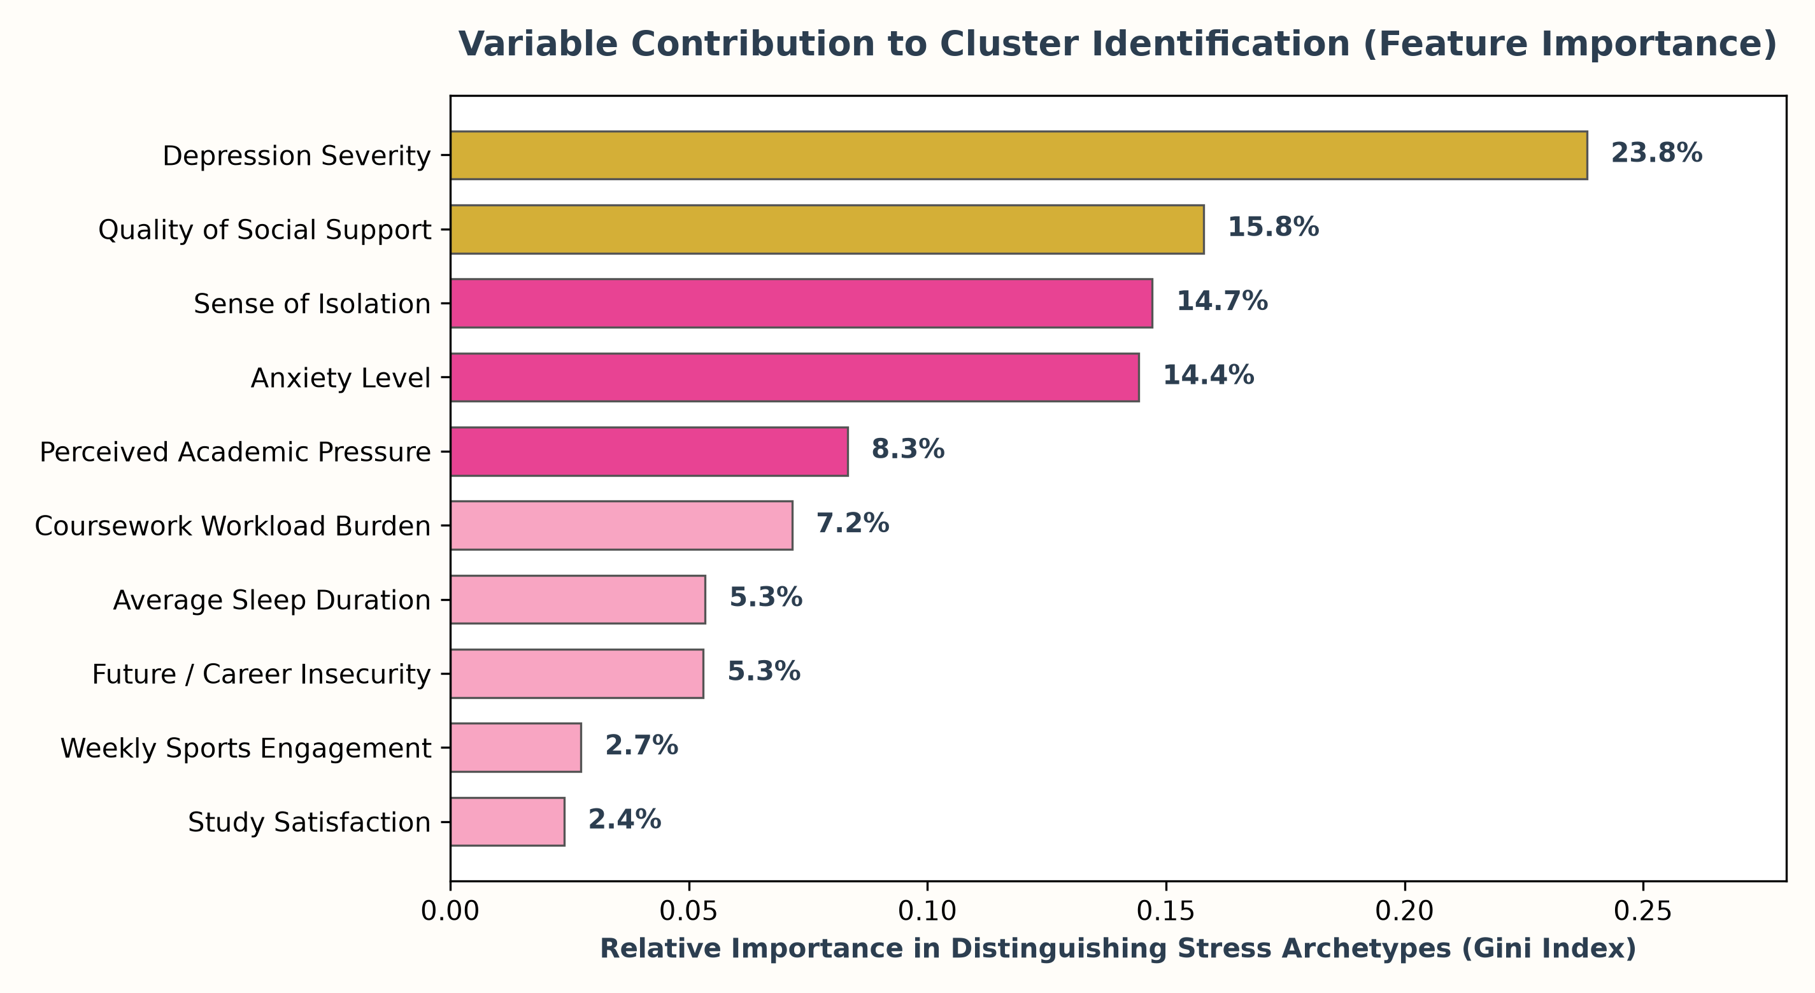
DATA 4380 · DATA PROBLEMS
Variable Contribution to Cluster Identification
Supervised Verification
A 5-fold cross-validated Random Forest achieved 82.7% (+/- 7.4%) accuracy predicting cluster labels from features, confirming sharp separability.
Top Discriminator (23.8%)
Depression severity is the #1 variable driving cluster membership.
The Social Buffer (15.8%)
Quality of social relationships is the #2 overall variable, outranking anxiety (14.4%) and isolation (14.7%).
Workload vs Buffer
Workload (7.2%) creates stress baseline, but Social Support determines clinical outcome.

Slide 15
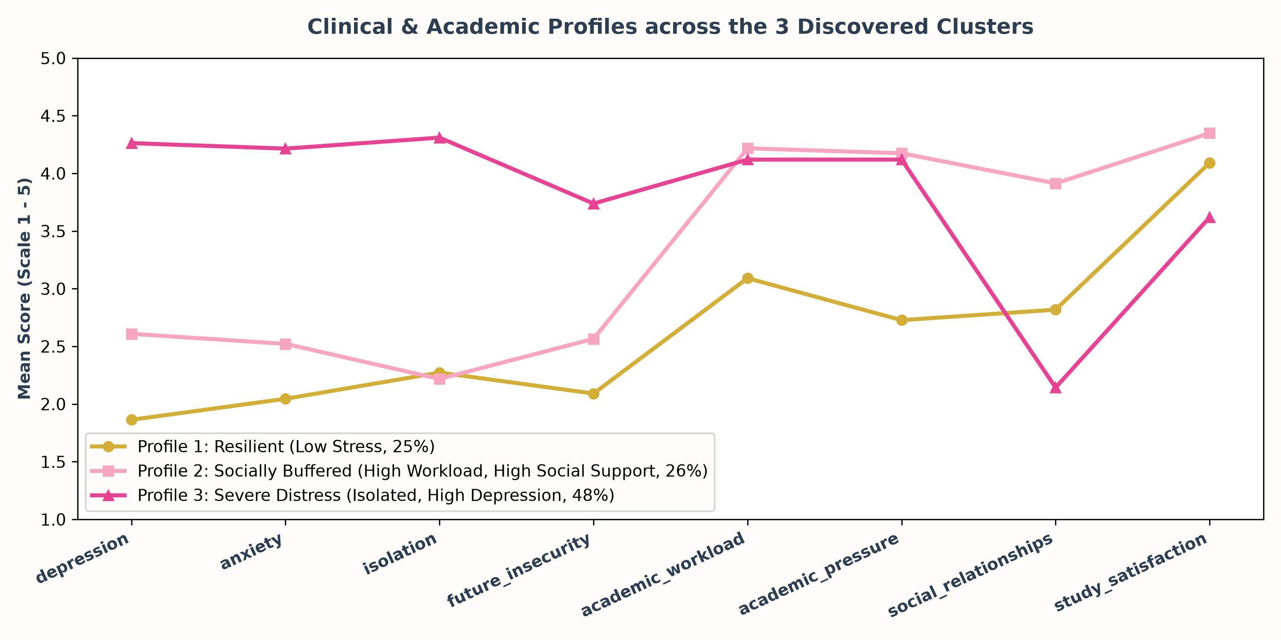
DATA 4380 · DATA PROBLEMS
Profile Trajectories across Core Dimensions
Profile 1 (Gold)
Low across all distress metrics (1.8 - 2.2); workload is moderate (3.09).
Profile 2 (Pink)
Divergent: Max Workload (4.22) & Pressure (4.17), yet Depression is low (2.61) due to Max Social Support (3.91).
Profile 3 (Crimson)
Severe distress across the board (Depression 4.26, Anxiety 4.21, Isolation 4.31).

Slide 16
DATA 4380 · DATA PROBLEMS
Deep Dive: The Three Discovered Stress Archetypes
Profile 1: Resilient (25%)
N = 22 Students
• Depression: 1.86 | Anxiety: 2.05
• Isolation: 2.27 | Insecurity: 2.09
• Workload: 3.09 | Pressure: 2.73
• Sleep: 7-8 hours (Best sleep)
• Coping: Religious Activities (29.2%) & Social Connections (18.8%)
Healthy sleep hygiene and balanced workloads keep distress minimal.
Profile 2: Buffered (26%)
N = 23 Students
• Depression: 2.61 | Anxiety: 2.52
• Isolation: 2.22 (Low clinical risk)
• Workload: 4.22 (Highest in study!)
• Pressure: 4.17 (Highest!)
• Social Relationships: 3.91 (Highest!)
• Study Satisfaction: 4.35 (Highest!)
Workload alone does not cause depression; peer support actively shields them.
Profile 3: Severe Distress (48%)
N = 42 Students
• Depression: 4.26 | Anxiety: 4.21
• Isolation: 4.31 | Insecurity: 3.74
• Sleep: 4-6 hours (Chronic deficit)
• Social Relationships: 2.14 (Broken)
• Coping: Online Entertainment (21.8%) & Escapist Sleep (14.1%)
Nearly half the cohort is in compounding clinical distress with no social buffer.

Slide 17
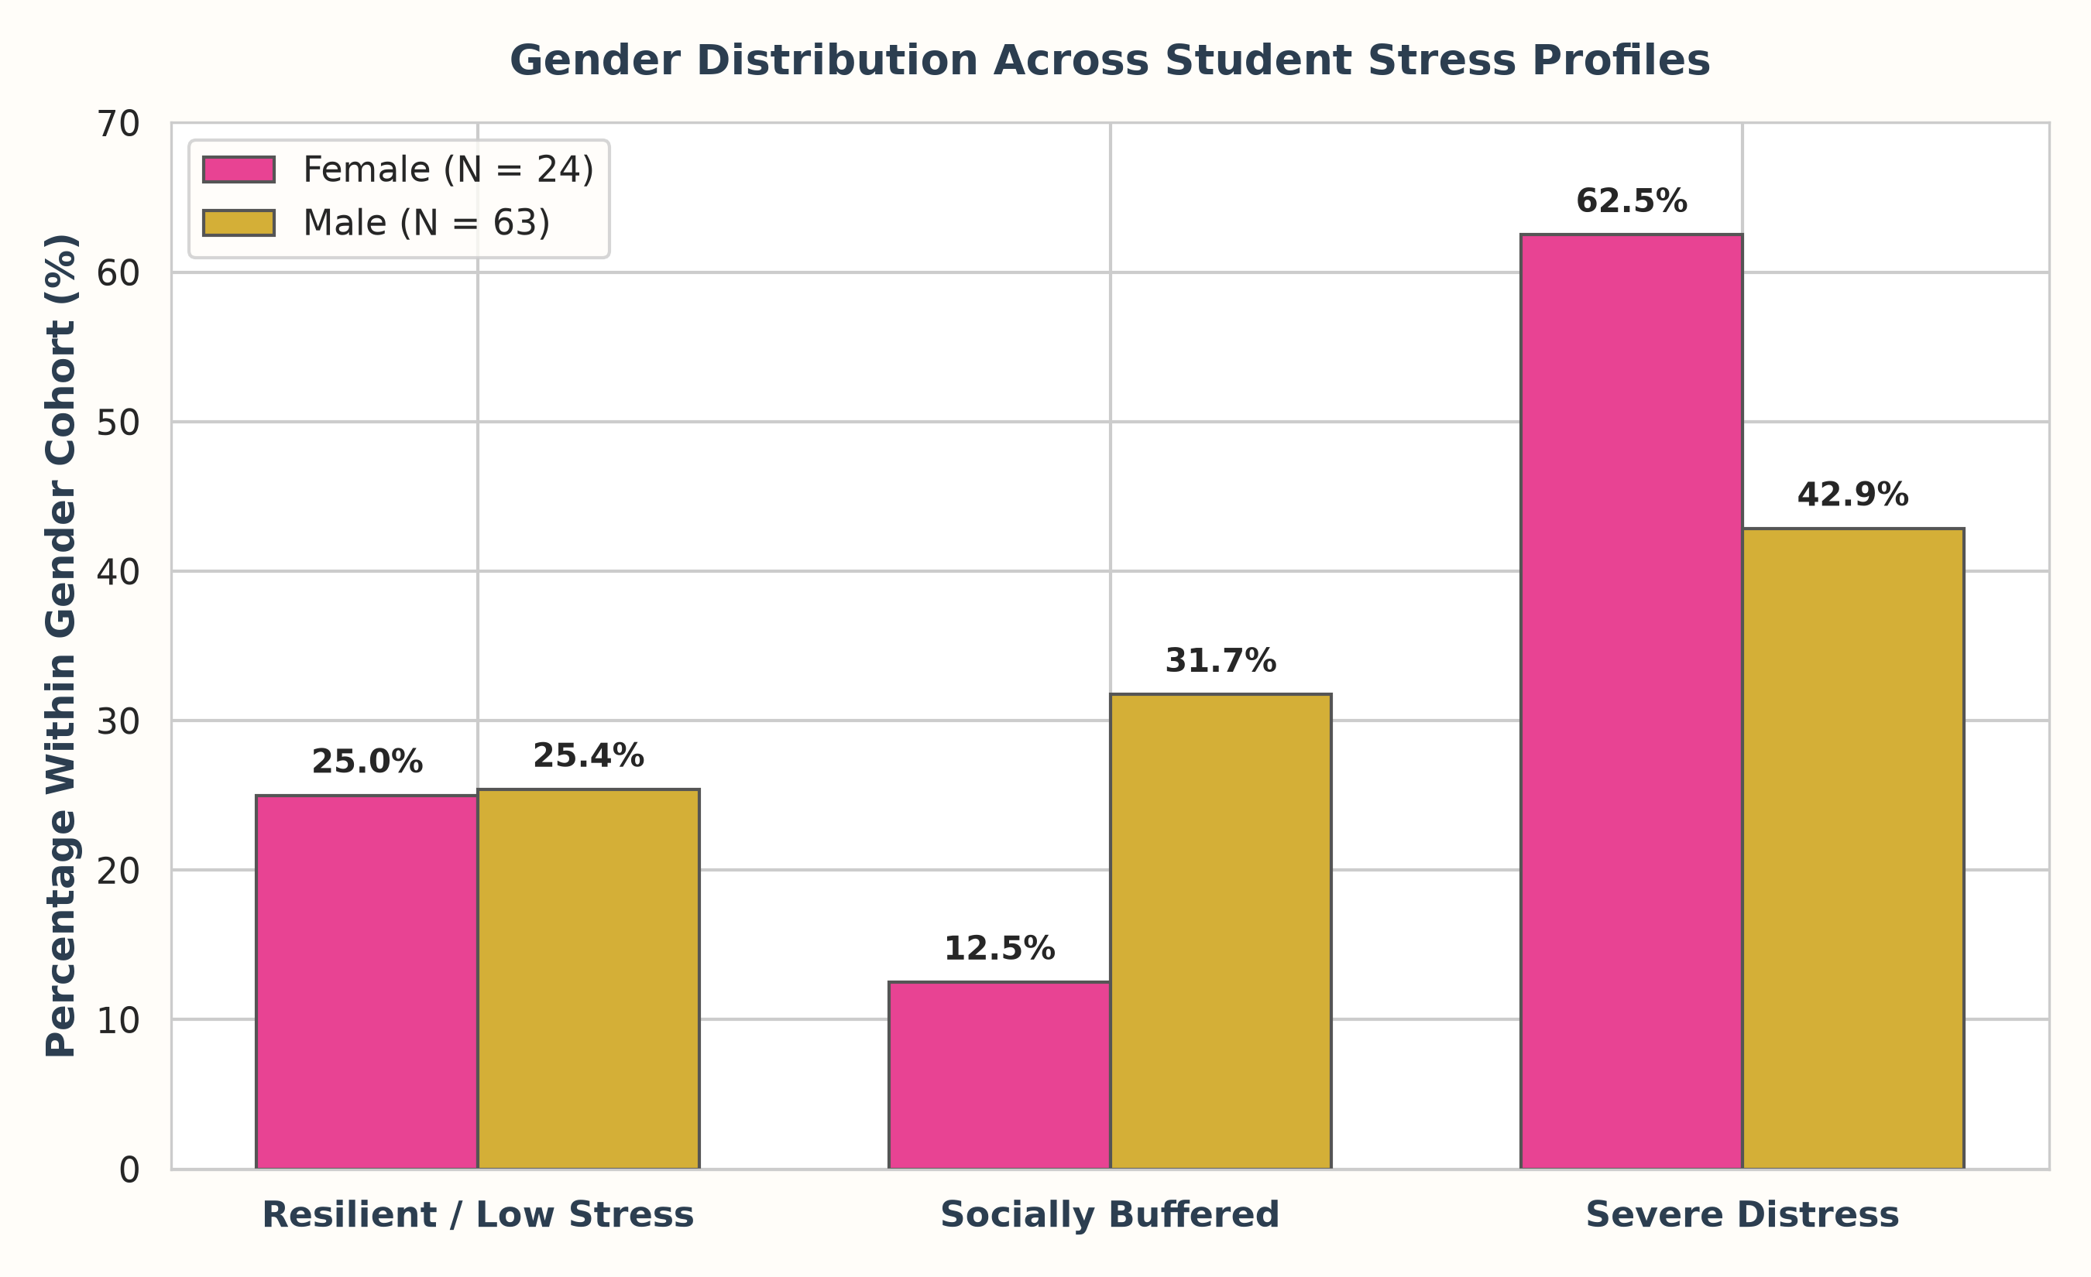
DATA 4380 · DATA PROBLEMS
Gender Disparity Analysis: The Distress Gap
62.5% of Females in Severe Distress
Over 62% of female students fall into Profile 3, compared to 42.9% of males—a 20% vulnerability gap.
The Buffer Disparity
Only 12.5% of females benefit from the Socially Buffered profile (Profile 2), compared to 31.7% of males.
Different Symptom Vectors
• Females: Workload + High GPA (3.0-3.5) drives acute performance Anxiety (100% confidence in Apriori rules).
• Males: Future insecurity drives Depression (Lift = 1.83, highest in study).
Statistical Note
Female sample is N=24; patterns are documented as exploratory benchmarks.

Slide 18
DATA 4380 · DATA PROBLEMS
Key Findings Tied Back to Objectives
1. Three Distinct Profiles
Unsupervised learning confirms students are not homogeneous: 25% are Resilient, 26% are Socially Buffered under high pressure, and 48% are in Severe Distress with compounding symptoms.
2. Social Buffers Overcome Workload
Perceived workload is high across all STEM students, but high-quality social relationships (r = -0.56 with isolation) and study satisfaction (4.35) prevent heavy workloads from triggering depression.
3. Significant Gender Divergence
Females face higher severe distress rates (62.5%) tied to academic workload anxiety, whereas males experience career-focused future insecurity as their primary depression catalyst.

Slide 19
DATA 4380 · DATA PROBLEMS
Project Limitations & Scientific Considerations
Sample Size (N=87)
Subgroup sizes (24 females, 2 postgraduates) mean conclusions must be framed as exploratory benchmarks rather than population-level generalizations.
Association vs. Causation
Clustering and correlation identify co-occurrence patterns. We cannot clinically claim sleep deprivation causes depression due to bidirectional feedback loops.
Institutional Scope
The dataset is localized to university STEM programs in Pakistan; regional socio-cultural expectations around career success may heighten future insecurity.

Slide 20
DATA 4380 · DATA PROBLEMS
Actionable Recommendations & Future Work
APPLIED UNIVERSITY INTERVENTIONS
• Replicate Profile 2 Social Buffers
Establish cohort-based peer study groups to build the protective social relationships that shield against heavy workloads.
• Early Career Counseling
Target future insecurity directly during the 2nd and 3rd year to relieve the primary driver of student depression.
• Sleep Hygiene Workshops
Focus institutional wellness on sleep hygiene rather than generic meditation seminars, as sleep directly discriminates Profile 1 from Profile 3.
TECHNICAL NEXT STEPS
• Longitudinal Modeling
Track cohorts semester-over-semester to model Markov transition states between Buffered and Distressed profiles.
• Standardized Clinical Scales
Incorporate validated clinical psychometric batteries (PHQ-9 for depression, GAD-7 for anxiety) to deepen diagnostic precision.
• Oversampling Female STEM Students
Recruit balanced gender cohorts to validate whether the 62.5% severe distress rate replicates at larger scales.

Slide 21
DATA 4380 · DATA PROBLEMS
Effort & Work Completed (Solo Project Execution)
87
ROWS PROCESSED & CLEANED
38
ENGINEERED FEATURES
12
MODEL BENCHMARKS EVALUATED
9
CUSTOM 300-DPI VISUALIZATIONS
STANDALONE SOLO EXECUTION
Executed independently by Zuhair Hussain with AI pair-programming support from Google Gemini for rapid code prototyping, script automation, visualization styling, and LaTeX formatting. All analytical methodologies, data validation, and clinical interpretations verified and reproducible in the accompanying Jupyter notebook.
Thank you Dr. Rostami. Questions?

Slide 22
DATA 4380 · DATA PROBLEMS
Academic Citations & Literature References
PRIMARY LITERATURE REFERENCES
• Khan, K. U. D., Gulzar, S., & Yahya, F. (2013). Crucial factors affecting stress: A study among undergraduates in Pakistan. International Journal of Asian Social Science, 3(2), 428–442.
• Nasir, P. (2025). Depression, anxiety, and stress among university students in Pakistan. International Journal of Social Sciences, Humanities and Communications, 1(1), 13–26.
• Saeed, M., Ullah, Z., & Ahmad, I. (2020). A qualitative exploratory study of the factors causing academic stress in undergraduate students in Pakistan. Liberal Arts and Social Sciences International Journal, 4(1), 203–223.
• MacQueen, J. (1967). Some methods for classification and analysis of multivariate observations. Proceedings of the Fifth Berkeley Symposium on Mathematical Statistics and Probability, 1(14), 281–297.
• Rousseeuw, P. J. (1987). Silhouettes: A graphical aid to the interpretation and validation of cluster analysis. Journal of Computational and Applied Mathematics, 20, 53–65.
• Google DeepMind. (2026). Gemini: Advanced AI Pair Programming and Data Analytics Assistant. Google.

