Slide 1

OS Image Recovery and Backup
Presented by:
Fatematuz Zuhra
ID: 15
Course:It support for office management

Slide 2
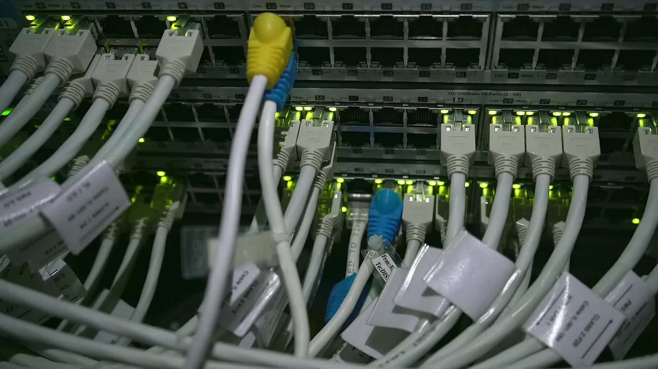
OS Image Recovery and Backup
OS image recovery and backup are processes aimed at safeguarding your operating system (OS), applications, configurations, and files. They create a snapshot or clone of your entire OS, which can be restored in case of system failure, malware attack, or hardware crash

Slide 3
Choose a Backup Tool
Built-in:
Windows
MacOS
Clonezilla
Third Party:
Acrinic True Image
Macrium Reflect
Easeus Todo Backup
Linux:
dd for bit-by-bit copies
rsync for custom backup
Timeshift for system snapshot

Slide 4
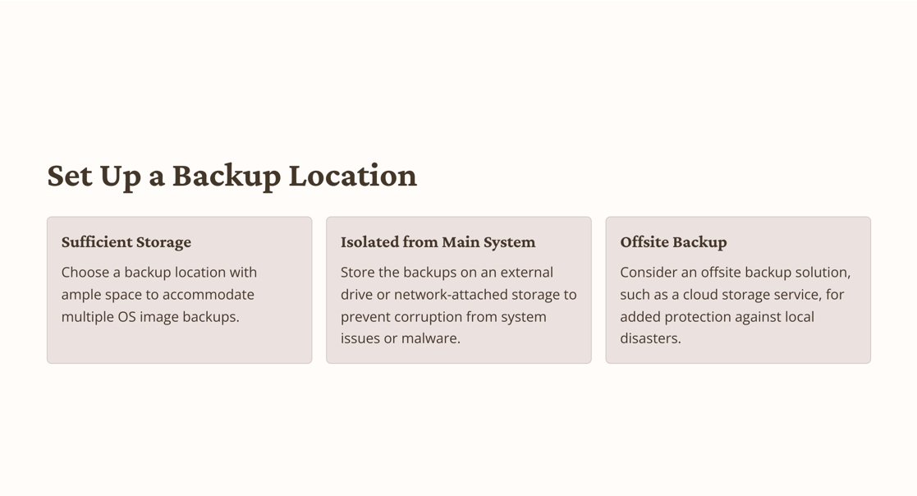

Slide 5
Create OS Image Backup:
For Windows:
Control Panel → System & Security → Backup & Restore
Click on “Create system image”
Follow the prompts

Slide 6
For MacOS
Connect an external drive and open Time Machine.
Select the drive as your backup disk
Time Machine will begin creating backups automatically.

Slide 7
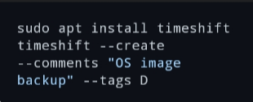

For Linux
For Ubuntu based System:
For more control use dd:

Slide 8
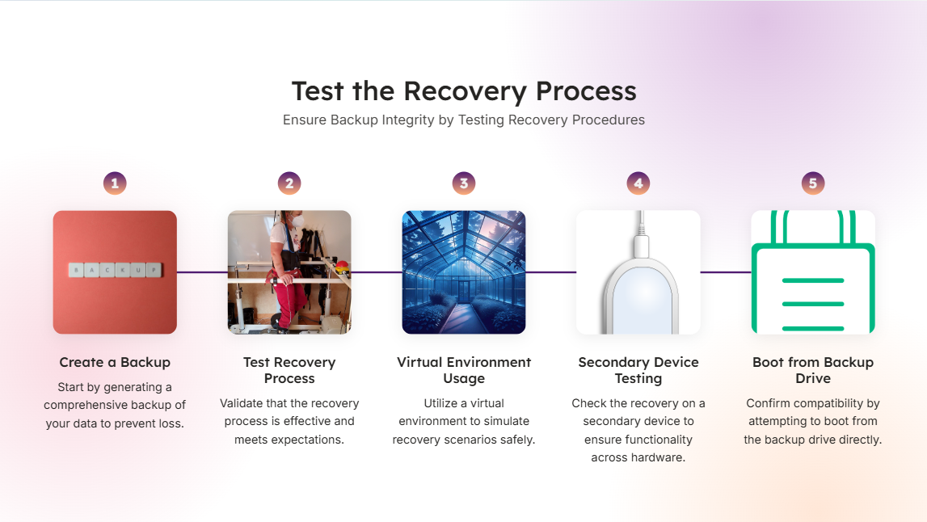

Slide 9
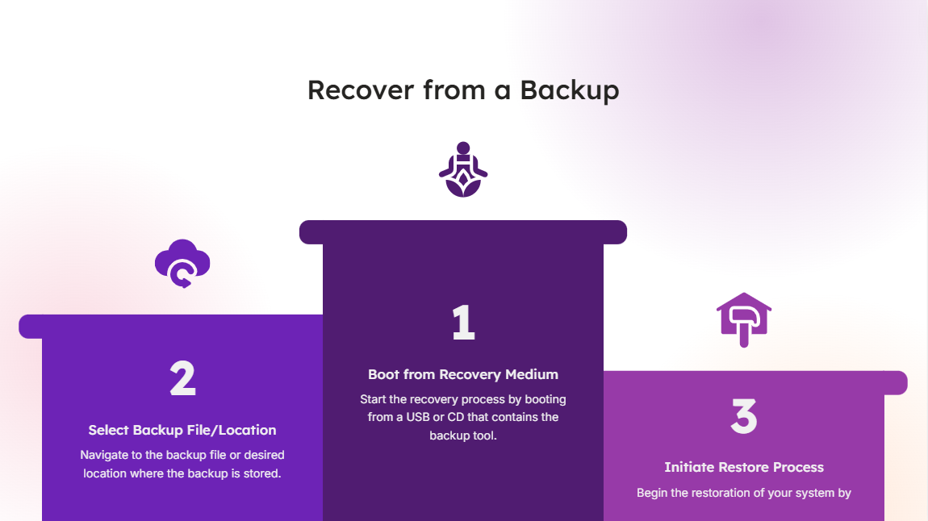

Slide 10
Thank You

