Slide 1
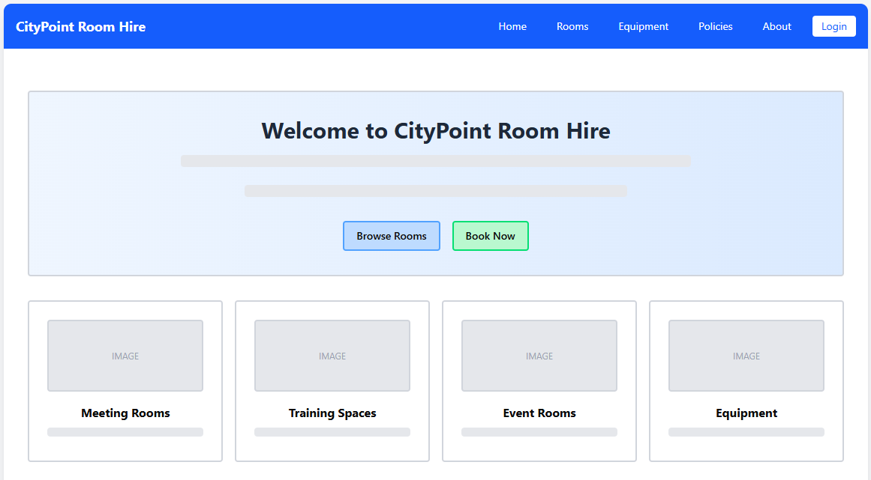
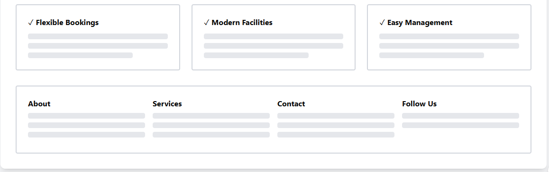
Will be clickable on every page and will send the user to the home page
The background should be white, with each card being a lighter version of the accent colour (blue)
These will take the user to the already filtered Rooms page as a short cut to improve user experience with the website
These show that the company has all these things, which will gain user trust. It’s on the home page so it’ll be one of the first things users notice

Slide 2
Navigation Bar
-Height: 64px fixed, background #2563EB (blue-600)
-Logo: 24px font-size, 700 weight
-Nav items: 14px font-size, 12px horizontal padding
-Login button: white background, #2563EB text, 6px border-radius
-Sticky positioning on scroll for easy access
Hero Section Design
-Hero height: 400px with gradient background (#EFF6FF to #E0E7FF)
- Heading: 48px font-size, 700 weight, #1F2937 colour
-Subtext: 18px, line-height 28px for readability
-CTA buttons: 48px height, 16px padding, rounded-lg (8px)
-Primary button: #3B82F6 (blue-600), Secondary: #10B981 (green-600)
Quick Links Grid
-Grid: 4 columns on desktop, 2 on tablet, 1 on mobile
- Card size: Min-height 200px with 24px padding
-Images: 192px height, 16:9 aspect ratio
-Hover effect: translateY(-4px) with shadow-xl
- Gap between cards: 16px (gap-4)

Slide 3
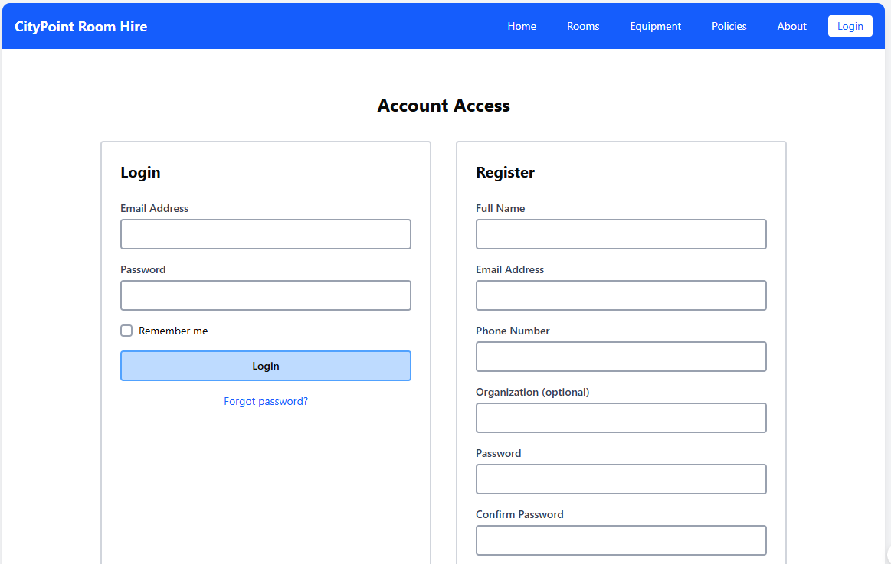
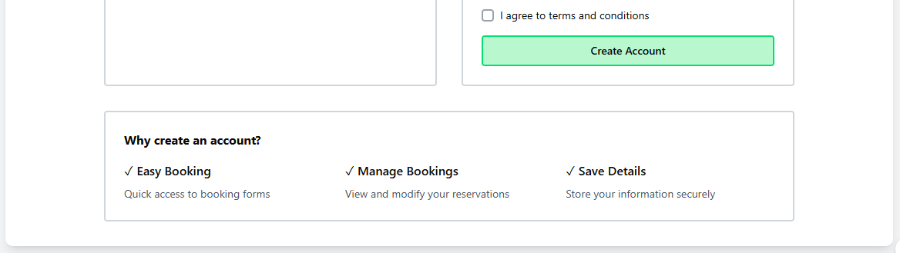
Accessibility Feature
-All inputs have visible labels (not placeholders)
-Tab index order: flows naturally top to bottom
-Error messages: #DC2626 (red-600) with icons
-Min contrast ratio: 4.5:1 for WCAG AA compliance
-Checkbox: 16px touch target, increased to 44px on mobile
-Why: Meets WCAG 2.1 AA standards for inclusive design
Form Layout Design
-Two-column grid: 50/50 split on desktop (max-width 1024px)
-Form container: 600px max-width each, 24px padding
-Input fields: 48px height, 16px text, 12px border-radius
-Labels: 14px font-size, 600 weight, #374151 colour
-Focus state: #3B82F6 border (2px), #DBEAFE background
Terms and conditions so the user understands that if they break any of them, they will be held liable and not the company
Security & Trust
-Password field: type="password" with show/hide toggle
-Benefits section: #EFF6FF background, builds trust
-Terms checkbox: Required before registration
-SSL badge in footer (planned)
-Colors: Blue (#3B82F6) for trust, Green (#10B981) for action

Slide 4
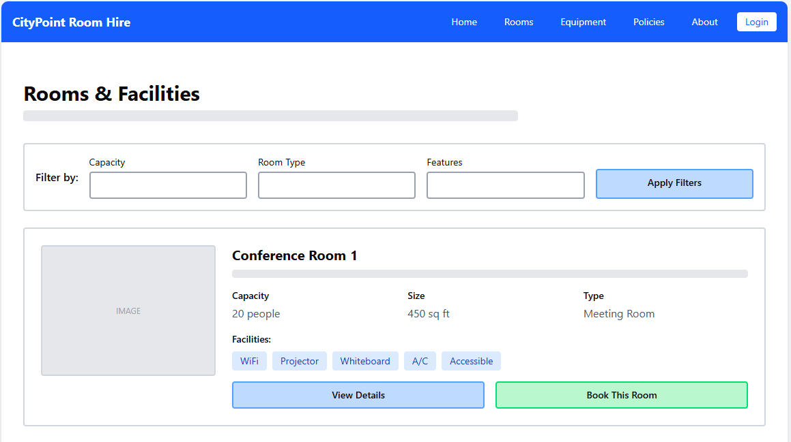
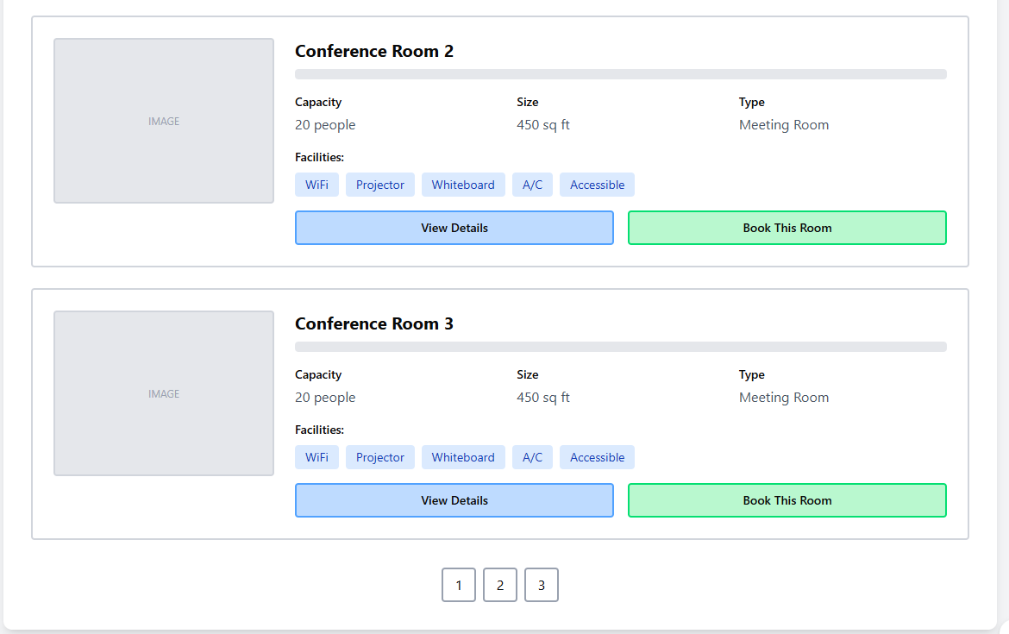
Room Card Layout
Card height: min-height 240px, full-width
Image: 256px width, 192px height, object-fit cover
Grid on stats: 3 columns, gap-16px
Facility badges: #DBEAFE background, #1E40AF text, 6px rounded
Padding: 24px all around
Why: Horizontal cards show more info without scrolling
Filter System Design
Filter bar: 80px height, #F9FAFB background
Dropdown selects: 40px height, 12px padding
Filter button: #3B82F6, transitions on 300ms
Mobile: Filters collapse into drawer/modal
Active filters show as removable chips below
Why: Instant filtering helps users find rooms quickly
CTA Button Strategy
Primary CTA "Book This Room": #10B981 (green), 48px height
Secondary "View Details": #3B82F6, ghost style
Button width: flex-1 (equal distribution)
Hover: brightness(110%), shadow-lg
Text: 16px, 600 weight
Why: Green signals action, blue for information gathering

Slide 5
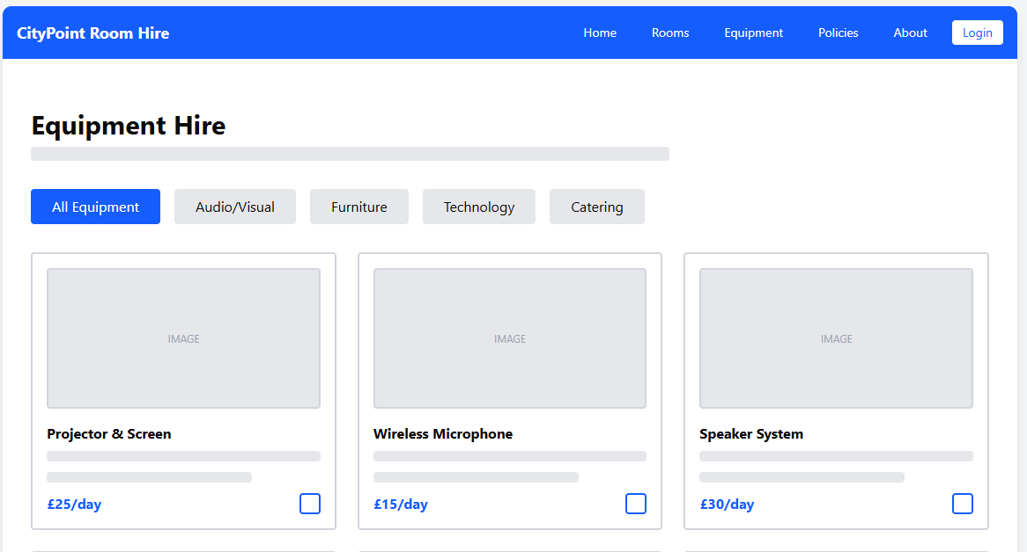
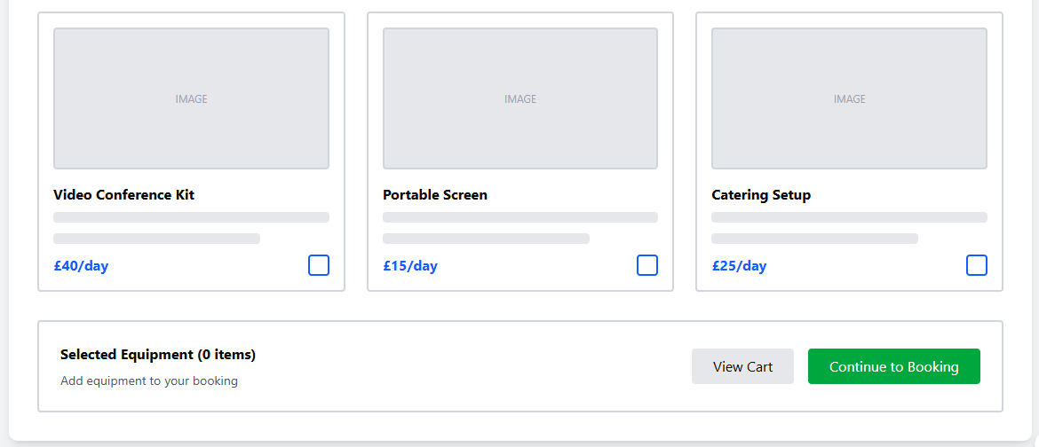
Category Tabs
Tab height: 40px, horizontal scroll on mobile
Active tab: #EA580C background (orange-600)
Inactive: #E5E7EB background, hover #D1D5DB
Text: 14px, 600 weight
Padding: 24px horizontal, 8px vertical
Why: Quick category switching improves browsing experience
Product Grid Design
Grid: 3 columns desktop, 2 tablet, 1 mobile
Card size: 280px width, auto height, 16px padding
Product images: 320px height, 1:1 aspect ratio
Price text: 24px, 700 weight, #2563EB colour
Gap: 24px between cards (gap-6)
Why: Square images work best for equipment photos
Shopping Cart
Sticky bottom bar: 72pc height, #EFF6FF background
Item count badge: #DC2626 (red) circle with white text
Continue button: #059669 (green-600), 48px height
Updates in real time as items are selected
Mobile: Fixed position, z-index 50
Why: persistent cart access reduces friction in booking flow

Slide 6
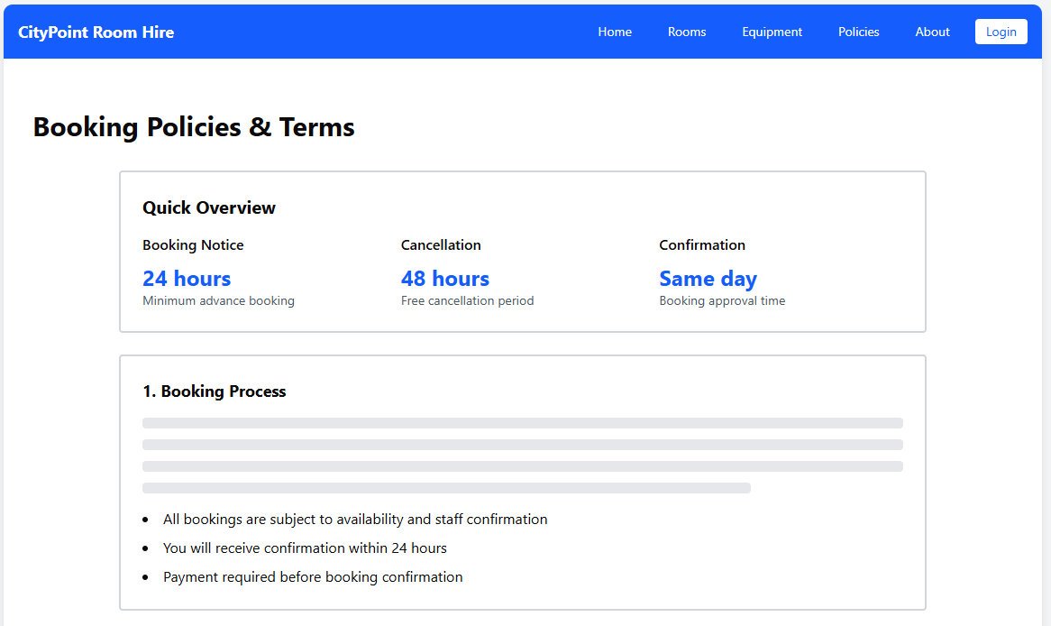
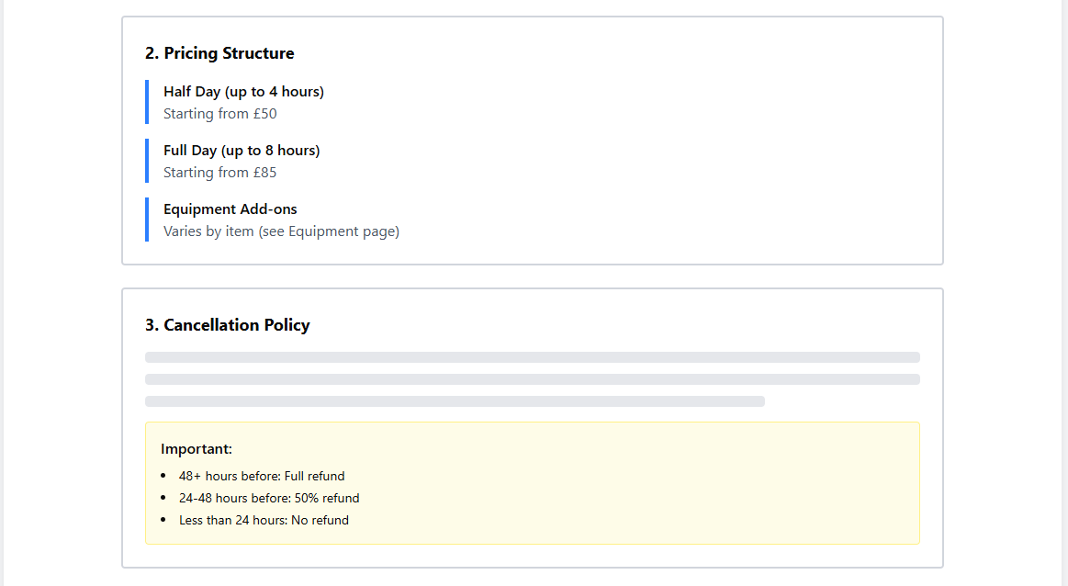
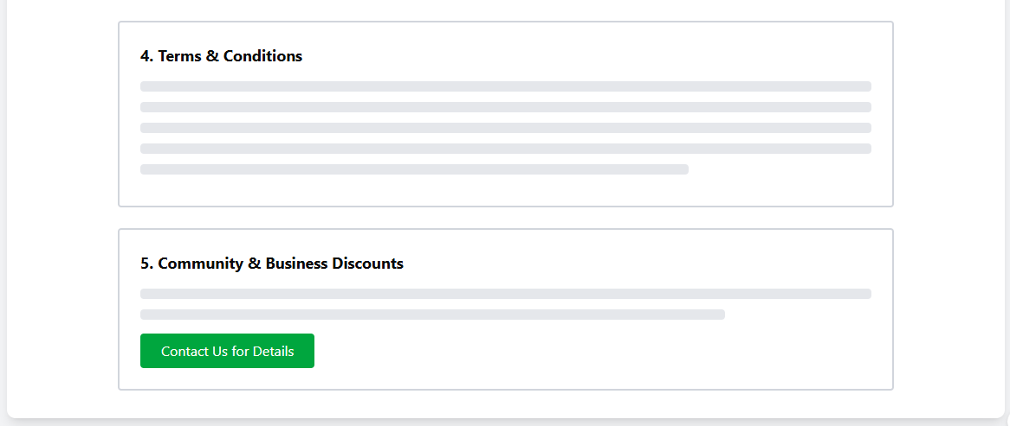
Visual Callouts
Stats cards: 200px height, gradient background
Large numbers: 48px, 700 weight, #2563EB
Warning boxes: #FEF3C7 background, #F59E0B border
Important sections: 4px left border #3B82F6
Icon size: 24px with 8px margin
Why: Visual breaks make policy documents less intimidating
Content Hierarchy
Max content width: 1024px for readability
H1: 36px, 700 weight, #111827
H2: 24px, 700 weight, #1F2937
Body text: 16px, line-height 1.75, #4B5563
Section spacing: 24px margin-bottom
Why: Clear typography hierarchy aids comprehension of legal text
Color-Coded Sections
Overview: Blue (#EFF6FF) - informational
Pricing: Blue (#DBEAFE) - transparent costs
Cancellation: Yellow (#FEF3C7) - warning/caution
T&Cs: Gray (#F9FAFB) - standard info
Discounts: Green (#D1FAE5) - positive/benefits
Why: Colour psychology guides user attention to key policies

Slide 7
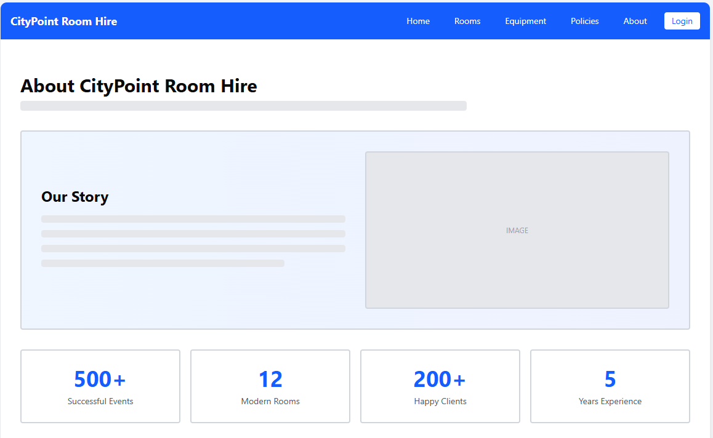
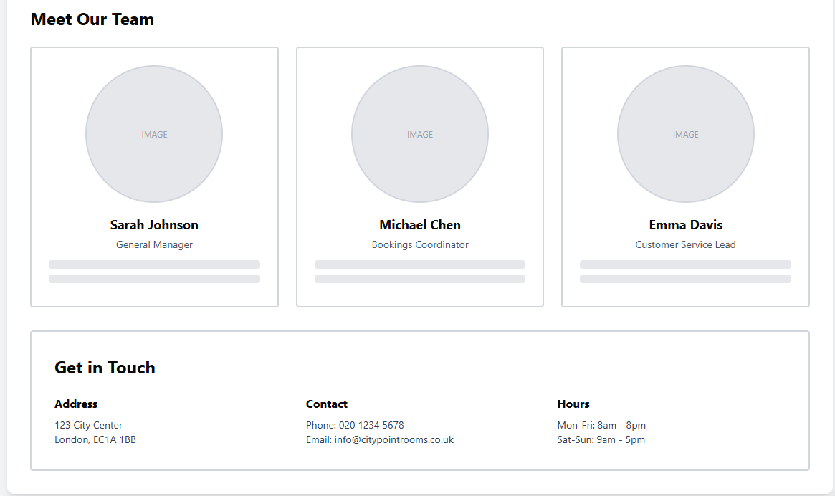
Statistics Display
Stat cards: 4-column grid, equal width
Number size: 48px, 700 weight, #2563EB
Label: 14px, #6B7280
Card padding: 24px, white background
Border-radius: 8px with hover shadow
Why: Numbers build credibility and trust instantly

Slide 8
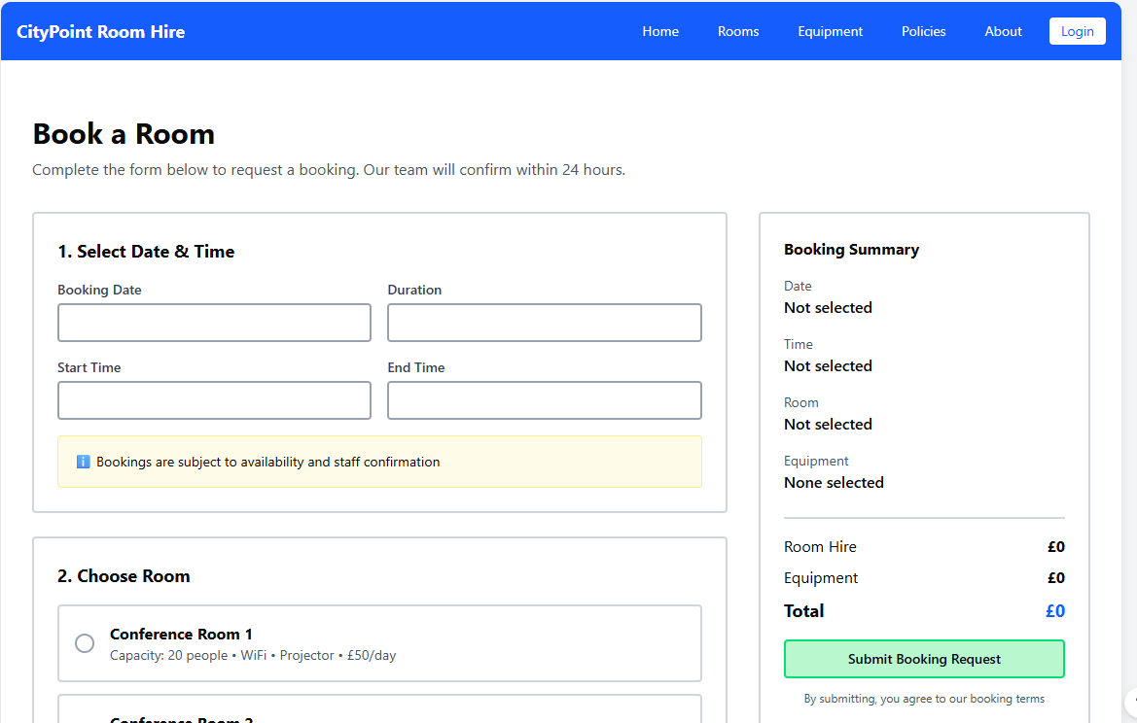
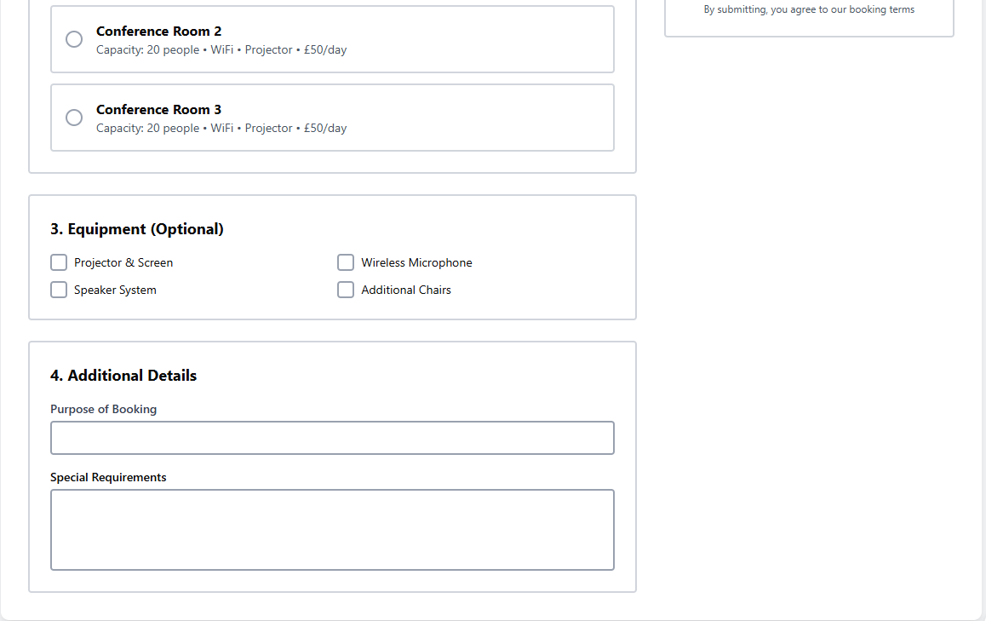

Slide 9
