Slide 1
My humblest apologies </3

Slide 2
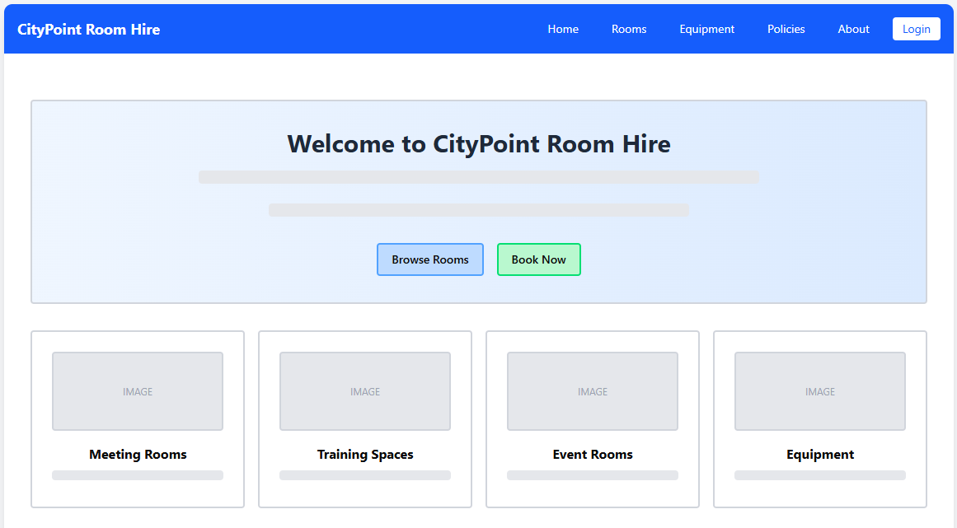
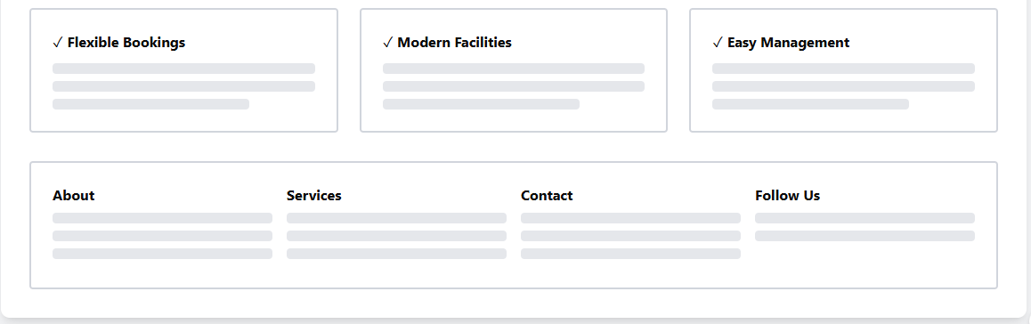
Will be clickable on every page and will send the user to the home page
The background should be white, with each card being a lighter version of the accent colour (blue)
These will take the user to the already filtered Rooms page as a short cut to improve user experience with the website
These show that the company has all these things, which will gain user trust. It’s on the home page so it’ll be one of the first things users notice

Slide 3
Navigation Bar
-Height: 64px fixed, background #2563EB (blue-600)
-Logo: 24px font-size, 700 weight
-Nav items: 14px font-size, 12px horizontal padding
-Login button: white background, #2563EB text, 6px border-radius
-Sticky positioning on scroll for easy access
Hero Section Design
-Hero height: 400px with gradient background (#EFF6FF to #E0E7FF)
- Heading: 48px font-size, 700 weight, #1F2937 colour
-Subtext: 18px, line-height 28px for readability
-CTA buttons: 48px height, 16px padding, rounded-lg (8px)
-Primary button: #3B82F6 (blue-600), Secondary: #10B981 (green-600)
Quick Links Grid
-Grid: 4 columns on desktop, 2 on tablet, 1 on mobile
- Card size: Min-height 200px with 24px padding
-Images: 192px height, 16:9 aspect ratio
-Hover effect: translateY(-4px) with shadow-xl
- Gap between cards: 16px (gap-4)

Slide 4
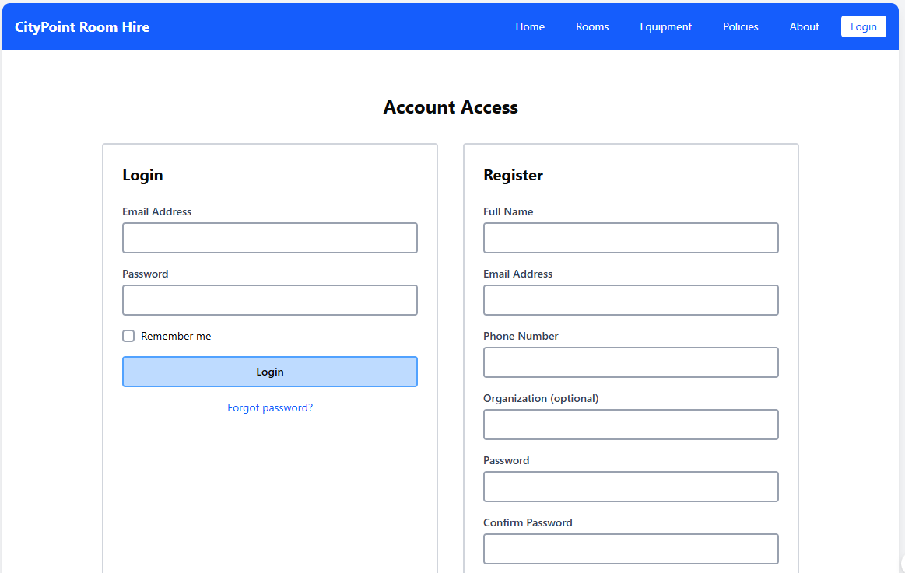
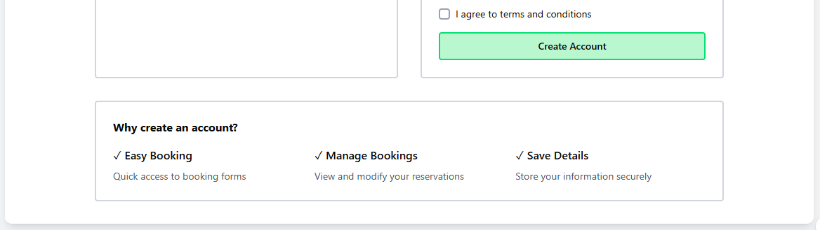
Accessibility Feature
-All inputs have visible labels (not placeholders)
-Tab index order: flows naturally top to bottom
-Error messages: #DC2626 (red-600) with icons
-Min contrast ratio: 4.5:1 for WCAG AA compliance
-Checkbox: 16px touch target, increased to 44px on mobile
-Why: Meets WCAG 2.1 AA standards for inclusive design
Form Layout Design
-Two-column grid: 50/50 split on desktop (max-width 1024px)
-Form container: 600px max-width each, 24px padding
-Input fields: 48px height, 16px text, 12px border-radius
-Labels: 14px font-size, 600 weight, #374151 colour
-Focus state: #3B82F6 border (2px), #DBEAFE background
Terms and conditions so the user understands that if they break any of them, they will be held liable and not the company
Security & Trust
-Password field: type="password" with show/hide toggle
-Benefits section: #EFF6FF background, builds trust
-Terms checkbox: Required before registration
-SSL badge in footer (planned)
-Colors: Blue (#3B82F6) for trust, Green (#10B981) for action

Slide 5
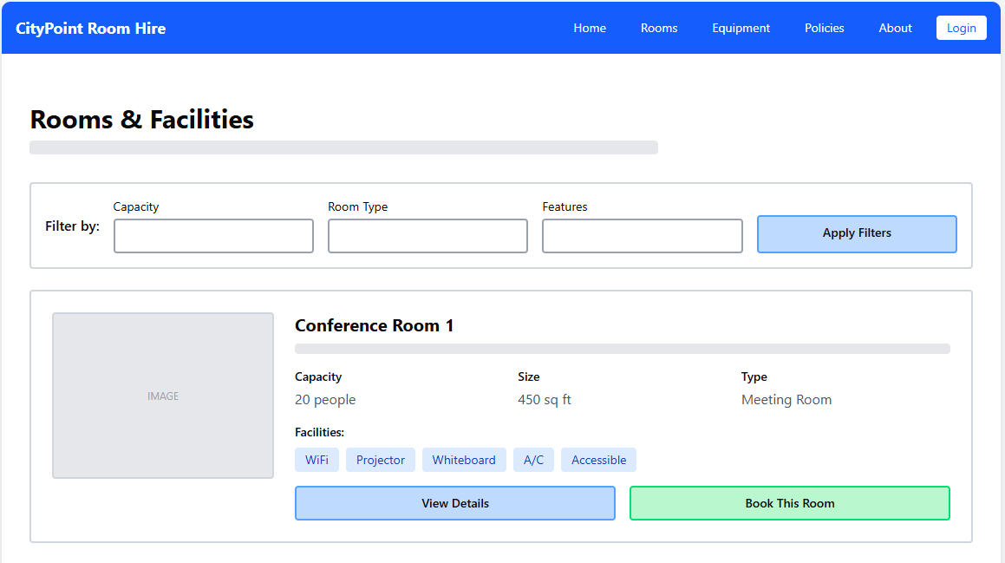
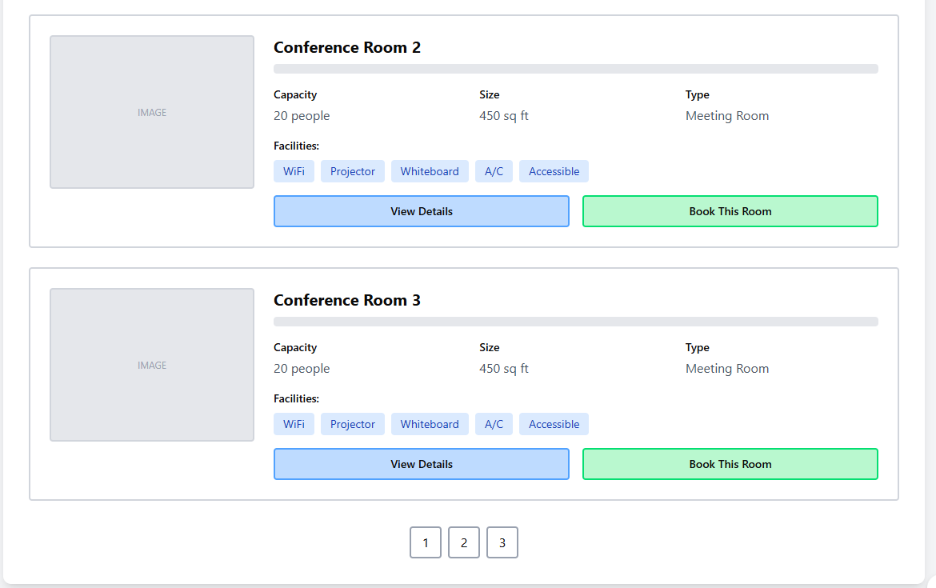
Room Card Layout
Card height: min-height 240px, full-width
Image: 256px width, 192px height, object-fit cover
Grid on stats: 3 columns, gap-16px
Facility badges: #DBEAFE background, #1E40AF text, 6px rounded
Padding: 24px all around
Why: Horizontal cards show more info without scrolling
Filter System Design
Filter bar: 80px height, #F9FAFB background
Dropdown selects: 40px height, 12px padding
Filter button: #3B82F6, transitions on 300ms
Mobile: Filters collapse into drawer/modal
Active filters show as removable chips below
Why: Instant filtering helps users find rooms quickly
CTA Button Strategy
Primary CTA "Book This Room": #10B981 (green), 48px height
Secondary "View Details": #3B82F6, ghost style
Button width: flex-1 (equal distribution)
Hover: brightness(110%), shadow-lg
Text: 16px, 600 weight
Why: Green signals action, blue for information gathering

Slide 6
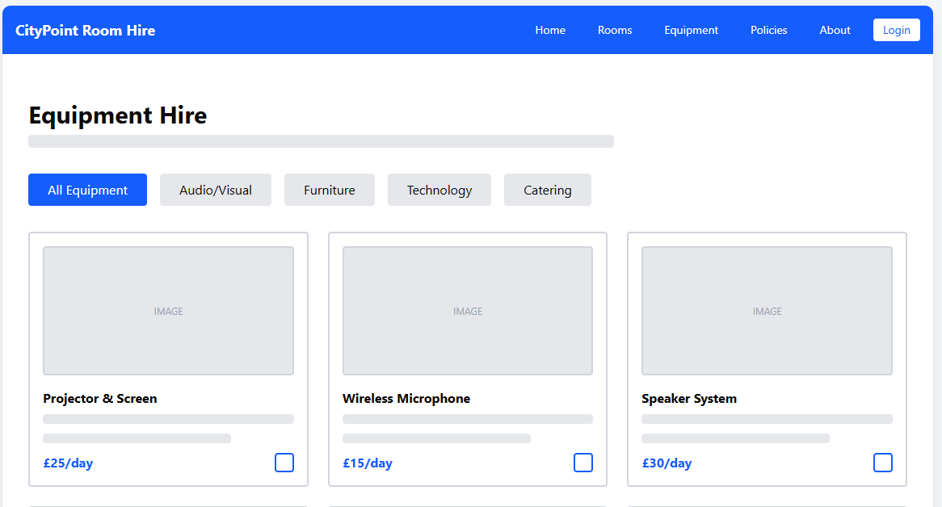
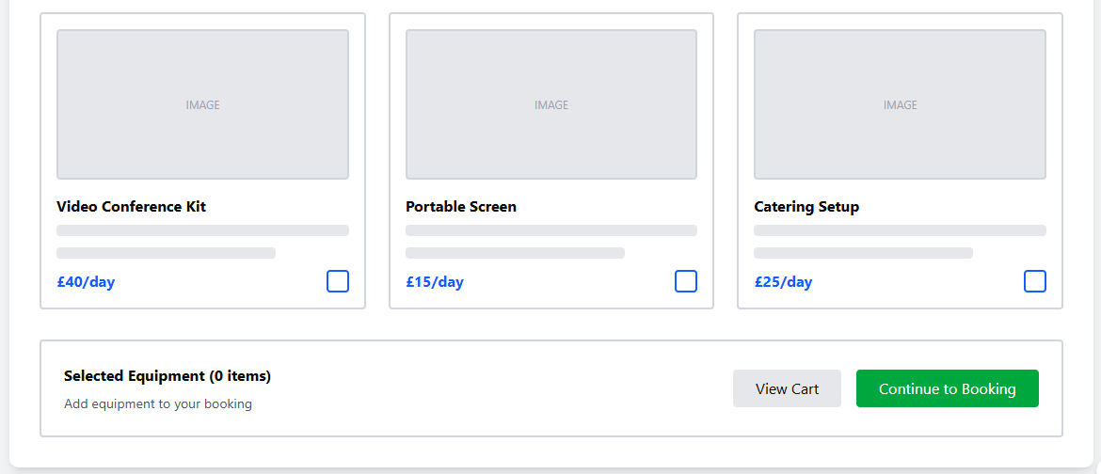
Category Tabs
Tab height: 40px, horizontal scroll on mobile
Active tab: #EA580C background (orange-600)
Inactive: #E5E7EB background, hover #D1D5DB
Text: 14px, 600 weight
Padding: 24px horizontal, 8px vertical
Why: Quick category switching improves browsing experience
Product Grid Design
Grid: 3 columns desktop, 2 tablet, 1 mobile
Card size: 280px width, auto height, 16px padding
Product images: 320px height, 1:1 aspect ratio
Price text: 24px, 700 weight, #2563EB colour
Gap: 24px between cards (gap-6)
Why: Square images work best for equipment photos
Shopping Cart
Sticky bottom bar: 72pc height, #EFF6FF background
Item count badge: #DC2626 (red) circle with white text
Continue button: #059669 (green-600), 48px height
Updates in real time as items are selected
Mobile: Fixed position, z-index 50
Why: persistent cart access reduces friction in booking flow

Slide 7
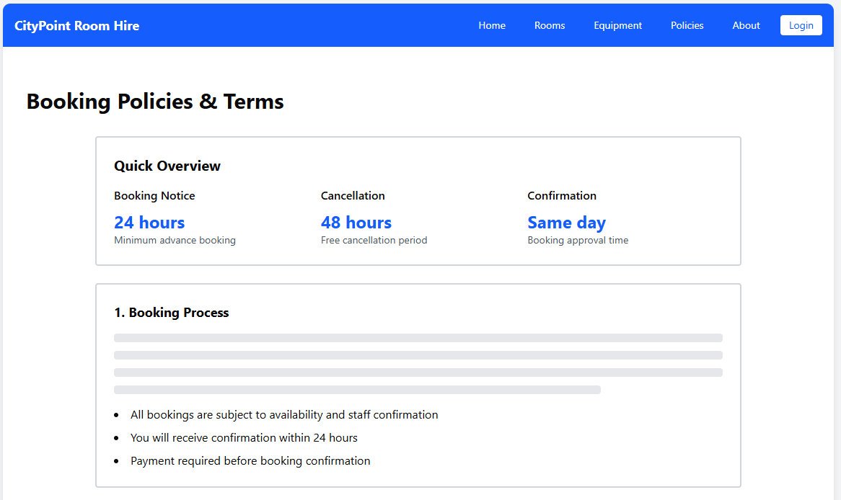
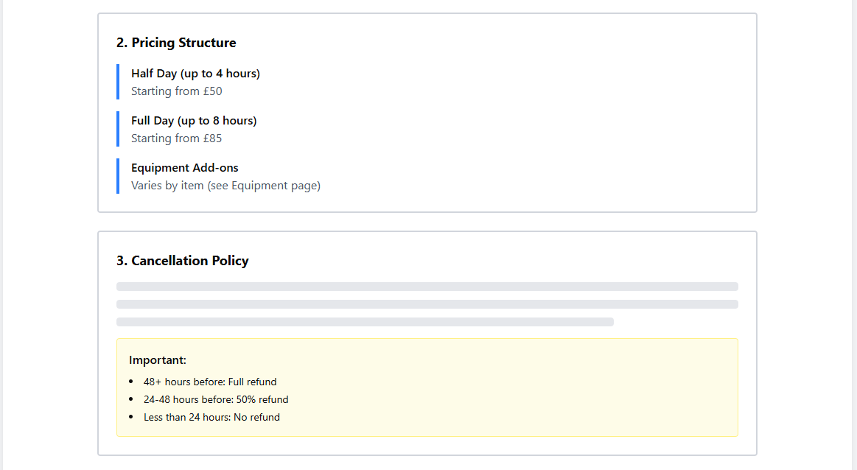
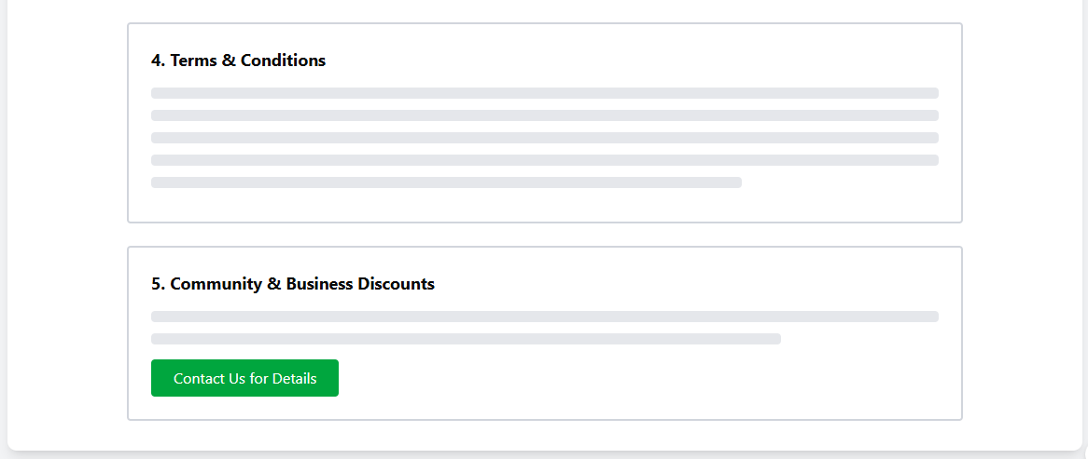
Visual Callouts
Stats cards: 200px height, gradient background
Large numbers: 48px, 700 weight, #2563EB
Warning boxes: #FEF3C7 background, #F59E0B border
Important sections: 4px left border #3B82F6
Icon size: 24px with 8px margin
Why: Visual breaks make policy documents less intimidating
Content Hierarchy
Max content width: 1024px for readability
H1: 36px, 700 weight, #111827
H2: 24px, 700 weight, #1F2937
Body text: 16px, line-height 1.75, #4B5563
Section spacing: 24px margin-bottom
Why: Clear typography hierarchy aids comprehension of legal text
Color-Coded Sections
Overview: Blue (#EFF6FF) - informational
Pricing: Blue (#DBEAFE) - transparent costs
Cancellation: Yellow (#FEF3C7) - warning/caution
T&Cs: Gray (#F9FAFB) - standard info
Discounts: Green (#D1FAE5) - positive/benefits
Why: Colour psychology guides user attention to key policies

Slide 8
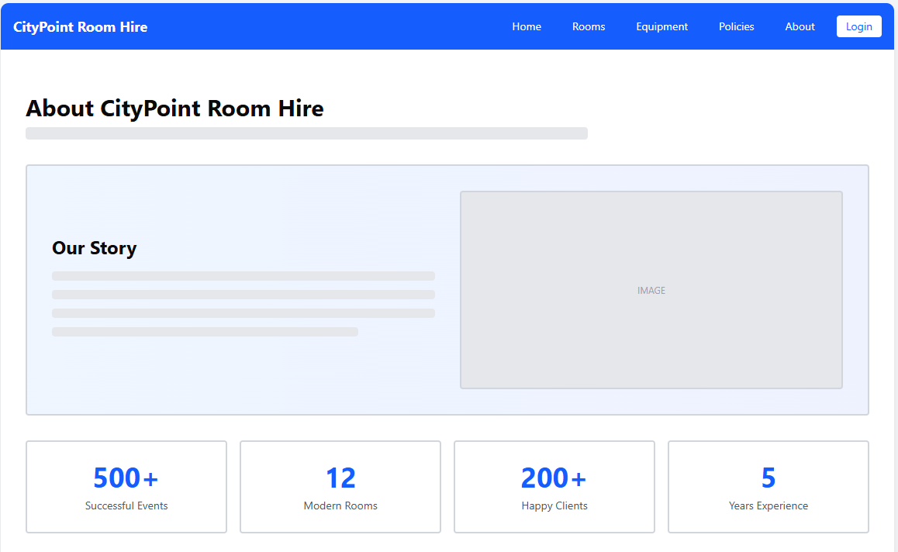
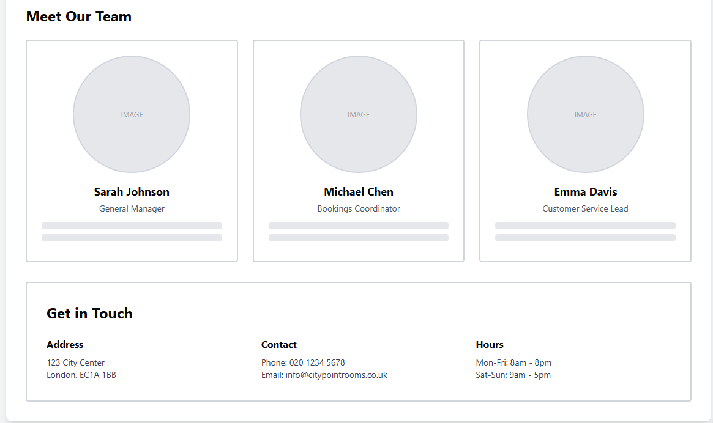
Hero Story Section
Two-column grid: 60/40 text-to-image ratio
Gradient background: #EFF6FF to #E0E7FF
Heading: 32px, 700 weight
Body text: 16px, line-height 1.75
Image: 512px height, rounded-lg (8px)
Why: Visual storytelling builds emotional connection
Statistics Display
Stat cards: 4-column grid, equal width
Number size: 48px, 700 weight, #2563EB
Label: 14px, #6B7280
Card padding: 24px, white background
Border-radius: 8px with hover shadow
Why: Numbers build credibility and trust instantly
Team Profile Cards
Grid: 3 columns, gap 24px
Profile image: 192px circle (rounded-full)
Name: 20px, 700 weight
Role: 14px, #6B7280, 500 weight
Bio text: 12px, line-height 1.5
Why: Personal photos humanize the brand, build rapport
Contact Section
Background: #EFF6FF (light blue) for distinction
Grid: 3 columns for address/contact/hours
Icons: 20px with #2563EB colour
Text: 14px, #374151
Click-to-call on phone, mail to on email
Why: Easy access to contact info improves support accessibility

Slide 9
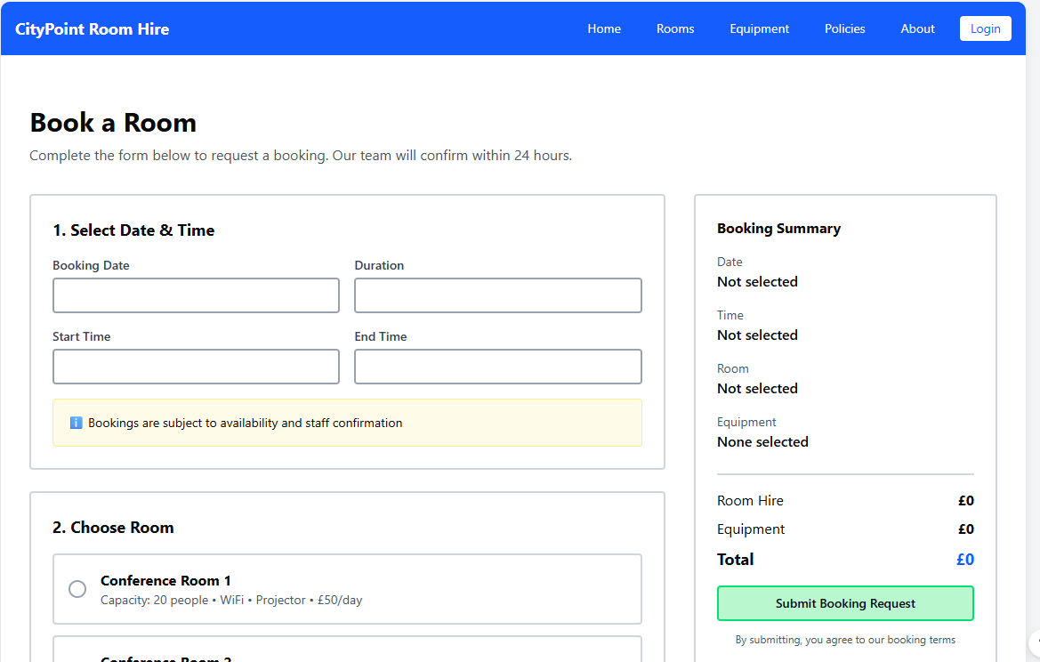
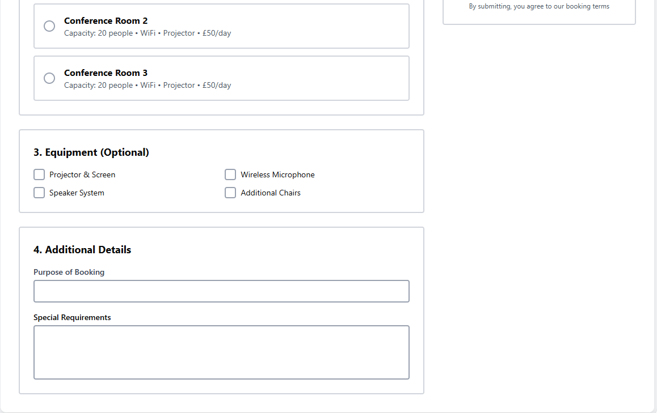
Form Field Design
Input height: 48px for easy touch/click
Date picker: Native HTML5 or custom calendar widget
Radio selections: 56px min height, clear clickable area
Labels: Always visible, 14px, 600 weight
Validation: Real-time on blur, errors in #DC2626
Why: Large touch targets improve mobile accessibility
Multi-Step Form Layout
Main form: 66% width (2/3 grid), sidebar 33% (1/3)
Section cards: 24px padding, 16px margin-bottom
Step numbers in headings for clarity
Progress indicator at top (planned)
Mobile: Sidebar moves below form
Why: Chunking reduces cognitive load, increases completion
Sticky Summary Sidebar
Position: sticky, top 16px offset
Background: white with shadow-lg
Updates dynamically as user fills form
Total: 24px font, 700 weight, #2563EB
Submit button: #10B981 (green-600), 56px height
Why: Constant visibility of booking details builds confidence

Slide 10
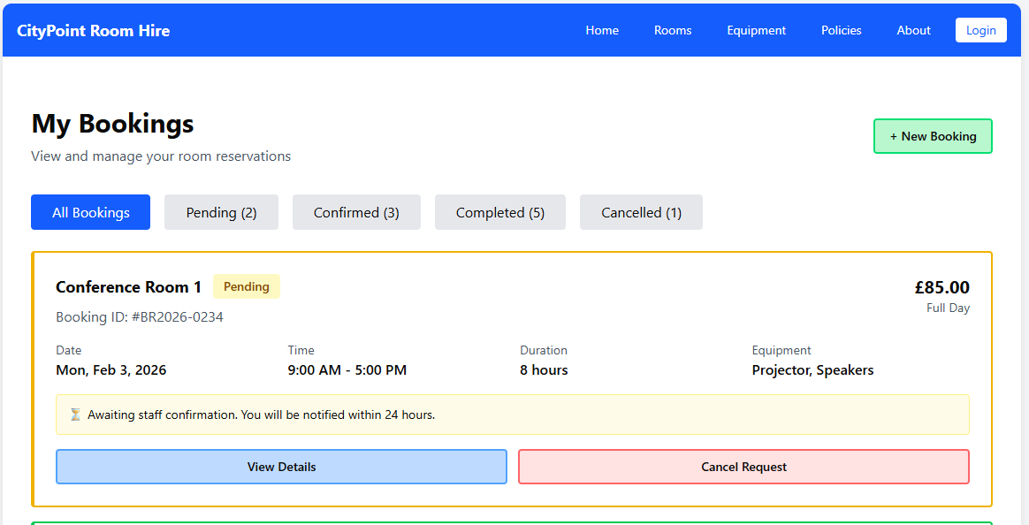
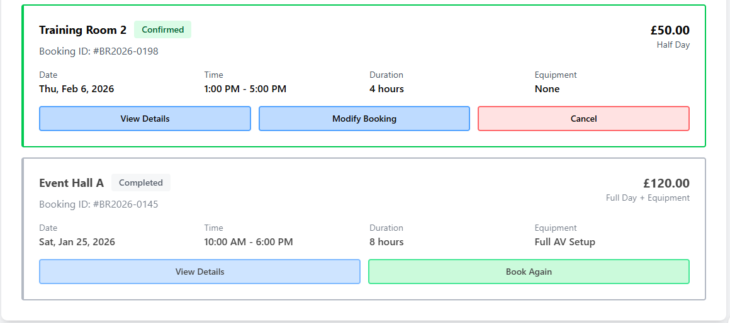
Filter Tab System
Tab height: 40px, horizontal layout
Active tab: #2563EB background, white text
Count badges: Circle, 18px, positioned top-right
Inactive: #E5E7EB background, hover #D1D5DB
Padding: 24px horizontal, 8px vertical
Why: Quick filtering reduces overwhelm for active users
Status-Based Colour Coding
Pending: Yellow (#FEF3C7 bg, #F59E0B border)
Confirmed: Green (#D1FAE5 bg, #10B981 border)
Completed: Gray (#F3F4F6 bg, #6B7280 border)
Cancelled: Red (#FEE2E2 bg, #EF4444 border)
Left border: 4px solid to indicate status
Why: Colour psychology for instant status recognition
Booking Card Information
Card padding: 24px all sides
Grid layout: 4 columns for booking details
Booking ID: Monospace font for clarity
Price: 32px, 700 weight, right-aligned
Action buttons: Equal width (flex-1), 40px height
Why: Horizontal data display shows more info above fold

