Slide 1
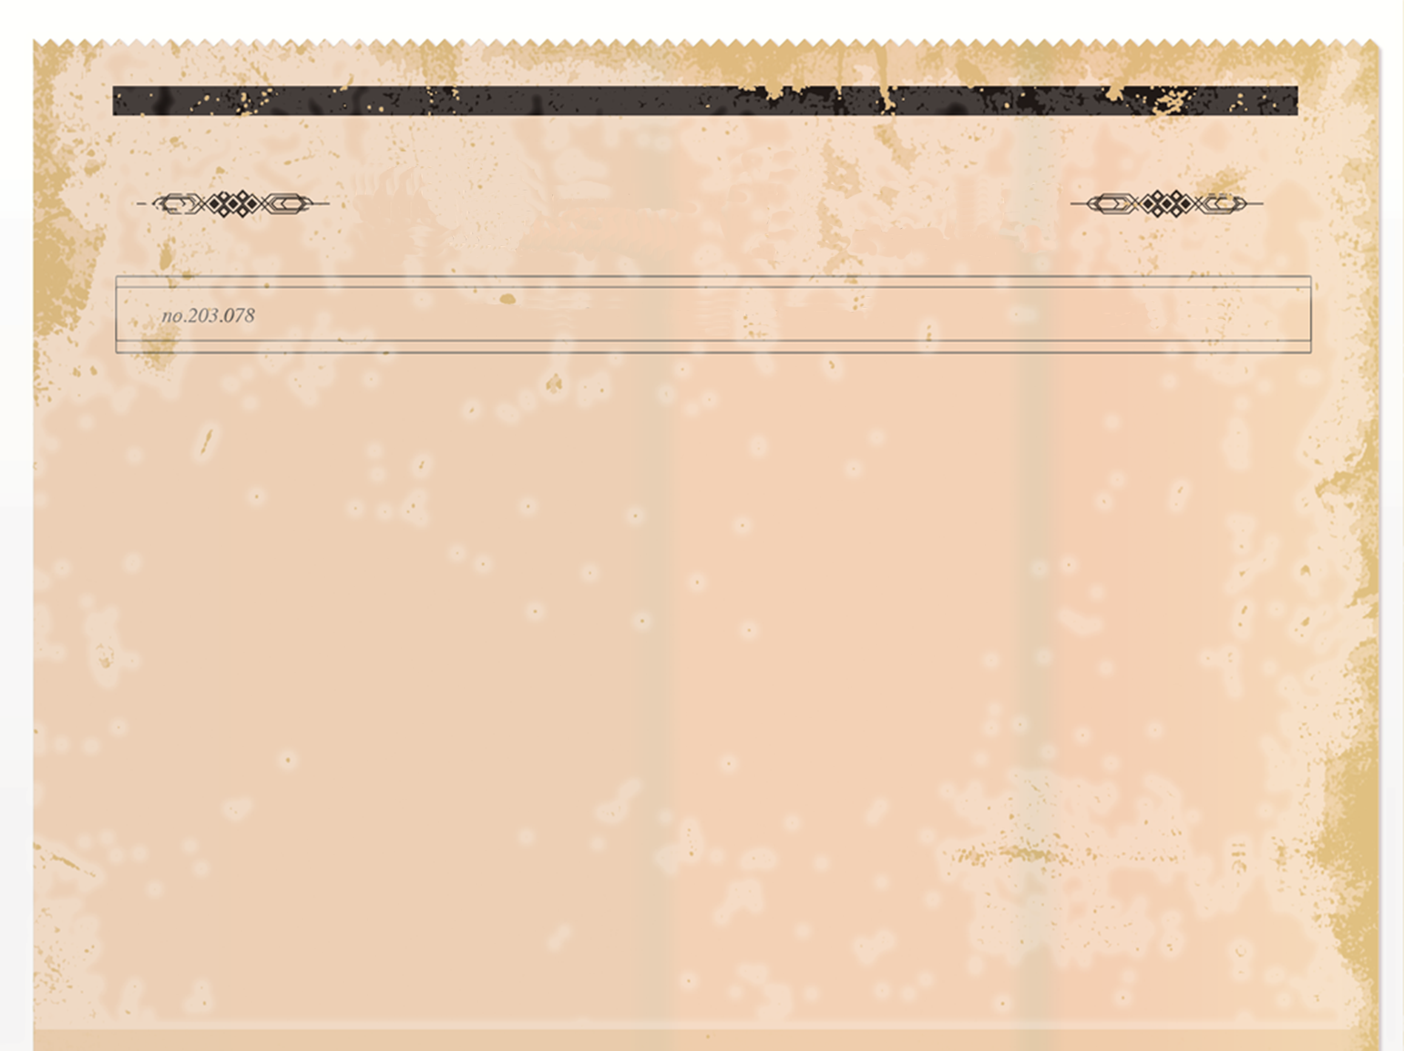
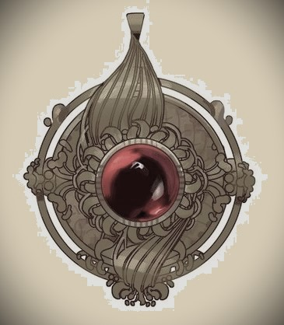
The Brindum Times
LATEST FROM THE COBBLESTONE JUNGLE
- Since 1202
THE RED RUBY STOLEN!
A local nobleman was arrested for indecent exposure.
Kangland begins the tournament to crown the new Kang Lord as tourists flock to see the spectacle at the Proving Grounds.
New RAF Knights prove useful against Dorronian terrorists.
A heist job at the local Museum of Arts leaves ten guards dead. The Red Ruby amongst other artifacts goes missing. Detective Reginald reports this to be the job of an amateur group and promises the quick arrest of the criminals. Two RAF Nighthawks were demoted due to their failure to guard the Museum.

