Slide 2
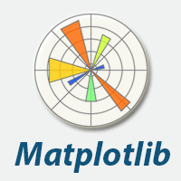
Matplotlib - bu Python dasturlash tilidagi kutubxona bo'lib , ikki o'lchovli va uch o'lchovli grafiklarda ma'lumotlarni vizualizatsiya qilish uchun mo'ljallangan. Matplotlib asosan Jon Hunter tomonidan yozilgan va qo'llab-quvvatlanadi
Hujjatlarda muallif Matplotlib MATLAB ning grafik buyruqlarini taqlid qilishdan boshlanganini , lekin undan mustaqil loyiha ekanligini tan oladi
https://matplotlib.org/

Slide 3
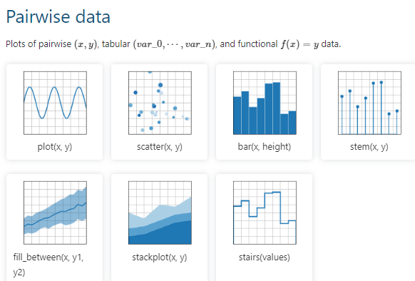

Slide 4
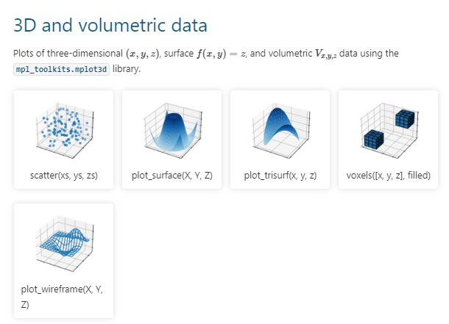

Slide 5
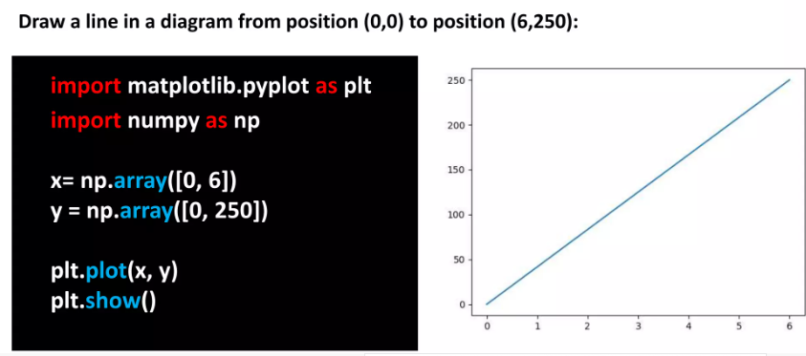

Slide 6
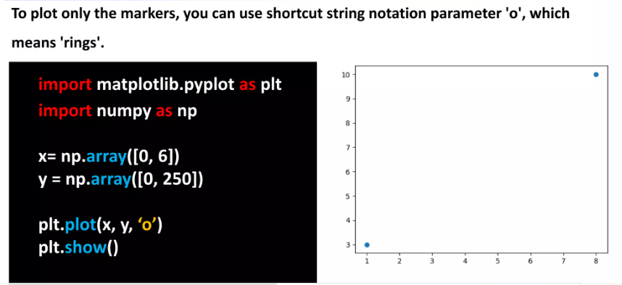

Slide 7
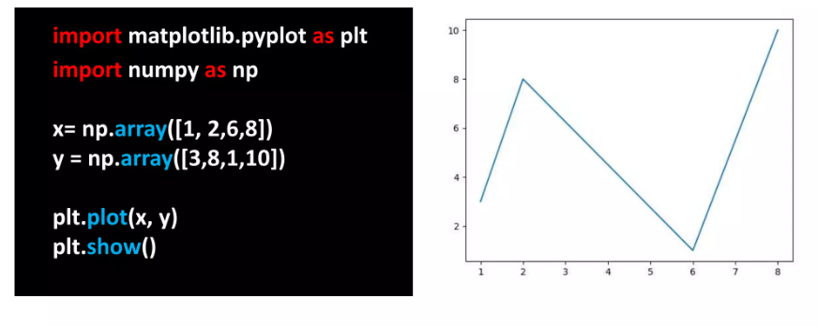

Slide 8
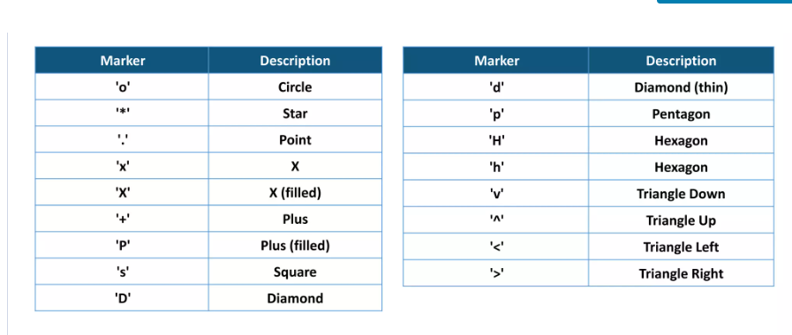

Slide 9
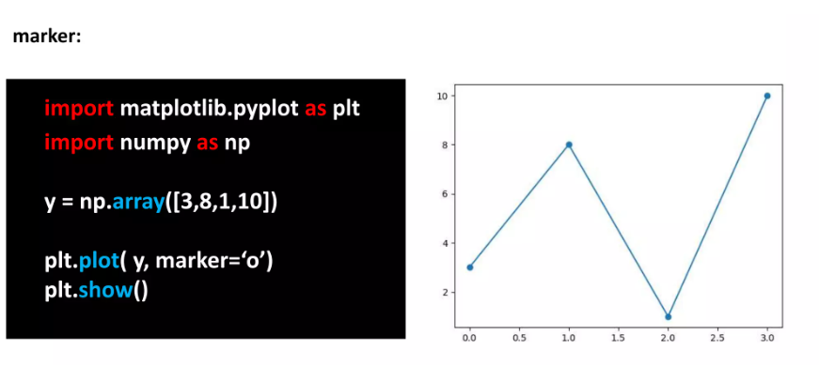

Slide 10
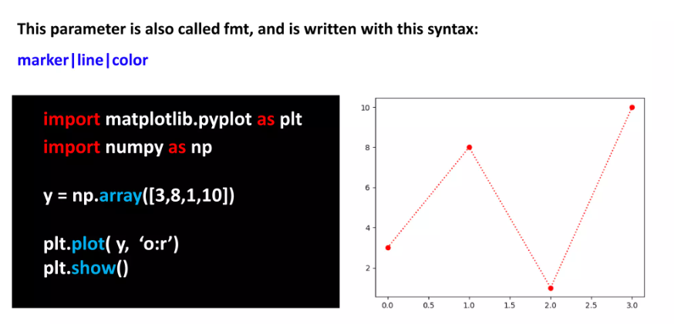

Slide 11
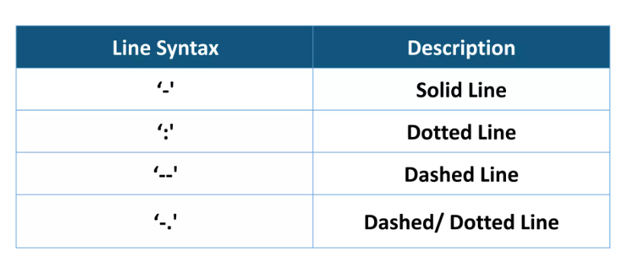

Slide 12
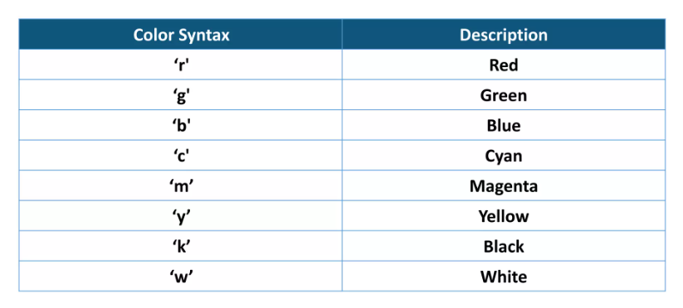

Slide 13
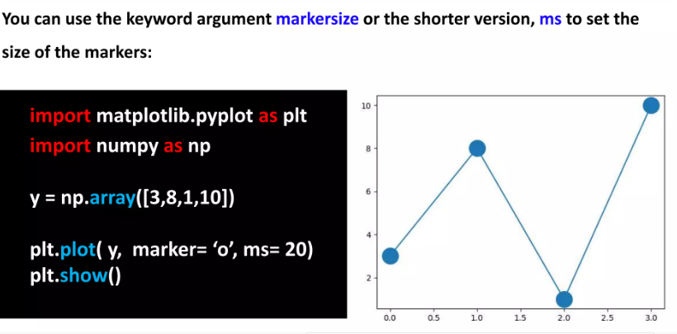

Slide 14
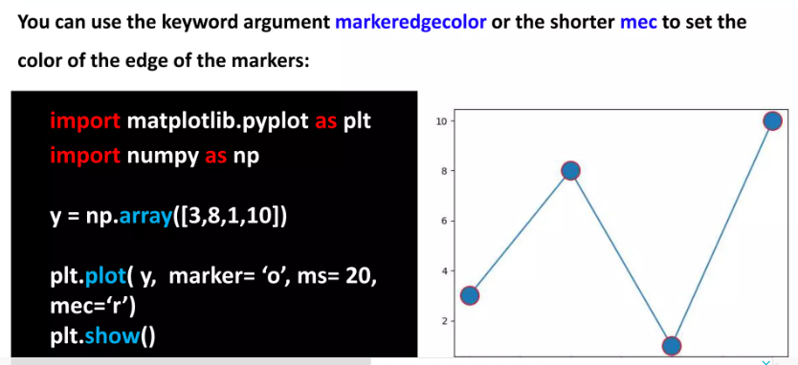

Slide 15
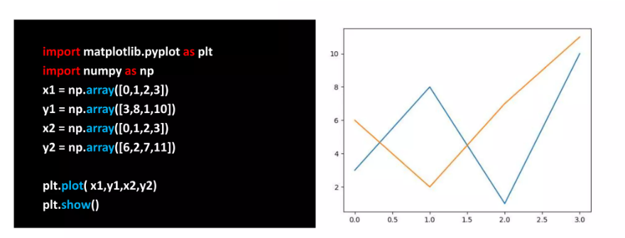

Slide 16
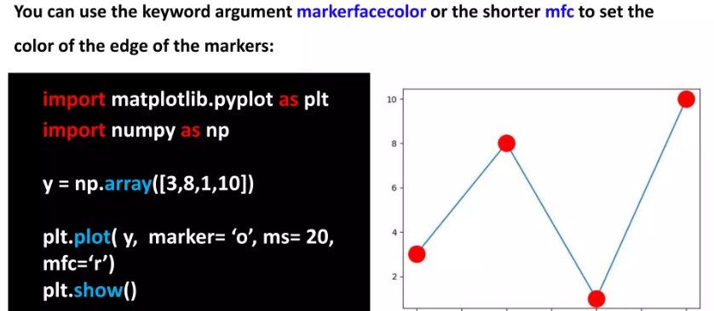

Slide 17
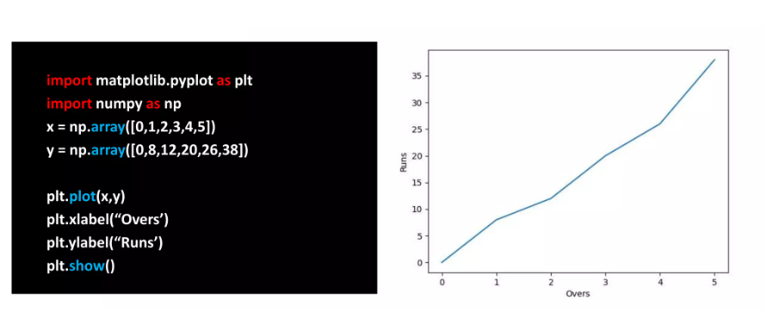

Slide 18
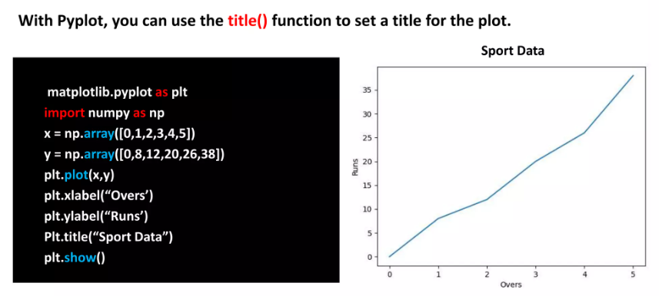

Slide 19
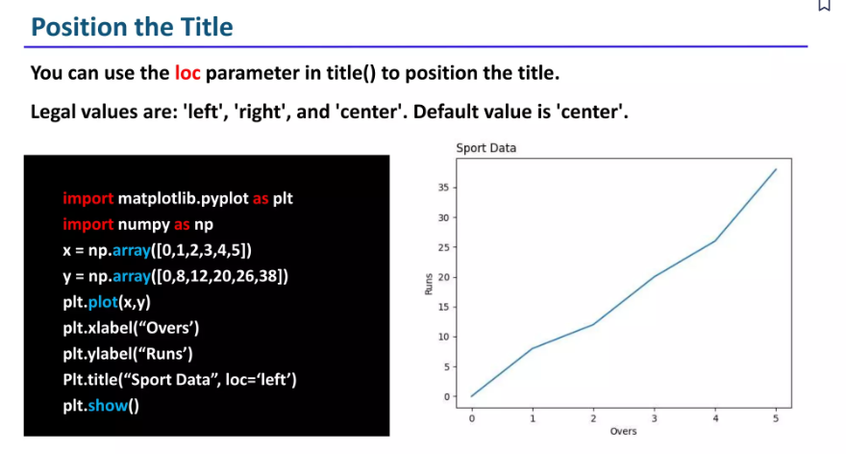

Slide 20
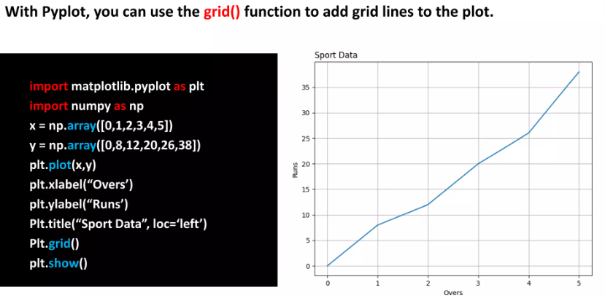

Slide 21
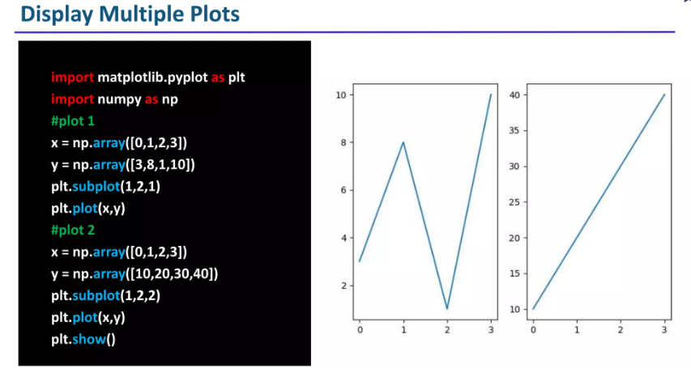

Slide 22
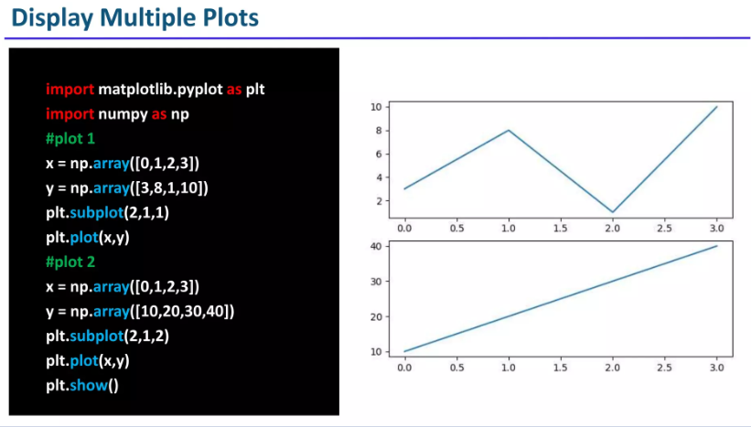

Slide 23
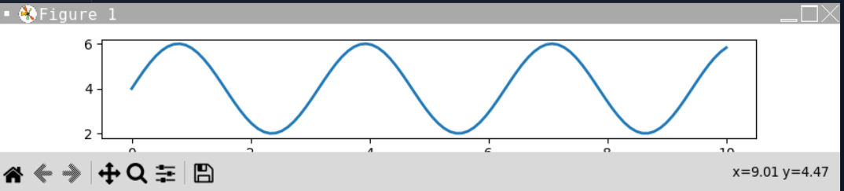
import matplotlib.pyplot as plt
import numpy as np
# make data
x = np.linspace(0, 10, 100) #linspace funksiyasi kesmani bo’laklarga bo’ladi
print(x)
y = 4 + 2 * np.sin(2 * x)
print (y)
# plot
fig, ax = plt.subplots() #platformani yaratish
ax.plot(x, y, linewidth=2.0)
plt.show()

Slide 24
plot(x, y) # plot x and y using default line style and color
standart chiziq uslubi va rangidan foydalangan holda x va y ni chizing
plot(x, y, 'bo') # plot x and y using blue circle markers
ko'k doira belgilaridan foydalangan holda x va y ni chizing
plot(y) # plot y using x as index array 0..N-1
plot(y, 'r+') # qizil plyuslar bilan
plot(x, y, 'go--', linewidth=2, markersize=12)
plot(x, y, color='green', marker='o', linestyle='dashed',
linewidth=2, markersize=12)

Slide 25
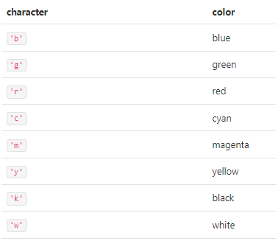
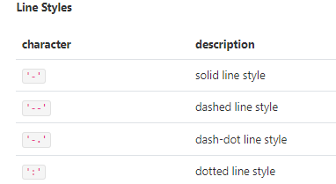
'b' # blue markers with default shape
'or' # red circles
'-g' # green solid line
'--' # dashed line with default color
'^k:' # black triangle_up markers connected by a dotted line

Slide 26
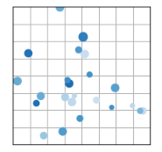
import matplotlib.pyplot as plt
import numpy as np
# make the data
np.random.seed(3)
x = 4 + np.random.normal(0, 2, 24)
y = 4 + np.random.normal(0, 2, len(x))
# size and color:
sizes = np.random.uniform(15, 80, len(x))
colors = np.random.uniform(15, 80, len(x))
# plot
fig, ax = plt.subplots()
ax.scatter(x, y, s=sizes, c=colors, vmin=0, vmax=100)
ax.set(xlim=(0, 8), xticks=np.arange(1, 8),
ylim=(0, 8), yticks=np.arange(1, 8))
plt.show()

Slide 27
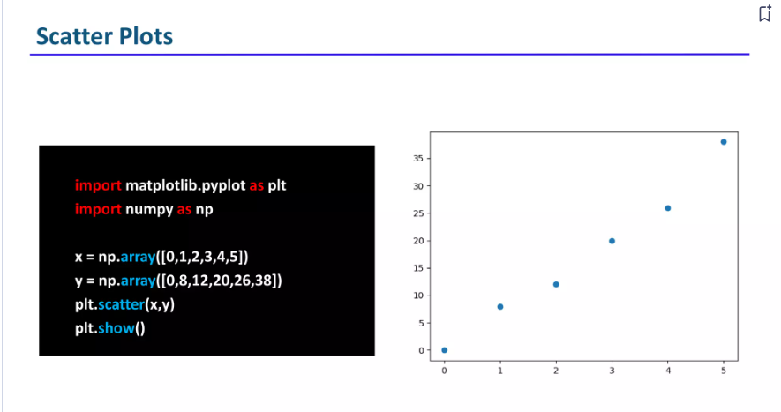

Slide 28
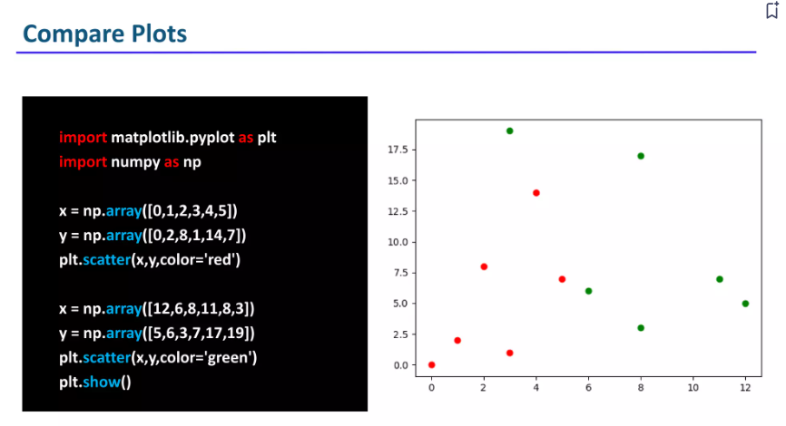

Slide 29
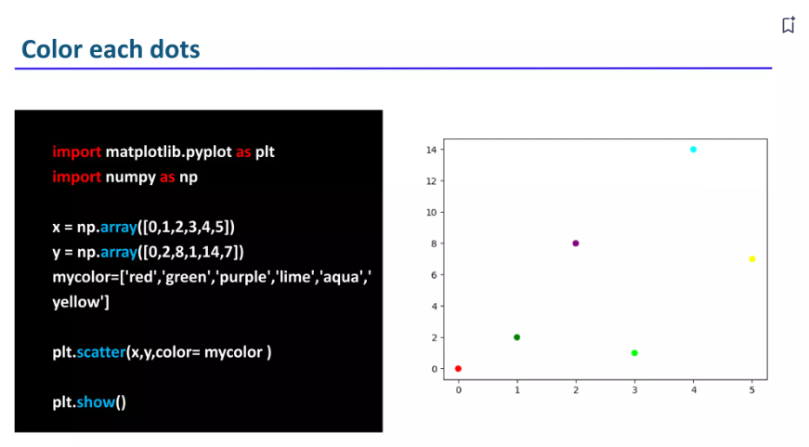

Slide 30
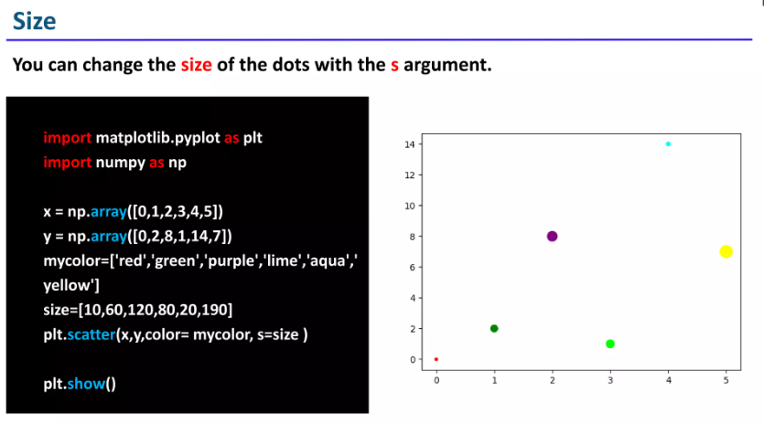

Slide 31
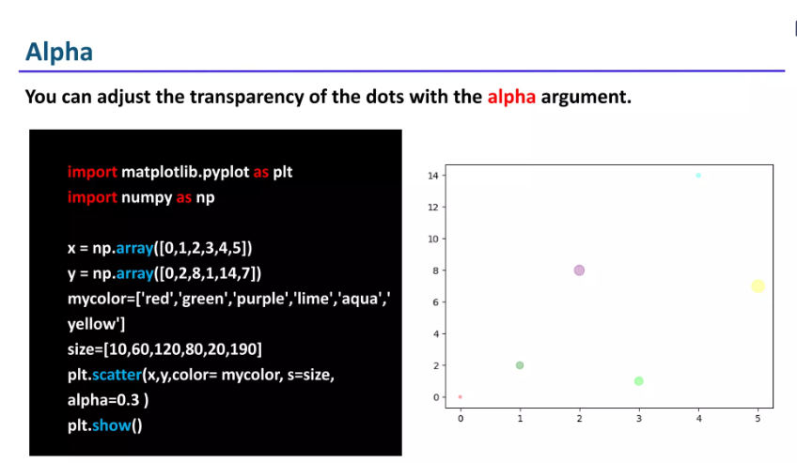

Slide 32
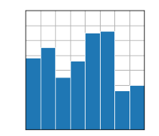
import matplotlib.pyplot as plt
import numpy as np
plt.style.use('_mpl-gallery')
# make data:
x = 0.5 + np.arange(8)
y = [4.8, 5.5, 3.5, 4.6, 6.5, 6.6, 2.6, 3.0]
# plot
fig, ax = plt.subplots()
ax.bar(x, y, width=1, edgecolor="white", linewidth=0.7)
ax.set(xlim=(0, 8), xticks=np.arange(1, 8),
ylim=(0, 8), yticks=np.arange(1, 8))
plt.show()

Slide 33
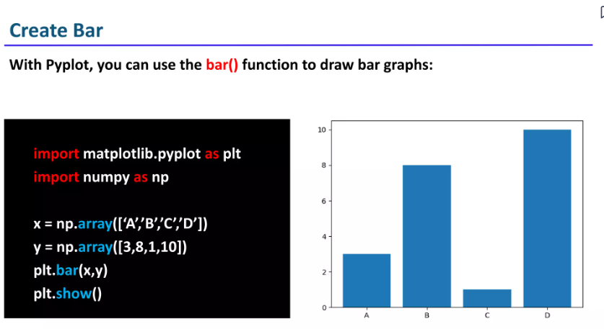

Slide 34
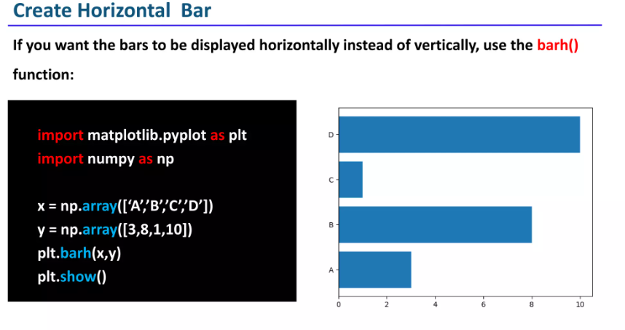

Slide 35
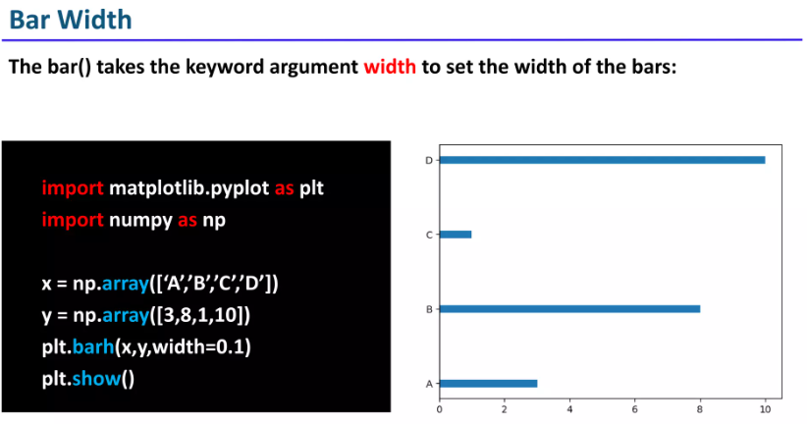

Slide 36
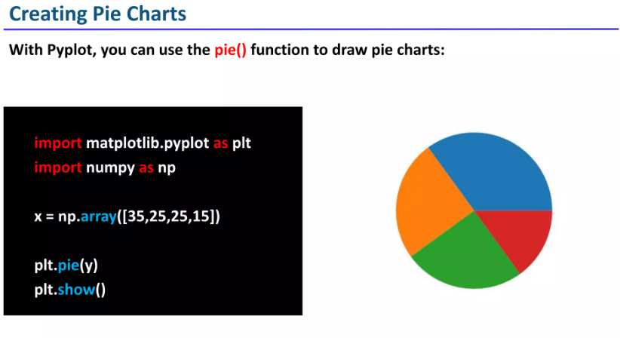

Slide 37
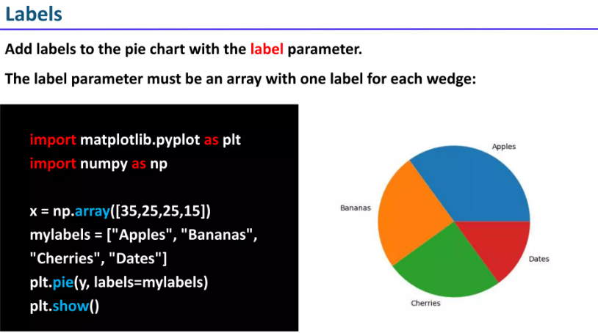

Slide 38
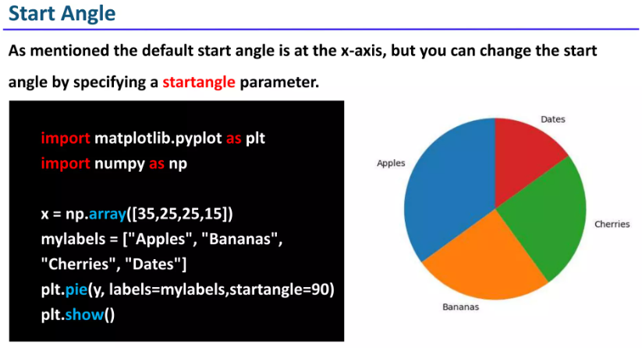

Slide 39
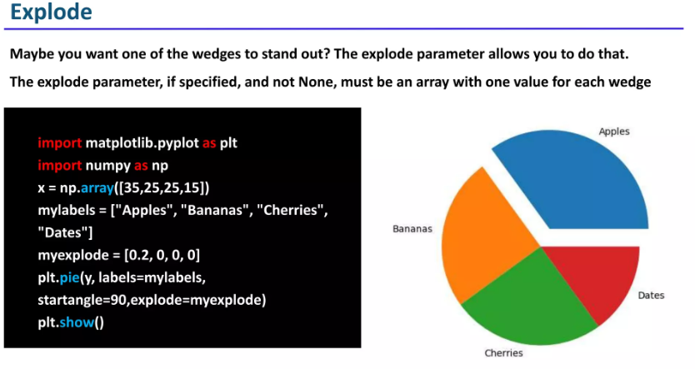

Slide 40
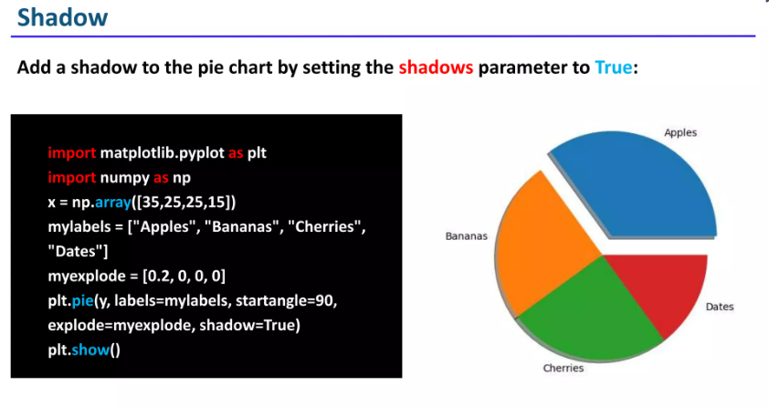

Slide 41
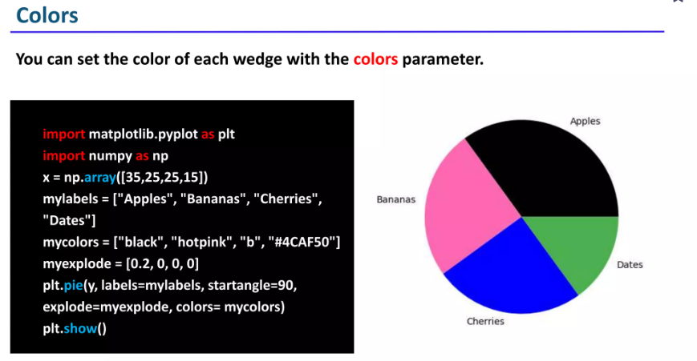

Slide 42
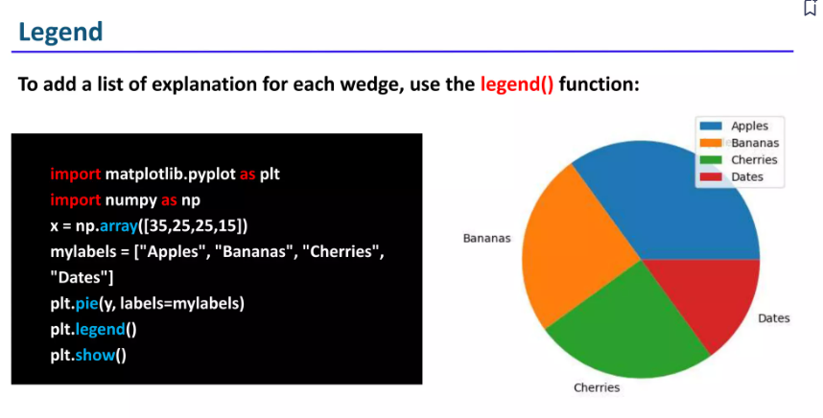

Slide 43
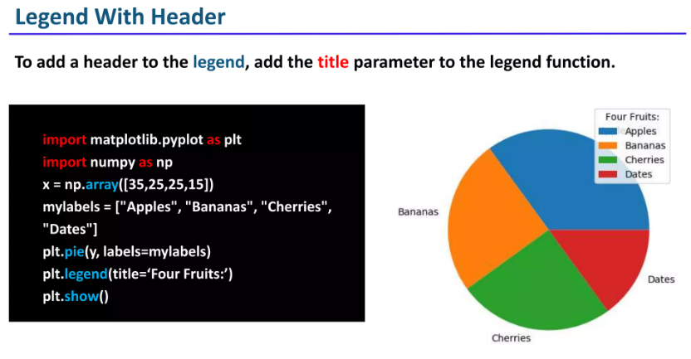

Slide 44
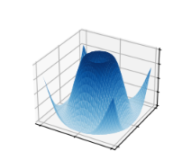
import matplotlib.pyplot as plt
import numpy as np
from matplotlib import cm
plt.style.use('_mpl-gallery')
# Make data
X = np.arange(-5, 5, 0.25)
Y = np.arange(-5, 5, 0.25)
X, Y = np.meshgrid(X, Y)
R = np.sqrt(X**2 + Y**2)
Z = np.sin(R) #
# Plot the surface
fig, ax = plt.subplots(subplot_kw={"projection": "3d"})
ax.plot_surface(X, Y, Z, vmin=Z.min() * 2, cmap=cm.Blues)
ax.set(xticklabels=[],
yticklabels=[],
zticklabels=[])
plt.show()

Slide 45
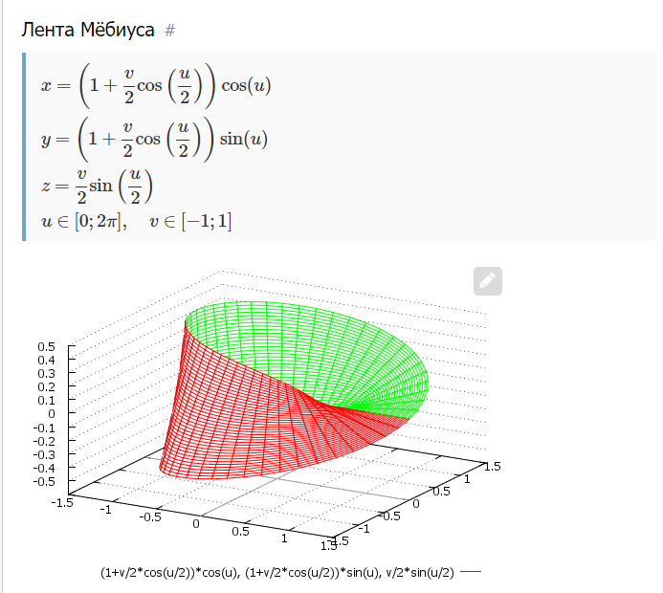
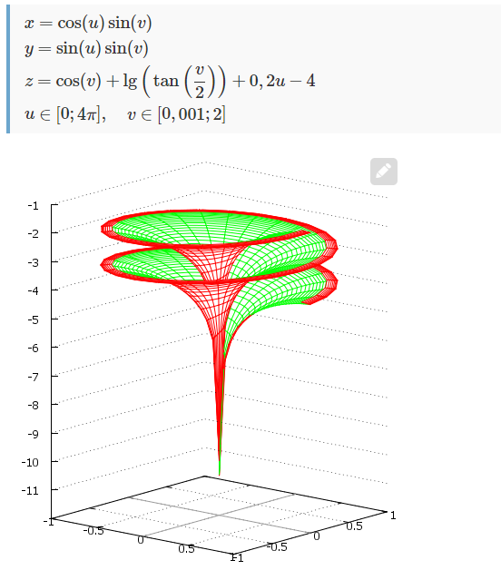

Slide 46
