Slide 1

The Development of Science Portal for SMK Teluk Gadung
DR MASLINA ABD AZIZ

Slide 2
Research Background
An education portal is designed to provide a host of educational services. The educational portal website can also be an effective marketing tool to attract consumers of educational services and to form a positive image. (Shpolianskaya, 2019).
SMK Teluk Gadung need a portals website because they have the complete facilities that can support student to use the portals and enhance student science learning.
Educational portals can be utilized in two ways as a supportive tool during preparation, either to retrieve information or to share knowledge and information. Education portals offer a range of integrated tools to help you communicate, collaborate, and communicate with students, students, parents, and colleagues. (Kodirov, E. S. 2018)

Slide 3
Problem Statement
Does not have an organized and own science portal website platform.
Student has lack of online learning experience.
Unavailability of study materials such as additional notes, exercise and videos to fit into students’ time and place for them to study.

Slide 4
Research Objective
To identify requirements needed for the science portal website for SMKTG
To design the web-based system for science portal website for SMKTG
To develop the science portal website for SMKTG

Slide 5
Research Scope
Consists of two modules (SPM student module and Teacher module).
The science portal website output is intended for use by the science teacher and form 5 student.
The Waterfall development will be used as a methodology.

Slide 6
Significance
Significance to the students form 5 and science teacher.
Students can make use of the portals as a reference for revision and complete the exercise given by the teacher.
Beneficial to the teachers that teach science by doing the simple activity to measure understanding of the topic or chapter instead of asking if the students understand about the topic.

Slide 7
Literature Review
Portal
Definition
The relevancy of portal for educational purpose
Different Between Portal and Website
Major Functions of Portal.
Review of Existing Educational Portal
Comparison on Interface Design
Comparison on Web Elements
Outcomes Of Comparison on User Interface Design
Study on Suitable Programming Language
Comparison On Php and Java
Advantages of Php Over Java
Outcome Of Study on Suitable Programming Language.

Slide 8
Literature Review
Study on System Development Methodology
Waterfall Development
Outcome of Study on System Development Methodology

Slide 9
Topic/ Subtopics | Topic Components | Paper Title | Year | Author | Findings
Portals | Definition | The Importance of educational web portals in improving the education system | 2018 | Kodirov, E. S. | Designed to illustrate a multifunctional web site that deals with public or private businesses.
 | The relevancy of portal for educational purpose | E-learning in higher inclusive education: needs, opportunities and limitations | 2019 | Meskhi, B., Ponomareva, S., & Ugnich, E | Changes in global digital have significantly influenced the development of e-learning in inclusive education as well
 | Different Between Portal and Website | Educational web portals of higher education and their problems. Universal Journal of Educational Research | 2020 | Dangwal, K. L., & Mishra, D. | Bring much software under one umbrella such as search engines, emails, forums Provide an excellent user interface, which helps user to get quality experience

Slide 10
Topic/ Subtopics | Topic Components | Paper Title | Year | Author | Findings
Portals | Major Functions of Portal. | Evaluation of e-learning web-portals | 2017 | Imran, S. M., & Malik | Can find information related to the courses offered, mode of teaching and learning.
Review of Existing Educational Portal | Comparison on Interface Design | User experience in the development of the education system | 2019 | Pilarcikova, K., Rusnak, P., Rabcan, J., & Kostolny, J. | Equally important to know whether the graphic design will allow its users to use it effectively.
 | Comparison on Web Elements | A comprehensive analysis of academic library websites: design, navigation, content, services, and web 2.0 tools | 2019 | Al-Qallaf, C. L., & Ridha, A. | Comprises six subcategories, which includes:- Aesthetic design, Consistency, Appropriate images and Fonts, Appropriate colors and Appropriate page design.
 | Outcomes Of Comparison on User Interface Design | Potential Students Preferences Towards University Website Interface Design | 2020 | Ishak, Z., Alexander, O., Al-Sanjary, O. I., & Yusuf, E. | Proper design of a user interface can contribute to user satisfaction, and the user’s retention of knowledge of operations over time

Slide 11
Topic/ Subtopics | Topic Components | Paper Title | Year | Author | Findings
Study on Suitable Programming Language | Comparison On Php and Java | Analysis and practical application of PHP frameworks in development of web information systems | 2017 | Prokofyeva, N., & Boltunova, V. | Open source scripting language with many advantages such as support for different database types, many language structures.
 | Advantages of Php Over Java | Analytical and Comparison Study of Main Web Programming Languages‒ASP and PHP | 2019 | Odeh, A. H. | Well-suited for creating dynamic web pages with connectivity to various database systems. MySQL is the most widely used because PHP provides native support for it and the database is free and an open-source project
 | Outcome Of Study on Suitable Programming Language. | A Comparative study of PHP frameworks performance. | 2019 | Laaziri, M., Benmoussa, K., Khoulji, S., & Kerkeb, M. L. | The PHP programming language is considered one of the most widely used scripting languages in web application development because it offers great flexibility.

Slide 12
Topic/ Subtopics | Topic Components | Paper Title | Year | Author | Findings
Study on System Development Methodology | Waterfall Development | A study on using waterfall and agile methods in software project management. | 2019 | Andrei, B. A., Casu-Pop, A. C., Gheorghe, S. C., & Boiangiu, C. A | The first applied software development strategy, resembling the designs that were used in other industries. Allows for a project to be split into multiple fixed phases
 | Outcome of Study on System Development Methodology | Software Requirement in Iterative SDLC Model | 2020 | Okesola, O. J., Adebiyi, A. A., Owoade, A. A., Adeaga, O., Adeyemi, O., & Odun-Ayo, I. | SDLC is system development as it breaks down the entire life cycle of software development thus making it easier to evaluate Each part of software development while providing some levels of comforts for programmers to work concurrently on each phase.

Slide 13
Research Methodology
Analysis
Design
Implementation
Planning
System Development Life Cycle (SDLC) (Iqbal, S. Z., Idrees, M, 2017)

Slide 14
Phase | Actions | Deliverables | Research Objective
Planning | Requirements gathering Define problem statement, objective and project scope Develop Gantt chart | Identify problem statement, objective and project scope. Identify the requirements | N/A
Analysis | Analyse user requirements Produce user requirements document Develop use case diagram Develop class diagram | Use Case Diagram Class Diagram Functional and non-functional requirement | To identify requirements needed for the science portal website for SMKTG.
Design | Develop design for database Develop design for user interface | User interface design Database design (ERD) | To design the web-based system for science portal website for SMKTG
Implementation | Implement the database Develop prototype for FYP Portal Testing Documentations | MYSQL database Initial version of system | To develop the science portal website for SMKTG.

Slide 15
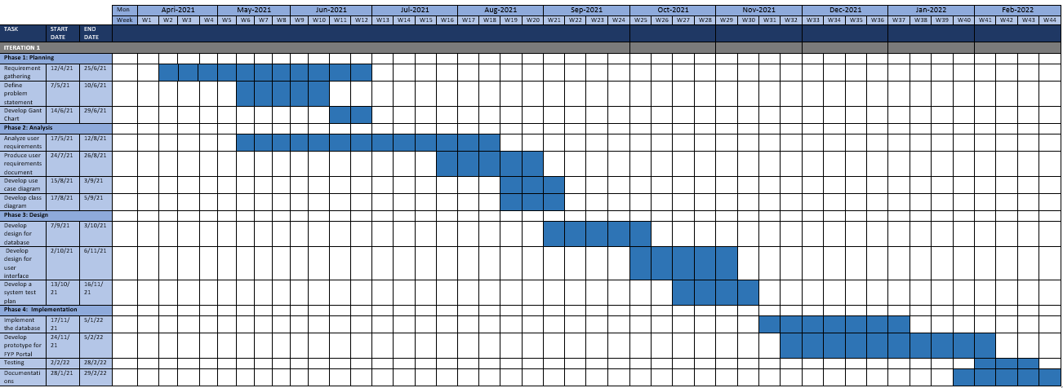
Gantt Chart

