Slide 1
Group Meeting #8
05/21/2025
Final Project Paper

Slide 2
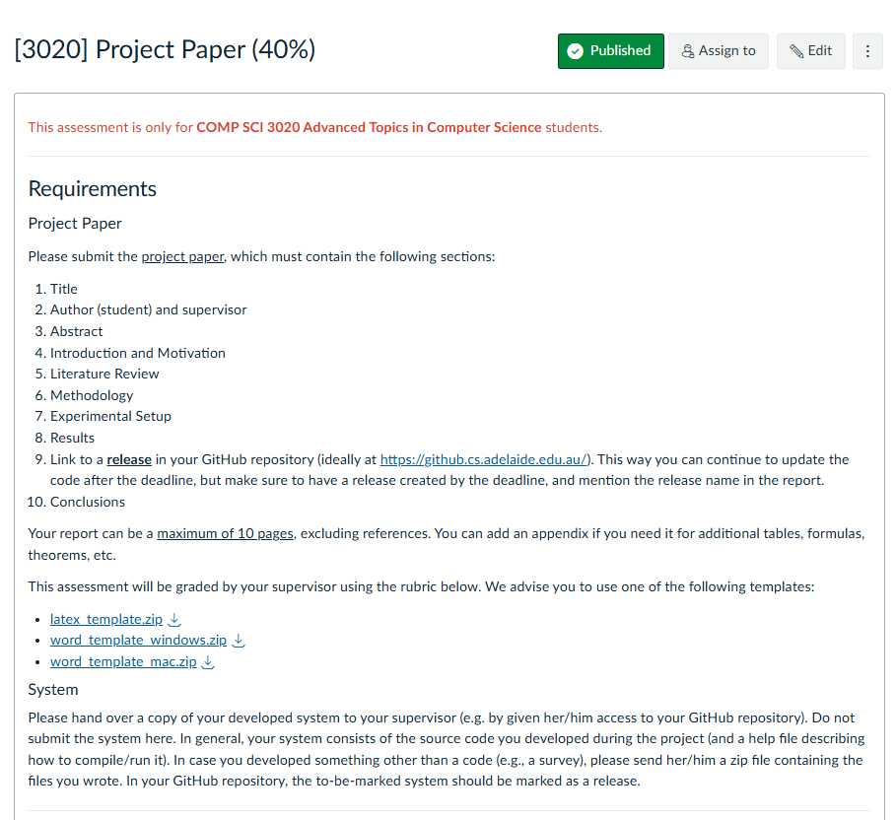
Templates

Slide 3
Structure
Section | Double Column (~8 Pages) | Focus
Introduction | <= 2 Pages | Motivation
Related Work | <= 1.5 Pages | Literature Review
Method | ~ 2 Pages | Technical Details
Experiments | ~ 2 Pages | Quantitative Results
Conclusion | ~ 0.25 Pages | Conclusion

Slide 4
Introduction
Consider refining from your Design Document
Component | Proportion | What to include
Background | 10% | Task, Progress of the Field, Applications, etc.
Knowledge Gap | 40% | Why existing methods are not good enough? -> (What motivates your own work?). What scientific problem you are going to solve?
Your Methodology | 30% | Briefly introduce your work
Your contribution | 20% | Itemize your contribution, ideally 3 contributions per paper. Try to include some important numbers extracted from your experiment results, e.g., performance.

Slide 5
Related Work
Component | Proportion | What to include
e.g. Large Language Model | 33% | Previous Works follow a logical order (publication time, technique, etc.). What problems they solved, and what are the shortcomings they still have. 1-2 sentences to introduce your own project under each filed, compared to these existing works, what knowledge gaps you addressed
e.g. Evaluation of LLM | 33%
e.g. Games for LLMs/AI | 33%
Select 2-3 Relevant Fields

Slide 6
Method
Component | Proportion | What to include
Framework | 60% | Game rules, game board, capabilities that need to play this game, etc. How to run the battle between players? Use a figure to demonstrate the overview pipeline
Evaluation Metrics | 40% | How do you evaluate and compare the results? Try to include a few mathematical equations.

Slide 7
Experiments
Component | Proportion | What to include
Experiment Settings | 10% | Which LLMs included? Hyper-parameters, such as battle rounds, context length, …
Quantitative Results and Analysis | 60% | Use tables and figures to demonstrate the quantitative results you obtained. Analyze the experiment results and try to provide some insights you have gain from the results. How these insights could help for developing future LLMs?
Qualitative Results | 30% | Show some visualizations of the gameplays, and provide some analysis

Slide 8
Conclusion
Component | Proportion | What to include
Summarization | 80% | A brief summarization about what you have done in this project, the novelties of your methods, the
Future works | 20% | The challenges still not solved, and the future directions

