Slide 1
Binary Search Trees
44
17
88
32
65
97
28
54
82
29
7`6
80

Slide 2
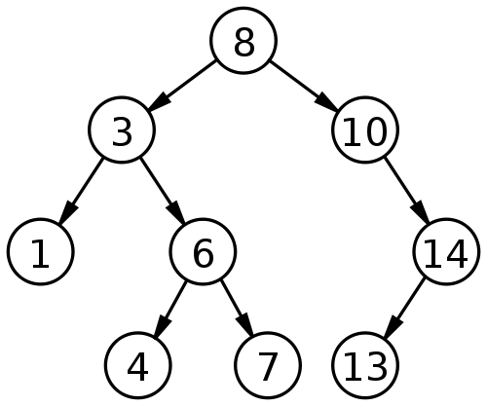
Binary Search Trees
A binary search tree (BST) is a node-based binary tree data structure which has the following properties:
  The left subtree of a node contains only nodes with keys less than the node's key.
  The right subtree of a node contains only nodes with keys greater than or equal to the node's key.
  Both the left and right subtrees must also be binary search trees.

Slide 3
Binary Search Trees
Firstly, it is a binary tree
It is represented by a linked data structure
It combines
  the advantage of an array -- the ability to do a binary search with
  the advantage of a linked list -- its dynamic size
The efficiency of all of the operations is O(log n), only if the tree is reasonably height-balanced
Each node contains at least the following fields
  key: an identifying field
  left: pointer to a left child (may be NIL)
  right: pointer to a right child (may be NIL)
  p: pointer to the parent node (NIL for root)

Slide 4
Binary Search Trees
Secondly, the binary-search-tree property
  For any node x,
  Key [y] < Key [x] if y in left subtree of x
  Key [y] ≥ Key [x] if y in right subtree of x
15
6
18
3
7
17
20
2
4
13
9

Slide 5
Binary Search Trees: Example
44
17
88
32
65
97
28
54
82
76
29
80

Slide 6
Operations on BSTs: Search
44
Search for 28
17
88
32
65
97
28
54
82
76
29
80

Slide 7
Operations on BSTs: Search
Compare with root
<
44
Search for 28
17
88
32
65
97
28
54
82
76
29
80

Slide 8
Operations on BSTs: Search
44
Search for 28
Compare with node
>
17
88
32
65
97
28
54
82
76
29
80

Slide 9
Operations on BSTs: Search
44
Search for 28
17
88
Compare with node
<
32
65
97
28
54
82
76
29
80

Slide 10
Operations on BSTs: Search
44
Search for 28
17
88
32
65
97
Compare with node
Found
28
54
82
76
29
80

Slide 11
Operations on BSTs: Search
Given a key k and a pointer to the root, Tree-Search returns a pointer to a node with key k or NIL:
    Tree-Search(x, k)
    if (x = = NIL or k = = key[x])
    return x;
    if (k < key[x])
    return Tree-Search(left[x], k);
    else
    return Tree-Search(right[x], k);

Slide 12
Operations on BSTs: Search
Here is another function that does the same:
    Tree-Search(x, k)
    while (x != NIL and k != key[x])
    if (k < key[x])
    x = left[x];
    else
    x = right[x];
    return x;
Which of these two functions is more efficient?

Slide 13
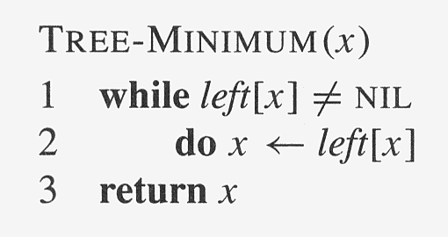
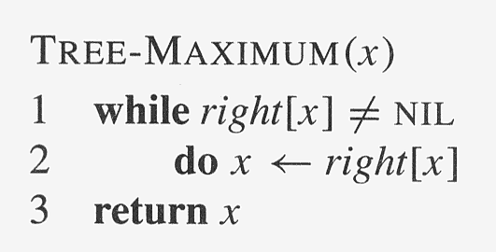
Operations on BSTs: Min & Max

Slide 14
Operations on BSTs: Successor
Two cases:
  x has a right subtree: successor is minimum node in right subtree
  x has no right subtree: successor is first ancestor of x whose left child is also ancestor of x
    Intuition: As long as you move to the left up the tree, you’re visiting smaller nodes.
Predecessor: similar algorithm

Slide 15
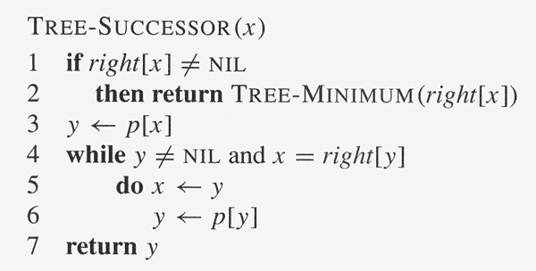
Operations on BSTs: Successor

Slide 16
Operations of BSTs: Insert
Inserts an element z to the tree so that the binary search tree property continues to hold
The basic algorithm
  Like the search procedure as discussed before
  Insert z in place of NIL
  Use a “trailing pointer” to keep track of where you came from (like inserting into singly linked list)

Slide 17
Operations of BSTs: Insert
44
Insert 35
17
88
32
65
97
28
54
82
76
29
80

Slide 18
Operations of BSTs: Insert
Compare with root
<
44
Insert 35
17
88
32
65
97
28
54
82
76
29
80

Slide 19
Operations of BSTs: Insert
44
Insert 35
Compare with node
>
17
88
32
65
97
28
54
82
76
29
80

Slide 20
Operations of BSTs: Insert
44
Insert 35
17
88
Compare with node
>
32
65
97
28
54
82
76
29
80

Slide 21
Operations of BSTs: Insert
44
Insert 35
17
88
32
65
97
External Node
28
54
82
76
29
80

Slide 22
Operations of BSTs: Insert
44
Insert 35
17
88
32
65
97
28
35
54
82
76
29
80

Slide 23
Operations of BSTs: Insert
Example: Insert 74
44
17
88
32
65
97
28
54
82
29
76
Search for the element as if it were in the tree. When reach a NULL node, that’s where to insert.
80
NULL

Slide 24
Operations of BSTs: Insert
Example: Insert 74
44
17
88
32
65
97
28
54
82
29
76
Search for the element as if it were in the tree. When reach a NULL node, that’s where to insert.
New node
80
74

Slide 25
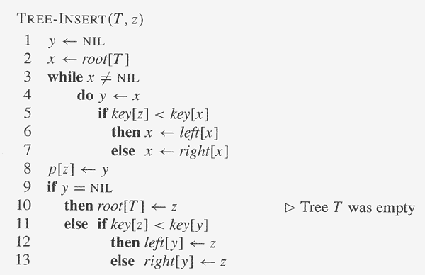
Operations of BSTs: Insert
Use Tree-search !

Slide 26
Operations of BSTs: Delete
Deletion is a bit tricky
3 cases:
  x has no children:
    Remove x
  x has one child:
    Splice out x
  x has two children:
    Find its inorder successor y
    Replace x with y
    Delete y
F
B
H
A
D
K
Example: delete K
or H or B
C
y cannot have left child !

Slide 27
Operations of BSTs: Delete
44
17
88
32
65
97
28
54
82
76
29
80

Slide 28
Operations of BSTs: Delete
Compare with root
<
44
Delete 29
17
88
32
65
97
28
54
82
76
29
80

Slide 29
Operations of BSTs: Delete
<
44
Delete 29
>
17
Compare with nodes
88
<
32
65
97
>
28
54
82
76
29
Found
80

Slide 30
Operations of BSTs: Delete
44
Delete 29
17
88
32
65
97
28
54
82
76
29
z
80

Slide 31
Operations of BSTs: Delete
44
Delete 29
17
88
32
65
97
28
54
82
76
80

Slide 32
Operations of BSTs: Delete
44
Delete 32
17
88
32
65
97
28
54
82
76
29
80

Slide 33
Operations of BSTs: Delete
Compare with root
<
44
Delete 32
17
88
32
65
97
28
54
82
76
29
80

Slide 34
Operations of BSTs: Delete
44
Delete 32
Compare with node
>
17
88
32
65
97
28
54
82
76
29
80

Slide 35
Operations of BSTs: Delete
44
Delete 32
17
88
Compare with node
Found
32
65
97
rightChild == external
28
54
82
76
29
80

Slide 36
Operations of BSTs: Delete
44
Delete 32
17
88
32
z
65
97
28
54
82
76
29
80

Slide 37
Operations of BSTs: Delete
44
Delete 32
17
88
32
65
97
28
54
82
76
29
80

Slide 38
Operations of BSTs: Delete
44
Delete 65
17
88
32
65
97
Find the inoder successor
28
54
82
76
29
80

Slide 39
Operations of BSTs: Delete
44
Delete 65
17
88
32
65
97
28
54
82
inoder successor
76
29
80
external

Slide 40
Operations of BSTs: Delete
44
Delete 65
17
88
32
65
97
28
54
82
76
76
29
z
80

Slide 41
Operations of BSTs: Delete
Given two nodes u and v, Transplant replaces the subtree rooted at u with the subtree rooted at v: node u’s parent becomes node v’s parent.
    Transplant(T, u, v)
    if (p[u] = = NIL)
    root[T] = v
    elseif (u = = left[ p[u] ]
    left[ p[u] ] = v;
    else right[ p[u] ] = v;
    if v != NIL
    p[v] = p[u];

Slide 42
Operations of BSTs:
Deletes node z from binary search tree T
    Tree-Delete(T, z)
    if (left[z] = = NIL)
    Transplant(T, z, right[z])
    elseif (right[z] = = NIL)
    Transplant(T, z, left[z])
    else y = Tree-Minimum(right[z])
    if p[y] != z
    Transplant(T, y, right[y])
    right[y] = right[z]
    p[ right[y] ] = y
    Transplant(T, z, y) // p[y] = = z
    left[y] = left[z]
    p[ left[y] ] = y

Slide 43
Sorting with BSTs
Informal code for sorting array A of length n:
  BSTSort(A)
  for i=1 to n
  TreeInsert(A[i]);
  InorderTreeWalk(root);
Running time is Ω(n lg n)
What will be the running time in the
  Worst case?
  Average case?

Slide 44
BST: Remarks
All complexity depends on height h
h = Ω (lg n)
To guarantee performance:
  Balanced tree !
Randomly build tree
  Theorem: The expected height of a randomly built binary search tree on n distinct keys is O(lg n)

Slide 45
Balanced Binary Search Trees
Keep O(lg n) height under dynamic operations
General framework:
  First a binary search tree
  Maintain properties that ensure height guarantee
AVL tree, red-black tree, …

