Slide 1

Name: ID:
Zulkar Nine 163432601
Faruqe Hasan 163432560
Presentation on:
NEWTON’S FORWARD INTERPOLATION:

Slide 2


What is forward interpolation?
Newton's forward difference formula is a finite difference identity giving an interpolated value between tabulated points in terms of the first value and the powers of the forward difference.

Slide 3
• Formula of Newton’s Forward Interpolation:

Slide 4
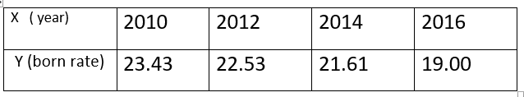
Problem: Find the Number of Approximate Children born Rate in Bangladesh in the year of x=2013.

Slide 5


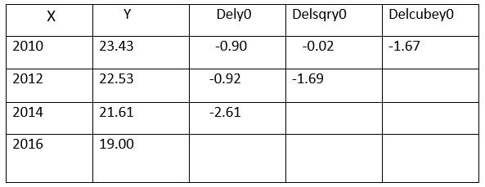
◆ Newton’s Forward Difference Table:

Slide 6

Solution
u= (x-x1)/h
= (2013-2012)/2
=0.5
F (2013) = y (1) + u*Dely1+ ((u*(u-1)/2)*Delsqry1)
=22.53 +0.5*(-0.92) + ((0.5*(0.5-1))/2)*(-1.69)
= 22.53 + (-0.46) + 0.21125
=22.28125

Slide 7

Conclusion:
According to the analysis the performance of Newton interpolation formula on different types of functions is presented.
In conclusion, it can be said that this formula is designed for a function whose value will increase or remain constant with the independent variable.

Slide 8
Thank You

