Slide 1
Stacks

Slide 2
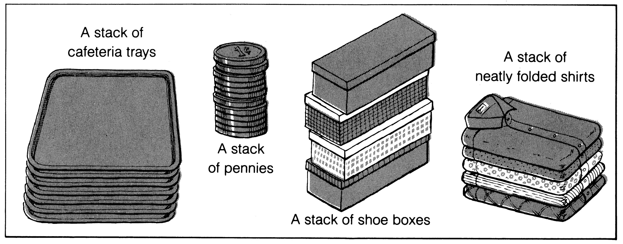
What is a Stack?
Stores a set of elements in a particular order
It is an ordered group of homogeneous items of elements
Elements are added to and removed from the top of the stack
Stack principle: LAST IN FIRST OUT = LIFO
It means: the last element inserted is the first one to be removed
Example

Slide 3
Last In First Out
top
B
A
C
B
A
D
C
B
A
E
D
C
B
A
D
C
B
A
top
top
top
top
A
top

Slide 4
Applications of Stacks
Direct applications
  Page-visited history in a Web browser
  Undo sequence in a text editor
  Saving local variables when one function calls another, and this one calls another, and so on.
Indirect applications
  Auxiliary data structure for algorithms
  Component of other data structures
Stacks

Slide 5
C++ Run-time Stack
main() {
int i = 5;
14 fo(i);
}
fo(int j) {
int k;
k = j+1;
21 ba(k);
}
32 ba(int m) {
…
}
The C++ run-time system keeps track of the chain of active functions with a stack
When a function is called, the run-time system pushes on the stack a frame containing
  Local variables and return value
  Program counter, keeping track of the statement being executed
When a function returns, its frame is popped from the stack and control is passed to the function on top of the stack
ba
PC = 32
m = 6
fo
PC = 21
j = 5
k = 6
main
PC = 14
i = 5
Stacks

Slide 6
Array-based Stack
A simple way of implementing the Stack uses an array
We add elements from left to right
A variable keeps track of the index of the top element
Algorithm size()
return t + 1
Algorithm pop()
if isEmpty() then
throw EmptyStackException
else
t ← t − 1
return S[t + 1]
…
S
0
1
2
t
Stacks

Slide 7
Array-based Stack (cont.)
The array storing the stack elements may become full
A push operation will then throw a FullStackException
Algorithm push(x)
if t = S.length − 1 then
throw FullStackException
else
t ← t + 1
S[t] ← x
…
S
0
1
2
t
Stacks

Slide 8
Performance and Limitations
Performance
  Let n be the number of elements in the stack
  The space used is O(n)
  Each operation runs in time O(1)
Limitations
  The maximum size of the stack must be defined a priori , and cannot be changed
  Trying to push a new element into a full stack causes an implementation-specific exception
Stacks

Slide 9
Abstract Data Types (ADTs)
An abstract data type is a type and a collection of operations to manipulate that type
An abstract data type (ADT) is an abstraction of a data structure
An ADT specifies:
  Data stored
  Operations on the data
  Error conditions associated with operations
Example: ADT modeling a simple stock trading system
  The data stored are buy/sell orders
  The operations supported are
    order buy(stock, shares, price)
    order sell(stock, shares, price)
    void cancel(order)
  Error conditions:
    Buy/sell a nonexistent stock
    Cancel a nonexistent order
Stacks

Slide 10
The Stack ADT
The Stack ADT stores arbitrary objects
Insertions and deletions follow the last-in first-out scheme
Main stack operations:
  push(object e): inserts element e
  pop(): removes and returns the last inserted element
Auxiliary stack operations:
  top(): returns a reference to the last inserted element without removing it
  size(): returns the number of elements stored
  isEmpty(): returns a Boolean value indicating whether no elements are stored
Stacks

Slide 11
Exceptions
Attempting the execution of an operation of ADT may sometimes cause an error condition, called an exception
Exceptions are said to be “thrown” by an operation that cannot be executed
In the Stack ADT, operations pop and top cannot be performed if the stack is empty
Attempting the execution of pop or top on an empty stack throws an EmptyStackException
Stacks

Slide 12
List-based Stack Implementation: Push
void push(pnode top, element item)
{
/* add an element to the top of the stack */
pnode temp =
(pnode) malloc (sizeof (node));
if (IS_FULL(temp)) {
fprintf(stderr, “ The memory is full\n”);
exit(1);
}
temp->item = item;
temp->next= top;
top= temp;
}
Stacks

Slide 13
List-based Stack Implementation: Pop
element pop(pnode top) {
/* delete an element from the stack */
pnode temp = top;
element item;
if (IS_EMPTY(temp)) {
fprintf(stderr, “The stack is empty\n”);
exit(1);
}
item = temp->item;
top = temp->next;
free(temp);
return item;
}
Stacks

