Slide 1
Team members:
Zulkar Nine 163432601
Sajedul Islam 163432559
Alomgir Hossain 163432584
Faruqe Hasan 163432560
Our Three project name :
1. Presentation on E-Commerce (online shopping)
2. Chat Application
3. Point of sale (POS)

Slide 2

Presentation on E-Commerce (online shopping)

Slide 3
Our System
◆ Our System is an e-commerce website from where people can buy products online.
◆ Admin monitors the activity of the users and checks the transactions.

Slide 4
Features:
1/ Menu
2/ Catalog Browsing
Category List
Product List
3/ Catalog Management
4/ Product Browsing
Product Reviews
Related Products
5/ Shopping Cart
6/ Checkout
7/ Auto generated bill
8/ Payment Gateway

Slide 5
Languages:
Tools:
❖ HTML 5
❖ CSS 3
❖ Bootstrap
❖ PHP
❖ MySQL
Framework
❖ Adobe Photoshop
❖ Sublime text
❖ Xampp

Slide 6
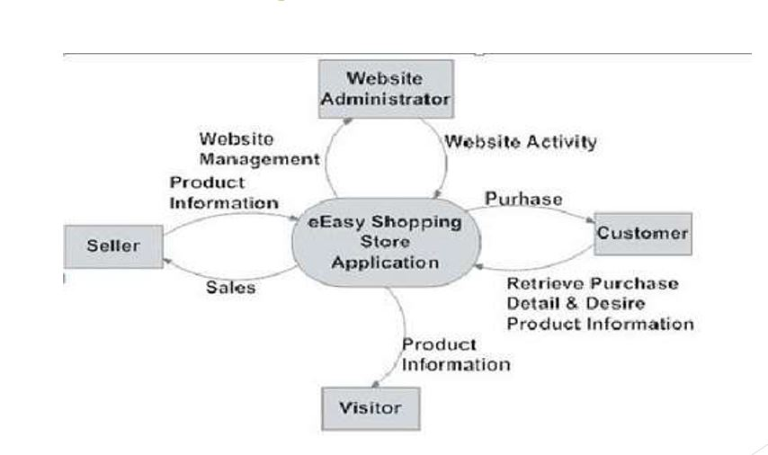
Data Flow Diagram

Slide 7
Reference
Slideshare.com

Slide 8
Chat Application

Slide 9
Related works
Messanger
What’s App
Imo
viber

Slide 10
Features
Transfer Smilies with Text
Private Chat
Great Look and Feel with Customized Color
Audio Enabled

Slide 11
Tools
NetBeans
Java swing
Mysql

Slide 12
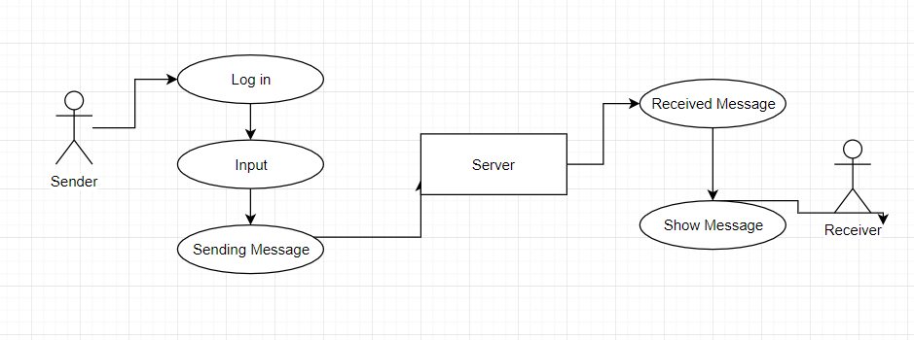
Data Flow Diagram

Slide 13
Point of sale (POS)

Slide 14
Related Works
Quick keys and/or product lookup
Multiple payment methods/split payments
Returns, refunds and store credit features
User accounts and permissions
Mobile Registers
Barcodes

Slide 15
Features
Add product
Stock product
Payment Methods
Product report

Slide 16
Tools
NetBeans
Java Swing
mysql

Slide 17
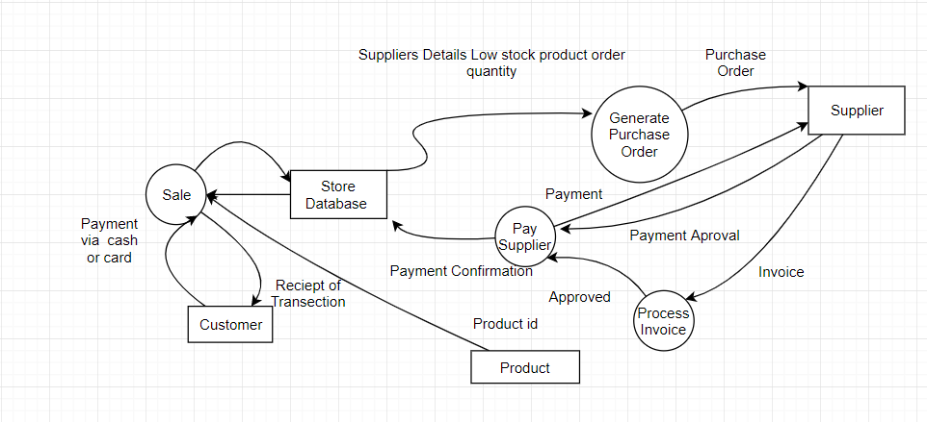
Data Flow Diagram

