Slide 1
Welcome Our presentation
Team Member:
Zulkar Nine -163432601
Sajedul Islam-163432559

Slide 2

Topics Name
Online shopping on Medicine

Slide 3
Background study
The e-commerce industry is growing rapidly every year in Bangladesh . Online shopping is becoming a suitable way to make all your purchases, whether you’re at home in office, or in a different country.
Consumer can easily convey medicine the promotions like cash on delivery and special discounts on online purchases. Taking to online shopping to search products or service, compare prices & to shop online.

Slide 4
Abstract
1. Our System is an e-commerce website from where people can
buy medicines online.
2. Admin monitors the activity of the users and checks the
transactions.

Slide 5
Related works
pharmacy.com.bd
Medicine Shopping Site
Rokomari.com:
Educational Shopping Site
daraz.com.bd:
Fashionable Shopping Site
Chaldal.com:
Food Shopping Site

Slide 6
Feature List
Register
add , manage medicine
Special Offers
Medicine Details
Orders
Utilities:
Shopping Cart
Checkout
Invoice
Delivery
Reports
Feedback

Slide 7
Gantt chart

Slide 8
Software needed
Sublime text
Xampp
MySQL
laravel framework

Slide 9
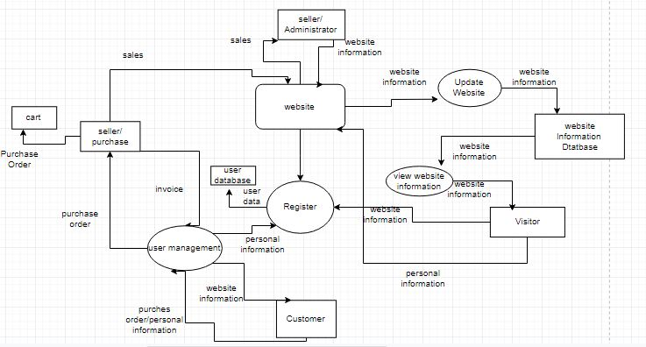
Data flow Diagram

Slide 10
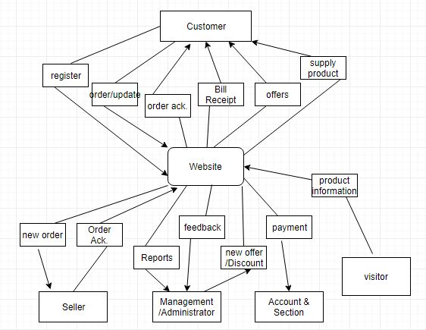
Document flow Diagram

Slide 11
Contribution
Add Different Brands Medicine:
Square Pharmaceuticals Ltd.
Beximco Pharmaceuticals Ltd.
Incepta Pharmaceutical Ltd.
ACI Limited.
Etc.

Slide 12
Future plan
We are thinking of some modifications and adding some advanced
new features in out system.
Some of them are –
# GUI modification (more user friendly)
# Users can sell their products
# Users can signup / login using their social media account such as
facebook , google+ etc.

Slide 13
Conclusion
E-commerce is a great way for business and consumers to interact internationally.
The future of E-commerce will drastically progress over the years as the amount of internet users among businesses and consumers grows drastically every year.

Slide 14
Thank You

