Slide 1
Welcome to our presentation

Slide 2
Participants :
Name ID
Abul Hossain 163432558
Zulkar Nine 163432601
Sajedul Islam 163432559
Faruqe Hasan 163432560

Slide 3
Topic Name
Accident Obstruct , Identification & Notification System

Slide 4
ABSTRACT
The Accident threatens human lives more and mainly road accident is common today. During accident many people lose their life because medical services and family member not getting accidental information on time. In this paper, an efficient vehicle wireless system is designed and implemented for vehicle accident detection and reporting using accelerometer and GPS.

Slide 5
Accelerometer sensor is used to detect crash and GPS give location of vehicle. In case of any accident, the system send automated message to the preprogrammed number such as family member or emergency medical services via GSM.

Slide 6
Introduction
Road accidents constitute the major part of the accident deaths all over the world. accusing bad driving behaviors like drunken driving, speeding and not using seatbelts for still causing major traffic deaths. The purpose of the project is to find the vehicle where it is and locate the vehicle .Most of the times we may not be able to find accident location because we don’t know where accident will happen.
In order to give treatment for injured people, first we need to know where the accident happened through location tracking and sending a message to your related one or to the emergency services. The exact and GSM modules which helps to trace the vehicle anywhere location of the vehicle is sent to mobile phones using GSM modem.

Slide 7
PROBLEM STATEMENT
Whenever accident being met, the nearby people call the ambulance. The problem associated with this is that the victims depend on the mercy of nearby people. There is a chance that there are no people nearby the accident spot or people who are around neglects the accident. This is the flaw in the manual system.

Slide 8
PROJECT OBJECTIVES
To design a GPS and GSM based accident identification and information system using PIC.
To trigger the car alarm when accidents are detected.
To write a program in C programming language for the microcontroller to detect the sensors signals and trigger the alarm as well as send the alert message to owner via GSM modem.
To provide security for the vehicle user and also detects the accident if occurred and informs the respective authority (like ambulance, police, owner etc.) through wireless technologies.
To display the alarm status on 2x16LCD.

Slide 9
PROJECT SCOPE
The proposed system deals with the detection of the accidents. But this can be extended by providing medication to the victims at the accident spot.
By increasing the technology we can also avoid accidents by providing alerts systems that can stop the vehicle to overcome the accidents.

Slide 10
APPLICATION
Can be used in Car/Motor Vehicles to secure the driver.
With slight modification, can also be used in LIFTs in case damaged being done.
With some modification we can also use this system for traffic estimation.

Slide 11
PROJECT LIMITATION
Difficult for communication in areas with poor coverage of GSM network and GPS communication
Change of car ownership would result in need to reprogram the system details.
Traffic jams can slow down the emergency responders.

Slide 12
HARDWARE REQUIREMENTS
GSM module
GPS module
Vibration sensor
Ultrasonic sensor
Pic16f877A microcontroller
Liquid crystal display (LCD)
I2C (EEPROM)
Arduino Uno
Connecting Wires
Breadboard or PCB
Power supply 12v 1amp

Slide 13
SOFTWARE REQUIREMENTS
Proteus simulation software
Arduino compiler
Programming Language: C
GOOGLE MAP
serial communication

Slide 14
ADVANTAGE
Low power hardware components being used in our system.
Uses some already existing hardware components of mobile phone hence lower the total cost/budget involved.
Use of more than one sensor increases the accuracy of our system.
DISADVANTAGE
Bluetooth of phone monitors the accident regularly hence takes the power even if no accident being met.
If the phone battery is dead by any means then we can’t intimate to the concerned people.

Slide 15
CONCLUSION
This study solves the issues like automatic speed control mechanism, accident detection and information sending. From this we conclude that this system will reduce the accidents and save the human lives. On the whole this system proves to be very cost effective and efficient.
The experimentations and results prove that the system is easily implementable in real time. This system can also be extended by inducing automation concepts like automatic driverless vehicle system, inter vehicular communication etc.

Slide 16
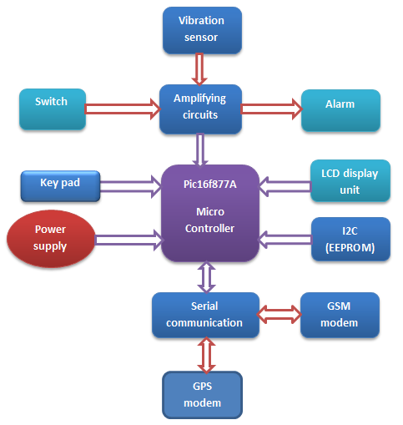
Diagram

Slide 17
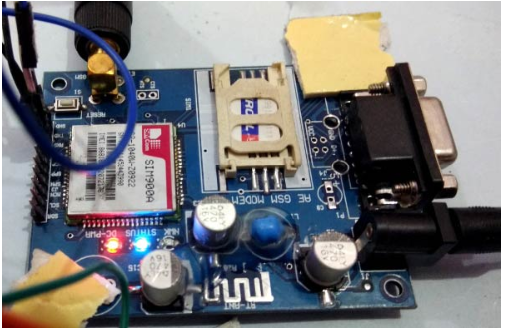
GSM MODEM

Slide 18
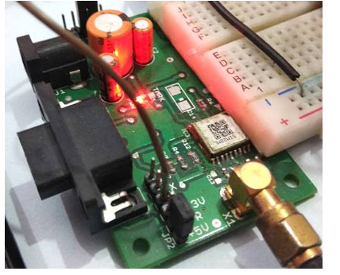
GPS DEVICE

Slide 19
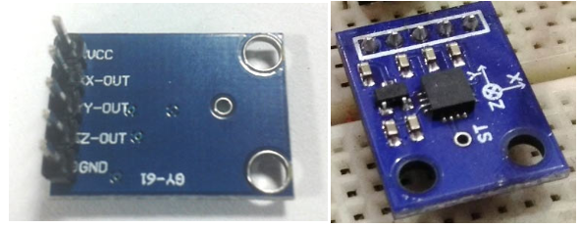
ACCELEROMETER

Slide 20
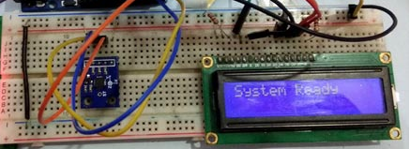
Circuit Board & LCD Display & Wires

Slide 21
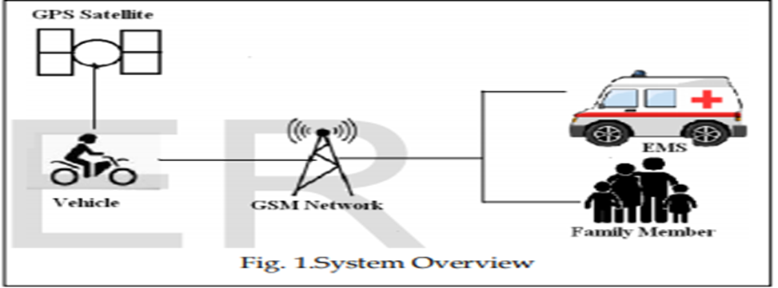
System Overview

Slide 22
Thank You

