Slide 1


Slide 2
WELCOME TO OUR PRESENTATION
MD.FARUQE HASAN
163432560
SAJEDUL ISLAM 163432559
ZULKAR-NINE 163432601
ABUL HOSAN 163432558

Slide 3
Abstract
The agricultural information system provides is users to get online information about , fruits, vegetables statistical details and new tendencies.
The main features of the information system includes information retrieval facilities for Farmers are Import product for Bidding from anywhere in the form of obtaining statistical information about fruits, vegetables, statistical information about exports etc. Customer Can buy Crops with bidding.

Slide 4
INTRODUCTION
Bangladesh is a agriculture dependent country . Agriculture is the largest employment in Bangladesh.
Online agriculture is becoming a suitable way to make all your purchases crops, whether you’re at home or anywhere.
Taking to online agriculture to search Crops or service, compare prices & to shop by bidding.

Slide 5
Problem Statement
In Bangladesh, the agricultural sector is one of the main contributors to the national GDP.
But, most of the farmers of Bangladesh are still in lack of modern agricultural knowledge and information. People having internet facilities have better access to information, which help them to acquire better position in economic activities.

Slide 6
FEATURES OF E-AGRICULTURAL
Register/login (admin, farmer, user)
Crops Import/Manage
Permission(Admin Management)
Crops category
Database Design
Special Offers
Search System
Crop Bidding
Add to Cart
Comment box

Slide 7
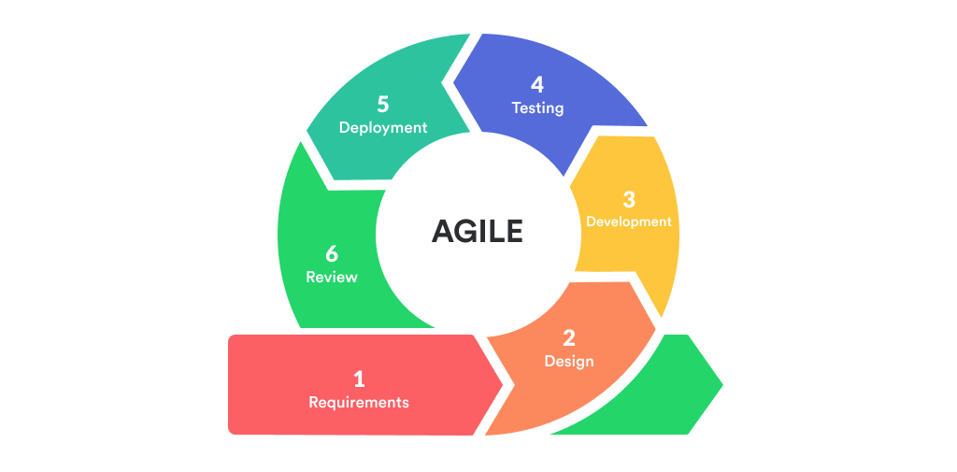
AGILE METHOLOGY

Slide 8
GANTT CHART

Slide 9
Requirement
Software
Hardware
Sublime text
Xampp
HTML,CSS,JAVASCRIPT,MYSQL
Laravel Framework
Processor 1.6 GHz CPU
RAM 4 GB RAM
HDD 1x 40 GB of free space or more is recommended for the software that is listed in the software requirements (system drive)

Slide 10
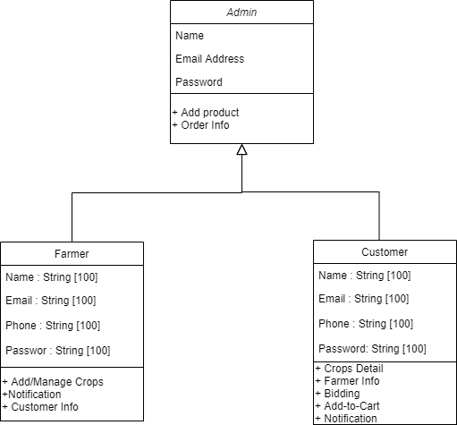
CLASS DIAGRAM

Slide 11
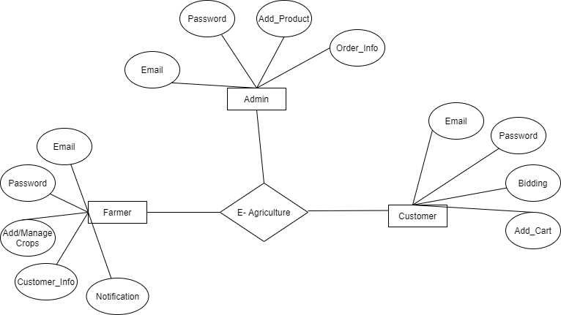
E-R DIAGRAM

Slide 12
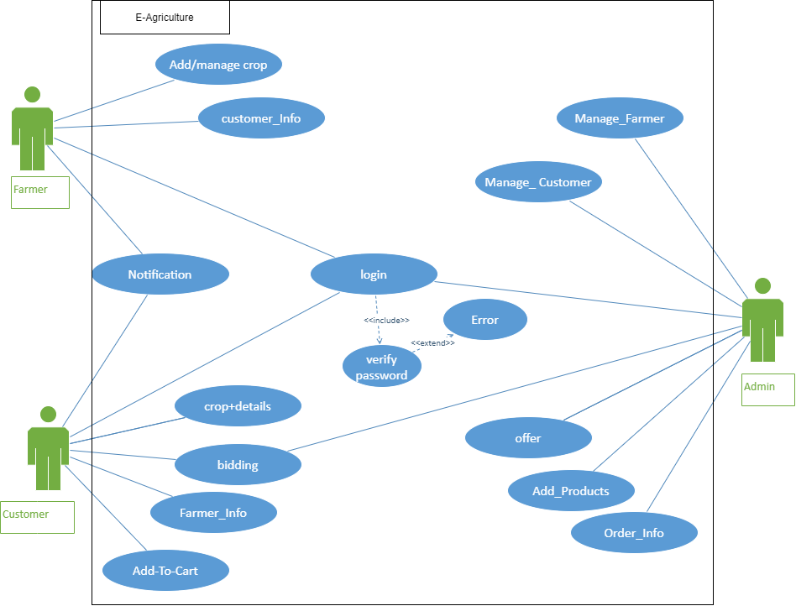
USE CASE DIAGRAM

Slide 13
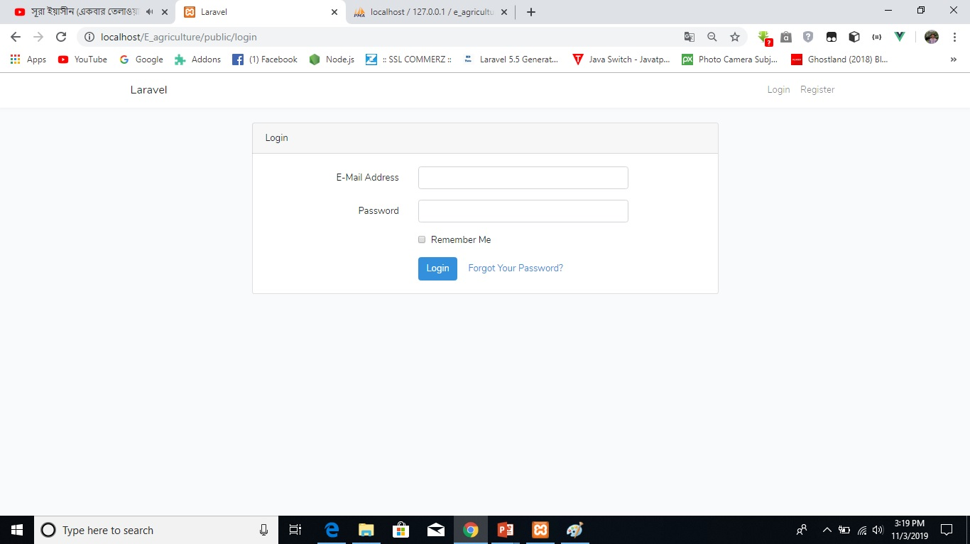
Admin login

Slide 14
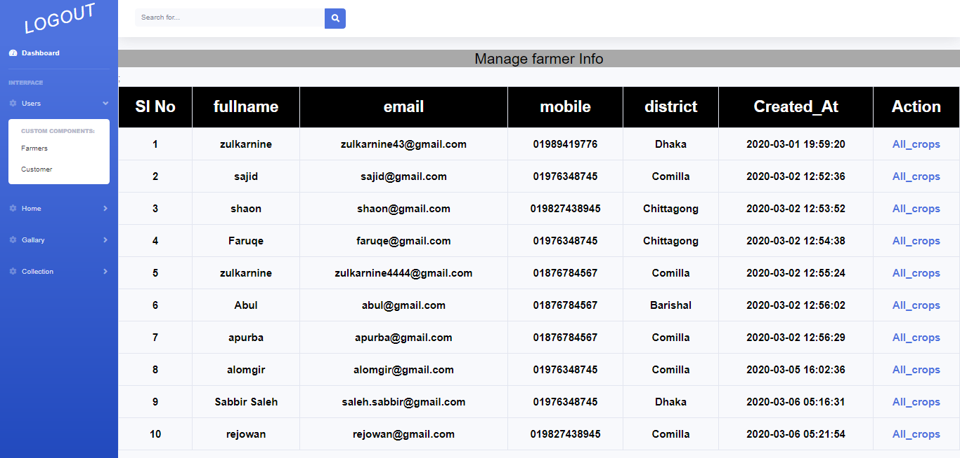
Admin panel

Slide 15
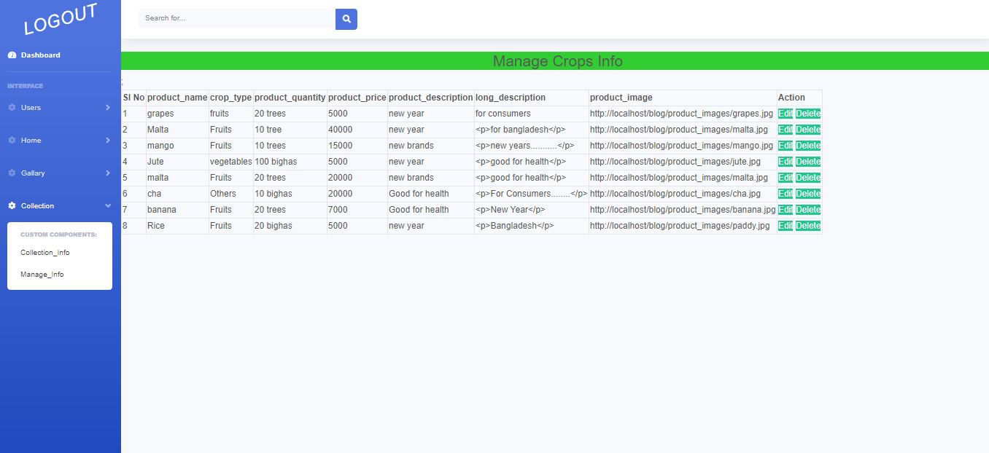
Admin panel

Slide 16
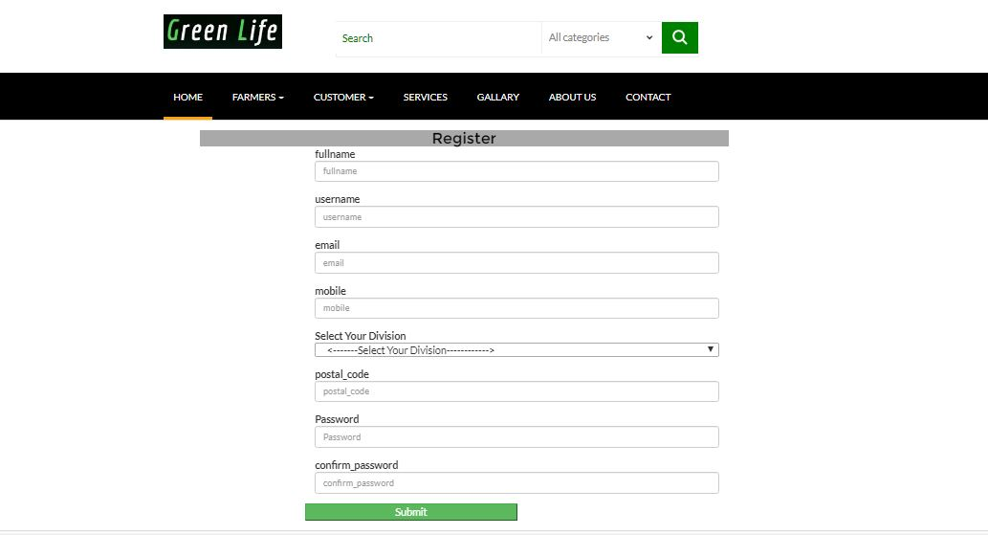
Customer/Farmer register

Slide 17
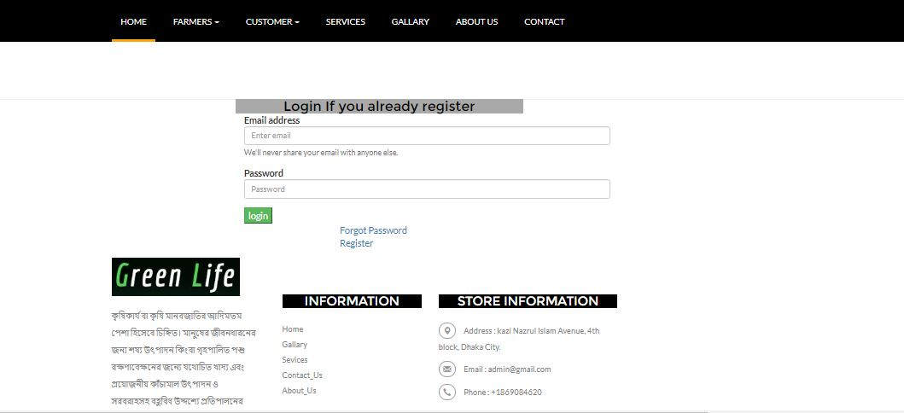
Customer/Farmer login

Slide 18
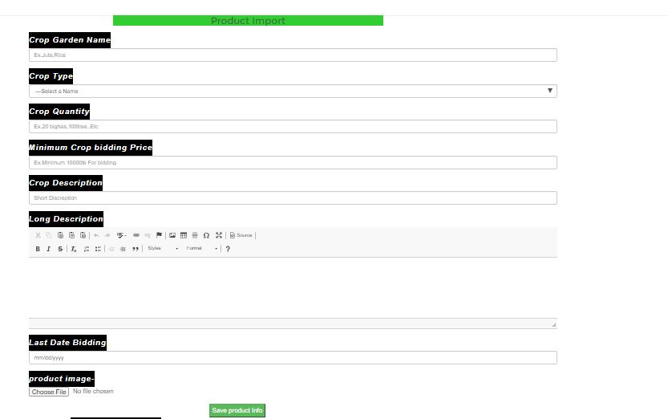
Farmer Import Crop

Slide 19
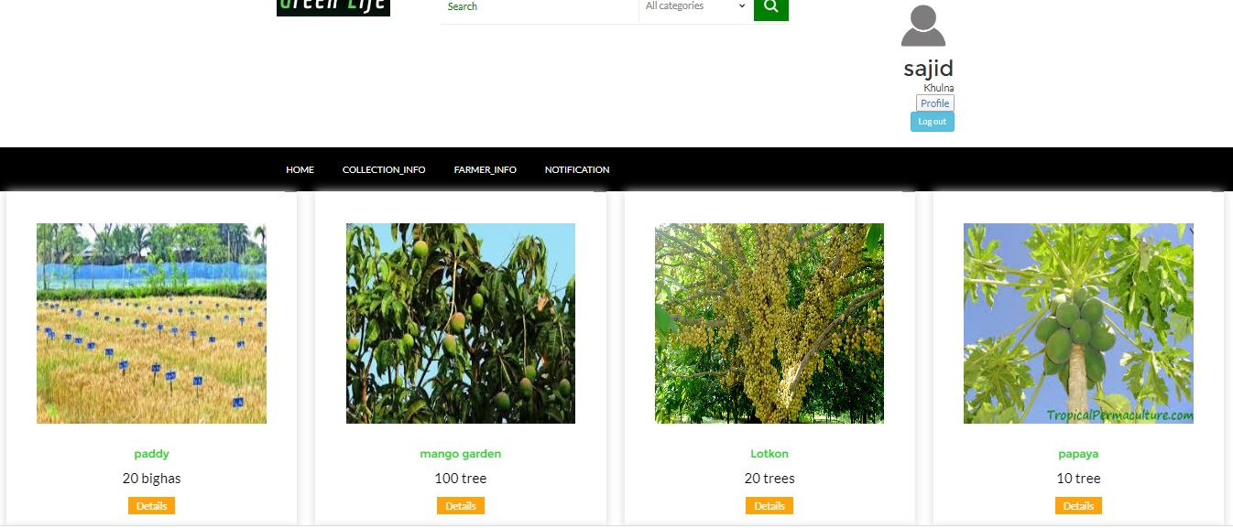
Crop Collection

Slide 20
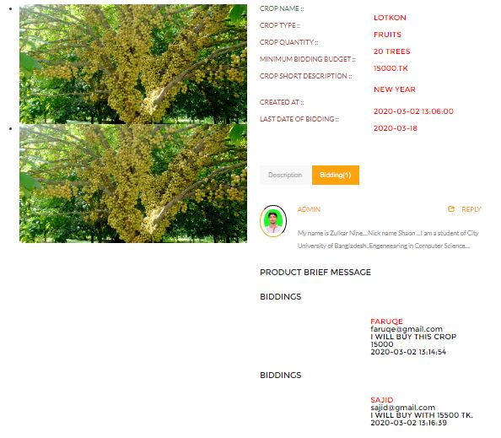
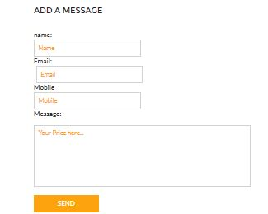
Bidding

Slide 21
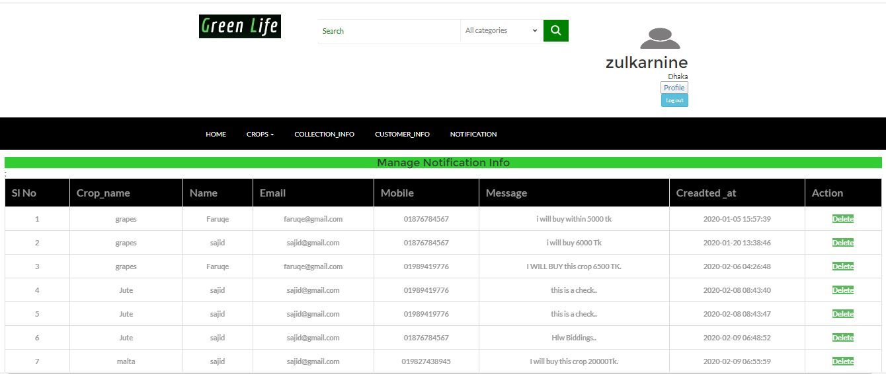
Notification

Slide 22
Advantages
Disadvantages
Save Effort and Time
Easily farmer can sell crops
Customer easily find & buy crops
Increase Additional Cost
Must be Farmer are Experienced with using website
Must be planned When Crops time limited.
May Increase risk of bidding

Slide 23
Future Scope
Encourage good quality and good farming practices by giving recognition to those who farm in a sustainable way.
We will make also android app for this E- Agriculture project.

Slide 24
Thank You

