Slide 1



Introduction to DBMS and the Importance of Data Modelling
Data management is the backbone of modern enterprises. Databases and data modeling are essential tools for organizing, storing, and retrieving information effectively. This section explores the fundamentals of database management systems (DBMS) and the critical role of data modeling in ensuring data integrity and enabling strategic decision-making.
Notes:
What is Data Modeling?
Definition: Data modeling is the process of creating a conceptual representation of data objects, relationships, and constraints to design a database schema. It helps in understanding and visualizing the structure of the database.
Real-Life Example: Architectural Blueprint Before constructing a building, architects create detailed blueprints to visualize the structure, layout, and design. Similarly, data modeling provides a blueprint or visual representation of how data will be organized, connected, and stored in the database.
Importance of Data Modeling:
Ensuring Data Integrity: Data modeling helps in defining rules and constraints that maintain the accuracy and consistency of data.
Real-Life Example: Online Shopping In an online shopping system, data modeling ensures that each product has a unique identifier, price, and description, preventing errors like two products with the same identifier or missing price information.
Enabling Strategic Decision-Making: By visualizing the relationships and dependencies between data entities, data modeling aids in making informed business decisions.
Real-Life Example: Sales Analytics In a retail business, data modeling can help analyze the relationship between sales data, customer demographics, and product categories to identify trends, optimize inventory, and develop targeted marketing strategies.
In summary, data management is like organizing and maintaining your personal address book, a database is like a library catalog, a DBMS is like librarian software, and data modeling is like creating a blueprint for a building. Together, they play a critical role in ensuring data quality, security, and strategic decision-making in modern enterprises.

Slide 2
What is an Entity Relationship Diagram (ERD)?
An Entity Relationship Diagram (ERD) is a visual tool used in database design to represent the relationships between different entities, or data objects, within a system. It provides a clear and organized way to model the structure of a database, helping to ensure data integrity and facilitating effective data management.
ERDs depict entities (such as customers, products, or orders) as rectangles, and relationships between these entities as lines connecting them.
Entities have attributes, which are the specific pieces of data that describe each entity, shown as columns within the entity rectangles.
The relationships between entities can be one-to-one, one-to-many, or many-to-many, and these are indicated by the symbols and labels on the connecting lines.

Slide 3
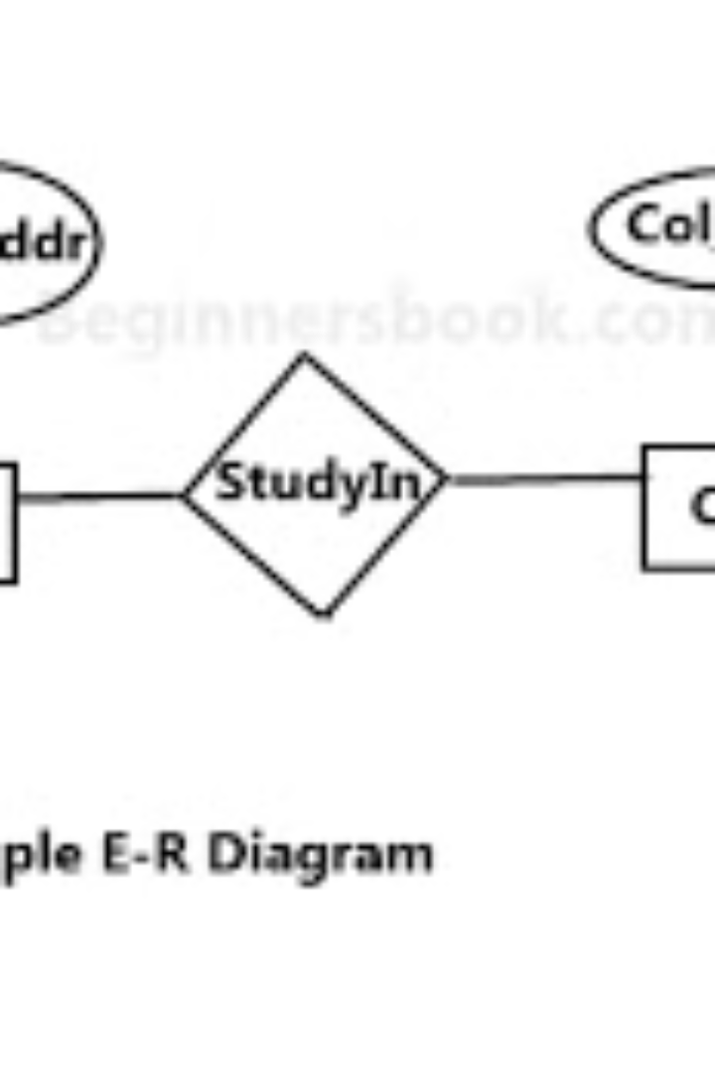
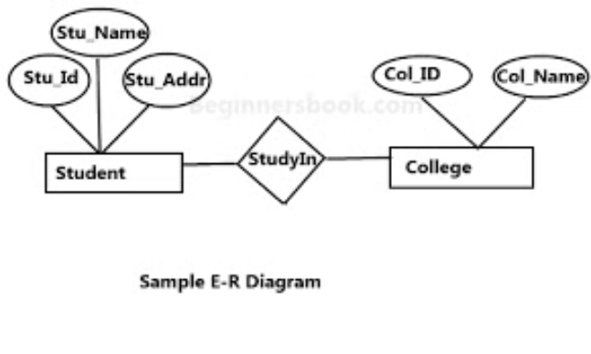
Key Components of an ERD
An Entity Relationship Diagram (ERD) is a data modelling technique that visually represents the relationships between the key elements of a database: entities, attributes, and relationships.
Entities are the primary objects or concepts being modeled, such as customers, products, or orders. Attributes are the specific characteristics or properties that describe each entity. Relationships define how the entities interact with one another.

Slide 4
Advantages of using an ERD in database design
1
Visualizes Data Structure
2
Identifies Relationships
An ERD provides a clear, visual representation of the entities, attributes, and relationships within a database, making it easier to understand the data model.
The ERD helps identify the different types of relationships between entities, such as one-to-one, one-to-many, and many-to-many, which is crucial for ensuring data integrity.
3
Facilitates Communication
4
Supports Scalability
The visual nature of an ERD makes it a useful tool for communicating the database design to stakeholders, developers, and other team members, fostering better collaboration.
By clearly defining the data structure, an ERD helps ensure the database can accommodate future growth and changes, making it more scalable.

Slide 5

What are Business Rules in DBMS?
Business rules are the guidelines, policies, and constraints that govern the operations and data management within a database management system (DBMS). These rules ensure the integrity, consistency, and accuracy of data stored in the database.

Slide 6

Identifying and Documenting Business Rules
Identifying and documenting business rules is a crucial step in database design. Business rules are the constraints, policies, and guidelines that govern how an organization operates. They define what data is valid, what relationships exist between entities, and how the system should behave.
The process involves carefully analyzing the organization's requirements, interviewing stakeholders, and extracting the key rules that must be enforced in the database. These rules should be documented in a clear and concise manner, using natural language or a formal specification language.

Slide 7




Incorporating business rules into the ERD
Identify Business Rules
Map to ERD Elements
Validate and Refine
Carefully examine the business requirements to identify all the relevant rules and constraints that must be reflected in the database design.
Translate each business rule into the appropriate constructs within the ERD, such as entity types, attributes, and relationships.
Review the ERD to ensure all business rules are accurately represented, making adjustments as needed to align the model with the requirements.

Slide 8
Differences and Complementary Nature of ERDs and Business Rules
Conceptual vs Logical
Scope and Focus
Flexibility
Synergy
ERDs have a broader, holistic view of the entire database structure. Business rules address specific data-related policies and constraints.
ERDs are more static, representing the core data entities. Business rules can be more dynamic, adapting to changing organizational requirements.
Together, ERDs and business rules provide a comprehensive data model that ensures data integrity, validity, and alignment with business needs.
ERDs represent the conceptual data model, focusing on entities, attributes, and relationships. Business rules describe the logical constraints and validations on the data.

Slide 9



Practical examples of ERDs and business rules
ERD for an Online Store
Business Rules for HR System
ERD and Business Rules in Sync
This ERD illustrates the key entities involved in an e-commerce website, such as customers, orders, and products, and how they interrelate. It provides a blueprint for the database design.
The business rules document outlines critical policies and constraints for an HR management system, covering areas like employee data, leave management, and organizational hierarchy.
This combined diagram demonstrates how an ERD and documented business rules work hand-in-hand to capture the complete data model and operational requirements for a course registration system.

Slide 10

Conclusion and Best Practices for Effective Data Modeling
1
Iterative Process
Data modeling is an iterative process, requiring regular review and refinement as business requirements evolve. Adaptability is key to ensuring the model remains relevant and effective.
2
Collaboration & Communication
Effective data modeling relies on close collaboration between IT professionals and subject matter experts. Clear communication and a shared understanding of business needs are essential.
3
Validation & Testing
Regularly validate the data model against real-world data and test its ability to support desired functionality. This helps ensure the model accurately reflects the business and its needs.

