Slide 1


Introduction to Enhanced Entity Relationship Modeling (EERM)
EERM is a powerful data modeling technique that extends the classic Entity Relationship Diagram (ERD) to capture more complex relationships and structures within an information system. It provides a comprehensive way to visualize and understand the entities, attributes, and connections that make up a database or application.
Notes:
Imagine you're planning a big event like a wedding. You'll need to keep track of a lot of different things: guests, invitations, seating arrangements, vendors, and more. Each of these things is like a piece of information in a system.
Now, think of each piece of information as an "entity." So, guests are one entity, invitations are another, and so on.
In a regular diagram, like a family tree, you might draw lines connecting one person to their parents or siblings. That's a basic version of what's called an Entity Relationship Diagram (ERD). It's like saying "this person is related to these other people in these ways."
Now, let's say you want to get more detailed. You not only want to know who's related to who, but also how they're related. For example, you might want to know if someone is a friend, a colleague, or a relative. That's where Enhanced Entity Relationship Modeling (EERM) comes in.
With EERM, you can capture more complex relationships and structures. So, going back to our wedding example, you might want to track not just who's coming to the wedding, but also how they're related to the bride and groom – are they family, friends, coworkers, or something else?
In simple terms, EERM helps you see the bigger picture and understand how different pieces of information are connected in more detail. It's like having a more detailed map that shows not just the roads, but also the landmarks, traffic lights, and shortcuts – all the things that help you navigate a complex system more effectively.

Slide 2
Types of EERM Diagrams
Conceptual EERM Diagram: Depicts the high-level entities, their attributes, and the relationships between them in a business domain.
Logical EERM Diagram: Translates the conceptual model into a more detailed representation, including data types, keys, and normalization.
Physical EERM Diagram: Represents the actual implementation of the database, including table structures, indexes, and other physical design elements.
Notes:
Conceptual EERM Diagram:
Definition: A conceptual EERM diagram depicts the high-level entities, their attributes, and the relationships between them in a business domain. It focuses on understanding the overall structure of the information system without getting into specific technical details.
Example: Imagine you're designing a system for a library. In the conceptual EERM diagram, you'd identify entities like "Book," "Author," "Member," and "Borrowing." You'd also define the relationships between these entities – for instance, a book can be written by one or more authors, and each member can borrow multiple books.
Logical EERM Diagram:
Definition: A logical EERM diagram translates the conceptual model into a more detailed representation, including data types, keys, and normalization. It's a step closer to the actual database design, but still abstracted from the physical implementation.
Example: Continuing with the library system example, in the logical EERM diagram, you'd specify details like the data type of each attribute (e.g., book title as a string, publication date as a date), primary and foreign keys to establish relationships between tables, and normalization to ensure efficient data storage and retrieval. You'd also refine the cardinality of relationships – for example, specifying that each book can have multiple authors, but each author can contribute to many books.
Physical EERM Diagram:
Definition: A physical EERM diagram represents the actual implementation of the database, including table structures, indexes, and other physical design elements. It's closely tied to the specific database management system being used.
Example: Now, in the physical EERM diagram for the library system, you'd translate the logical model into the actual database tables, specifying details like column names, data types, constraints, and indexes. For instance, you'd create tables for "Book," "Author," "Member," and "Borrowing," with columns corresponding to their attributes. You'd also define primary and foreign key constraints to enforce data integrity, and indexes to optimize query performance.
In summary, the conceptual EERM diagram gives you a big-picture view of the system, the logical EERM diagram delves into the specifics of the data model, and the physical EERM diagram provides the blueprint for the actual database implementation. Each stage adds more detail and specificity, ultimately leading to a fully realized and efficiently designed database system.

Slide 3
Subtypes and Supertypes in EERM
In EERM, subtypes and supertypes are used to model hierarchical relationships between entities. A supertype is a general entity that has more specialized subtypes branching off from it. Subtypes inherit the attributes and relationships of their supertype, allowing for more detailed and nuanced modeling.
Notes:
Supertype as the Bigger Box:
Imagine a supertype as a big nesting doll that holds all the common characteristics. In daily life, this could be the concept of a "Vehicle."
Subtypes as the Specialized Dolls Inside:
Branching off from this "Vehicle" supertype, we have subtypes like "Car," "Truck," and "Motorcycle." These subtypes inherit the general properties of a vehicle (having wheels, an engine) but have their own unique features.
Attributes Inheritance - Sharing and Owning Traits:
All the subtypes inherit common attributes from the supertype. Cars, trucks, and motorcycles all have attributes like a manufacturer, color, and top speed (inherited from "Vehicle").
Subtypes can also have their own unique attributes. Cars might have "number of doors," trucks might have "cargo capacity," and motorcycles might have "engine size" (specific to each subtype).
Relationships - How They Interact:
The supertype can also define relationships that all subtypes inherit. Vehicles can have a relationship with "Roads" (a separate entity).
Examples in Action:
Imagine a car rental service. Their EERM might have a "Vehicle" supertype with attributes like ID, make, model, and daily rate. Subtypes like "Car" and "Truck" would inherit these attributes and add their own (e.g., Car: number of doors; Truck: cargo capacity). This allows for efficient data management as only common info goes in the supertype, while specific details reside in subtypes.
Real-world Benefits:
Using supertypes and subtypes helps avoid data redundancy. You define common features once in the supertype and avoid repeating them for each subtype.
It makes the model more flexible and adaptable. As new vehicle types (e.g., electric scooters) emerge, you can easily create a new subtype without changing the entire structure.
So, supertypes and subtypes in EERM are like a hierarchy in your house. You have a general category like "Furniture" (supertype) with common features like material and color. Then, specific types like "Chair" and "Table" (subtypes) inherit these traits and add their own functionalities. This keeps your data organized and reflects the natural way things are categorized in the real world.

Slide 4

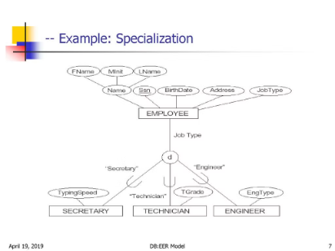
Specialization in EERM
1
Defining Subtypes
Subtypes in EERM are more specialized entities that inherit attributes and relationships from a broader supertype. They allow for modeling nuanced differences within a domain.
2
Disjoint vs Overlapping
Subtypes can be defined as disjoint, where an instance can only belong to one subtype, or overlapping, where an instance can belong to multiple subtypes.
3
Applying Specialization
Specialization is useful for modeling complex hierarchies, such as employee-manager relationships or product categorization. It enhances the expressiveness of the data model.

Slide 5




Generalization in EERM
Supertype
1
The broad, general entity
Subtype 1
2
More specific entity
Subtype 2
3
More specific entity
Subtype 3
4
More specific entity
Generalization in EERM allows you to model a hierarchy, where a supertype entity represents a general concept, and subtypes inherit its attributes and relationships. This enables more precise and expressive data modeling, capturing nuanced distinctions within a domain.

Slide 6
Relationships in EERM
Entity Relationships
Cardinality
EERM models the complex relationships between entities, capturing the connections and dependencies that exist in the real world.
Cardinality specifies the number of instances of one entity that can be associated with a single instance of a related entity.
Recursive Relationships
Associative Entities
EERM allows for modeling recursive relationships, where an entity can be related to itself, such as a manager-employee hierarchy.
EERM supports the creation of associative entities, which represent the relationship between two other entities and can have their own attributes.
Notes:
Entity Relationships: The Connections
Imagine a social media app. Here, "User" and "Post" are entities. A user can create many posts, and a post can be created by one user. This is a one-to-many relationship.
Cardinality: How Many?
One-to-One: A user can have only one profile picture (one-to-one with "Profile Picture" entity).
One-to-Many: A user can follow many other users (one-to-many with "Follows" entity).
Many-to-One: A post can have one category (many-to-one with "Category" entity).
Many-to-Many: A user can be tagged in many posts, and a post can have many tags (many-to-many with "Tags" entity).
Recursive Relationships: When Entities Relate to Themselves
Organizational Hierarchy: An employee (entity) can have one manager (who is also an employee). This creates a self-referential or recursive relationship.
Associative Entities: The Intermediaries
Course Enrollment: Imagine a "Course" entity and a "Student" entity. An "Enrollment" entity captures the relationship between them. It can have its own attributes like "semester" or "grade."
Examples Explained:
Social Media App: A one-to-many relationship between "User" and "Post" depicts how one user can create many posts. Similarly, many users can follow one user (one-to-many with "Follows").
University Course Registration: A many-to-many relationship exists between "Student" and "Course." A student can enroll in many courses, and a course can have many students enrolled.
Bill of Materials: In a manufacturing company, a product (entity) can be composed of many components (another entity). An "Assembly" entity (associative entity) captures this relationship and might have attributes like "quantity" of each component needed.
By understanding these entity relationships and cardinalities, we can effectively model the complex web of connections that exist in real-world scenarios. EERM provides the tools to represent these relationships accurately, ensuring our data models reflect the true nature of the information they manage.

Slide 7
Attributes in EERM
In EERM, attributes are the specific pieces of information that define and describe each entity. These can include unique identifiers, key characteristics, and other details that help paint a comprehensive picture of the entity and its relationships.
Identifiers: Unique codes, numbers, or names that distinguish one entity instance from another.
Characteristics: Descriptive properties like size, color, price, or any other relevant details.
Relationships: Attributes that capture the connections between entities, such as a customer's order history or an employee's manager.
Notes:
Attributes: The Details That Matter
Imagine a library. Here, "Book" is an entity. Attributes of a book could be:
Identifiers: ISBN (unique identifier), Book ID (assigned by the library)
Characteristics: Title, Author, Genre, Publication Year, Number of Pages
Relationships (attributes capturing connections): Borrowing History (list of patrons who borrowed the book)
Breaking it Down:
ISBN: This unique code identifies a specific book edition globally.
Title & Author: These descriptive attributes tell us what the book is about and who wrote it.
Genre: This helps categorize the book (fiction, non-fiction, etc.).
Publication Year & Number of Pages: These provide additional details.
Borrowing History: This captures the relationship between the book and patrons who borrowed it.
More Examples:
Online Store: In an online store, a "Product" entity might have attributes like:
Identifier: Product ID (unique)
Characteristics: Name, Description, Price, Color, Size
Relationships: Reviews (written by customers)
University: A "Student" entity could have:
Identifier: Student ID (unique)
Characteristics: Name, Major, Year
By understanding these different types of attributes, we can create a comprehensive picture of each entity and how they relate to each other. This is crucial for designing effective and informative EER models.
Key Points:
Identifiers uniquely distinguish entities (like ISBN for books).
Characteristics describe the entity's properties (e.g., book title).
Relationship attributes capture connections between entities (e.g., borrowing history for books).
Remember, the specific attributes chosen depend on the domain you're modeling. However, understanding these categories helps you build robust and informative EERM diagrams.

Slide 8
Cardinality in EERM
Cardinality in EERM specifies the numerical relationship between instances of two entities. It defines the minimum and maximum number of instances of one entity that can be associated with a single instance of another entity.
One-to-One
Each instance of an entity is related to at most one instance of another entity, and vice versa.
One-to-Many
Each instance of an entity can be related to multiple instances of another entity, but each instance of the second entity is related to at most one instance of the first.
Many-to-Many
Each instance of an entity can be related to multiple instances of another entity, and each instance of the second entity can also be related to multiple instances of the first.

Slide 9
Advantages of EERM
1
Improved Data Modeling
2
Enhanced Flexibility
EERM allows for more comprehensive and accurate modeling of complex entities, relationships, and business rules, leading to better data integrity and understanding.
The enhanced features of EERM, such as subtypes, supertypes, and associative entities, provide greater flexibility in adapting the data model to changing business requirements.
3
Increased Clarity
4
Optimized Performance
EERM diagrams offer a visually intuitive way to communicate the structure and dependencies within an information system, facilitating better collaboration and understanding among stakeholders.
The detailed physical modeling capabilities of EERM can help identify opportunities for performance optimization, such as indexing and partitioning, leading to more efficient database design.

Slide 10

Conclusion and Key Takeaways
In conclusion, Enhanced Entity Relationship Modeling (EERM) offers a powerful approach to data modeling that goes beyond traditional ER diagrams. By incorporating specialized features like subtypes, supertypes, and associative entities, EERM empowers designers to create more expressive, flexible, and performant database schemas.
The key takeaways from our exploration of EERM include the importance of hierarchical relationships, the ability to model nuanced business rules, and the visual clarity that EERM diagrams provide for communicating system architecture. Leveraging these advanced modeling techniques can lead to significant improvements in data integrity, system adaptability, and stakeholder understanding.

Slide 11

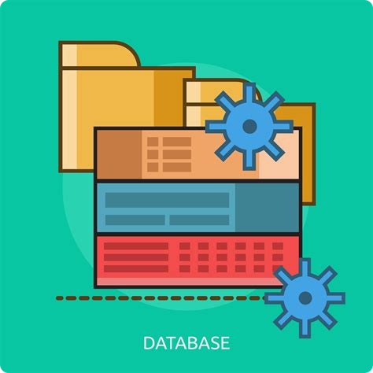
Introduction to Logical Database Design
Logical database design is a crucial step in creating robust and efficient data systems. This phase focuses on transforming conceptual models into a relational representation, ensuring the integrity and consistency of the data.

Slide 12

Relational Model and its Integrity Constraints
The Relational Model organizes data into tables (relations) with rows (tuples) and columns (attributes).
Integrity Constraints are rules that ensure the data remains consistent and valid, including domain constraints, entity integrity, and referential integrity.
These constraints protect the reliability and quality of the data, preventing invalid or contradictory information from being stored in the database.
Notes:
Imagine a Video Rental Store Database:
Tables: We have two main tables: "Movies" and "Rentals."
Movies Table (Like a File Folder): This table has columns (attributes) to describe each movie, like:
MovieID (unique identifier)
Title
Genre
Release Year
Rentals Table (Another File Folder): This table keeps track of who rented which movie:
RentalID (unique identifier)
MovieID (references the Movies table) - This is a foreign key
CustomerID (who rented the movie)
Rental Date
Return Date
Integrity Constraints: The Filing Cabinet Rules
These rules ensure the data makes sense and avoids errors:
Domain Constraints (Like Labeling Folders):
Movie titles must be text (not numbers).
Release year must be a valid year (e.g., not 2050 for a movie not yet released).
Entity Integrity (Ensuring Unique Folders):
MovieID must be unique (no duplicate movies).
RentalID must be unique (no duplicate rentals).
Referential Integrity (Cross-referencing Folders):
The MovieID in the Rentals table must exist in the Movies table (ensuring a valid movie was rented).
Benefits of Constraints:
Data Accuracy: They prevent typos, invalid entries, and contradictory information.
Data Consistency: They maintain relationships between tables (a rental record references an actual movie).
Data Reliability: You can trust the information stored in your database.
Real-life Analogy:
Think of a library. Books (entities) have unique identifiers (call numbers). When you borrow a book (rental record), the library ensures the book exists (referential integrity) and assigns you a unique borrowing record (entity integrity). These rules keep the library's data organized and reliable.
By enforcing integrity constraints, you create a robust and trustworthy database, just like a well-organized filing cabinet ensures you can find the information you need quickly and accurately.

Slide 13

Domain Constraints
Data Type Constraints: Ensure that data stored in each attribute matches the specified data type, such as integers, strings, or dates.
Range Constraints: Limit the acceptable values for an attribute to a specific range, such as ages between 0 and 120 or salaries between $30,000 and $150,000.
Enumeration Constraints: Restrict an attribute to a predefined set of valid values, like gender (male, female, other) or account status (active, inactive, pending).

Slide 14
Entity Integrity
Primary Key Constraint: Ensures that each tuple (row) in a relation (table) has a unique identifier, known as a primary key, to differentiate it from other tuples.
Uniqueness Constraint: Guarantees that the values of a specified attribute or set of attributes are unique across all tuples in a relation.
Not Null Constraint: Requires that an attribute cannot have a null value, ensuring that every tuple has a non-missing value for that attribute.

Slide 15

Referential Integrity
Relationship Constraints: Ensure that relationships between entities are valid and consistent, preventing the creation of "orphan" records without a valid parent.
Cascade Actions: Define how changes to a parent record, such as deletion or updates, should propagate to dependent child records, maintaining data consistency.
Referential Integrity Checks: Continuously monitor the database to identify and resolve any violations of referential integrity, keeping the data structured and reliable.

Slide 16

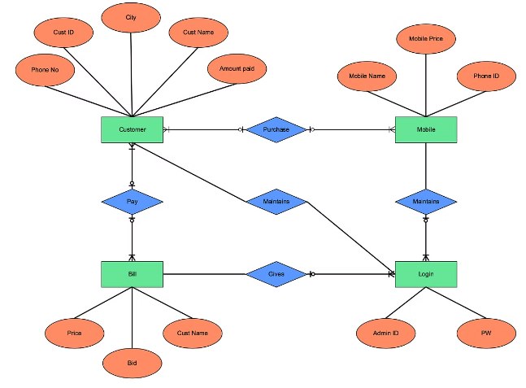
Transforming Entity Relationship Diagrams (ERDs)
Entity Relationship Diagrams (ERDs) are conceptual models that visually represent the entities, attributes, and relationships within a database. Transforming an ERD into a relational schema involves mapping these elements into tables, columns, and foreign key constraints.
The key steps include identifying entities as relations, defining primary keys, and establishing referential integrity through foreign key relationships. This process ensures the logical design seamlessly translates the conceptual model into an efficient, normalized relational database structure.

Slide 17

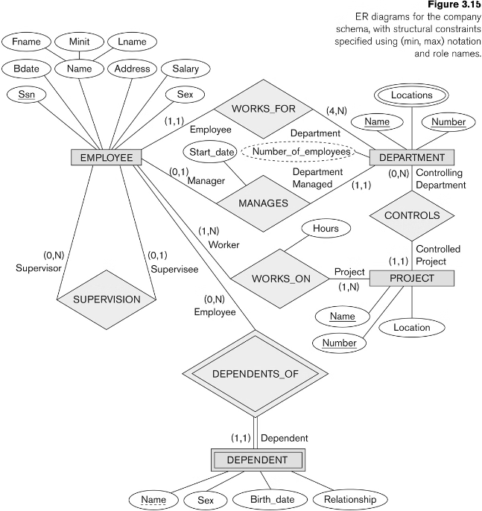
Transforming Enhanced Entity Relationship Diagrams (EERDs)
Enhanced Entity Relationship Diagrams (EERDs) build upon the basic ERD model, adding advanced concepts like inheritance, categories, and specialization. Transforming an EERD into a relational schema involves carefully mapping these complex relationships into a normalized set of tables and constraints.
Key steps include identifying supertype and subtype entities, handling generalization and specialization, and ensuring the integrity of the relational model through appropriate foreign key links and inheritance rules.

Slide 18
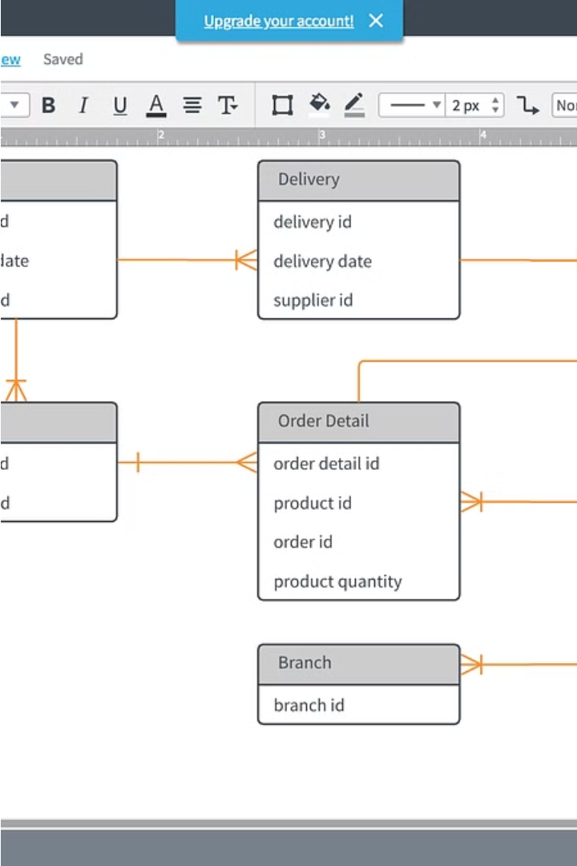
Mapping Entities to Relations
Transforming entities from the conceptual Entity Relationship Diagram (ERD) into relations (tables) in the relational model is a crucial step. Each entity becomes a relation, with its attributes mapped to columns in the table.
The primary key of the entity is designated as the primary key for the relation, ensuring unique identification of each tuple (row).

Slide 19

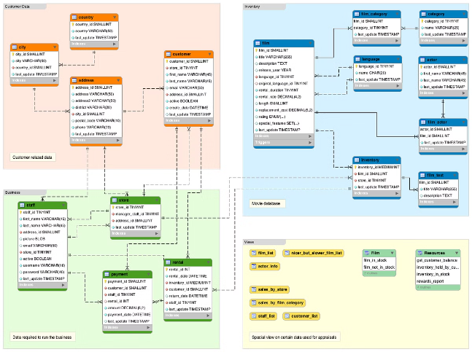
Mapping Relationships to Relations
Transforming the relationships defined in the conceptual Entity Relationship Diagram (ERD) into the corresponding relational schema is a crucial step. Relationships are mapped to foreign key constraints, ensuring referential integrity between related tables.
The cardinality of the relationship, such as one-to-many or many-to-many, determines how the foreign keys are structured to preserve the logical connections between entities.

Slide 20
Conclusion and Key Takeaways
Logical Database Design
Integrity Constraints
Translating conceptual models like ERDs and EERDs into a robust relational database structure is crucial for maintaining data integrity and reliability.
Domain, entity, and referential integrity constraints protect the database from inconsistent, invalid, and contradictory information.
Mapping Entities and Relationships
Optimal Database Structure
Following best practices in logical database design results in a normalized, efficient, and scalable relational database that supports the organization's data needs.
Carefully mapping entities to relations and relationships to foreign key constraints ensures the logical design aligns with the conceptual model.

Slide 21

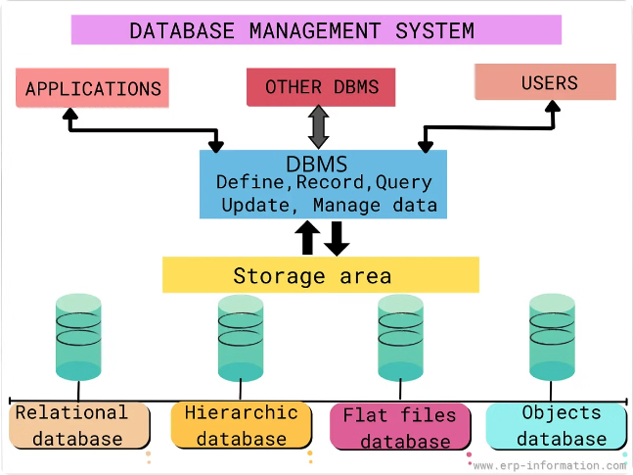
Introduction to Transaction Management and Concurrency Control
Database systems are the backbone of modern applications, handling complex tasks and ensuring data integrity. At the core of this are transactions and concurrency control, which enable reliable, secure, and efficient data processing. This presentation will explore the key principles and best practices in this critical area.

Slide 22

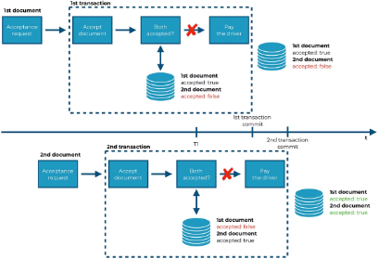
Importance of Transaction Management in Database Systems
1
Data Integrity
Transactions ensure that database updates are completed fully or not at all, preventing partial or inconsistent changes.
2
Reliability
Transactions provide a way to recover from failures, rolling back incomplete changes and restoring the database to a valid state.
3
Concurrency
Concurrency control mechanisms allow multiple users to access the database simultaneously without conflicting with each other.

Slide 23
ACID Properties of Transactions
Atomicity
Consistency
Isolation
Transactions are executed as a single, indivisible unit of work. Either the entire transaction completes or none of it does.
Transactions preserve the integrity of the database by ensuring that data remains in a valid state before and after execution.
Concurrent transactions are isolated from each other, as if they were running independently, even when they access the same data.

Slide 24
Locking Mechanisms for Concurrency Control
1
Shared Locks
2
Exclusive Locks
Allow multiple transactions to read the same data simultaneously, but prevent modifications.
Allow a single transaction to read and modify data, preventing access by other transactions.
3
Intention Locks
4
Escalation
Indicate that a transaction plans to acquire locks on lower-level objects, such as rows or pages.
Upgrading from fine-grained locks to coarser-grained locks to improve performance.

Slide 25
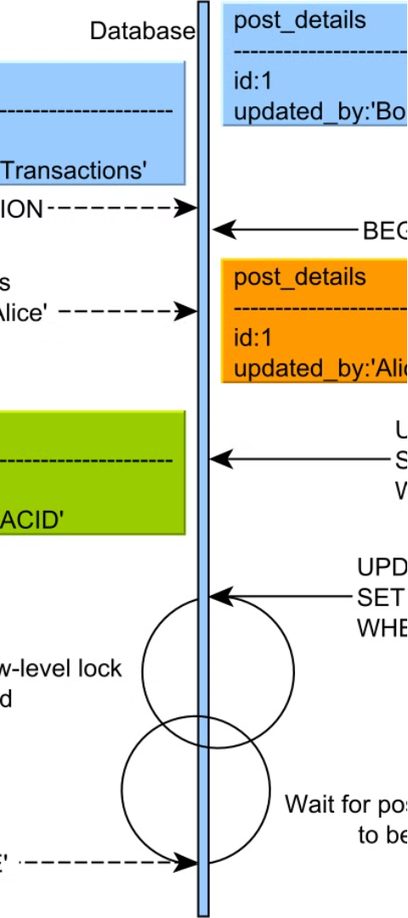

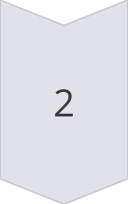
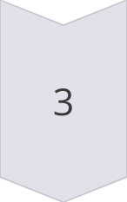
Deadlock Detection and Resolution
Detection
Algorithms like Wait-for Graph and Deadlock Cycle Detection identify deadlock situations.
Avoidance
Strategies like Deadlock Prevention and Deadlock Victim Selection help avoid deadlocks.
Resolution
Deadlocks are resolved by rolling back one or more transactions to break the cycle.

Slide 26
Isolation Levels in Database Transactions
Read Uncommitted
Read Committed
The least restrictive level, allowing transactions to read data that has been modified but not yet committed.
Transactions can only read data that has been committed, preventing them from seeing partial updates.
Repeatable Read
Serializable
Transactions see a consistent snapshot of the data, preventing phantom reads and non-repeatable reads.
The strictest level, ensuring that transactions are executed in a way that produces the same result as if they were executed serially.

Slide 27
Optimistic vs. Pessimistic Concurrency Control
Optimistic
Pessimistic
Hybrid
Allows concurrent access, but detects and resolves conflicts at commit time. Suitable for low-contention environments.
Acquires locks to prevent conflicts, ensuring data integrity but potentially reducing concurrency. Suitable for high-contention environments.
Combines optimistic and pessimistic approaches, leveraging the strengths of both to achieve better performance and reliability.

Slide 28

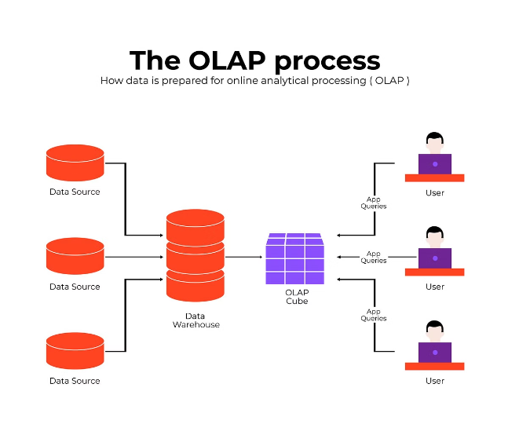
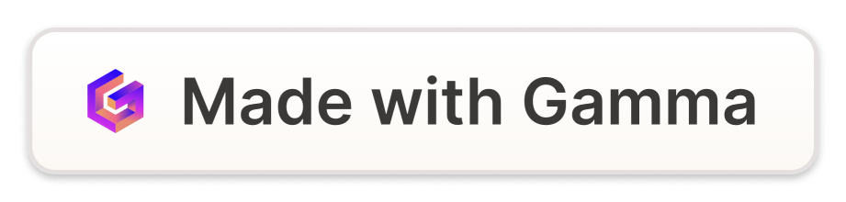
Introduction to Data Mining, Data Warehousing, OLAP, and OLTP
Explore the fundamental concepts of data mining, data warehousing, online analytical processing (OLAP), and online transaction processing (OLTP). Understand how these technologies work together to unlock valuable insights from complex data.

Slide 29
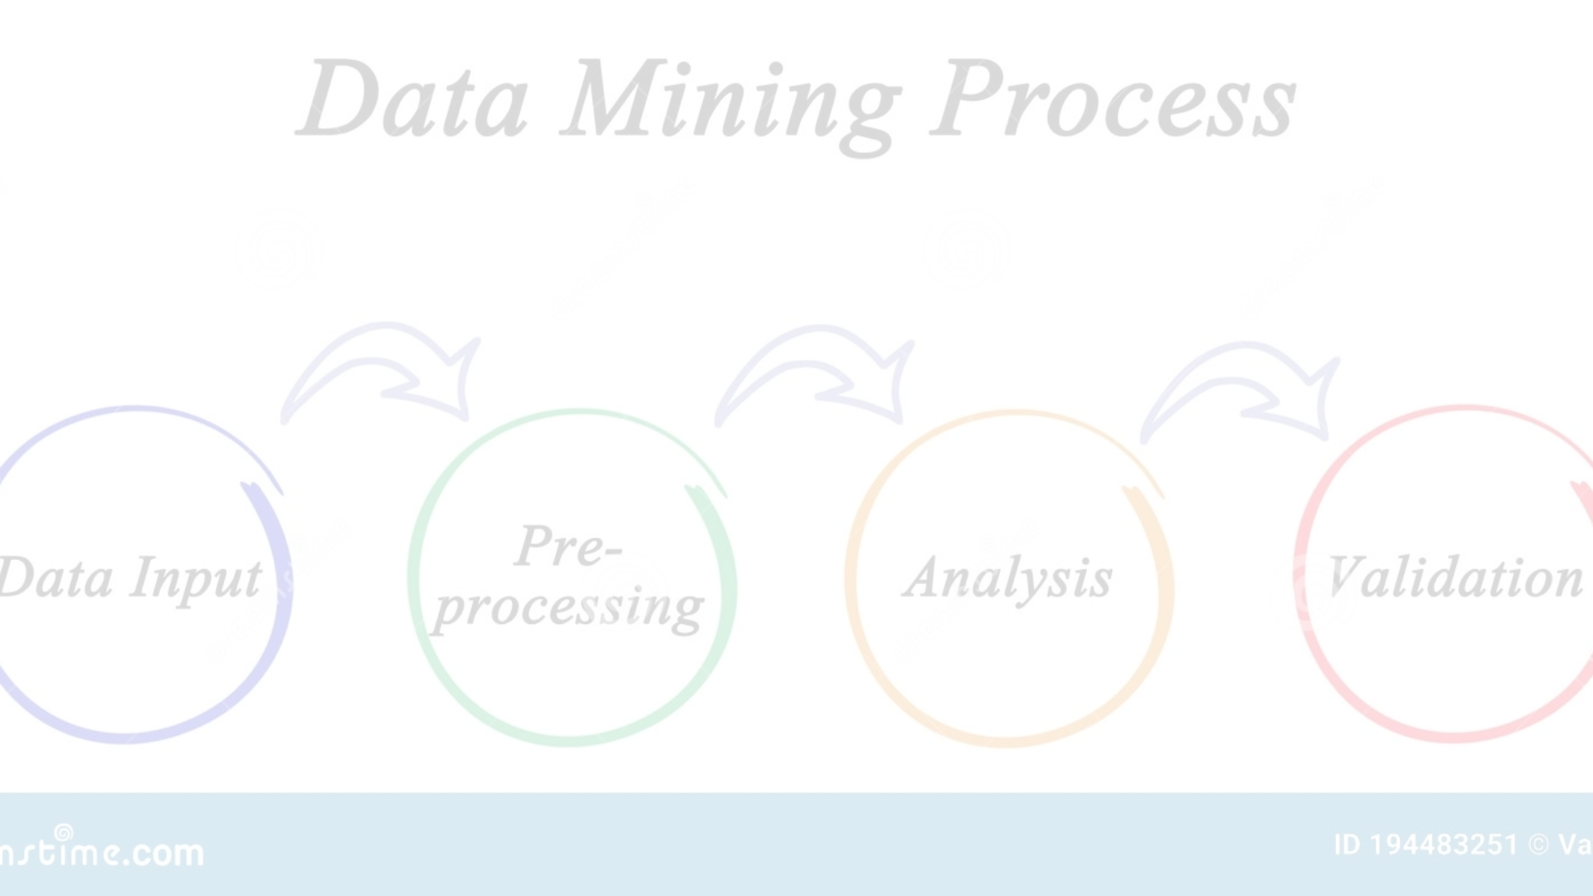
What is Data Mining?
Data mining is the process of extracting valuable insights and patterns from large, complex datasets. It involves using advanced analytical techniques to uncover hidden relationships, trends, and predictions that can drive informed decision-making. Data mining enables organizations to gain a deeper understanding of their data and unlock new business opportunities.

Slide 30

Fundamentals of Data Warehousing
Consolidation of Data: A data warehouse aggregates data from various sources, such as operational databases, into a centralized repository for analysis and reporting.
Multidimensional Data Model: Data warehouses utilize a multidimensional data model, where data is organized into dimensions (e.g., time, product, customer) and facts (quantitative measurements).
Historical Data: A key characteristic of a data warehouse is the ability to store and analyze historical data, enabling organizations to identify trends and patterns over time.

Slide 31

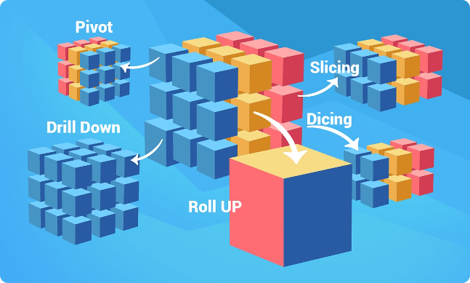
OLAP (Online Analytical Processing)
OLAP is an analytical approach that enables users to explore and analyze multidimensional data from various perspectives. It allows for the quick and flexible querying and manipulation of large datasets, enabling informed decision-making based on real-time insights.
OLAP systems utilize a multidimensional data model, which organizes data into cubes with dimensions and measures, facilitating complex, ad-hoc queries and advanced data analysis.

Slide 32

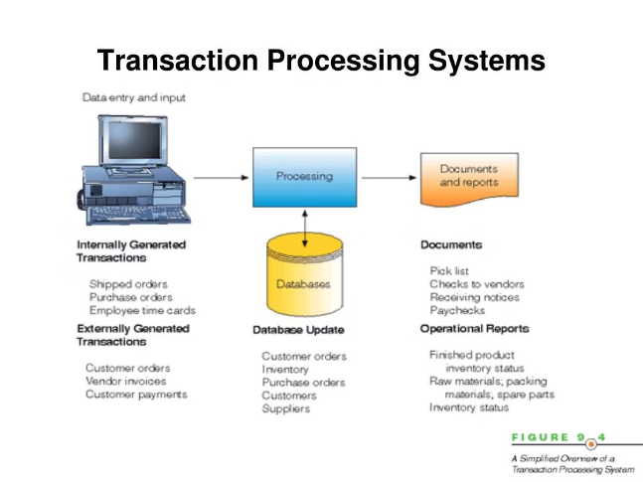
OLTP (Online Transaction Processing)
OLTP systems are designed to handle high-volume, low-latency transactions in real-time. They focus on efficiency, consistency, and reliability for mission-critical business operations like order processing, banking transactions, and inventory management.
OLTP systems prioritize transactional integrity, ensuring data accuracy and atomicity through features like locking, logging, and rollbacks. They enable rapid data entry, retrieval, and updates to support critical day-to-day business activities.

Slide 33
Differences between OLAP and OLTP
Purpose
Data Structure
Query Complexity
Performance
OLAP systems are designed for analytical and decision-support tasks, while OLTP systems focus on the execution of day-to-day business transactions.
OLAP utilizes a multidimensional data model organized into cubes, while OLTP relies on a relational database structure optimized for transactional efficiency.
OLAP systems prioritize query speed and data analysis, while OLTP systems focus on high transaction throughput and low latency for real-time processing.
OLAP supports complex, ad-hoc queries that involve data aggregation and analysis, while OLTP handles simpler, predefined queries for routine business operations.

Slide 34

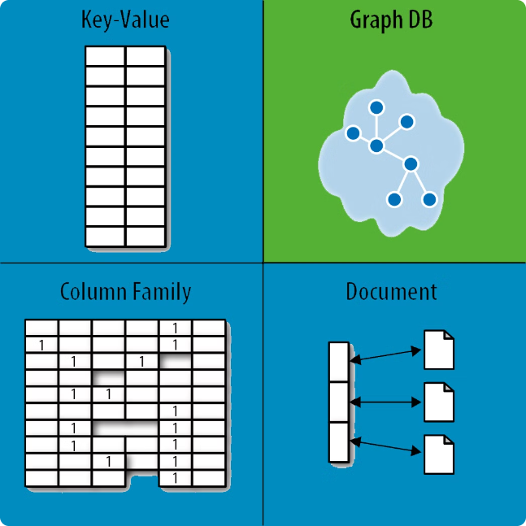
Introduction to NoSQL Databases
NoSQL databases offer a flexible, scalable alternative to traditional relational databases. They are designed to handle large, unstructured datasets and provide high availability and rapid querying capabilities for modern data-intensive applications.

Slide 35

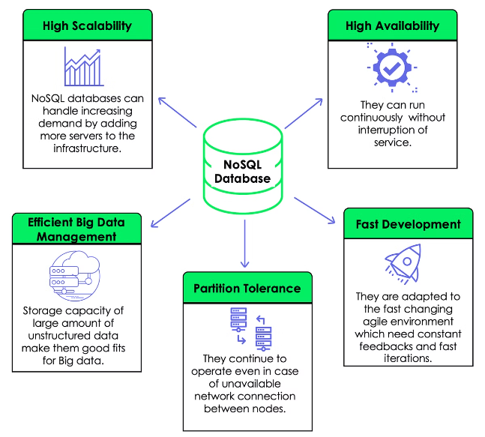
Advantages and Use Cases of NoSQL
Flexible Data Modeling: NoSQL databases can handle unstructured and semi-structured data, allowing for more flexible data models that adapt to changing requirements.
Scalability and High Availability: NoSQL systems can easily scale horizontally, distributing data and processing across multiple servers, providing high availability and fault tolerance.
Real-Time Processing: NoSQL databases excel at handling high-velocity data streams and enabling real-time analytics, making them well-suited for applications like IoT, social media, and e-commerce.

Slide 36
Database Lifecycle Management
Planning
1
Assess business requirements, define database architecture, and create a comprehensive implementation plan.
2
Design
Design the database schema, data models, and security policies to meet the organization's needs.
Implementation
3
Deploy the database infrastructure, migrate data, and test the system to ensure seamless integration.
4
Maintenance
Continuously monitor, optimize, and maintain the database to ensure optimal performance and uptime.
Evolution
5
Adapt the database to changing business requirements, upgrade software, and implement new features as needed.
6
Retirement
Properly archive and retire outdated databases, ensuring data preservation and compliance with regulations.

Slide 37
Conclusion and Key Takeaways
Comprehensive Overview
Complementary Approaches
This presentation has provided a comprehensive introduction to the key concepts in data mining, data warehousing, OLAP, OLTP, NoSQL databases, and database lifecycle management.
OLAP and OLTP systems serve distinct but complementary purposes, unlocking insights and powering mission-critical operations respectively.
NoSQL Flexibility
Lifecycle Management
NoSQL databases offer a flexible, scalable alternative to traditional relational databases, well-suited for handling unstructured data and enabling real-time processing.
Effective database lifecycle management is essential for ensuring optimal performance, security, and alignment with evolving business needs.

Slide 38




Conclusion and Best Practices
Documentation
Monitoring
Testing
Optimization
Maintain detailed documentation on your transaction management and concurrency control policies.
Continuously monitor your database for potential issues, such as deadlocks or performance degradation.
Thoroughly test your transaction and concurrency control implementations to ensure correctness and efficiency.
Regularly review and optimize your locking strategies, isolation levels, and other concurrency control parameters.

