Slide 1

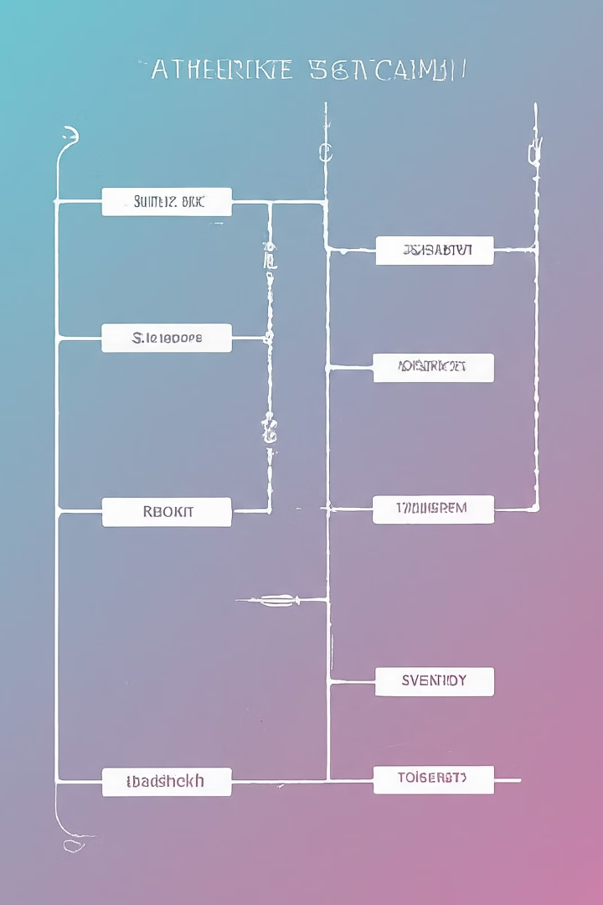
Introduction to Entities and Attributes in Database Management
Entities and their associated attributes are the fundamental building blocks of database design. Understanding these core concepts is essential for effective data management and retrieval.
Ayesha jarral

Slide 2

Defining Entities: What are Entities?
Strong vs week entities
Weak Entities:
Definition:
A weak entity is an entity that cannot exist without being associated with a strong entity. It doesn't have its own unique identifier; instead, it relies on a foreign key which is linked to a strong entity.
Example in Real Life:
Consider a Bank Account as a weak entity. A bank account cannot exist without being associated with a person (a strong entity). The bank account number alone is not enough to uniquely identify an account; it needs the person's identifier (e.g., SSN) to do so.
Summary:
Strong Entity: Can exist on its own, has its own unique identifier.
Weak Entity: Cannot exist without being associated with a strong entity, relies on a foreign key for identification.
I hope this clears up the difference between strong and weak entities!
Entities are the fundamental building blocks of a database. They represent the key objects or concepts that an organization wants to track and manage. Entities can be physical things, such as products or customers, or abstract ideas, like orders or invoices.
Strong Entities:
Definition: A strong entity is an entity that can exist independently of any other entity. It has its own unique identifier (or primary key) that distinguishes it from other entities.
Example in Real Life: Think of a Person as a strong entity. A person can exist on their own and can be identified uniquely by their Social Security Number (SSN) or Passport Number.

Slide 3

Attributes of Entities: Types and Examples
Identifying Attributes - These are the unique characteristics that distinguish one entity from another, such as a customer ID or a product SKU.
Descriptive Attributes - These provide additional details about an entity, such as a customer's name, product description, or order date.
Derived Attributes - These are values that can be calculated or inferred from other attributes, like a customer's age based on their date of birth or a product's total sales based on individual order quantities.
Notes:
Identifying Attributes:
Definition: These are unique characteristics that distinguish one entity from another. They are like the "name tags" that make each entity distinct.
Real-Life Example: Library Books Each book in a library has a unique ISBN (International Standard Book Number). This ISBN serves as an identifying attribute that distinguishes one book from all others in the library.
Descriptive Attributes:
Definition: These provide additional details about an entity, giving us more information beyond just its unique identifier.
Real-Life Example: Library Books Apart from the ISBN, a book also has a title, author, publication year, and genre. These are descriptive attributes that give us more information about the book beyond its ISBN.
Derived Attributes:
Definition: These are values that can be calculated or inferred from other attributes. They are like the "side notes" that we can figure out based on the main information we have.
Real-Life Example: Library Members If you know a person's date of birth, you can calculate their age. In a library system, if you have a member's date of birth, you can derive their age from it without needing an additional "age" attribute.
I hope these examples help clarify the different types of attributes in a straightforward way!

Slide 4

Relationship between Entities and Attributes
Entities and attributes are the fundamental building blocks of database design. Entities represent the main objects or concepts being modeled, while attributes describe the specific characteristics and properties of those entities.
The relationship between entities and attributes is crucial, as attributes provide the detailed information that defines and describes each entity. Entities cannot exist without their associated attributes, and attributes are meaningless without being tied to a specific entity.

Slide 5

Cardinality and Multiplicity in Entity-Attribute Relationships
Cardinality
1
Cardinality defines the numerical relationship between an entity and its attributes. It specifies the minimum and maximum number of attribute instances associated with each entity instance.
2
Multiplicity
Multiplicity describes the possible number of relationships an entity can have with another entity. It represents the degree or strength of the relationship between entities.
Relationship Constraints
3
Cardinality and multiplicity constraints enforce business rules and ensure data integrity by defining the allowed relationships between entities and their attributes.

Slide 6
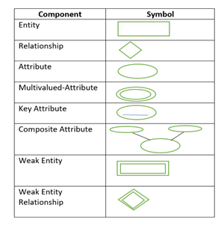
Representing Entities and Attributes in Database Diagrams
Database diagrams, such as Entity-Relationship Diagrams (ERDs), provide a visual representation of the entities and their attributes in a database system. These diagrams help designers and developers understand the structure and relationships between different data elements.
Entities are depicted as rectangles, and their attributes are listed inside the rectangle. Relationships between entities are shown using lines and connectors, indicating the type and cardinality of the relationship.

Slide 7




Conceptual Data Modeling: Entity-Relationship Diagrams (ERDs)
Entity-Relationship Modeling
Graphical Notation
Identifying Entities
Modeling Relationships
ERDs use a standardized graphical notation to depict entities as rectangles, attributes as ovals, and relationships as diamond-shaped connectors.
The process begins by identifying the key entities or "things" that the database needs to represent, such as customers, orders, or products.
Relationships between entities are then defined, including their cardinality (one-to-many, many-to-many, etc.) and the type of relationship (e.g., parent-child).
Entity-Relationship Diagrams (ERDs) are a conceptual data modeling technique that visually represent the entities, attributes, and relationships in a database.

Slide 8
Types of relationships
Real-Life Example: Students and Courses Many students can enroll in many courses, and each course can have many students.
Cardinality:
Definition: Cardinality specifies the number of instances of one entity that can or must be associated with each instance of another entity.
Real-Life Example: Library Members and Books A library member can borrow many books (1:N), but each book can be borrowed by only one member at a time.
In summary, an ERD is a visual tool that helps us understand how different entities in a database are related to each other, and what attributes each entity has. It uses rectangles for entities, lines for relationships, and annotations to describe the type and cardinality of relationships.
Types of Relationships:
One-to-One (1:1):A single instance of an entity is related to a single instance of another entity.
Real-Life Example: Person and Passport One person can have only one passport, and each passport belongs to one person.
One-to-Many (1:N):A single instance of an entity is related to multiple instances of another entity.
Real-Life Example: Author and Books One author can write multiple books, but each book is written by one author.
Many-to-Many (M:N):Multiple instances of an entity are related to multiple instances of another entity.

Slide 9
Logical Data Modeling: Translating ERDs into Relational Schemas
Once the conceptual data model has been established using an Entity-Relationship Diagram (ERD), the next step in database design is to translate the ERD into a logical data model, specifically a relational schema. This process involves mapping the entities, attributes, and relationships into tables and columns within a relational database.
ERD Concept
Relational Schema Mapping
Entities
Tables, with each entity represented as a table
Attributes
Columns within the tables, with each attribute represented as a column
Relationships
Foreign key constraints between tables, representing the relationships
The process of translating an ERD into a relational schema requires careful consideration of data types, primary and foreign keys, and normalization principles to ensure a robust and efficient database design.

Slide 10
Importance of Proper Entity and Attribute Design
1
Data Integrity
2
Query Optimization
Well-designed entities and attributes ensure data integrity by establishing clear boundaries and relationships, reducing redundancy and inconsistencies in the database.
Thoughtful entity and attribute modeling enables efficient database queries, improving performance and responsiveness of applications that rely on the data.
3
Scalability and Flexibility
4
Reporting and Analytics
A robust entity-attribute structure allows the database to scale and evolve to accommodate growing data and changing business requirements over time.
Proper entity and attribute design facilitates accurate and meaningful reporting, enabling better data-driven decision making for the organization.

Slide 11

Conclusion: Best Practices for Entity and Attribute Management
In conclusion, effective entity and attribute management is crucial for building robust and scalable database systems. By following best practices such as clearly defining entities, properly assigning attributes, and establishing strong relationships, organizations can ensure the integrity and efficiency of their data infrastructure.

