Slide 2
Objectives Overview
Differentiate among laptops, tablets, desktops, and servers
Describe the purpose and uses of smartphones, digital cameras, portable and digital media players, e-book readers, wearable devices, and game devices
Explain the purpose of a browser, a search engine, and an online social network
Differentiate the web from the Internet, and describe the relationship among the web, webpages, websites, and web servers
Briefly explain various input options
Describe the relationship between data and information
See Page 2
for Detailed Objectives

Slide 3
Objectives Overview
Briefly describe digital security risks associated with viruses and other malware, privacy, your health, and the environment
Differentiate between an operating system and applications
Differentiate between wired and wireless technologies, and identify reasons individuals and businesses use networks
Discuss how society uses technology in education, government, finance, retail, entertainment, health care, science, travel, publishing, and manufacturing
Identify technology used by home users, small/home office users, mobile users, power users, and enterprise users
See Page 2
for Detailed Objectives

Slide 4
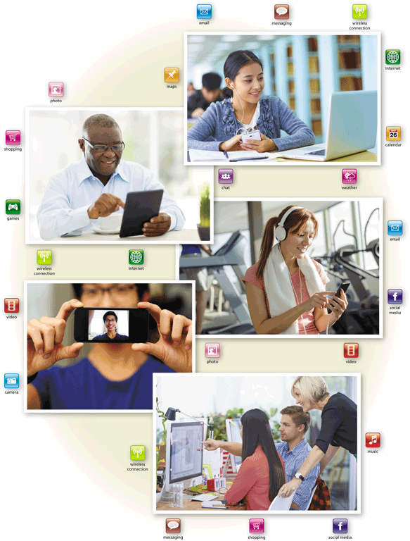
Today’s Technology
Because technology changes, you must keep up with the changes to remain digitally literate
Digital literacy involves having a current knowledge and understanding of computers, mobile devices, the web, and related technologies
Pages 2 - 3
Figure 1-1

Slide 5
Computers
A computer is an electronic device, operating under the control of instructions stored in its own memory
Accepts data (input)
Processing
Producesinformation(output)
Page 4

Slide 6
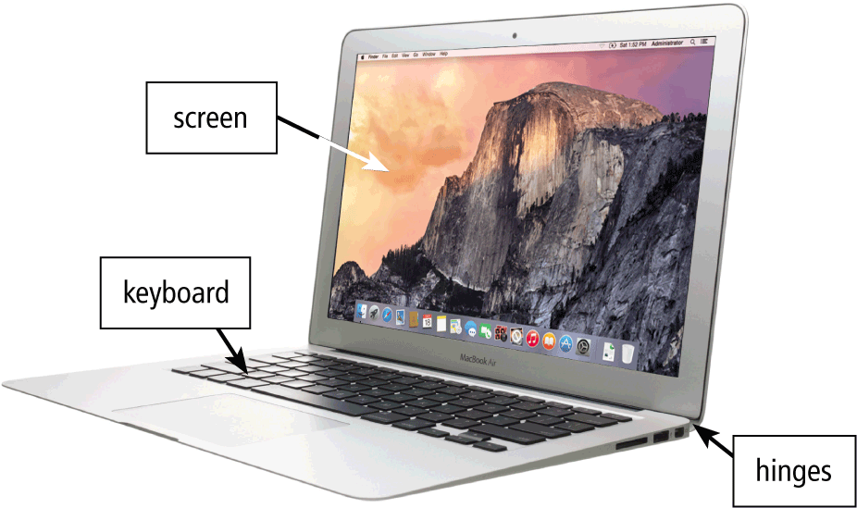
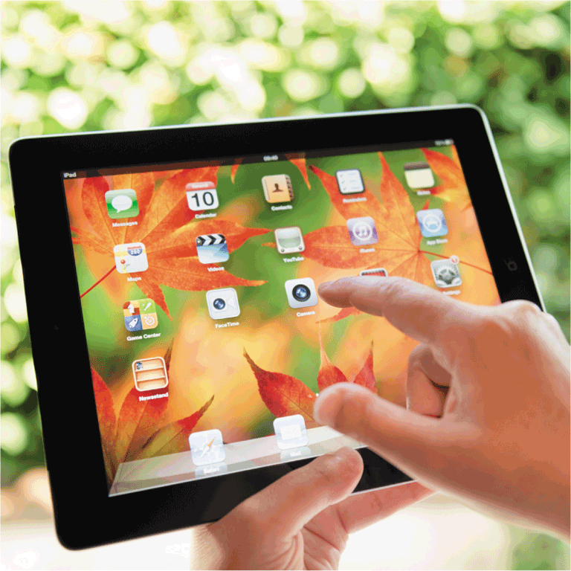
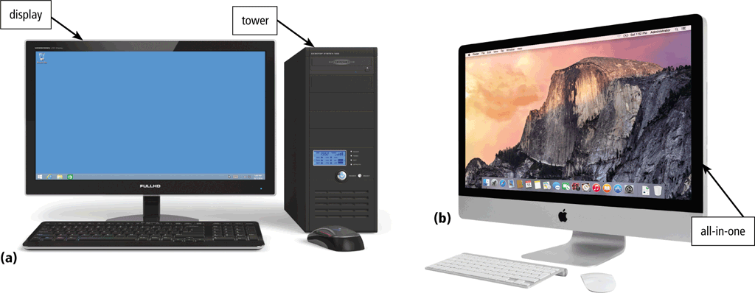
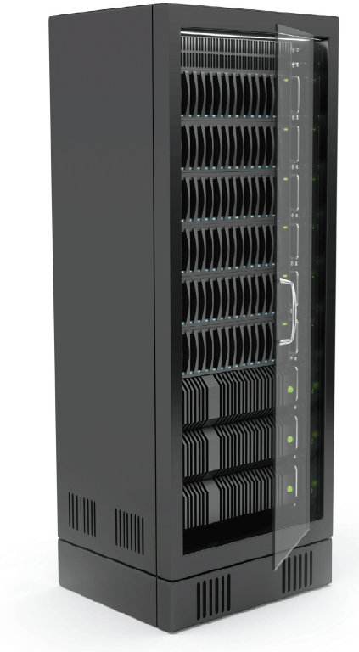
Computers
Laptop
Tablet
Desktop and All-in-One
Server
Pages 4 and 6
Figures 1-2 – 1-5

Slide 7
Mobile and Game Devices
Smartphone
Digital camera
Portable and digital media player
E-book reader
Game device
Wearable device
Pages 7 - 10
Figures 1-6 – 1-11

Slide 8
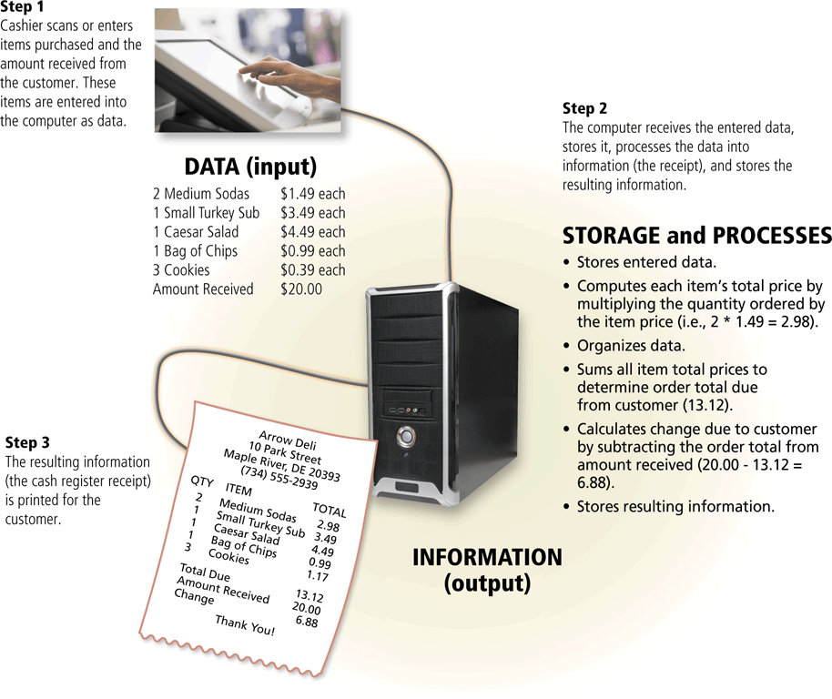
Data and Information
Page 12
Figure 1-12

Slide 9
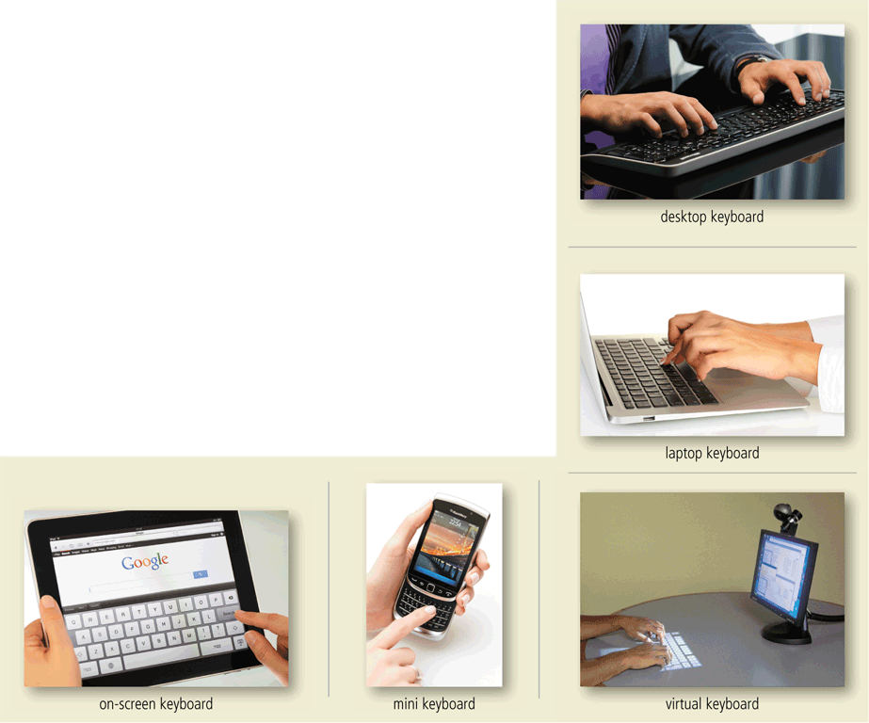
Data and Information
A keyboard contains keys you press to enter data and instructions into a computer or mobile device
Page 13
Figure 1-13

Slide 10
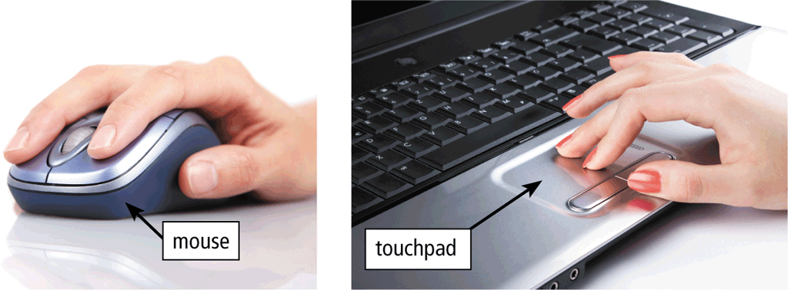
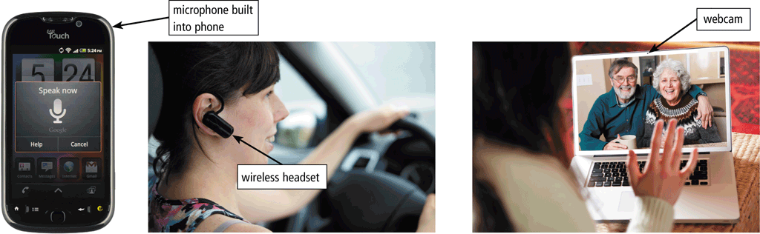
Data and Information
A pointing device is an input device that allows a user to control a small symbol on the screen called the pointer
Some mobile devices and computers enable you to speak data instructions using voice input and to capture live full-motion images using video input
Pages 13 – 14
Figures 1-14 – 1-15

Slide 11
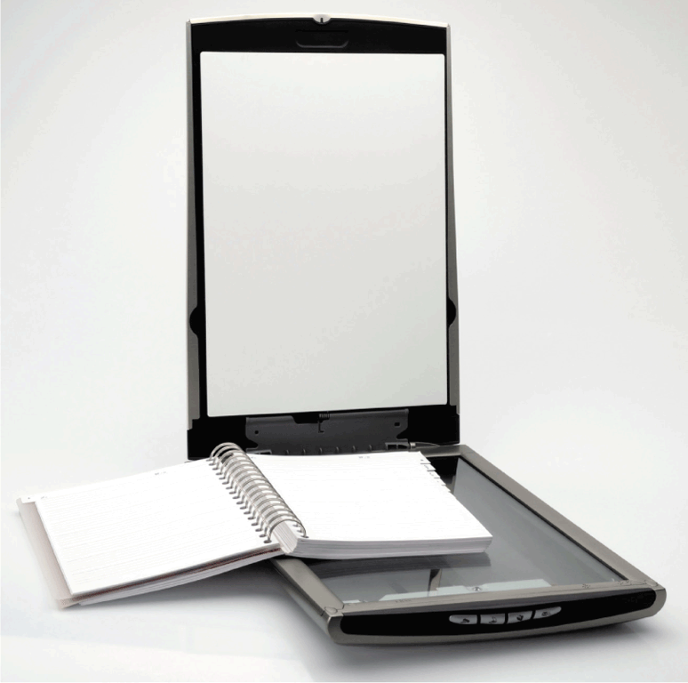
Data and Information
A scanner is a light-sensing input device that converts printed text and images into a form the computer can process
Page 14
Figure 1-16

Slide 12
Data and Information
An output device is any hardware component that conveys information from a computer or mobile device to one or more people
A printer is an output device that produces text and graphics on a physical medium, such as paper or other material
A 3-D printer can print solid objects, such as clothing, prosthetics, eyewear, implants, toys, parts, prototypes, and more
Pages 14 - 15

Slide 13
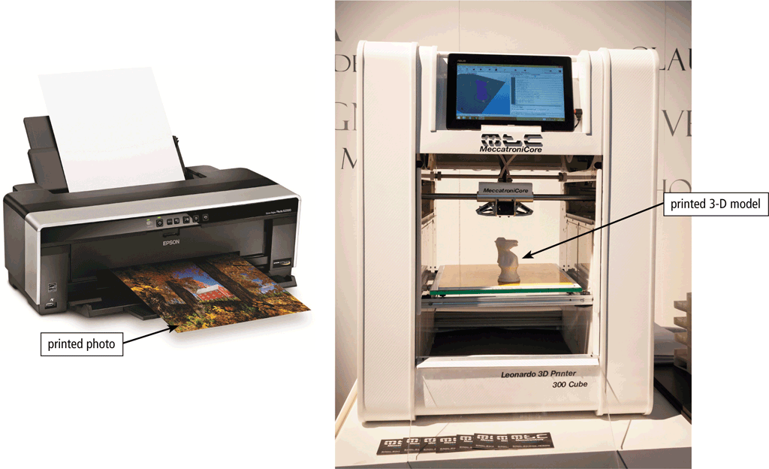
Data and Information
Page 15
Figure 1-17

Slide 14
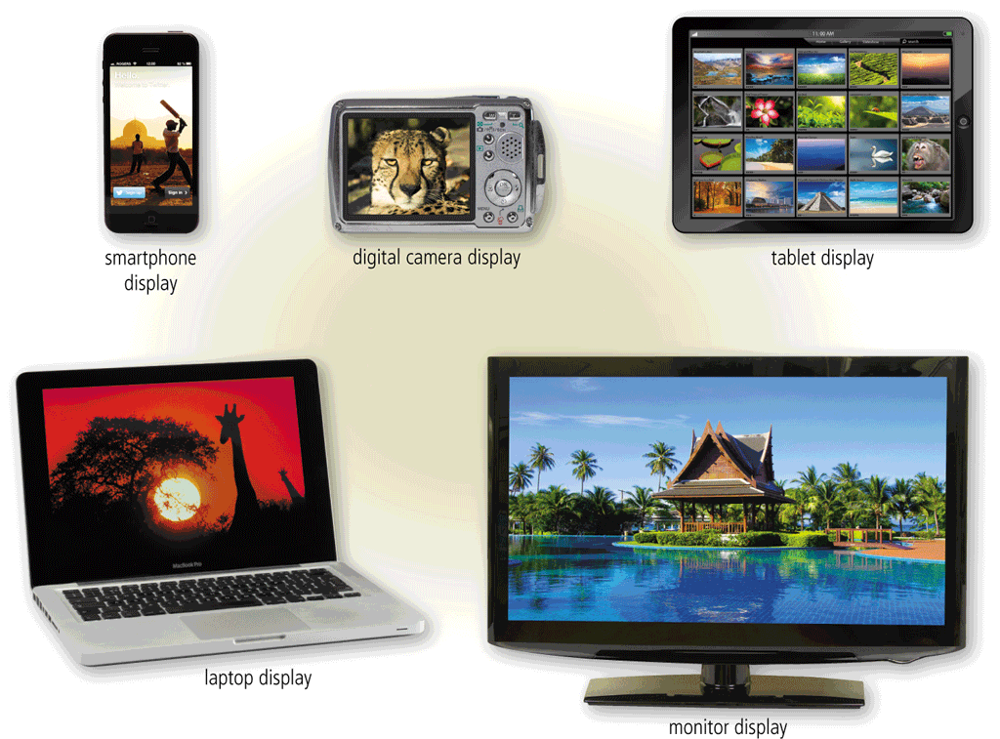
Data and Information
A display is an output device that visually conveys text, graphics, and video information
Page 15
Figure 1-18

Slide 15
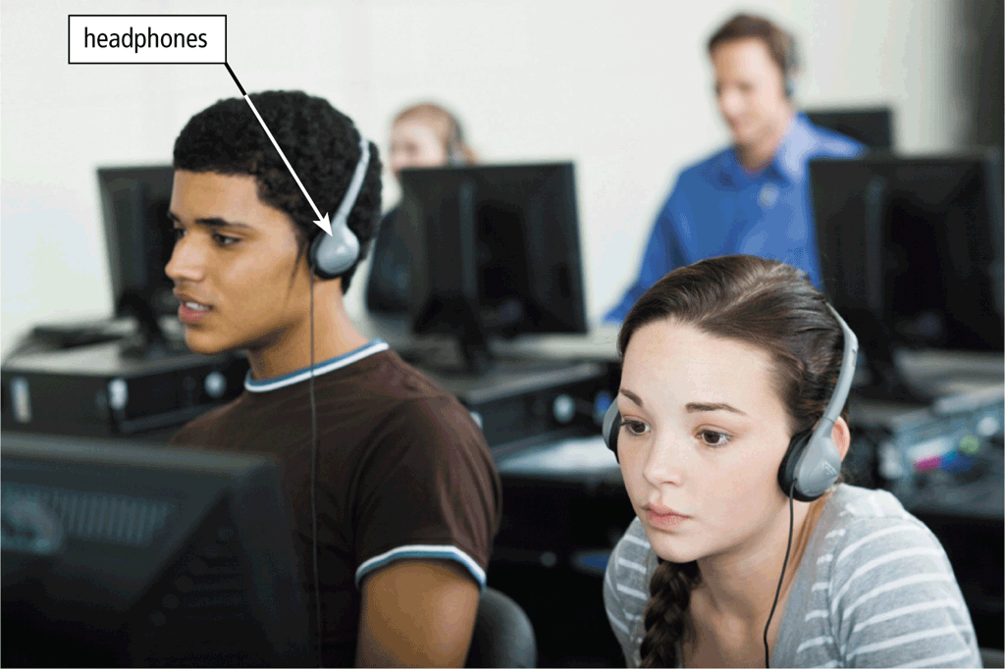
Data and Information
Speakers allow you to hear audio such as music, voice, and other sounds
Earbuds
Headphones
Page 16
Figure 1-19

Slide 16
Data and Information
Memoryconsists of electronic components that store instructions waiting to be executed and the data needed by those instructions
A computer keeps data, instructions, and information onstorage media
Astorage devicerecords (writes) and/or retrieves (reads) items to and from storage media
Pages 16 - 17

Slide 17
Data and Information
Hard Disk
Solid-State Drive
USB Flash Drive
Memory Card
Optical Disc
Cloud Storage
Pages 17 – 19
Figures 1-20 – 1-26
Notes:
HDD: A hard disk drive (HDD) is an old-school storage device that uses mechanical platters and a moving read/write head to access data.
SSD: A solid-state drive (SSD) is a newer, faster type of device that stores data on instantly-accessible memory chips.

Slide 18
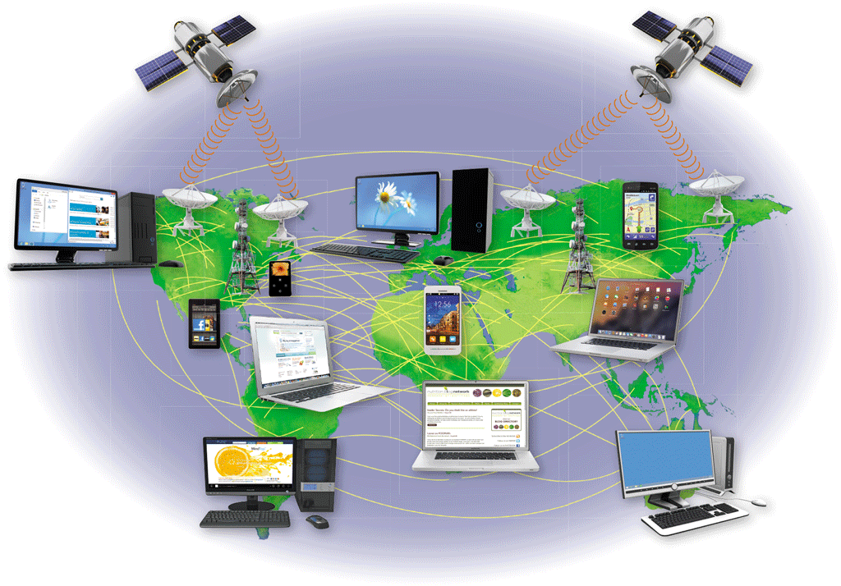
The Web
The Internet is a worldwide collection of computer networks that connects millions of businesses, government agencies, educational institutions, and individuals
Page 20
Figure 1-27

Slide 19
The Web
The World Wide Web (or web, for short) is a global library of information available to anyone connected to the Internet
Thewebconsists of a worldwide collection of electronic documents, each of which is called awebpage
Awebsiteis a collection of related webpages
Aweb serveris a computer that delivers requested webpages to your computer
Pages 20 – 21

Slide 20
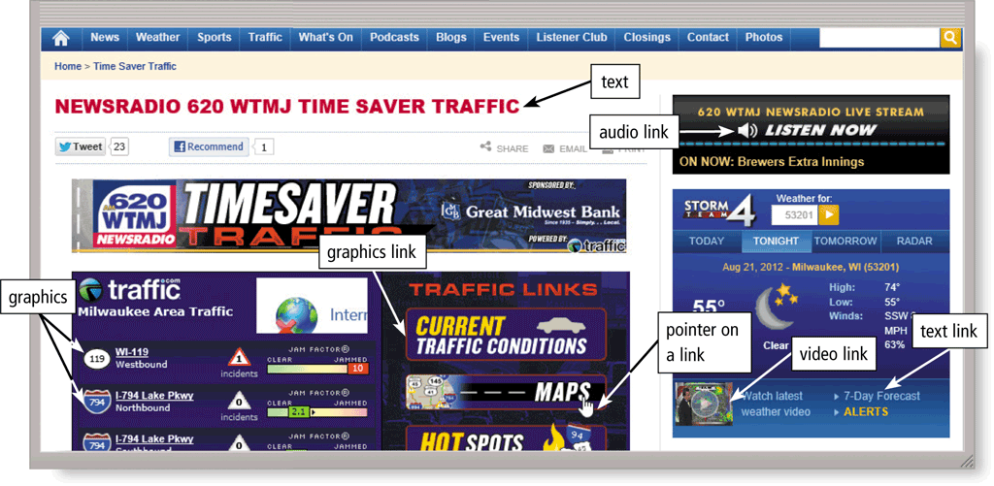
The Web
Page 19
Figure 1-26

Slide 21
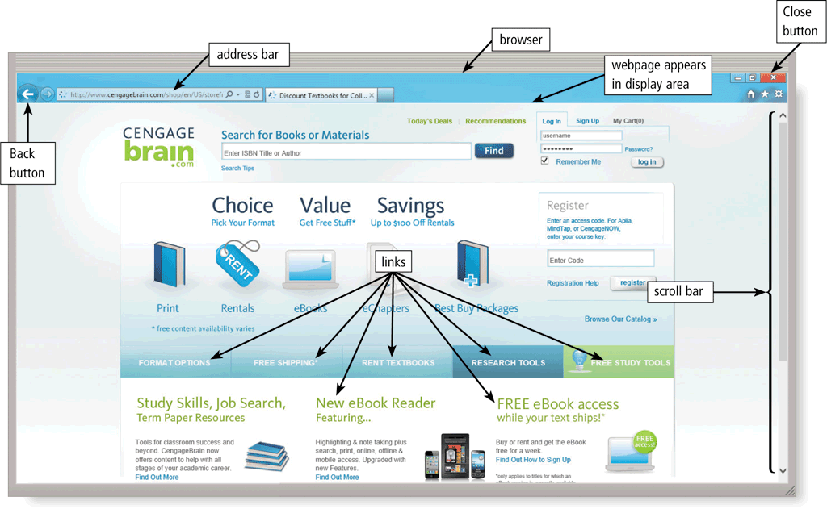
The Web
A browser is software that enables users with an Internet connection to access and view webpages on a computer or mobile device
Page 21

Slide 22
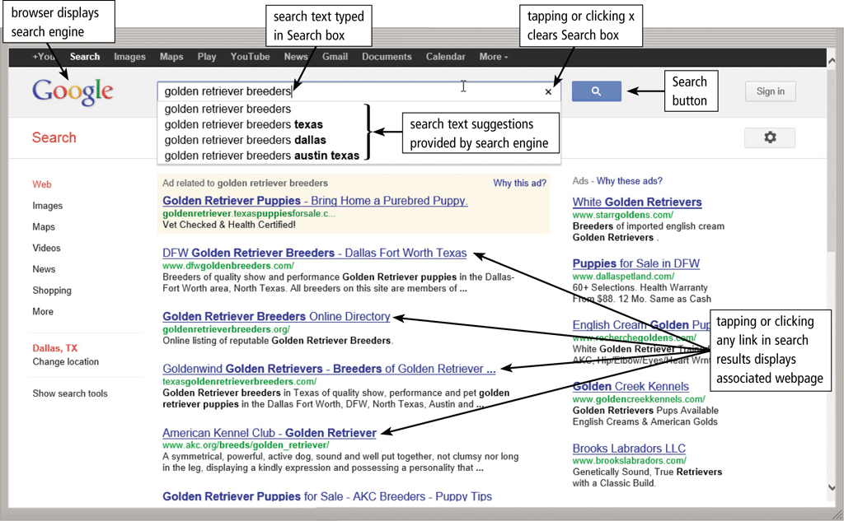
The Web
A search engine is software that finds websites, webpages, images, videos, news, maps, and other information related to a specific topic
Page 22

Slide 23
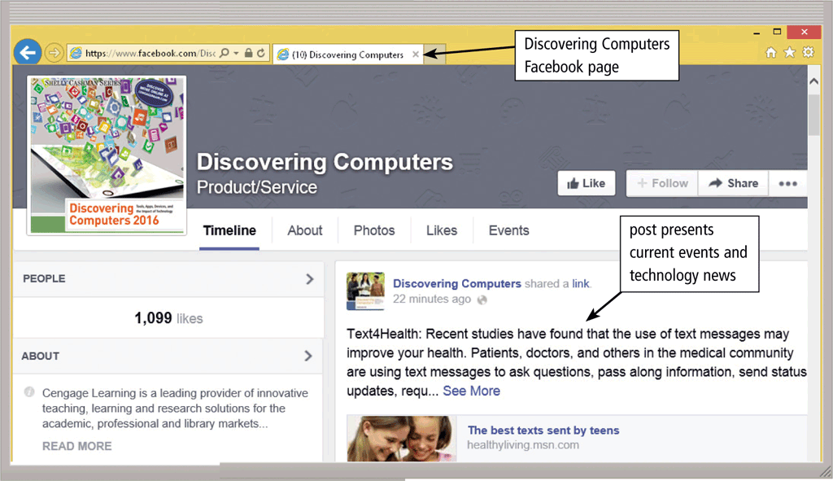
The Web
An online social network encourages members to share their interests, ideas, stories, photos, music, and videos with other registered users
Page 23
Figure 1-29

Slide 24
Digital Safety and Security
It is important that users protect their computers and mobile devices
Viruses and Other Malware
Privacy
Health Concerns
Environmental Issues
Pages 24 - 26

Slide 25
Digital Safety and Security
Green computing involves reducing the electricity consumed and environmental waste generated when using a computer
Strategies include:
Recycling
Using energy efficient hardware and energy saving features
Regulating manufacturing processes
Extending the life of computers
Immediately donating or properly disposing of replaced computers
Page 26

Slide 26
Programs and Apps
Software, also called a program, tells the computer what tasks to perform and how to perform them
System Software
Operating system
Tools
Applications
Pages 26 - 27
Figure 1-30

Slide 27
Programs and Apps
Installing a program is the process of setting up the program to work with the computer, mobile device, printer, and/or other hardware
Once installed, you can run a program so that you can interact with it
You interact with a program through its user interface
Pages 28 - 29

Slide 28
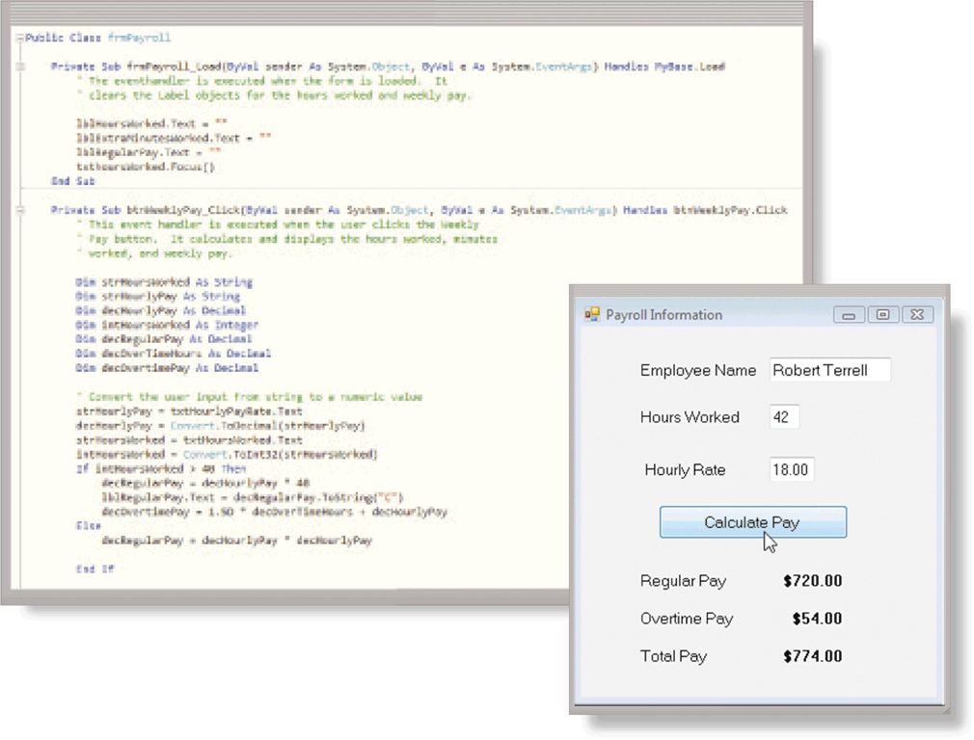
Programs and Apps
A software developer, sometimes called a developer or programmer, is someone who develops programs and apps or writes the instructions that direct the computer or mobile device to process data into information
Pages 29 - 30
Figure 1-31

Slide 29
Communications and Networks
In the course of a day, it is likely you use, or use information generated by, one or more of these communications technologies
Chat rooms
Email
Fax
FTP
GPS
Instant messaging
Internet
Newsgroups
RSS
Videoconference
Voice mail
VoIP
Wireless Internet access points
Wireless messaging services
Pages 30 - 31

Slide 30
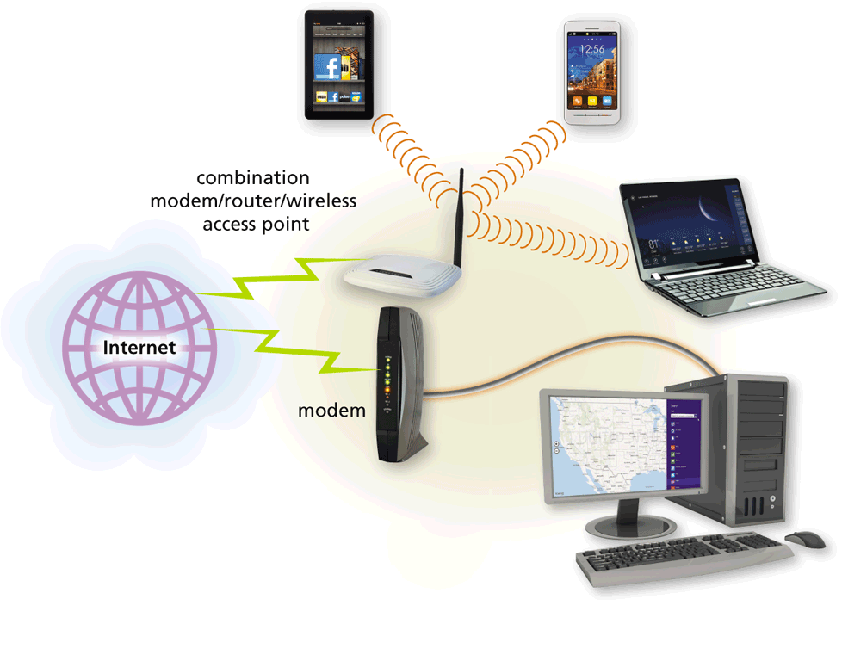
Communications and Networks
A communications device is hardware capable of transferring items from computers and devices to transmission media and vice versa
Page 31
Figure 1-32

Slide 31
Communications and Networks
Examples of wireless communications technologies include:
Wi-Fi
Bluetooth
Cellular radio
Pages 31 - 32

Slide 32
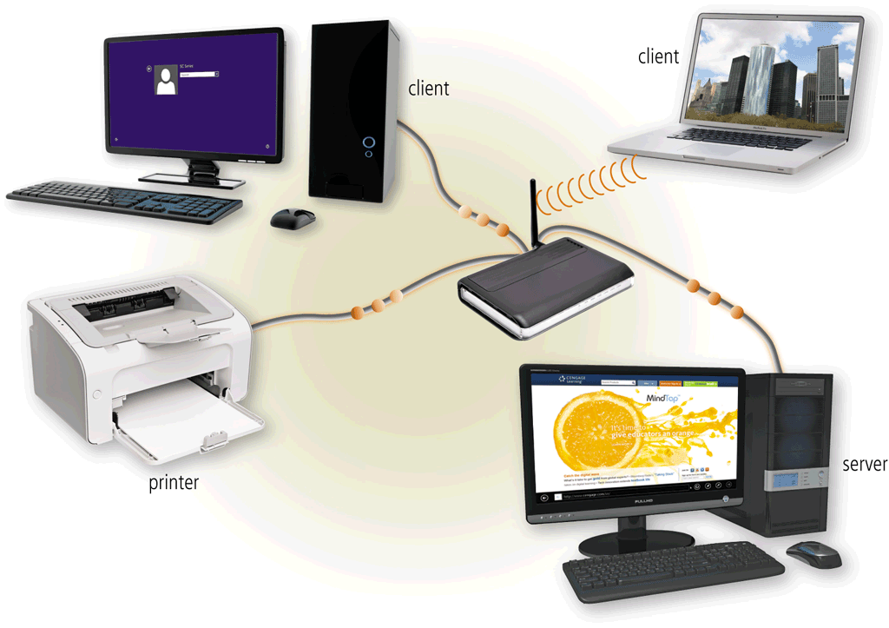
Communications and Networks
A network is a collection of computers and devices connected together, often wirelessly, via communications devices and transmission media
Page 32
Figure 1-33

Slide 33
Communications and Networks
Home Networks
Connect to the Internet
Access photos, music, videos, and other content
Share devices
Connect game consoles to the Internet
Subscribe to and use VoIP
Play multiplayer games
Share a single high-speed Internet connection
Interact with other devices in a smart home
Business Networks
Facilitate communications
Share hardware
Share data, information, and software
Page 33

Slide 34
Technology Uses
Education
Government
Finance
Retail
Entertainment
Health Care
Science
Travel
Publishing
Manufacturing
Pages 35 - 41

Slide 35
Technology Users
Home User
Small/Home Office User
Mobile User
Power User
Enterprise User
Pages 41 - 42

Slide 36
Chapter Summary
Basic computer concepts
Various methods for input, output, memory, and storage
The Internet
Digital security and safety risks and precautions
Uses of technology applications in society
Page 43

Slide 37
Chapter 1 Complete

