Slide 2
Objectives Overview
Describe the various computer and mobile device cases and the contents they protect
Describe multi-core processors, the components of a processor, and the four steps in a machine cycle
Identify characteristics of various personal computer processors on the market today, and describe the ways processors are cooled
Explain the advantages and services of cloud computing
Define a bit, and describe how a series of bits represents data
Explain how program and application instructions transfer in and out of memory
See Page 276
for Detailed Objectives

Slide 3
Objectives Overview
Differentiate among the various types of memory
Describe the purpose of adapter cards and USB adapters
Explain the function of a bus
Explain the purpose of a power supply and batteries
Describe how to care for computers and mobile devices
See Page 276
for Detailed Objectives

Slide 4
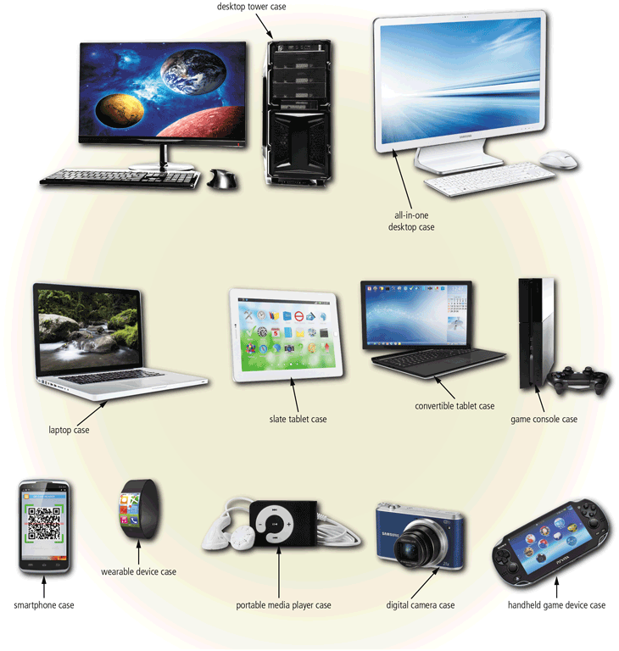
Inside the Case
The case contains and protects the electronics of the computer or mobile device from damage
Pages 276 - 277
Figure 6-1

Slide 5
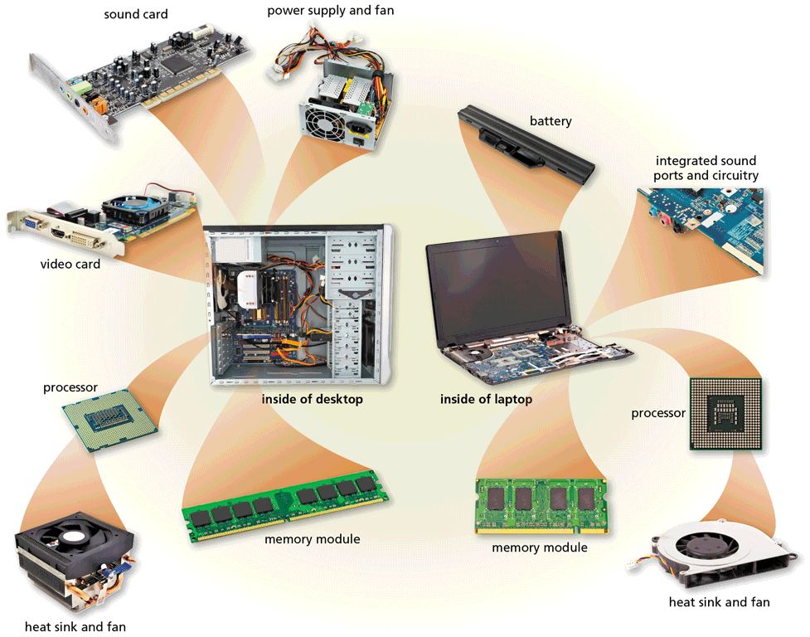
Inside the Case
Page 278
Figure 6-2

Slide 6
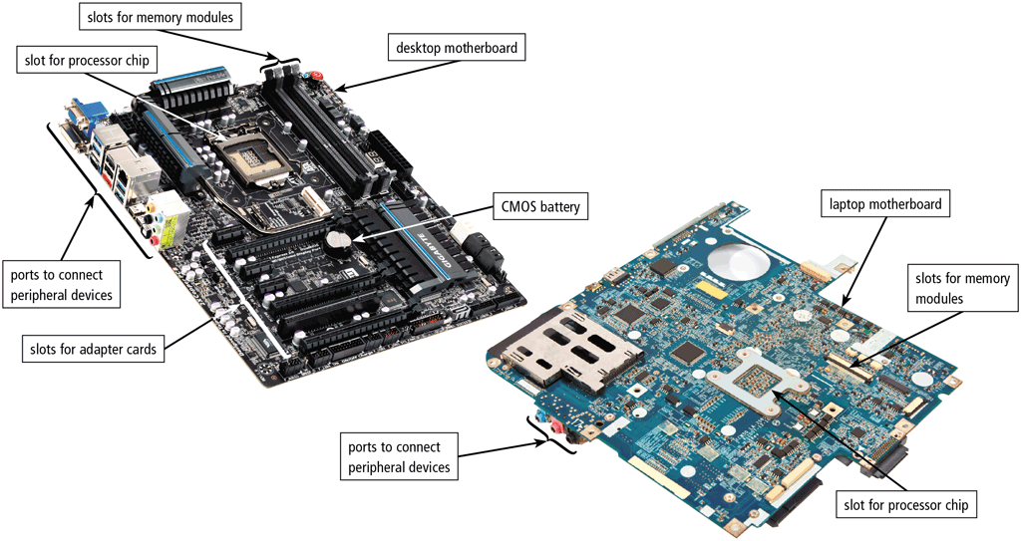
Inside the Case
The motherboard is the main circuit board of the computer
A computer chip contains integrated circuits
Pages 278 - 279
Figure 6-3

Slide 7
Processors
The processor, also called the central processing unit (CPU), interprets and carries out the basic instructions that operate a computer
A multi-core processor is a single chip with two or more separate processor cores
Processors contain a control unit and an arithmetic logic unit (ALU)
Pages 280 - 281

Slide 8
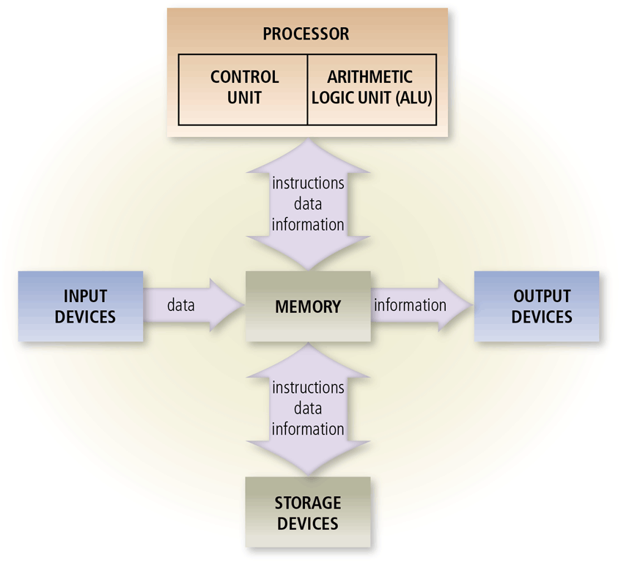
Processors
Page 281
Figure 6-4

Slide 9
Processors
The control unit is the component of the processor that directs and coordinates most of the operations in the computer
The arithmetic logic unit (ALU) performs arithmetic, comparison, and other operations
Page 281

Slide 10
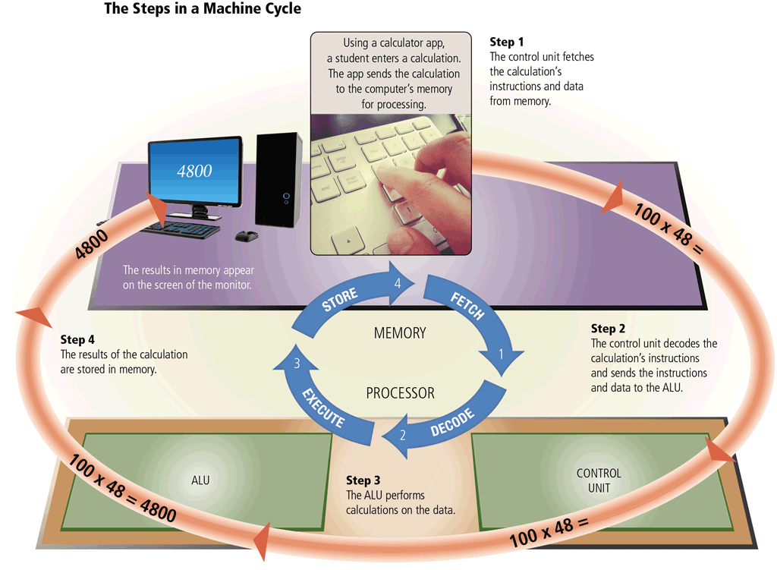
Processors
For every instruction, a processor repeats a set of four basic operations, which comprise a machine cycle
Pages 281 - 282
Figure 6-5

Slide 11
Processors
The processor contains registers, that temporarily hold data and instructions
The system clock controls the timing of all computer operations
The pace of the system clock is called the clock speed, and is usually measured in gigahertz (GHz)
Pages 282 - 283

Slide 12
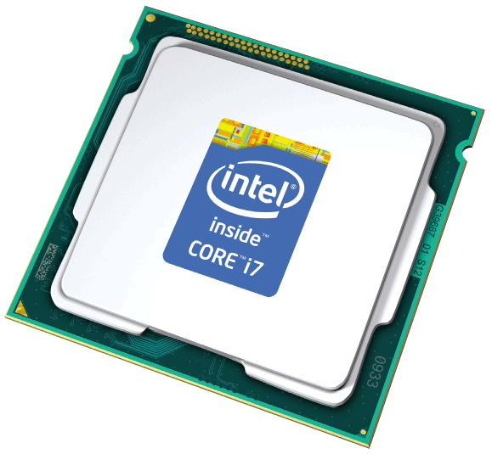
Processors
The leading manufacturers of personal computer processor chips are Intel and AMD
Page 283

Slide 13
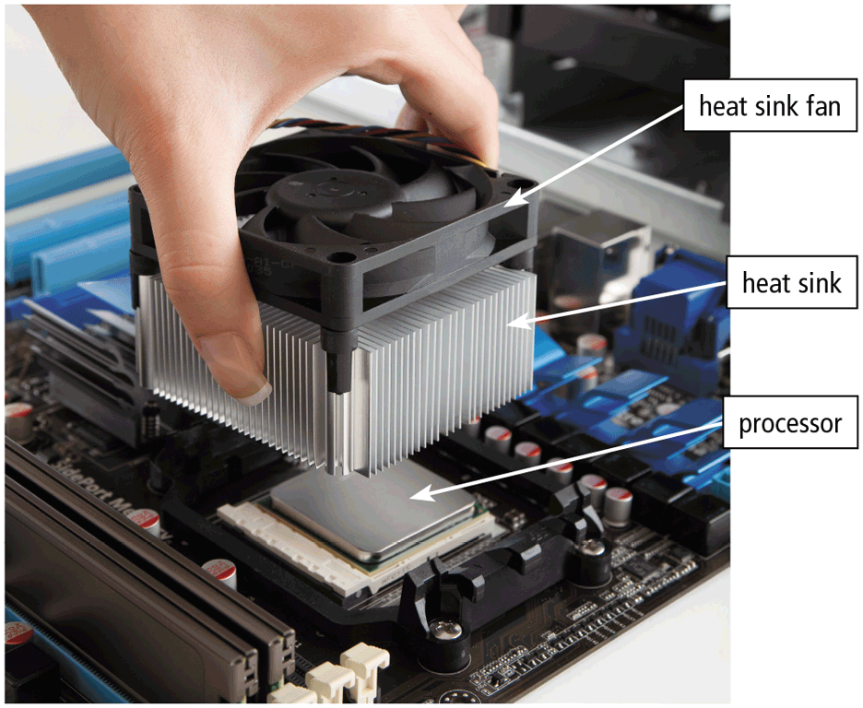
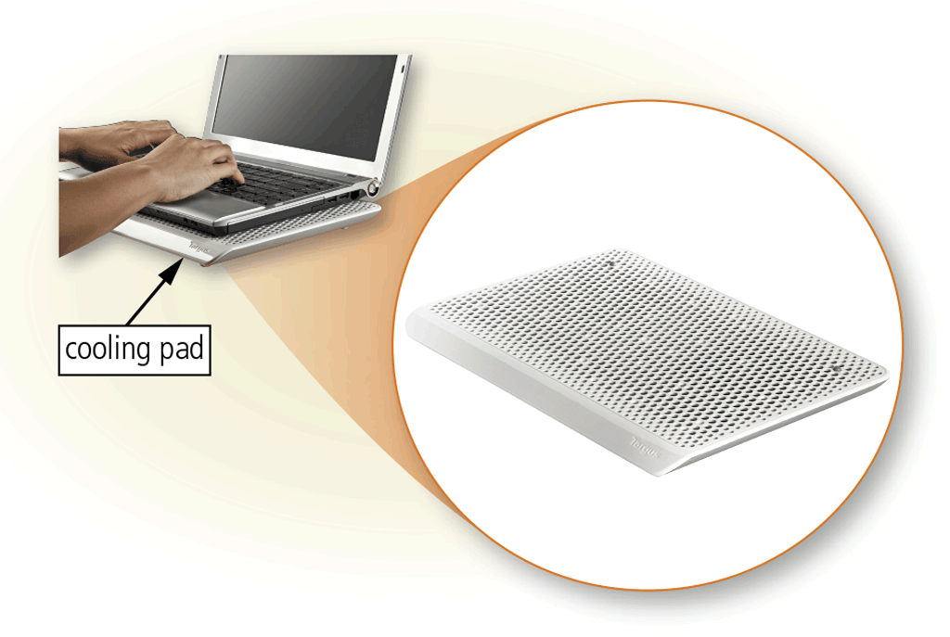
Processors
A processor chip generates heat that could cause the chip to malfunction or fail
Require additional cooling
Heat sinks
Liquid cooling technology
Cooling pads
Page 284
Figures 6-6 – 6-7

Slide 14
Cloud Computing
Home and business users choose cloud computing for a variety of reasons
Accessibility
Cost savings
Space savings
Scalability
Page 287

Slide 15
Data Representation
Analog signals are continuous and vary in strength and quality
Digital signals are in one of two states: on or off
Most computers are digital
The binary system uses two unique digits (0 and 1)
Bits and bytes
Page 288

Slide 16
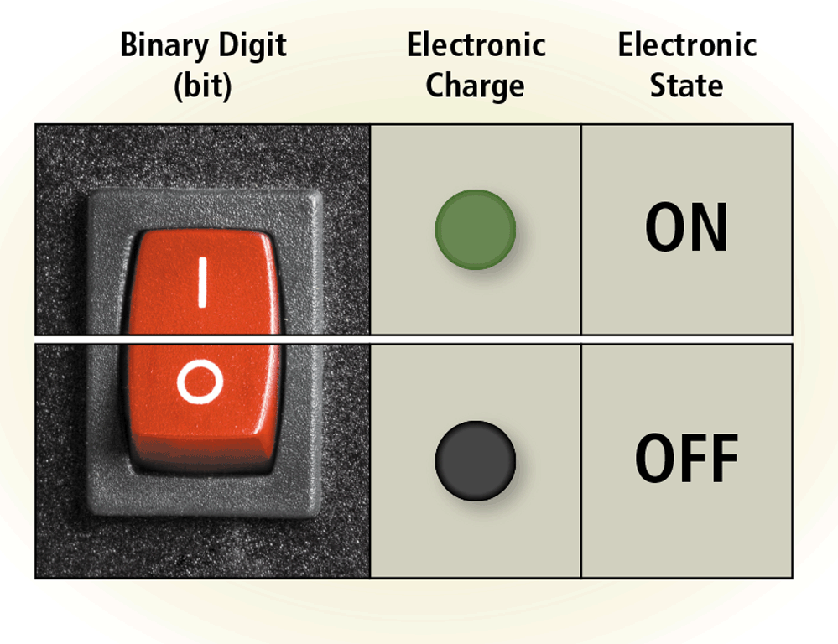
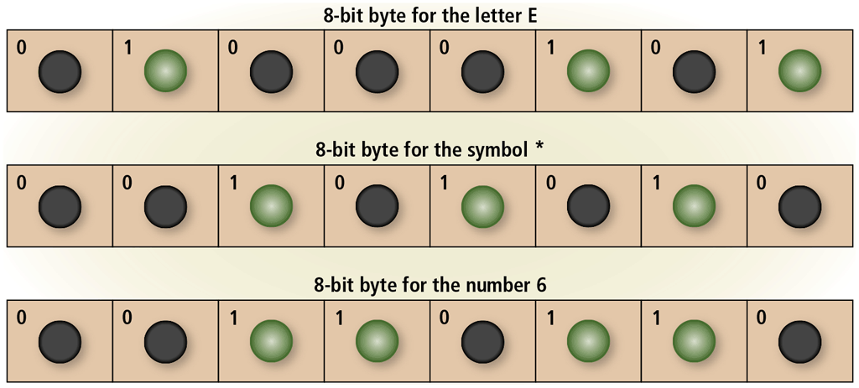
Data Representation
The circuitry in a computer or mobile device represents the on or the off states electronically by the presence or absence of an electronic charge
Eight bits grouped together as a unit are called a byte. A byte represents a single character in the computer or mobile device
Pages 288- 289
Figures 6-8 – 6-9

Slide 17
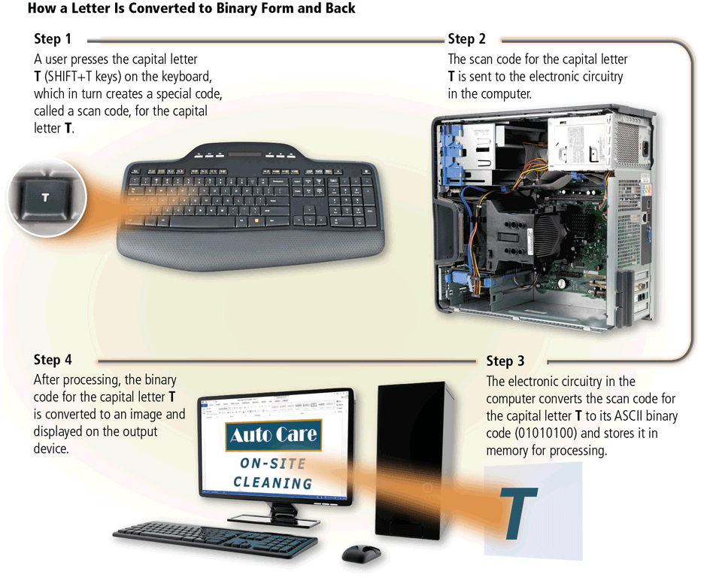
Data Representation
Page 289
Figure 6-10

Slide 18
Memory
Memory consists of electronic components that store instructions waiting to be executed by the processor, data needed by those instructions, and the results of processing the data
Stores three basic categories of items:
The operating system and other programs
Applications
Data being processed and the resulting information
Page 290

Slide 19
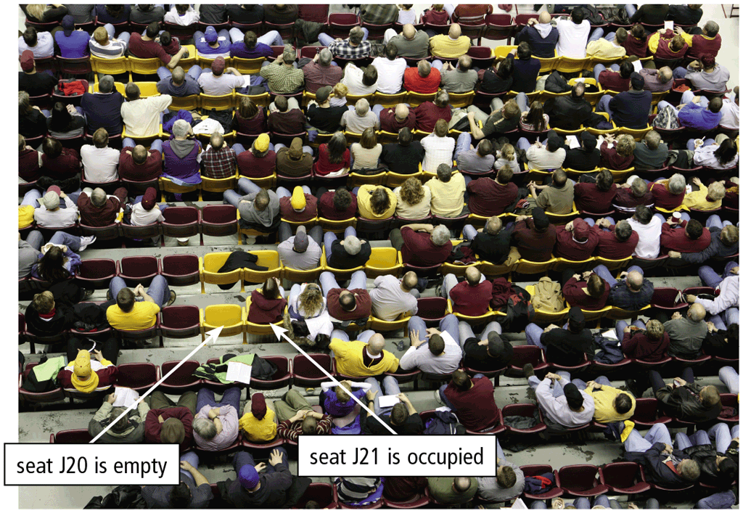
Memory
Each location in memory has an address
Memory size commonly is measured in gigabytes (GB) or terabytes (TB)
Page 290
Figure 6-11

Slide 20
Memory
Computers and mobile devices contain two types of memory:
Volatile memory
Nonvolatile memory
Loses its contents when power is turned off
Does not lose contents when power is removed
Example includes RAM
Examples include ROM, flash memory, and CMOS
Page 290

Slide 21
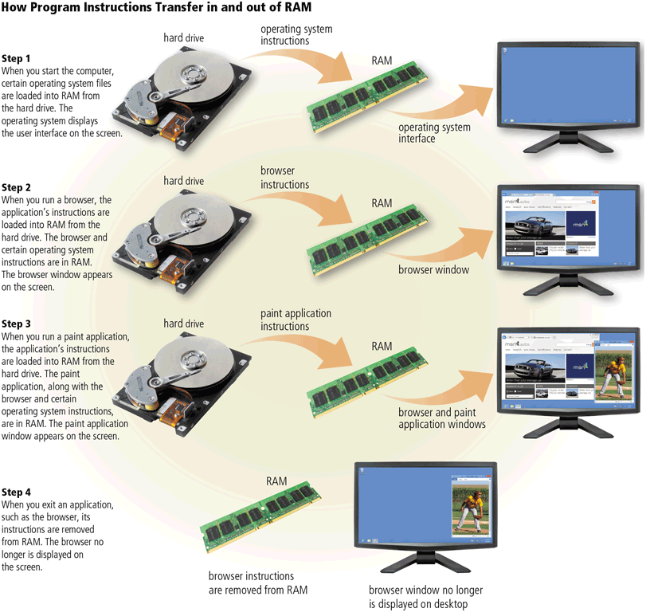
Memory
Page 291
Figure 6-12

Slide 22
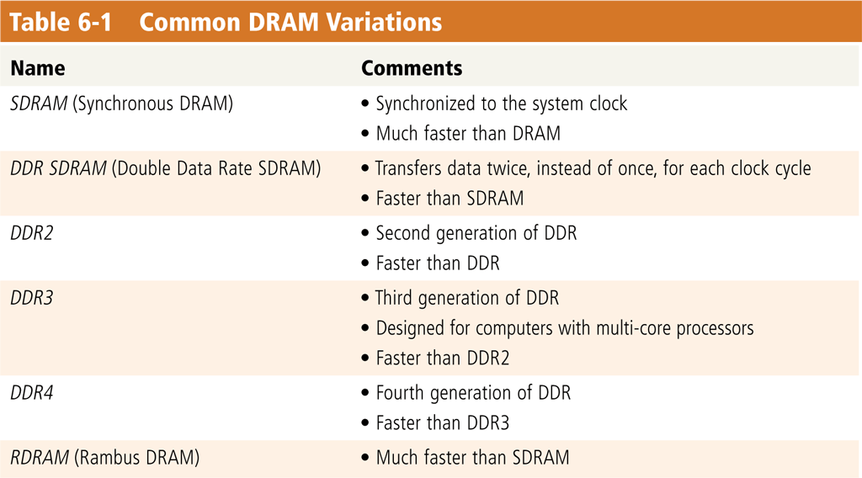
Memory
Two common types of RAM exist:
Dynamic RAM (DRAM)
Static RAM (SRAM)
Page 292
Table 6-1

Slide 23
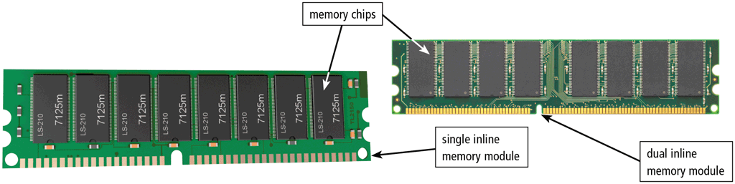
Memory
RAM chips usually reside on a memory module and are inserted into memory slots
Page 293
Figure 6-13

Slide 24
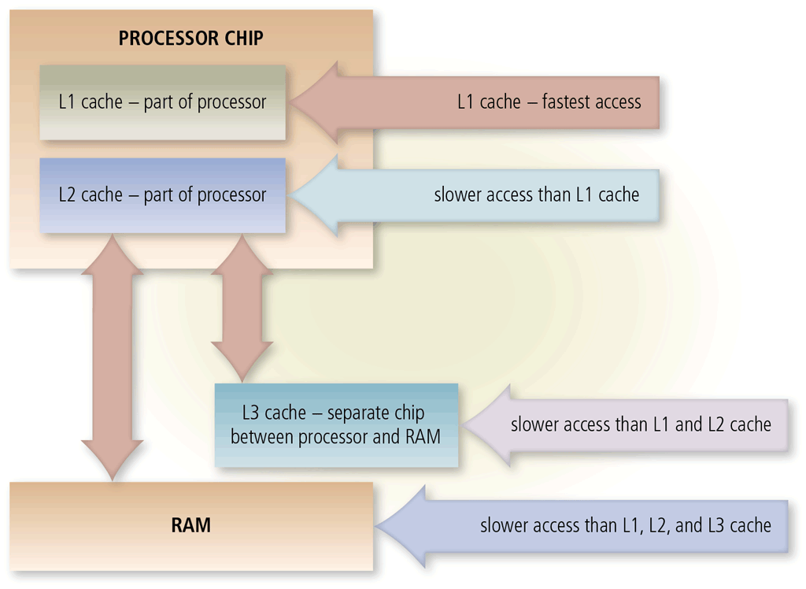
Memory
Memory cache speeds the processes of the computer because it stores frequently used instructions and data
Page 294
Figure 6-14

Slide 25
Memory
Read-only memory (ROM) refers to memory chips storing permanent data and instructions
Firmware
Page 294

Slide 26
Memory
Flash memory can be erased electronically and rewritten
CMOS technology uses battery power to retain information when when the power to the computer is off
Pages 295- 296

Slide 27
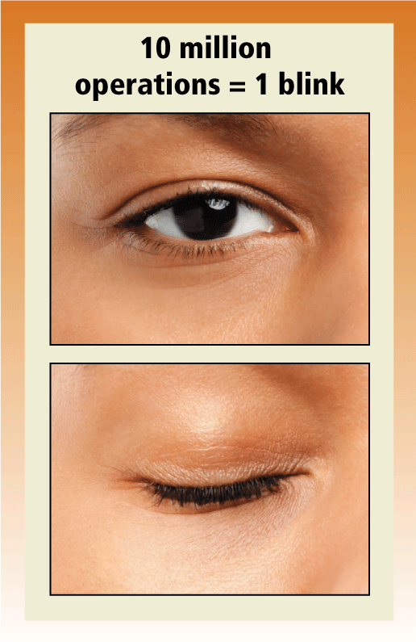
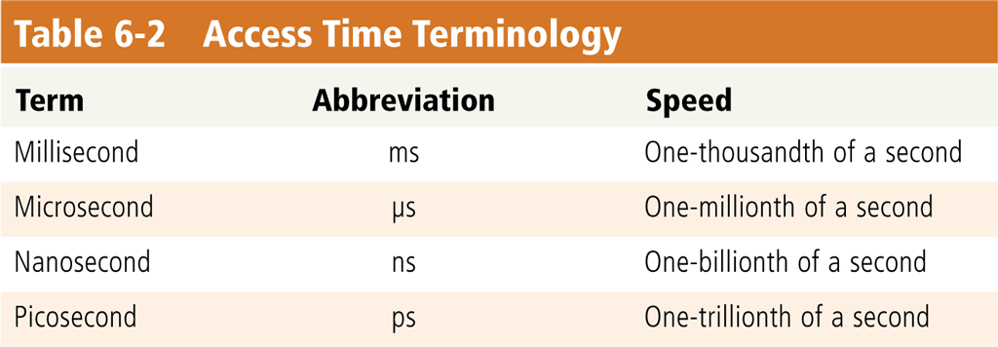
Memory
Access time is the amount of time it takes the processor to read from memory
Measured in nanoseconds
Page 296
Table 6-2 and Figure 6-15

Slide 28
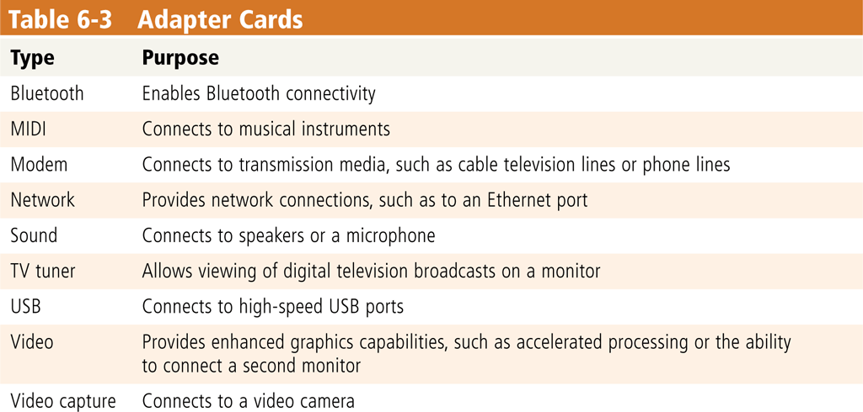
Adapters
An adapter card enhances functions of a component of a desktop or server system unit and/or provides connections to peripherals
Sound card and video card
An expansion slot is a socket on a desktop or server motherboard that can hold an adapter card
Pages 297 - 298
Table 6-3

Slide 29
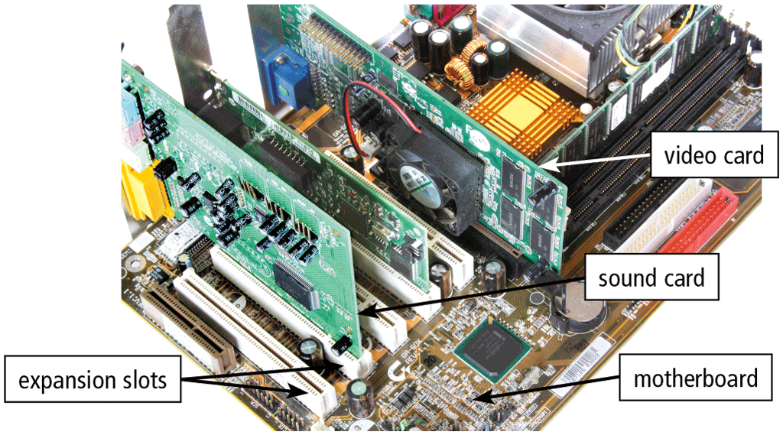
Adapters
With Plug and Play, the computer automatically can recognize peripheral devices as you install them
Pages 297 - 298
Figure 6-16

Slide 30
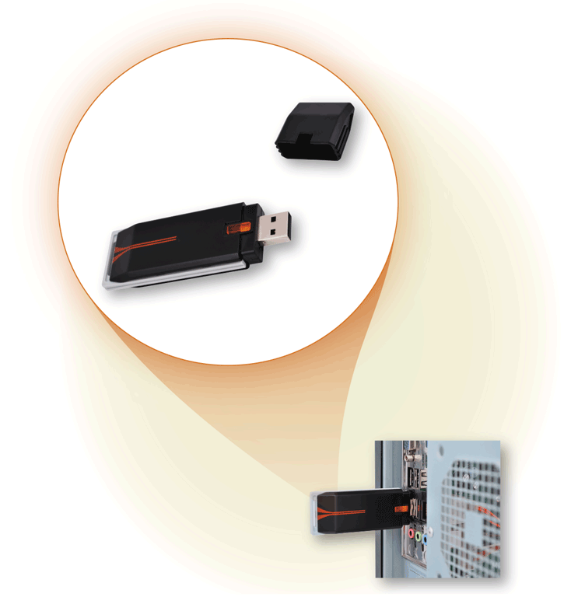
Adapters
A USB adapter enhances functions of a mobile computer and/or provides connections to peripheral devices
Pages 298 - 299
Figure 6-17

Slide 31
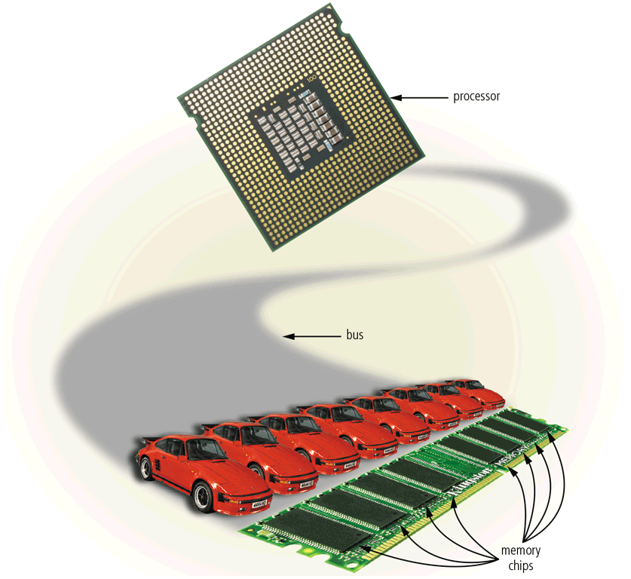
Buses
A bus allows the various devices both inside and attached to the system unit to communicate with one another
Data bus
Address bus
Word size is the number of bits the processor can interpret and execute at a given time
Pages 299 - 300
Figure 6-18

Slide 32
Buses
A computer might have these three types of buses:
System bus
Expansion bus
Backside bus
Page 300

Slide 33
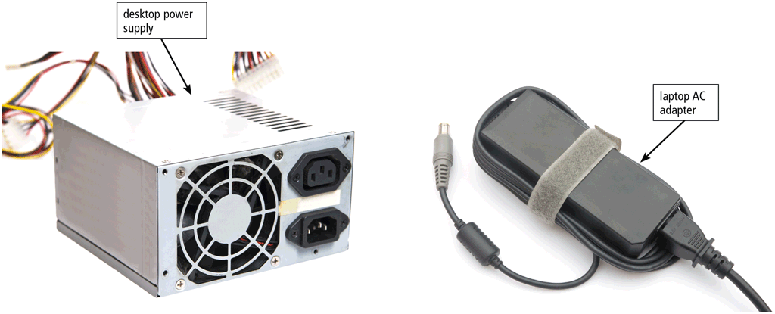
Power Supply and Batteries
The power supply or laptop AC adapter converts the wall outlet AC power into DC power
Page 301
Figure 6-19

Slide 34
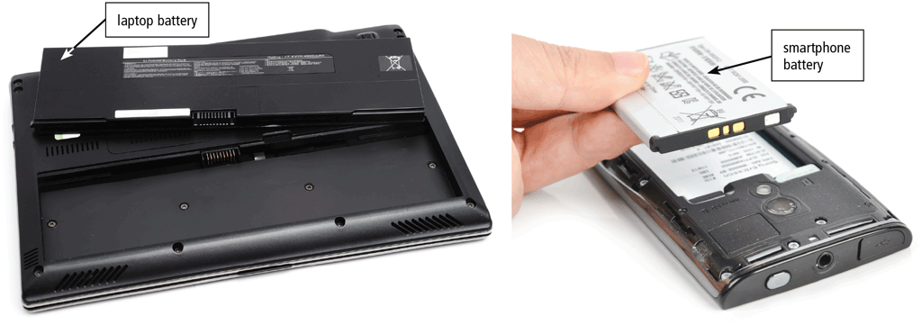
Power Supply and Battery
Mobile computers and devices can run using either a power supply or batteries
Batteries typically are rechargeable lithium-ion batteries
Pages 301 – 302
Figure 6-20

Slide 35
Summary
Various components inside computers and mobile devices
Types of processors, steps in a machine cycle, and processor cooling methods
Advantages and services of cloud computing
How memory stores data and described various types of memory
Adapters, buses, power supplies and batteries
Ways to care for computers and mobile devices
Page 305

Slide 36
Chapter 6 Complete

